Slide 1
System Specification
Partitioning
Architectural Design
ENTITY test is
port a: in bit;
end ENTITY test;
Functional Design
and Logic Design
Chip Planning
Circuit Design
Placement
Physical Design
Clock Tree Synthesis
Physical Verification
and Signoff
DRC
LVS
ERC
Signal Routing
Fabrication
Timing Closure
Packaging and Testing
Chip

Slide 2
Outline
Introduction to Floorplanning
Optimization Goals in Floorplanning
Floorplan Representations
Floorplanning Algorithms
Floorplan Sizing

Slide 3
I/O Pads
Floorplan
Module a
Module b
Block a
Block c
Module c
Chip
Planning
GND
Block d
VDD
Block Pins
Block
b
Module d
Block e
Module e
Supply Network

Slide 4
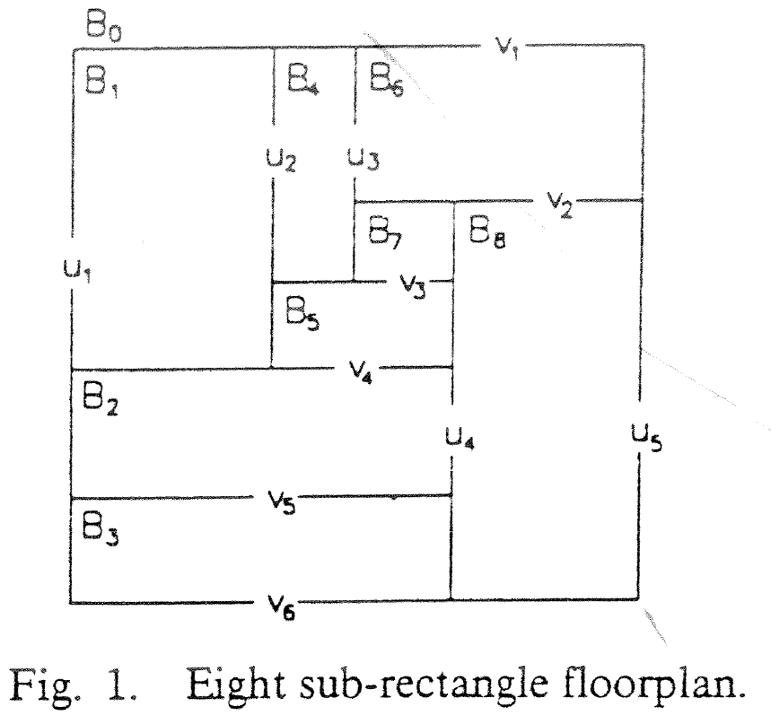
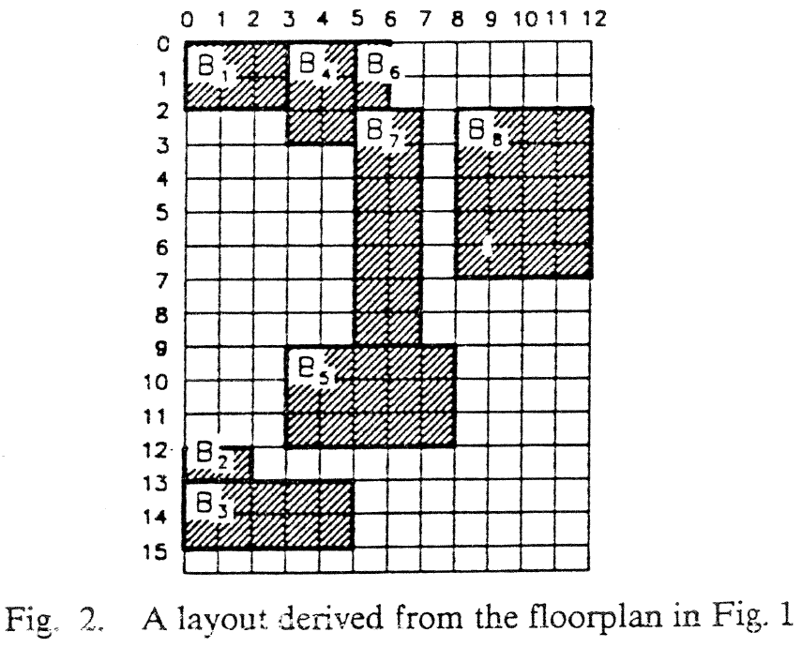

Slide 5
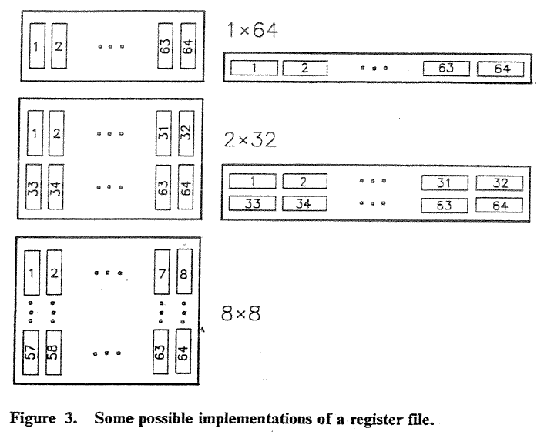

Slide 6
Example
Given: Three blocks with the following potential widths and heights
Block A: w = 1, h = 4 or w = 4, h = 1 or w = 2, h = 2
Block B: w = 1, h = 2 or w = 2, h = 1
Block C: w = 1, h = 3 or w = 3, h = 1
Task: Floorplan with minimum total area enclosed
C
A
B
B
C
A
A

Slide 7
Example
Given: Three blocks with the following potential widths and heights
Block A: w = 1, h = 4 or w = 4, h = 1 or w = 2, h = 2
Block B: w = 1, h = 2 or w = 2, h = 1
Block C: w = 1, h = 3 or w = 3, h = 1
Task: Floorplan with minimum total area enclosed

Slide 8
Example
Given: Three blocks with the following potential widths and heights
Block A: w = 1, h = 4 or w = 4, h = 1 or w = 2, h = 2
Block B: w = 1, h = 2 or w = 2, h = 1
Block C: w = 1, h = 3 or w = 3, h = 1
Task: Floorplan with minimum total area enclosed
Solution:
Aspect ratios
Block A with w = 2, h = 2; Block B with w = 2, h = 1; Block C with w = 1, h = 3
This floorplan has a global bounding box with minimum possible area (9 square units).

Slide 9
Area and shape of the global bounding box
  Global bounding box of a floorplan is the minimum axis-aligned rectangle
  that contains all floorplan blocks.
  Area of the global bounding box represents the area of the top-level floorplan
  Minimizing the area involves finding (x,y) locations, as well as shapes,
  of the individual blocks.
Total wire length
  Long connections between blocks may increase signal propagation delays
  in the design.

Slide 10
Combination of area area(F) and total wire length L(F) of floorplan F
  Minimize α ∙ area(F) + (1 – α) ∙ L(F)
  where the parameter 0 ≤ α ≤ 1 gives the relative importance between area(F) and L(F)
Signal delays
  Static timing analysis is used to identify the interconnects that lie on critical paths.

Slide 11
A rectangular dissection is a division of the chip area into a set of blocks
or non-overlapping rectangles.
A slicing floorplan is a rectangular dissection
  Obtained by repeatedly dividing each rectangle, starting with the entire chip area, into two smaller rectangles
  Horizontal or vertical cut line.
A slicing tree or slicing floorplan tree is a binary tree with k leaves and k – 1 internal nodes
  Each leaf represents a block
  Each internal node represents a horizontal or vertical cut line.

Slide 12
Slicing floorplan and two possible corresponding slicing trees
V
V
c
H
H
H
H
b
e
f
a
b
c
H
a
b
d
H
a
d
d
V
c
V
e
f
e
f

Slide 13
Non-slicing floorplans (wheels)
b
b
c
a
e
e
a
c
d
d

Slide 14
Floorplan tree: Tree that represents a hierarchical floorplan
d
H
b
e
g
V
H
c
a
f
H
W
h
i
H
h
i
a
b
c
d
e
f
g
H
Horizontal division
(objects to the top and bottom)
H
W
Wheel (4 objects cycled
around a center object)
Vertical division
(objects to the left and right)
H
V
H

Slide 15
Floorplan and Layout
Floorplan
Graph representation
B₁
B₂
B₈
B₇
B₂
B₈
B₉
B₁
B₇
B₉
B₁₂
B₁₀
B₃
B₅
B₁₀
B₃
B₅
B₄
B₁₂
B₁₁
B₁₁
B₆
B₆
B₄
Floorplan is represented by a planar graph.
Vertices - vertical lines. Arcs - rectangular areas where blocks are embedded.
A dual graph is implied.

Slide 16
From Floorplan to Layout
Actual layout is obtained by embedding real blocks into floorplan cells.
  Blocks’ adjacency relations are maintained
  Blocks are not perfectly matched, thus white area (waste) results
Layout width and height are obtained by assigning blocks’ dimensions to corresponding arcs.
  Width and height are derived from longest paths
Different block sizes yield different layout area, even if block sizes are area invariant.

Slide 17
Area Minimization of Slicing Floorplan
Top block’s area is divided by vertical and horizontal cut-lines
Slicing tree. Leaf blocks are associated with areas.
B₁
B₂
B₈
B₇
v
h
h
B₉
v
v
v
v
B₁₂
B₁₀
h
h
h
h
B₁
B₂
B₇
B₁₂
B₃
B₅
B₁₁
B₆
B₄
B₃
B₄
B₅
B₆
B₈
B₉
B₁₀
B₁₁

Slide 19
Merge horizontally two width-height sets (vertical cut-line)
v
+
=
+
=
+
=

Slide 20
h
Size of new width-height list equals sum of lengths of children lists, rather than their product.

Slide 21
Sketch of Proof
Problem is solved by a bottom-up dynamic programming algorithm working on corresponding slicing tree.
Each node maintains a set of width-height pairs, none of which can be ruled out until root of tree is reached. Size of sets is in the order of node’s leaf count. Sets in leaves are just B_{i}’s two orientations.

Slide 22
Sketch of Proof
The sets of width-height pairs at each node is created by merging the sets of left-son and right-son sub-trees in time linear in their size.
Width-height pair sets are maintained as a sorted list in one dimension (hence sorted inversely in the other dimension).
Final implementation is obtained by backtracking from the root.

Slide 23
Shape functions
h
h
Legal shapes
Legal shapes
w
w
h_{a}*_{a}w ≥ A
Block with minimum width and
height restrictions

Slide 24
Shape functions
h
w
w
Discrete (h,w) values
Hard library block

Slide 25
Corner points
h
5
5
2
2
2
5
w
2
5

Slide 26
Algorithm
This algorithm finds the minimum floorplan area for a given slicing floorplan in
polynomial time. For non-slicing floorplans, the problem is NP-hard.
Construct the shape functions of all individual blocks
Bottom up: Determine the shape function of the top-level floorplan
from the shape functions of the individual blocks
Top down: From the corner point that corresponds to the minimum top-level floorplan area, trace back to each block’s shape function to find that block’s dimensions and location.

Slide 27
Step 1: Construct the shape functions of the blocks
3
Block A:
5
5
3
Block B:
4
2
2
4

Slide 28
Step 1: Construct the shape functions of the blocks
3
h
Block A:
5
5
3
6
5
Block B:
4
4
2
2
2
4
2
3
4
6
w

Slide 29
Step 1: Construct the shape functions of the blocks
3
h
Block A:
5
5
3
6
Block B:
4
3
4
2
2
2
4
2
4
5
6
w

Slide 30
Step 1: Construct the shape functions of the blocks
3
h
Block A:
5
5
3
6
Block B:
4
h_{A}(w)
4
2
2
2
4
2
4
6
w

Slide 31
Step 1: Construct the shape functions of the blocks
3
h
Block A:
5
5
3
6
Block B:
4
h_{A}(w)
4
2
h_{B}(w)
2
2
4
2
4
6
w

Slide 32
Step 2: Determine the shape function of the top-level floorplan (vertical)
h
h
8
8
6
6
h_{C}(w)
4
4
h_{A}(w)
h_{A}(w)
2
h_{B}(w)
2
h_{B}(w)
2
4
6
w
2
4
6
w

Slide 33
Step 2: Determine the shape function of the top-level floorplan (vertical)
3 x 9
h
h
8
8
6
6
4 x 7
h_{C}(w)
4
4
h_{A}(w)
h_{A}(w)
2
h_{B}(w)
2
5 x 5
h_{B}(w)
2
4
6
w
2
4
6
w
Minimimum top-level floorplan
with vertical composition

Slide 34
Step 3: Find the individual blocks’ dimensions and locations
h
(1) Minimum area floorplan: 5 x 5
6
5 x 5
4
2
(2) Derived block dimensions : 2 x 4 and 3 x 5
2
4
6
8
w
2 x 4
3 x 5
Horizontal composition

