Slide 1
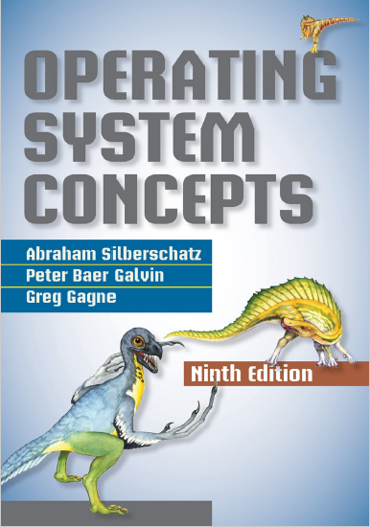
Virtual Memory
prepared and instructed by
Shmuel Wimer
Eng. Faculty, Bar-Ilan University

Slide 2
Virtual Memory (VM) Concept
So far the entire logical address space was placed in physical memory.
Requiring executed instructions be in physical memory is necessary and reasonable.
It is also unfortunate, since it limits the size of a program to the size of physical memory.
In many cases, the entire program is not needed.
Code handling unusual error conditions.
Arrays, lists, and tables are often allocated more memory than actually needed.

Slide 3
Even if the entire program is needed, it may not all be needed at the same time.
Executing program only partially in memory would have many benefits:
Program no longer constrained by available physical memory, simplifying programming.
Programs using less physical memory enable more programs running concurrently, increasing CPU utilization and throughput.
Less I/O needed to load or swap user programs into memory, so user program would run faster.

Slide 4
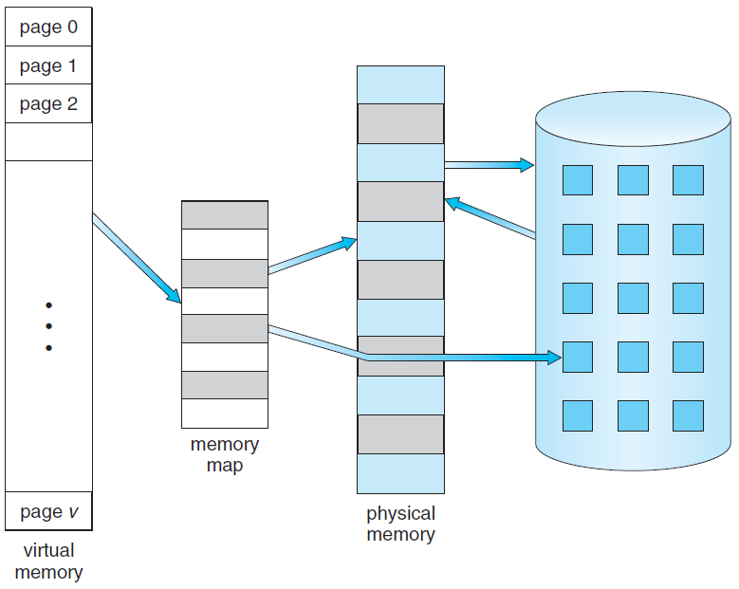
page swapping
logical addresses
main memory
hard disk
page in memory
page table
page in disk
VM that is larger than physical memory.

Slide 5
Virtual Memory (VM) separates the logical memory as perceived by users from the physical memory.
The virtual address space of a process is the logical view of how a process is stored in memory.
Typically, a process begins at a certain logical address, say 0, and exists in contiguous memory.
Physical memory is organized in frames assigned to process, which may not be contiguous (MMU maps logical pages to physical page frames in memory).

Slide 6
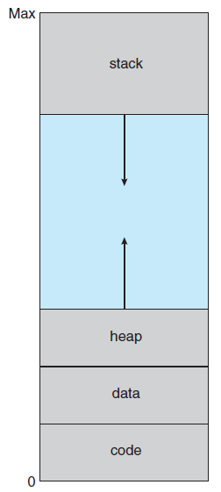
The large blank space (hole) between the heap and the stack is part of the virtual address space.
It will require actual physical pages only if the heap or stack grows.
Virtual address space.

Slide 7
Virtual address spaces that include holes can be filled as the stack or heap grow or by dynamically link libraries during program execution.
VM allows files and memory to be shared by processes through page sharing.
System libraries can be shared by processes through mapping of shared object into a virtual address space.
Each process considers the libraries as part of its virtual address space, but their frames in physical memory are shared by all processes.

Slide 8
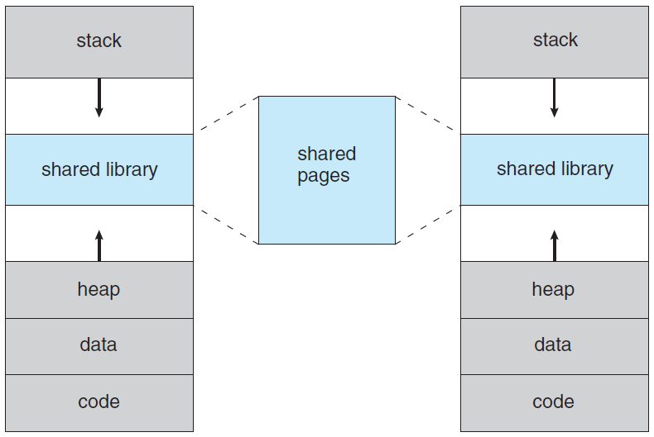
logical addresses (virtual, pages)
logical addresses (virtual , pages)
physical addresses (frames)
Shared library using virtual memory.

Slide 9
Demand Paging
Instead of loading entire program in physical memory, pages are loaded only as needed, called demand paging.
Pages never accessed are never loaded.
A demand-paging system is similar to a paging system with swapping, where processes reside in disk.
When process swapped in, pager guesses which pages will be used, before another process swapped out.
The pager brings only those pages into memory, thus decreasing swap time and amount of physical memory.

Slide 10
Need HW support to distinguish between pages in memory and the pages on disk. Valid–invalid bit is used.
Valid means the page is both legal and in memory, Invalid means page is either not in logical address space, or currently on disk.
Entry for a page not currently in memory is either marked invalid or contains the disk address of the page.

Slide 11
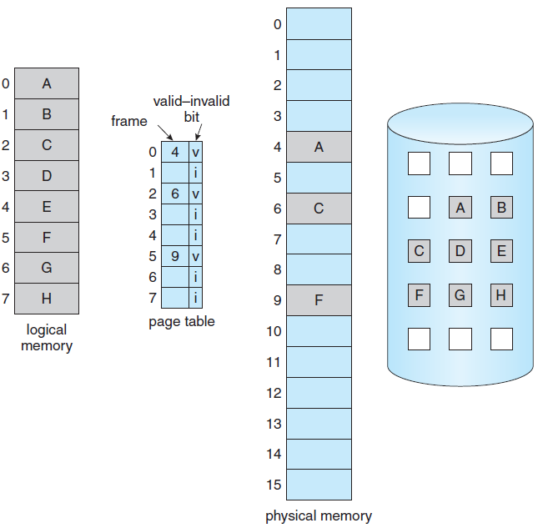
Some pages are not in main memory.

Slide 12
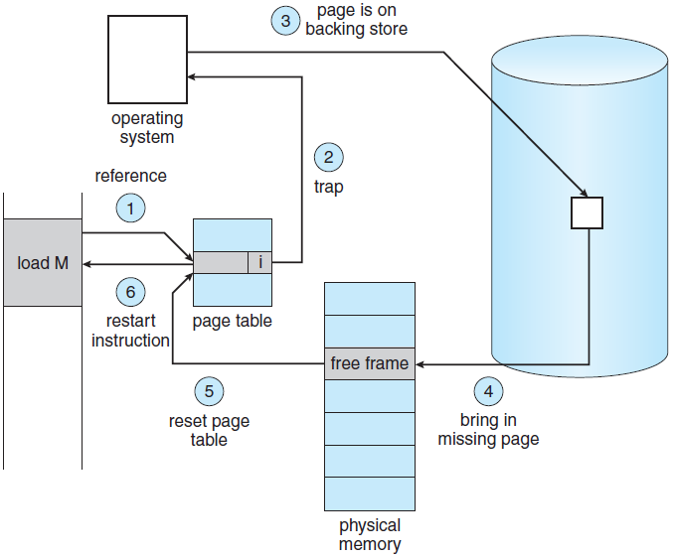
Steps in handling a page fault.

Slide 13
Attempt to access a page marked invalid causes a page fault.
Paging HW notice at translation that invalid bit is set, causing OS trap of failure to bring page into memory.
The procedure for handling page fault is
Check table (kept with PCB) for this process to determine whether the reference was valid invalid memory access.
If invalid, process terminated. If valid but not yet brought in, it is paged in.

Slide 14
Find a free frame (taking one from the free-frame list).
Schedule a disk operation to read the desired page into newly allocated frame.
When disk read completes, modify the internal table kept with PCB and the page table to indicate page is now in memory.
Restart the instruction that was interrupted by the trap. The process can now access the page.

Slide 15
Performance of Demand Paging
Memory access time ranges from $10\text{nSec}$ to $200\text{nSec}$. With no page faults this is the effective access time.
Let $0≤p≤1$ be the probability of a page fault, desired to be close to zero. ($0≤p≤1$).
The effective access time is:
$(1−p) ×\text{ma}+ p× \text{page} \text{fault} \text{time}$.
A page fault causes the following sequence:
Trap to the operating system.
Save the user registers and process state.

Slide 16
Determine that interrupt was a page fault.
Check legal page ref and determine disk location.
Issue a read from the disk to a free frame:
Wait in device queue until read request is serviced.
Wait for the device seek and/or latency time.
Begin the transfer of the page to a free frame.
While waiting, allocate the CPU to some other user.
Receive completion interrupt from I/O subsystem.
Save registers and process state for the other user.

Slide 17
Determine that the interrupt was from the disk.
Correct tables to show that page is now in memory.
Wait for CPU to be allocated to this process again.
Restore user registers, process state, and new page table, then resume the interrupted instruction.
Three major components of the page-fault service time:
Service the page-fault interrupt $1μ\text{Sec}$ - $100μ\text{Sec}$.
Read in the page $\sim 8\text{m}\text{Sec}$.
Restart the process $1μ\text{Sec}$ - $100μ\text{Sec}$.

Slide 18
Page-switch takes $8\text{m}\text{Sec}$ (latency $3\text{m}\text{Sec}$, seek $5\text{m}\text{Sec}$, and transfer $0.05\text{m}\text{Sec}$.)
Device-queueing time is added, increasing time swap. Page-fault may slow process execution dramatically.
The effective access time is
$$(1−p)×200\text{nSec}+p×8,000,000\text{n}\text{Sec}$$
If 1/1,000 causes page fault, effective access time is $8.2μ\text{Sec}$, X40 computer slow down by demand paging!
Degradation < 10%, requires less than 1/400,000 faults.

Slide 19
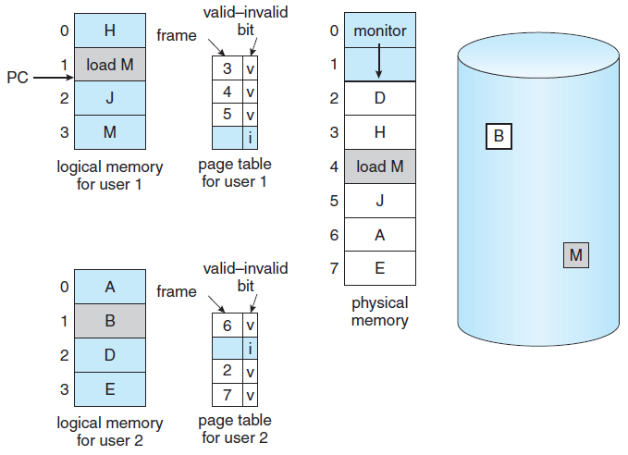
Page Replacement
Need for page replacement.

Slide 20
Page-fault service routine does:
Finds location of desired page on the disk.
Finds free frame:
If there is, it is used.
If not, replacement algorithm selects victim frame.
Victim written to disk, update page and frame tables.
Read desired page into freed frame, update page and frame tables.
Continue process from where page fault occurred.
If no frames are free, two page transfers are required.

Slide 21
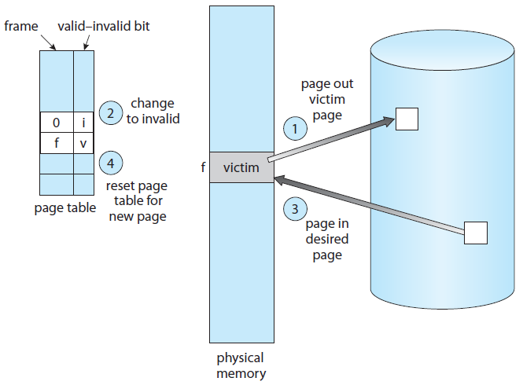
physical frame f occupied this logic page
v
i
logic page caused fault
page table after update
selected for eviction (paged out)
faulted page will occupy frame f (paged in)
Page replacement.

Slide 22
Usage of a dirty bit can save writing the victim back to disk. Also applies to read-only pages (e.g. binary code).
Page replacement enables enormous VM for programmers on a smaller physical memory.
Without demand paging, all the pages of a process must be in physical memory. Two major problems:
Frame-allocation algorithm. How many frames to allocate to each process?
Page-replacement algorithm. When page replacement is required, select the frames to be replaced.

Slide 23
Algorithm evaluation is done by applying memory reference strings and computing the page faults.
Example. A 100 bytes per page and address sequence:
0100, 0432, 0101, 0612, 0102, 0103, 0104, 0101, 0611, 0102, 0103, 0104, 0101, 0610, 0102, 0103, 0104, 0101, 0609, 0102, 0105
is shortened to the following reference string:
1, 4, 1, 6, 1, 6, 1, 6, 1, 6, 1 $∎$
Need to know the number of page frames available. Increasing their number decreases page faults.

Slide 24
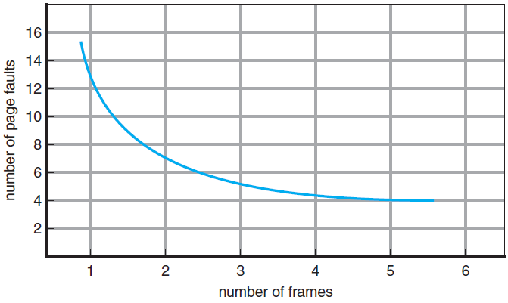
Page faults versus number of frames.

Slide 25
FIFO Page Replacement
For the reference
7, 0, 1, 2, 0, 3, 0, 4, 2, 3, 0, 3, 2, 1, 2, 0, 1, 7, 0, 1
and 3 frames, FIFO yields
FIFO is easy to implement but may suffer of poor performance.

Slide 26
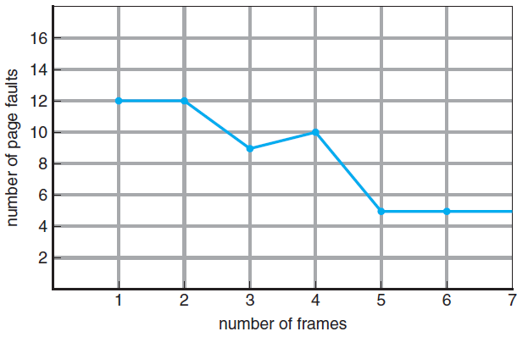
To illustrate the problems with FIFO, consider the reference 1, 2, 3, 4, 1, 2, 5, 1, 2, 3, 4, 5
Anomaly: the page-fault rate may increase as the number of allocated frames increases!

Slide 27
Optimal Page Replacement
Optimal replacement, called OPT or MIN, has the lowest page-fault rate and does not suffer from anomaly:
Replace the page that will not be used for the longest period of time.
Unfortunately, MIN requires future knowledge of reference, so it is used mainly for comparison studies.

Slide 28
LRU Page Replacement
Replace the page that has not been used for the longest period of time, namely, the least recently used (LRU).
This is MIN looking backward in time.
LRU is popular and considered good, but its HW implementation is expensive.

Slide 29
Two SW implementations are possible:
Time-stamp associated with each page-table entry, updated at page reference. Page with smallest is replaced.
Stack. A referenced page is removed from the stack and put on the top. MRU is at the top and LRU is at the bottom (implementation with doubly linked list).
Both implementation require HW assistance, since updated occurs at each memory reference.
Using interrupt for every reference to allow SW update would slow memory reference by X10!

Slide 30
LRU-Approximation
Additional-reference-bits algorithm. Each page table is supplemented with 8-bit shift register. Reference to page sets the MSB.
At regular intervals (e.g. $100\text{mSec}$), an interrupt transfers control to OS, which shifts the bits right.
The shift registers thus contain the history of page use for the last eight time periods.
00000000 means the page has not been used for eight time periods, 11111111 means it was used at each.
The page with the lowest number is replaced.

Slide 31
We can either swap out all pages with the smallest value or use FIFO method to choose among them.
The number of bits of history included in the shift register can vary and is selected to make the updating as fast as possible.
In the extreme case, the number can be reduced to zero, leaving only reference bit.
Second-chance page-replacement algorithm. Basic FIFO with inspection of reference bit.
If 0, replacement takes place, else, page is given a second chance, moving to next FIFO page.

Slide 32
Second chance clears the reference bit, and its arrival time is reset to the current time.
Page given second chance will not be replaced until all other pages are replaced or given second chances. Page used often enough, will never be replaced.
Second-chance uses a circular queue, where pointer indicates the next page to be replaced.
The pointer advances until it finds page with 0 reference bit, clearing reference bits along advancements.
Once victim is found, it is replaced, and new page is inserted in the circular queue in that position.

Slide 33
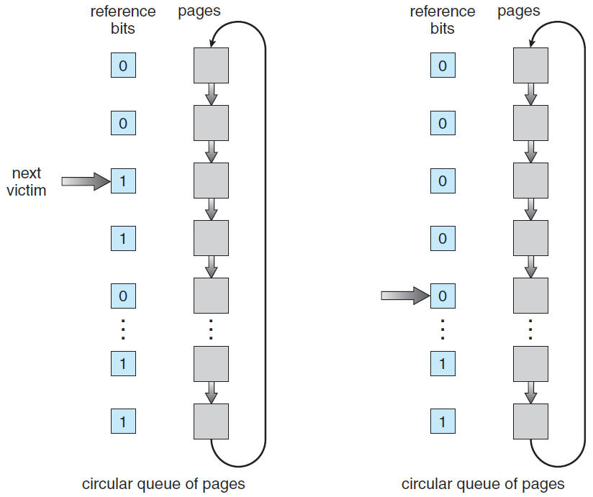
Second-chance page-replacement algorithm.

Slide 34
Enhanced second-chance algorithm uses two bits. Each page is in one of four classes:
(0,0) Neither recent use nor modified, best to replace.
(0,1) Not recent use but modified, page need written out before replaced.
(1,0) Recent use but clean, probably used again soon.
(1,1) Recent use and modified, probably used again soon, page need written out before replaced.
Same scheme as second-chance, replacing the first page encountered in the lowest nonempty class.

Slide 35
Counting-Based Page Replacement
Least frequently used (LFU) replaces the page with smallest count.
Problem: page used heavily initially but never used again. Due to the large count it remains in memory though not needed.
Solved by 1-bit shift right at regular intervals, forming exponentially decaying average usage count.
Most frequently used (MFU) assumes that page with smallest count was just brought in, yet to be used.
Both uncommon. Expensive, badly approximate OPT.

Slide 36
Allocation of Frames
How to allocate the fixed amount of free memory among processes?
The architecture (ISA) determines the minimum number of frames allocated to process.
ISA with memory instructions of direct address requires at least two frames, one for the instruction and one for the memory reference.
ISA with indirect addressing require at least three frames, e.g. load instruction on page 16 refers to address on page 0, which is indirectly referring page 23.

Slide 37
What happens if a process had only two frames?
The maximum number of frames per process is defined by the amount of available physical memory.
Equal allocation splits $m$ frames among $n$ processes giving everyone $m/n$ frames.
Proportional allocation recognizes that various processes need different amounts of memory, allocating memory to process according to its size.

Slide 38
Global and Local Allocation
Page-replacement algorithms are classified into:
Global: selecting replacement frame from all frames, even if currently allocated to other process.
It allows high-priority process increasing its frames on the account of a low-priority process.
Local: selecting from process’s own allocated frames.
Problem with global is that process’s pages in memory depend not only on its paging behavior but also on other processes.

Slide 39
Thrashing
If the number of process’s allocated frames falls below the minimum required by ISA, it must be suspended.
Its remaining pages are paged out and all its allocated frames are freed, resulting swap in/out intermediate CPU scheduling.
Process having not number of frames needed to support pages in active use, will quickly page-fault, replacing needed very soon.
This results in extensive paging, called thrashing, where process spending more time paging than executing.

Slide 40
A cause of trashing is the OS monitoring CPU utilization, if too low it increases the multiprogramming.
Global page-replacement replaces pages regardless of process to which they belong.
A process entering new execution phase needs more frames, starting faulting, taking other processes’ frames.
As processes wait for the paging device, CPU utilization decreases, causing CPU scheduler to increase multiprogramming degree.
Eventually, no work is done, as processes just paging.

Slide 41
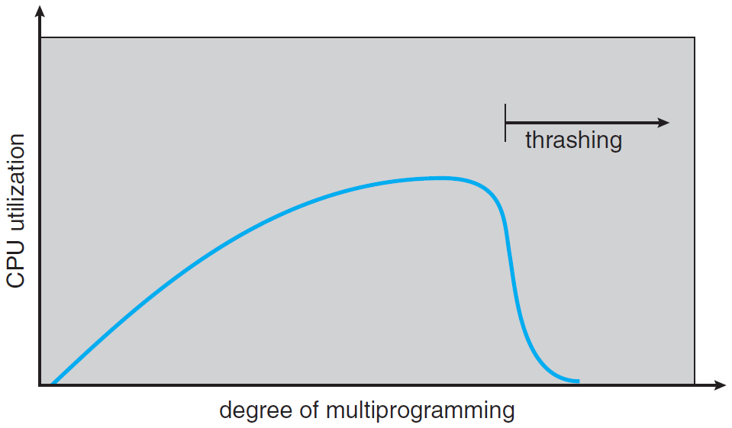
Thrashing.

