Slide 1
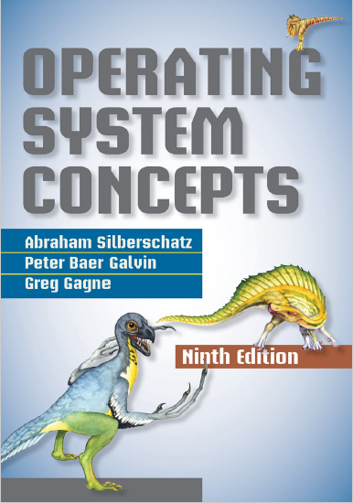
Process Synchronization
prepared and instructed by
Shmuel Wimer
Eng. Faculty, Bar-Ilan University

Slide 2
Race Conditions
A process can affect or be affected by other processes by sharing address space (e.g., by threads) or files.
Concurrent and parallel access to shared data may result in data inconsistency.
The CPU scheduler switches rapidly between processes, so one process may not complete execution before another one is scheduled.
In parallel execution two instruction streams execute simultaneously on separate processing cores.

Slide 3
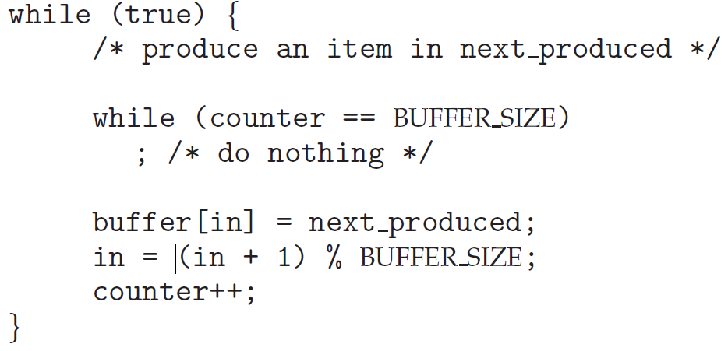
Another producer-consumer implementation allows BUFFER_SIZE items by using a counter initialized to 0.

Slide 4
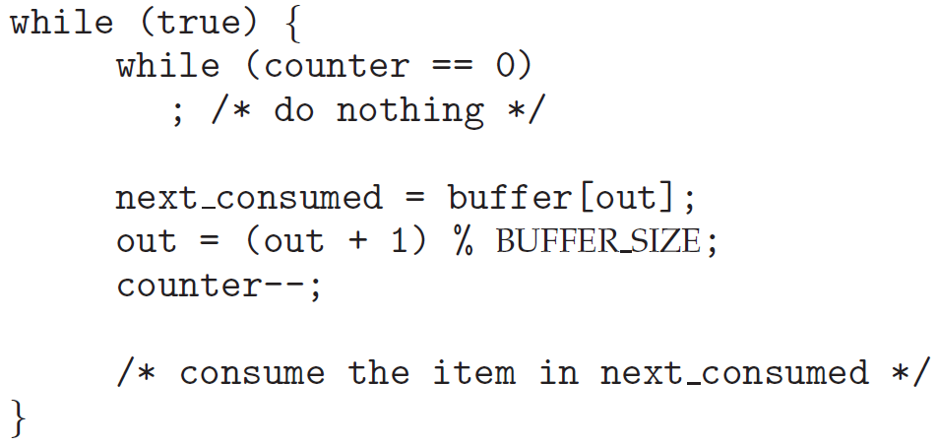
Although correct separately, producer-consumer may not function correctly when executed concurrently.
If counter is 5 and producer and consumer concurrently execute the ++ and --, counter may be 4, 5, or 6!

Slide 5
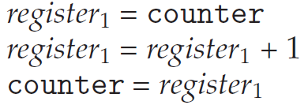
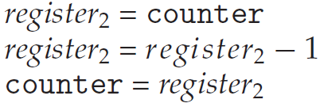
“counter++” is implemented in machine level by:
register1 is a local CPU registers.
“counter--” is implemented by:
register2 is a local CPU registers.

Slide 6
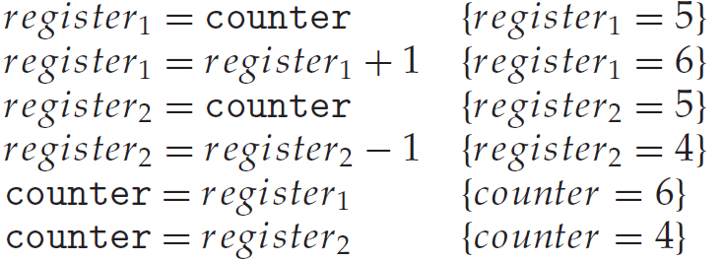
These registers are saved and restored by the interrupt handler.
Concurrent execution of “counter++” and “counter--” may result in the order
Machine instructions are arbitrarily interleaved, but the order within each high-level statement is preserved.

Slide 7
The code yields “counter == 4”, while five buffers are full. Swapping the last statements yields “counter == 6”.
This is called a race condition. To guard against it only one process at a time should be manipulating counter.
The processes must be synchronized in some way.
Any changes that result from threads sharing data running in parallel on different processing cores should not interfere with one another.

Slide 8
The critical-section problem
A system consists of $n$ processes $\left\{P_{0},P_{1}…,P_{n−1}\right\}$, each has a segment of code, called a critical section.
The processes are changing common variables, tables, files, etc. No two are executing in their critical sections simultaneously.
Design a cooperation protocol where each process must request permission to enter its critical section.
The request code section is called the entry section. The critical section is followed by an exit section. The remaining code is the remainder section.

Slide 9
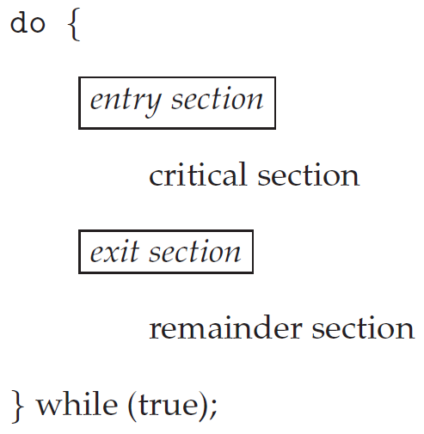
General structure of a typical process $P_{i}$.

Slide 10
The protocol should satisfy:
Mutual exclusion. Only a single $P_{i}$ is executing in its critical section.
Progression. Decision which enters its critical section next is only from these not in their remainder sections. Selection cannot be postponed indefinitely.
Bounded waiting. Limit the number of times other processes enter critical sections after process requested to enter its critical section and before it is granted.
The kernel code is subject to race conditions.

Slide 11
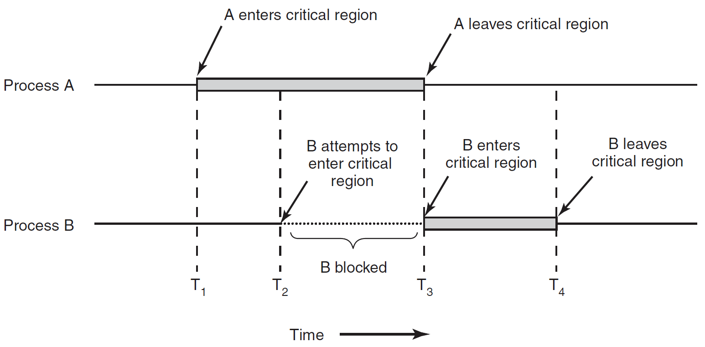
Mutual exclusion using critical regions.

Slide 12
Example: Kernel data structure maintaining list of open files, modified when new file is opened or closed.
If two processes open files simultaneously, the separate updates could result in a race condition. $∎$
Similarly, data structures of memory allocation, process lists, and interrupt handling, subject to race conditions.
Two approaches are used to handle critical sections in OS: preemptive and non-preemptive kernels.
A preemptive kernel allows a process to be preempted while it is running in kernel mode.

Slide 13
A non-preemptive kernel-mode process runs until it exits kernel-mode, blocks, or voluntarily yields control of the CPU.
A non-preemptive kernel is race conditions free, only one process is active in the kernel at a time.
Preemptive kernels must be carefully designed to ensure that shared kernel data are free from race conditions.
Why a preemptive kernel is favored?
It is more responsive, since a kernel-mode process will not run for an arbitrarily long period. Suitable for real-time programming.

Slide 14
Peterson’s Solution
A SW-based solution to the critical-section problem is Peterson’s solution.
It is restricted to two processes alternating execution of their critical and remainder sections.
It illustrates the complexities in designing SW addressing mutual exclusion, progress, and bounded waiting.
No correctness is guaranteed for modern computer architectures, because of how they perform basic machine-language instructions.

Slide 15
The two processes share two data items:
If $turn==i$ $P_{i}$ is allowed to execute in its critical section.
$flag\left[i\right]==true$ indicates that $P_{i}$ is ready to enter its critical section.
To enter the critical section, $P_{i}$first sets $flag\left[i\right]=true$ and then $turn=j$ , asserting that if $P_{j}$ wishes to enter the critical section, it can do so.

Slide 16
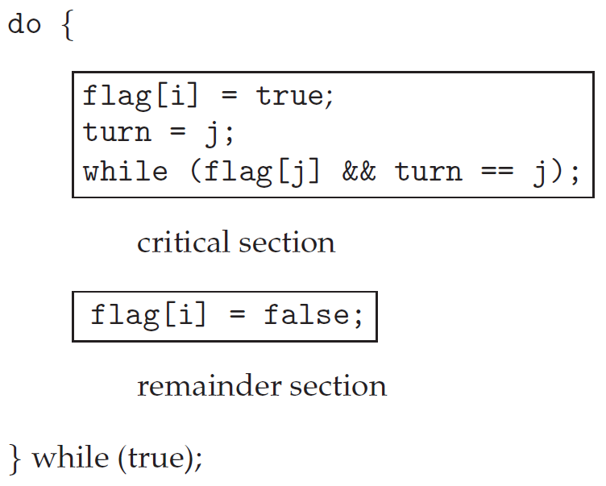
entry section
null statement
exit section
The structure of $P_{i}$ in Peterson’s solution.

Slide 17
If $P_{i}$ and $P_{j}$ try to enter at the same time, $\text{turn}$ sets to $i$ and $j$ at roughly the same time.
One will last, the other is overwritten immediately.
The eventual $\text{turn}$determines which processes is allowed to enter its critical section first.
Need to show that the protocol adheres mutual exclusion, progression and bounded-waiting.
Mutual exclusion: $P_{i}$ enters its critical section only if either $flag\left[j\right]==false$ or $turn==i$.

Slide 18
Since it is impossible that $turn==i$ and $turn==j$ togather, if both are in critical sections at the same time, there must be $flag\left[i\right]==false$ or $flag\left[j\right]==false$.
Both being in critical sections at the same time implies $flag\left[i\right]==flag\left[j\right]==true$, a contradiction.
Progression and bounded waiting: $P_{i}$is prevented from entering critical section only if it is stuck in the while loop with $flag\left[j\right]==true$ and $turn==j$.
Let us consider the various stages $P_{j}$can be.
If $P_{j}$ is not ready to enter the critical section, then $flag\left[j\right]==false$, and $P_{i}$ can enter its critical section.

Slide 19
If $P_{j}$ has set $flag\left[j\right]=true$ and is also executing in its while statement, then either $turn==i$ or $turn==j$.
If $turn==i$, then $P_{i}$ will enter the critical section. If $turn==j$, then $P_{j}$ enters critical section (progression) .
Once $P_{j}$ exits its critical section, it will reset $flag\left[j\right]=false$ , allowing $P_{i}$ to enter its critical section.
If $P_{j}$ sets $flag\left[j\right]=true$ again, it must also set $turn=i$.
Thus, since $P_{i}$ does not change the value of $\text{turn}$in the while loop, $P_{i}$ will enter the critical section (progress) after at most one entry by $P_{j}$ (bounded waiting). $∎$

Slide 20
Mutex Locks
A simple OS SW tool to solve the critical-section problem is the mutex lock (short for mutual exclusion).
A process must acquire the lock before entering a critical section, releasing it upon exits.
Solution to the critical-section problem using mutex locks.

Slide 21
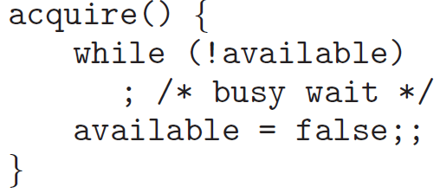
A mutex lock has a Boolean variable available whose value indicates if the lock is available or not.
If the lock is available, a call to acquire() succeeds, and the lock is then considered unavailable.
A process that attempts to acquire an unavailable lock is blocked until the lock is released.

Slide 22
Calls to acquire() or release() are performed atomically (no interrupts), requiring dedicated HW mechanisms.
A disadvantage of the busy waiting is the continuous looping, wasting CPU cycles that other process may use productively.

Slide 23
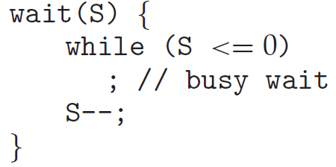
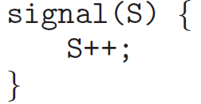
Semaphores
A semaphore S is an integer variable accessed only through two atomic operations: wait() and signal().
When a process modifies $\text{S}$, no other process can simultaneously modify it.
Testing of $\text{S}\text{ ≤ }\text{0}$ and $S−−$, must be executed without interruption (atomic).

Slide 24
Semaphore Usage
There are counting semaphore, having any integral value, and binary semaphore having only 0 and 1 values.
Binary semaphores behave similarly to mutex locks.
Example: Two concurrent processes $P_{1}$ executing statement $S_{1}$ and $P_{2}$ executing statement $S_{2}$.
It is required that $S_{2}$ be executed only after $S_{1}$ has completed.
Synchronization is obtained by letting $P_{1}$and $P_{2}$ share a binary semaphore $\text{synch}$, initialized to $\text{synch}\text{=}\text{0}$.

Slide 25
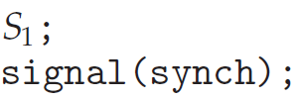
$P_{1}$ inserts the statements
$P_{2}$ inserts the statements
Because synch is initialized to $\text{synch}\text{=}\text{0}$, $P_{2}$ will execute $S_{2}$ only after $P_{1}$ has invoked $\text{signal}\text{(}\text{synch}\text{)}$, which is after statement $S_{1}$ has been executed.

Slide 26
Counting semaphores are used to control access to a finite resource.
The semaphore is initialized to the number of resources available.
Each process that wishes to use a resource performs a wait() and when a process releases a resource, it performs signal().
When semaphore’s $\text{count}==0$, all resources are used.
After that, processes wishing to use a resource will block until $\text{count}>0$.

Slide 27
Semaphore Implementation
wait() and signal() semaphore still suffers from busy waiting problem.
To overcome, the process can block itself, placing it into a waiting queue associated with the semaphore, and its state is switched to the waiting.
Then control is transferred to the CPU scheduler, which selects another process to execute.
A blocked process waiting on a semaphore $\text{S}$ is restarted when another process executes signal().
The process is then placed in the ready queue.

Slide 28
A semaphore is defined as follows:
When a process must wait on a semaphore, it is added to the list of processes.
A signal() operation removes one process from the list of waiting processes and awakens that process.
The wait() and signal() operations are defined as

Slide 29
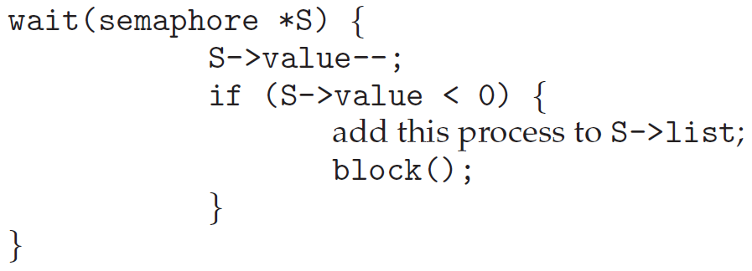
suspend operation of invoking process
resume operation of blocked process

Slide 30
In this implementation semaphore may be negative (number of processes waiting on that semaphore), unlike semaphores with busy waiting.
Semaphore operations must be executed atomically, so processes cannot execute wait() and signal() on the same semaphore at the same time.
Single-processor solves it by simply inhibiting interrupts during execution of wait() and signal().
Multiprocessor must disabled interrupts on every processor, seriously diminishing performance.
SMP uses alternative locking techniques (not discussed).

Slide 31
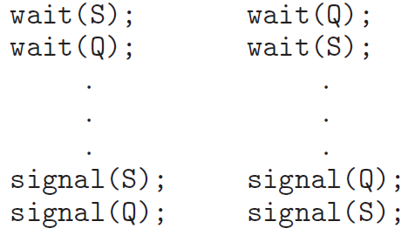
Deadlocks
There are situations where processes are waiting indefinitely for signal() obtained only by one of the waiting processes, a situation called deadlocked.
Example: A system consisting of two processes, $P_{0}$ and $P_{1}$, each accessing semaphores $S$ and $Q$, initialized to 1.
$$P_{0}$$
$$P_{1}$$

Slide 32
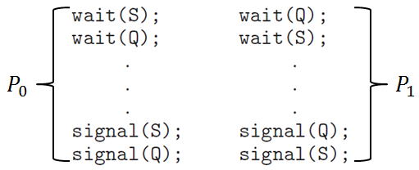
Suppose $P_{0}$ executes wait(S) and then $P_{1}$ wait(Q).
When $P_{0}$executes wait(Q), it must wait until $P_{1}$ executes signal(Q).
Similarly, when $P_{1}$ executes wait(S), it must wait until $P_{0}$ executes signal(S).
Since these signal() operations cannot be executed, $P_{0}$ and $P_{1}$ are deadlocked.

Slide 33
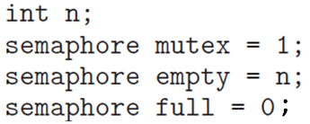
The Producer–Consumer Problem
The producer and consumer processes share the following data structures:
Pool consists of $n$ buffers, each holding one item.
The mutex semaphore provides mutual exclusion for accesses to the buffer pool.
Empty and full semaphores count the empty and full buffers.

Slide 34
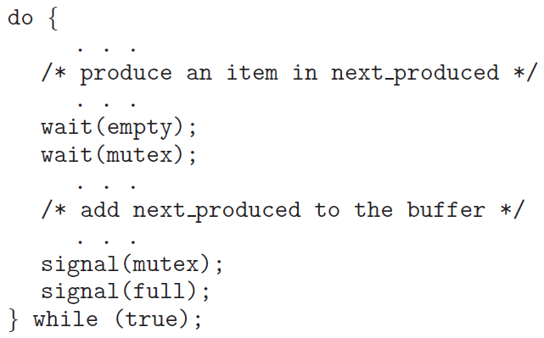
The structure of the producer process.

Slide 35
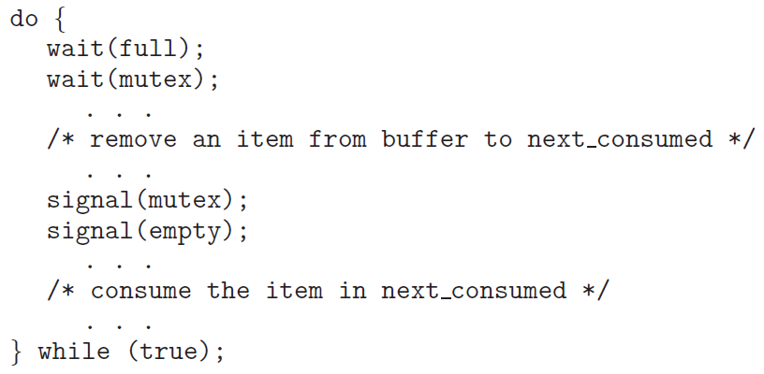
The structure of the consumer process.

Slide 36
Note the symmetry between the producer and the consumer.
The producer producing full buffers for the consumer and the consumer producing empty buffers for the producer.

Slide 37
The Readers–Writers Problem
A database is shared among several concurrent processes, some want only to read, called readers, others want to update (read/write), called writers.
Two simultaneous readers access is okay, but simultaneous writer and other process may result chaos.
This requires that writers have exclusive access while writing to the database.
This synchronization is called readers–writers problem.

Slide 38
First readers–writers problem requires that no reader be waiting unless a writer has already obtained permission to use the shared object.
Second readers–writers problem requires that once a writer is ready, it perform its write as soon as possible.
A solution to either problem may result in starvation. In the first case, writers may starve; in the second case, readers may starve.
In the solution to the first problem, the reader processes share the following data structures:

Slide 39
The semaphore $\text{rw}\text{_}\text{mutex}$ is common to both reader and writer processes, functioning as a mutual exclusion semaphore for the writers.
The $\text{read}\text{_}\text{count}$ variable keeps track of how many processes are currently reading the object.
The $\text{mutex}$ semaphore is used to ensure mutual exclusion when the variable read count is updated.

Slide 40
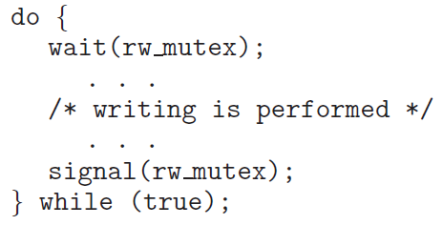
$\text{rw}\text{_}\text{mutex}$ is used by the first or last reader entering or exiting critical section, but not by readers while other readers are in their critical sections.
entry section
critical section
exit section
The structure of a writer process.

Slide 41
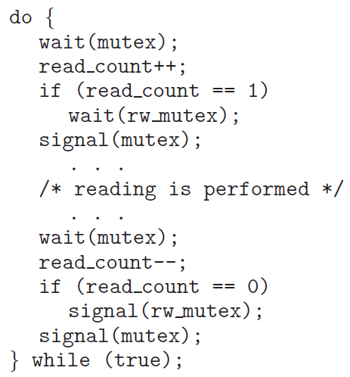
critical section
entry section
entry section
critical section
exit section
entry section
critical section
exit section
exit section
The structure of a reader process.

Slide 42
If a writer is in the critical section and $n$ readers are waiting, then one reader is queued on $\text{rw}\text{_}\text{mutex}$, and $n−1$readers are queued on $\text{mutex}$.
When a writer executes $\text{signal}\text{(}\text{rw}\text{_}\text{mutex}\text{)}$, we may resume the execution of either the waiting readers or a single waiting writer.
The selection is made by the scheduler.

Slide 43
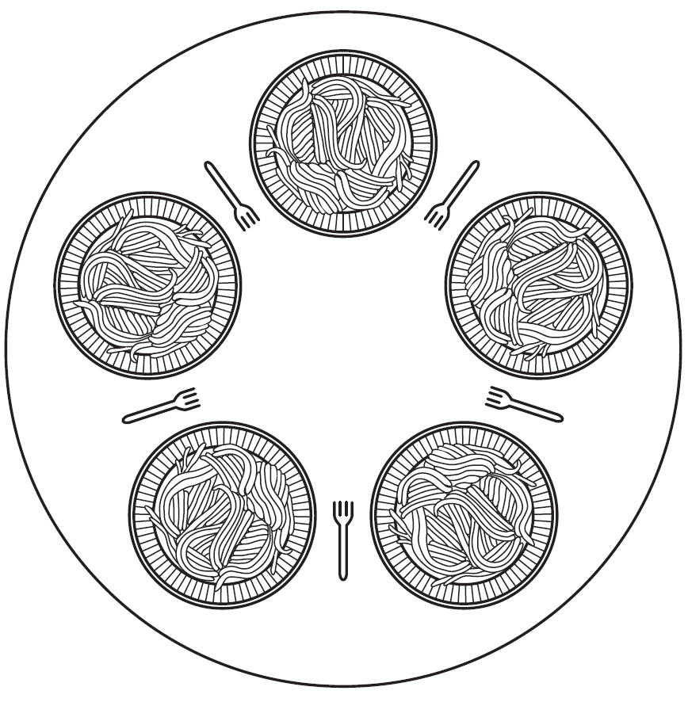
The Dining Philosophers Problem
In the dining philosophers problem, five philosophers are siting around a circular table, each has a plate of spaghetti. a philosopher needs two forks to eat.
Lunch time in the Philosophy Department.

Slide 44
A philosopher’s life consists of alternating periods of eating and thinking.
Getting sufficiently hungry, a philosopher tries to acquire left and right forks, one at a time, in either order.
If successful, the philosopher eats for a while, then puts down the forks, and continues to think.
Question: Is there a program for each philosopher that enabling think-eat alternation and never gets stuck?
Here is an obvious (yet wrong) solution.

Slide 45
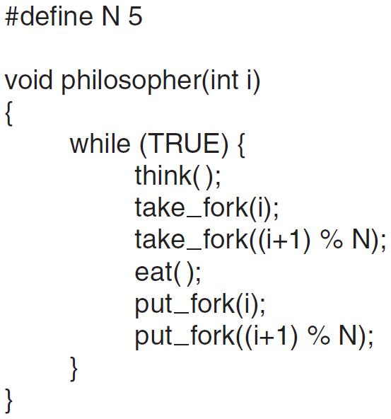
/* philosophers number*/
/* philosopher thinking*/
/* take left fork*/
/* take right fork*/
/* put left fork*/
/* put right fork*/

Slide 46
The procedure take fork() waits until the specified fork is available and then seizes it.
The solution is wrong. If all take left forks simultaneously none will be able to take right forks, a deadlock.
The program could checks after taking the left fork if the right is available. If not, the philosopher puts the left, waits some time, and then repeats the whole process.
This fails too if all start the algorithm simultaneously.
If philosophers waits random time before trying again, good chance it will work, though not desirable solution.

Slide 47
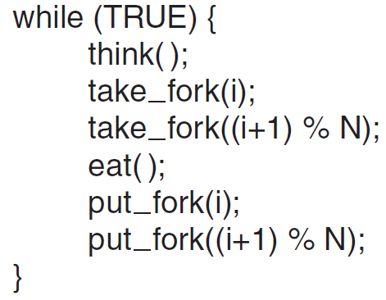
Will it work?
Yes, but only one eats at a time while two can.
What about that? (homework).

Slide 48
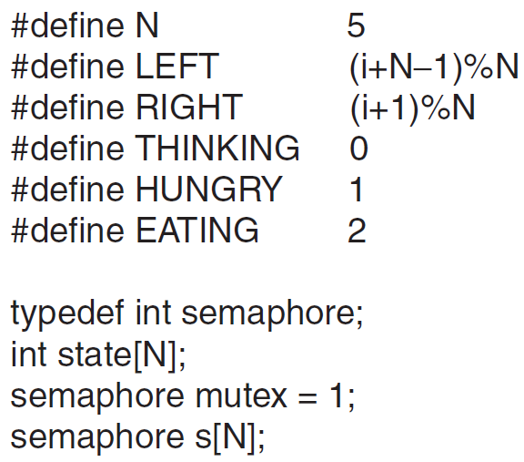
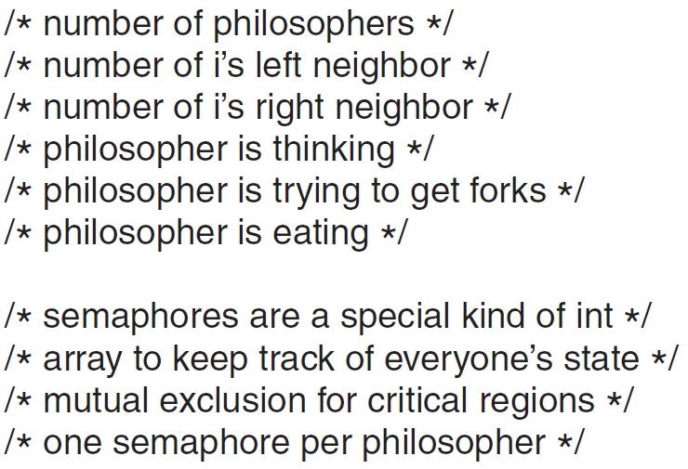

Slide 49
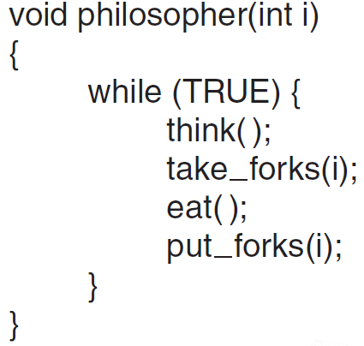
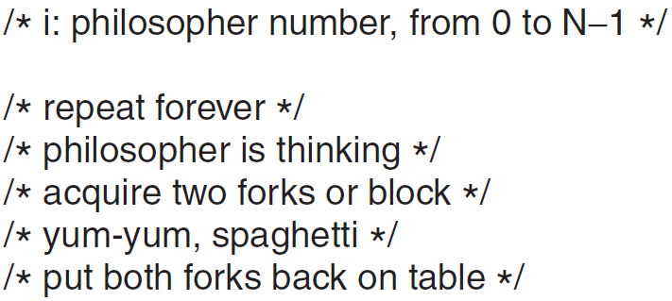

Slide 50
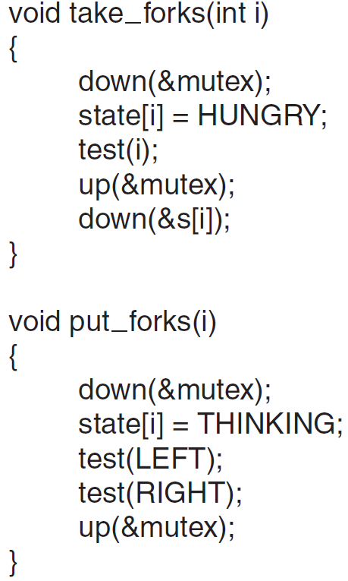
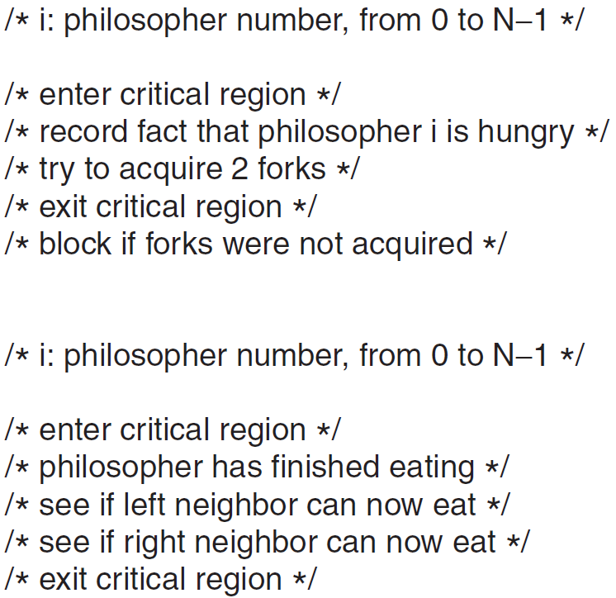

Slide 51
