Slide 1
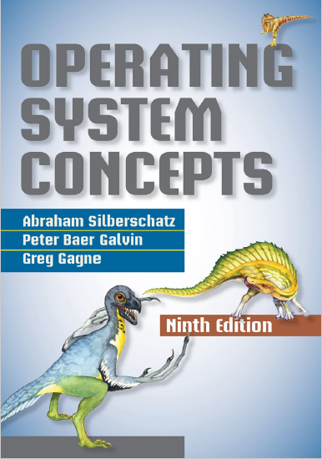
Security
prepared and instructed by
Shmuel Wimer
Eng. Faculty, Bar-Ilan University

Slide 2
The Security Problem
A system is secure if its resources are used and accessed as intended under all circumstances.
Security violations can be accidental (easier to protect) or intentional (malicious) (harder to protect).
Some accidental and malicious security violations are:
Confidentiality breach, unauthorized data reading (info theft), credit-card info, identity info for identity theft.
Integrity breach, unauthorized data modification, passing liability to innocent party, commercial application source code modification.

Slide 3
Availability breach, unauthorized data destruction, website defacement.
Service theft, unauthorized use of resources.
Denial of service (DOS), prevent legitimate system use.
In masquerading attack method one participant in a communication pretends to be someone else (another host or another person).
Attackers breach authentication, the correctness of identification, gaining access they would not normally be allowed.

Slide 4
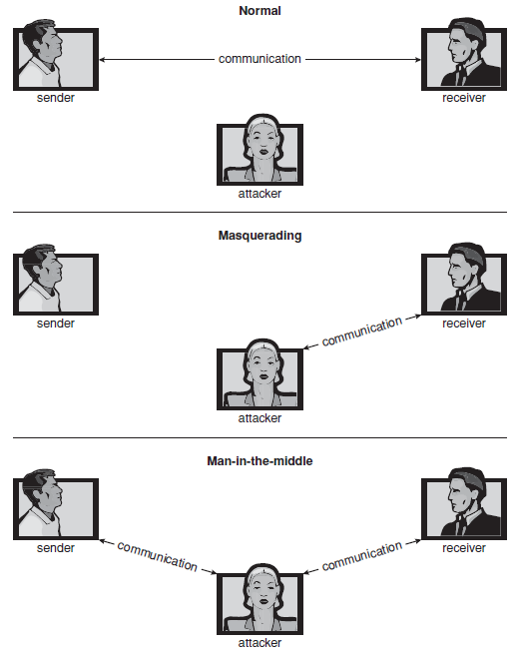
Standard security attacks.

Slide 5
Replay attack is a malicious repeat of valid data transmission, e.g. transfer of money.
In man-in-the-middle attacker sits in the data flow of a communication, masquerading as the sender to the receiver, and vice versa.
Security measures have four levels:
1. Physical, e.g. machine rooms and the terminals or having access to the machines must be secured.
2. Human. Authorization must be done carefully to assure that only appropriate users have system access.

Slide 6
3. Operating system, e.g. runaway process causing accidental denial-of-service attack, a query to a service could reveal passwords.
4. Network. Data interception of private leased lines, Internet, wireless connections, dial-up lines.
OS cannot implement security measures or to run securely without ability to authorize users, processes, control their access, and log their activities.
Hardware protection, e.g. memory protection, features are a must for overall protection scheme.

Slide 7
Program Threats
Processes, along with the kernel, are the only means of accomplishing work
on a computer. Therefore, writing a program that creates a breach of security,
or causing a normal process to change its behavior and create a breach, is a
common goal of crackers. In fact, even most nonprogram security events have
as their goal causing a program threat. For example, while it is useful to log in
to a system without authorization, it is quite a lot more useful to leave behind
a back-door daemon that provides information or allows easy access even if
the original exploit is blocked. In this section, we describe common methods
by which programs cause security breaches. Note that there is considerable
variation in the naming conventions for security holes and that we use the
most common or descriptive terms.

