Slide 1
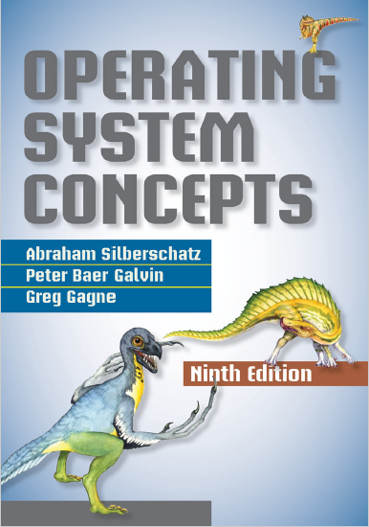
CPU Scheduling
prepared and instructed by
Shmuel Wimer
Eng. Faculty, Bar-Ilan University

Slide 2
Basic Concepts
In a single-processor, only one process can run at a time. Others wait until CPU is free and can be rescheduled.
Multiprogramming aims at maximizing CPU utilization.
A process is executed until it must wait, e.g. for completion of I/O request. Rather then CPU staying idle, multiprogramming uses this time productively.
When one process has to wait, OS gives the CPU to another process residing in memory.
Scheduling is a fundamental OS function.

Slide 3
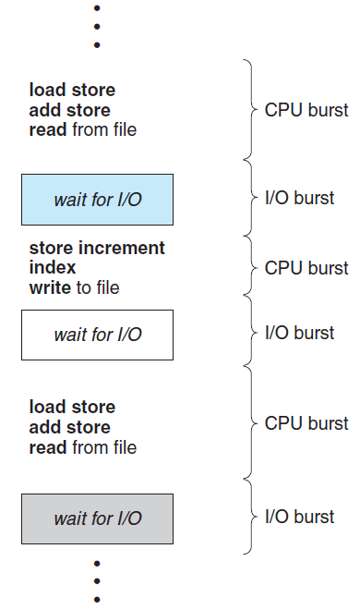
CPU–I/O Burst Cycle
Process execution consists of a cycle of CPU execution and I/O wait alternation, beginning with a CPU burst, followed by an I/O burst.
Eventually, the final CPU burst ends with a system request to terminate execution.

Slide 4
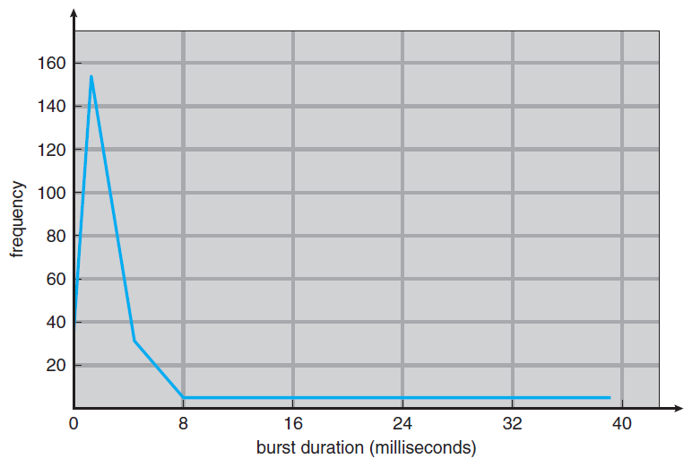
large number of short CPU bursts
small number of long CPU bursts
Histogram of CPU-burst durations.

Slide 5
An I/O-bound program has many short CPU bursts. A CPU-bound program have long CPU bursts.
When CPU becomes idle, OS selects by the short-term scheduler one of the processes in the ready queue for execution.
The records in the queues are process control blocks (PCBs) of the processes.

Slide 6
Preemptive Scheduling
CPU-scheduling occurs when a process:
Switches from the running state to the waiting state (e.g. I/O request, wait() for termination of a child).
Switches from the running state to the ready state (e.g. by interrupt).
Switches from the waiting state to the ready state (e.g. at completion of I/O).
Terminates.
In situations 1 and 4 a new process (if ready queue nonempty) is selected for execution.

Slide 7
Situations 2 and 3 may or may not imply scheduling.
Scheduling under 1 and 4 only is called non-preemptive or cooperative. Otherwise, it is preemptive.
Non-preemptive scheduling keeps the CPU allocated to a process until it either terminates or switched to waiting state (Windows 3.x).
Most OS use preemptive scheduling, which can cause race conditions when data are shared among processes (see synchronization lecture).

Slide 8
Preemption problems occur also in kernel processes. It may be busy on behalf of a process, which may involve changing important kernel data (e.g. I/O queues).
If the process is preempted in the middle of these changes and the kernel (or device driver) needs to read or modify this structure a chaos occurs.
UNIX-based OSs wait either for a system call to complete or for an I/O block, before switching context.
The kernel will not preempt a process while the kernel data are inconsistent (bad for real-time systems).

Slide 9
Dispatcher
A dispatcher is the module giving control of the CPU to the process selected by the short-term scheduler.
Dispatching involves:
Switching context.
Switching to user mode.
Jumping to the user’s program PC location for restart.
The dispatcher should be as fast as possible, since it is invoked during every process switch.
The time it takes for the dispatcher to switch processes is called dispatch latency.

Slide 10
Scheduling Criteria
Scheduling criteria include:
CPU utilization. Keeping the CPU as busy as possible. 40% - 90% in real systems. Maximize.
Throughput. Completed processes per time unit. Maximize.
1/hours for long process, 10/Sec for short transactions.
Turnaround time. Time it takes to execute a process, from submission to completion. Minimize.
Sum of time waiting to get into memory, waiting in ready queue, executing on CPU, doing I/O.

Slide 11
Waiting time. The CPU-scheduling algorithm affects the total time a process spends waiting in the ready queue. Minimize.
Response time. From the submission of a request until it starts responding. Important for interaction. Minimize.
The average is usually optimized. Sometimes min_max or max_min are preferred, e.g., getting good service, min_max of response time is sought.
Interactive systems prefer minimizing response time variance rather than average (predicted response preferred over fast on the average but highly variable).

Slide 12
First-Come, First-Served Scheduling
The simplest CPU-scheduling is first-come, first-served (FCFS), implemented with a FIFO queue.
When a process enters the ready queue, its PCB is linked onto the tail of the queue.
When the CPU is free, it is allocated to the process at the head of the queue.
The average waiting time under the FCFS policy is often quite long.

Slide 13
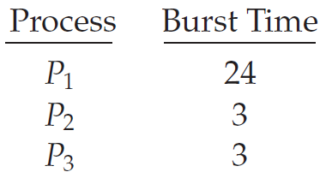
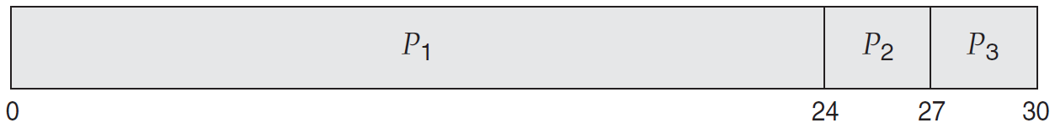
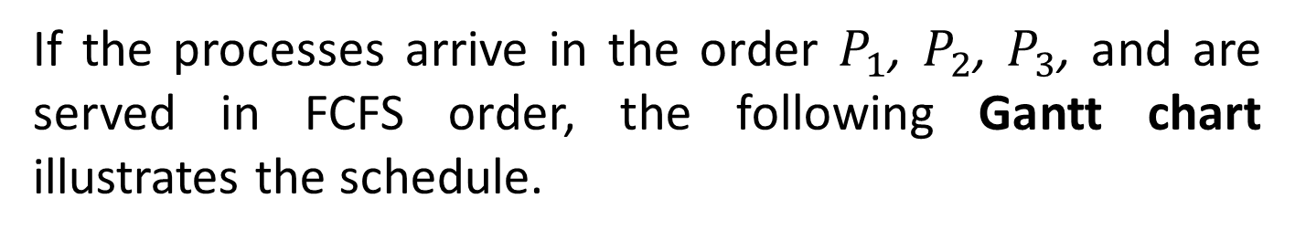
Processes arrive at time 0 with CPU burst in mSec.
If the processes arrive in the order $P_{1}$, $P_{2}$, $P_{3}$, and are served in FCFS order, the following Gantt chart illustrates the schedule.
$average waiting time={\left(0+24+27\right)}/3=17$.

Slide 14
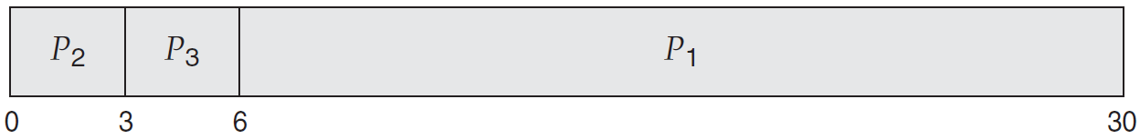
If the processes arrive in the order $P_{2}$, $P_{3}$, $P_{1}$, as shown
$average waiting time={\left(6+0+3\right)}/3=3$. $∎$
FCFS average waiting time is not minimal and vary substantially if processes’ CPU burst times vary greatly.
Consider FCFS performance in a dynamic situation, with one CPU-bound and many I/O-bound processes.
The CPU-bound process will get and hold the CPU.

Slide 15
Meanwhile, all the other processes finish their I/O and move into the ready queue, waiting for the CPU, leaving the I/O devices idle.
Eventually, the CPU-bound finishes its CPU burst and moves to an I/O device.
All the I/O-bound processes, having short CPU bursts, execute quickly and move back to the I/O queues, leaving the CPU idle.
The CPU-bound will then move back to the ready queue for CPU allocation.

Slide 16
Again, all the I/O bound processes end up waiting in the ready queue until the CPU-bound process is done.
There is a convoy effect. All the other processes wait for the big to get off the CPU, yielding lower CPU and device utilization.
Allowing the shorter processes higher priority would be better.
FCFS algorithm is non preemptive. Process keeps CPU until releasing it, either terminating or requesting I/O.

Slide 17
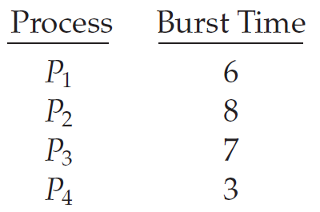
Shortest-Job-First Scheduling
Shortest-job-first (SJF) associates with process the length of its next CPU predicted burst.
It assigns the CPU to the process having the smallest burst. In case of tie FCFS scheduling is used.
The following processes have length of next predicted CPU bursts in mSec.

Slide 18
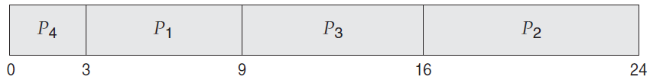
The SJF scheduling is:
$average waiting time={\left(3+16+9+0\right)}/4=7$. $∎$
FCFS scheduling yields average waiting 10.25 mSec.
The SJF scheduling algorithm is provably optimal. (why?)
Problem: SJF requires knowing the length of the next CPU request.
Batch system (long-term) uses user specified time limit. SJF is used in long-term scheduling.

Slide 19
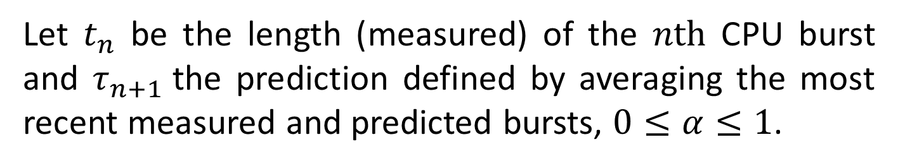
With short-term scheduling, there is no way to know the length of the next CPU burst and prediction is used.
The next CPU burst is generally predicted as an exponential average of the measured lengths of previous CPU bursts.
Let $t_{n}$ be the length (measured) of the $n\text{th}$ CPU burst and $τ_{n+1}$the prediction defined by averaging the most recent measured and predicted bursts, $0≤α≤1$.
$$τ_{n+1}=αt_{n}+\left(1−α\right)τ_{n}$$
commonly $α=1/2$.

Slide 20
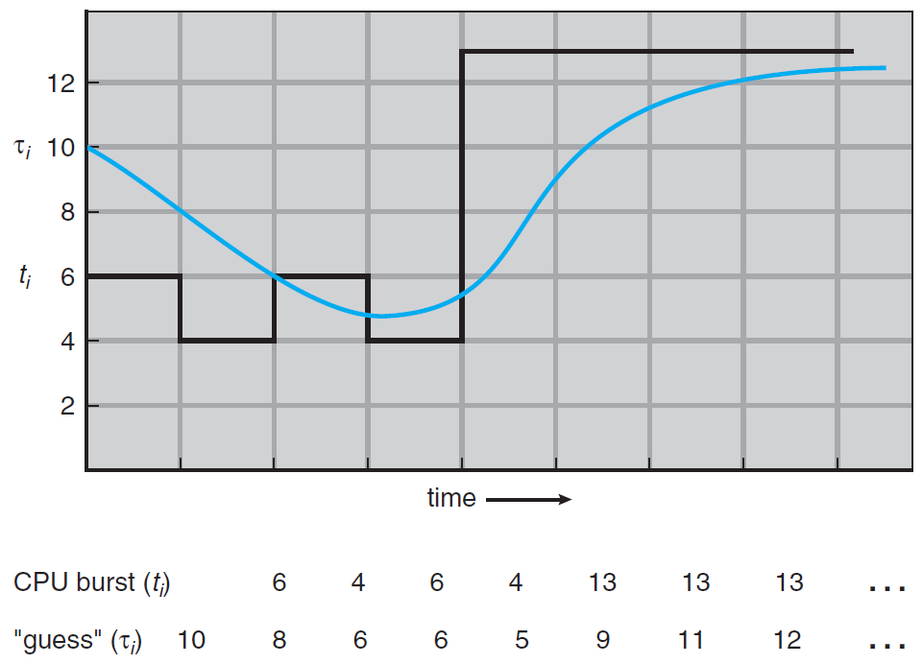

$α=1/2$

Slide 21
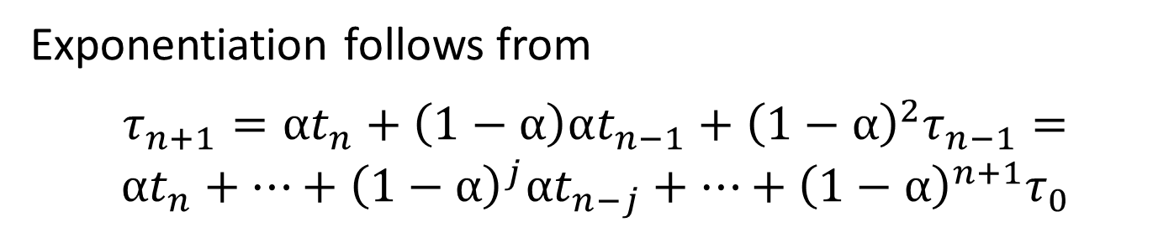
Exponentiation follows from
$$τ_{n+1}=αt_{n}+\left(1−α\right)αt_{n−1}+{\left(1−α\right)}^{2}τ_{n−1}=$$
$$αt_{n}+⋯+{\left(1−α\right)}^{j}αt_{n−j}+⋯+{\left(1−α\right)}^{n+1}τ_{0}$$
SJF can behave preemptively or non-preemptively.
The next CPU burst of a new process arriving at the ready queue may be shorter than what left of the currently executing.
Preemptive SJF will preempt the currently executing, whereas a non-preemptive SJF algorithm will allow the currently running finish its CPU burst.

Slide 22
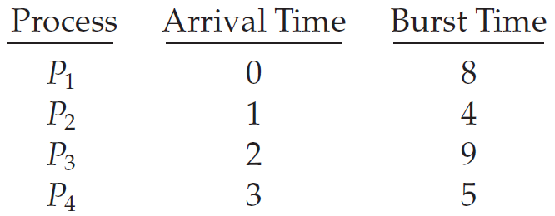
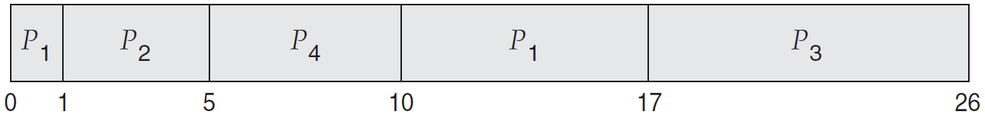
Example: The following processes have length of next predicted CPU bursts in mSec.
The preemptive SJF schedule is:

Slide 23
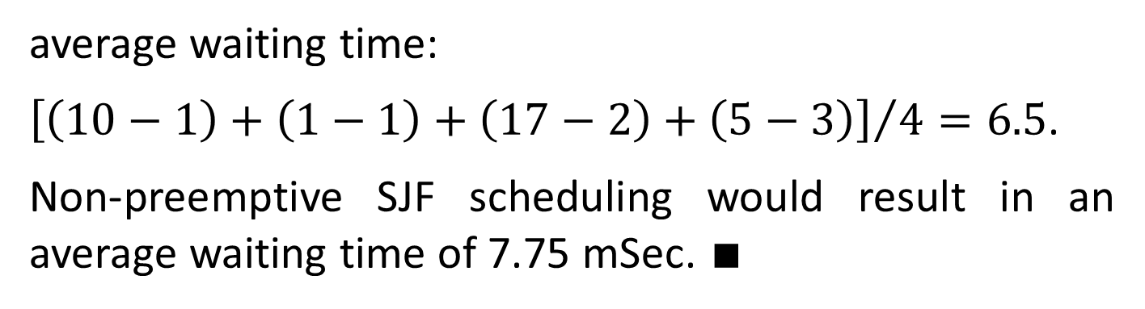
average waiting time:
${\left[\left(10−1\right)+\left(1−1\right)+\left(17−2\right)+\left(5−3\right)\right]}/4=6.5$.
Non-preemptive SJF scheduling would result in an average waiting time of 7.75 mSec. $∎$

Slide 24
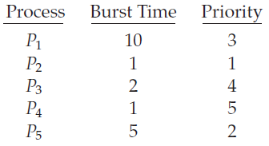
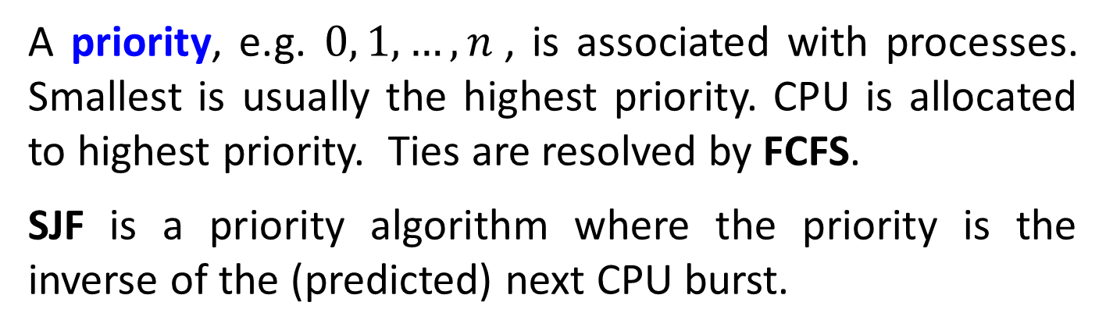
Priority Scheduling
A priority, e.g. $0, 1,…,n$, is associated with processes. Smallest is usually the highest priority. CPU is allocated to highest priority. Ties are resolved by FCFS.
SJF is a priority algorithm where the priority is the inverse of the (predicted) next CPU burst.
Example: Processes with burst time and priorities.

Slide 25

Average waiting time is $8.2$. $∎$
Internal priorities are based on OS measures, such as time limits, memory requirements, number of open files, the ratio of average I/O burst to average CPU burst.
External priorities are set outside OS: importance, amount of funds paid, etc.
The priority of an arriving process is compared with that of the currently running.

Slide 26
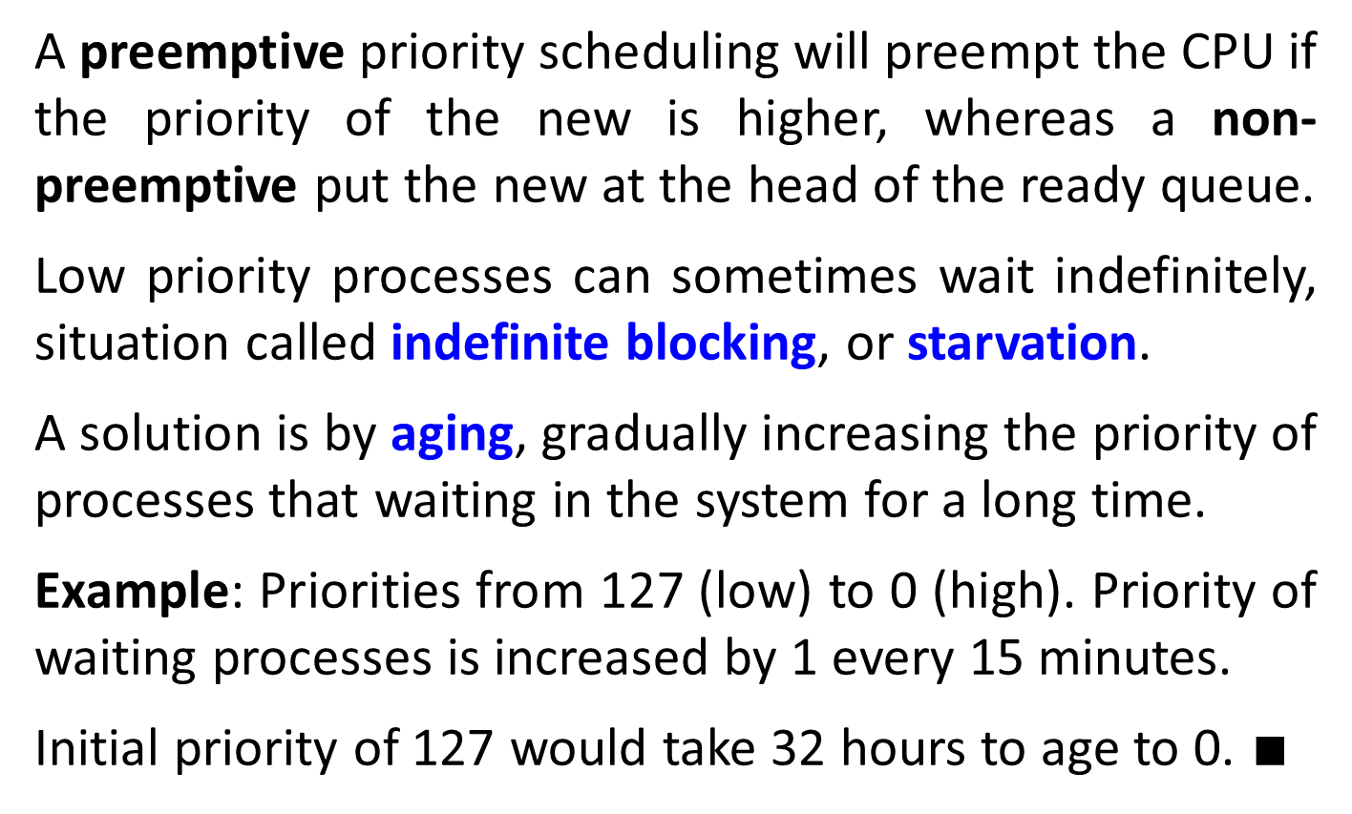
A preemptive priority scheduling will preempt the CPU if the priority of the new is higher, whereas a non-preemptive put the new at the head of the ready queue.
Low priority processes can sometimes wait indefinitely, situation called indefinite blocking, or starvation.
A solution is by aging, gradually increasing the priority of processes that waiting in the system for a long time.
Example: Priorities from 127 (low) to 0 (high). Priority of waiting processes is increased by 1 every 15 minutes.
Initial priority of 127 would take 32 hours to age to 0. $∎$

Slide 27
Round-Robin Scheduling
The round-robin (RR) is a FCFS with preemption added to enable switching between processes, especially for timesharing systems.
RR uses a time unit from 10 to 100 milliseconds, called a time quantum or time slice.
The ready queue is treated as a circular queue. CPU is allocated to process for a time interval of 1quantum.
A new process is added to tail of ready queue.
CPU scheduler picks the first in queue, sets a timer to interrupt after 1 quantum, and dispatches the process.

Slide 28
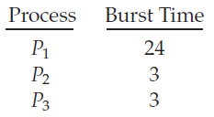
If CPU burst of current process is longer than 1 slice, the timer will interrupt, the context will be switched, and the process will be put at the queue tail.
The average waiting time under the RR is often long.
Example: Processes arrive at time 0, with the length of the CPU burst in mSec and time quantum of 4 mSec.

Slide 29

average waiting time: ${\left[\left(10−4\right)+4+7\right]}/3=5.66$. $∎$
If a process’s CPU burst exceeds 1 quantum, that process is preempted and is put back in the ready queue.
The RR scheduling algorithm is thus preemptive.
The performance of the RR algorithm depends heavily on the size of the time quantum.
If the time quantum is extremely large, RR turns FCFS.

Slide 30
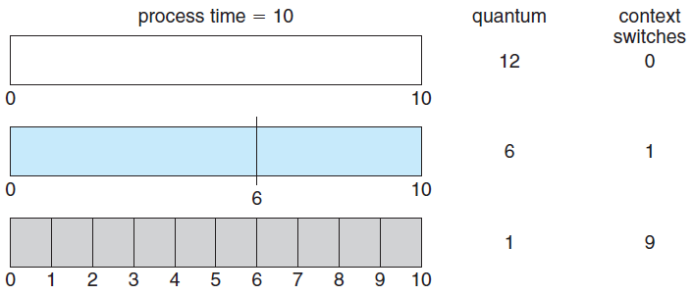
Small quantum results in a large number of context switches overhead.
Example: One process of 10 time units.
Time quantum and context switches.

Slide 31
We want the time quantum to be large with respect to the context switch time.
If the context-switch time is 10% of the quantum, about 10% of the CPU time will be spent in context switching.
Modern systems have time quanta 10 to 100 mSec, while context switch is less than 10 μSec.
Turnaround time (from submission to completion) also depends on quantum.
The average turnaround time of a set of processes does not necessarily improve with quantum increase.

Slide 32
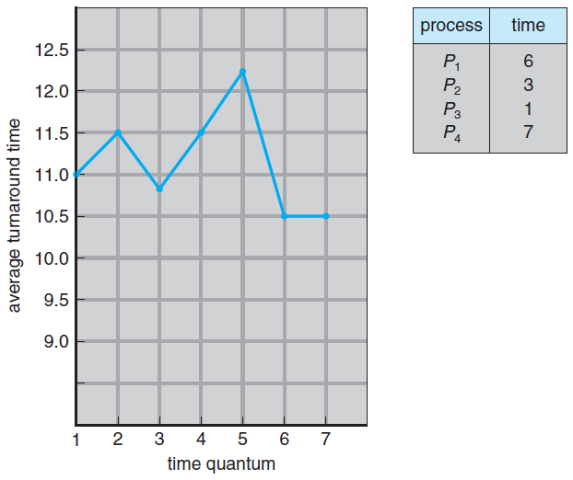

$${\left[\begin{aligned}\begin{aligned}\left(6−0\right)+ \\ \left(9−0\right)+\end{aligned} \\ \begin{aligned}\left(10−0\right)+ \\ \left(17−0\right)\end{aligned}\end{aligned}\right]}/4=10.5$$
Turnaround time variation with the time quantum.

Slide 33
The average turnaround time improves if most processes finish next CPU burst in a single quantum.
For three processes of 10 time units each and a quantum of 1, the average turnaround time is 29.
If quantum is 10, the average turnaround time is 20.
If context-switch time is added in, the average turnaround time increases even more for a smaller time quantum.
A rule of thumb is that 80 percent of the CPU bursts should be shorter than the time quantum.

Slide 34
Multilevel Queue Scheduling
Foreground (interactive) processes and background (batch) processes have different response-time requirements, hence different scheduling needs.
Foreground may also have priority over background.
Multilevel queue scheduling partitions the ready queue into several separate queues.
Processes are assigned to queues, based on some memory size, priority, process type, etc.
Each queue has its own scheduling algorithm, e.g. foreground by RR and background by FCFS.

Slide 35
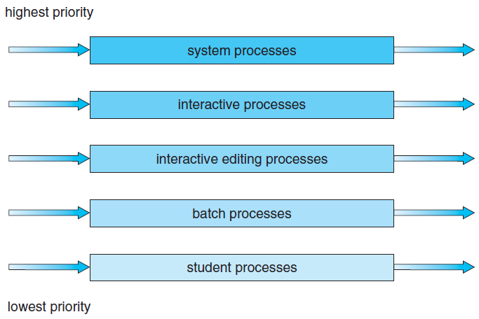
Multilevel queue scheduling.

Slide 36
There must be scheduling among the queues, commonly fixed-priority, preemptive.
Each queue has absolute priority over lower-priority queues. No batch could run unless system, interactive, and editing are empty.
If editing process entered the ready queue while a batch process was running, the batch is preempted.
Another possibility is to time-slice among the queues, foreground is given 80% for RR scheduling and background 20% for FCFS.

Slide 37
Multilevel Feedback Queue Scheduling
Multilevel queue scheduling fixes processes to queue, since their nature is unchanged. Multilevel feedback queue allows processes migrate between queues.
It separates processes according to their CPU bursts. A process using much CPU moves to lower-priority queue.
I/O-bound and interactive processes migrate to higher-priority queues. A process waiting too long in a lower-priority queue may move to a higher-priority queue.
Such aging prevents starvation.

Slide 38
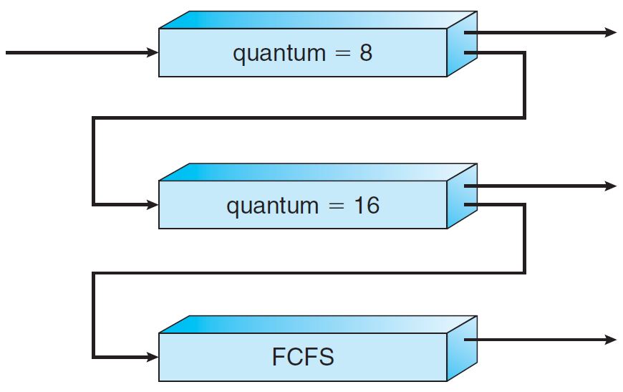
0
1
2
Multilevel queue scheduling.

Slide 39
All processes in 0 are executed first. 1 is executed only when 0 is empty. 2 is executed only if 0 and 1 empty.
A process arriving 1 will preempt a process in 2, but will be preempted by a process in 0.
A process in 0 is given quantum of 8. If it does not finish within 8, it moves to the tail of 1.
If 0 is empty, the head of 1 is given a quantum of 16. If not completed, it is put into 2, using FCFS scheduling.
This scheduling algorithm gives highest priority to any process with a CPU burst of 8 or less.

Slide 40
Processes between 8 and 24 are also served quickly, but lower priority than shorter ones. Long ones sink to 2, served by FCFS with any CPU cycles left over.
Multilevel feedback queue scheduler is defined by:
Number of queues.
Scheduling algorithm for each queue.
Methods of process priority promotion / demotion.
Which queue process enters when it needs service.
This it the most general CPU-scheduling which can be configured to match a specific system under design.

