Slide 1
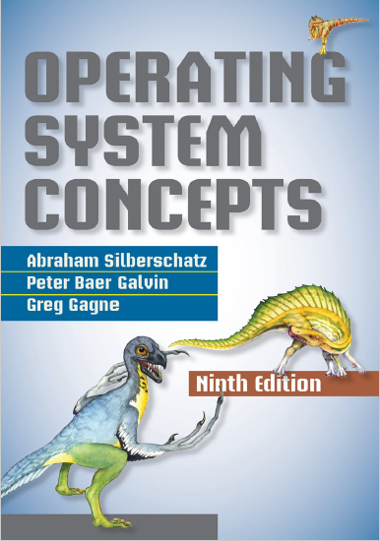
Processes
prepared and instructed by
Shmuel Wimer
Eng. Faculty, Bar-Ilan University

Slide 2
Process Concept
Process (job): instance of executing program, including current values of PC, registers and variables.
Each process has its own virtual CPU. In reality the real CPU switches back and forth from process to process, called multiprogramming.

Slide 3
A process is more than the program code (text section).
It also includes:
value of program counter
contents of processor’s registers,
process stack, containing temporary data (function parameters, return addresses, local variables),
data section, which contains global variables,
heap, which is a dynamic memory allocated during run time.

Slide 4
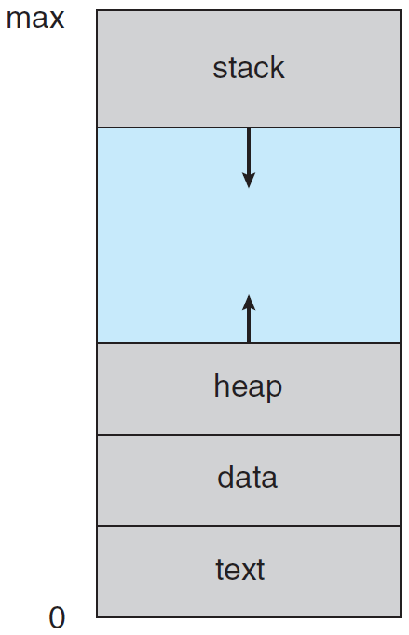
Process in memory.
A program is not a process but a passive entity, such as file containing instructions (executable file).
Program becomes process when executable file is loaded into memory.

Slide 5
Few processes may be associated with the same program.
They are nevertheless considered separate execution sequences.
Examples: running different copies of the mail program by different users.
A user invokes many copies of web browser program.
Although the text sections are equivalent, the data, heap, and stack sections are different. $∎$

Slide 6
Process State
A process may be in one of the following states:
New. It is being created.
Running. Instructions are being executed.
Waiting. The process is waiting for some event to occur (e.g., I/O completion or reception of a signal).
Ready. It is waiting to be assigned to a processor.
Terminated. It has finished execution.
Only one process can be running on any processor at any instant. Many processes may be ready and waiting.

Slide 7
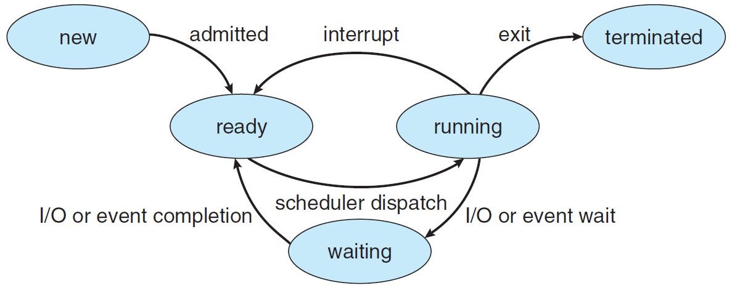
Diagram of process state.

Slide 8
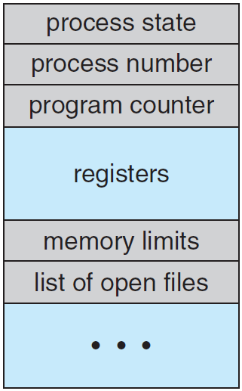
Process Control Block
Process is represented in a process control block (PCB).
Process state.
Program counter (PC).
CPU registers. Accumulators, index registers, stack pointers, general-purpose registers, any condition-code information.
With PC, this info is saved when interrupt occurs.

Slide 9
CPU-scheduling info. Process priority, pointers to scheduling queues, other scheduling parameters.
Memory-management info. Value of base and limit registers and the page tables.
Accounting info. Amount of CPU and real time used, time limits, account numbers, process number, etc.
I/O status info. Lists of I/O devices allocated to the process, open files, etc.
PCB is repository of any process dependent information.

Slide 10
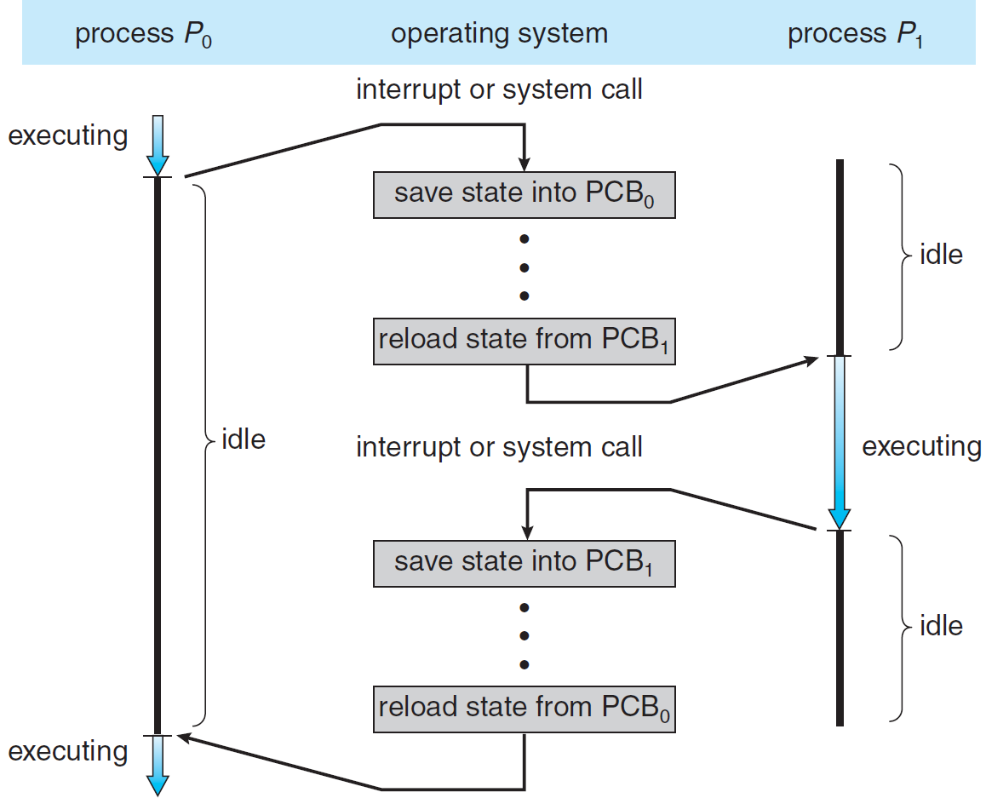
CPU switch from process to process.

Slide 11
Scheduling Queues
All processes are put into a job queue. Those in memory and ready for execution are put in ready queue.
There are other queues.
A process executes for a while and eventually quits, interrupted, or waits for a particular event, e.g., completion of an I/O request.
Example: A process makes I/O request to shared disk, which may be busy with request of another process.
The list of processes waiting for a particular I/O device is called a device queue. Each device has its queue. $∎$

Slide 12
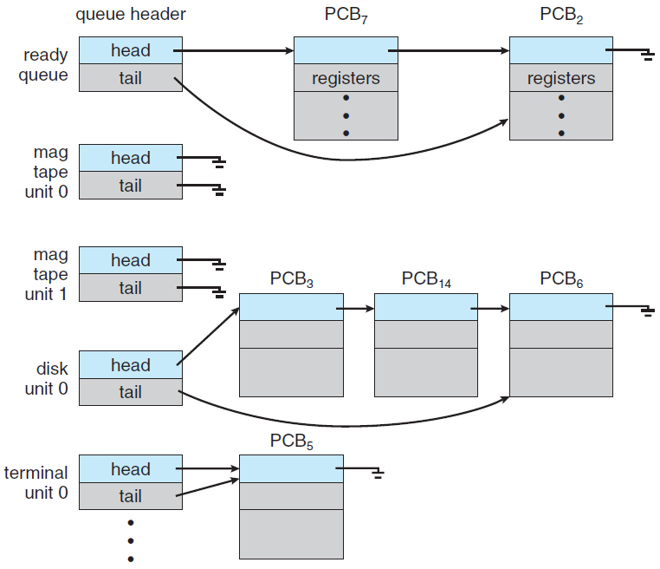
The ready queue and various I/O device queues.

Slide 13
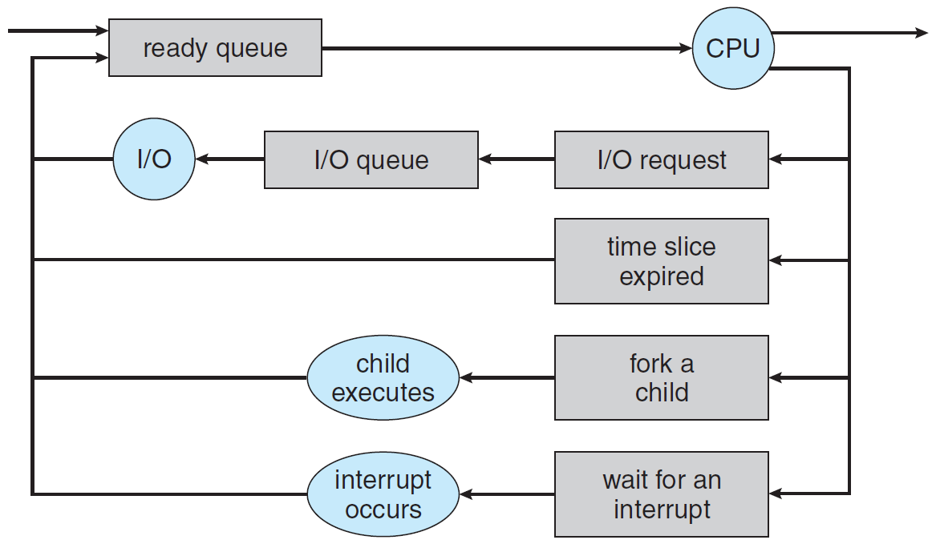
Queueing-diagram representation of process scheduling.
A new process is put in the ready queue.
It waits there until it is selected for execution, or dispatched.

Slide 14
The process could issue an I/O request and then be placed in an I/O queue.
The process could create a new child process and wait for the child’s termination.

Slide 15
The process could be removed forcibly from the CPU, as a result of an interrupt, and be put back in the ready queue.
Expiration of time slot.
Continues this cycle until termination. Removed from all queues. Deallocate PCB and resources.

Slide 16
Schedulers
The selection process from queues is carried out by an appropriate scheduler.
In a batch system, processes are spooled to the disk. Long-term scheduler selects processes from this pool and loads them into memory for execution.
It works in seconds to minutes resolution.
The long-term scheduler controls the degree of multiprogramming (the number of processes in memory).
Most processes are either I/O bound or CPU bound.

Slide 17
Long-term scheduler should select a good process mix of I/O-bound and CPU-bound processes.
If all are I/O bound, the ready queue is almost always empty, and CPU may hardly work.
If all are CPU bound, the I/O waiting queue is empty, devices are unused, and system is unbalanced.
Best performance requires a combination of CPU-bound and I/O-bound processes.
UNIX and MS Windows have no Long-term scheduler.

Slide 18
Short-term scheduler (CPU scheduler) selects one from ready processes and allocates the CPU.
Executes in milliseconds resolution since process may execute only few milliseconds before waiting for I/O.
It must work fast.
Some OSs use medium-term scheduler to remove a process from memory (CPU contention), reducing the multiprogramming degree.
Process returns later to memory, continuing execution, a scheme called swapping. It improve the process mix.

Slide 19
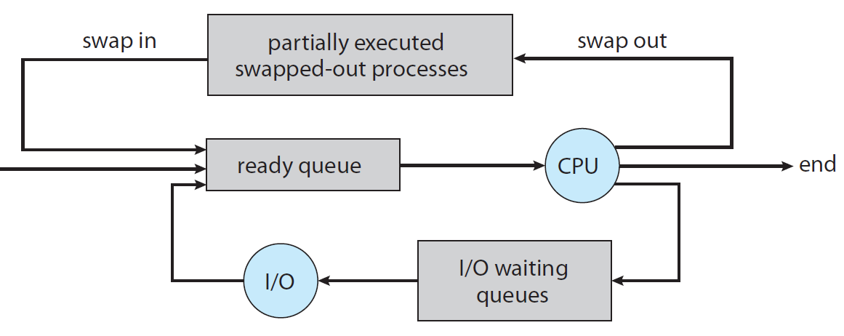
Medium-term scheduling addition to the queueing diagram.

Slide 20
Context Switch
Interrupts cause OS to change the CPU from user to kernel mode.
The current context (represented in PCB) of the running process is saved so that the CPU can later restore it.
Similarly, witching the CPU to another process requires performing a state save and a later restore, known as context switch, which is a timing overhead.
Its speed (milliseconds) depends on memory speed, number of copied registers, existence of special instructions to load or store all registers, and alike.

Slide 21
Process Creation
During execution, a process called parent, may create several new processes called children, which may in turn create other processes, forming a tree.
Most OSs (UNIX, Linux, Windows) identify processes by a unique integer called process identifier (pid).
pid is used as an index to access various attributes of a process within the kernel.
The init process (pid 1) is the root of the processes tree.
After boot the init process can create various user processes.

Slide 22
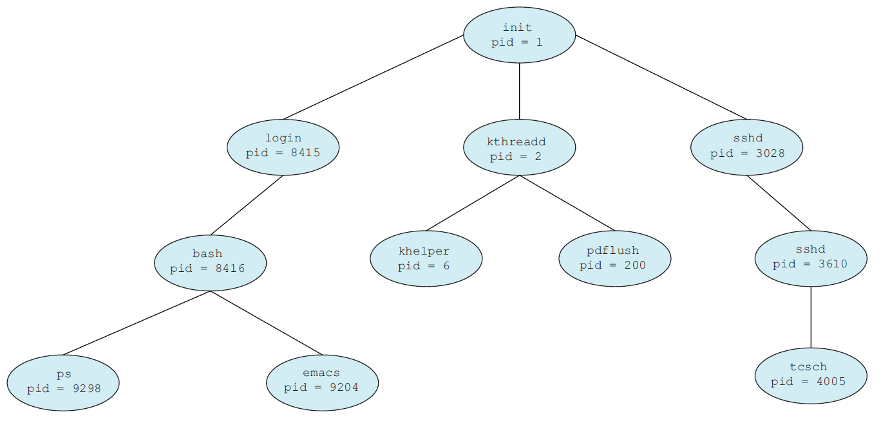
A tree of processes on a typical Linux system.

Slide 23
When parent creates child, the child needs resources (CPU, memory, files, I/O devices) to accomplish its task.
These may be obtained directly from the OS, or may be constrained to a subset of the resources of the parent.
The parent can partition or share some its resources (memory, files) among children.
Such restriction prevents any process from overloading the system by creating too many child processes.
The parent may pass along initialization data (input file name, output device) to the child.

Slide 24
New process creation has two execution possibilities:
Parent continues execute concurrently with children.
Parent waits until some or all children terminate.
New process has two address-space possibilities:
Child is a duplicate of the parent, having same program and data.
The child has a new program loaded into it.
In UNIX, a new process is created by fork() system call.
It copies parent’s address, allowing the parent to communicate easily with its child.

Slide 25
Both processes continue execution at the instruction after the fork().
The return code for the fork() is zero for the child, while nonzero pid of the child is returned to the parent.
Process creation using the fork() system call.

Slide 26
After fork() one of the two processes uses exec() to replace the process’s memory space with new program.
The exec() loads a binary file into memory, destroying the memory image, and starts its execution.
The two processes are able to communicate and then go their separate ways.
The parent can create more children, or issue wait() to move itself off the ready queue until child terminates.

Slide 27
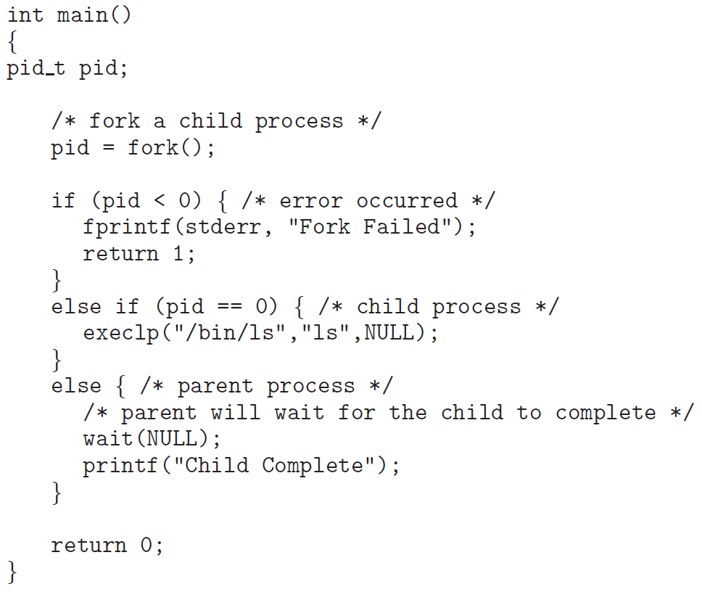
Process creation using the fork() system call.

Slide 28
The child may not invoking exec(), case it continues to execute as a copy of the parent process.
Parent and child are concurrent processes running the same code, each has its own copy of any data.
MS-Windows processes are created by CreateProcess(), which as in fork() the parent creates a new child.
Unlike fork(), CreateProcess() requires loading specified program into the address space of the child.
CreateProcess() expects ten parameters.

Slide 29
Process Termination
A process terminates by using the exit() system call, returning a status value (integer) to parent.
OS deallocates all its resources (physical and virtual memory, open files, I/O buffers).
Parent can forcibly terminate child via a system call (TerminateProcess() in MS-Windows), otherwise, users could arbitrarily kill each other’s jobs.
A parent may terminate the execution of child for a variety of reasons:

Slide 30
Child exceeded a resource that it has been allocated.
The task assigned to child is no longer required.
The parent exits, and OS prohibits child to continue if its parent terminates, referred to as cascading termination.
In Linux and UNIX, process terminates by using exit(), providing an exit status parameter, e.g., exit(1).
exit() may be called also indirectly by return statement.
Parent may wait for the termination of child by using wait() with a parameter to obtain exit status of the child.

Slide 31
wait() returns the pid of the terminated child so parent knows what child is concerned.
Though child’s resources are deallocated by OS, its entry in the process table must remain until parent calls wait(), because table contains the child’s exit status.
A process that has terminated, but whose parent has not yet called wait(), is known as zombie.
All processes transition to zombie when terminate, but exist such only briefly.
Once the parent calls wait(), the pid of the zombie and its entry in the process table are released.

Slide 32
Interprocess Communication
A process is independent if it cannot affect or be affected by the other executing processes.
A process is cooperating if it can affect or be affected by other executing processes, e.g. sharing data with others.
Reasons for process cooperation:
Information sharing, e.g. concurrent access to file.
Speedup, e.g. a task is broken into subtasks executed in parallel (in multiple processing cores).
Modularity, e.g. dividing system functions into separate processes or threads.

Slide 33
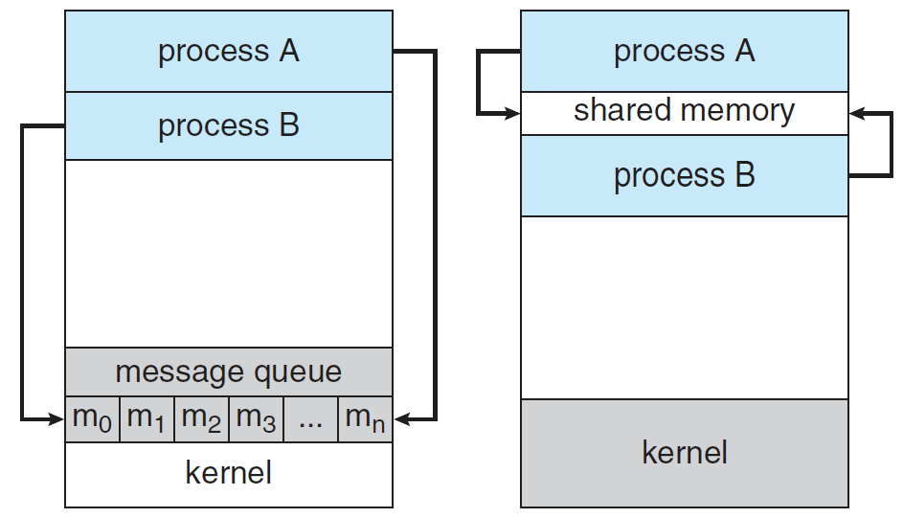
Cooperation requires an interprocess communication (IPC) mechanism to allow data and info exchange.
There are shared memory and message passing models. OS may implement both.

Slide 34
Message passing is useful for exchanging smaller data, because no conflicts need be avoided.
Shared memory is faster than message passing, which implementation uses system calls. Shared-memory needs no kernel assistance.
Shared memory suffers from cache coherency issues, arising from shared data migration among few caches.
As the number of processing cores increases, message passing may take over shared-memory.

Slide 35
Shared-Memory Systems
Shared-memory resides in the address space of the process creating it. The communicating processes attach it to their address space.
Since OS normally prevents one process from accessing another process’s memory, shared memory requires to remove this restriction.
The form of the data and the location are determined by the processes and are not under the OS control.
The processes are responsible to not writing to the same location simultaneously.

Slide 36
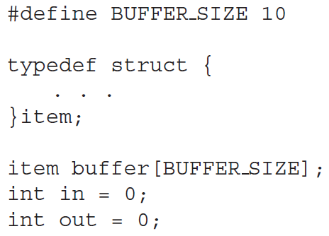
Example: producer–consumer problem.
A compiler produces assembly code, consumed by an assembler. The assembler produces object modules consumed by the loader. $∎$
/* shared memory */
/* producer pointer*/
/* consumer pointer*/

Slide 37
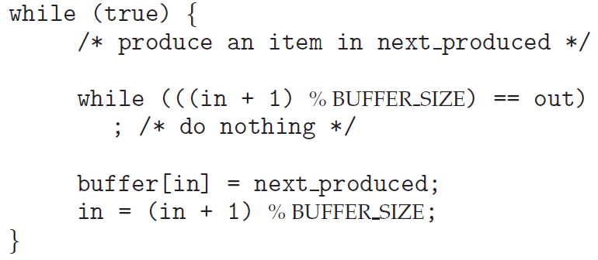
/* cyclic buffer is full */
/* produce item */
/* next pointer */
The producer process using shared memory.

Slide 38
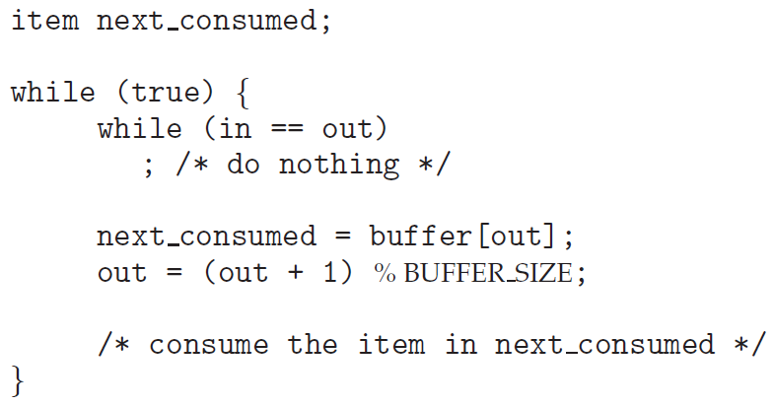
/* cyclic buffer is empty */
/* consume item */
/* next pointer */
The consumer process using shared memory.
What happens when producer and consumer attempted simultaneously? left for later lecture.

Slide 39
Message-Passing Systems
Message-passing provides two operations: send(message) and receive(message).
A communication link must exist between processes.
There are several methods for logically implementing a link and the send() / receive() operations:
Direct or indirect communication
Synchronous or asynchronous communication
Automatic or explicit buffering

Slide 40
Naming
In direct communication, process must explicitly name the recipient or sender:
send($P$, message)—Send a message to process $P$.
receive($Q$, message)—Receive a message from $Q$.
A symmetric communication link is established automatically.
In asymmetric addressing
send($P$, message)—Send a message to process $P$.
receive($id$, message)—Receive a message from any.
$id$ is set to the name of the communicated process.

Slide 41
With indirect communication, the messages are sent to and received from mailboxes, or ports, having a unique identification.
send($A$, message): Send a message to mailbox $A$.
receive($A$, message): Receive a message from mailbox $A$.
Processes can communicate via few mailboxes. Few processes can share the same mailbox.
Let $P1$, $P2$, and $P3$ share mailbox $A$. $P1$ sends to $A$, while both $P2$ and $P3$ receive from $A$. Which will receive the message sent by $P1$?

Slide 42
The system may define an algorithm for selecting which process will receive the message (e.g. round robin).
A mailbox may be owned by process, a part of its address space. Termination disappears the mailbox.
The owner can only receive through it, while a user can only send to it.
If owned by OS, it provides create and delete functions. The creator process is the mailbox’s owner.
Ownership may be passed to other processes by appropriate system call.

Slide 43
Synchronization
Message passing may be either blocking or non-blocking
Blocking send. Sending process is blocked until the message is received by a process or by the mailbox.
Non-blocking send. The sending process sends the message and resumes operation.
Blocking receive. The receiver blocks until a message is available.
Non-blocking receive. The receiver retrieves either a valid message or a null.

Slide 44
The solution to the producer–consumer problem becomes trivial by blocking send() and receive().

Slide 45
Buffering
Messages exchanged reside in a temporary queue, implemented in three ways:
Zero capacity. The sender must block until the recipient receives the message.
Bounded capacity. If the link is full, the sender must block until space is available in the queue.
Unbounded capacity. The sender never blocks.
zero-capacity is a message system with no buffering.
The others are systems with automatic buffering.

Slide 46
Pipes
Pipe allows two processes to communicate. Four issues must be considered:
Bidirectional or unidirectional communication
If bidirectional, is it half or full duplex?
Must a parent–child relationship exist between the communicating processes?
Can the pipes communicate over a network, or just on the same machine?
Ordinary pipes are unidirectional, allowing processes to communicate in standard producer–consumer fashion.

Slide 47
The producer writes to the write-end and the consumer reads the read-end.
In two-way communication, two pipes must be used, with each pipe sending data in a different direction.
UNIX ordinary pipes are constructed using the function pipe(int fd[]), creating a pipe accessed through file descriptors.
UNIX treats a pipe as a special type of file, accessed using ordinary read() and write() system calls.
An ordinary pipe cannot be accessed from outside the process that created it.

Slide 48
A parent creates a pipe and uses it to communicate with a child that it creates via fork().
Since a pipe is a special type of file, the child inherits the pipe from its parent process.
File descriptors for half-duplex pipe.

Slide 49
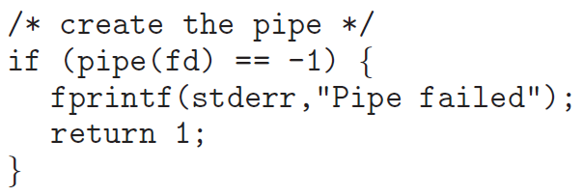

Slide 50
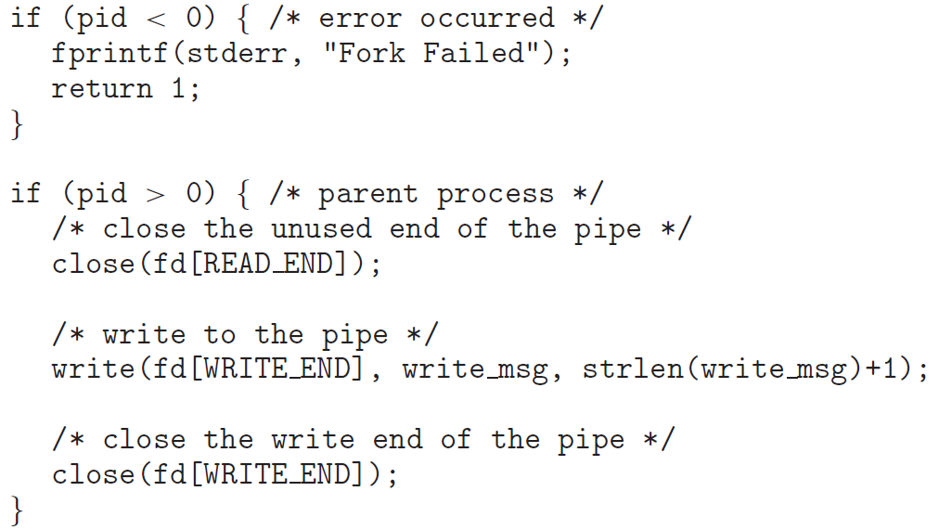
0
1

Slide 51
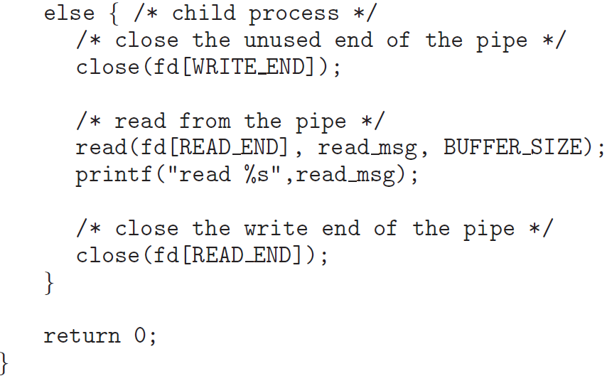

Slide 52
Pipes are used in the UNIX command-line when the output of one command serves as input to another.
Example: ls command produces a directory listing, which may scroll through several screens. The command more displays only one screen of output at a time.
Setting up a pipe between the ls and more commands delivers the output of ls to the input to more.
A pipe is constructed using the | character. The complete command is ls | more, the ls is the producer, and the more command is the consumer. $∎$

