Slide 1
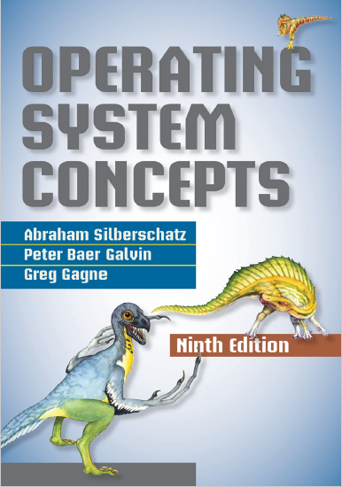
Operating System Structures
prepared and instructed by
Shmuel Wimer
Eng. Faculty, Bar-Ilan University

Slide 2
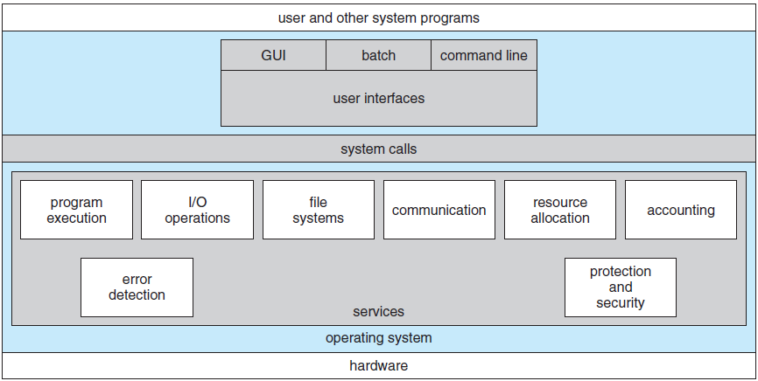
Operating system services

Slide 3
User interface (UI)
command-line interface (CLI) via the keyboard
batch interface: commands and directives are entered into executable files
graphical user interface (GUI): window interface
Program execution. Load into memory and run.
I/O operations. Programs require I/O. Users usually cannot control I/O devices directly. Done by the OS.
File-system manipulation. Read, write, create, delete and search within files and directories, manage permissions.

Slide 4
Communications. Processes on same or different computers may exchange information.
Via shared memory. Processes read and write to a shared section of memory.
Via message passing. OS moves packets of information in predefined formats between processes.
Error detection (correction)
HW (CPU , memory)
I/O devices (connection failure, lack of paper)
User program (arithmetic overflow, access illegal memory location, excessive CPU time).

Slide 5
OS takes appropriate action: halt the system, terminate an error-causing process, return an error.
Resource allocation. When multiple users or jobs run at the same time, resources must be allocated to each (CPU cycles, main memory, file storage, IO devices).
Accounting. Which users use how much and what resources (billing, statistics, improve service, research).
Protection and security
Avoid inter-processes and OS interfere (via memory).
Control access to system resources.
User authentication (ID, password).

Slide 6
User and OS interface
OS provides command-line interpreter, called shell, that allows users to directly enter commands to be performed by the operating system (UNIX, MS-DOS).
The interpreter does not understand the command. It identifies a file to be loaded into memory and executed.
Example: The UNIX command to delete a file rm file.txt searches for a file rm, loads it into memory, and executes it with the parameter file.txt. $∎$
Addition of new commands is easy. The interpreter program is small and does not have to be changed.

Slide 7
System Calls
System calls provide an interface to the OS services.
These calls are usually C or C++ routines, but can also be in assembly for low-level tasks of HW.
Even simple programs may use the OS heavily, thousands of system calls per second.
Example: a program reading data from one file and copy them to another file.
Involves getting file names, open one and create another, validity check, loop of copying, etc. $∎$

Slide 8
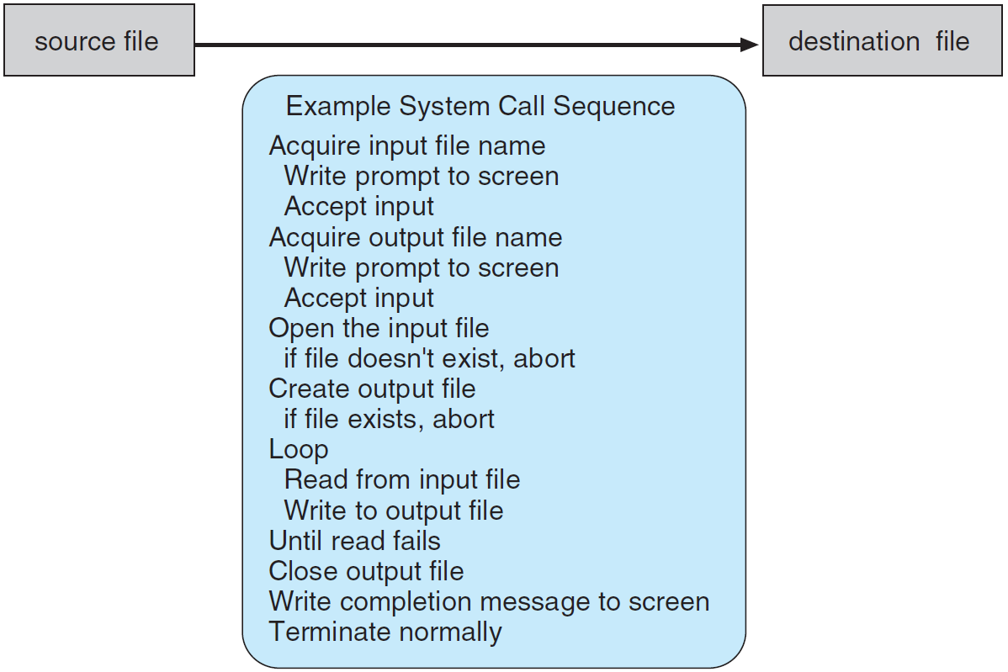

Slide 9
Programmers do not see system calls level of details.
Programmers use application programming interface (API), hiding most system calls and providing program portability.
Example: Windows function CreateProcess() invokes the NTCreateProcess() system call in the Windows kernel. $∎$
Most common APIs are Windows, POSIX (include all versions of UNIX and Linux), and Java.
UNIX and Linux API is written in C, the library is libc.

Slide 10
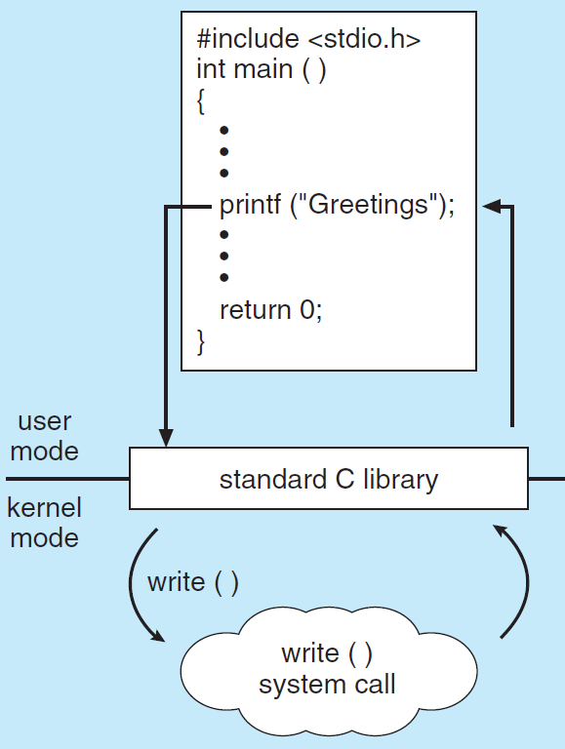
Example of standard C library.
API call
API code
system call

Slide 11
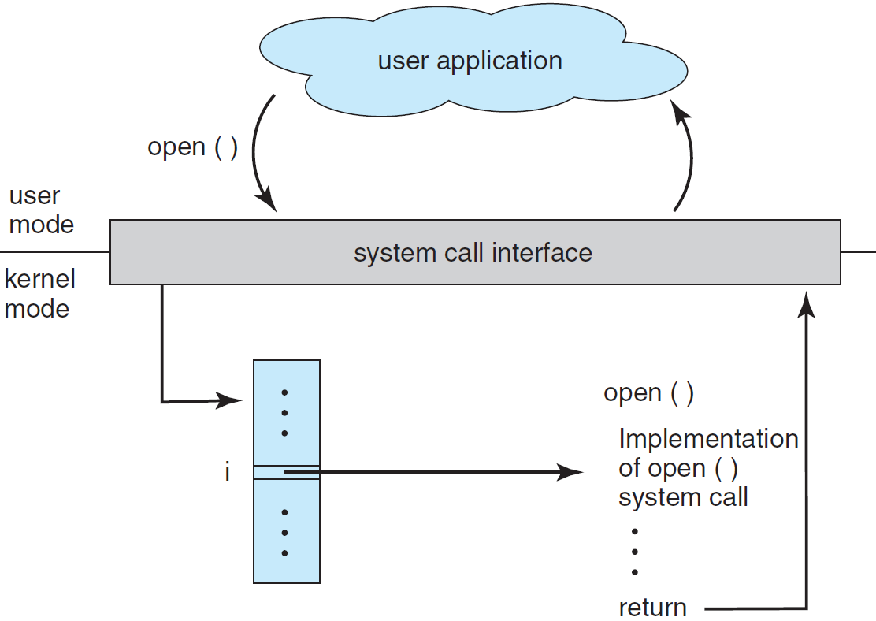
User application invoking a system call.

Slide 12
A number is associated with each system call. The systemcall interface maintains an indexed table.
The system call interface invokes the intended system call in the kernel, returning its status and values.
Parameters can be passed to OS in registers (restrictive).
A block in memory can be used instead (Linux, Solaris). Only the address of the block is passed.
Parameters also can be pushed onto the stack by the program and popped off the stack by the OS.

Slide 13
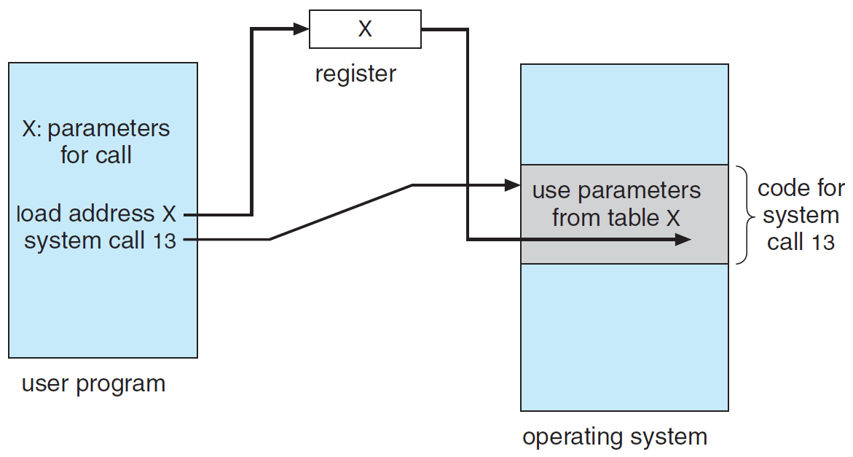
Passing of parameters as a table.

Slide 14
Types of System Calls
Process control
end, abort
load, execute
create process, terminate process
get process attributes, set process attributes
wait for time
wait event, signal event
allocate and free memory

Slide 15
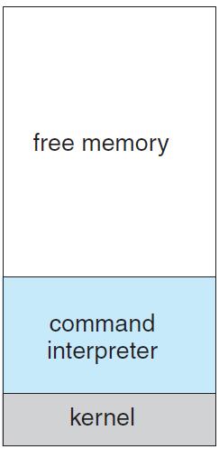
Example: A single-tasking OS (e.g. MS-DOS) invokes command-line interpreter when computer is started.
Because it is single-tasking there is just a single process.
It loads the program into memory.
It may override the command-line interpreter.

Slide 16
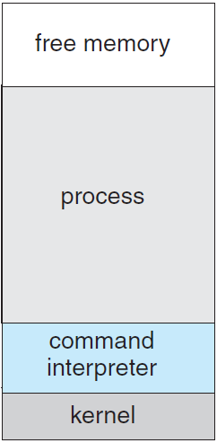
The program runs. The return code is saved in system memory for later use.
Then the command interpreter resumes execution.
It first reloads the rest of the command interpreter from disk.
Then it avails the return code to the user or next program.

Slide 17
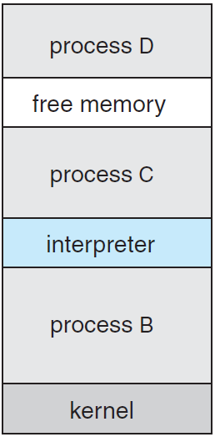
Example: Multitasking system (UNIX). At login the shell (command interpreter) is run.
It continues running while another program is executed.
To start a new process, the shell executes a fork() system call.
The selected program is loaded into memory via exec() system call. The program is executed.

Slide 18
The shell then either waits for the process to finish or runs the process in the background.
In background, the shell immediately requests another command.
The user is free to ask the shell to run other programs.
When the process is done, it executes an exit() system call to terminate.
exit() returns to the parent process a return code (0 or nonzero), available to the shell or other programs.

Slide 19
File management
create file, delete file
open, close
read, write, reposition
get file attributes, set file attributes

Slide 20
Device management
request device, release device
read, write, reposition
get device attributes, set device attributes
logically attach or detach devices
The resources controlled by the OS are physical devices (e.g., disk drives) or virtual devices (e.g., files).
A system with multiple users first request() a device, to ensure exclusive use of it, and release() it after finished.

Slide 21
Information maintenance
get / set time or date
get / set system data
get / set process, file, or device attributes

Slide 22
Communications
create, delete communication connection
send, receive messages
transfer status information
attach or detach remote devices
In message-passing, processes exchange messages with one another either directly or through a mailbox.

Slide 23
A connection is first opened. The communicator process is either on the same system or another computer.
Each computer in a network has a host name and a network identifier, such as an IP address.
A process has a name, translated into identifier by which the OS can refer it. get_hostid() and get_processid() do this translation.
The identifiers are passed to the open() and close() calls provided by the file system or to specific open_connection() and close_connection() system calls.

Slide 24
Processes receiving connections are system programs called daemons, executing a wait_for_connection() call, awakened when a connection is made.
The source of the communication (client), and the receiving daemon (server), exchange messages by using read_message() and write_message() system calls.
close_connection() call terminates communication.
Shared-memory model use shared_memory_create() and shared_memory_attach() system calls to access to regions of memory owned by other processes.

Slide 25
Protection controls access to the resources of the computer system.
It is a concern only on multi programmed computer systems with several users.
With the advent of networking and Internet, all systems, from servers to mobile devices, must be protected.
protection system calls include set_permission() and get_permission(), allow_user() and deny_user().

Slide 26
System Programs
System programs, (system utilities), provide an environment for program development and execution.
File management. Create, delete, copy, rename, print, dump, list, files and directories.
Status information. Date, time, amount of available memory or disk space, number of users, status information, performance, logging, and debugging information.
File modification. Text editors, file transformations and conversions.

Slide 27
Programming-language. Compilers, assemblers, debuggers, and interpreters.
Program loading and execution. Load compiled programs, debuggers.
Communications. Connect processes, users, and computer systems. Send messages to screens, browse Web, e-mail, remote login, transfer files.
Background services. Launching system-program processes at boot time, known as services, subsystems, or daemons.

Slide 28
Operating-System Structure
OS may be huge, hence partitioned into small modules, (components) rather than being a monolithic system.
A module is a well-defined portion of the system, with well-defined I/O and functions.
MS-DOS was badly designed. Intel’s 8088 had no user/kernel mode, no HW protection. MS-DOS interfaces and functionality were not well separated.
Application programs could write directly to display and disk, causing system crashes when user programs fail.

Slide 29
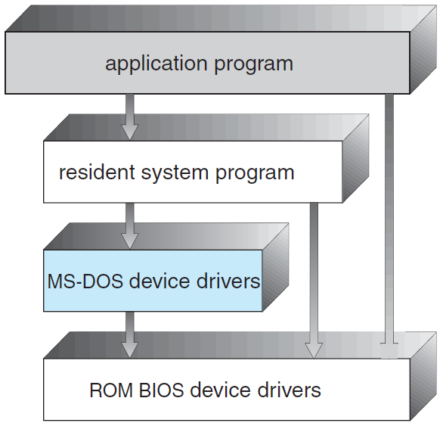
MS-DOS layer structure.

Slide 30
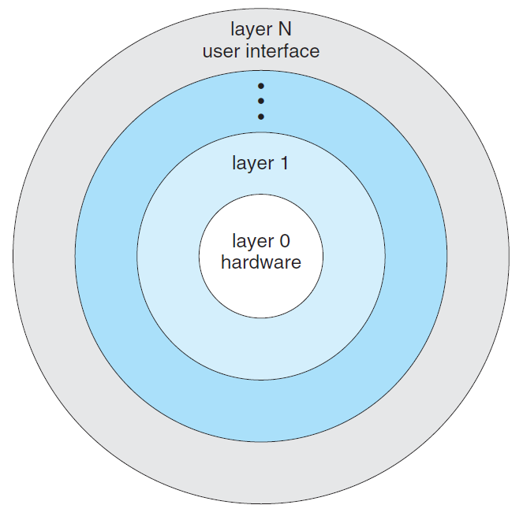
Traditional UNIX consists of two separable parts: the kernel and the system programs.
The kernel is separated into interfaces and device drivers, which have been expanded over the years.
UNIX is layered. Everything below the system-call interface and above the physical HW is the kernel.

Slide 31
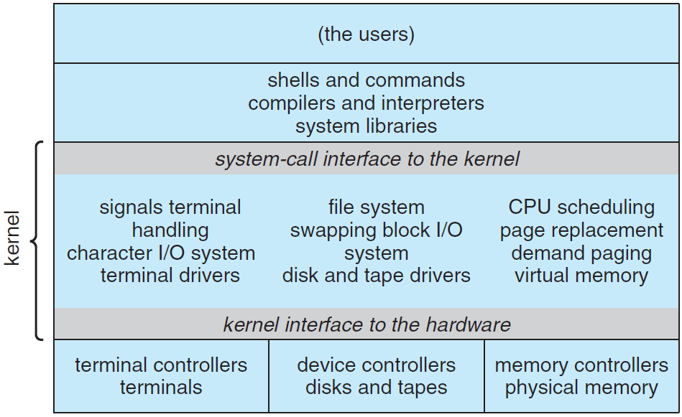
Traditional UNIX system structure.

Slide 32
A layer is an abstract object made up of data and the operations that can manipulate those data.
Layer M routines can be invoked by higher-level layers, layer M can invoke operations on lower-level layers.
Simplifies debug and verification to work bottom-up. 1st layer is debugged w/o concerning the rest system, as it uses only basic hardware (assumed correct).
Major difficulty in layered approach is in appropriately defining the various layers.

Slide 33
Example: Disk driver use by VM may wait for I/O, so scheduler let CPU working on something else. Disk driver should be above scheduler.
Scheduler info about processes may exceed memory. Swapping requires disk driver be below scheduler. $∎$
Layered implementations is less efficient than other types. Each layer adds overhead to the system call.
These limitations have caused a small backlash against layering in recent years.

Slide 34
Operating-System Generation
A program SYSGEN generates the OS, distributed on disk or CD-ROM or other media.
SYSGEN reads from file info about HW configuration, or it probes HW directly to determine its components.
What CPU is used? What options are installed? (extended ISA, FP)
How to format the system disk (boot)? How many “partitions” will it be separated into, and what will go into each partition?

Slide 35
How much memory is available? Some systems will determine this value themselves.
Available devices. The system needs know how to address devices (device number), device interrupt number, the device’s type and model.
OS options. What type of CPU-scheduling algorithm to use, maximum number of processes to be supported, etc.
The OS then is compiled, producing an output-object OS version tailored to the system described.

Slide 36
System Boot
The procedure of starting a computer by loading the kernel (compiled) is known as booting the system.
A small code bootstrap program, stored in ROM, locates the kernel, loads it into main memory, and starts its execution.
When a CPU it is powered up or rebooted, PC is loaded with predefined ROM address where the bootstrap program is, to start boot execution.
ROM storage makes it difficult for virus to infect bootstrap.

Slide 37
Bootstrap first runs diagnostics, continuing with booting, initializing the system. It then starts the OS.
Such ROM is known as firmware, since its characteristics fall somewhere between those of HW and SW.
Executing firmware code is slower than executing code in RAM. (why?) It can be copied into RAM for fast execution.
When full bootstrap is loaded, it traverses the file system to find the OS kernel, load it into memory, and start execution. At this point the OS is running.

