Slide 1
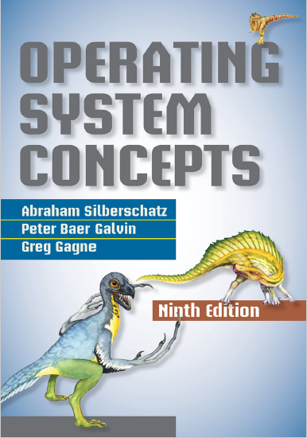
Main Memory
prepared and instructed by
Shmuel Wimer
Eng. Faculty, Bar-Ilan University

Slide 2
Hardware
OS is protected from access by user processes.
User processes are protected from one another.
Protection is provided by HW because OS doesn’t intervene between the CPU and its memory accesses.
Protection ensures that each process has a separate memory space.
Protection is done by using two registers, a base register and a limit register.

Slide 3
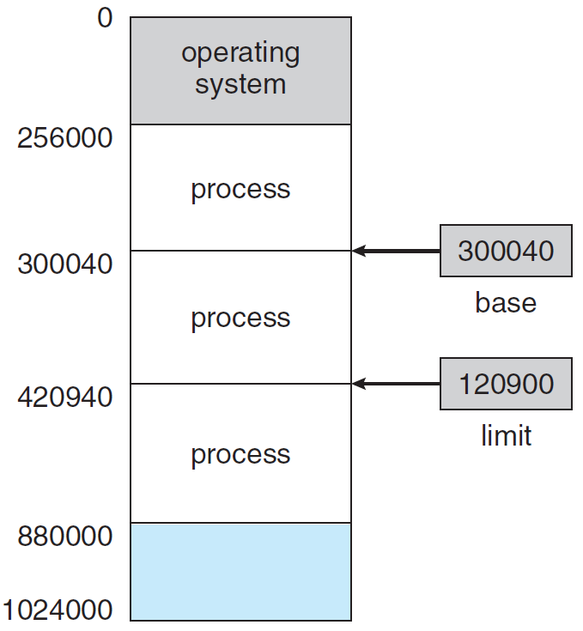
Base and limit register define a logical address space.

Slide 4
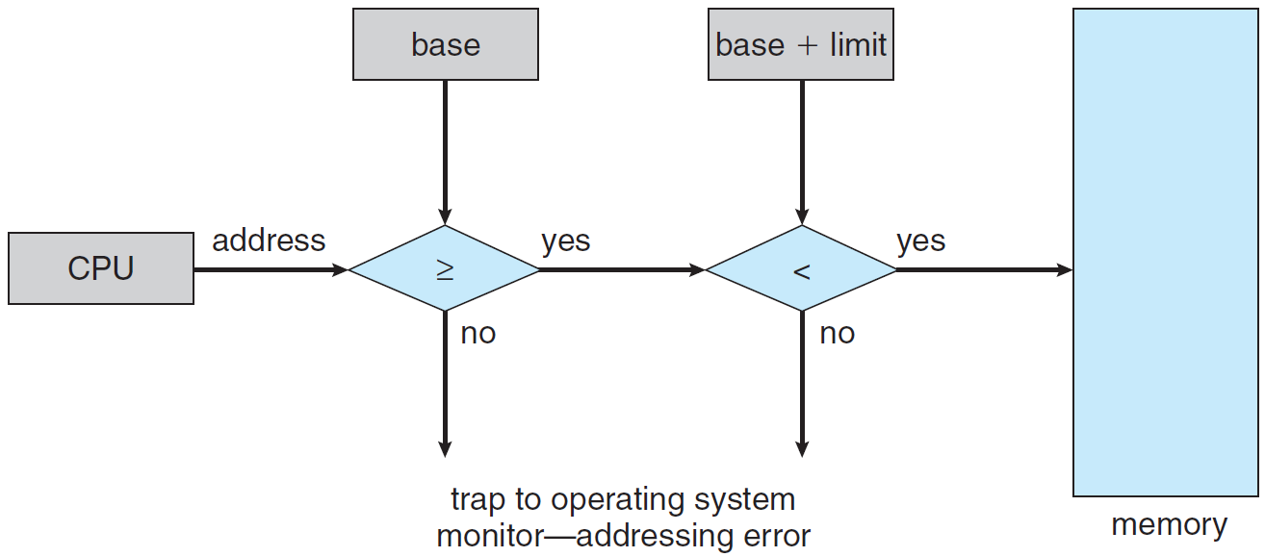
HW address protection with base and limit registers.
Prevents user program from modifying the code or data of OS and other users.

Slide 5
Address Binding
Binding is a mapping from one address space to another.
A program residing on a disk as binary file is executed by bringing it into memory and placing it within a process.
The process may move between disk and memory during its execution.
Most OSs allow user process to reside in any part of the physical memory (but not VM).
User program goes through several steps before executed.

Slide 6
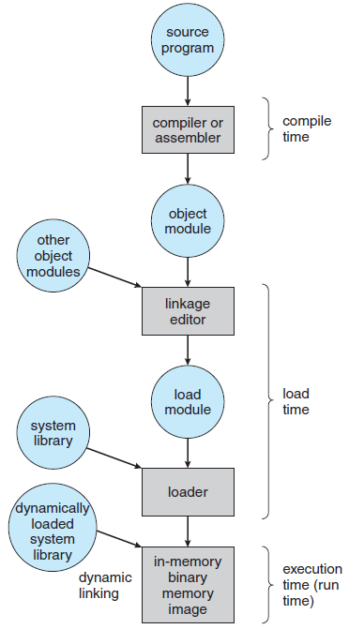
Addresses in the source program are symbolic.
Compiler binds symbolic addresses to relocatable addresses (e.g. “14 bytes from beginning of module”).
Linkage editor or loader binds the relocatable to absolute addresses (e.g. 74014).

Slide 7
If compiler knows where the process will reside in memory, absolute code can be generated.
If later starting location changes, the code is recompiled.
If process location in memory is unknown, compiler generate relocatable code, delaying final binding until load time.
Changing starting address requires reloading user code.
If process moves during execution between memory segments, binding is delayed until run time.
Most OSs use this method.

Slide 8
Logical Versus Physical Address Space
Address generated by the CPU is logical (virtual), address loaded into the memory-address register is physical.
The set of all logical addresses generated by a program is logical (virtual) address space.
The set of all corresponding physical addresses is physical address space.
The run-time virtual to physical addresses mapping is done by HW called memory-management unit (MMU).

Slide 9
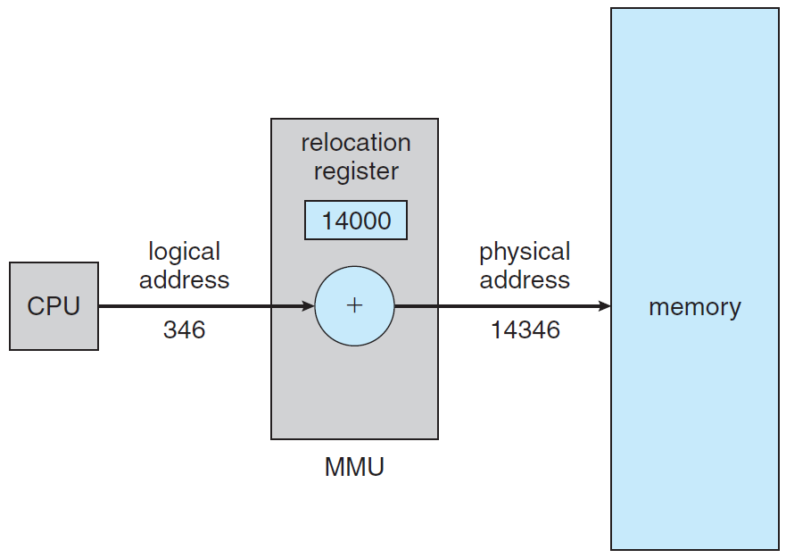
Dynamic relocation using a relocation register.

Slide 10
Dynamic Loading
So far entire program and all data of a process existed in physical memory at execution.
Dynamic loading better utilizes the memory-space by loading routines only when called.
When a routine calls another routine, it first checks to see whether the other routine has been loaded.
If not, the loader is called to load the routine and update the program’s address tables to reflect this change.
Then control is passed to the newly loaded routine.

Slide 11
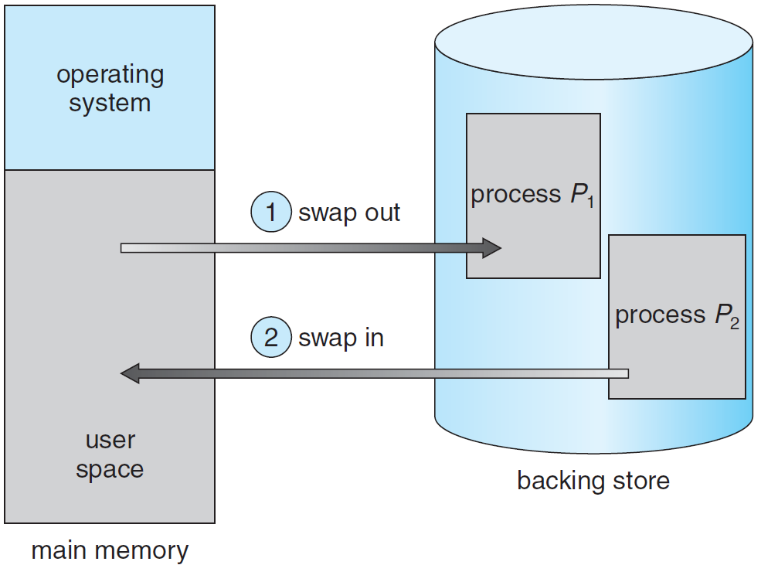
Swapping
The total physical address space of all processes can exceed real physical memory.

Slide 12
Backing store is a fast disk, accommodating copies of all memory images for all users.
A ready queue contains all processes whose memory images are on the disk or memory and are ready to run.
When CPU scheduler decides on the next process to execute, the dispatcher checks whether it is in memory.
If not, and if there is no free memory, the dispatcher swaps out a process from memory and swaps in the desired process.
It reloads registers and transfers control to the selected process. The context-switch time in high.

Slide 13
Example: If the user process is $\text{100}\text{MB}$ and the disk transfer rate is $\text{50}\text{MB}\text{/}\text{Sec}$, swap takes 2 seconds.
There is swap both out and in, and the total swap time is 4 seconds. $∎$
OS must know the size of the process for proper swapping, and user must update OS of any changes in memory requirements.
Process with dynamic memory issues system calls request_memory() and release_memory() to inform OS of changing memory needs.

Slide 14
A swapped out process must be completely idle, otherwise a pending I/O will read/write from/to memory location containing wrong process.
A possible solutions is to never swap a process with pending I/O.
A double buffering solution executes I/O operation only into OS buffers, transferring to memory only when the process is swapped in.
Double buffering adds overhead of copying from kernel memory to user memory.

Slide 15
Contiguous Memory Allocation
Main memory is highly demanded resource hence allocating it must be efficient.
Memory is divided into two partitions: one for the resident OS and one for the user processes.
Since the interrupt vector is often in low memory (why?), OS is placed in low memory too.
Contiguous memory allocation locates each process in single memory section contiguous to section containing the next process.

Slide 16
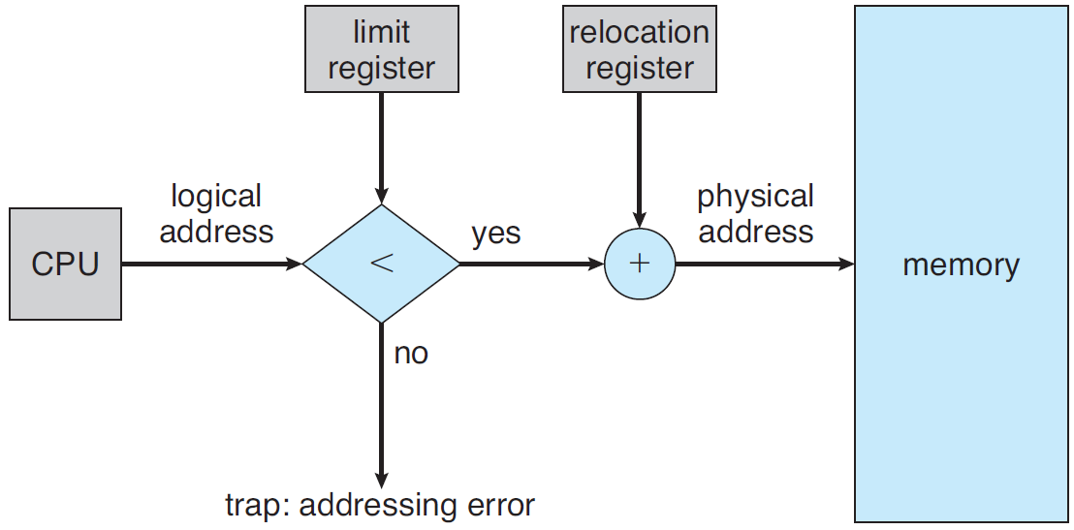
Memory Protection
Process’s relocation register contains the smallest physical address, the limit register contains the range of logical addresses.
MMU
HW support for relocation and limit registers.

Slide 17
The MMU maps the logical address dynamically by adding the value in the relocation register.
The dispatcher loads the relocation and limit registers with the correct values at context switch.
Every address generated by CPU is checked against these registers, protecting OS and users’ programs and data from modifications by the running process.
Relocation register allows dynamic change of OS’s size, desirable for adding and deleting drivers and system programs.

Slide 18
Memory Allocation
The simplest method allocates memory to processes by dividing it into several fixed-sized partitions, containing one process.
The degree of multiprogramming is bounded by the number of partitions. Used by IBM OS/360, but no longer in use.
Variable-partition keeps a table indicating which parts of memory are available and which are occupied.
Initially, all memory is available for user processes. Eventually, memory contains holes of various sizes.

Slide 19
OS accounts the memory requirements and the amount of available memory space in determining which processes are allocated memory.
When process terminates, it releases its memory, which the OS fill with another process from the input queue.
Memory is allocated to processes until no hole is large enough to hold the next process in input queue.
OS can then wait until large block is available, or it can skip in queue to find smaller memory requirements of another process fitting a hole.

Slide 20
When a process terminates, it releases its block of memory, which is then placed back in the set of holes.
Adjacent abutting holes are merged to form larger holes.
OS checks whether the newly freed memory can accommodate waiting processes.
This procedure is a particular instance of the general dynamic storage allocation problem.
The most commonly used allocations are:

Slide 21
First fit. Allocate the first hole that is big enough.
Best fit. Allocate the smallest big enough hole, producing smallest leftover hole.
Worst fit. Allocate the largest hole. producing largest leftover hole. May be more useful than smallest hole.
Simulations show that both first fit and best fit are better than worst fit in terms of storage utilization.
Neither first fit nor best fit is better than the other in terms of storage utilization.

Slide 22
Fragmentation
Processes load and removal break free memory space into small pieces, called fragmentation, severe problem.
While there is enough total memory space to satisfy a request, the available spaces are not contiguous.
Statistical analysis of first fit reveals that given $N$ allocated blocks, another $0.5N$ blocks will be lost to fragmentation, known as the 50-percent rule.
A solution to fragmentation is compaction, shuffling memory to place free memory together in large block.

Slide 23
Compaction is impossible in static relocation done at assembly or load time.
It is possible only if relocation is dynamic, done at execution time, requires only moving the program and data and then changing the base register.
Compaction moves all processes toward one end of memory, producing one large hole of available memory, expensive.
Another solution is to permit the logical address space of the processes to be noncontiguous, using segmentation and paging.

Slide 24
Segmentation
User’s and programmer’s view of memory is not the same as the actual physical memory.
Programmer thinks of main, procedures, functions, arrays, variables, etc., not caring of their addresses in memory.
HW maps programmer’s view to physical memory, providing the OS more freedom to manage memory.
Segmentation is a memory-management scheme that supports this programmer view of memory.

Slide 25
A logical address space is a collection of segments, each having name and length. Segments are numbered.
Logical address consists of : <segment-number, offset>.
The compiler constructs segments, comprising code, global variables, heap, stacks, standard C library.
Libraries linked in during compilation are assigned separate segments.
The loader assigns numbers to segments.

Slide 26
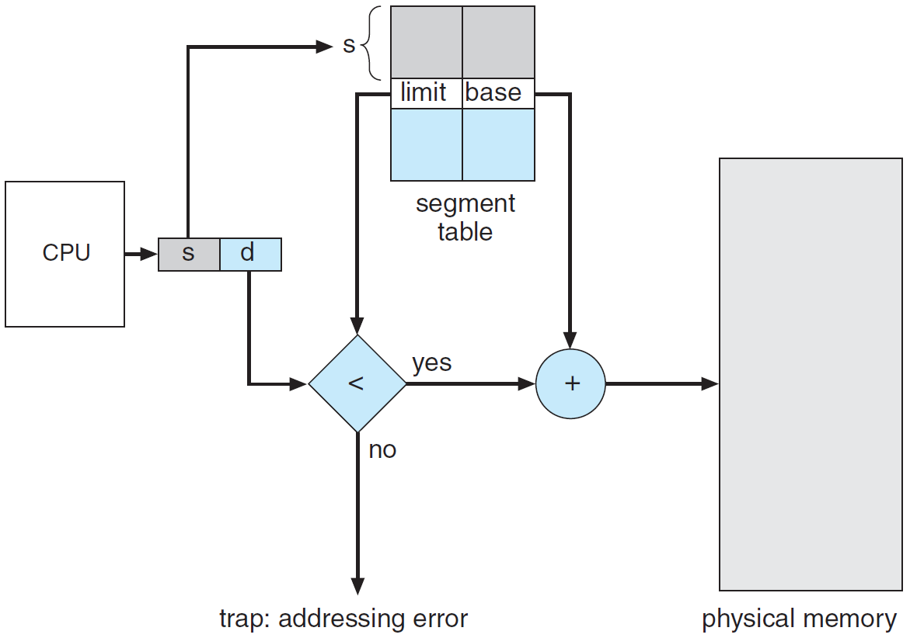
Segmentation Hardware
logical address
physical address
Mapping logical into physical addresses.

Slide 27
Mapping of 2D logical addresses <segment-number, offset> into 1D physical addresses, supported by segment table.
Each entry has a segment base and a segment limit.
Base contains the starting segment’s physical address. Limit specifies segment’s length.
Segment number indexes the segment table.
Offset $d$ of the logical address must be between 0 and the segment limit, added to the segment base to produce the physical address.

Slide 28
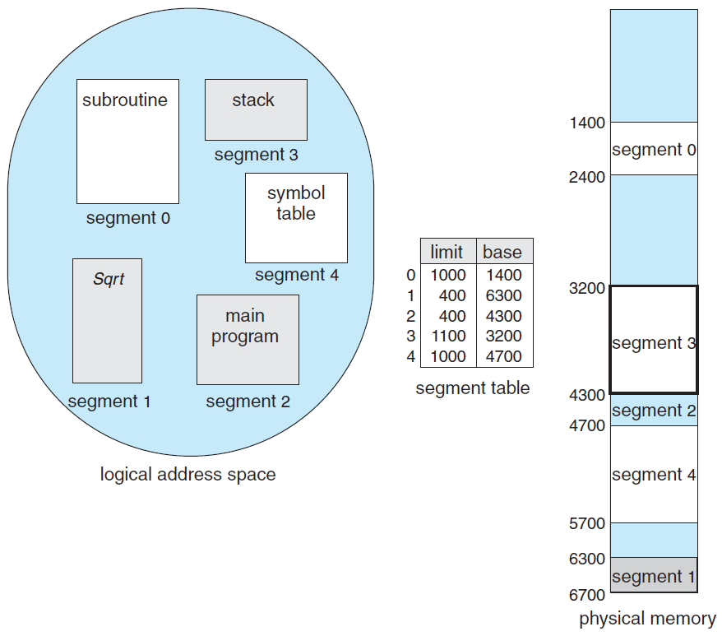
Example of segmentation.
<2,53> maps to
4300 + 53 = 4353.
<0,1222> results in a trap.
<3,852> maps to
3200 + 852 = 4052.

Slide 29
Paging
Paging, used by most today’s OSs, avails noncontiguous process’s space, but avoids fragmentation and compaction, whereas segmentation does not.
It also solves considerable problem of fitting memory chunks of varying sizes onto the disk.
The problem arises when main memory fragments need to be swapped out, and disk space must be found, arising same fragmentation problems.
Compaction is impossible since disk access is very slow.

Slide 30
Basic Method
Physical memory is broken into fixed-sized blocks called frames, logical memory is broken into blocks of same size called pages.
The pages of a process aims at execution are loaded from disk into any available memory frames.
The disk is divided into fixed-sized blocks of size as memory frames or clusters of multiple frames.
The logical address space is separate from the physical. A process can have $64$-bit logical address, though system has less than $2^{64}$ physical memory bytes.

Slide 31
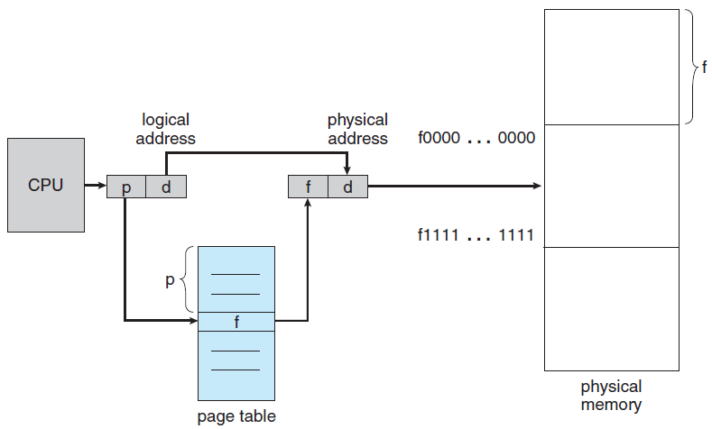
frame #
frame
frame
frame
offset
Paging hardware.

Slide 32
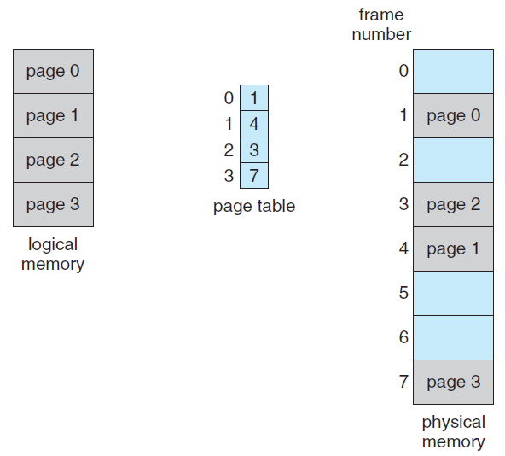
Paging model of logical and physical memory.

Slide 33
CPU address is divided into two parts: page number $(p)$and page offset $(d)$.
$p$indexes into a page table, containing the base address of each page in physical memory.
Base address is combined with the page offset to define the physical memory address.
If size of logical space is $2^{m}$, and page size is $2^{n}$ bytes (0.5KB – 1GB), $m−n$ MSBs of address is page number, and $n$ LSBs is page offset.

Slide 34
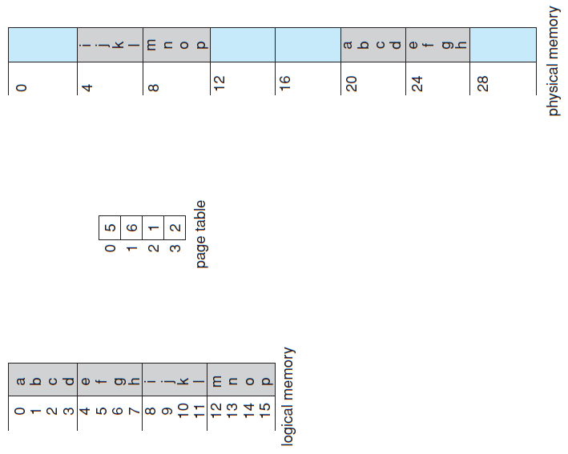
Paging for a 32-byte memory with 4-byte pages.

Slide 35
Paging is a dynamic relocation with no fragmentation. Any free frame can be allocated to process that needs it.
Some memory waste occurs if memory requirements of a process do not coincide with page boundaries.
An average memory waste of one-half page per process is expected, suggesting small page sizes.
However, page-table increases (may be huge) with page size decreases.
Also, disk I/O is more efficient when the amount transferred data is larger.

Slide 36
If a process requires $n$ pages, at least $n$ frames must be available in physical memory.
Difference between programmer’s view of memory and actual physical memory is handled by translation HW, controlled by OS.
User process cannot address memory outside its page table, including only pages that the process owns.

Slide 37
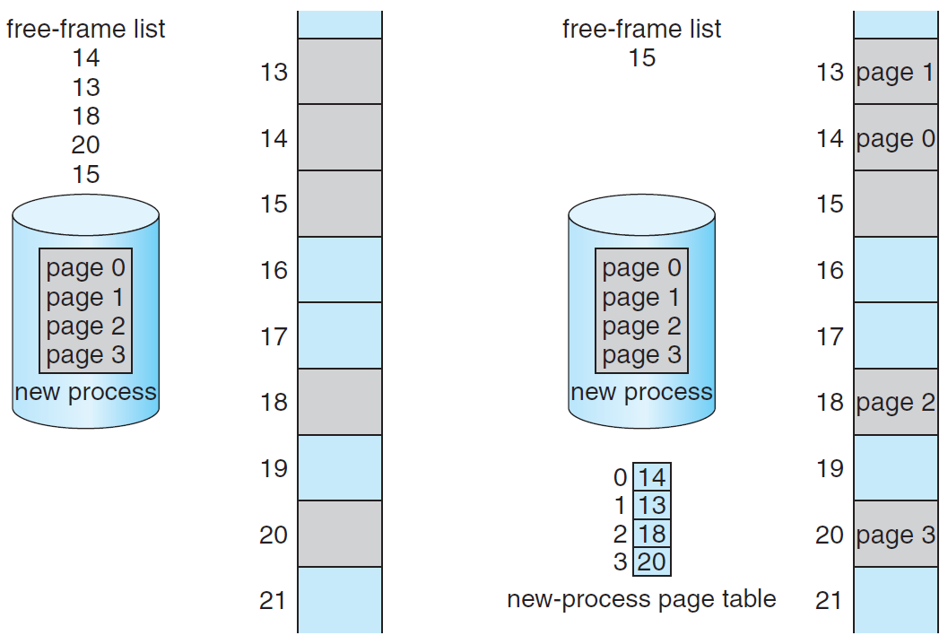
Free frames before and after allocation.

Slide 38
OS maintains a data structure called frame table, having an entry for each physical frame.
The entry indicates whether it is free or allocated, and if allocated, to which page of which process.
OS maintains a copy of the page table for each process, just as the PC and registers.
It is used by the CPU dispatcher to define HW page table when a process is allocated the CPU.
Paging therefore increases the context-switch time.

Slide 39
Page Table HW
The page table is implemented by dedicated fast registers with very high-speed logic to make the paging-address translation efficient.
DEC PDP-11 had 16-bit address, and page size 8KB. The page table thus had eight entries.
Using registers is okay for small page table (e.g. 256 entries).
Modern computers allow 1M entries page table (huge). Fast register implementation is not feasible.

Slide 40
A solution is a small, associative high-speed memory, called a translation look-aside buffer (TLB).
Each entry in the TLB consists of two parts: a key (tag) and value.
The search is fast; a TLB lookup is part of the instruction pipeline, adding no performance penalty.
To meet clock speed, TLB is typically between 32 and 1,024 entries.

Slide 41
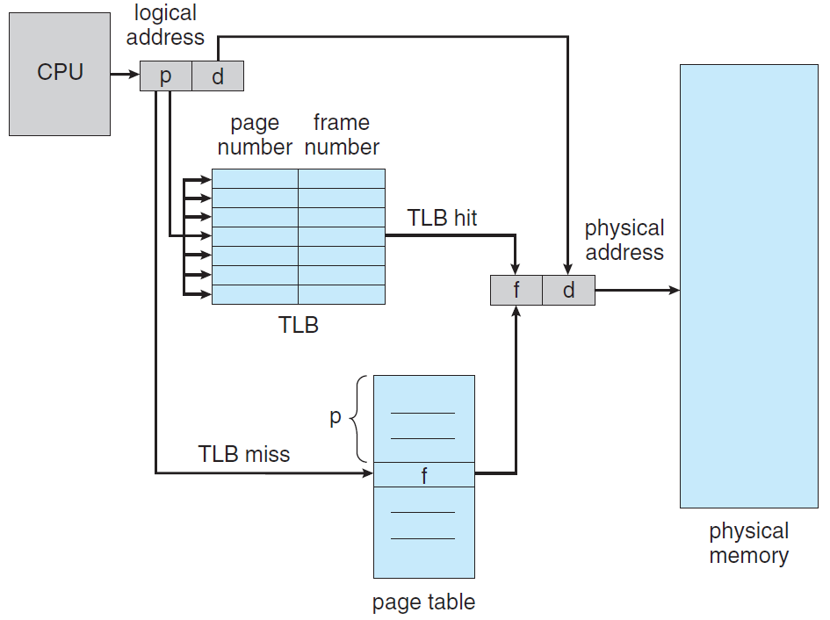
main memory
hit
page #
offset
offset
frame #
miss
main memory
Paging hardware with TLB.

Slide 42
The page number of a logical address generated by CPU, searched in the TLB. If found, its frame number is immediately available.
These steps are executed as part of the instruction pipeline within the CPU.
If page number is not in the TLB (TLB miss), memory reference to the page table must be made.
Depending on CPU, this may be done automatically in HW or via an interrupt to OS.
The frame number is used to access memory.

Slide 43
If the TLB is full of entries, an entry must be replaced.
Replacement policies range from least recently used (LRU) through round-robin to random.
Some CPUs allow the OS to handle the LRU replacement, others handle the it themselves in HW.
Some TLBs allow certain entries to be wired down, so they cannot be removed (typically key kernel code).
Percentage of page number found in TLB is called hit ratio.

Slide 44
For $100\text{nSec}$ memory access, memory access takes $100\text{nSec}$ in TLB hit and $200\text{nSec}$ in TLB miss.
(It is assumed that a page-table lookup takes only one access, but it can take more, as shown below.)
For a 99% hit ratio, the effective access $\text{time}=0.99 ×100+0.01×200=101\text{nSec}$.
Comment: $100\text{nSec}$ is typical access to main memory. Access time is usually nearly one clock cycle due to cache.

Slide 45
CPUs today may provide multiple levels of TLBs, making memory access times calculation more complex.
Intel Core i7 CPU has 128-entry L1 instruction TLB, 64-entry L1 data TLB and L2 512-entry TLB, taking six cycles to check entry in L2.
L2 miss cause the CPU seeking the associated frame in the main memory page-table, taking hundreds of cycles (either by HW or by interrupt and OS code).
HW features can have a significant effect on memory performance, enabling OS improvements.

Slide 46
Protection
Memory protection is accomplished by protection bits associated with each frame, kept in the page table.
Attempt to write to a read-only page causes a HW trap to the OS (memory-protection violation).
Additional valid–invalid bit is attached to each entry in the page table.
Valid means the page is in the process’s logical address space and thus legal. Invalid it is illegal.

Slide 47
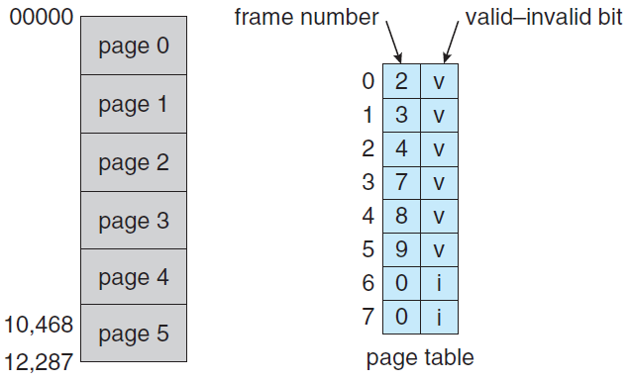
Example: 14-bit address space with 2KB page size. Program can use only addresses 0 to 10468.
Problem, solvable by page-table length register

Slide 48
Shared Pages
Paging enables sharing common code, particularly important for time-sharing environment.
Example: 40 users, each executes a text editor, consists of 150 KB of code and 50 KB of data space, implying ~8MB to support the 40 users.
Pure code can be shared. Each process has its own data page.
Each process has its own copy of registers and data storage for process execution. $∎$

Slide 49
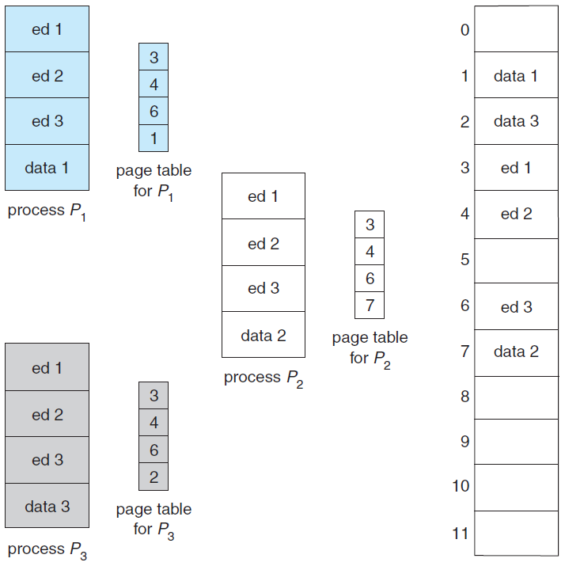
2,150 KB instead of 8,000 KB
Code sharing in paging.

Slide 50
Heavily used programs can be shared: compilers, window systems, run-time libraries, database systems.
The code must be reentrant. Read-only should not be left to the correctness of code, OS should enforce it.
Sharing memory among processes is similar to sharing the address space of a task by threads.

Slide 51
Hierarchical Paging
Modern computer support logical address space of $2^{32}$ to $2^{64}$, making page table excessively large.
Example: In 32-bit address with $\text{4}\text{KB}$ ($2^{12}$) page size, page table may have ${2^{32}}/{2^{12}}=\text{1}\text{M}$ entries, 4byte each, yielding $\text{4}\text{MB}$ physical space for a page table. $∎$
We do not want to allocate the page table contiguously in main memory.
A solution is to use a two-level paging algorithm, in which the page table itself is also paged.

Slide 52
Example: 32-bit logical address and 4KB page size. Logical address is divided into 20-bit page # and 12-bit page offset.
The page number is further divided into 10-bit page number and 10-bit page offset. $∎$
index into the outer page table
displacement within the page of the inner page table

Slide 53
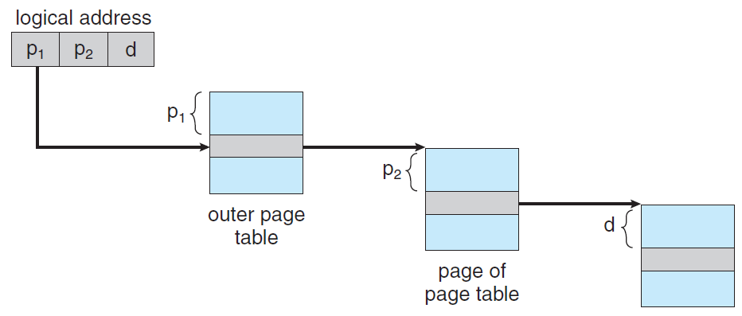
CPU generated
per-process base register
32-bit base
address
Instruction or data
32-bit base
address
$2^{10}$entries
displacement
$2^{10}$entries
$2^{12}$frame size
Address translation for a two-level 32-bit paging.

Slide 54
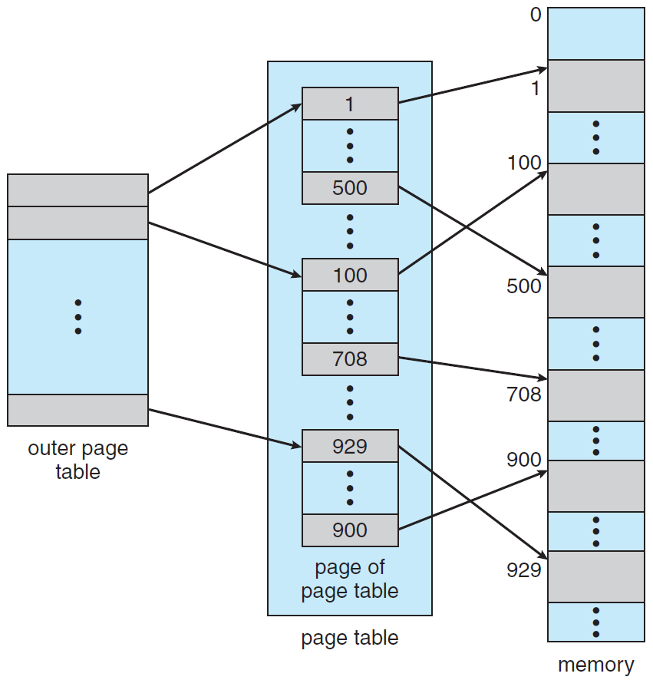
$2^{p_{1}}$ $32$-bit entries
$2^{d}$ words in main memory
$2^{p_{2}}$ entries per page
$2^{p_{1}}$ pages in main memory
Two-level page-table (forward-mapped page table).

