Slide 1
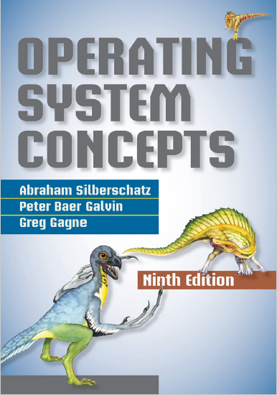
Introduction
prepared and instructed by
Shmuel Wimer
Eng. Faculty, Bar-Ilan University

Slide 2
What operating system do?
Operating system (OS): a program that manages a computer’s hardware.
OS provides a basis for application programs and acts as an intermediary between the user and the hardware.
Some OS are designed to be convenient, others to be efficient, and others to be a combination.
OS kernel is the one program running at all times.
Other program types :
system programs, not part of the kernel but still OS.
application programs, not associated with the OS.

Slide 3
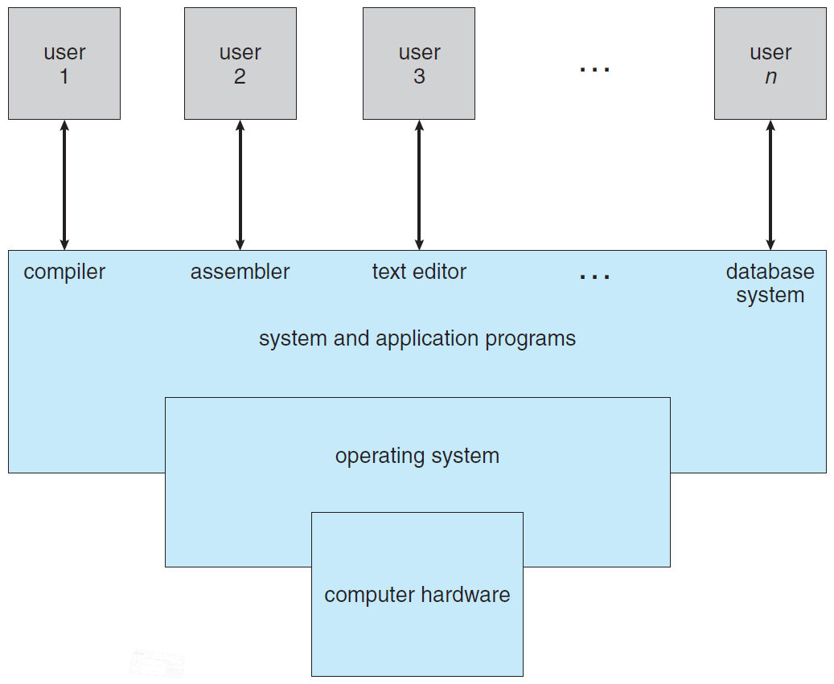
Abstract view of a computer system

Slide 4
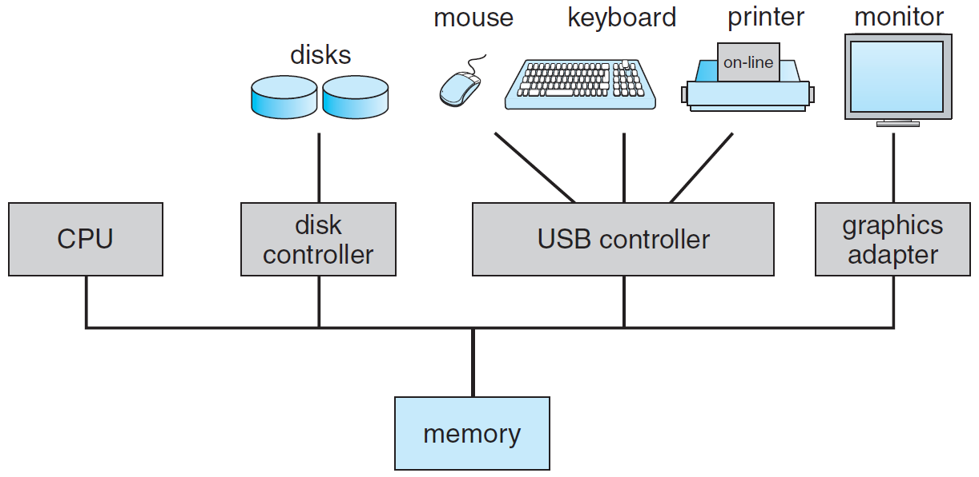
Modern computer system

Slide 5
Computer system operation
A computer starts by an initial bootstrap program (boot) stored in a ROM or EEPROM.
Boot initializes CPU registers, device controllers, memory contents.
It loads the OS kernel and starts executing it, providing services to the system and users.
Some services run outside the kernel by system programs loaded into memory at boot time, called system processes, (daemons) running with the kernel.
On UNIX, the first system process is called init.

Slide 6
Once boot completes, system waits for events to occur.
An event is signaled by an interrupt from HW or SW.
HW triggers an interrupt by sending a signal to the CPU.
SW triggers an interrupt by executing a special operation called a system call.
At interrupt, CPU immediately transfers execution to the starting memory address of the service routine.
Once interrupt service routine completes, the CPU resumes the interrupted computation.

Slide 7
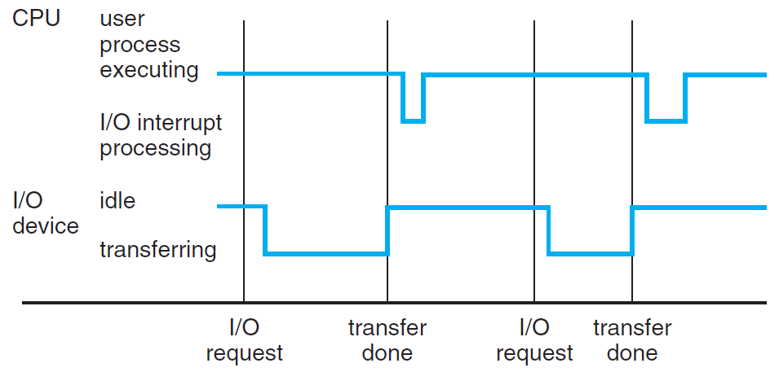

Slide 8
Storage structure
Ideally, we want the programs and data to reside in main memory permanently. This is impossible.
Main memory is too small to store all programs and data permanently.
Main memory is a volatile storage device.
Computer systems provide secondary storage as an extension of main memory.
The main requirement for secondary storage is to hold large quantities of data permanently.

Slide 9
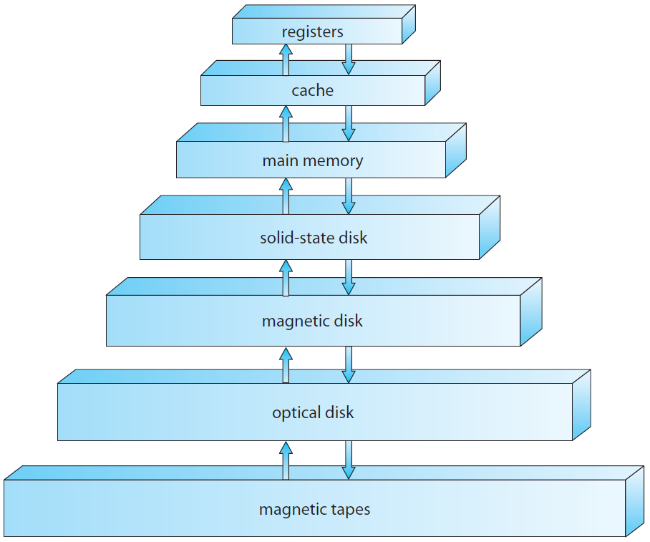
Volatile
Semiconductors technology
Non volatile

Slide 10
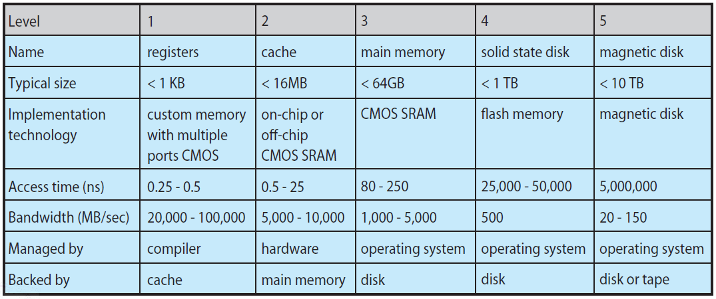
DRAM

Slide 11
I/O structure
Storage is one of many I/O devices. A large portion of OS code is dedicated to managing I/O.
The CPUs and the device controllers are connected through a common bus.
A controller has local buffer and registers.
It moves the data between the peripheral devices and its local buffer.
OS has a device driver for each controller, which provides the OS with a uniform interface to the device.

Slide 12
Once data transfer completes, the controller informs the driver by interrupt it finished. The driver returns control to OS.
Interrupt-driven I/O is fine for moving small data but is high overhead for bulk data movement such as disk I/O.
Direct memory access (DMA) controller is used. It transfers a block of data directly to/from its buffer to memory, with no CPU intervention.
Only one interrupt per block, telling the driver that operation completed, rather than one interrupt per byte in low-speed devices.

Slide 13
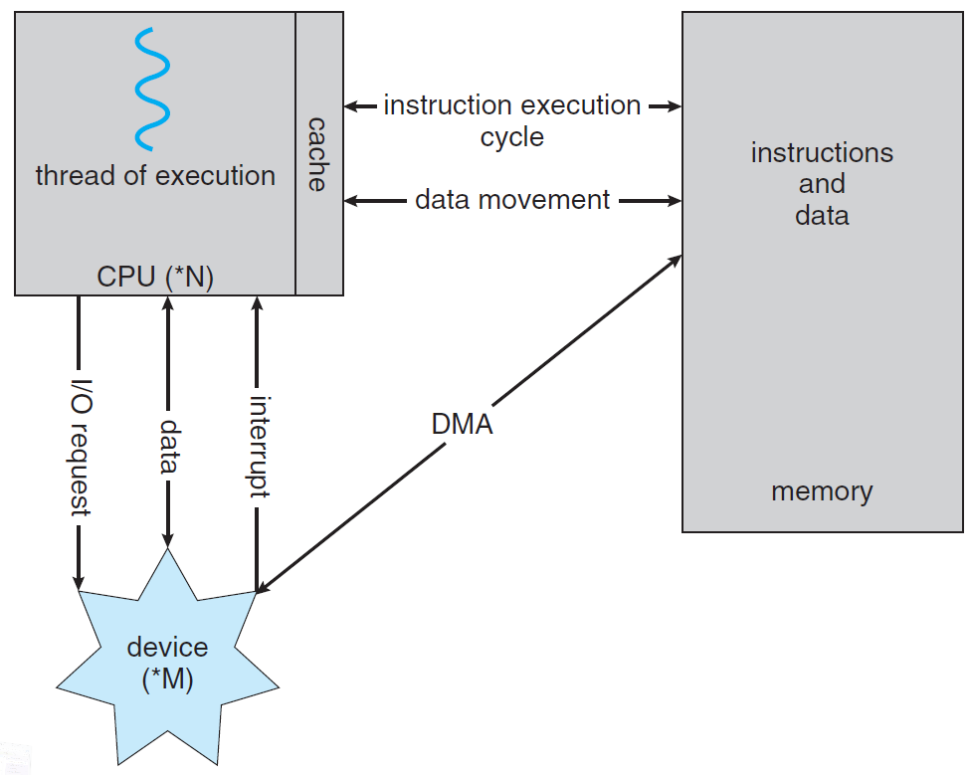
How a modern computer system works.

Slide 14
Operating-System operations
OSs are interrupt driven.
A trap (exception) is a SW interrupt caused either by error or by request from user program for OS service.
For proper OS execution, the execution of OS code and user-defined code are distinguished by HW support.
Two separate operation modes : user mode and kernel mode (called also supervisor, system, privileged mode).
A mode bit is added to the HW to indicate the current mode: kernel (0) or user (1).

Slide 15
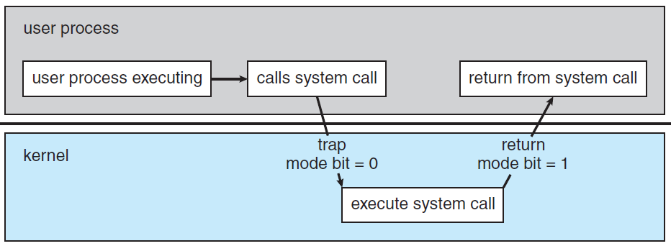
User mode (mode bit = 1)
Kernel mode (mode bit = 0)
Transition from user to kernel mode.

Slide 16
Dual mode protects OS from errant users. Instructions that may cause harm are privileged, allowed only by kernel mode.
Examples: mode switch, I/O control, timer management, interrupt management.
If privileged instruction is attempted in user mode, the HW treats it as illegal and traps it to the OS.
System calls allow a user program to ask the OS to perform tasks reserved for OS.
A system call takes the form of a trap to a specific location in the interrupt vector (HW sets mode bit = 0).

Slide 17
Timer
User program cannot stuck in an infinite loop or call system services and never return control to OS.
A timer can be set to interrupt the computer after a specified period, e.g. from 1 mSec to 1 Sec.
A timer is implemented by fixed-rate clock and counter, set by the OS (privileged instruction).
When counter==0, an interrupt occurs, control transfers to OS, treating the interrupt as fatal error or giving user program more time.
Timer can prevent a program from running too long.

Slide 18
Process management
A process is a job or a time-shared program (e.g., compiler), single-user word-processing, sending output to a printer.
System calls allow processes to create sub processes to execute concurrently.
Process needs resources: CPU time, memory, files, and I/O devices, either given when created or allocated while running.
Various initialization data (input) may be passed along, e.g., file name, display name.

Slide 19
A process is the unit of work in a system.
A system consists of a collection of processes, some are OS and the rest are user.
Processes can execute concurrently by multiplexing on a single CPU.
OS supports the following for process management:
Scheduling processes and threads on the CPUs
Creating and deleting user and system processes
Suspending and resuming processes
Synchronizing processes
Communicating between processes

Slide 20
Memory management
Main memory is a repository of quickly accessible data shared by the CPU and I/O devices.
The CPU reads instructions from memory at IF cycle and reads / writes data from memory during the MEM cycle.
Main memory is the only large storage device that the CPU is able to address and access directly.
For CPU to process instructions / data from disk, these are first transferred to memory by CPU-generated I/O calls and mapped to absolute addresses.

Slide 21
Eventually, the program terminates, its memory space is freed, so the next program can be loaded and executed.
To improve response and utilization, few programs reside in the memory, requiring memory management.
OS is responsible for the following to manage memory:
Keeping track of which parts of memory are currently being used and who is using them.
Deciding which processes and data to move into and out of memory.
Allocating / deallocating memory space as needed.

Slide 22
Storage management
OS provides a uniform, logical view of information storage in file.
A file is a collection of related information defined by its creator.
Files are organized into directories to ease their use.
Files represent programs (source, object) and data, which may be alphanumeric or binary.
Storage devices differ in access speed, capacity, data-transfer rate and access method (sequential random).

Slide 23
OS maps files onto physical media and accesses these by drivers, thus hiding the physical device from the user.
When multiple users have file access, it is controlled by which user may access and how (read, write, append).
OS is responsible for the following activities:
Creating and deleting files.
Creating and deleting directories.
Supporting files / directories manipulation primitives.
Mapping files onto secondary storage.
Backing up files on nonvolatile storage media.

Slide 24
Mass storage management
Main memory is too small to accommodate all data and programs, and it is volatile.
The computer system must provide secondary storage to back up main memory in magnetic or solid-state disk.
Most programs, compilers, assemblers, word processors, editors, user applications, are stored on disk until loaded into memory.
They then use the disk as both the source and destination of their processing.

Slide 25
Management of disk storage is of central importance to a computer system.
The OS is responsible for the following activities:
Free-space management.
Storage allocation.
Disk scheduling.
Because secondary storage is used frequently, it must be used efficiently.
The computer speed depends on the disk subsystem speed and its manipulation algorithms.

Slide 26
Tertiary storage devices such as magnetic tapes and optical media are slower, used for backup and long-term archives.
Not crucial to system performance, but still must be managed.
Some of the functions that OS provide include:
Mounting and unmounting media in devices.
Allocating and freeing the devices for exclusive use by processes.
Migrating data from secondary to tertiary storage.

Slide 27
Caching
Information kept in main memory is copied temporarily into a faster storage, the cache, as it is used.
When a particular piece of information is called, it is first checked to be in the cache for direct usage.
If not in cache, info from main memory is copied into cache under temporal and spatial locality assumption.
Systems have instruction cache holding the instructions expected to be executed next.
Without it, the CPU would have to wait several cycles while an instruction was fetched from main memory.

Slide 28
HW-only caches are outside the OS control.
Main memory can be viewed as a fast cache for secondary storage.
The file-system data, residing permanently on secondary storage, may appear on several levels in the storage hierarchy (main memory, HW caches).
The OS may maintain a cache of file-system data in main memory.
The magnetic-disk storage is often backed up onto magnetic tapes or removable disks.

Slide 29
In hierarchical storage structure, the same data may appear in different levels of the storage system.
Example: An integer A located in file B is subject to be incremented by 1, and file B resides on magnetic disk.
Increment operation issues an I/O operation, copying the disk block on which A resides, to main memory.
It is followed by copying A to the cache and to an internal register.
Thus, the copy of A appears in several places.

Slide 30
Once the increment takes place in the internal register, the value of A differs in the various storage systems.
The value of A becomes the same only after the new value of A is written from the internal register back to the magnetic disk. $∎$
This is okay in computing environment where only one process executes at a time.
Multi-tasking environment must ensure that, if several processes wish to access A, each will obtain the most recently updated value of A.

Slide 31
It is more complicated in a multiprocessor environment where each of the CPUs also contains a local cache.
A copy of A may exist simultaneously in several caches.
Since CPUs can execute in parallel, an update of A in one cache is immediately reflected in all other caches.
This situation is called cache coherency, handled by HW.
In a distributed environment, this becomes even more complex.
Several copies of a file can exist in different computers.

