Slide 1
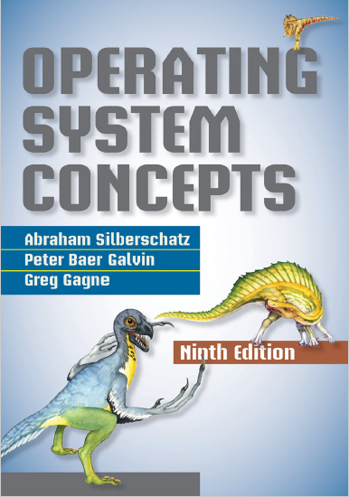
I/O Systems
prepared and instructed by
Shmuel Wimer
Eng. Faculty, Bar-Ilan University

Slide 2
Overview
The two main jobs of a computer are I/O and processing. Sometimes processing is merely incidental, e.g. web browse or file edit.
Controlling devices is major OS design concern, since I/O vary in function and speed (e.g. mouse, hard disk).
I/O-device technology exhibits two conflicting trends:
standardization of SW and HW interfaces, easing incorporation of improved device generations.
Increasing variety of I/O devices, challenging incorporation into computers and OS.

Slide 3
I/O HW elements, such as ports, buses, and device controllers, accommodate a wide variety of I/O devices.
To encapsulate the details and oddities of different devices, OS kernel uses device-driver modules.
Device drivers allow uniform access I/O interface, as system calls provide standard interface between the application and OS.

Slide 4
I/O Hardware
The device communicates with the machine via port.
Devices are connected by bus with well defined protocol specifying the messages that can be sent.
Buses vary in their signaling methods, speed, throughput, and connection methods.
PC bus called PCI bus connects the processor–memory subsystem to fast devices.
Expansion bus connects slow devices (keyboard, serial and USB ports).

Slide 5
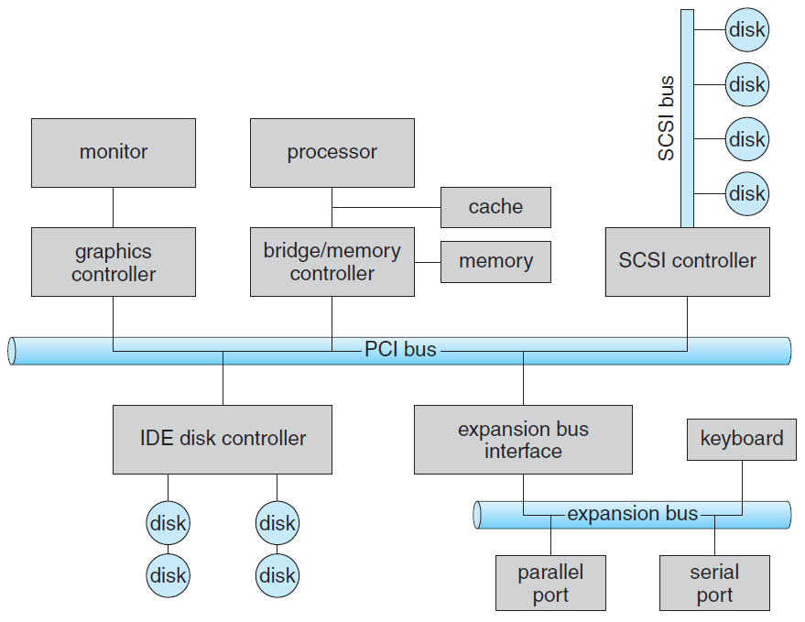
PC bus structure.

Slide 6
Disks are connected on a Small Computer System Interface (SCSI) bus.
Other buses are PCI Express (PCIe), with $\text{16 }\text{GB}\text{/}\text{Sec}$, and Hyper Transport, with $\text{25 }\text{GB}\text{/}\text{Sec}$throughput.
Controller can be simple, implemented in single chip, or complex (e.g. SCSI) implemented as a separate board.
SCSI controller contains processor, microcode and private memory.
Devices may have their own built-in controllers, e.g. disk drive, implementing the disk side of the protocol. SCSI or Serial Advanced Technology Attachment (SATA).

Slide 7
It has microcode and processor doing many tasks, as bad-sector mapping, prefetching, buffering, and caching.
The controller has registers for data and control, used by the processor to communicate with the controller.
Special I/O instructions specify the transfer of a byte or word to an I/O port address.
The I/O instruction triggers bus lines to select the proper device and to move bits into or out of a device register.
Alternatively, the device controller can support memory-mapped I/O.

Slide 8
Device-control registers are mapped into the address space of the processor.
CPU executes I/O requests by ordinary R/W instructions to mapped locations in physical memory.
Graphics controller for instance has I/O ports for basic control operations, but has large memory mapped region for screen contents.
The controller generates the screen image based on the contents of this memory.
Writing millions bytes to the graphics memory is faster than issuing millions of I/O instructions.

Slide 9
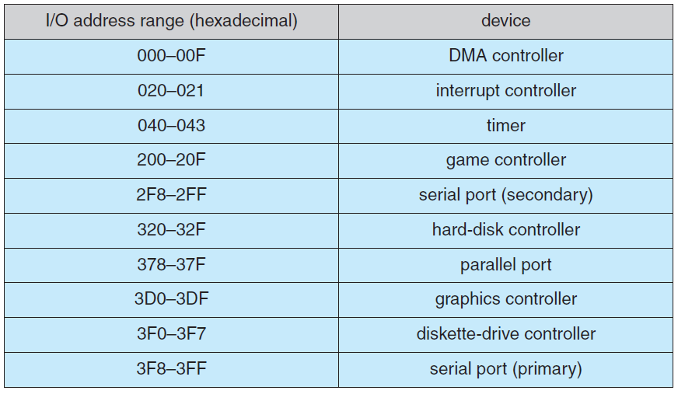
Device I/O port locations on PC.

Slide 10
I/O port has four registers:
Data-in, read by the host to get input.
Data-out, written by the host to send output.
Status read by the host, indicating command completion, byte availability to be read from the data-in, device error occurrence.
Control written by the host to start command, change device mode (e.g. full-duplex or half-duplex, enable parity check, select speed of serial port).
Controller may have FIFO to expand data register capacity, to hold device or host data burst until receive is possible.

Slide 11
Polling
2 bits coordinate the producer–consumer relationship between the controller and the host.
Busy bit in status register indicates controller state, set when busy, clear when ready to accept next command.
Command-ready bit in the command register signals host wishes, sets when a command is available for the controller to execute.
The host writes output through a port, coordinating with the controller by handshaking as follows.
1. Host repeatedly reads busy bit until becomes clear.

Slide 12
2. Host sets write bit in the command register and writes a byte into the data-out register.
3. Host sets command-ready bit.
4. Once controller notices that command-ready bit is set, it sets busy bit.
5. Controller reads the command register and sees the write command. It reads the data-out register to get the byte and does I/O to device.
6. Controller clears command-ready bit, clears error bit in the status register to indicate device I/O succeeded, and clears busy bit to indicate it is finished.

Slide 13
Polling loop is reasonable if controller device are fast, but if the wait is long, the host switches to another task.
How, then, does it know when the controller has become idle?
Polling is inefficient when attempted repeatedly yet rarely finds a device ready for service, while other useful CPU processing remains undone.
It is more efficient that hardware controller notifies the CPU when device becomes ready for service.
The HW enabling device notify the CPU is called interrupt.

Slide 14
Interrupts
The CPU has a wire called the interrupt-request line sensed after executing every instruction.
When detecting that controller has asserted a signal on the line, CPU state is saved.
CPU jumps to the interrupt-handler routine at fixed address in memory.
Interrupt handler determines cause of interrupt and performs necessary processing, and returns CPU state prior to the interrupt.

Slide 15
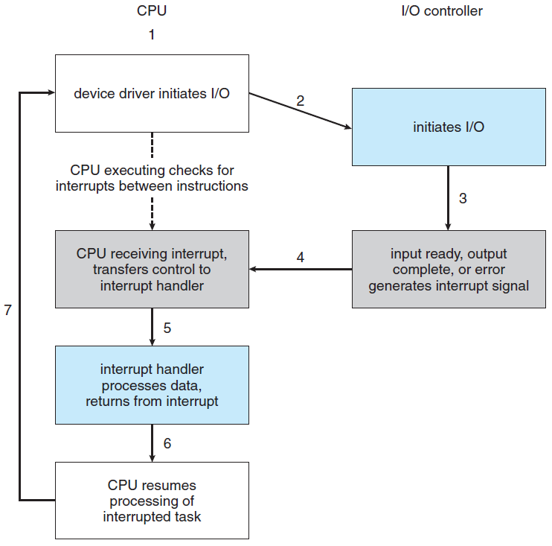
Interrupt-driven I/O cycle.

Slide 16
Modern OS, use more sophisticated interrupt-handling features.
1. Defer interrupt handling during critical processing.
2. Dispatch to proper interrupt handler without polling all devices to see which one raised the interrupt.
3. Support multilevel interrupts, allowing OS responding by interrupts priority.
Above are provided by the CPU and by the interrupt controller hardware.
CPUs have two interrupt request lines.

Slide 17
One is nonmaskable interrupt, reserved for events such as unrecoverable memory errors.
Second is maskable, used by device controllers to request service, is turned off by CPU before executing critical instruction that must not be interrupted.
Interrupt accepts an address (offset in interrupt vector) to selects interrupt-handling routine.
Interrupts have priority levels, enabling CPU to defer low-priority interrupts without masking all, making high priority interrupt to preempt.

Slide 18
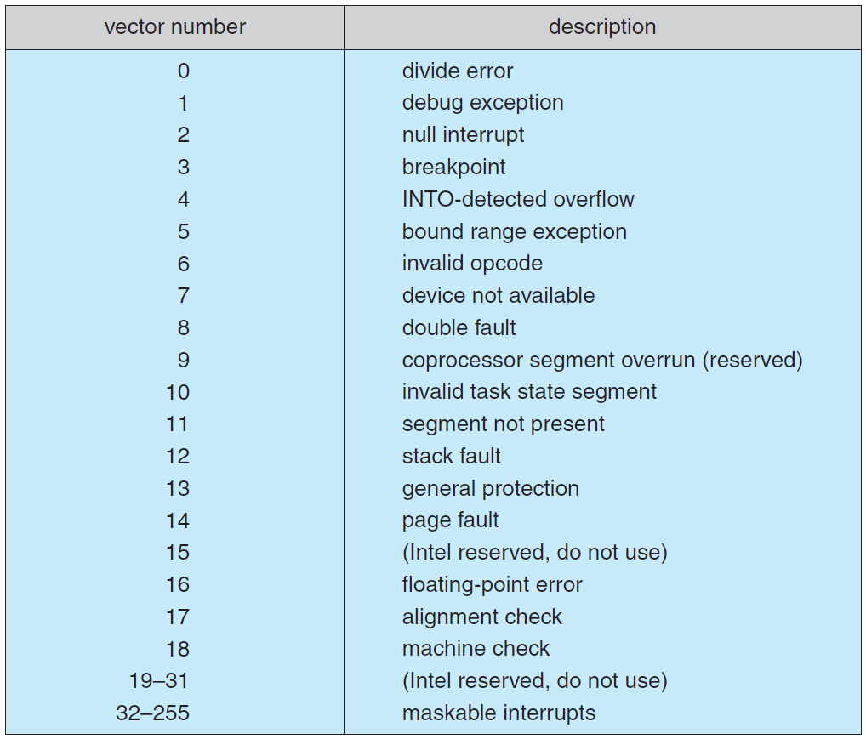
Intel Pentium processor event-vector.

Slide 19
Interrupts are used to handle exceptions (e.g. dividing by 0, access protected memory address, attempt execute non user mode instruction).
Interrupts are also used for trap, used to issue system calls, calling the kernel.
Trap has low priority compared to device. System call on behalf of application is less urgent than servicing device controller, before FIFO queue overflows and loses data.
Threaded kernel is well suited to implement multiple interrupt priorities and enforce precedence.

Slide 20
Direct Memory Access
Interrupts or polling are wasteful for transferring big amount of data between the disk and memory.
Rather, special-purpose processor called direct-memory-access (DMA) is used.
The CPU writes a DMA command block into memory, containing a pointer to transfer source, a pointer to transfer destination, and number of transferred bytes.
The CPU writes the address of this command block to the DMA controller, then goes on with other work.

Slide 21
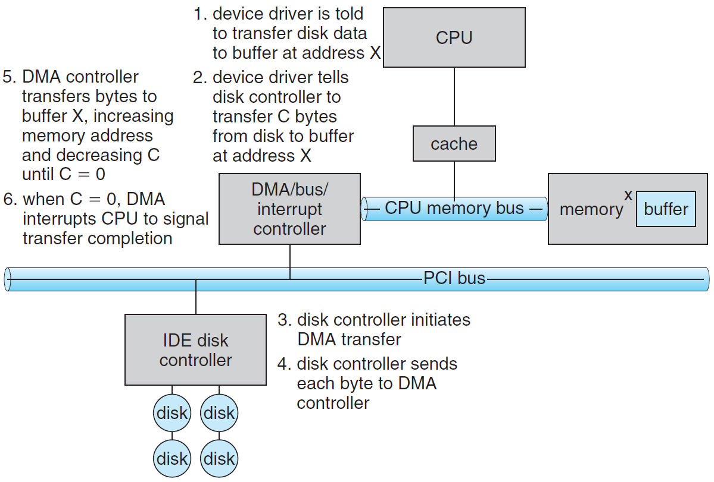
DMA transfer.

Slide 22
The DMA places addresses on the bus to perform transfers without CPU intervention.
DMA-disk handshaking is performed via a pair of DMA-request and DMA-acknowledge wires.
Disk controller sets DMA-request when data is available for transfer.
DMA controller seizes memory bus, placing address on memory-address wires, and setting DMA-acknowledge.
Device controller receives DMA-acknowledge, transfers word of data to memory and clears the DMA-request.

Slide 23
When the entire transfer is finished, the DMA controller interrupts the CPU.
DMA controller seize of memory bus prevents CPU momentary access to main memory (but not to cache), called cycle stealing.
Although cycle stealing can slow down the CPU, offloading data-transfer work to a DMA improves the total system performance.

