Slide 1
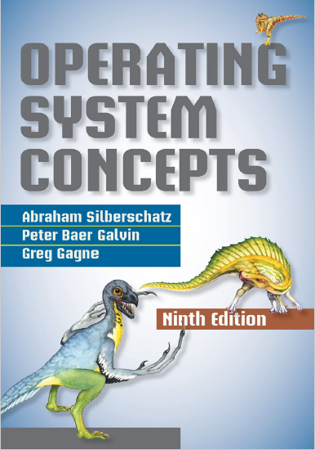
Deadlocks
prepared and instructed by
Shmuel Wimer
Eng. Faculty, Bar-Ilan University

Slide 2
System Model
A Deadlock occurs when a process is waiting for a resource forever because that resource is held by another waiting process.
A process utilizes a resource in the following sequence:
Request. If the request cannot be granted immediately it must wait until it can acquire it.
Use
Release
Resources examples: request() / release() device, open() / close() file, allocate() / free() memory, wait() / signal() semaphores, acquire() / release() mutex lock.

Slide 3
The OS makes sure that the process has requested and has been allocated the resource.
System table records whether each resource is free or allocated and the process to which it is allocated.
Process requesting a currently allocated resource is added to a waiting queue for this resource.

Slide 4
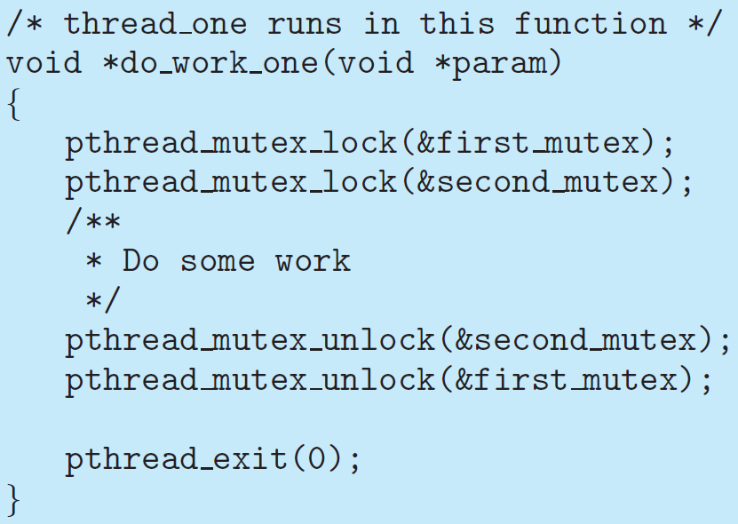

Slide 5
