Slide 1
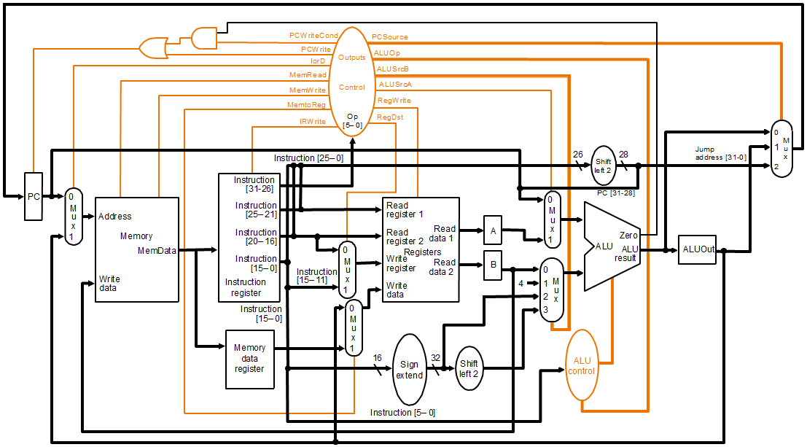
RegDst
1: RegFile destination No. for the WR Reg. comes from rd field.
0: RegFile destination No. for the WR Reg. comes from rt field.

Slide 2
RegWrite
1: general-purpose Reg. selected by the WR Reg. No. is
written with the value of the WR data input.
0: None.

Slide 3
ALUSrcA
1: 1st ALU operand comes from Reg. A.
0: 1st ALU operand is the PC.

Slide 4
MemRead
1: Memory contents as the location specified by the address input is
put on MDR.
0: None.

Slide 5
MemWrite
1: Memory contents as the location specified by the address input is
replaced by the value on WR data input.
0: None.

Slide 6
MemtoReg
1: Value fed to the RegFile WR data input comes from MDR.
0: Value fed to the RegFile WR data input comes from ALUOut.

Slide 7
IorD
1: ALUOut is used to supply the address to the MEM.
0: PC is used to supply the address to the MEM.

Slide 8
IRWrite
1: Output of the MEM is written into the IR.
0: None.

Slide 9
PCWrite
1: PC is written; its source is decided by PCSource.
0: None.

Slide 10
PCWriteCond
1: PC is written if Zero output of ALU is 1.
0: None.

Slide 11
ALUOp
00: ALU performs add operation.
01: ALU performs subtract operation.
10: ALU operation determined by Func. field of instruction.

Slide 12
ALUSrcB
00: 2nd ALU input comes from Reg. B.
01: 2nd ALU input is constant 4.
10: 2nd ALU input is sign-extended 16 LSBs of IR.
11: 2nd ALU input is sign-extended 16 LSBs of IR, left shifted in 2 bits.

Slide 13
PCSource
00: Output of ALU (PC + 4).
01: ALUOut Reg. (branch target address).
10: Jump address (PC[31:28]IR[25:0]00).

