Slide 1
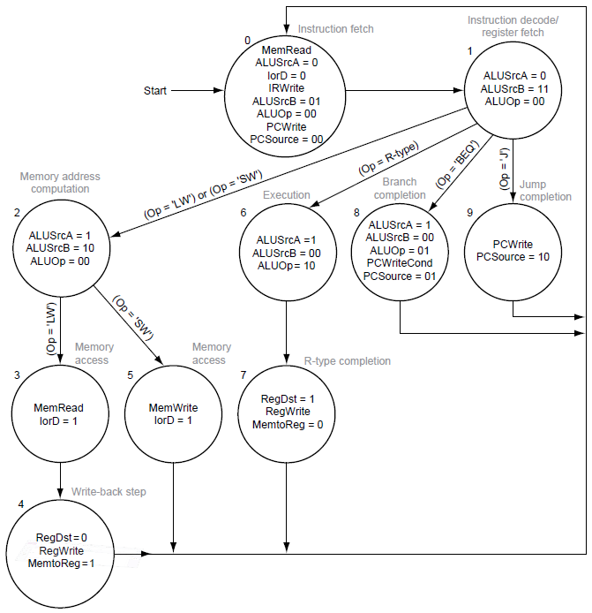

Slide 2
בקר "מיקרו-קוד"
C
o
n
t
r
o
l
u
n
i
t
P
C
W
r
i
t
e
P
C
W
r
i
t
e
C
o
n
d
I
o
r
D
M
i
c
r
o
c
o
d
e
m
e
m
o
r
y
M
e
m
R
e
a
d
D
a
t
a
p
a
t
h
M
e
m
W
r
i
t
e
I
R
W
r
i
t
e
B
W
r
i
t
e
O
u
t
p
u
t
s
M
e
m
t
o
R
e
g
P
C
S
o
u
r
c
e
A
L
U
O
p
A
L
U
S
r
c
B
A
L
U
S
r
c
A
R
e
g
W
r
i
t
e
R
e
g
D
s
t
I
n
p
u
t
A
d
d
r
C
t
l
1
M
i
c
r
o
p
r
o
g
r
a
m
c
o
u
n
t
e
r
A
d
d
e
r
A
d
d
r
e
s
s
s
e
l
e
c
t
l
o
g
i
c
]
0
–
5
[
p
O
I
n
s
t
r
u
c
t
i
o
n
r
e
g
i
s
t
e
r
o
p
c
o
d
e
f
i
e
l
d
December 2013
2

Slide 3
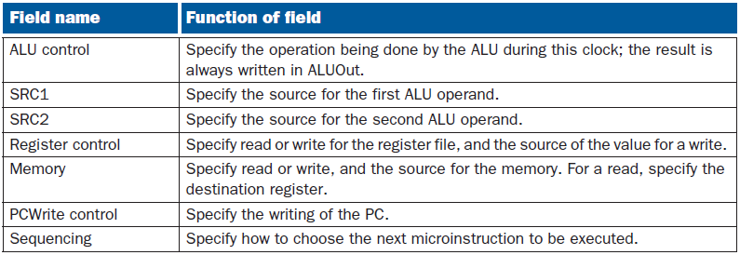
Each microinstruction contains these seven fields

Slide 4
The values of each field of a microinstruction

Slide 7
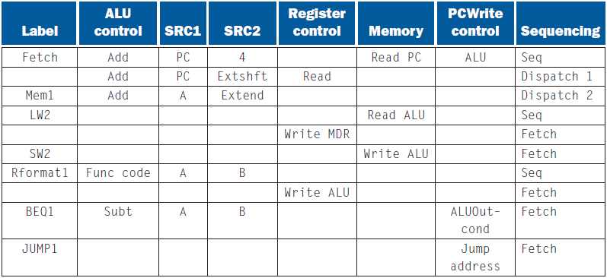
The microprogram for the control unit

