Slide 1
Multiplication and Shift Circuits
Shmuel Wimer
Bar Ilan University, Engineering Faculty
Technion, EE Faculty

Slide 2
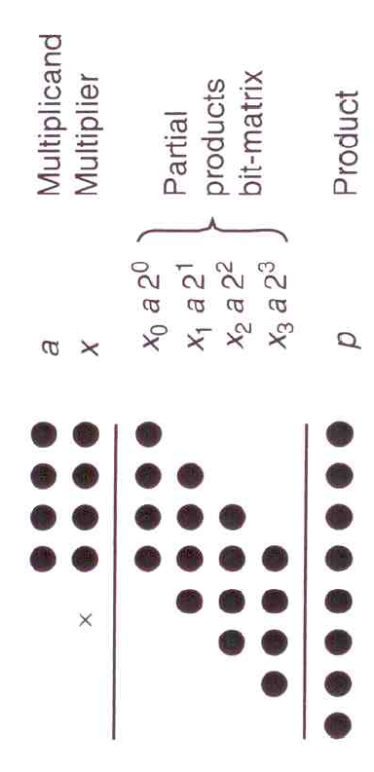
Shift/Add Unsigned Multiplication Algorithms
Shift partial products

Slide 3
In right shift multiplication the partial products x_{j}a, 0<=j<=k-1, are recursively accumulated from top to bottom.
shift right
add
x₀a2^{k} will be multiplied by 2^{-k} after k iterations. a is pre multiplied by 2^{k} to offset the effect of right shifts.
After k iteration the recurrence yields p^{(k)}=ax+p⁽⁰⁾2^{-k}=ax
a is aligned to the left (MSB) k bits of a 2k-bit .
How to obtain p=ax+y?
Initialize p⁽⁰⁾ to y2^{k}

Slide 4
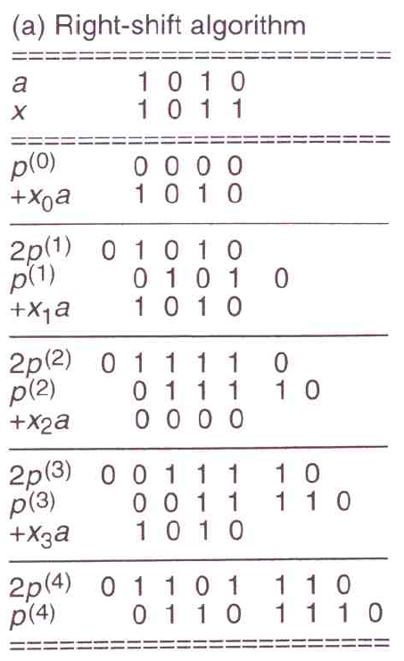
initialize
add partial product aligned to left
multiply by 2⁻¹ by right-shift
add partial product aligned to left
multiply by 2⁻¹ by right-shift
add partial product aligned to left

Slide 5
In left shift multiplication the partial products x_{k-1-j}a, 0<=j<=k-1, are recursively accumulated from bottom to top.
shift left
add
After k iteration the recurrence yields p^{(k)}=ax+p⁽⁰⁾2^{k}=ax
How to obtain p=ax+y?
Initialize p⁽⁰⁾ to y2^{-k}

Slide 6
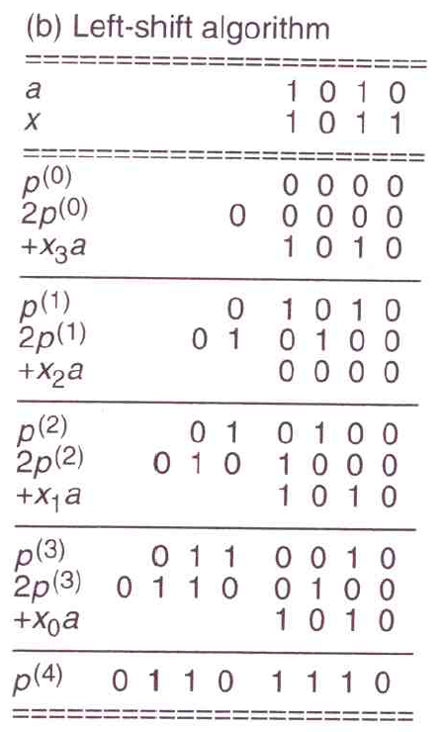
initialize
multiply by 2 by left-shift
add partial product aligned to right
multiply by 2 by left-shift
add partial product aligned to right
multiply by 2 by left-shift
add partial product aligned to right

Slide 7
Serial multiplication by add and shift entails k additions and k shifts
Right shift is favored since the addition of partial product takes place at the MSB k-bit part of the 2k word. In left shift it takes place at the LSB k-bit part and carry can propagate to MSB part.
Left shift algorithm requires therefore 2k bit adder, while for right shift k bit suffice.

Slide 8
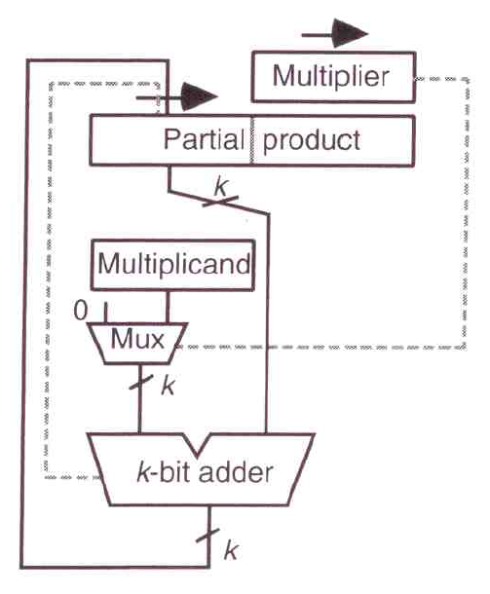
Hardware of right-shift multipliers (without control)
Shift registers
Next bit of multiplier
Control requires counter
Adder’s carry out must be stored
Addition of a partial product requires two clock cycles. One for add and one for a shift.

Slide 9
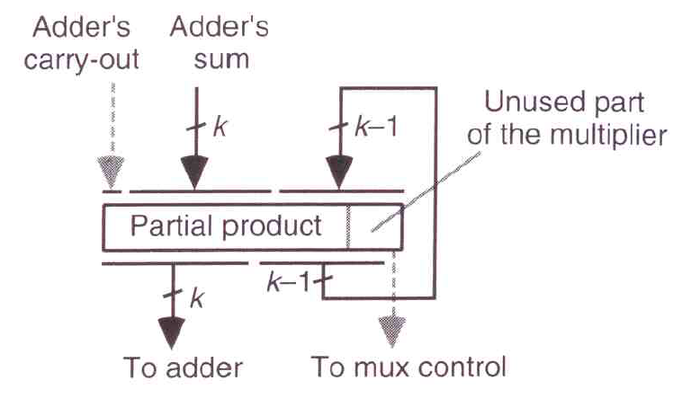
Reducing addition of partial product to one cycle
Next bit of
multiplier
2k-bit
Shift register
At each clock cycle adder’s carry-out is written to MSB and LSB is used for multiplication (via a MUX)

Slide 10
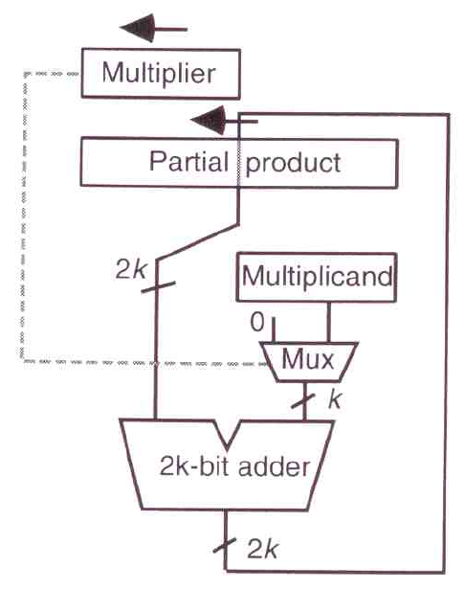
Hardware of left-shift multipliers (without control)
Next bit of multiplier
Shift registers
Adder is 2k bits rather than k bits in right-shift.
Register sharing of multiplier and MSB of cumulative partial product is possible.

Slide 11
Multiplication of Signed Numbers
Sign-magnitude representation requires only XOR-ing of the operands’ sign bits.
In 1’s-complement, a negative operand is complemented and unsigned multiplication takes place. The result is complemented by XOR-ing of operands’ sign bits.
For 2’s-complement, right-shift multiplication is proper for negative multiplicand and positive multiplier.

Slide 12
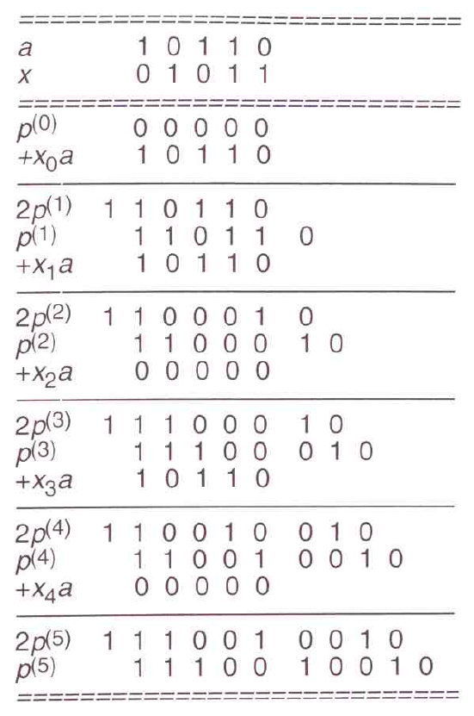
Right-shift multiplication
Negative multiplicand
Positive multiplier
Negative sign extensions

Slide 13
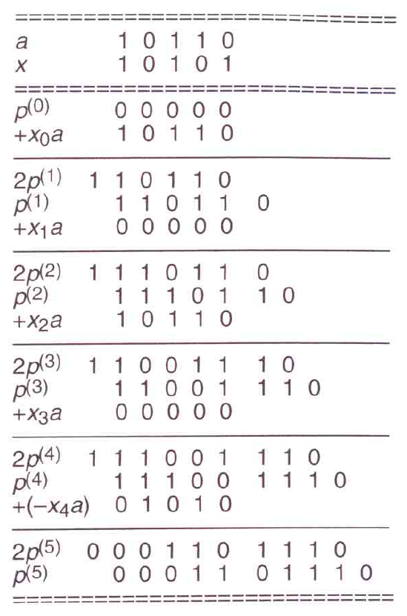
Negative multiplicand and multiplier
Negative multiplicand
Negative multiplier
Negative sign extensions
Handle correctly by subtracting x_{k-1}a rather than adding
Hardware complements multiplicand and adds 1 via carry-in

Slide 14
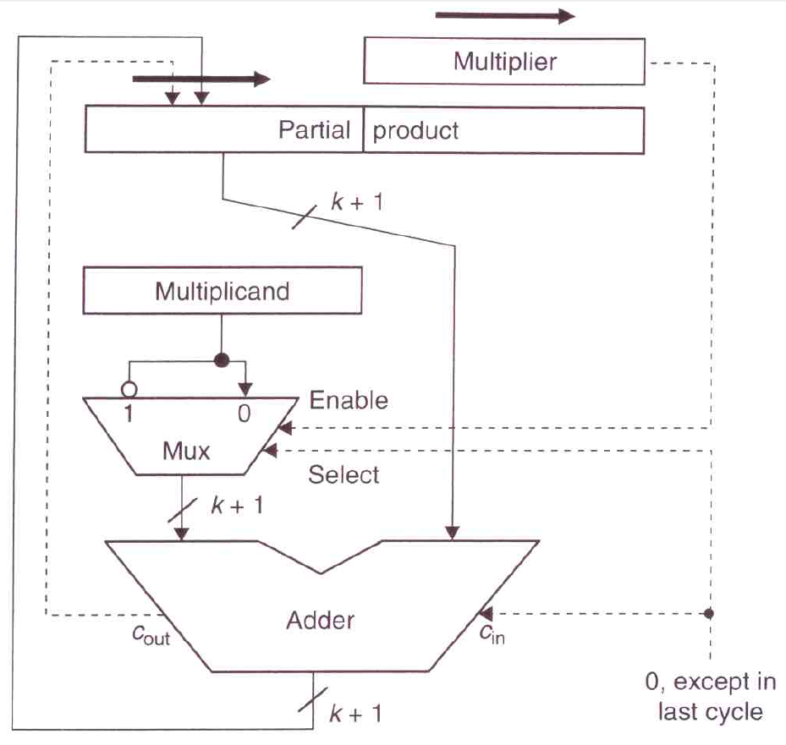
Hardware implementation (control logic not shown)
Bypassed MUX for positive multiplier
Subtracting x_{k-1}a by negation plus 1
Left-shift requires more logic due to sign extension, and is also slower (2k bit adder).

Slide 15
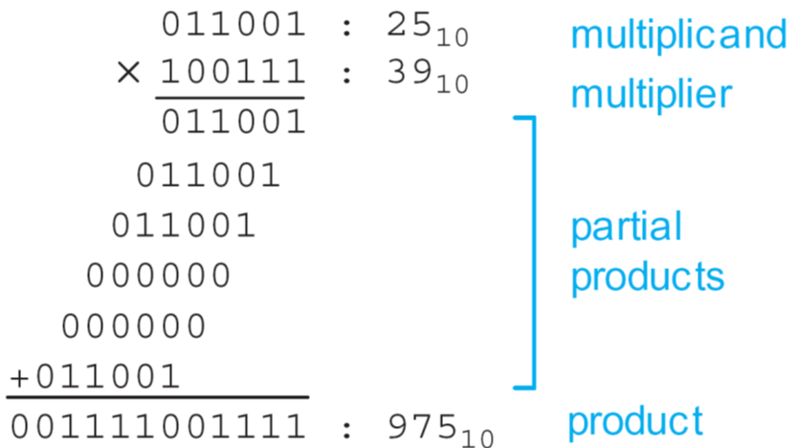
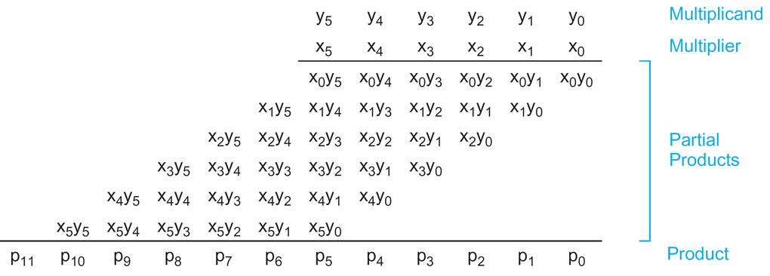
Parallel Multiplication Algorithms

Slide 16
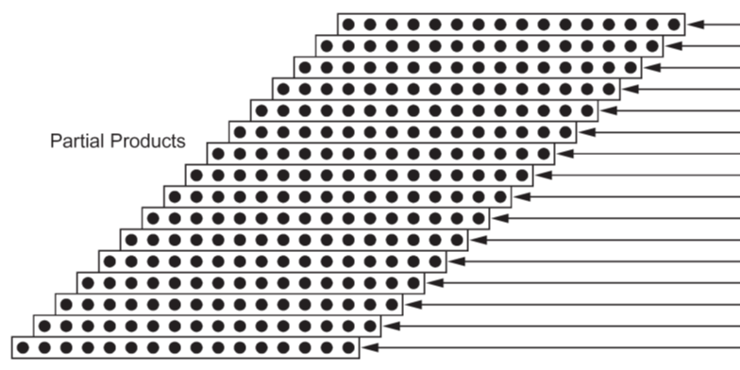
Dot diagram is convenient to illustrate large array multiplication.
multiplier

Slide 17
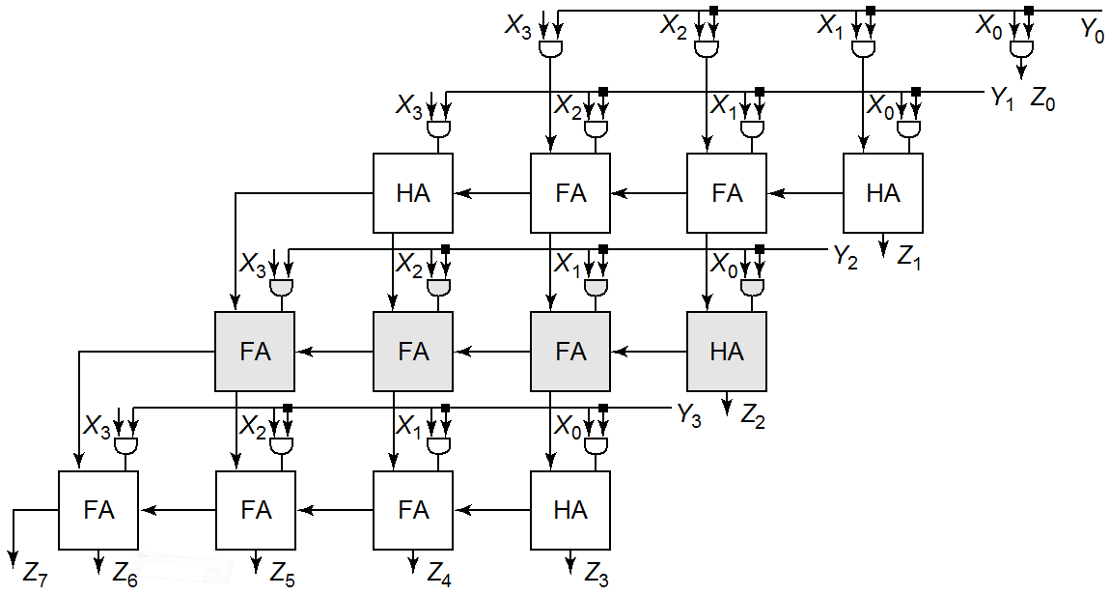
The most obvious of adding k N-bit numbers is by cascading k-1 CPAs.

Slide 18
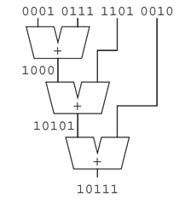
The most obvious of adding k N-bit numbers is by cascading k-1 CPAs.
This is slow and area consuming, taking O(kN) time and area (not really).
Observation:
A Full-adder has three inputs x, y and z.
It is producing an output s of weight 1 and an output c of weight 2.
The inputs are symmetric with respect to s and c.

Slide 19
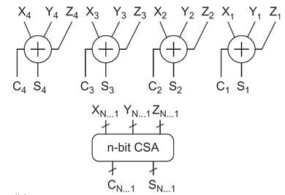
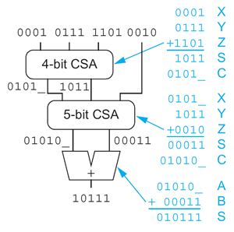
Carry-Save Adder
The sum X+Y+Z can therefore be obtained by first summing xi+yi+zi in parallel, producing C and S.
Then summing S and left shifted C by CPA. This is called Carry-Save Adder (CSA).

Slide 20
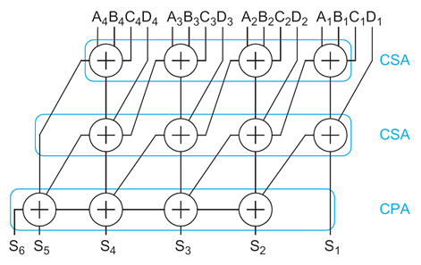
Summation of k numbers requires stacking k-2 CSAs and a single CPA.
The resulting delay is O(k+n) rather than O(kn) if CPAs were used (not exactly…).
CSA was invented by von Neumann early digital computer (1946).

Slide 21
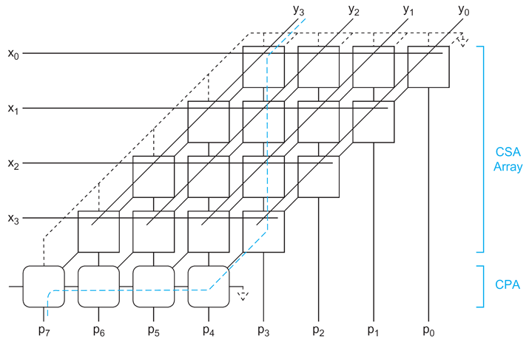
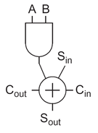
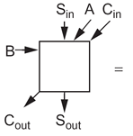
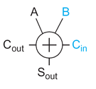
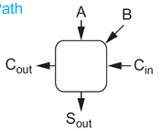
Unsigned Array Multiplication
B
Cin
Critical path has N CASs and M-bit CPAs, yielding O(N+M) delay.
The N LSBs are obtained directly from the sum outputs of CSAs.
The M MSBs are obtained by CPA.
It can be squashed in layout to occupy a rectangle.

Slide 22
2’s Complement Array Multiplication
Same CSA array multiplication can be used.
2’s complement
positive
negative
To handle the negative part, 2’s complement will be used.
Recall that 2’s complement equals 1’s complement plus 1.
1’s complement is obtained by bit complement.

Slide 23
bit complement + 1
bit complement + 1

Slide 24
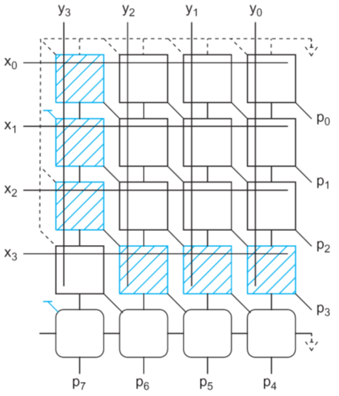
Physical layout
Notice how all 1s were summed and propagated leftward.

Slide 25
Acceleration of Serial Multiplication
Observation: 2^{j} + 2^{j-1} + … + 2^{i+1} + 2^{i} = 2^{j+1} - 2^{i}
Consequently, additions occurring by a string of 1s in the multiplier can be replaced by an addition and a subtraction.
Bits x_{i-1} and x_{i} of the multiplier are encoded in y_{i} as follows:
(x_{i},x_{i-1}) = (00) => y_{i} = 0 ; No string of 1s in sight
(x_{i},x_{i-1}) = (01) => y_{i} = 1 ; End of string of 1s
(x_{i},x_{i-1}) = (10) => y_{i} = ⁻1 ; Beginning of string of 1s
(x_{i},x_{i-1}) = (11) => y_{i} = 0 ; Continuation of string of 1s
Example: radix-2 encoding of a 16-bit word
artifact
x
1 0 0 1 1 1 0 1 1 0 1 0 1 1 1 0 0
⁻1 0 1 0 0 ⁻1 1 0 ⁻1 1 ⁻1 1 0 0 ⁻1 0
y

Slide 26
x
1 0 0 1 1 1 0 1 1 0 1 0 1 1 1 0 0
⁻1 0 1 0 0 ⁻1 1 0 ⁻1 1 ⁻1 1 0 0 ⁻1 0
(1)
y
Above is a proper interpretation for signed multiplication. A MSB string 111…111 of 1s will be encoded into a string of 000…00⁻1, resulting in appropriate subtraction.
Problem: Assume that the unsigned value of X is intended.
Booth encoding results in -2¹⁵ rather than +2¹⁵.
Solution: Add 2¹⁶ by extending y with 1 MSB.

Slide 27
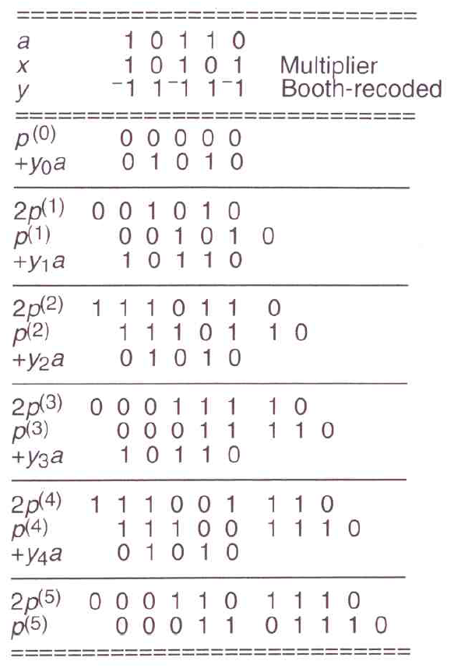
2’s Comp. addition (negative)
2’s Comp. addition (positive)

Slide 28
Booth Encoding
Proposed by Booth in 1951 to accelerate serial multiplication (series of shift and add).
requires 5 shifts and additions.
requires 1 add, 1 subtract (add 2’s complement) and 2 shifts.
Multiplication can be considerably accelerated by turning sequences of 1s into leading and trailing 1s.

Slide 29
Instead of multiplying Y and adding bit-by-bit of X we look at groups of 2 bits, hence working in radix-4.
In radix-4 each partial product has 4 times the weight of its predecessor one.
Radix-4 multiplication will reduce to half the number of partial products, with 2-bit left shift at each one. The partial products are {0, Y, 2Y, 3Y}.
3Y is a problem since it cannot be obtained by a shift but rather requires addition 3Y=2Y+Y .
Radix-4 algorithm implements 3Y= 4Y –Y and 2Y= 4Y –2Y.

Slide 30
Weight of LSB in current pair is twice the MSB in previous.
Weight of MSB in current pair is 4 times the MSB in previous.
artifact
Sign ext.
Y’s 2’s comp.
LSB
X=3. PP=–Y. 4Y will be discovered in next step.
X=1. PP=2Y. 4Y is carried from previous, which is 1 in current.
Sign ext.
Sign ext.
X=2. PP=–2Y. 4Y will be discovered in next step.
MSB
X=0. PP=Y. No need for sign. Always Y or 0.
artifact

Slide 31
PP table defines the appropriate encoding of multiplicand: 0, Y, - Y, 2Y or -2Y.
Partial Product (PP) Selection Table
Multiplier | Selection | Explanations
000 | +0
001 | Multiplicand | MSB=1 in previous pair
010 | Multiplicand | LSB=1 in current pair
011 | 2 x Multiplicand | 1 from prev., 1 from current
100 | -2 x Multiplicand | compensated by +1 in next
101 | -Multiplicand | +1 from prev., -2 from current
110 | -Multiplicand | compensated by +1 in next
111 | -0 | +1 from prev., -1 from current

Slide 32
Radix-4 modified Booth encoding values
Inputs |  |  | Partial Products | Booth Selects
X2i+1 | X2i | X2i-1 | PP i | SINGLE i | DOUBLE i | NEG i
0 | 0 | 0 | 0 | 0 | 0 | 0
0 | 0 | 1 | Y | 1 | 0 | 0
0 | 1 | 0 | Y | 1 | 0 | 0
0 | 1 | 1 | 2Y | 0 | 1 | 0
1 | 0 | 0 | -2Y | 0 | 1 | 1
1 | 0 | 1 | -Y | 1 | 0 | 1
1 | 1 | 0 | -Y | 1 | 0 | 1
1 | 1 | 1 | -0(=0) | 0 | 0 | 1

Slide 33
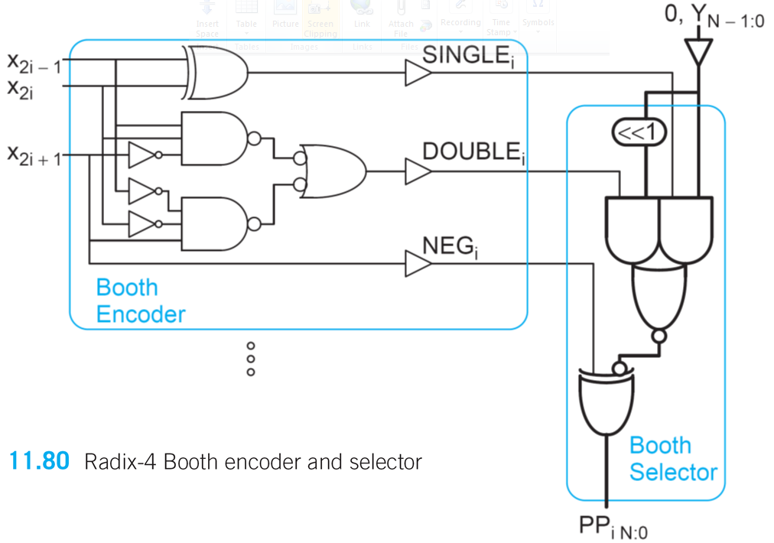
Radix-4 Booth encoder and selector
Encodes 0, Y, or 2Y according to 3 successive bits of multiplier.
Multiplicand Y is 0-extended to M+1 bits. If the NEG is asserted Y is negated and extra 1 is added in the next row.

Slide 34
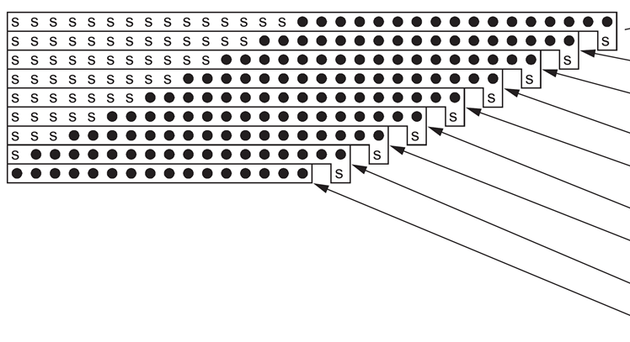
Radix-4 Booth-encoded partial products with sign extension for unsigned multiplication
0
PP0
PP1
PP2
PP3
multiplier
PP4
Though unsigned, Booth Alg. generates negative PPs.
PP5
PP6
PP7
Negative PPs are handled in 2’s complement by sign extension and addition of the sign bit.
PP8
0
0
To squash into rectangular floor plan the sign bit triangle should better be out.

Slide 35
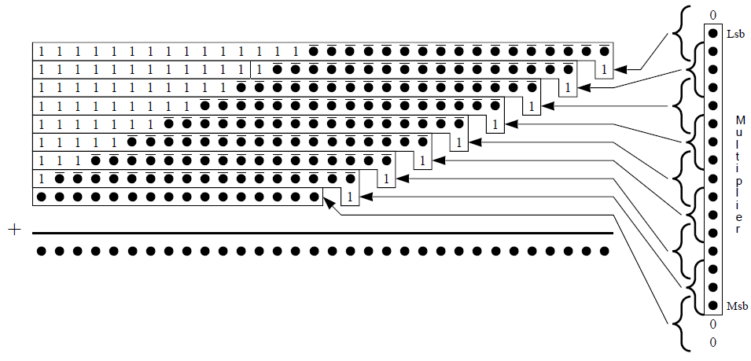
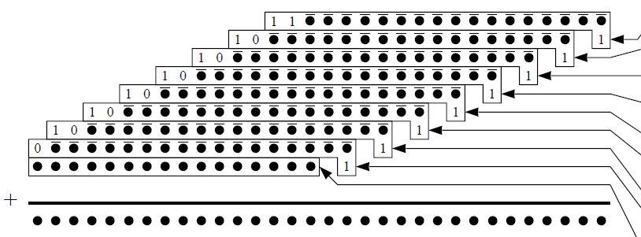
Suppose that all partial products are negative.
PP0
PP1
PP2
PP3
PP4
PP5
PP6
PP7
Summation of the 1s results in
PP8

Slide 36
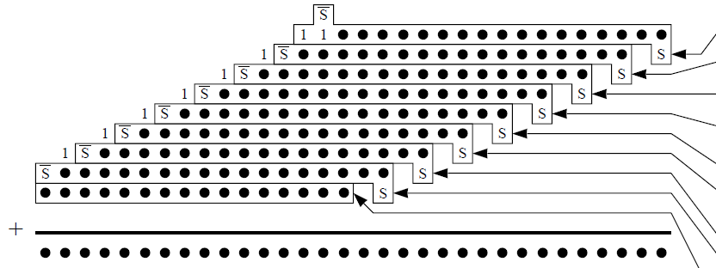
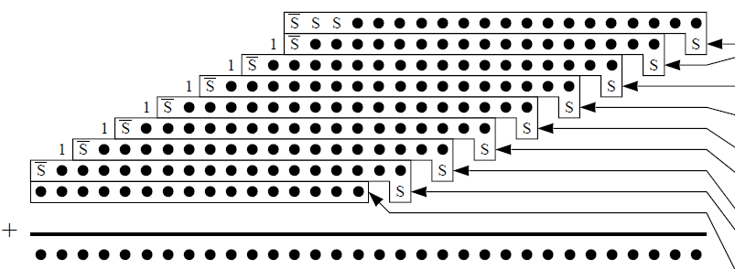
If a particular PP is positive, the negation can be reverted by adding 1 to the LSB of the original 1s string.
resulting in this configuration

Slide 37
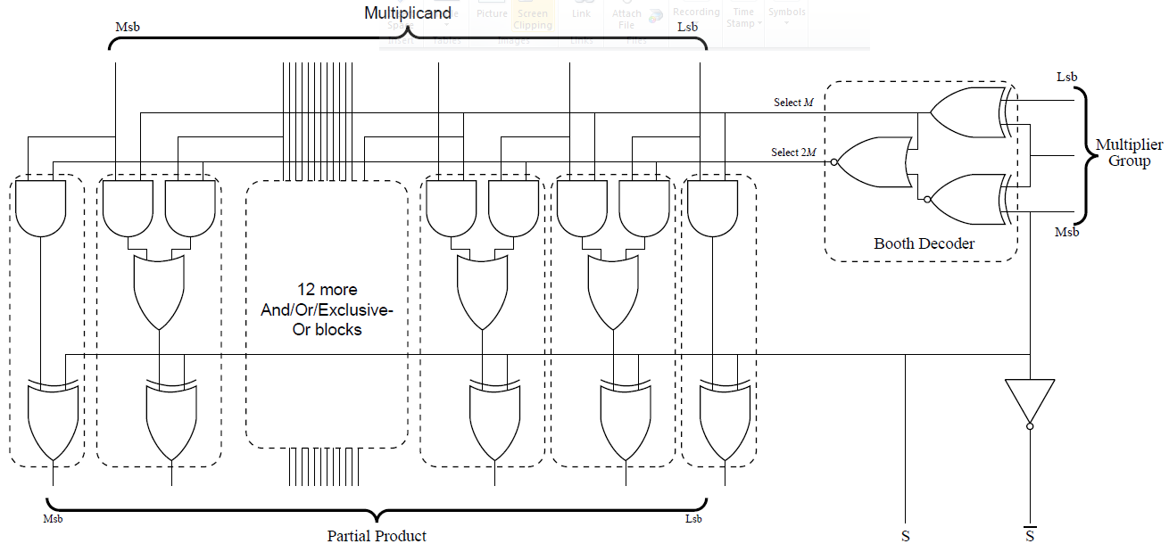
1-bit shift
Booth Encoder
negation
Critical path involves:
Booth encoder,
select line driver,
Booth selector,
N/2 CSAs
and final CPA.
Selector resides in every bit of the array, consuming significant area. Good area/power/performance tradeoff is to downsize it as much as possible. (why?)

Slide 38
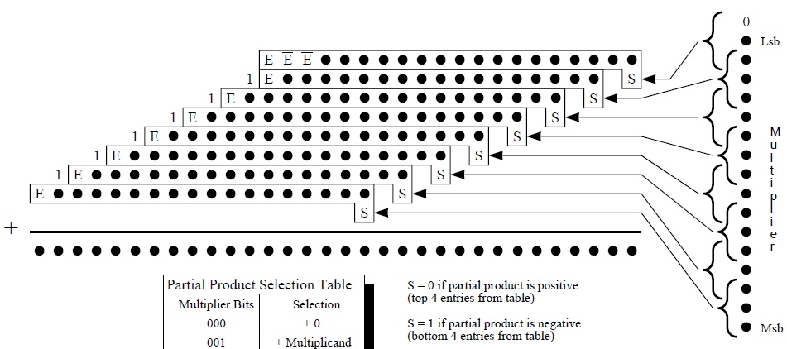
Booth Encoding Signed Multiplier
PP0
PP1
PP2
PP3
PP4
PP5
PP6
PP7
Multiplier needs not 2-bit extension (x16, x17) since it is already sign extended (x15) . Then x15=x16=x17 and encoding is 0.
x16
x17
PP8 is therefore not required.

Slide 39
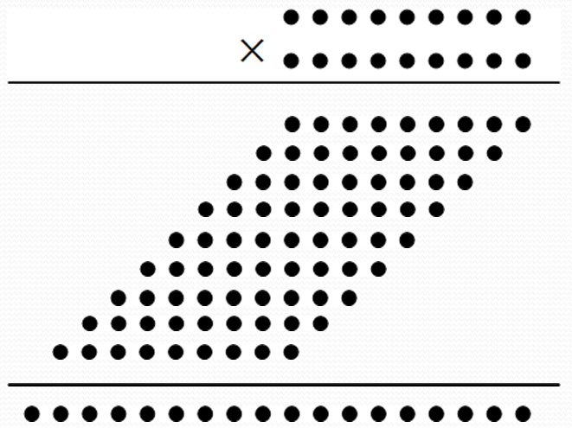
Wallace Tree Multiplication
Consider the following 9-bit unsigned multiplication
Every dot of the array represents a partial product.
Partial products are vertically summed by half and full adders (CSA).
Multiplication time complexity is O(n), There are n-2 sequential CSAs additions.
Wallace tree accelerates CSAs time complexity to O(logn) by different organization of CSAs sums.

Slide 40
In each column of partial products, every three adjacent rows construct a group.
Reduction in each group is done by one of the following cases:
Applying a full adder (CSA) to the 3-bit groups
Applying a half adder to the 2-bit groups
Passing any 1-bit group to the next stage without change

Slide 41
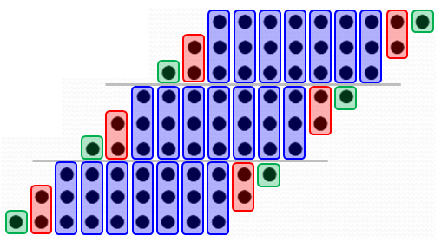
Passing any 1-bit group to the next stage without change
Sum of half adder stays in column, carry sent to next column.
Sum of full adder stays in column, carry sent to next column.

Slide 43
All the full-adder (CSA) and half-adder additions in a stage are performed simultaneously.
Every stage has its own adders.
Data is progressing through O(log_{3/2}n) stages (proven below).
The final two rows are summed by CPA.
Other groups organizations called Modified Wallace and Dadda reductions, yielding slight area improvement (number of circuits), are possible. Asymptotically all are similar.

Slide 44
Time and Area Complexity
At each stage of the computation each group of 3 bits is reduced to 2 bits, with at most 2 bits left over.
The depth of Wallace tree D(n) satisfies
This is a recursive equation solved to .
The final addition is implemented by CPA.
Carry-lookahead adder takes , so using CLA for final addition yields overall time complexity.

Slide 45
The number of adders C(n) is .
The number of bits in a row is between n and 2n. There are n rows so 2/3n² full and half adders are required in the first stage.
The number of rows is reducing by factor 2/3 from stage to stage, hence the total sums to as well.

Slide 46
Shifters
Logical shifter: Shifts the number to left or right and fills the empty spots with 0s. Specified by << or >> in Verilog.
1011 LSR 1 = 0101; 1011 LSL 1 = 0110
Arithmetic shifter: Similar to logical, but on right shift fills empty spots with sign bit. Specified by <<< or >>> in Verilog.
1011 ASR 1 = 1101; 1011 ASL 1 = 0110
Barrel shifter (rotator): Rotates numbers cyclically.
1011 ROR 1 = 1101; 1011 ROL 1 = 0111

Slide 47
Conceptually, rotation of N -bit word involves array of N N-input MUXes to select each of the outputs from each of the possible input positions. This is called array shifter.
Array shifter requires a decoder to produce 1-of-N shift.
MUXes of more than 8 inputs have excessive parasitic capacitance, so it is faster to construct shifters from log_{v}N v-input MUXes. This is called logarithmic shifter.
Left rotate by k bits is equivalent to right rotate by N-k bits. Computing N-k requires subtracter in the critical path.

Slide 48
We take advantage of 2’s complement and the fact that rotation is cyclic modulo N .
Left shift can therefore be done by first pre shifting right by 1 and then right shifting by the complement.
Logical and arithmetic shifts are similar to rotate except that the bits at one end or the other are replaced by 0 or sign bit.

Slide 49
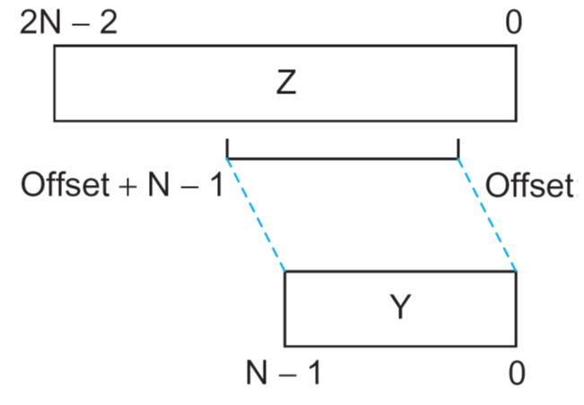
Funnel Shifter
Creates a 2N-1 bit input word Z from A and kill variables. It then selects N-bit field from Z according to shift amount.
Shift Style | Z_{2N-2:N} | Z_{N-1} | Z_{N-2:0} | Offset
Logical Right | 0 | A_{N-1} | A_{N-2:0} | k
Logical Left | A_{N-1:1} | A₀ | 0
Arithmetic Right | A_{N-1} | A_{N-1} | A_{N-2:0} | k
Arithmetic Left | A_{N-1:1} | A₀ | 0
Rotate Right | A_{N-2:0} | A_{N-1} | A_{N-2:0} | k
Rotate Left | A_{N-1:1} | A₀ | A_{N-1:1}

Slide 50
