Slide 1
Division Circuits
Shmuel Wimer
Bar Ilan University, Engineering Faculty
Technion, EE Faculty

Slide 2
Sequential Division
Like sequential multiplication of k-bit operands, yielding a 2k-bit product, the division of 2k-bit dividend by k-bit divisor can be realized in k cycles of shift and subtraction.

Slide 3
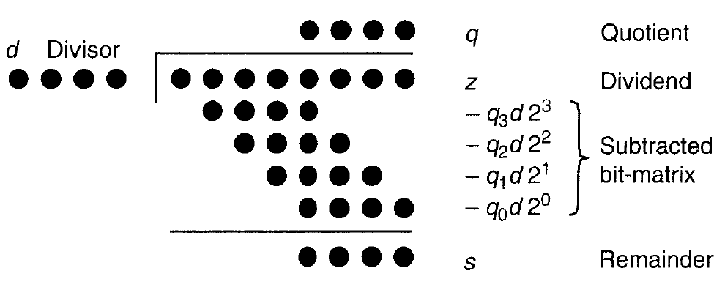
k bits
2k bits
First subtraction must consider k+1 MSBs for non negative difference. Considering k bits would mean that quotient is 2^{k} at least, which requires k+1 bits at least.

Slide 4
Since for unsigned division we have q<2^{k} and s<d, to avoid overflow we must have
z<(2^{k}-1)d+d=2^{k}d
d must be strictly greater than the k MSBs of z, as otherwise the quotient would have more than k bit. This is called overflow detection and done prior to division and can be used also to detect division by zero.

Slide 5
Fractional Division
Unsigned integer and unsigned fractional can be converted to each other as follows
Since z is 2k-bit and d, q, and s are k-bit, we obtain
We can therefore divide fractions just as integers, except that the reminder is right shifted by k bits.
Overflow detects that z_{frac} < d_{frac} , as otherwise the quotient would be no smaller than 1.

Slide 6
Sequential Bit-at-a-Time Division
It is performed by initializing s⁽⁰⁾=z, and successively subtracting from it the properly shifted terms q_{k-j}d.
Rather than shifting q_{k-j}d rightwards, we shift the partial quotient leftward, leading to left-shift division algorithm.
shift left
subtract

Slide 7
shift left
subtract
2^{k} pre multiplies d to unsure proper alignment. After k iterations the above recursion turn into
In the fractional version the dividend is aligned to the radix point. The bits of the quotient begin from -1.

Slide 8
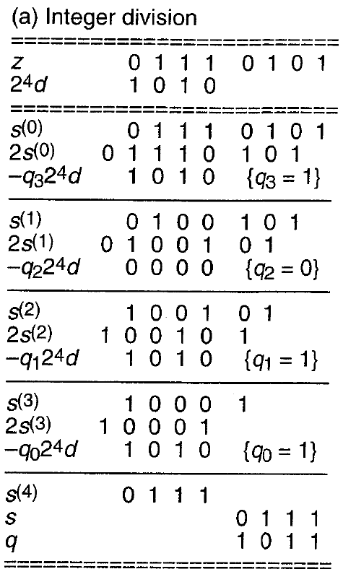
multiply divisor by 2^{k}
initialize reminder
left-shift
subtract
left-shift
subtract
left-shift
subtract
left-shift
subtract

Slide 9
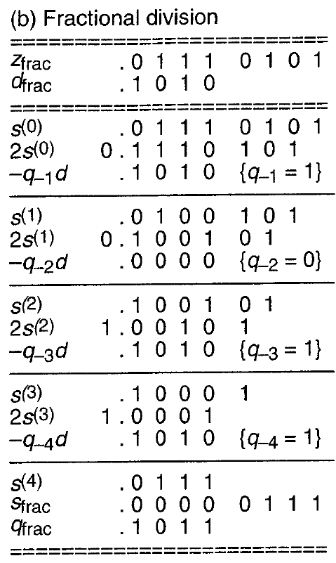
In fractional division the dividend is aligned to the radix point. The bits of the quotient begin from -1.

Slide 10
Unlike multiplication that can be done by right and left shifts, division can be done only by left shift.
This follows from the bit of the quotient that are known progressively, starting from MSB. In multiplication, then multiplier bits are known in the outset.

Slide 11
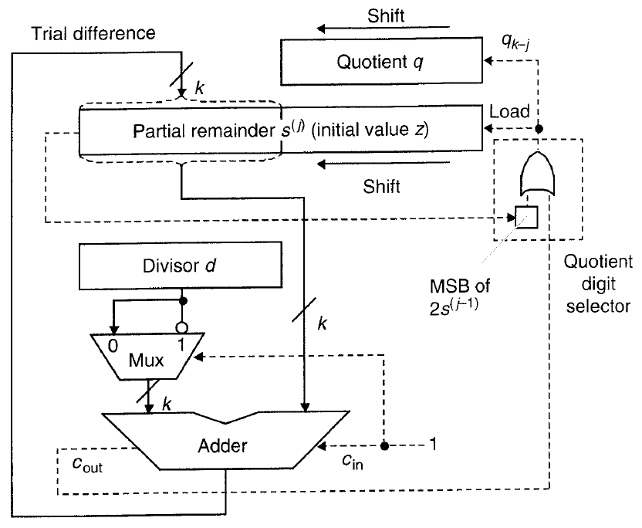
The partial reminder is left shifted and its MSB is loaded into a special FF.
A trial difference
2s^{(j-1)}-q_{k-j}(2^{k}d) is computed.

Slide 12
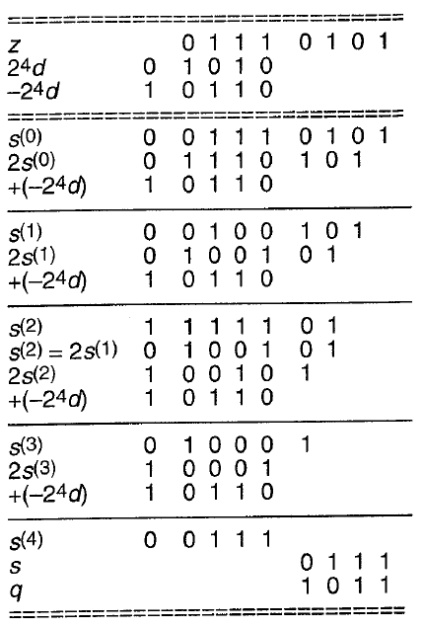

Slide 13
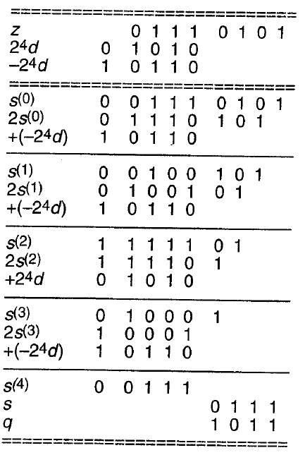

Slide 14
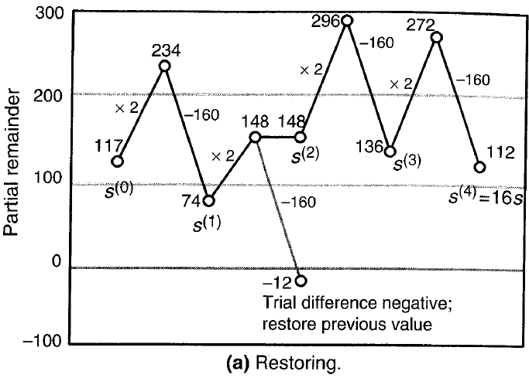
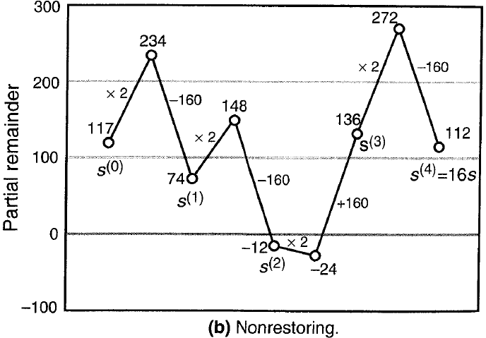

Slide 15
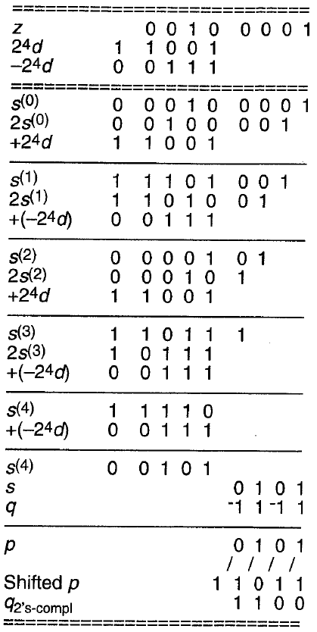

Slide 16
