Slide 1
Addition Circuits
Shmuel Wimer
Bar Ilan University, Engineering Faculty
Technion, EE Faculty

Slide 2
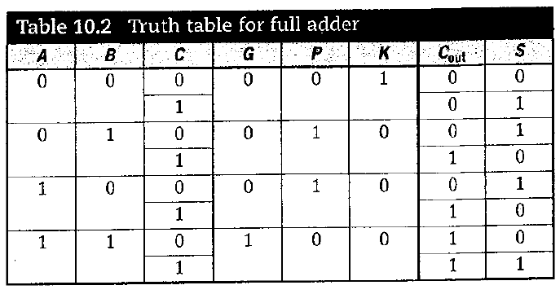
Full Adders

Slide 3
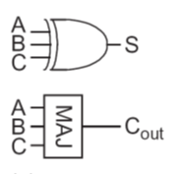
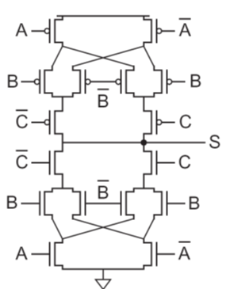
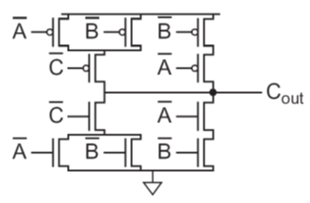
Design I: Mirror CMOS logic
odd 1s
1-propagate
generate
kill
0-propagate
odd 0s
N and P networks are identical rather than complementary!

Slide 4
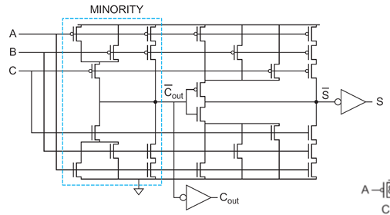
Design II: S is factored to reuse Cout
0-propagate
kill
odd 0s
1-propagate
generate
odd 1s
Uses only 28 transistors. Can be reduced to 24 transistors.
S has larger delay but it is not on the critical path

Slide 5
The transistors connected to C_{in} are closest to the output of the carry (and sum) circuits. (why?)
Only the transistors of the carry are optimized for speed. (why?)

Slide 6
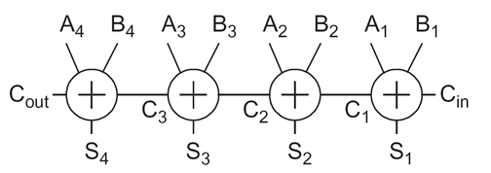
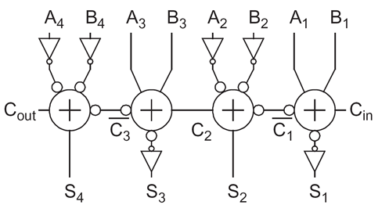
Ripple-Carry Addition
Carry computation is the critical path
Carry propagation delay is reduced by using inverting adders where every other stage is working on complementary data.

Slide 7
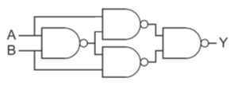
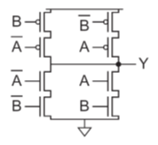
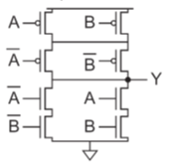
XOR / XNOR Circuits
Straight-forward, 16 transistors
14 transistors
More efficient, less contacts, smaller layout, commonly used in STD cell Lib.
Complementary CMOS, 12 transistors

Slide 8
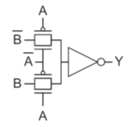
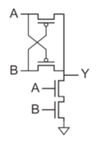
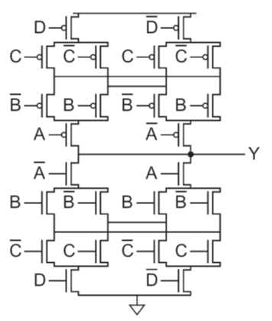
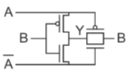
Only 4 transistors, fast, but doesn’t swing rail-to-rail.
4-way
Transmission gate design, 10 transistor
Only 6 transistors, but non restoring.

Slide 9
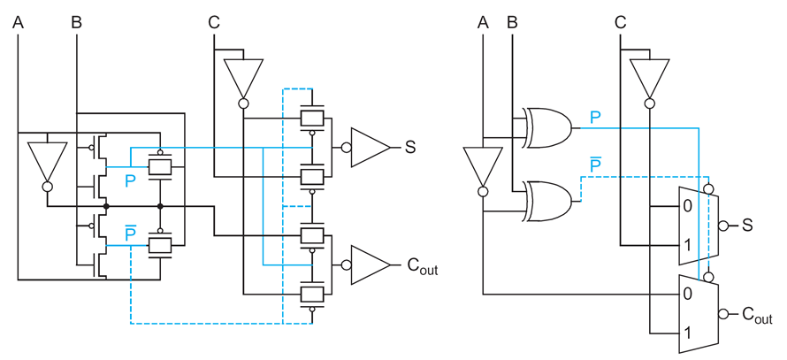
Full-adder using XOR and MUX
24 transistors and buffered outputs. Cout and S have same delay.

Slide 10
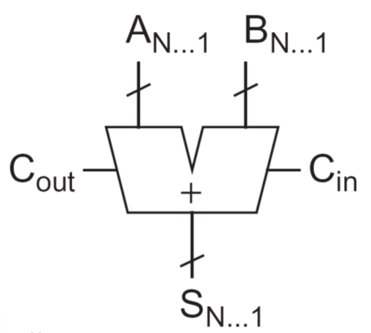
Carry-Propagate Addition
Ripple-Carry Addition
Carry computation is the critical path in addition
Recall:
Generate and Propagate signals are a key for fast addition

Slide 11
with the base case
Define
Recall:
The sum for bit i can be computed by:

Slide 12
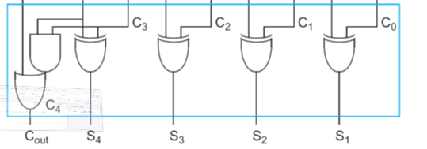
Addition is reduced into 3-step computation process
bitwise propagate
and generate logic
group propagate
and generate logic
sum logic
Addition acceleration is obtained by smart PG grouping

Slide 13
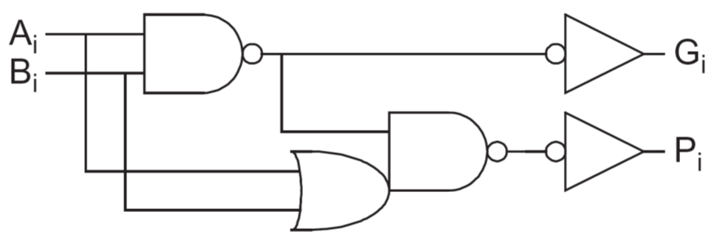
shared bitwise propagate-generate (PG) logic
A combined pair of smaller groups is called valency-2 group PG logic.
To use fewer stages for carry propagation, higher valency comprising more complex gates is possible, e.g. valency-4:

Slide 14
PG Carry-Ripple Addition

Slide 15
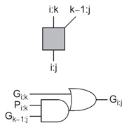
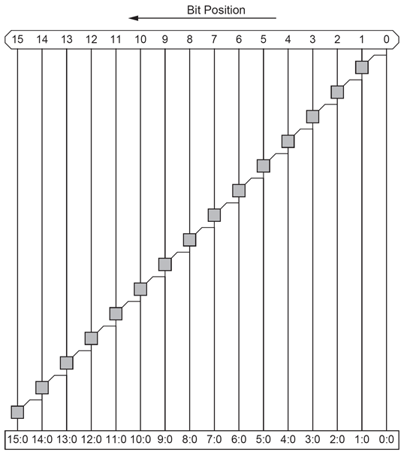
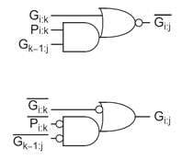
Adder architecture diagram
PG logic
Group generate
actual CMOS
sum XOR

Slide 16
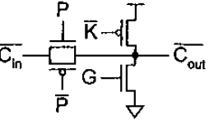
Carry Chain Adder
majority (carry) CMOS logic
pass transistor
kill
propagate
generate
Manchester valeny-4 carry chain adder (dynamic logic)

Slide 17
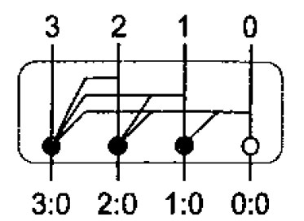
C3 is calculated in “one” time unit but we must wait for carry to ripple through group to be ready.
How delay grows with chain length?
quadratic!
Chain should be broken and buffered. Common length is 3-4.

Slide 18
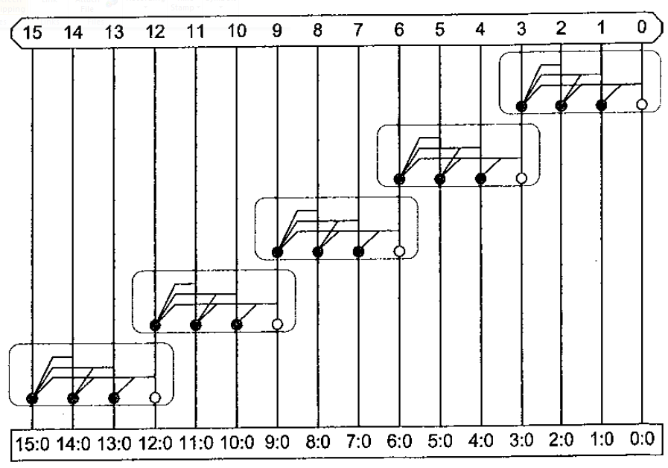
Manchester carry chain adder using valency-4 stages
Similar to ripple carry adder but uses N/3 stages.
Involves a series propagate transistor per bit.
Faster than AND-OR or majority gate per bit in carry ripple.

Slide 19
Carry Skip Adder
Assume that the propagate computed for a group i:j is 1.
Consequently, the carry-out of group i:j is the same as the carry-in and carry computation can be skipped.
bitwise propagate and generate + group propagate
skip path
skip MUX

Slide 20
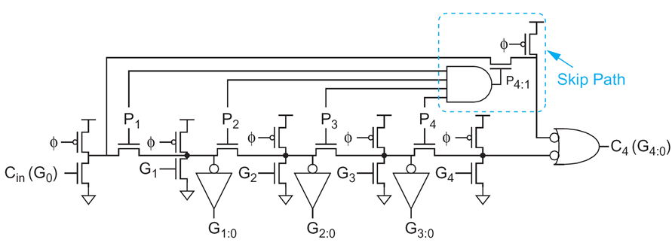
For group propagate 0 the carry generated within group is taken.
This is a considerable acceleration compared to carry-ripple, while hardware overhead is small.
Was proposed in 19th century by Charles Babbage and used by mechanical calculators.
Carry-skip adder Manchester stage (dynamic logic)
skip MUX

Slide 21
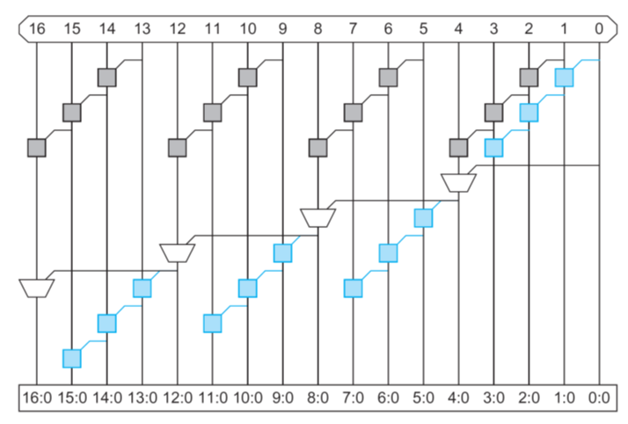
Propagation delay
4-bit carry chain if each group generates a carry
carry skip chain
4-bit ripple chain if carry-in is by passed to chain

Slide 22
N-bit adder with k groups of n bits each (N=kn).
Delay of a chain is slower than skip propagation delay (AND, MUX).
First chain must compute sums and carry within n-1 delay units.
Carry propagates through k-2 stages.
Last chain must compute sums within n-1 delay units.

Slide 23
Example: consider 32-bit addition.
Question: Can we further accelerate carry propagation?
Answer: Yes we can, block size may vary across adder.

Slide 24
Consider t ripple-carry adder groups A0, A1, … , At-2, At-1. How should we distribute the N bits in those blocks?
Assume a skip chain of A1, … , At-2. Since skip is far faster than ripple carry, we wish to minimize the number b of bits in A0 and At-1.
Bits are distribute as follows:
Summing over all blocks:

Slide 25
delay is decreased
number of blocks is increased

Slide 26
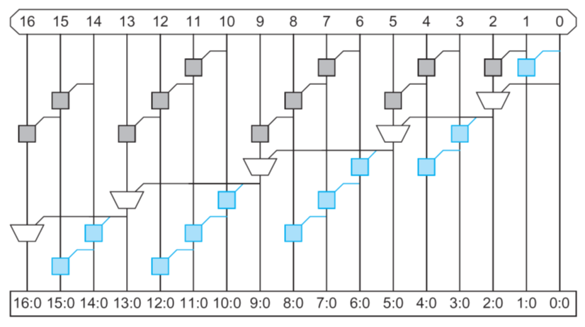
Groups are of lengths [2, 3, 4, 4, 3] compared to [4, 4, 4, 4].
Saved 2 levels of logic on critical path compared to fixed.

Slide 27
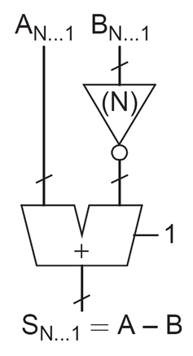
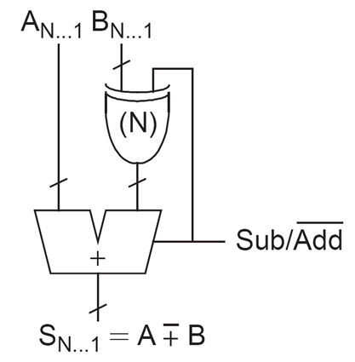
Subtraction
How to compute A-B?
Recall that in 2’s complement
We’d like to combine adder and subtracter in one circuit

Slide 28
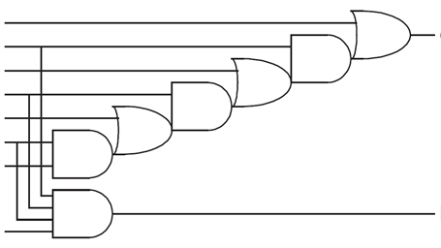
Carry-Lookahead Adder
Carry-skip adder ripples the carry through the group, requiring waiting to determine whether the first group generates a carry.
Carry-lookahead (CLA) computes group generate signals as well as group propagate signals to avoid waiting for a ripple.
Valency-4 PG

Slide 29
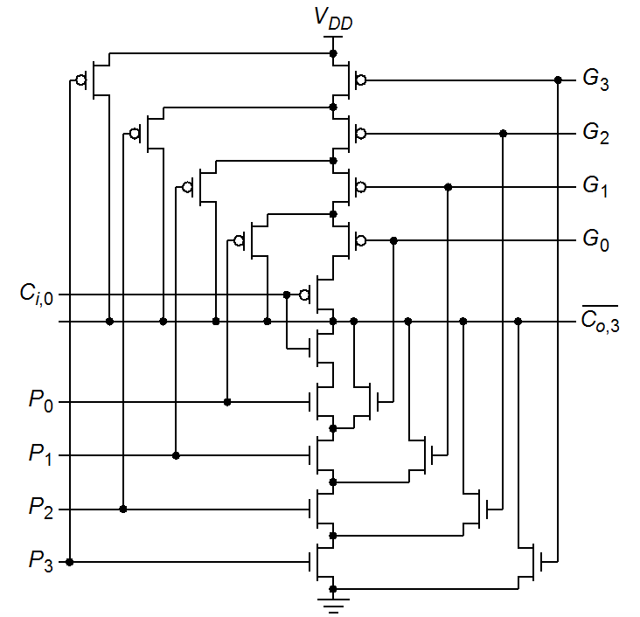
Carry-lookahead circuit with half devices compared to AOAO…
Cout is complementary
P and G signals connect and disconnect path to Vdd / Vss
What happens when all P=1 and G=0?
Both paths to Vdd and Vss are closed.
Cin then takes care

Slide 30
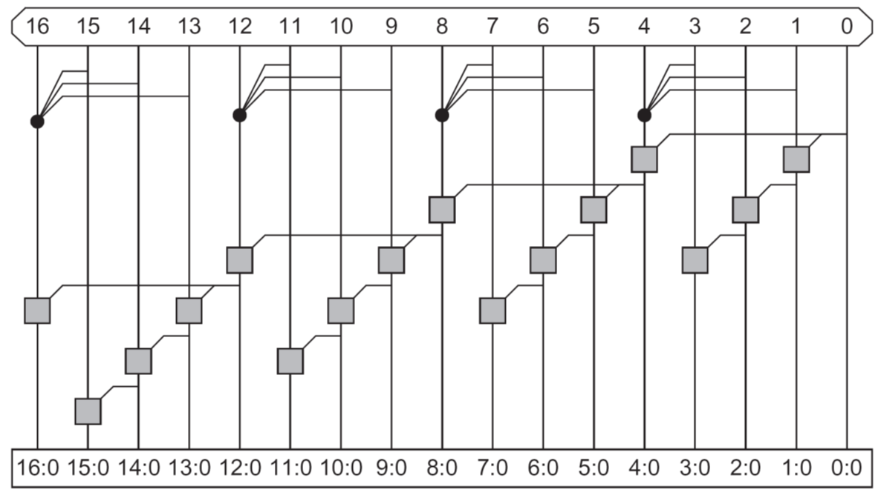
AND-OR
group PG
N-bit adder with k groups of n bits each (N=kn).

Slide 31
Propagation delay
No better than variable-length carry skip, but requires more HW due to PG generation per group.

Slide 32
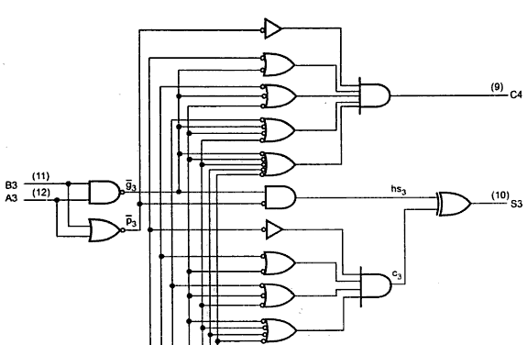
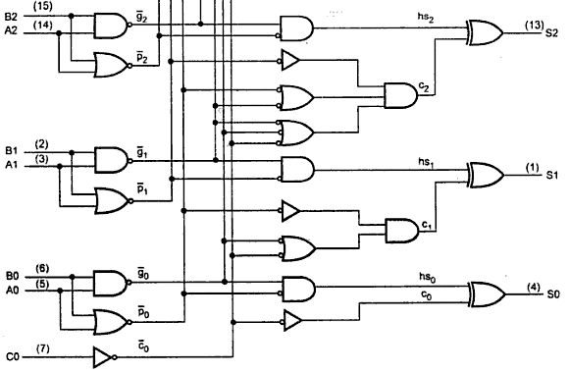
Commercial MSI 4-bit CLA adder
bit PG
2-level logic CLA
sum

Slide 33
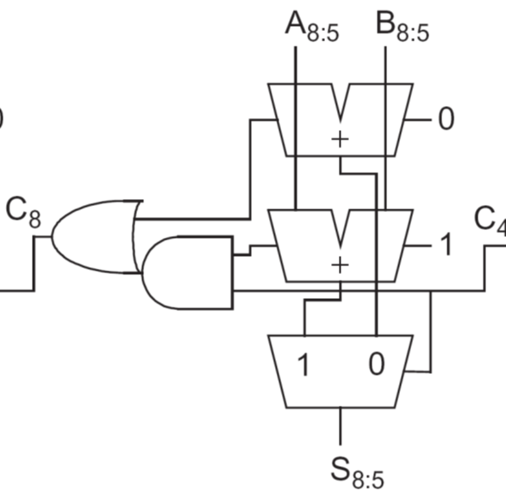
Carry-Select Adder
The critical paths in carry-skip and carry-lookahead involves carry calculation into each n-bit group and then using it for the sums within the group.
It is possible to pre compute the outputs for both 0/1 carry inputs and then select accordingly.
If C4=0, top adder applies for C8.
If C4=1 bottom adder applies for C8. Notice that cout(cin=1) >= cout(cin=0).

Slide 34
Select accordingly
Compute for both carries
1st group computes carry out
Propagation delay
Simultaneous PG for all bits
n-bits of first group adder

Slide 35
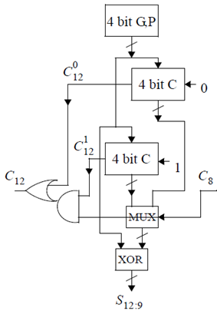
Carry-Increment Adder
Carry-select adder is fast but the amount of circuits is about twice compared to others. This is both power and area penalty.
The PG and XOR circuits are similar in 0 and 1 adders, independent , hence MUX can be used to select the proper input of XOR.
This is called carry-increment adder.

Slide 36
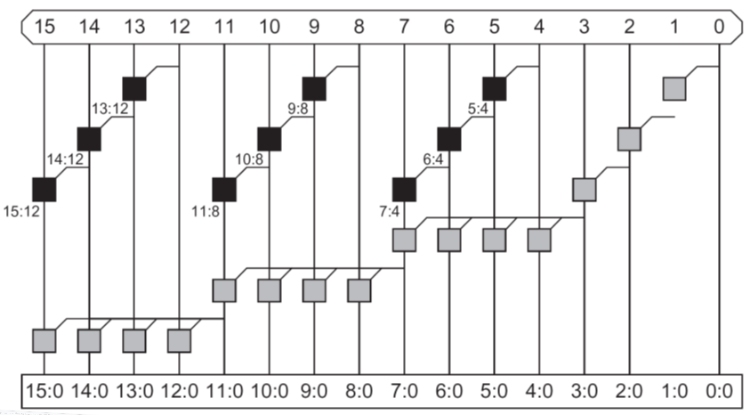
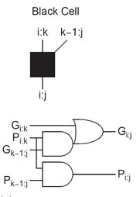
Acceleration is possible by variable group size

Slide 37
Tree Adders
In wide adders the delay of the carry passing through stages becomes dominant.
The delay can be reduced by looking ahead across lookahead blocks.
The square root delay can be improved to logarithmic delay by constructing multilevel lookahead structures.
There are many ways to build lookahead trees, offering tradeoffs between number of circuits, fan-out and amount of interconnects. Those are translated into area and power.
Such adders are known as lookahead adders, logarithmic adders or parallel-prefix adders.

Slide 38
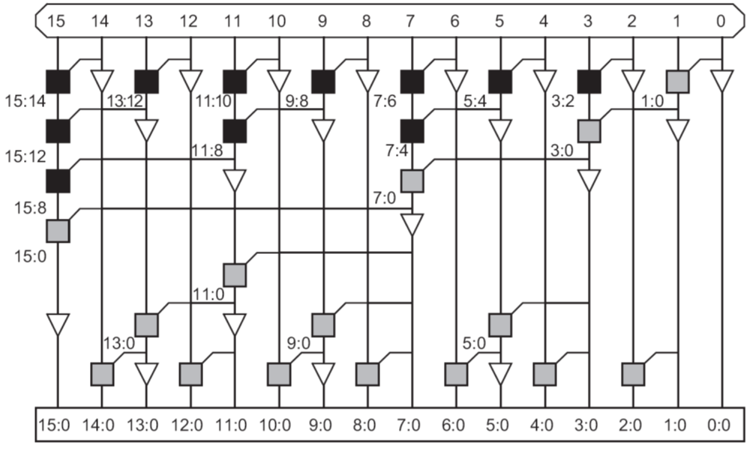
Brent-Kung tree
Compute prefixes for 2-bit groups.
Then prefixes for 4-bit groups.
Then 8-bit and 16-bit groups.
Prefixes fan back down to compute
carry-in to each bit.
2(log2N) - 1 levels (area), fan-out 2.

Slide 39
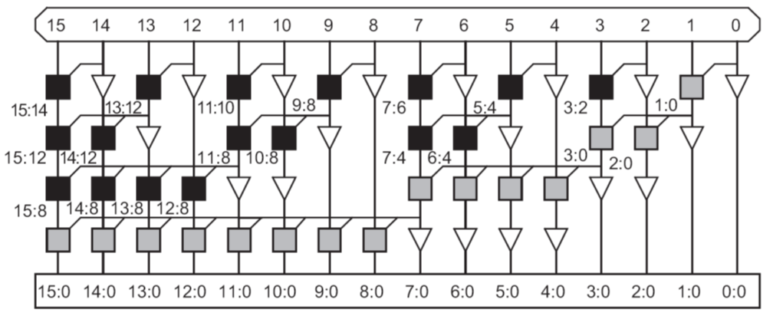
Sklansky tree
Intermediate prefixes can be computed along with those of large groups.
Delay reduced to log2N. Fan out is doubled at each row. Transistor sizing and buffering is required (area, power).

Slide 40
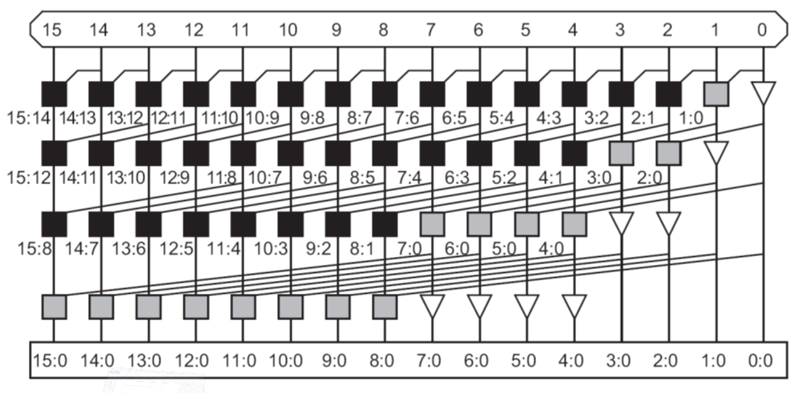
Kogge-Stone tree
Achieves log2N stages. Fan out is 2.
Wire length grows is quadratic with N. It significantly increases area, buffers, power.

Slide 41
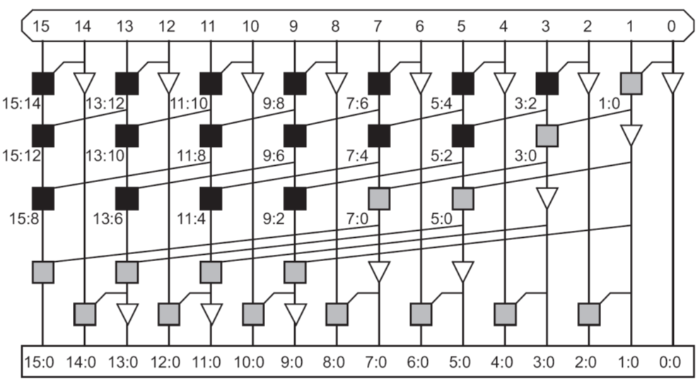
Han-Carlson tree
Use Kogge-Stone on odd bits, cutting hardware by factor 2. Use one more stage to ripple into even bits.

Slide 42
Comparison of Adder Architectures
Architecture | Logic Levels | Max Fan-out | # Wiring Tracks | # Cells
Ripple-Carry |  | 1 | 1
Carry-Skip (n=4) |  | 2 | 1
Carry-Increment (n=4) |  | 4 | 1
Carry-Increment (var.) |  |  | 1
Brent-Kung |  | 2 | 1
Sklansky |  |  | 1
Kogge-Stone |  | 2
Han-Carlson |  | 2
PG and XOR logic is not counted.
Ripple-carry should be used when they meet timing constraints (small area and power).
For 64 bits and up tree adders are distinctly faster.

Slide 43
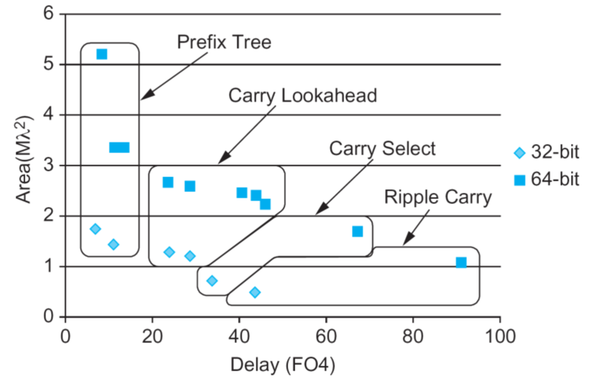
Logic synthesizers automatically map the “+” operator into appropriate adder to meet timing constraints while minimizing area and power (aka design ware).

Slide 44
Carry Probabilities

Slide 46
The short length of average carry propagation indicates that the average worst-case may also be short.
A usual design of a k-bit adder is targeting the worst-case where the carry is propagating along the entire bits, regardless of adder architecture.
Burks, Goldstine and von Neumann [1946] noticed that the average worst-case carry propagation length is log₂k.

Slide 50
Carry-Completion Detection
Worst-case carry propagation of length k almost never materializes.
A carry-completion detection adder performs addition in average O(log₂k) time.
A carry 0 is also explicitly represented and allowed to propagate between stages. The carry into stage i is represented by the two-rail code:

Slide 51
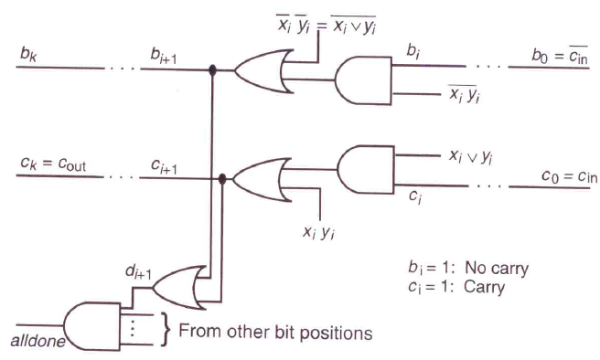

Slide 52
Two 1s generate a carry of 1 propagating towards MSB.
Two 0s generate a carry of 0 propagating towards MSB.
Initially, all carries are (0,0), namely, unknown.
When every carry assumes one of the values (0,1) or (1,0) carry propagation is complete.

Slide 53
Excluding initialization and carry-completion detection times, the latency of k-bit carry-completion adder ranges from 1 to 2k+1 gate delays, with 2log₂k+1 average gate delays.
Behrooz Parhami, Computer Arithmetic, Oxford, 2010, page 100:
"Because the latency of the carry-completion adder is data-dependent, the design of Fig. 5.9 is suitable for use in asynchronous systems. Most modern computers, however, use synchronous logic and thus cannot take advantage of the high average speed of a carry-completion adder."

