Slide 1
Visibility Graphs
Shmuel Wimer
Bar-Ilan Univ., Eng. Faculty
Technion, EE Faculty

Slide 2
We would like to find a good path, rather than any feasible path as done in motion planning.
Shortest path is usually good, but not necessarily the best. Number of turns is important, speed is important, etc.
We consider only translating planar robot and seek shortest path.

Slide 3
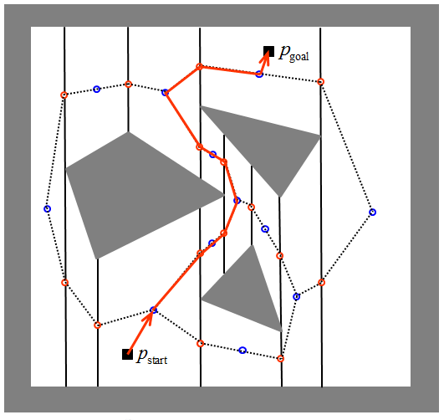
Roadmap Reminder
Free area obtained Minkowski sum
Get trapezoids of free area
Roadmap construction
Find shortest path in roadmap
This is not necessarily the shortest path

Slide 4
Roadmap
Shortest path
Shortest path of roadmap
When BFS is used, path of minimum number of vertices is found.
For weighted roadmap Dijkstra’s algorithm can be used.

Slide 5
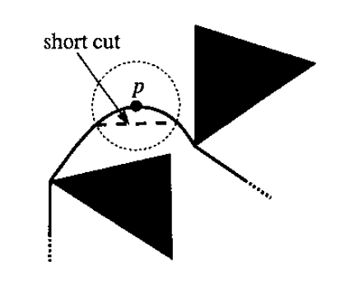

Slide 6
○

Slide 7
Visibility Graph: Nodes are the vertices in S. Edge is defined for each vertices visible to each other.

Slide 8
Shortest path

Slide 9
With n polygonal objects and O(n) nodes, naïve computation of Gvis would take O(n³) time.
Dijkstra’s algorithm finds shortest path between two nodes of n nodes and k arcs graph in O(nlogn + k) time.
It is possible to compute Gvis in O(n²logn) time.

Slide 10
Computing the Visibility Graph
Checking the visibility between two vertices, not much can be done. All objects must be tested for intersection, taking O(n) time. By ordering the vertices it is possible to accelerate tests by using info obtained in previous tests.

Slide 11
Scanning Ray – Rotational Planar Sweep
4
5
3
2
1
6
7
8
14
9
13
10
12
11

Slide 12
The intersection status of edges with the scanning ray is stored in a balanced binary tree T, were edges are stored at leaves. It
is possible by bi-section to locate the vertex w with respect to the edges. It is visible from p if it falls left to the leftmost (nearest to p) leaf.
If p and w are of the same polygon w is invisible.

Slide 13
Scanning ray maintains a binary balances tree T. Vertices are first sorted in clockwise order. Vertices are checked for visibility and then incident edges are inserted and / or deleted to / from T, depending on their position with respect to the scanning ray.

Slide 14
All such operations take O(logn) time per vertex.
T is initialized by inserting all the edges intersecting the ray of negative X axis (angle 0), an operation taking 0(nlogn) time.
Vertices are sorted clockwise starting from angle 0.

Slide 17
wi is visible
wi is not visible
All special cases can be detected at visibility test of wi

Slide 19
Probabilistic Roadmaps
Planar problems with translational robot (2 degrees of freedom) are simple. Finding visibility graph explodes with degrees of freedom increase.

Slide 20
Random roadmap construction

Slide 21
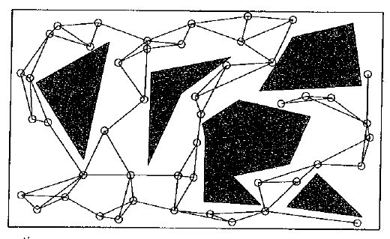

Slide 22
Sampling Strategies
Random sampling works well in many practical cases involving robots with large number of degrees of freedom. It is not well performing when essential narrow passage exists, or when
more intensive sampling is required near obstacles.
Quasirandom is a deterministic alternative to random sampling, ensuring better uniformity.

Slide 23
Discrepancy provides a measure of how uniformly points are distributed over a space X

Slide 27
