Slide 1
Convex Hulls
Shmuel Wimer
Bar Ilan Univ., Eng. Faculty
Technion, EE Faculty

Slide 2
Preliminaries

Slide 5
○

Slide 6
Convex Hull Algorithms in the Plane

Slide 9
Graham’s Scan
To determine whether a point is extreme, is it necessary to examine all triangles?
R. L. Graham showed in 1972 that sorting the point first, the extreme points can be found in linear time.
Suppose an internal point was found and was set as the origin, while all points are trivially transformed accordingly. The points can be sorted lexicographically by angle and distance from origin. The points are then stored in doubly-linked circular list.
No divisions or square roots are needed.

Slide 10
Scan starts at the lowest rightmost point which is certainly extreme.
It repeatedly examines triples of consecutive points to determine whether or not they define a reflex angle.
Scan
Start
The following rules apply:
p1p2p3 is a right turn. Eliminate p2 and check p0p1p3.
p1p2p3 is a left turn. Advance the scan and check p2p3p4.

Slide 11
Theorem: The convex hull of N points in the plane can be found in O(NlogN) time and O(N) storage, using only arithmetic operations and comparisons.
The sort of polar coordinate (divisions and square toot are not necessary) can be replaced by left to right sorting as follows.
Upper subset
Split into upper and lower points by the line passing through the leftmost and rightmost points
Scan
Lower subset

Slide 12
Construct the upper and lower boundaries separately by
left to right scan of the sorted points, and applying same
rules for reflex angles. The points l and r are necessarily
on the boundary.

Slide 13
Jarvis’s March
A polygon can be described by the sequence of its edges, similar as the sequence of vertices. Given two points, it is straightforward to test whether the line segment joining them is an edge of the convex hull.
Theorem: The line segment l defined by two points is an edge of a convex hull iff all other points of the set lie on l or to one side of it.
Convex hull

Slide 14
There are O(N²) edges to examine. For each, all N points are tested, yielding O(N³) run time.
The algorithm finds successive hull vertices by repeatedly turning angles. New vertex is discovered in O(N) time, yielding O(N²) total time.

Slide 15
In the worst case where all N points lie on the convex hull Jarvis’s march consumes O(N²) time, which is inferior to O(NlogN) Graham’s scan run time. In many cases where the number of convex hull points is h and h<<N, run time is O(hN).
Jarvis’s march is reminiscent of gift-wrapping, and can be extended to 3D, while Graham’s scan does not.

Slide 16
QUICKHULL Techniques
Inspired by QUICKSORT sorting algorithm (Hoare 1962). Reminder: QUICKSORT worst case run time is O(N²). Expected runs time is O(NlogN) (division of set into two subsets, adhering some “balance” criterion).
QUICKHULL works recursively. It partitions the set S of N points into two subsets each results in a polygonal chain. The chains concatenations yields the convex hull polygon.
The initial partitioning is defined by the line passing through the points with the smallest and largest abscissae.

Slide 20
Finding the point which maximizes the area of the triangle takes O(N). Chain concatenation takes O(1). Therefore, if the size of point subsets adheres some balance, the run time is O(NlogN). As QUICKSORT, worst run time is O(N²).
Though QUICKHULL is a divide-and-conquer algorithm, the uncontrolled size of the two remaining parts results square worst-case time complexity. Moreover, the algorithm that inherently can be parallelized, may suffer from inefficiency due to poor balancing.

Slide 21
Divide-and-Conquer Algorithms
Suppose the point set S is divided into two arbitrary halves S₁ and S₂, where there is no separation between S₁ and S₂. Let us compute the convex hulls CH(S₁) and CH(S₂). How much work is required to form CH(S₁US₂)?

Slide 22
Theorem: The convex hull of the union of two convex polygons can be found in time proportional to their total number of vertices.

Slide 23
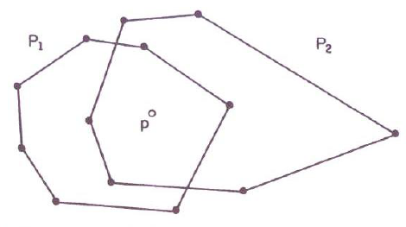

Slide 24



