Slide 1
Binary Relations
Prepared by Shmuel Wimer

Slide 2
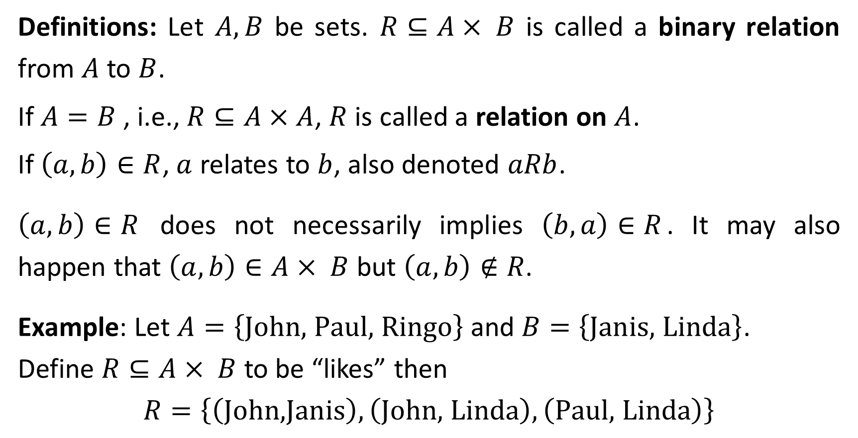
Definitions: Let $A, B$ be sets. $R⊆A× B$ is called a binary relation from $A$ to $B$.
If $A=B$ , i.e., $R⊆A×A$, $R$is called a relation on $A$.
If $\left(a,b\right)∈R$, $a$ relates to $b$, also denoted $aRb$.
$\left(a,b\right)∈R$ does not necessarily implies $\left(b,a\right)∈R$. It may also happen that $\left(a,b\right)∈A× B$ but $\left(a,b\right)∉R$.
Example: Let $A=\left\{\text{John}\text{, }\text{Paul}\text{, }\text{Ringo}\right\}$ and $B=\left\{\text{J}\text{anis}\text{, }\text{Linda}\right\}$.
Define $R⊆A× B$ to be “likes” then
$$R=\left\{\left(\text{John}\text{,}\text{Janis}\right),\left(\text{John}\text{, }\text{Linda}\right),\left(\text{Paul}\text{, }\text{Linda}\right)\right\}$$

Slide 3
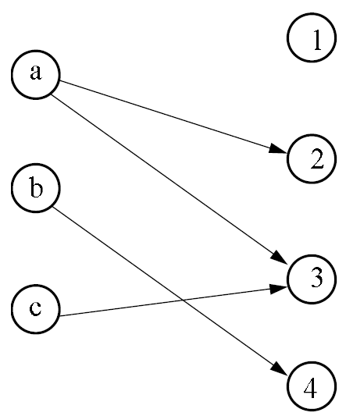
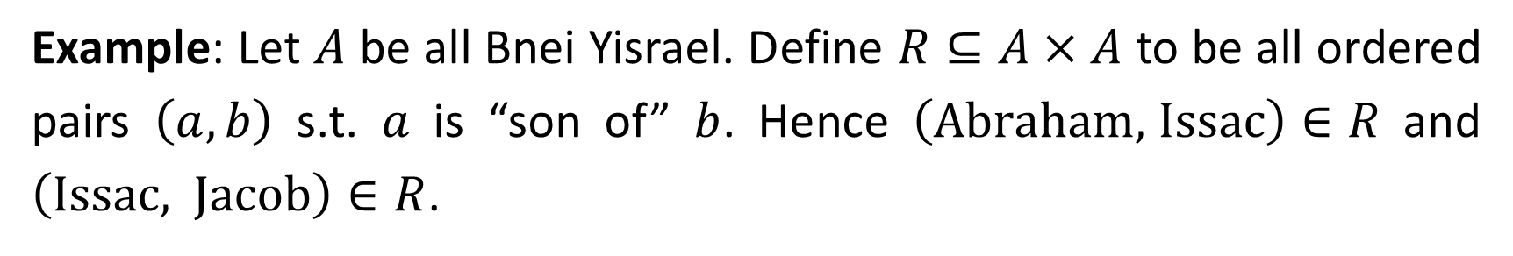
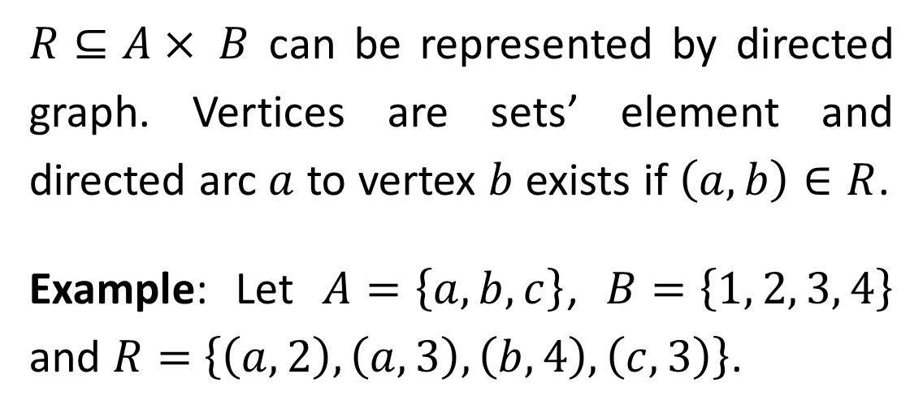
$R⊆A× B$ can be represented by directed graph. Vertices are sets’ element and directed arc $a$ to vertex $b$ exists if $\left(a, b\right)∈R$.
Example: Let $A=\left\{a, b, c\right\}$, $B=\left\{1, 2, 3, 4\right\}$ and $R=$ $\left\{\left(a, 2\right),\left(a, 3\right),\left(b, 4\right),\left(c, 3\right)\right\}$.
Example: Let $A$ be all Bnei Yisrael. Define $R⊆A×A$ to be all ordered pairs $\left(a, b\right)$ s.t. $a$ is “son of” $b$. Hence $\left(\text{Abraham}\text{, }\text{Issac}\right)∈R$ and $\left(\text{Issac}\text{, }\text{Jacob}\right)∈R$.

Slide 4

Abraham
Issac
Ishmael
Esau
Jacob
Reuven
Shimon
$$⋯$$
Benjamin

Slide 5
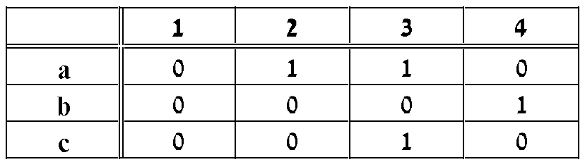
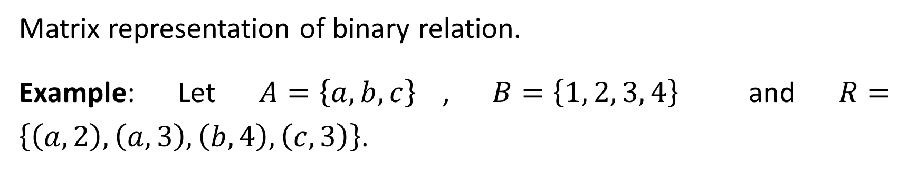
Matrix representation of binary relation.
Example: Let $A=\left\{a, b, c\right\}$, $B=\left\{1, 2, 3, 4\right\}$ and $R=$ $\left\{\left(a, 2\right),\left(a, 3\right),\left(b, 4\right),\left(c, 3\right)\right\}$.

Slide 6
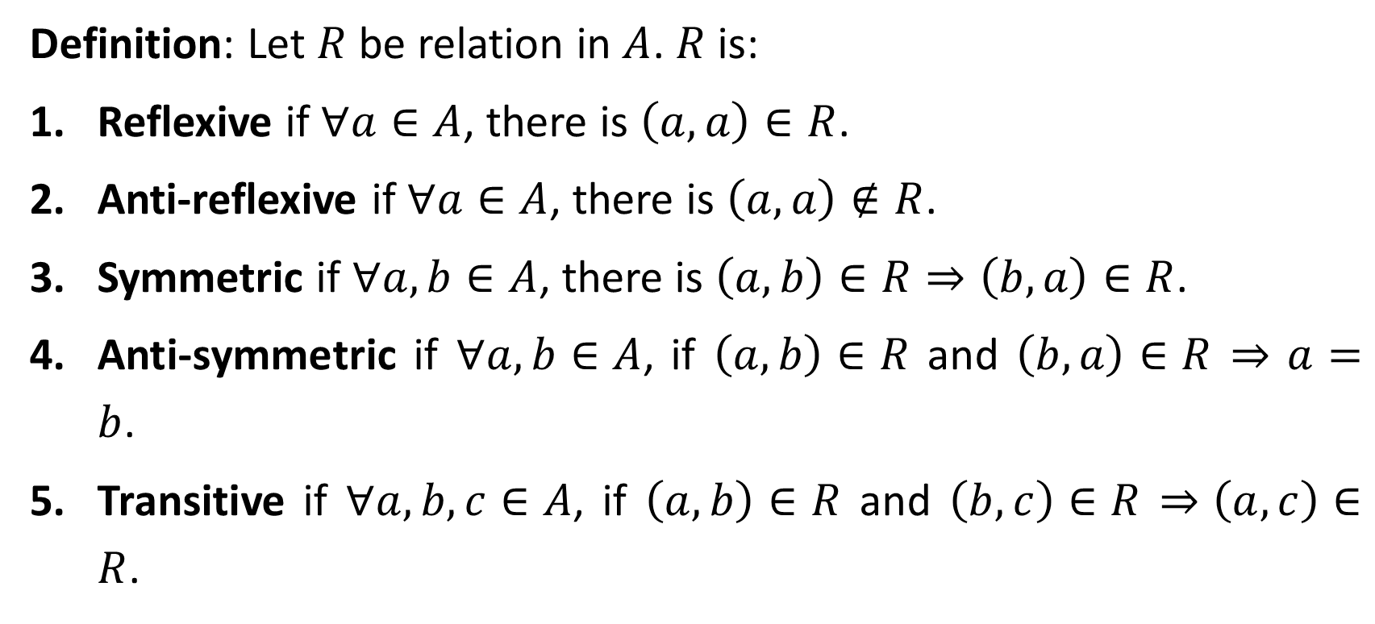
Properties of Relations
Definition: Let $R$ be relation in $A$. $R$is:
Reflexive if $∀a∈A$, there is $\left(a, a\right)∈R$.
Anti-reflexive if $∀a∈A$, there is $\left(a, a\right)∉R$.
Symmetric if $∀a,b∈A$, there is $\left(a, b\right)∈R⇒\left(b, a\right)∈R$.
Anti-symmetric if $∀a,b∈A$, if $\left(a, b\right)∈R$ and $\left(b, a\right)∈R$ $⇒$ $a=b$.
Transitive if $∀a,b,c∈A$, if $\left(a, b\right)∈R$ and $\left(b, c\right)∈R$ $⇒\left(a, c\right)∈R$.

Slide 7
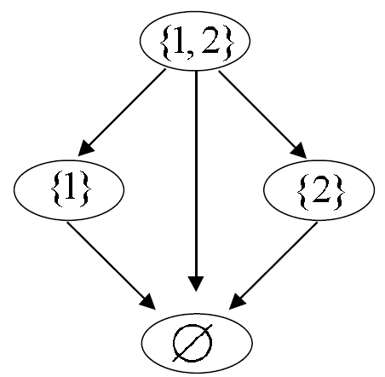
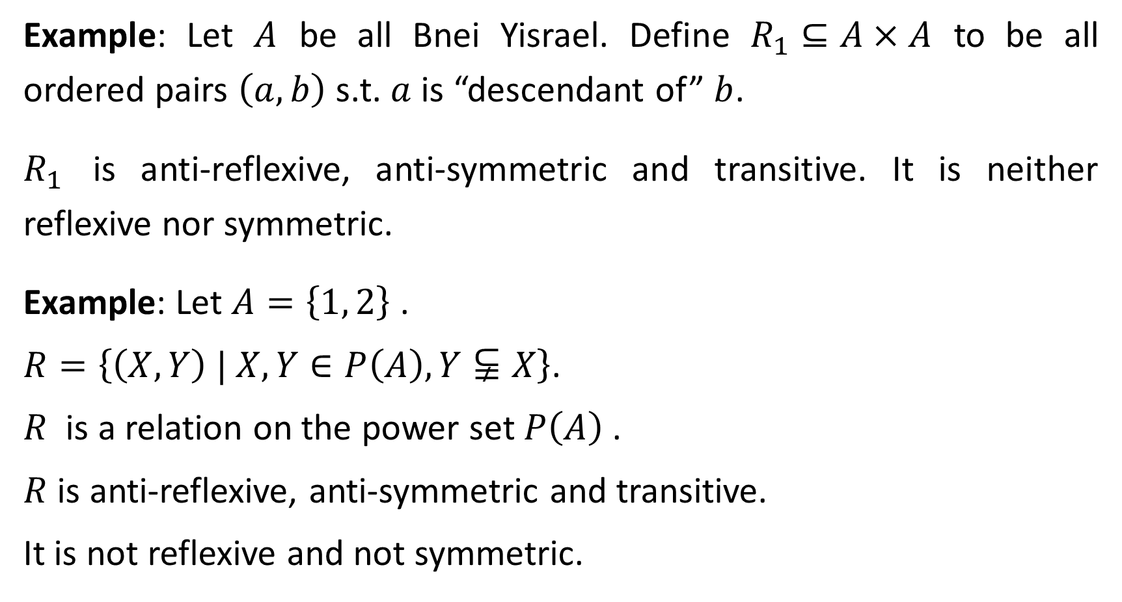
Example: Let $A$ be all Bnei Yisrael. Define $R_{1}⊆A×A$ to be all ordered pairs $\left(a, b\right)$ s.t. $a$ is “descendant of” $b$.
$R_{1}$ is anti-reflexive, anti-symmetric and transitive. It is neither reflexive nor symmetric.
Example: Let $A=\left\{1, 2\right\}$ .
$R=\left\{\left(X, Y\right) | X, Y∈P\left(A\right),Y⫋X\right\}$.
$R$ is a relation on the power set $P\left(A\right)$.
$R$ is anti-reflexive, anti-symmetric and transitive.
It is not reflexive and not symmetric.

Slide 8
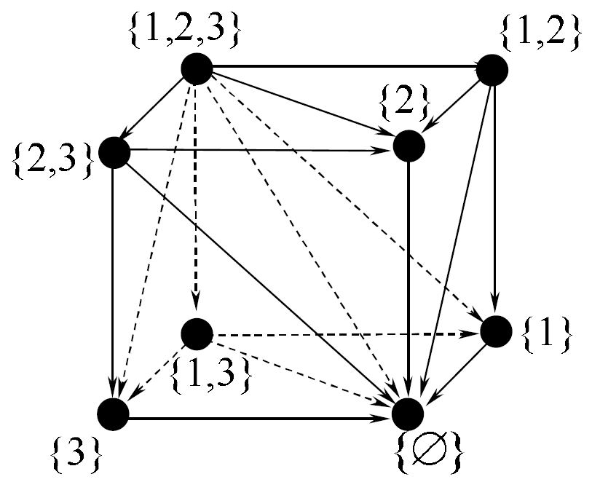
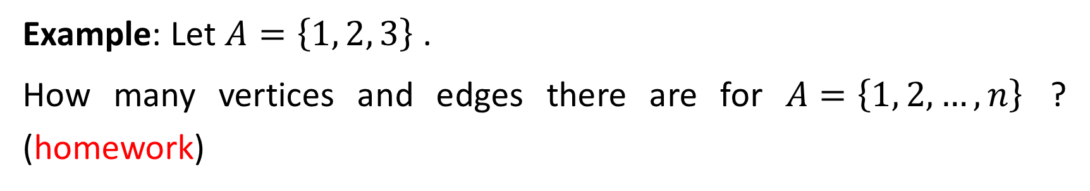
Example: Let $A=\left\{1, 2, 3\right\}$ .
How many vertices and edges there are for $A=\left\{1, 2, …, n\right\}$ ? (homework)

Slide 9
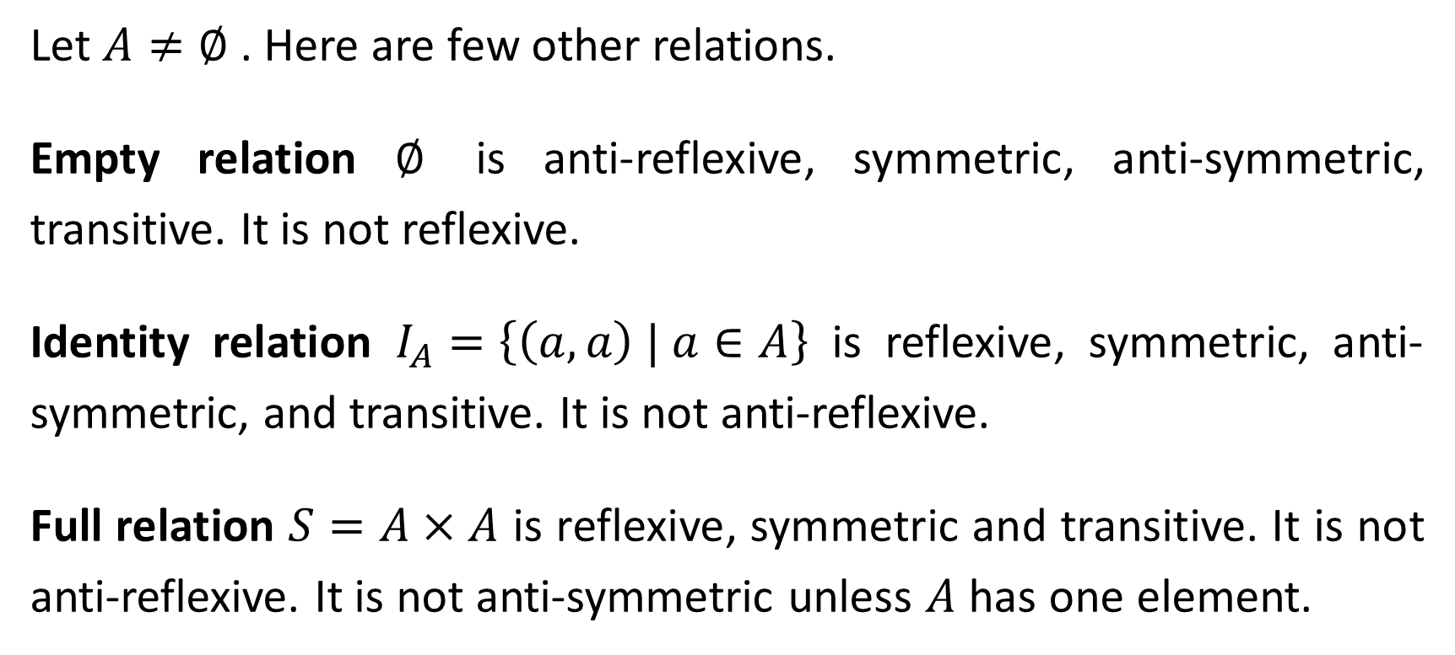
Let $A≠∅$ . Here are few other relations.
Empty relation $∅$ is anti-reflexive, symmetric, anti-symmetric, transitive. It is not reflexive.
Identity relation $I_{A}=\left\{\left(a,a\right) | a∈A\right\}$ is reflexive, symmetric, anti-symmetric, and transitive. It is not anti-reflexive.
Full relation $S=A×A$ is reflexive, symmetric and transitive. It is not anti-reflexive. It is not anti-symmetric unless $A$ has one element.

Slide 10
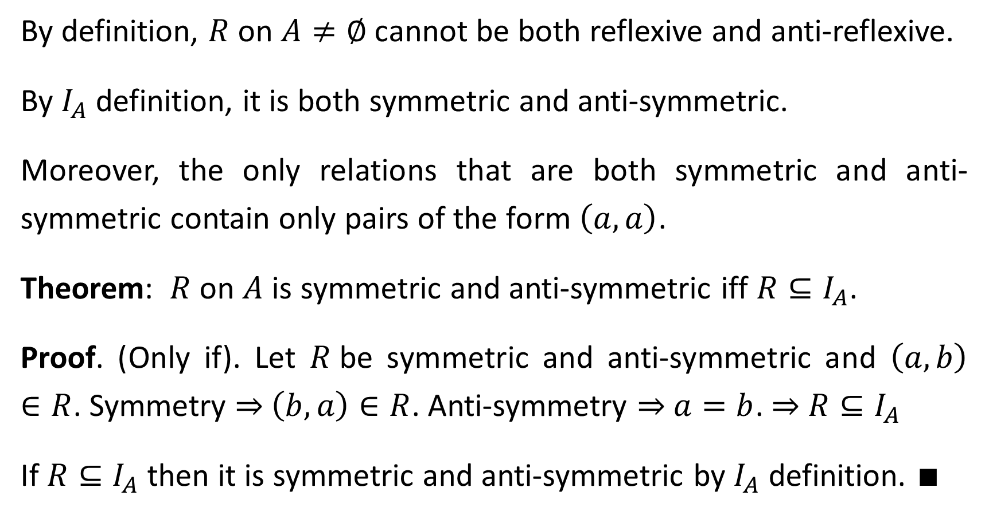
By definition, $R$on $A≠∅$ cannot be both reflexive and anti-reflexive.
By $I_{A}$definition, it is both symmetric and anti-symmetric.
Moreover, the only relations that are both symmetric and anti-symmetric contain only pairs of the form $\left(a,a\right)$.
Theorem: $R$on $A$ is symmetric and anti-symmetric iff $R⊆I_{A}$.
Proof. (Only if). Let $R$be symmetric and anti-symmetric and $\left(a,b\right)∈R$. Symmetry ⇒ $\left(b,a\right)∈R$. Anti-symmetry ⇒ $a=b$. ⇒ $R⊆I_{A}$
If $R⊆I_{A}$ then it is symmetric and anti-symmetric by $I_{A}$ definition. ∎

Slide 11
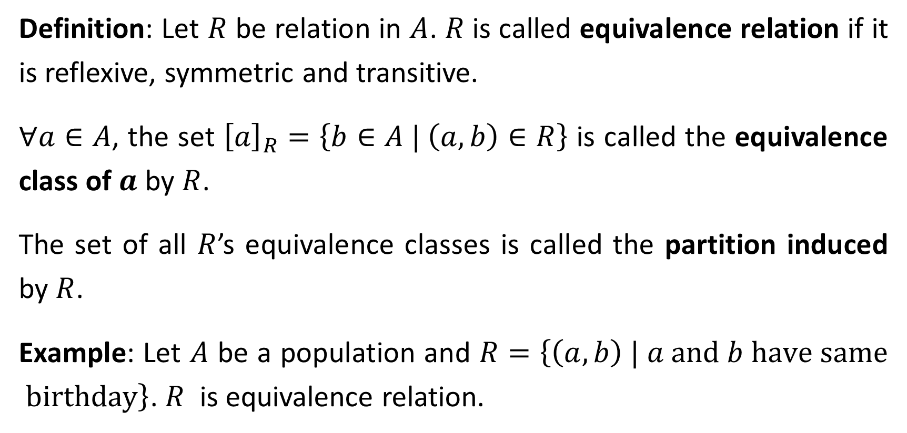
Equivalence Relations
Definition: Let $R$ be relation in $A$. $R$is called equivalence relation if it is reflexive, symmetric and transitive.
$∀a∈A$, the set ${\left[a\right]}_{R}=\left\{b∈A | \left(a, b\right)∈R\right\}$ is called the equivalence class of $a$ by $R$.
The set of all $R$’s equivalence classes is called the partition induced by $R$.
Example: Let $A$ be a population and $R=\left\{\left(a,b\right) | a \text{and} b \text{have} \text{same} \text{birthday}\right\}$. $R$ is equivalence relation.

Slide 12
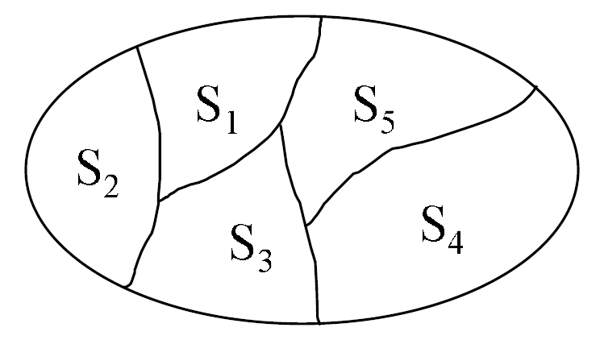
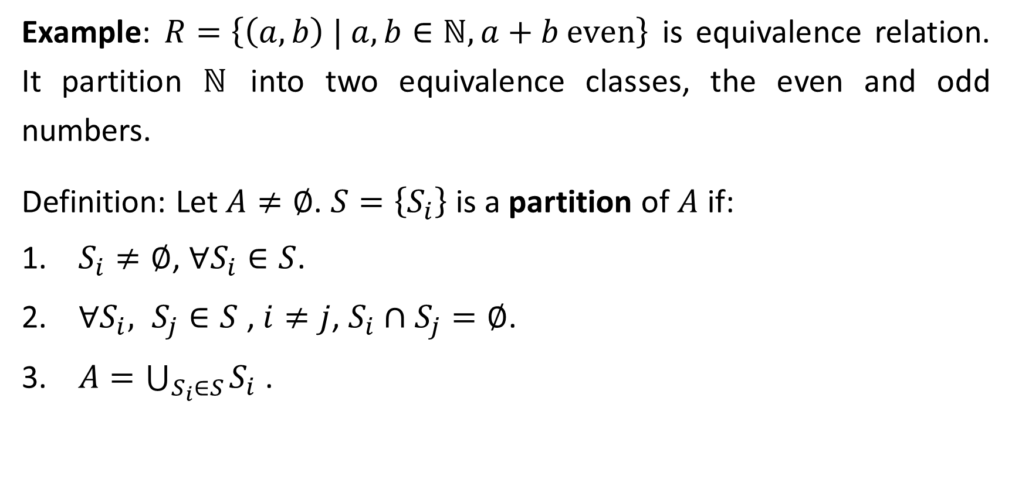
Example: $R=\left\{\left(a,b\right) | a, b∈ℕ, a+b \text{even}\right\}$ is equivalence relation. It partition $ℕ$ into two equivalence classes, the even and odd numbers.
Definition: Let $A≠∅$. $S=\left\{S_{i}\right\}$ is a partition of $A$ if:
$S_{i}≠∅$, $∀S_{i}∈S$.
$∀S_{i}, S_{j}∈S$ , $i≠j$, $S_{i}∩S_{j}=∅$.
$A=\bigcup_{S_{i}∈S}{S_{i}}$ .

Slide 13
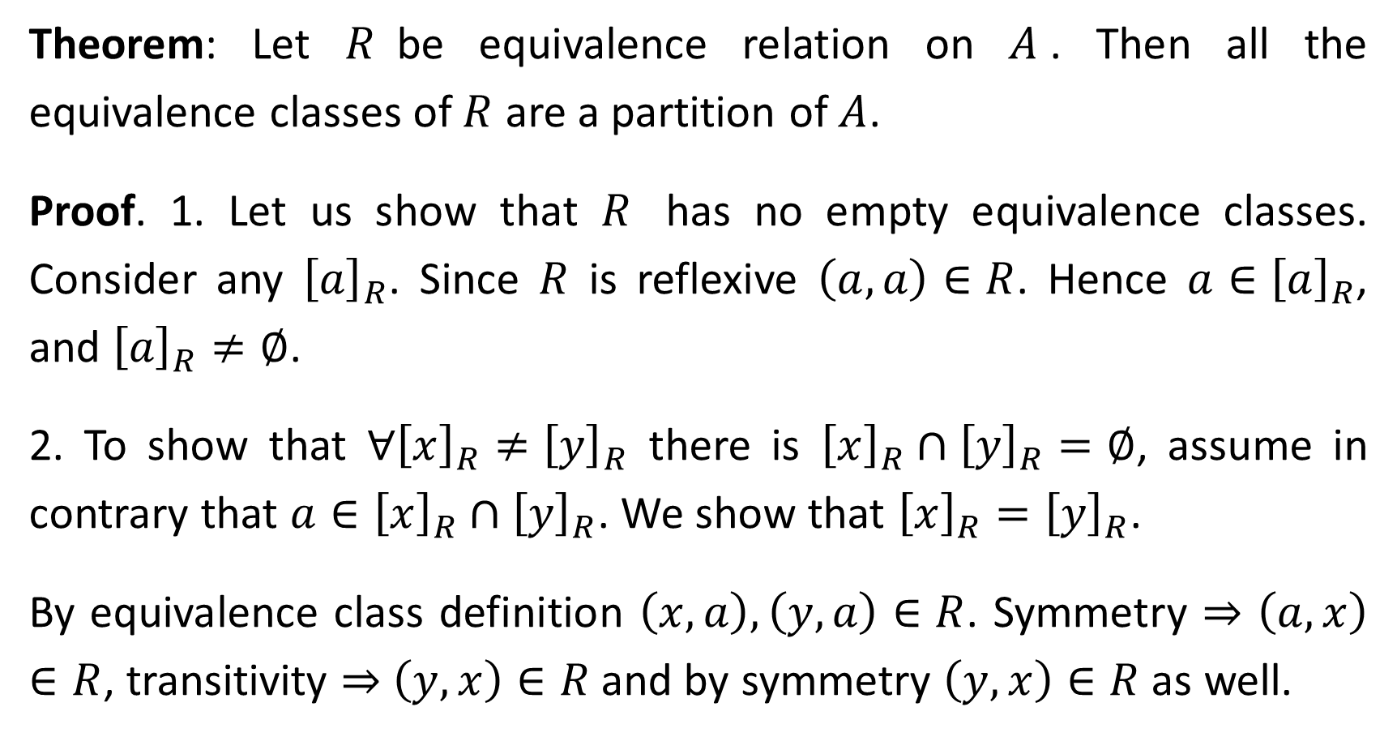
Theorem: Let $R$be equivalence relation on $A$. Then all the equivalence classes of $R$ are a partition of $A$.
Proof. 1. Let us show that $R$ has no empty equivalence classes. Consider any ${\left[a\right]}_{R}$. Since $R$ is reflexive $\left(a, a\right)∈R$. Hence $a∈{\left[a\right]}_{R}$, and ${\left[a\right]}_{R}≠∅$.
2. To show that $∀{\left[x\right]}_{R}≠{\left[y\right]}_{R}$ there is ${\left[x\right]}_{R}∩{\left[y\right]}_{R}=∅$, assume in contrary that $a∈{\left[x\right]}_{R}∩{\left[y\right]}_{R}$. We show that ${\left[x\right]}_{R}={\left[y\right]}_{R}$.
By equivalence class definition $\left(x, a\right),\left(y, a\right)∈R$. Symmetry ⇒ $\left(a, x\right)$ $∈R$, transitivity ⇒ $\left(y, x\right)∈R$ and by symmetry $\left(y, x\right)∈R$ as well.

Slide 14
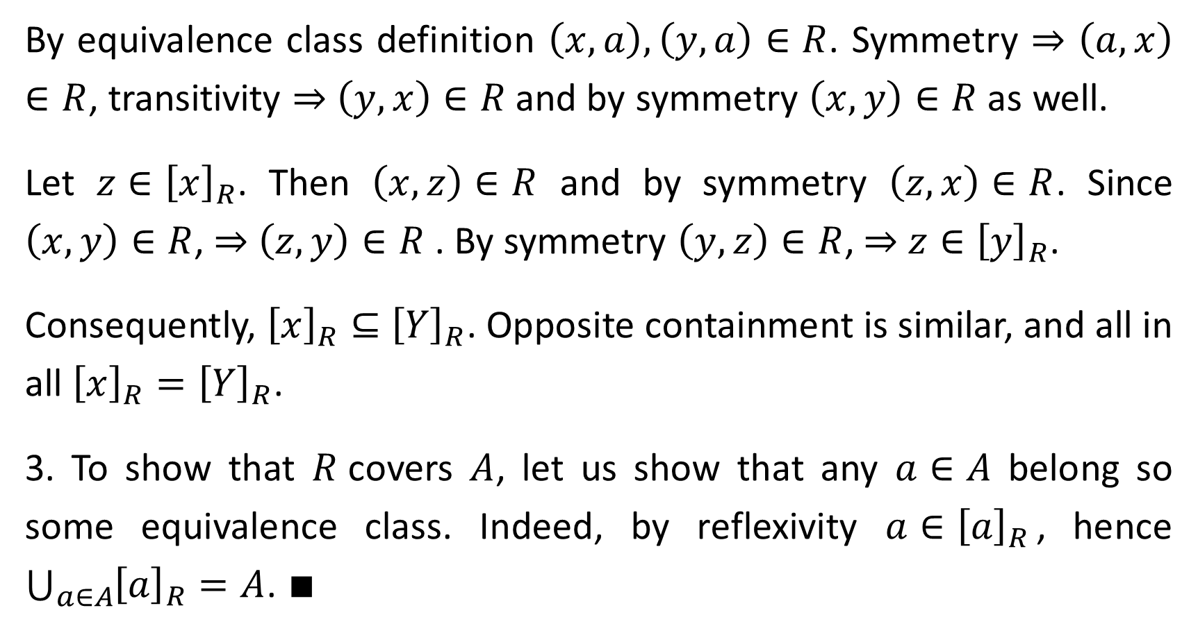
By equivalence class definition $\left(x, a\right),\left(y, a\right)∈R$. Symmetry ⇒ $\left(a, x\right)$ $∈R$, transitivity ⇒ $\left(y, x\right)∈R$ and by symmetry $\left(x, y\right)∈R$ as well.
Let $z∈{\left[x\right]}_{R}$. Then $\left(x, z\right)∈R$ and by symmetry $\left(z, x\right)∈R$. Since $\left(x, y\right)∈R$, ⇒ $\left(z, y\right)∈R$ . By symmetry $\left(y, z\right)∈R$, ⇒ $z∈{\left[y\right]}_{R}$.
Consequently, ${\left[x\right]}_{R}⊆$ ${\left[Y\right]}_{R}$. Opposite containment is similar, and all in all ${\left[x\right]}_{R}={\left[Y\right]}_{R}$.
3. To show that $R$covers $A$, let us show that any $a∈A$ belong so some equivalence class. Indeed, by reflexivity $a∈{\left[a\right]}_{R}$, hence $\bigcup_{a∈A}{{\left[a\right]}_{R}}=A$. ∎

Slide 15
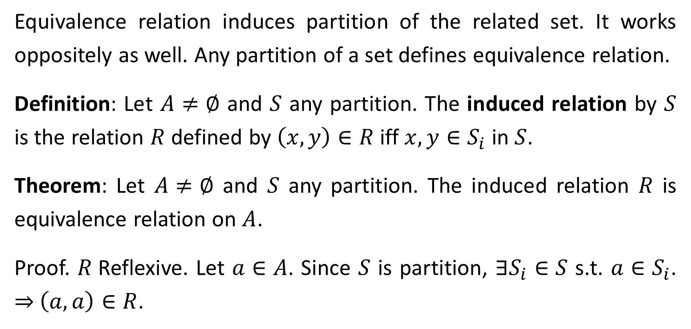
Equivalence relation induces partition of the related set. It works oppositely as well. Any partition of a set defines equivalence relation.
Definition: Let $A≠∅$ and $S$ any partition. The induced relation by $S$ is the relation $R$ defined by $\left(x, y\right)∈R$ iff $x, y∈S_{i}$ in $S$.
Theorem: Let $A≠∅$ and $S$ any partition. The induced relation $R$ is equivalence relation on $A$.
Proof. $R$Reflexive. Let $a∈A$. Since $S$ is partition, $∃S_{i}∈S$ s.t. $a∈S_{i}$. ⇒ $\left(a, a\right)∈R$.

Slide 16
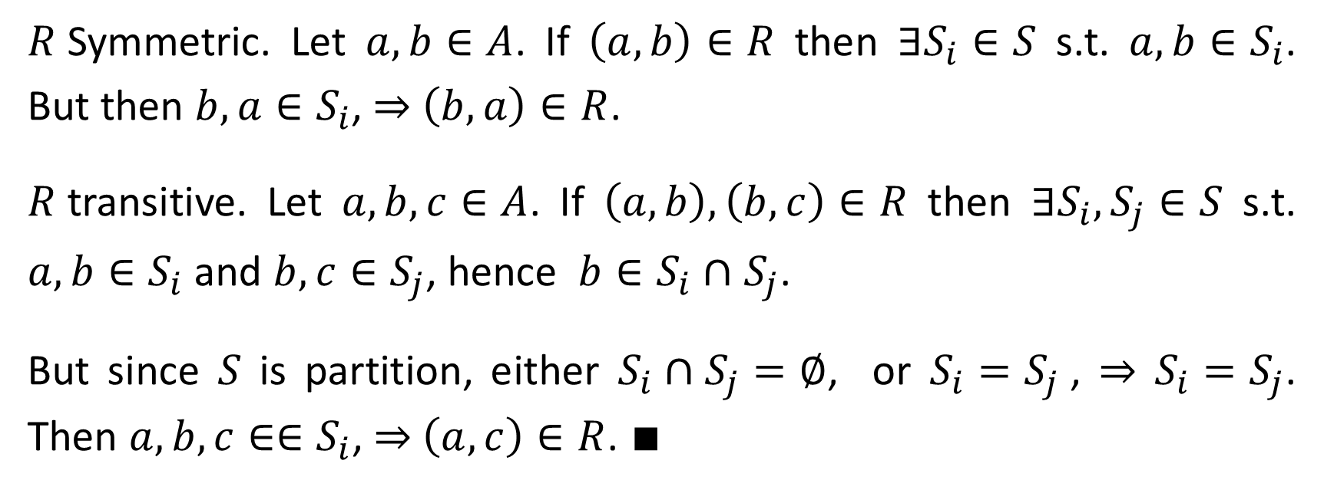
$R$Symmetric. Let $a,b∈A$. If $\left(a, b\right)∈R$ then $∃S_{i}∈S$ s.t. $a,b∈S_{i}$. But then $b,a∈S_{i}$, ⇒ $\left(b, a\right)∈R$.
$R$transitive. Let $a,b,c∈A$. If $\left(a, b\right),\left(b, c\right)∈R$ then $∃S_{i},S_{j}∈S$ s.t. $a,b∈S_{i}$ and $b,c∈S_{j}$, hence $b∈S_{i}∩$ $S_{j}$.
But since $S$ is partition, either $S_{i}∩S_{j}=∅$, or $S_{i}=S_{j}$, ⇒ $S_{i}=S_{j}$. Then $a,b,c∈∈S_{i}$, ⇒ $\left(a, c\right)∈R$. ∎

Slide 17
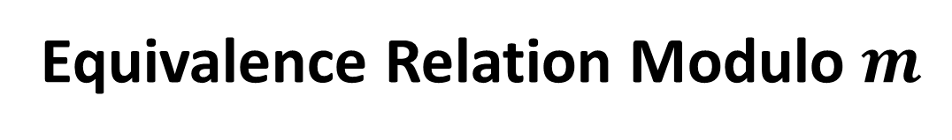
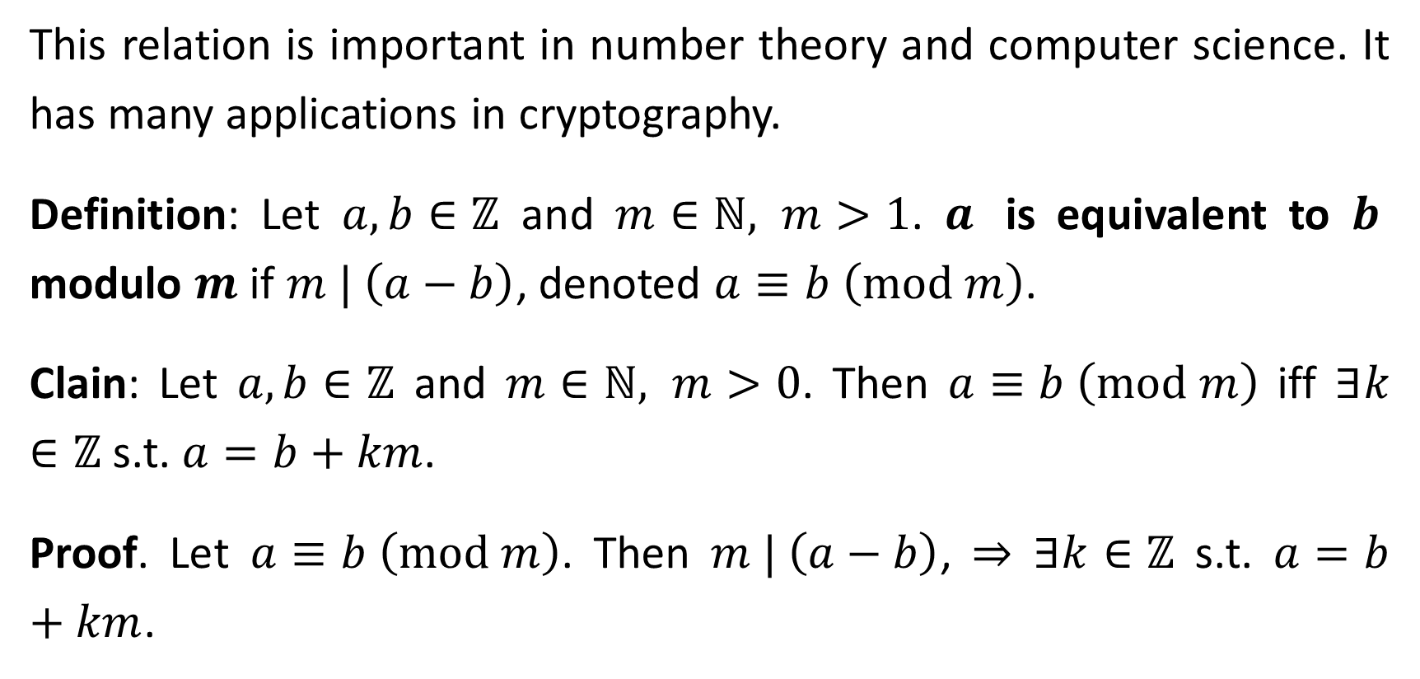
Equivalence Relation Modulo $m$
This relation is important in number theory and computer science. It has many applications in cryptography.
Definition: Let $a,b∈ℤ$ and $m∈ℕ, m>1$. $a$ is equivalent to $b$ modulo $m$ if $m | \left(a−b\right)$, denoted $a≡b \left(\text{mod} m\right)$.
Clain: Let $a,b∈ℤ$ and $m∈ℕ, m>0$. Then $a≡b \left(\text{mod} m\right)$ iff $∃k∈ℤ$ s.t. $a=b+km$.
Proof. Let $a≡b \left(\text{mod} m\right)$. Then $m | \left(a−b\right)$, ⇒ $∃k∈ℤ$ s.t. $a=b+km$.

Slide 18
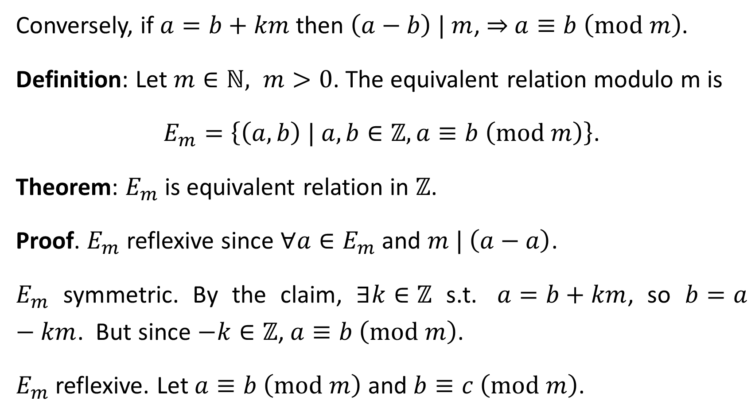
Conversely, if $a=b+km$ then $\left(a−b\right) | m$, ⇒ $a≡b \left(\text{mod} m\right)$.
Definition: Let $m∈ℕ, m>0$. The equivalent relation modulo m is
$E_{m}=\left\{\left(a,b\right) | a,b∈ℤ,a≡b \left(\text{mod} m\right)\right\}$.
Theorem: $E_{m}$ is equivalent relation in $ℤ$.
Proof. $E_{m}$ reflexive since $∀a∈E_{m}$ and $m | \left(a−a\right)$.
$E_{m}$ symmetric. By the claim, $∃k∈ℤ$ s.t. $a=b+km$, so $b=a−km$. But since $−k∈ℤ$, $a≡b \left(\text{mod} m\right)$.
$E_{m}$ reflexive. Let $a≡b \left(\text{mod} m\right)$ and $b≡c \left(\text{mod} m\right)$.

Slide 19
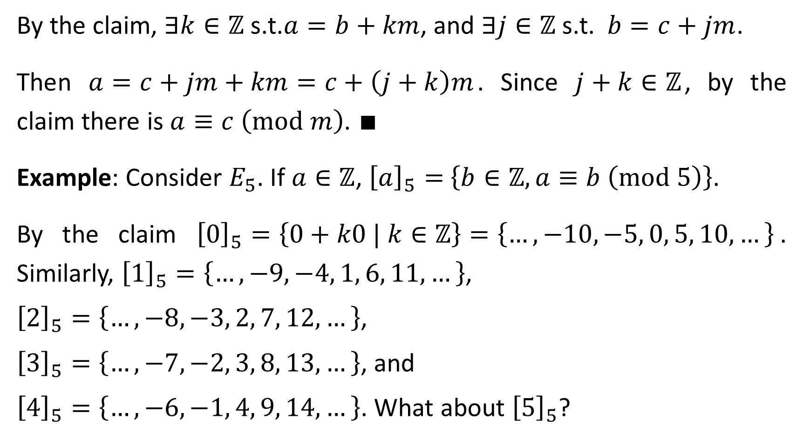
By the claim, $∃k∈ℤ$ s.t.$a=b+km$, and $∃j∈ℤ$ s.t. $b=c+jm$.
Then $a=c+jm+km=c+\left(j+k\right)m$. Since $j+k∈ℤ$, by the claim there is $a≡c \left(\text{mod} m\right)$. ∎
Example: Consider $E_{5}$. If $a∈ℤ$, ${\left[a\right]}_{5}=$ $\left\{b∈ℤ,a≡b \left(\text{mod} 5\right)\right\}$.
By the claim ${\left[0\right]}_{5}=\left\{0+k0 | k∈ℤ\right\}=\left\{…,−10, −5, 0, 5, 10,…\right\}$. Similarly, ${\left[1\right]}_{5}=\left\{…,−9, −4, 1, 6, 11,…\right\}$,
${\left[2\right]}_{5}=\left\{…,−8, −3, 2, 7, 12,…\right\}$,
${\left[3\right]}_{5}=\left\{…,−7, −2, 3, 8, 13,…\right\}$, and
${\left[4\right]}_{5}=\left\{…,−6, −1, 4, 9, 14,…\right\}$. What about ${\left[5\right]}_{5}$?

Slide 20
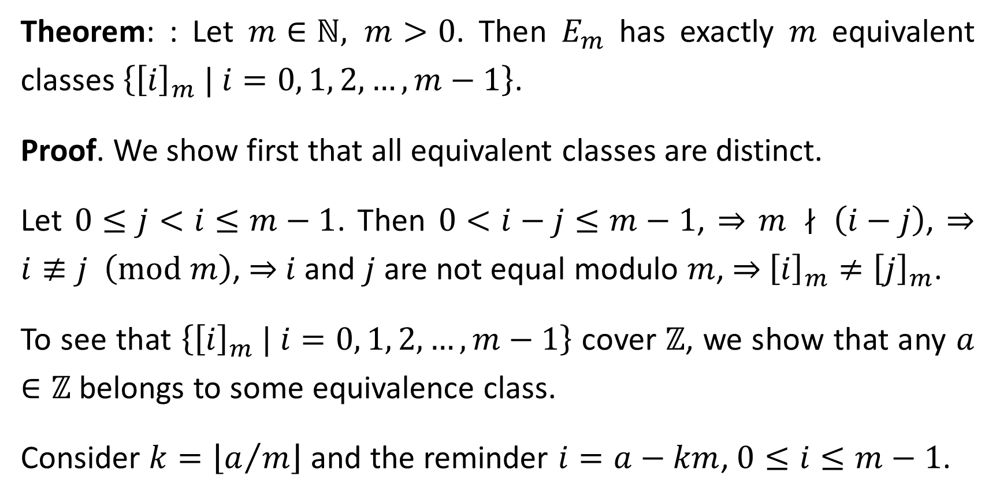
Theorem: : Let $m∈ℕ, m>0$. Then $E_{m}$ has exactly $m$ equivalent classes $\left\{{\left[i\right]}_{m} | i=0, 1, 2, …, m−1\right\}$.
Proof. We show first that all equivalent classes are distinct.
Let $0≤j<i≤m−1$. Then $0<i−j≤m−1$, ⇒ $m ∤ \left(i−j\right)$, ⇒ $i≢j \left(\text{mod} m\right)$, ⇒ $i$ and $j$ are not equal modulo $m$, ⇒ ${\left[i\right]}_{m}≠{\left[j\right]}_{m}$.
To see that $\left\{{\left[i\right]}_{m} | i=0, 1, 2, …, m−1\right\}$ cover $ℤ$, we show that any $a∈ℤ$ belongs to some equivalence class.
Consider $k=\left\lfloor a/m\right\rfloor$ and the reminder $i=a−km$, $0≤i≤m−1$.

Slide 21
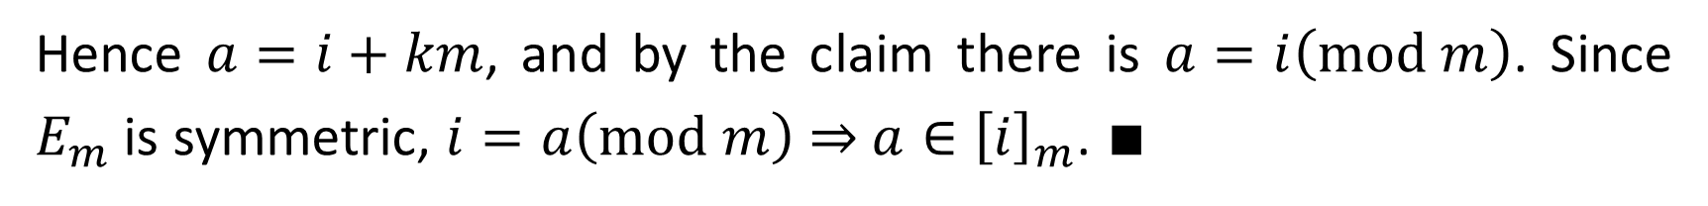
Hence $a=i+km$, and by the claim there is $a=i\left(\text{mod} m\right)$. Since $E_{m}$ is symmetric, $i=a\left(\text{mod} m\right)$ ⇒ $a∈{\left[i\right]}_{m}$. ∎

