Slide 1
Naïve Set Theory
Prepared by Shmuel Wimer

Slide 2
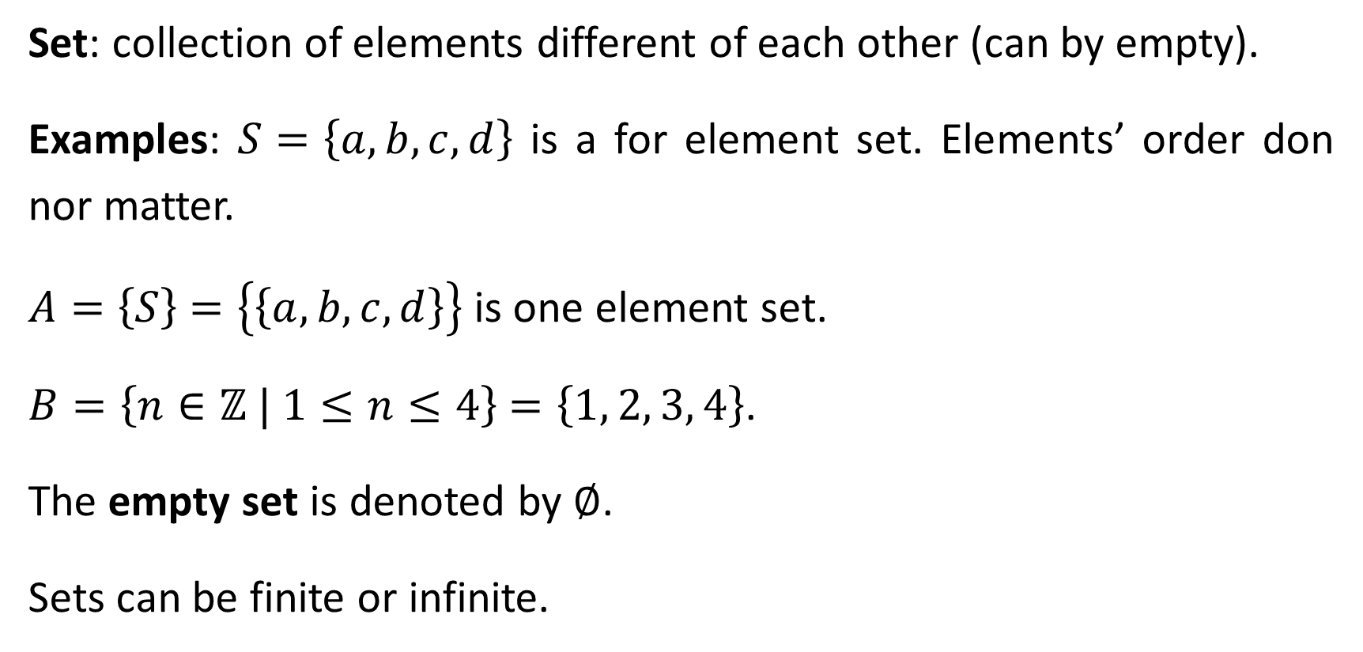
Sets
Set: collection of elements different of each other (can by empty).
Examples: $S=\left\{a,b,c,d\right\}$ is a for element set. Elements’ order don nor matter.
$A=\left\{S\right\}$ $=\left\{\left\{a,b,c,d\right\}\right\}$ is one element set.
$B=\left\{n∈ℤ | 1≤n≤4\right\}$ $=\left\{1, 2, 3, 4\right\}$.
The empty set is denoted by $∅$.
Sets can be finite or infinite.

Slide 3
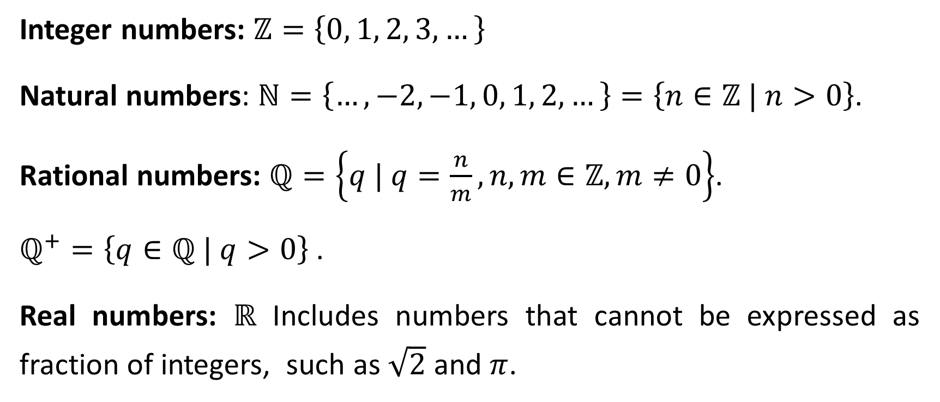
Important sets
Integer numbers: $ℤ=\left\{0, 1, 2, 3, …\right\}$
Natural numbers: $ℕ=\left\{…, −2, −1, 0, 1, 2, …\right\}=\left\{n∈ℤ | n>0\right\}$.
Rational numbers: $ℚ=\left\{q | q=\frac{n}{m},n, m∈ℤ,m≠0\right\}$.
$ℚ^{+}=\left\{q∈ℚ | q>0\right\}$ .
Real numbers: $ℝ$ Includes numbers that cannot be expressed as fraction of integers, such as $\sqrt{2}$ and $π$.

Slide 4
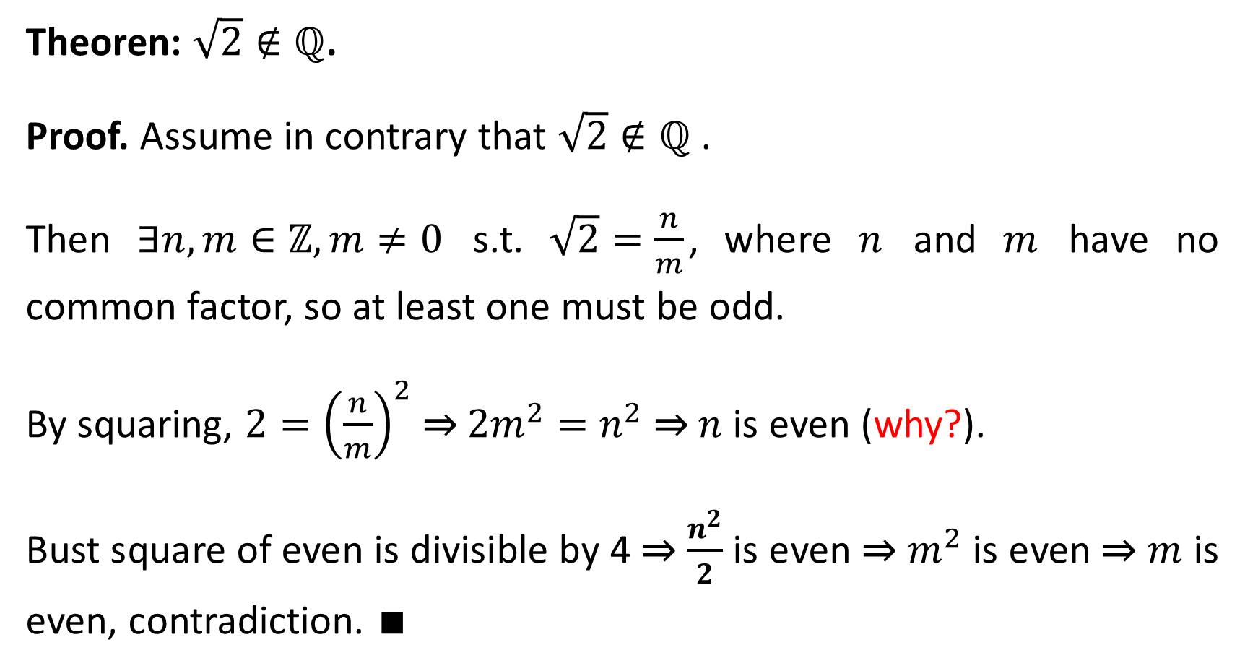
Theoren: $\sqrt{2}∉ℚ$.
Proof. Assume in contrary that $\sqrt{2}∉ℚ$ .
Then $∃n, m∈ℤ,m≠0$ s.t. $\sqrt{2}=\frac{n}{m}$, where $n$ and $m$ have no common factor, so at least one must be odd.
By squaring, $2={\left(\frac{n}{m}\right)}^{2}$ ⇒ ${2m}^{2}=$ $n^{2}$ ⇒ $n$ is even (why?).
Bust square of even is divisible by 4 ⇒ $\frac{n^{2}}{2}$ is even ⇒ $m^{2}$ is even ⇒ $m$ is even, contradiction. $∎$

Slide 5
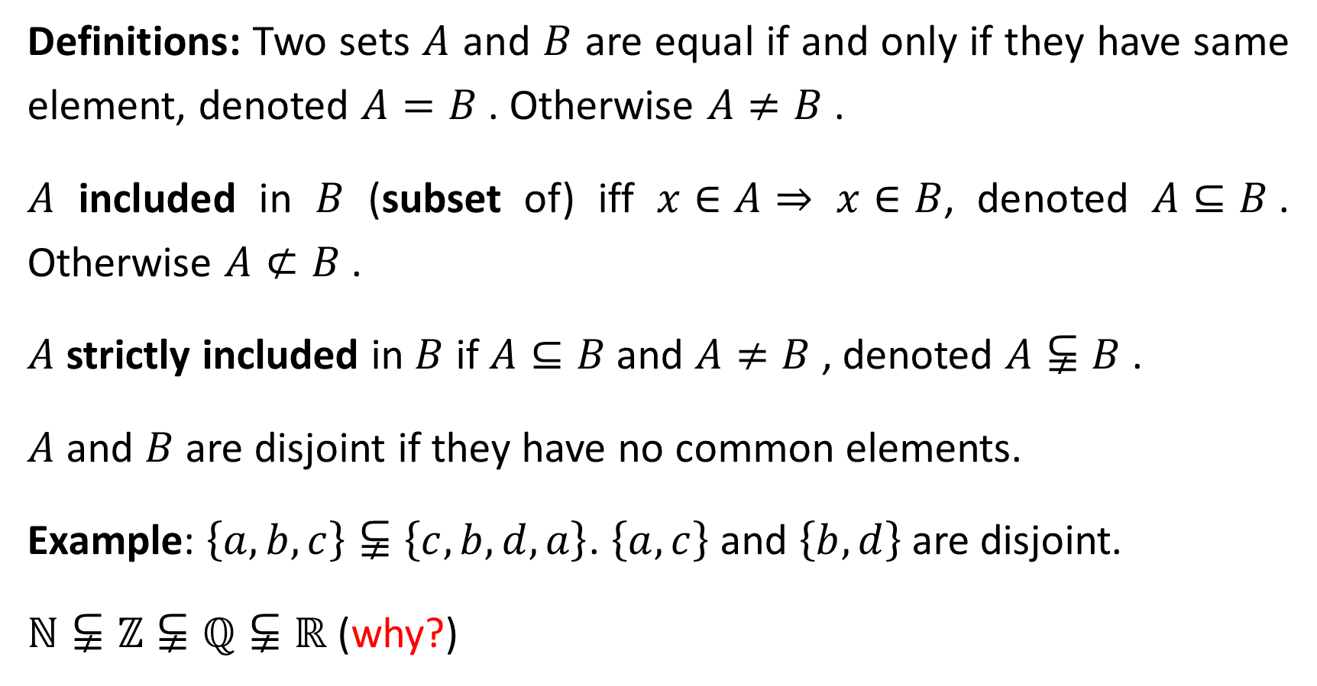
Definitions: Two sets $A$ and $B$ are equal if and only if they have same element, denoted $A=B$. Otherwise $A≠B$.
$A$ included in $B$ (subset of) iff $x∈A⇒$ $x∈B$, denoted $A⊆B$. Otherwise $A⊄B$.
$A$ strictly included in $B$ if $A⊆B$and $A≠B$, denoted $A⫋B$.
$A$ and $B$ are disjoint if they have no common elements.
Example: $\left\{a,b,c\right\}⫋\left\{c,b,d,a\right\}$. $\left\{a, c\right\}$ and $\left\{b,d\right\}$ are disjoint.
$ℕ⫋ℤ⫋ℚ⫋ℝ$ (why?)

Slide 6
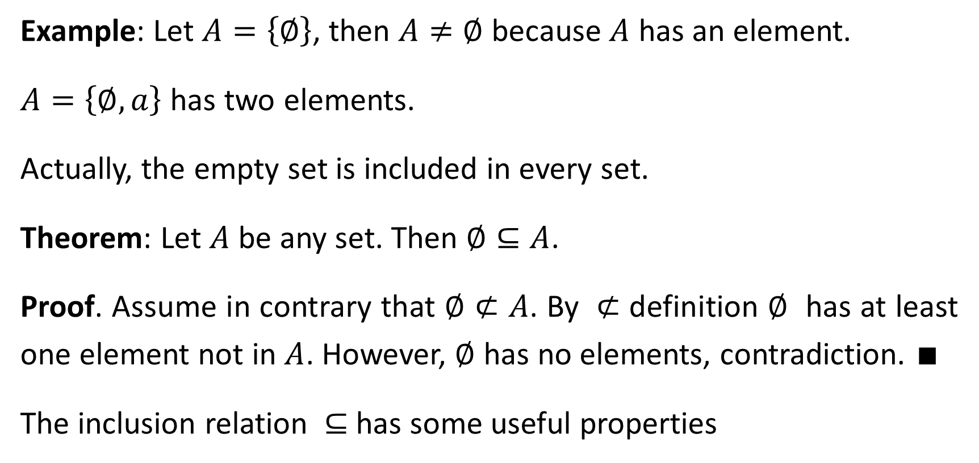
Example: Let $A=\left\{∅\right\}$, then $A≠∅$ because $A$ has an element.
$A=\left\{∅, a\right\}$ has two elements.
Actually, the empty set is included in every set.
Theorem: Let $A$ be any set. Then $∅⊆A$.
Proof. Assume in contrary that $∅⊄A$. By $⊄$ definition $∅$ has at least one element not in $A$. However, $∅$ has no elements, contradiction. $∎$
The inclusion relation $⊆$ has some useful properties

Slide 7
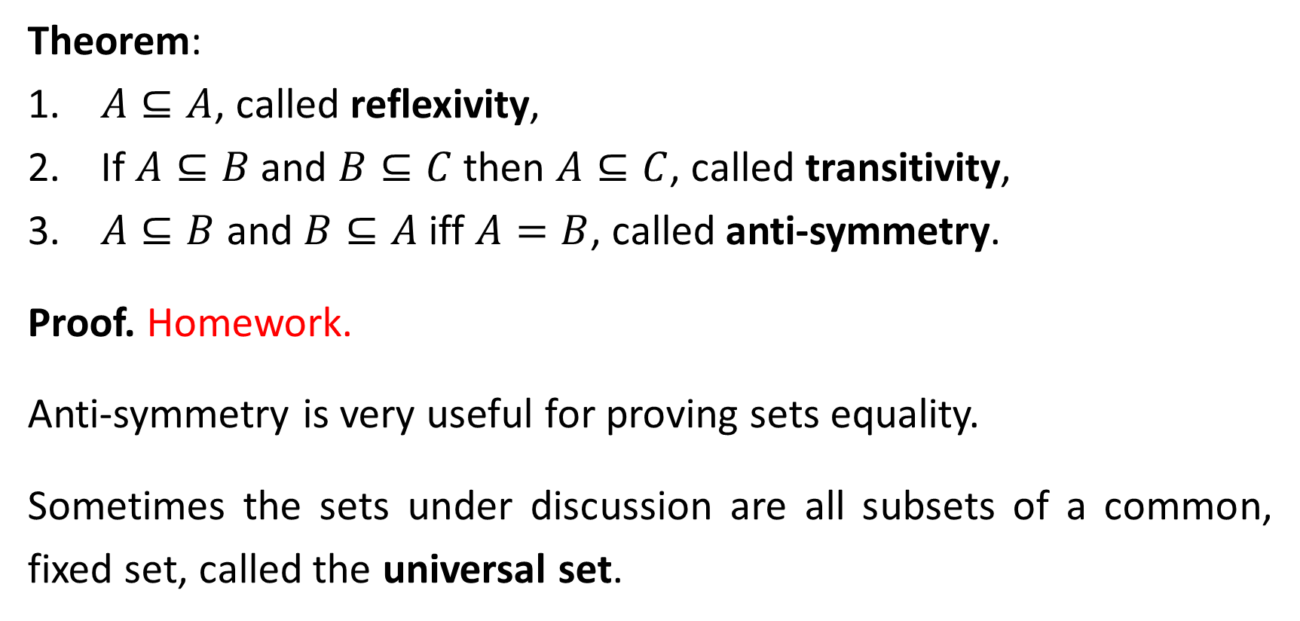
Theorem:
$A⊆A$, called reflexivity,
If $A⊆B$ and $B⊆C$ then $A⊆C$, called transitivity,
$A⊆B$ and $B⊆A$ iff $A=B$, called anti-symmetry.
Proof. Homework.
Anti-symmetry is very useful for proving sets equality.
Sometimes the sets under discussion are all subsets of a common, fixed set, called the universal set.

Slide 8
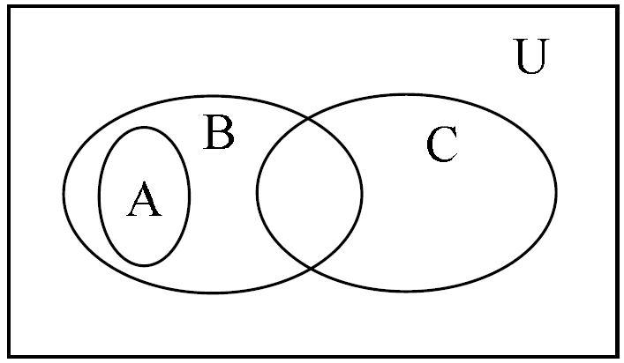
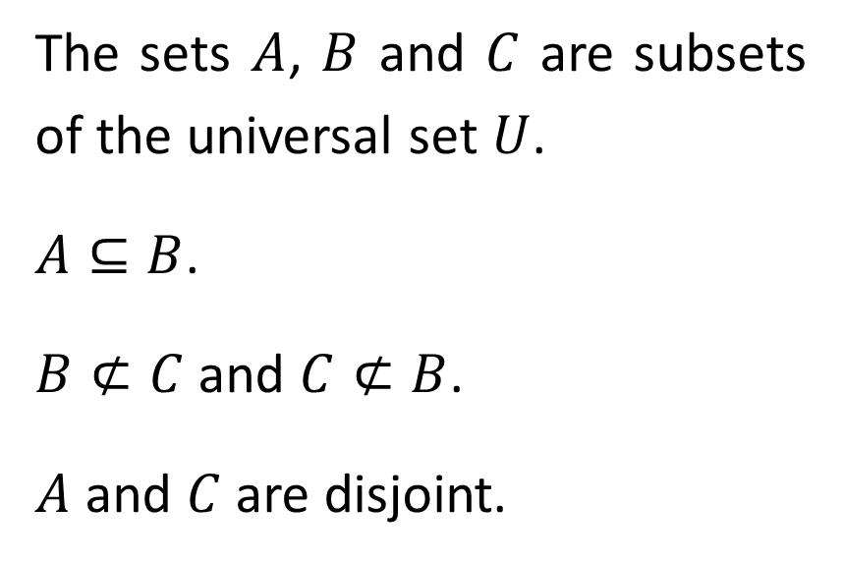
Venn Diagram
John Venn (1934-1923) used pictorial method to describe relations between sets.
The sets $A$, $B$ and $C$ are subsets of the universal set $U$.
$A⊆B$.
$B⊄C$ and $C⊄B$.
$A$ and $C$ are disjoint.

Slide 9
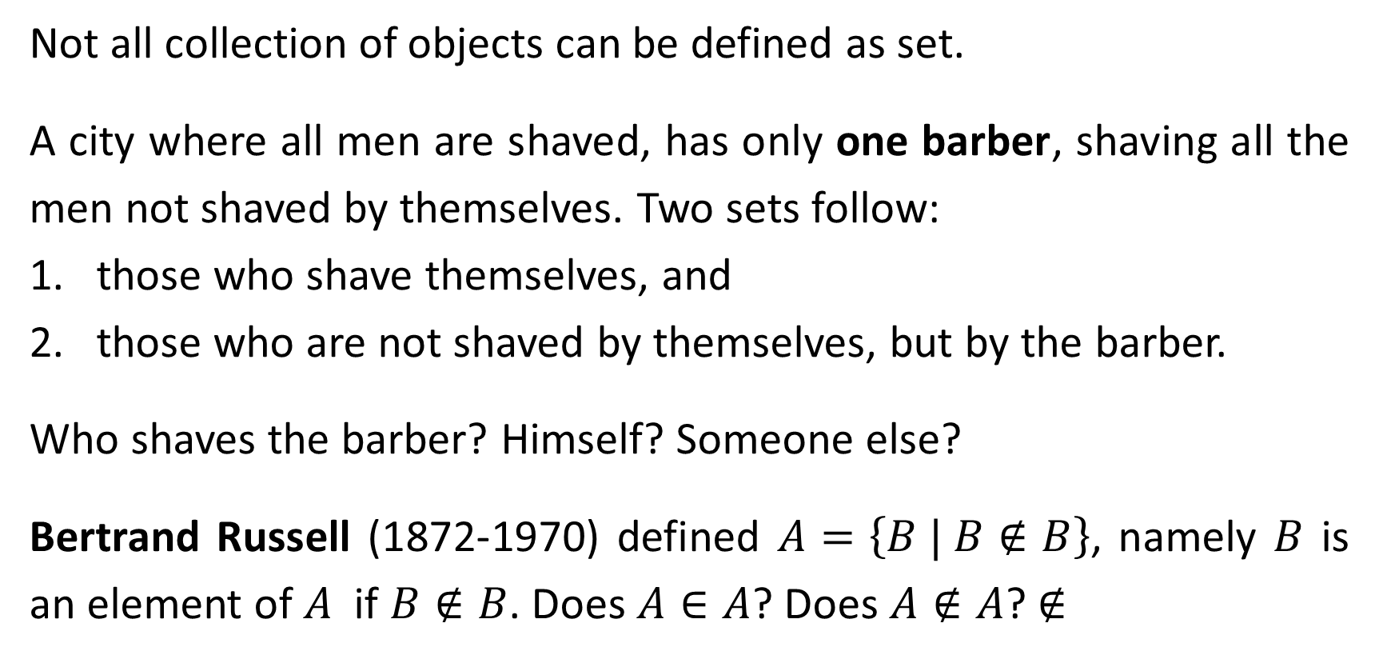
Russell Paradox
Not all collection of objects can be defined as set.
A city where all men are shaved, has only one barber, shaving all the men not shaved by themselves. Two sets follow:
those who shave themselves, and
those who are not shaved by themselves, but by the barber.
Who shaves the barber? Himself? Someone else?
Bertrand Russell (1872-1970) defined $A=\left\{B | B∉B\right\}$, namely $B$ is an element of $A$ if $B∉B$. Does $A∈A$? Does $A∉A$? $∉$

Slide 10
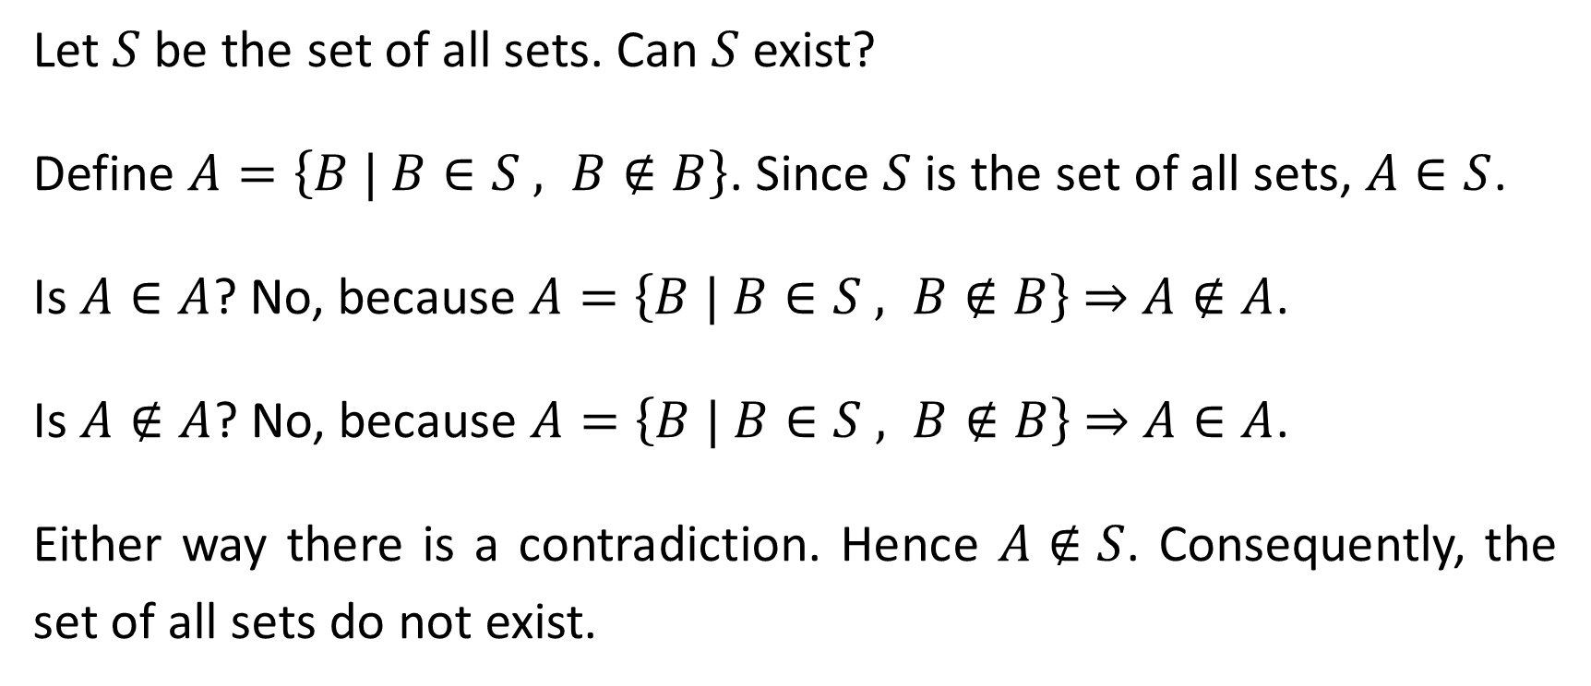
Let $S$ be the set of all sets. Can $S$ exist?
Define $A=\left\{B | B∈S , B∉B\right\}$. Since $S$ is the set of all sets, $A∈S$.
Is $A∈A$? No, because $A=\left\{B | B∈S , B∉B\right\}$ ⇒ $A∉A$.
Is $A∉A$? No, because $A=\left\{B | B∈S , B∉B\right\}$ ⇒ $A∈A$.
Either way there is a contradiction. Hence $A∉S$. Consequently, the set of all sets do not exist.

Slide 11
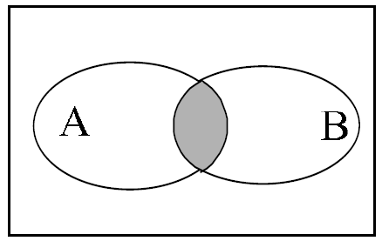
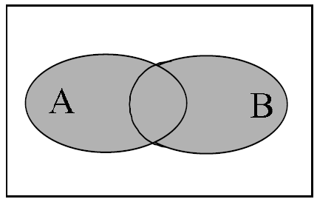
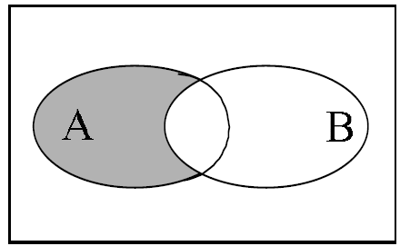

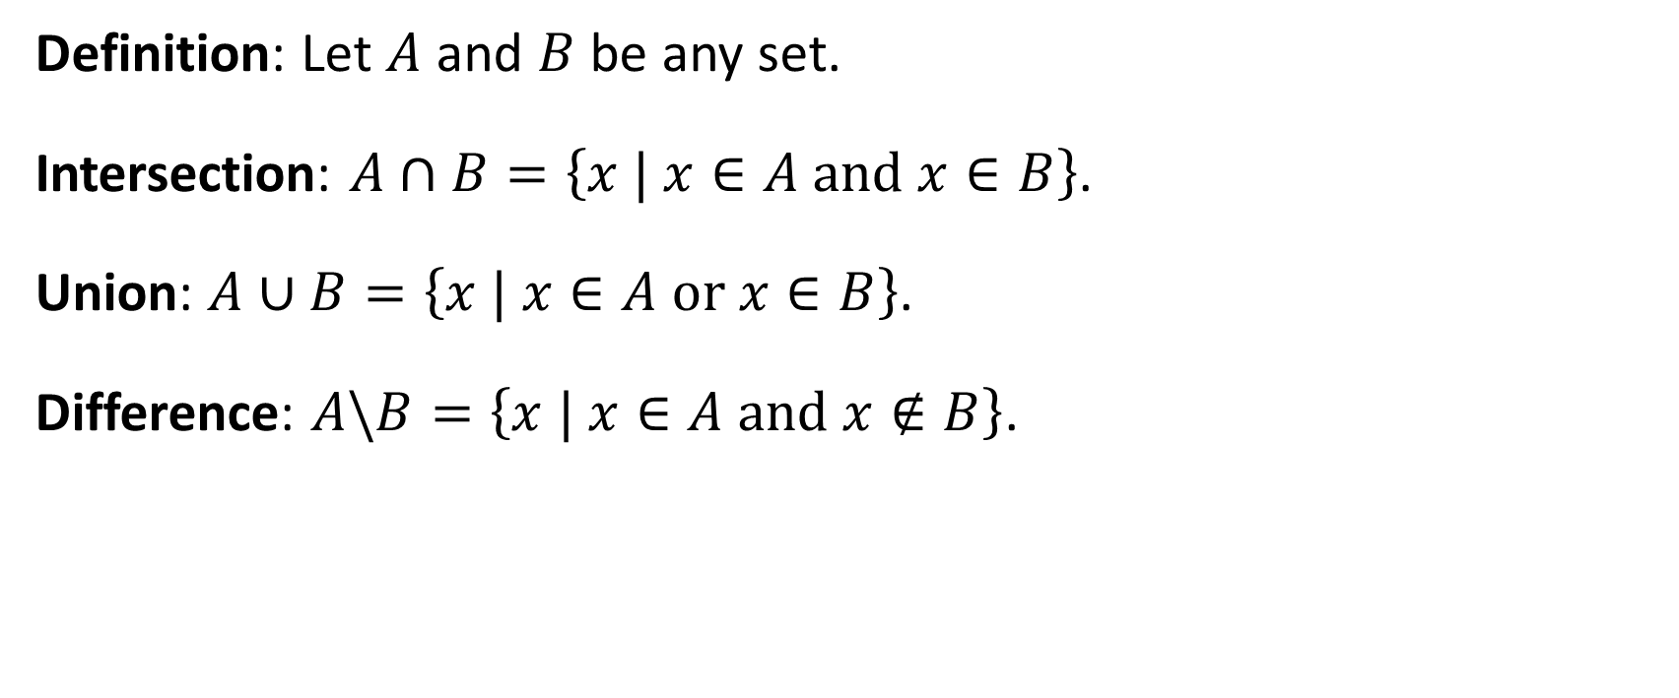


Set Operations
Definition: Let $A$ and $B$ be any set.
Intersection: $A∩B=\left\{x | x∈A \text{and} x∈B\right\}$.
Union: $A∪B=\left\{x | x∈A \text{or} x∈B\right\}$.
Difference: $A\backslash B=\left\{x | x∈A \text{and} x∉B\right\}$.
$$A∩B$$
$$A∪B$$
$$A\backslash B$$

Slide 12
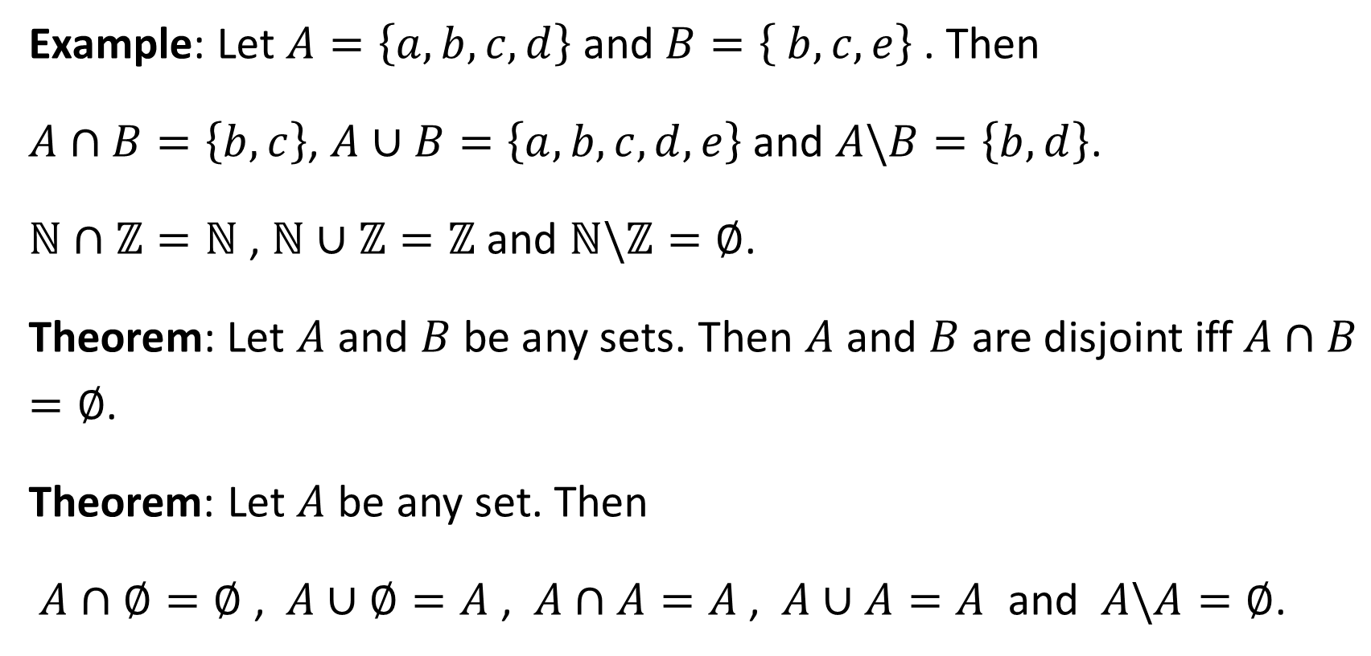
Example: Let $A=\left\{a, b, c, d\right\}$ and $B=\left\{ b, c, e\right\}$. Then
$A∩B=\left\{b, c\right\}$, $A∪B=\left\{a, b, c, d, e\right\}$ and $A\backslash B=\left\{b, d\right\}$.
$ℕ∩ℤ=ℕ$ , $ℕ∪ℤ=ℤ$ and $ℕ\backslash ℤ=∅$.
Theorem: Let $A$ and $B$ be any sets. Then $A$ and $B$ are disjoint iff $A∩B=∅$.
Theorem: Let $A$ be any set. Then
$A∩∅=∅$ , $A∪∅=A$ , $A∩A=A$ , $A∪A=A$ and $A\backslash A=∅$.

Slide 13
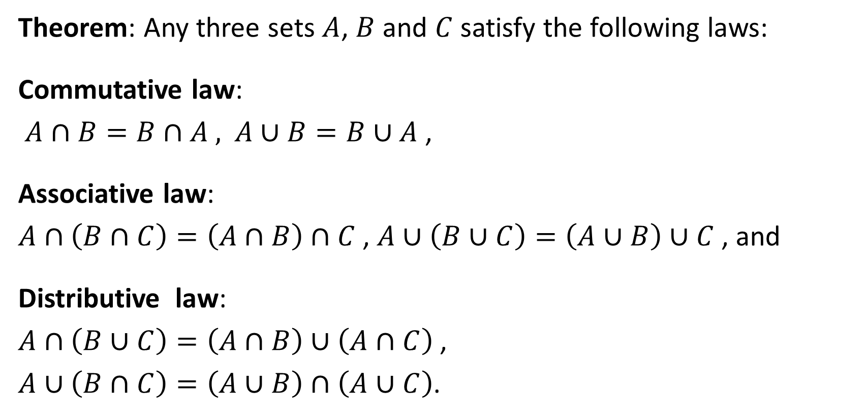
Theorem: Any three sets $A$, $B$ and $C$ satisfy the following laws:
Commutative law:
$A∩B=B∩A$ , $A∪B=B∪A$ ,
Associative law:
$A∩\left(B∩C\right)=\left(A∩B\right)∩C$ , $A∪\left(B∪C\right)=\left(A∪B\right)∪C$ , and
Distributive law:
$A∩\left(B∪C\right)=\left(A∩B\right)∪\left(A∩C\right)$ ,
$A∪\left(B∩C\right)=\left(A∪B\right)∩\left(A∪C\right)$.

Slide 14
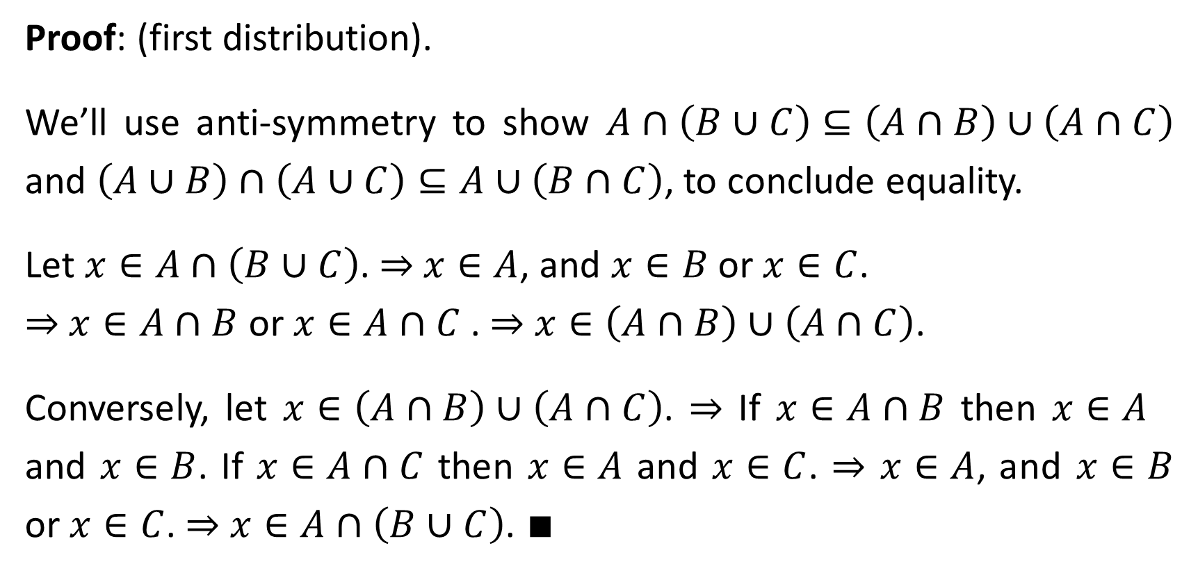
Proof: (first distribution).
We’ll use anti-symmetry to show $A∩\left(B∪C\right)⊆\left(A∩B\right)∪\left(A∩C\right)$ and $\left(A∪B\right)∩\left(A∪C\right)⊆A∪\left(B∩C\right)$, to conclude equality.
Let $x∈A∩\left(B∪C\right)$. ⇒ $x∈A$, and $x∈B$ or $x∈C$.
⇒ $x∈A∩B$ or $x∈A∩C$ . ⇒ $x∈\left(A∩B\right)∪\left(A∩C\right)$.
Conversely, let $x∈\left(A∩B\right)∪\left(A∩C\right)$. ⇒ If $x∈A∩B$ then $x∈A$ and $x∈B$. If $x∈A∩C$ then $x∈A$ and $x∈C$. ⇒ $x∈A$, and $x∈B$ or $x∈C$. ⇒ $x∈A∩\left(B∪C\right)$. $∎$

Slide 15
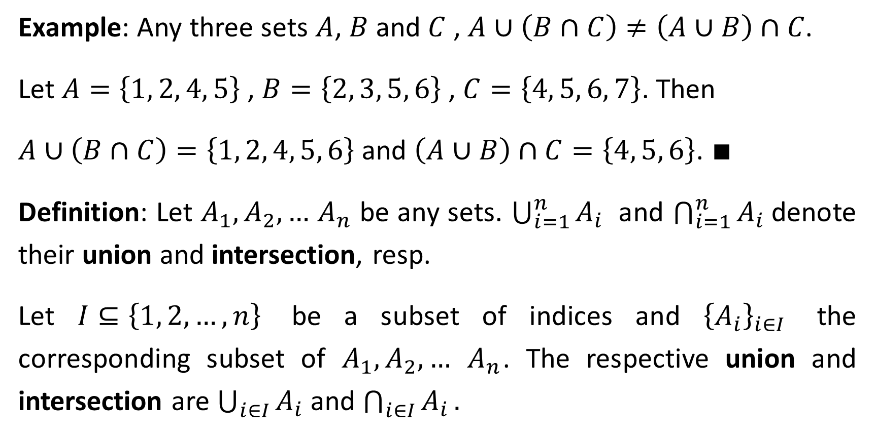
Example: Any three sets $A$, $B$ and $C$ , $A∪\left(B∩C\right)≠\left(A∪B\right)∩C$.
Let $A=\left\{1, 2, 4, 5\right\}$ , $B=\left\{2, 3, 5, 6\right\}$ , $C=\left\{4, 5, 6, 7\right\}$. Then
$A∪\left(B∩C\right)=\left\{1, 2, 4, 5, 6\right\}$ and $\left(A∪B\right)∩C=\left\{4, 5, 6\right\}$. $∎$
Definition: Let $A_{1},A_{2},…$ $A_{n}$ be any sets. $\bigcup_{i=1}^{n}{A_{i}}$ and $\bigcap_{i=1}^{n}{A_{i}}$denote their union and intersection, resp.
Let $I⊆\left\{1, 2, …, n\right\}$ be a subset of indices and ${\left\{A_{i}\right\}}_{i∈I}$ the corresponding subset of $A_{1},A_{2},…$ $A_{n}$. The respective union and intersection are $\bigcup_{i∈I}{A_{i}}$ and $\bigcap_{i∈I}{A_{i}}.$

Slide 16
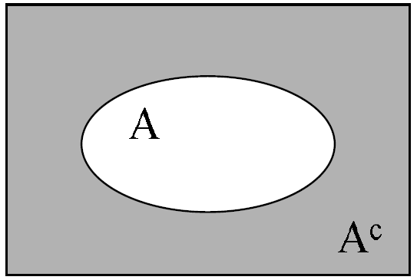
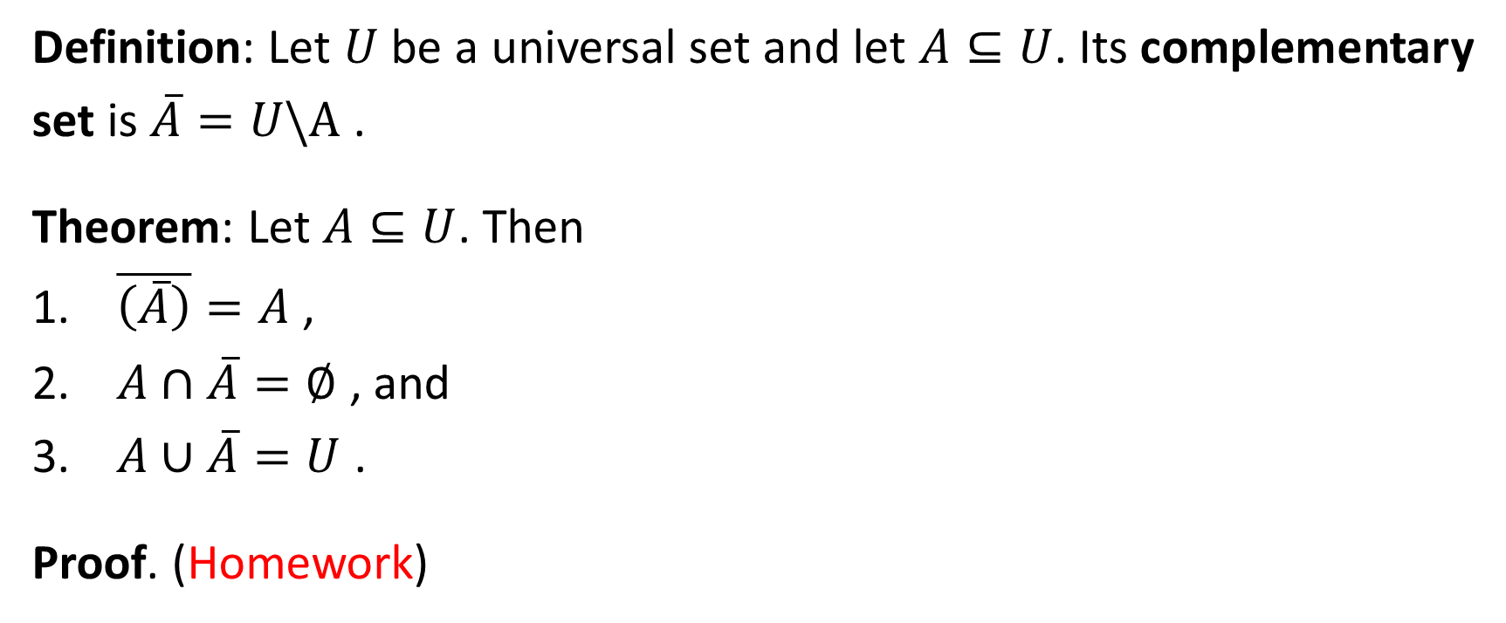


The Complementary Set
Definition: Let $U$ be a universal set and let $A⊆U$. Its complementary set is $\overline{A}=U\backslash A$ .
Theorem: Let $A⊆U$. Then
$\overline{\left(\overline{A}\right)}=A$ ,
$A∩\overline{A}=∅$ , and
$A∪\overline{A}=U$ .
Proof. (Homework)
$$A$$
$$\overline{A}$$

Slide 17
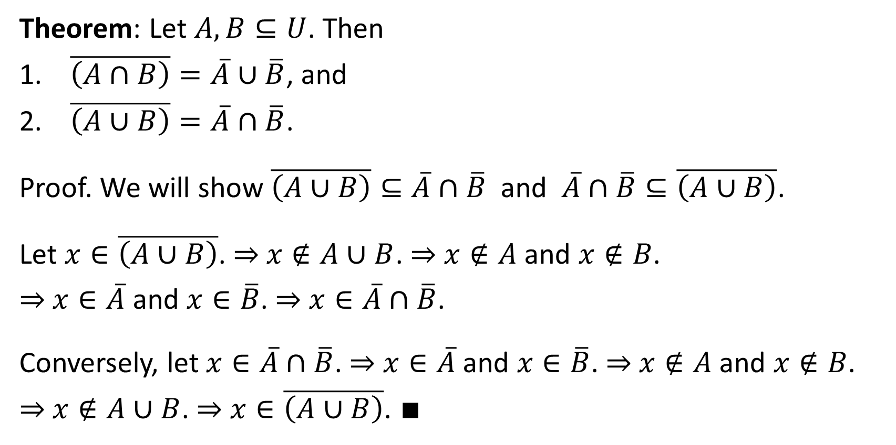
De-Morgan’s Laws
Theorem: Let $A, B⊆U$. Then
$\overline{\left(A∩B\right)}=\overline{A}∪\overline{B}$, and
$\overline{\left(A∪B\right)}=\overline{A}∩\overline{B}$.
Proof. We will show $\overline{\left(A∪B\right)}⊆\overline{A}∩\overline{B}$ and $\overline{A}∩\overline{B}⊆\overline{\left(A∪B\right)}$.
Let $x∈\overline{\left(A∪B\right)}$. ⇒ $x∉A∪B$. ⇒ $x∉A$ and $x∉B$.
⇒ $x∈\overline{A}$ and $x∈\overline{B}$. ⇒ $x∈\overline{A}∩\overline{B}$.
Conversely, let $x∈\overline{A}∩\overline{B}$. ⇒ $x∈\overline{A}$ and $x∈\overline{B}$. ⇒ $x∉A$ and $x∉B$.
⇒ $x∉A∪B$. ⇒ $x∈\overline{\left(A∪B\right)}$. ∎

Slide 18
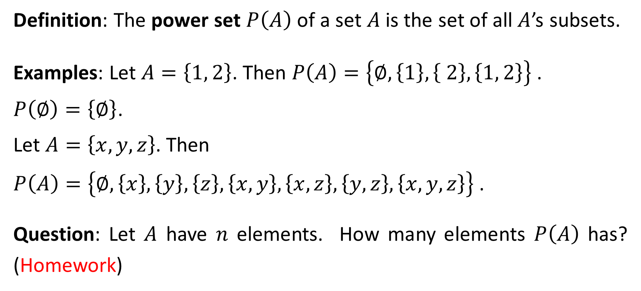
Power Set
Definition: The power set $P\left(A\right)$ of a set $A$is the set of all $A$’s subsets.
Examples: Let $A=\left\{1, 2\right\}$. Then $P\left(A\right)=\left\{∅,\left\{1\right\},\left\{ 2\right\},\left\{1, 2\right\}\right\}$ .
$P\left(∅\right)=\left\{∅\right\}$.
Let $A=\left\{x, y, z\right\}$. Then
$P\left(A\right)=\left\{∅,\left\{x\right\},\left\{y\right\},\left\{z\right\},\left\{x, y\right\},\left\{x,z\right\},\left\{y,z\right\},\left\{x, y, z\right\}\right\}$ .
Question: Let $A$ have $n$ elements. How many elements $P\left(A\right)$ has? (Homework)

Slide 19
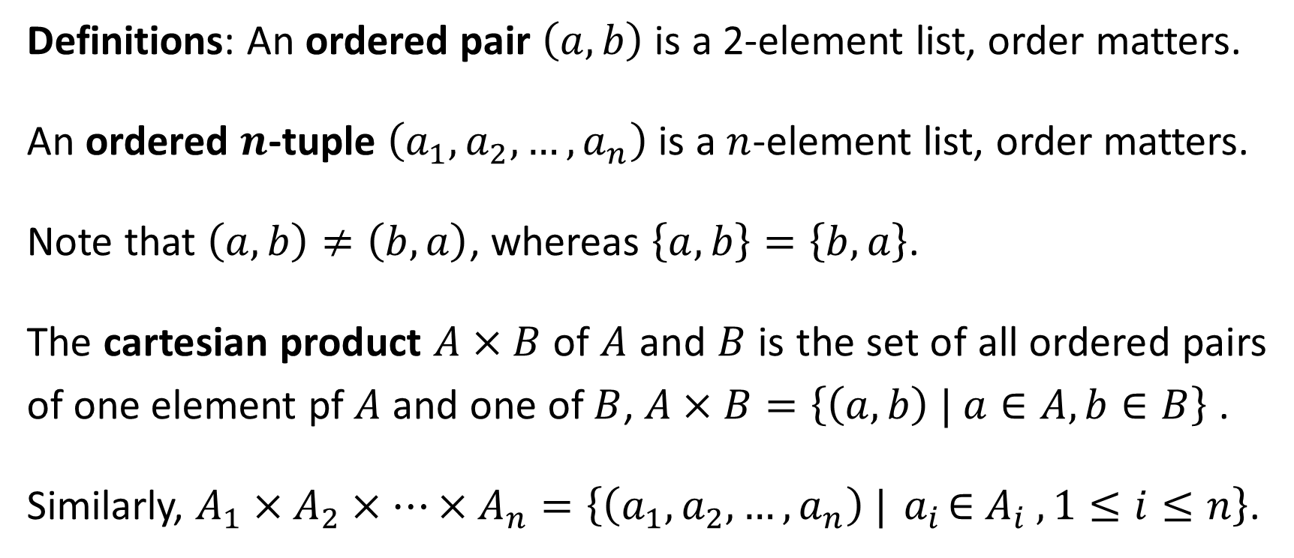
Cartesian Product
Definitions: An ordered pair $\left(a,b\right)$ is a 2-element list, order matters.
An ordered $n$-tuple $\left(a_{1},a_{2},…,a_{n}\right)$ is a $n$-element list, order matters.
Note that $\left(a,b\right)≠\left(b,a\right)$, whereas $\left\{a,b\right\}=\left\{b,a\right\}$.
The cartesian product $A×B$ of $A$ and $B$ is the set of all ordered pairs of one element pf $A$ and one of $B$, $A×B=\left\{\left(a,b\right) | a∈A, b∈B\right\}$ .
Similarly, $A_{1}×A_{2}×…×A_{n}=\left\{\left(a_{1},a_{2},…,a_{n}\right) |{ a}_{i}∈{ A}_{i} , 1≤i≤n\right\}$.

Slide 20
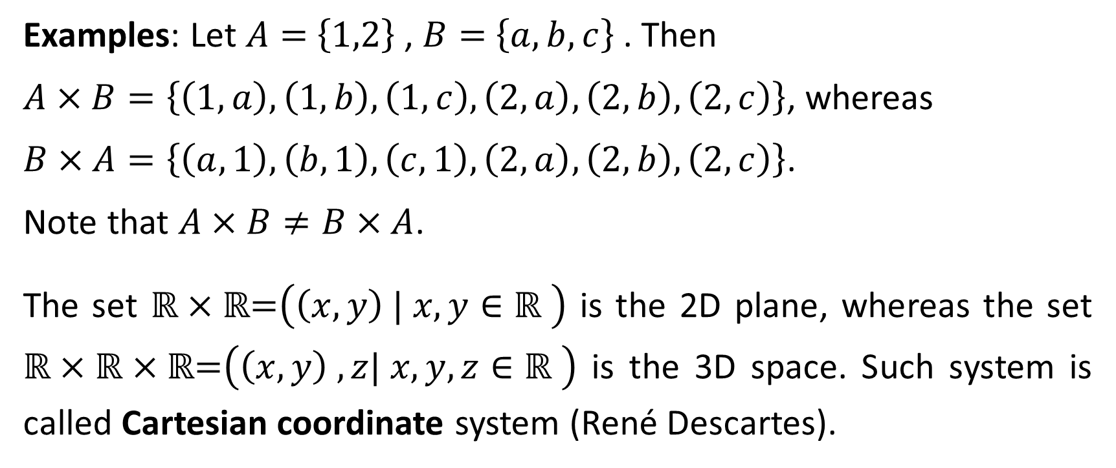
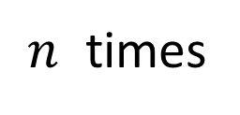
Examples: Let $A=$ $\left\{1,2\right\}$ , $B=$ $\left\{a,b, c\right\}$. Then
$A×B=\left\{\left(1,a\right),\left(1,b\right),\left(1,c\right),\left(2,a\right),\left(2,b\right),\left(2,c\right)\right\}$, whereas
$B×A=\left\{\left(a, 1\right),\left(b, 1\right),\left(c, 1\right),\left(2,a\right),\left(2,b\right),\left(2,c\right)\right\}$.
Note that $A×B≠B×A$.
The set $\text{ℝ}×\text{ℝ}\text{=}\left(\left(x,y\right) | x, y∈\text{ℝ} \right)$ is the 2D plane, whereas the set $\text{ℝ}×\text{ℝ}×\text{ℝ}\text{=}\left(\left(x,y\right) ,z| x, y, z∈\text{ℝ} \right)$ is the 3D space. Such system is called Cartesian coordinate system (René Descartes).
The cartesian product $A×A×⋯×A$ is denoted by $A^{n}$.
$n$ times

Slide 21
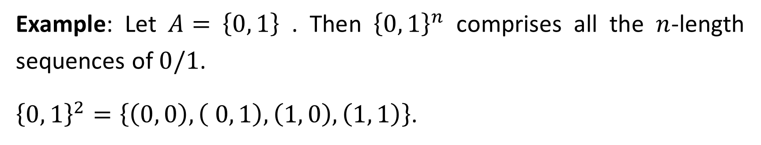
Example: Let $A=$ $\left\{0, 1\right\}$ . Then ${\left\{0, 1\right\}}^{n}$ comprises all the $n$-length sequences of $0/1$.
${\left\{0, 1\right\}}^{2}=\left\{\left(0, 0\right),\left( 0, 1\right),\left(1, 0\right),\left(1, 1\right)\right\}$.

