Slide 1
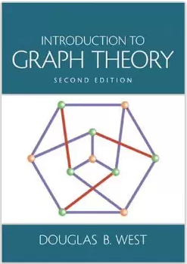
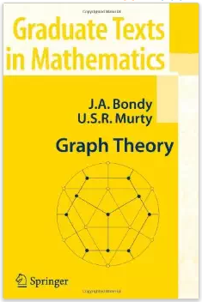
Planar Graphs
prepared and Instructed by
Shmuel Wimer
Eng. Faculty, Bar-Ilan University

Slide 2
Definition. $G$ is planar if it has a drawing without crossings. A particular drawing $G$is called plane graph.
Motivated by the four-color problem: four colors sufficient to color maps s.t. neighbor regions have different colors.
Important role in physical layout of VLSI circuits (transistors, wires) and the location of blocks in chips for best performance and utilization of die’s area.

Slide 3
Example. $K_{5}$ and $K_{3,3}$ are nonplanar.
Proof. (hand waving) If end vertices of edges interleave along outer cycle, they must be drown inside and outside the cycle to avoid crossing.
In $K_{5}$ only 2 can be drawn inside and 2 outside. In $K_{3,3}$ only 1 can be drawn inside and 1 outside. $∎$

Slide 4
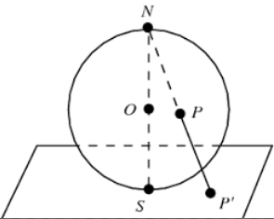
Consider a plane $G$, loops and parallel edges allowed.
Closed edge cycles containing no vertex is called face.
The infinite outer region of a plane graph is also a face.
A stereographic projection on a sphere turns it into finite face.

Slide 5
Dual Graphs
Definition: The dual $G^{∗}$ of $G$ is plane with vertex in every face of $G$.
$E\left(G^{∗}\right)⟺$ $E\left(G\right)$ as follows. If $e∈E\left(G\right)$ is border of $f,g∈F\left(G\right)$, then $e^{∗}\left(f^{∗},g^{∗}\right)∈E\left(G^{∗}\right)$, where $f^{∗},g^{∗}∈V\left(G^{∗}\right)$ correspond to $f,g$, resp.
$$G$$
$$G^{∗}$$

Slide 6
Let $d\left(f\right)$ be the number (degree) of edges of $f∈F\left(G\right)$. Duality and $\sum_{v∈V\left(G\right)}{d\left(v\right)}=2e\left(G\right)$ ⇒
$v\left(G^{∗}\right)=f\left(G\right)$
$$e\left(G^{∗}\right)=e\left(G\right)$$
$d_{G^{∗}}\left(f^{∗}\right)=d_{G}\left(f\right)$, $∀f∈F\left(G\right)$
$\sum_{f∈F}{d\left(f\right)}=\sum_{f^{∗}∈V\left(G^{∗}\right)}{d\left(f^{∗}\right)}=2e\left(G^{∗}\right)=2e\left(G\right)$
$G\backslash e$ leaves $G$ planar.
Contraction of edge $G/e$ leaves $G$ planar.

Slide 7
Lemma. Let $G$ be a plane graph. Then $G^{∗∗}≅G$ ⟺ $G$ is connected.
Proof. We show first that $G$ connected $⇒$ $G^{∗}$ connected.
Let $f^{∗},g^{∗}∈V\left(G^{∗}\right)$ belong to $X^{∗},Y^{∗}∈F\left(G^{∗}\right)$, resp.
$$f^{∗}$$
$$g^{∗}$$
$$X^{∗}$$
$$Y^{∗}$$

Slide 8
$$f^{∗}$$
$$g^{∗}$$
$$x$$
$$y$$
$$X^{∗}$$
$$Y^{∗}$$
$$p\left(f^{∗},g^{∗}\right)$$
$$p\left(x,y\right)$$
Duality $⇒$ $∃ x,y∈V\left(G\right)$, $G$ connected $⇒$ $∃ p\left(x,y\right)$, which vertices correspond to sequence of adjacent faces of $F\left(G^{∗}\right)$ from $X^{∗}$ to $Y^{∗}$.
Faces adjacency in $G^{∗}$ $⇒$ $∃$connecting path $p\left(f^{∗},g^{∗}\right)$.

Slide 9
$G$ connected $⇒$ $G^{∗}$ connected, apply duality again $⇒$ $G^{∗∗}$connected $⇒$ paths isomorphism between $G$ and $G^{∗∗}$ $⇒$ $G^{∗∗}≅G$.
Conversly, let $G$ be disconnected. $G^{∗}$ is however connected since
By former, dual of $G$’s component is connected in $G^{∗}$.
Any embedding shares the infinite face by all $G$’s component $⇒$ corresponding $G^{∗}$’s subgraphs share the dual vertex of $G$’s infinite face $⇒$ $G^{∗}$ connected.

Slide 10
$G^{∗}$ connected $⇒$ $G^{∗∗}$ connected $⇒$ $G^{∗∗}≇G$. $∎$
Proposition. Let $G$ be a connected plane graph and $e∈E\left(G\right)$ not a cut edge. Then ${\left(G\backslash e\right)}^{∗}≅G^{∗}/e^{∗}$.
$$G$$
$$G\backslash e$$
$$e$$
$$e^{∗}$$
$$G^{∗}$$
$$G^{∗}/e^{∗}$$

Slide 11
Proof. Because $e$ is not a cut edge its two adjacent faces are distinct.
The removal $G\backslash e$ yields the dual $G^{∗}/e^{∗}$ as shown. $∎$
Proposition. Let $G$ be connected plane and $e∈E\left(G\right)$ (not loop). Then ${\left(G/e\right)}^{∗}≅G^{∗}\backslash e^{∗}$.
$$G$$
$$G/e$$
$$e$$
$$e^{∗}$$
$$G^{∗}\backslash e^{∗}$$
$$G^{∗}$$

Slide 12
Proof. $G$ connected $⇒$ $G^{∗∗}≅G$. $e$ not loop $⇒$ $e^{∗}$ not cut edge in $G^{∗}$ $⇒$ $G^{∗}\backslash e^{∗}$ connected.
By former proposition ${\left(G^{∗}\backslash e^{∗}\right)}^{∗}≅G^{∗∗}/e^{∗∗}≅G/e$.
By taking the dual of the above $G^{∗}\backslash e^{∗}≅{\left(G/e\right)}^{∗}$. $∎$

Slide 13
Euler’s Formula (1752)
Relates $v\left(G\right)$, $e\left(G\right)$ and $f\left(G\right)$ in connected plane $G$.
Theorem. Euler’s formula. For a connected plane graph $G$ there is
$v\left(G\right)−e\left(G\right)$ $+f\left(G\right)=2$.
Proof. By induction on $f\left(G\right)$.
$f\left(G\right)=1$ ⇒ $G$ tree ⇒ $e\left(G\right)=v\left(G\right)−1$.
Suppose Euler formula holds for $f\left(G\right)<k$, $k≥2$, and let $f\left(G\right)=k.$

Slide 14
Choose $e∈E\left(G\right)$ not cut edge. $G\backslash e$ is connected and $f\left(G\backslash e\right)=k−1$.
By the induction hypothesis,
$v\left(G\backslash e\right)−e\left(G\backslash e\right)$ $+f\left(G\backslash e\right)=2$.
Substitution of $v\left(G\backslash e\right)=v\left(G\right)$, $e\left(G\backslash e\right)=e\left(G\right)−1$, and $f\left(G\backslash e\right)=f\left(G\right)−1$ yields Euler’s formula. $∎$

Slide 15
Corollary. All planar embedding of connected planar graph have the same number of faces.
Proof. Let $\tilde{G}$ be a planar embedding of $G$.
$e\left(\tilde{G}\right)=e\left(G\right)$ and $v\left(\tilde{G}\right)=v\left(G\right)$ $⇒$ $f\left(\tilde{G}\right)=f\left(G\right)$. $∎$
Corollary. Let $G$ be simple and planar and $v\left(G\right)≥3$. Then $e\left(G\right)≤3v\left(G\right)−6$.
Furthermore $e\left(G\right)=3v\left(G\right)−6$ iff every planar embedding of $G$ is a triangulation.

Slide 16
Proof. It is sufficient to prove for connected $G$. Let $\tilde{G}$ be any embedding.
Because $G$ is simple and connected and $v\left(G\right)≥3$, $d\left(f\right)≥3$ $∀f∈F\left(\tilde{G}\right)$.
$\sum_{f∈F}{d\left(f\right)}=2e\left(G\right)$ and $v\left(G\right)−e\left(G\right)$ $+f\left(G\right)=2$ $⇒$
(1) $2e\left(G\right)≥3f\left(\tilde{G}\right)=3\left(e\left(G\right)−v\left(G\right)+2\right)$ $⇒$
(2) $e\left(G\right)≤3v\left(G\right)−6$.
$=$ in (2) ⇔ $=$ in (1) $⇒$ $d\left(f\right)=3$ $∀f∈F\left(\tilde{G}\right)$ $∎$

Slide 17
Corollary. Let $G$ be simple and planar. Then $δ\left(G\right)≤5$.
Proof. Trivial for $v\left(G\right)<3$. For $v\left(G\right)≥3$ there is
$δ\left(G\right)v\left(G\right)≤\sum_{v∈V\left(G\right)}{d\left(v\right)}=2e\left(G\right)≤6v\left(G\right)−12$.
Hence $δ\left(G\right)≤\left\lfloor 6−{12}/{v\left(G\right)}\right\rfloor ≤5$. $∎$
Corollary. $K_{5}$ is nonplanar. (homework)
Corollary. $K_{3,3}$ is nonplanar. (homework)
Prove with Euler’s formula.

Slide 18
Preparations for Kuratowski Theorem
Any graph derived from $G$ by a sequence of edge divisions is called a subdivision.
Proposition: $G$ is planar iff every subdivision of $G$ is planar. (homework)

Slide 19
Kuratowski stated in 1930 that every nonplanar graph must contain a subgraph which is a subdivision of $K_{3,3}$ or $K_{5}.$
Avoidance of $K_{3,3}$ and $K_{5}$ subdivision subgraph is necessary and sufficient for planarity.
There are several proofs of Kuratowski’s theorem. We show a proof by Thomassen (1980).
Henceforth embedding means a planar embedding

Slide 20
Lemma 1: If $E$ is the edge set of a face in some embedding of $G$, $G$ has an embedding where $E$ constitutes the unbounded face.
Proof: use projection on a sphere (homework).
Lemma 2: Every minimal nonplanar graph is 2- connected.
Proof: Let $G$ be minimal nonplanar. An edge deletion makes it planar.

Slide 21
$G$ is connected. Otherwise, deletion of component $G^{′}$ turns $G\backslash G^{′}$ into planar graph.
$G^{′}$ could then be embedded inside a face of $G\backslash G^{′}$ embedding ⇒ planar embedding of $G$.
$G$ also cannot be one connected. Otherwise let $v$ be a cut vertex implying $k$ components.
Let $G_{1},…,G_{k}$the $k$ components, each of which connected to $v$.

Slide 22
$G$minimality ⇒ $G_{1},…,G_{k}$ planar.
By Lemma 1 $G_{1},…,G_{k}$ can be embedded s.t. $v$ is on their outer face.
$$v$$
$$G_{i}$$
It is possible to squeeze every $G_{i}$ embedding to fit an angle smaller than ${360}/k$ at $v$.
$${360}/k$$
$$v$$
$$G_{i}$$

Slide 23
Merging the embeddings at $v$ yields planar embedding of $G$, contradiction to $G$ non planarity.
$G$ must therefore be two connected. $∎$
Lemma 3: Let $S=\left\{x,y\right\}$ be a 2-cut of a nonplanar graph $G$.
Let $G=G_{1}∪G_{2}$ and $V\left(G_{1}\right)∩V\left(G_{2}\right)=S$.
Then at least one of $H_{i}=G_{i}∪xy$ is nonplanar.

Slide 24
Proof: Note that $xy$ is not necessarily an edge in $G$.
Suppose that both $H_{1}$ and $H_{2}$ are planar.
By Lemma 1 they can be embedded such that edge $xy$ resides on their outer face.
$$G$$
$$x$$
$$x$$
$$x$$
$$x$$
$$H_{1}$$
$$H_{2}$$
$$y$$
$$y$$
$$y$$
$$y$$

Slide 25
Delete $xy$ if it does not exist in $G$, yielding planar embedding of $G$, a contradiction.
Hence at least one of $H_{1}$ and $H_{2}$ is nonplanar $∎$
Lemma 4: If $G$has fewest edges s.t.
$G$is nonplanar
$G$has no Kuratowski subgraph
Then $G$ is 3-connected.

Slide 26
Proof: Any $G\backslash e$ cannot create a Kuratowski subgraph.
$G$’s fewest edges ⇒ $G\backslash e$ is planar ⇒ $G$ is minimal nonplanar ⇒ by Lemma 2 $G$ is 2-connected.
Let us show that if $G$ has 2-cut it must have a Kuratowski subgraph ⇒ $G$ 3-connected.
Let $S=\left\{x,y\right\}$ be a 2-cut, where $G_{1}∪$ $G_{2}=G$ and $V\left(G_{1}\right)∩V\left(G_{2}\right)=S$. Let $H_{i}=G_{i}∪xy$.
By Lemma 3 $H_{1}$ or $H_{2}$ is nonplanar, say $H_{1}$.

Slide 27
$$x$$
$$H_{1}$$
$$H_{2}$$
$$y$$
$G$has been assumed to have fewest edges s.t.
$G$nonplanar, (2) $G$ has no Kuratowski subgraph.
$H_{1}$ nonplanar with fewer edges than $G$⇒ $H_{1}$ has Kuratowski subgraph, otherwise $H_{1}$ should be selected rather than $G$.

Slide 28
$$G$$
$$x$$
$$H_{1}$$
$$H_{2}$$
$$y$$
$H_{1}$appears in $G$ except possibly $xy$, which can be replaced by $p\left(x,y\right)∈H_{2}$
⇒ ∃ Kuratowski subgraph of $G$, contradicts $G$ has no Kuratowski subgraph ⇒ $G$ must be 3-connected. $∎$

Slide 29
Convex Embeddings
Lemma 5: (Thomassen 1980) If $G$ 3-connected has at least 5 vertices, $∃$ $e$ s.t. $G/e$ (contraction) is 3-connected.
Proof: Assume in contrary $∀e∈E\left(G\right)$ $G/e$ has 2-cut.
2-cut must include vertex resulted by shrink $e=xy$.
If $z$ is another vertex of 2-cut then $\left\{x,y,z\right\}$ is a 3-cut.
Choose $\left\{x,y,z\right\}$ yielding the largest $V\left(H\right)$ and let $H^{′}$ be the other component.

Slide 30
$$z$$
$$u$$
$$x$$
$$H$$
$$H^{′}$$
$$v$$
$$v$$
$$y$$
Since $\left\{x,y,z\right\}$ is a minimal cut, each vertex has neighbors in $H$ and $H^{′}$. Let $u∈H^{′}$ be $z$’s neighbor.
It follows that $G/zu$ has also 2-cut, so let $v$ be the companion of the vertex resulted by $zu$ shrink s.t. $\left\{z,u,v\right\}$ separates $G$.

Slide 31
$G\left[V\left(H\right)∪\left\{x,y\right\}\right]$ is connected and if $v∈H^{′}$ then the cut $\left\{z,u,v\right\}$ contradicts the choice of the cut $\left\{x,y,z\right\}$ to yield the largest $V\left(H\right)$.
⇒ $v∈H$
$$z$$
$$u$$
$$x$$
$$H$$
$$H^{′}$$
$$v$$
$$v$$
$$y$$

Slide 32
$$z$$
$$u$$
$$x$$
$$H$$
$$H^{′}$$
$$v$$
$$y$$
If $v∈H$ the cut $\left\{z,u,v\right\}$ of $G$is such that $\left\{z, v\right\}$ is also a cut of $G$ since $v$ and $u$ are on opposite sides.
This however is impossible since $G$ is 3-connected.
All in all, it is impossible that any $G/e$ is 2-connected ⇒ $∃$ $e$ s.t. $G/e$ (contraction) is 3-connected. $∎$

Slide 33
Lemma 6: If $G/e$ has a Kuratowski subgraph, then so does $G$ (contraction cannot create Kuratowski).
Proof: Let $H⊂G^{′}=G/e$ be a Kuratowski subgraph and let $z∈V\left(G^{′}\right)$ obtained by contracting $e=xy$.
If $z∉H$ ⇒ $H⊂G$.
If $d_{G^{′}}\left(z\right)<3$, $G$ also has a Kuratowski subgraph obtained by turning $z$ back into the edge $xy$.
$$z$$
$$x$$
$$y$$

Slide 34
Let $d_{G^{′}}\left(z\right)≥3$.
If among edges incident to $z$ in $G^{′}$ there is at most one that was incident to $x$ (resp. $y$) in $G$, turning $z$ into the edge $xy$ obtaines $d_{G^{′}}\left(z\right)=d_{G}\left(y\right)$.
$$z$$
$$x$$
$$y$$
This is always the case if $H$ is subdivision of $K_{3,3}$.

Slide 35
$$K_{5}$$
$$K_{3,3}$$
$$u_{1}$$
$$v_{1}$$
$$u_{1}$$
$$v_{1}$$
$$u_{1}$$
$$v_{1}$$
$$y$$
$$x$$
$$y$$
$$x$$
$$z$$
$$v_{2}$$
$$u_{2}$$
$$v_{2}$$
$$u_{2}$$
$$v_{2}$$
$$u_{2}$$
The only remaining case is $K_{5}$, which by expanding $z$ and deletion of the edges $u_{1}u_{2}$ and $v_{1}v_{2}$ obtains a $K_{3,3}$ subdivision. $∎$

Slide 36
Convex (Tutte) Embeddings is a straight-line plane embedding where the outer face is a convex polygon, and every inner vertex is positioned at the average of its neighbors.
Tutte proved that given the outer face, the position of the inner vertices is unique, the solution implies crossing-free embedding, and the inner faces are convex.

Slide 37
Theorem (Tutte 1960,63): If $G$ is 3-connected with no $K_{5}$ or $K_{3,3}$ subdivision, then $G$ has a convex planar embedding (hence planar).
Proof (Thomassen 1980,81)
By induction on $\left|V\left(G\right)\right|$.
The only 3-connected graph with at most 4 vertices is $K_{4}$ which has a convex planar embedding, so suppose $\left|V\right|≥5$.

Slide 38
By Lemma 5 $∃$ $e=xy$ s.t $H=G/e$is 3-connected. Let $z∈V\left(H\right)$ be resulted by $xy$ contraction.
$H$has no Kuratowski subgraph, as otherwise by Lemma 6 $G$ must have too.
By induction $H$ has convex embedding.
$$z$$

Slide 39
Ignore $z$’s edges to $N\left(z\right)$. $z$ is located inside a face (cycle) $C$ of $H−z$ (can be the unbounded face).
Since $H$ is convexly embedded, $z$ is connected to $N\left(z\right)$ with straight lines.
$$C$$
$$C$$
$$x_{i+1}$$
$$z$$
$$x_{i+1}$$
$$x$$
$$y$$
$$x_{i}$$
$$x_{i}$$

Slide 40
$$C$$
$$C$$
$$x_{i+1}$$
$$x_{i+1}$$
$$y$$
$$z$$
$$x$$
$$x_{i}$$
$$x_{i}$$
Let $N\left(x\right)=\left\{x_{1},…, x_{k}\right\}$, where $x_{i}$ are cyclically ordered along $C$.
If entire $N\left(y\right)$ resides on $C$’s segment from $x_{i}$ to $x_{i+1}$, a convex embedding of $G$ is obtained by locating $x$ in $z$ and putting $y$ near $x$in the wedge $x_{i}xx_{i+1}.$

Slide 41
Otherwise, $N\left(y\right)$ interleaves with $N\left(x\right)$ along $C$. All such cases result in $K_{5}$ or $K_{3,3}$ subdivisions. (homework).
It means $G$ includes such subdivisions, in contradiction with theorem’s assumptions ⇒ impossible. $∎$
$$y$$
$$x$$
$$x$$
$$y$$

Slide 42
Floorplans and Planar Graphs
I/O Pads
Floorplan
Module a
Module b
Block a
Block c
Module c
Chip Planning
GND
Block d
VDD
Block Pins
Block b
Module d
Block e
Module e
Supply Network

Slide 43
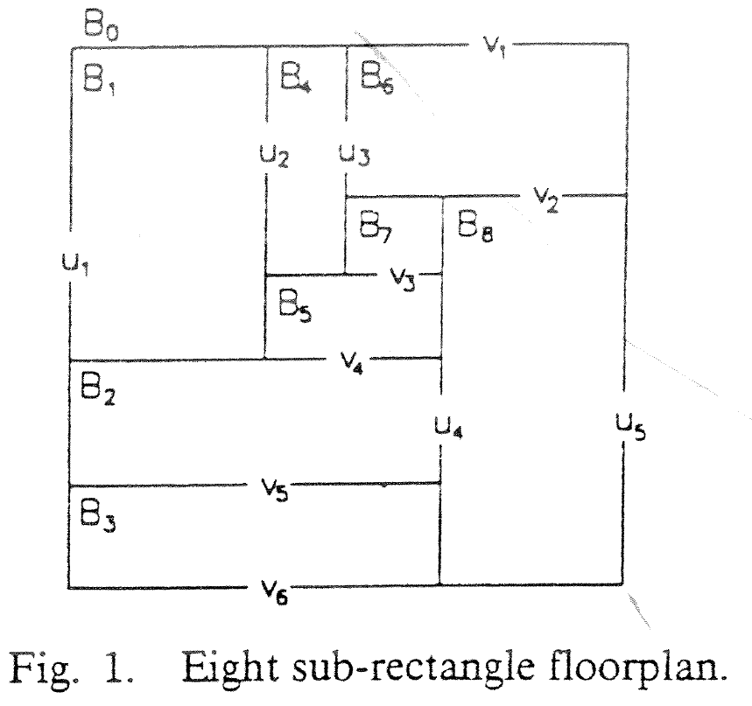
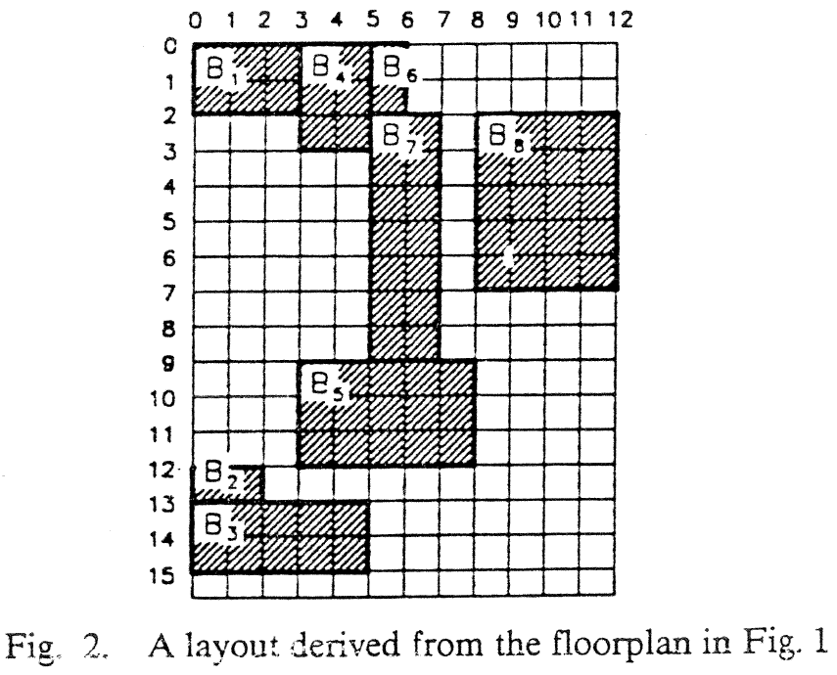
From Floorplan to Placement
Smallest, most compacted layout
floorplan

Slide 44
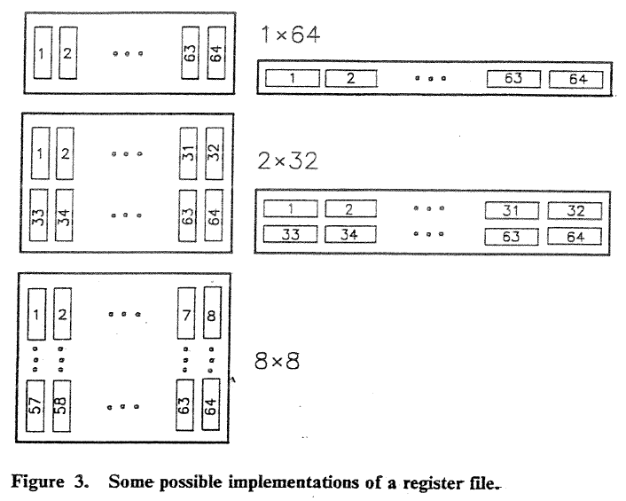
Blocks’ Aspect Ratios

Slide 45
From Floorplan to Placement
Actual layout is obtained by embedding real blocks into floorplan cells.
Blocks’ adjacency relations are maintained
Blocks are not perfectly matched, thus white area (waste) results
Layout width and height are obtained by assigning blocks’ dimensions to corresponding arcs.
Different block sizes yield different layout area, even if block sizes are area invariant.

Slide 46
Planar Graph Representation of Layout
floorplan
graph representation
B₁
B₂
B₈
B₇
B₂
B₈
B₉
B₁
B₇
B₉
B₁₂
B₁₀
B₃
B₅
B₁₀
B₃
B₅
B₄
B₁₂
B₁₁
B₁₁
B₆
B₆
B₄
Vertices - vertical lines. Arcs - blocks.
Dual graph is implied.
Assign blocks’ dimensions to minimize the product of $x$ and $y$ longest paths lengths.

