Slide 1
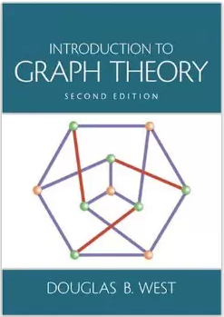
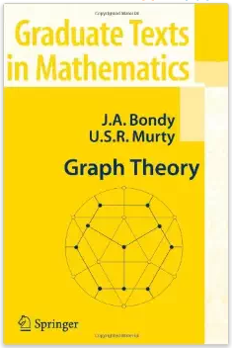
Graph Matching
prepared and Instructed by
Shmuel Wimer
Eng. Faculty, Bar-Ilan University

Slide 2
Matching in Bipartite Graphs
A matching in an undirected graph $G$ is a set of pairwise disjoint edges.
A perfect matching consumes (saturates) all $G$’s vertices. Also called complete matching.
$K_{n,n}$ has $n!$ perfect matchings. (why?)
$K_{2n+1}$has no perfect matchings. (why?)
$K_{2n}$ has $(2n)!/(2nn!)$perfect matchings. (why?)

Slide 3
Maximum Matching
A maximal matching is obtained by iteratively enlarging the matching with a disjoint edge until saturation.
A maximum matching is a matching of largest size. It is necessarily maximal.
Given a matching $M$, an $M$-alternating path $P$ is alternating between edges in $M$ and edges not in $M$.
Let $P$’s end vertices be not in $M$. Replacement of $M$’s edges with $E(P)−M$produces a matching $M’$ s.t. $|M’|=|M|+1$, called $M$-augmentation.

Slide 4
Maximum matching has no augmentation path. (why?)
Symmetric Difference:
$$G\left(V,E_{G}\right)$$
$$H\left(V,E_{H}\right)$$
$$G∆H≜F\left(V,E_{G}⊕E_{H}\right)$$
Symmetric difference is used also for matching.
If $M$ and $M′$ are two matchings then $MΔM′=(M∪M′)−(M∩M′)$.

Slide 5
Theorem. (Berge 1957) A matching $M$ in $G$ is maximum iff $G$ has no $M$-augmentation path.
Proof. Maximum ⇒ no $M$-augmentation. As if $G$ would have $M$-augmentation path, $M$ could not be maximum.
For no $M$-augmentation ⇒ maximum, suppose $M$ is not maximum. We construct an $M$-augmentation.
Consider a matching $M′$, $|M′|>|M|$, and Let $F$ be the spanning subgraph of $G$ with $E(F)=MΔM′$.
$M$ and $M′$ are matchings so a vertex of $F$ has degree 2 at most. $F$ has therefore only disjoint paths and cycles,
and cycles must be of even lengths. (why?)

Slide 6
Since $|M′|>|M|$there is an edge alternating path with more edges of $M′$than $M$. Consequently there is an $M$-augmentation in $G$. ■
Hall’s Matching Conditions
$Y$ applicants for $X$ jobs, $|Y|≫|X|$. Each applicant applies for a few jobs. Can all the jobs be assigned?
$$X$$
$$Y$$
Denote $N(S)⊆Y$ the neighbors of $S⊆X$.$|N(S)|≥|S|$∀ $S⊆X$ is necessary for matching saturating $X$.

Slide 7
Theorem. (Hall 1935) If $G[X,Y]$ is bipartite then $G$ has matching saturating $X$ iff $|N(S)|≥|S|$∀ $S⊆X$.
Proof. Sufficiency. Let $M$ be maximum and ∀ $S⊆X$ there is $|N(S)|≥|S|$. Let $X$ be not saturated. ⇒ ∃ $u∈X$ not $M$-saturated.
We show $S$ s.t. $\left|N\left(S\right)\right|<|S|$, contradicting hypothesis.
$$X$$
$$S$$
$$u$$
$$Y$$
$$T=N(S)$$

Slide 8
Let $S⊂X$ and $T⊂Y$ be reachable from $u$ by $M$-alternating paths. We claim that $M$ matches $T$ with $S−u$.
The paths reach $Y$ by edges not in $M$ and $X$ by $M$’s edges. $M$maximum ⇒ no $M$-augmentation paths, so every vertex of $T$ is $M$-saturated.
$∀$ $y∈T$ extends via $M$ to $x∈S$. Also, $S−u$ is reached by $M$ from $T$, thus $|T|=|S−u|=|S|−1$.

Slide 9
Matching between $T$ and $S−u$ ⇒ $T⊆N\left(S\right)$.
In fact, $T=N\left(S\right)$. If there was an edge $xy$, $x∈S$, $y∈Y−T$ ⇒ $xy∉M$, ⇒ ∃ augmentation path to $y$, ⇒ contradicting $M$ is maximum.
Hence $|N(S)|=|T|=|S|−1<|S|$, contradiction theorem’s hypothesis. ■

Slide 10
For $|X|=|Y|$, Hall’s Theorem is the Marriage Theorem, (Frobenius in 1917), proved for $n$ men and $n$ women.
If also every man is compatible (mutual preference) with $k$ women and vice versa, there exists a perfect matching of compatible pairs (perfect matrimonial $☺$).
Corollary. Every $k$-regular bipartite graph ($k>0$) has a perfect matching.
Proof. Let $X$,$Y$ be bipartition. Counting edges from $X$ to $Y$ and from $Y$ to $X$ $⇒$ $k|X|=k|Y|$ $⇒$ $|X|=|Y|$.

Slide 11
Since $|X|=|Y|$, satisfaction of Hall’s Theorem sufficient condition implies perfect matching saturating $X$and $Y$.
∀ $S⊆X$ the number $m$ of edges connecting $S$ to $Y$ is $m=k|S|$ and those $m$ edges are incident to $N(S)$.
The number of edges incident to $N(S)$ is $k|N(S)|$, ⇒ $m≤k|N(S)|$.
Thus $k|S|=m≤k|N(S)|$ ⇒ $|S|≤|N(S)|$, satisfying Hall’s Theorem sufficient condition. ■

Slide 12
Min-Max Dual Theorems
Can something be said on whether a matching is maximum when a complete matching does not exist?
Exploring all alternating paths to find whether or not $M$-augmentation exists is expensive.
We rather consider a dual problem.
Definition. A vertex cover of $G$ is a set $S⊆V$ containing at least one vertex of all $G$’s edges. We say that $S$’s vertices cover $G$’s edges.

Slide 13
Let $M$ be maximum matching. No two edges of $M$ share a vertex. ⇒ $\left|M\right|≤\left|S\right|$.
Exhibiting $\left|M\right|=\left|S\right|$ proves that both are optimal.
Bipartite graphs possess this min-max equality, but general graphs not necessarily.
maximum matching=2
minimum cover=2,3

Slide 14
Theorem. (Kӧnig 1931, Egerváry 1931) For $G[X,Y]$ bipartite, the sizes of maximum matching and minimum vertex cover are equal.
Proof. Let $U$ be vertex cover, and $M$ matching. There is always $|U|≥|M|$.
Let $U$ be minimum cover. We construct matching $M$ from $U$ s.t. $|U|=|M|$.
Let $R=U∩X$ and $T=U∩Y$. Two bipartite subgraphs $H$ and $H′$ induced by $R∪(Y−T)$ and $T∪(X−R)$, respectively.

Slide 15
If $∃$ complete matchings in $H$ from $R$ into $Y−T$ and in $H′$ from $T$ into $X−R$, their union will be a matching in $G$ of size $|U|$, proving the theorem.
$∄xy∈E$, $x∈X−R$ , $y∈Y−T$. Otherwise $U$ is not a cover. ⇒ the matchings in $H$ and $H′$ are disjoint.
$$U$$
$$X$$
$$R$$
$H$’
$$H$$
$$Y$$
$$T$$

Slide 16
Showing Hall’s Theorem conditions satisfied by $H$ and $H$’ ensure that matchings saturating $R$ and $T$ exist.
Let $S⊆R$ and consider $N_{H}\left(S\right)⊆Y−T$. If $|NH(S)|<|S|$, replacing $S$ by $NH(S)$ in $U$ yields smaller vertex cover, contradicting $U$ is minimum.
Hence $|NH(S)|≥|S|$ and Hall’s Theorem condition hold in $H$. ⇒ $H$ has complete matching of $R$ into $Y−T$. Same argument hold for $H$’. ■

Slide 17
Independent Sets in Bipartite Graphs
Definition. The independence number $α(G)$of a graph $G$ is the maximum size of an independent vertex set.
$α(G)$of bipartite graph not always equal size of partite.
Definition. An edge cover is an edge set covering $G$’s vertices.
Notations: $α(G)$: max size of independent set.
$α′(G)$: max size of matching.
$β(G)$: min size of vertex cover.
$β′(G)$: min size of edge cover.

Slide 18
Kӧnig-Egerváry Theorem states that for every bipartite graph $G$ $α′(G)=β(G)$.
No edges between vertices of independent set ⇒ edge cover cannot be smaller ⇒ $α(G)≤β′(G)$.
We will also prove that for every bipartite graph $G$ (without isolated vertices) $α(G)=β′(G)$.
Lemma. $S⊆V\left(G\right)$ is independent set iff $\overline{S}$ is a vertex cover ⇒ $α(G)+β(G)=n(G)$ ($n(G):=|V|$).

Slide 19
Proof. $S$ independence ⇒ no edges within $S$ ⇒ $\overline{S}$ must cover all the edges. Conversely, $\overline{S}$ covers all the edges ⇒ no edges connecting vertices of $S$. ■
Theorem. (Gallai 1959) If $G$ has no isolated vertices, then $α′(G)+β′(G)=n(G)$.
Proof. Let $M$ be maximum matching, $α′(G) =|M|$. Construct edge cover by adding edge incident to each of $n(G)−2|M|$ unsaturated vertices. ⇒ edge cover size $\left|M\right|+\left(n\left(G\right)−2\left|M\right|\right)=n\left(G\right)−\left|M\right|=n\left(G\right)−α′(G)$.
Min edge cover bounds below ⇒$β′(G)≤n(G)−α′(G)$.

Slide 20
Conversely, let $L$ be min edge cover, $β′(G)=|L|$. $L$ has no cycles, nor paths of more than two edges. (why?)
⇒ $L$ is a collection of $k$ isolated star subgraphs.
There are $k$ vertices at star centers, anyway covered with $n(G)−k$ star peripherals, ⇒ $|L|=n(G)−k$.
The $k$ isolated star subgraphs yield $k$-size matching by arbitrarily choosing one edge per star.
Max matching bounds $k$ ⇒ $α^{′}\left(G\right)≥k=n(G) − β′(G).$ All in all, $n(G) = α′(G) + β′(G)$. ■

Slide 21
Corollary. (Kӧnig 1916) If $G$ is bipartite with no isolated vertices, $α(G)=β′(G)$. (|max independent set| =|min edge cover|).
Proof. By last lemma $α(G)+β(G)=n(G)$. By Gallai Theorem $n(G)=α′(G)+β′(G)$.
By Kӧnig-Egerváry Theorem $α′(G)=β(G)$ (|max matching|=|min vertex cover|) ⇒ $α(G)=β′(G)$. ■

Slide 22
Maximum Matching Algorithm
Augmentation-path characterization inspires algorithm to find maximum matching .
Matching enlarged step-by-step by discovering an augmentation path.
If not found we will show a vertex cover of same size as current matching. Kӧnig-Egerváry Min-Max Theorem ⇒ matching is maximum.
Iteration looks at $M$-unsaturated vertices only at one partite since ends of augmented path are in opposite partite.

Slide 23
Search for all $M$-unsaturated vertices. Starting at $x$, a tree of $M$-alternating paths rooted at $x$ is implied.
Starting with zero matching, $α′(G)$ applications of the Augmentation Path Algorithm produce max matching.
$$U⊂X$$
$$S=U$$
x₁
x₂
x₃
x₄
x₅
x₆
x₁
x₂
x₃
x₄
x₅
x₆
$$M$$
$$T$$
y₁
y₂
y₃
y₄
y₅
y₆
y₁
y₂
y₃
y₄
y₅
y₆

Slide 24
$$U⊂X$$
x₁
x₂
x₃
x₄
x₅
x₆
End of iteration.
New augmented matching.
y₁
y₂
y₃
y₄
y₅
y₆
x₁
x₂
x₃
x₄
x₅
x₆
$$S$$
No augmentation found.
Max matching found.
$$T$$
y₁
y₂
y₃
y₄
y₅
y₆

Slide 25
Algorithm (iteration finding $M$-augmentation path). Input: $G[X,Y]$, matching $M$ in $G$, all $M$-unsaturated vertices $U⊂X$.
Initialization: $S=U$, $T=∅$.
Iteration: If all $S$ is marked stop: $M$ is a maximum matching and $T∪(X−S)$ is a minimum cover.
Otherwise, select unmarked $x∈S$. Consider each $y∈N\left(S\right)$ s.t. $xy∉M$. If $y$ unsaturated, $M$-ugmentation path from $U$ to $y$ exists. Augment $M$.
Otherwise, $y$ is matched by $M$ with some $w∈X$. In that case add $y$ to $T$ and $w$ to $S$.

Slide 26
After exploring all edges incident to $x$, mark $x$ and iterate. ■
Theorem. Iterating Augmenting Path Algorithm on bipartite graph produces same size matching and cover.
Proof. Consider $T∪(X−S)$ upon termination.
$M$-alternating path from $U$ enters $X$ only via $M$’s edges, hence there is a matching between $S−U$ and $T$.
$M$-alternating path traverses from $x∈S$ into $T$along any $M$-unsaturated edge, thus $N\left(x\right)⊂T$.

Slide 27
Since algorithm marks all $x∈S$ before termination, there could not be an unsaturated edge connecting $S$ to $Y−T$. ⇒ $T∪(X−S)$ is vertex cover.
Upon termination $T$ is saturated by $M$ (otherwise $M$-augmentation occurs), ⇒ $y∈T$ is $M$-matched to $S$.
Since $U⊆S$ contained all the $M$-unsaturated vertices, $X−S$ is $M$-saturated, but with edges not involved in $T$. ⇒ $M$involves at least $\left|T\right|+\left|X−S\right|$ edges.
Hence $\left|M\right|≥\left|T\right|+\left|X−S\right|$. Since always |matching|$≤$ |covering|, equality and optimality follow. $∎$

Slide 28
Weighted Bipartite Matching
Maximum matching in bipartite graphs generalizes to nonnegative weighted graphs. Missing edges are zero weighted, so $G=K_{n,n}$ is assumed.
Example. A farming company has $n$ farms $X=\left\{x_{1},…,x_{n}\right\}$ and $n$ plants $Y=\left\{y_{1},…,y_{n}\right\}$. The profit of processing $x_{i}$ in $y_{j}$ is $w_{ij}≥0$. Farms and plants should 1:1 matched.
The government will pay the company $u_{i}$ to stop farm $i$ production and $v_{j}$ to stop plant $j$ manufacturing.
If $u_{i}+v_{j}<w_{ij}$ the company will not take the offer and $x_{i}$ and $y_{j}$ will continue working.

Slide 29
What should the government offer to completely stop the farms and plants ?
It must offer $u_{i}+v_{j}≥w_{ij}$ for all $i, j$. The government also wishes to minimize $\sum{u_{i}}+\sum{v_{j}}$.
Definitions. Given an $n×n$ matrix $A$, a transversal is a selection of $n$ entries, one for each row and one for each column.
Finding a transversal of $A$ with maximum weight sum is called the assignment problem, a matrix formulation of the maximum weighted matching problem, where we seek a perfect matching $M$ maximizing $w(M)$.

Slide 30
The labels $u=\left\{u_{i}\right\}$and $v=\left\{v_{j}\right\}$ cover the weights $w=\left\{w_{ij}\right\}$ if $u_{i}+v_{j}≥w_{ij}$ for all $i, j$.
The minimum weighted cover problem is to find a cover $u, v$minimizing the cost $c\left(u,v\right)=\sum{u_{i}}+\sum{v_{j}}$.
The maximum weighted matching and the minimum weighted cover problems are dual.
They generalize the bipartite maximum matching and minimum cover problem. (how ?)
Edges are assigned with weight $∈\left\{0,1\right\}$, and cover uses labels $∈\left\{0,1\right\}$. Vertices receiving $1$ form the cover.

Slide 31
Lemma. If $M$ is perfect matching in bipartite $G$ and $u,v$ is cover, $c\left(u,v\right)≥w\left(M\right)$.
Furthermore, $c\left(u,v\right)=w\left(M\right)$ iff $M$ consists of edges $x_{i}y_{j}$ s.t. $u_{i}+v_{j}=w_{ij}$. $M$ is maximum weight matching and $u,v$ is minimum weight cover.
Proof. Since $M$edges are disjoint, $u_{i}+v_{j}≥w_{ij}$ ⇒ summation over all $M$’s edges yields $c\left(u,v\right)≥w\left(M\right)$.
If $c\left(u,v\right)=w\left(M\right)$equality $u_{i}+v_{j}=w_{ij}$ must hold for each of the $n$ summand.
Since $c\left(u,v\right)≥w\left(M\right)$, equality ⇒ both optimal. ■

Slide 32
Weighted Bipartite Matching Algorithm
Relation between max weighted matching and edge covered by equalities inspires the Hungarian Algorithm.
It combines $M$-augmentation path with cover trimming.
Denote $G_{u,v}$ the subgraph of $K_{n,n}$ spanned by the edges $x_{i}y_{j}$ s.t. $u_{i}+v_{j}=w_{ij}$.
Algorithm ensures that if $G_{u,v}$ has a perfect matching (in $G)$, its weight is $\sum{u_{i}}+\sum{v_{j}}$ and by lemma matching and cover are optimal.
Otherwise, algorithm modifies the cover.

Slide 33
Algorithm. (Kuhn 1955, Munkres 1957)
Input: Weighted $G[X,Y]$ ($K_{n,n}$).
Idea: Maintain cover $u,v$, iteratively reducing its cost, until the equality graph $G_{u,v}$ has perfect matching in $G$.
Initialization: Feasible labeling $u_{i}=\max_{j}{w_{ij}}$, $v_{j}=0$. Find max matching $M$ in $G_{u,v}$ (path augmentation).
Iteration: If $M$ is perfect in $G$ stop. $M$ is a max weight matching by lemma.
Else, let $U⊂X$ be $M$-unsaturated, $S⊆X$ and $T⊂Y$ be reached from $U$ by $M$-alternating paths.

Slide 34
$$U$$
$$−ε$$
$M$ in $G_{u,v}$
$$S$$
$$X$$
$$ε$$
$$Y$$
$$T$$
$$+ε$$
Let $ε=\text{min} \left\{u_{i}+v_{j}−w_{ij} | x_{i}∈S, y_{j}∈Y−T \right\}$
Decrease $u_{i}$ by $ε$ for all $x_{i}∈S$ and increase $v_{j}$ by $ε$ for all $y_{j}∈T$.
Derive new equality graph ${G′}_{u,v}$. If $M$-augmentation path exists, replace $M$ by a maximum matching in ${G′}_{u,v}$.
Iterate anyway. ■
Graph Matching
34

Slide 35
$$u$$
4
8
6
$$u$$
4
8
6
$$X$$
$$U$$
$$X$$
6
1
6
1
4
4
1
6
8
1
6
8
$$Y$$
$$Y$$
$$v$$
$$v$$
$$M$$
$$G_{u,v}$$
0
0
0
0
0
0
$$u$$
4
8
6
$$S$$
$$X$$
6
1
Minimum surplus from $S$ to $Y−T$:
$$ε=min⁡\{8−6,6−1\} =2$$
4
1
6
8
$$Y$$
$$M$$
$$T$$
$$v$$
0
0
$$G_{u,v}$$
0

Slide 36
$$u$$
4
6
4
$$u$$
4
6
4
$$X$$
$$X$$
6
1
6
1
4
4
1
6
8
1
6
8
$$Y$$
$$Y$$
$$v$$
0
2
0
$$v$$
0
$${G′}_{u,v}$$
2
$$M$$
0
$M$ which is max in ${G′}_{u,v}$ is perfect in $G$ $⇒$ max weight matching.
To validate, the total edge weight is 16, same as the total cover.

Slide 37
Theorem. The Hungarian Algorithm finds max weight matching and min cost cover.
Proof. Algorithm begins with cover, each iteration produces a cover, and termination occurs only when equality graph $G_{u,v}$ has perfect matching in $G$.
Let $u′,v′$ obtained from $u,v$ after decreasing $S$ and increasing $T$ by $ε$. $x_{i}∈S$ , $y_{j}∈T$ $⇒$ ${u′}_{i}+{v′}_{j}=u_{i}+v_{j}$ $⇒$ cover holds.

Slide 38
$x_{i}∈X−S$ , $y_{j}∈Y−T$, $⇒$ ${u′}_{i}+{v′}_{j}=u_{i}+v_{j}$ $⇒$ cover holds.
$x_{i}∈X−S$ , $y_{j}∈T$, $⇒$ ${u′}_{i}+{v′}_{j}=u_{i}+v_{j}+ε$, $⇒$ cover holds.
Finally, $x_{i}∈S$ , $y_{j}∈Y−T$, $⇒$ ${u′}_{i}+{v′}_{j}=u_{i}+v_{j}−ε$. $ε$ was smallest surplus from $S$ to $Y−T$, $⇒$cover holds.

Slide 39
Termination condition $⇒$ optimum is achieved. It is required to show termination indeed occurs after finite iterations.
First, $\left|M\right|$ never decreases since $G_{u,v}⊂{G′}_{u,v}$. If $\left|M\right|$ increases, great. If not, then $\left|T\right|$ increases in ${G′}_{u,v}$.
Follows from addition of new cover-equal edge between $S$ and $Y−T$, traversed in ${G′}_{u,v}$ by $M$-alternating path emanating from $U$ ($M$-unsaturated). ■

Slide 40
Stable Matching
Preferences optimized Instead of weight.
Matching $n$ men and $n$ women is stable if there is no $x∈\text{Men}$and $a∈\text{Wom}\text{en}$ s.t. $x$ and $a$ prefer each other over what they have.
Otherwise $x$ and $a$ will engage ⇒ unstable matching.
Men: $\left\{x,y,z,w\right\}$
$$x: a>b>c>d$$
$$y: a>c>b>d$$
$$z: c>d>a>b$$
$$w: c>b>a>d$$
Women: $\left\{a,b,c,d\right\}$
$$a: z>x>y>w$$
$$b: y>w>x>z$$
$$c: w>x>y>z$$
$$d: x>y>z>w$$
$\left\{xa, yb, zd, wc\right\}$is stable.

Slide 41
Stable matching always exists.
Algorithm. (Gale-Shapley Proposal Algorithm).
Input: Preference ranking by all $n$ men and $n$ women.
Idea: produce stable matching using proposals while tracking past proposals and rejections.
Iteration: Each unmatched man proposes to the highest woman on his list which has not yet rejected him.
If each woman receives one proposal stop. Stable matching obtained.

Slide 42
Otherwise, at least one woman receives at least two proposals. Every such woman rejects all but the highest on her list, to which she says “maybe”. ■
Theorem. (Gale-Shapley 1962) The Proposal Algorithm produces stable matching.
Proof. The algorithm terminates (with some matching) since at each nonterminal iteration at least one woman rejects a man, reducing the list of $n^{2}$ potential mates.
Observation: the proposals sequence made by a man is non increasing in his preference list, whereas the list of “maybe” said by a woman is non decreasing in her list.

Slide 43
(Repeated proposals by a man to the same woman and repeated “maybe” answers are possible, until rejected or assigned.)
Unstable matching ⇒ $∃\left(x,b\right)$ and $\left(y,a\right)$ s.t. 1: $x$ prefers $a$ over $b$ and 2: $a$ prefers $x$ over $y$.
1: Since on $x$’s list $a>b$, $x$ proposed to $a$ before proposed to $b$, a time where $x$ must have already been rejected by $a$.
2: By observation, “maybe” answer sequence made by $a$ is non decreasing in its preferences. Since on $a$’s list $y<x$, $x$ could never proposed to $a$, contradicting 1. ■

Slide 44
Question: Which gender is happier in Gale-Shapley Algorithm? (Algorithm is asymmetric.)
Once the choice of all men are distinct, all get highest possible preference ☺, whereas women are stuck with whomever proposed ☹.
“The men are happier” means that if we switch roles, each woman and man winds up happy and unhappy, resp. at least as in the original proposal algorithm. (HW)

Slide 45
Men: $\left\{x,y,z,w\right\}$
$$x: a>b>c>d$$
$$y: a>c>b>d$$
$$z: c>d>a>b$$
$$w: c>b>a>d$$
Women: $\left\{a,b,c,d\right\}$
$$a: z>x>y>w$$
$$b: y>w>x>z$$
$$c: w>x>y>z$$
$$d: x>y>z>w$$
Man proposing: $\left\{xa, yb, zd, wc\right\}$is stable.
Women proposing: $\left\{xd,yb,za,wc\right\}$ is stable

Slide 46
Of all stable matching, men are happiest by the men-proposal algorithm whereas women are happiest by the woman-proposal algorithm. (HW)
Study the case where all men and all women have same preference lists. (HW)
The algorithm can be used for assignments of new graduates of medicine schools to hospitals.
Who is happier, young doctors or hospitals? Hospitals are happier since they run hospital-proposal.
Hospitals started using it on early 50’s to avoid chaos, ten years before Gale-Shapley algorithm was proved.

Slide 47
Matching in Arbitrary Graphs
Establish lower bound on uncovered vertices of max matching $M$ in any $G.$
Definition. Odd component of a graph is a component having odd number of vertices.
$o\left(G\right)$ is the number of odd components of a graph $G$.
If $M$ is matching in $G$ and $U$ is the uncovered vertices, each odd component of $G$ must include at least one $v∉V\left(M\right)$ ⇒ $|U|≥o\left(G\right)$.
This inequality can be extended to all induced subgraphs of $G$.

Slide 48
Let $S⊂V\left(G\right)$, and let $H$ be an odd component of $G−S$. If $H$ is fully covered by $M$ (all $H$’s vertices touched), there must be at least one $v∈H$matching a vertex of $S$.
$$G$$
odd
odd
odd
$$M$$
$$G−S$$
$$M$$
$$M$$
$$S$$
even
even
$M$match at most $|S|$ $v∈V\left(G−S\right)$ to $v∈V\left(S\right)$.

Slide 49
Consider the uncovered vertices $U$ of a matching $M$ in $G$.
$H⊂G$ odd component
$S⊂G$
$$M$$
$$M$$
$$U$$
at most $|S|$
$M$match at most $|S|$ $v∈V\left(G−S\right)$ to $v∈V\left(S\right)$ ⇒
At least $o\left(G−S\right)−|S|$ odd components have $v∈V$ not covered by $M$ ⇒
$|U|≥o\left(G−S\right)−|S|$ $∀$ $S⊂V\left(G\right)$.

Slide 50
$$G−S$$
$$G$$
$$S$$
Does $G$ have a perfect matching ?
$o\left(G−S\right)=5$, whereas $|S|=3$ ⇒ $|U|≥2$.
Claim. If it happens that for some matching $M$ and $B⊂V\left(G\right)$there is $|U|=o(G−B)−|B|$, then $M$ is a maximum matching. (HW)

Slide 51
Such $B$ is called a barrier of $G$ and is a certificate that $M$ is maximum.
$$|U|≥2$$
$M$ is maximum since $|U|=2$.
$$U$$
$$M$$

Slide 52
$∅$ is trivial barrier of any $G$ possessing perfect matching since $|U|=o(G)=0$.
$\left\{v\right\}$ is barrier of any $G$ possessing perfect matching. (HW)
$∅$ is barrier of $G$ for which $G\backslash \left\{v\right\}$ has perfect matching. (HW)
The union of barriers of the components of a graph is a barrier of the graph. (HW)
Any min cover of bipartite graph is barrier. (HW)

Slide 53
Theorem. (Tutte 1947) $G$ has a perfect matching iff $o(G−S)≤|S|$ ∀ $S⊆V(G)$.
Proof (Lovász 1975). $G$ has perfect matching $⇒$ $0=|U|$. Let $S⊆V(G)$. Since $|U|≥o\left(G−S\right)−|S|$ (shown before) $⇒$ $o(G−S)≤|S|$.
Opposite direction is more complex.
First, $o(G−S)≤|S|$ ∀ $S⊆V(G)$ $⇒$ $o(G^{′}−S)≤|S|$ ∀ $S⊆V(G^{′})$ for $G^{′}=G+e$.
Because $e$ may merge two odd components into one, ⇒ $o(G′−S)≤o(G−S)≤|S|$.

Slide 54
$G$ must be even, since taking $S=∅$ implies $o(G−S)≤0$, hence no odd component could exist.
Consider maximal $G$ s.t. perfect matching not exists, but any edge addition yields perfect matching.
Let $U⊆V(G)$s.t. $d\left(v\right)=\left|V\right|−1$ $∀v ∈U$($U$ can be empty).
Suppose $G−U$ consists of disjoint cliques.

Slide 55
$$G−U$$
odd clique
$$U$$
even clique
$G−U$ vertices can be arbitrarily matched, with leftover residing in the odd components.
$o\left(G−U\right)≤\left|U\right|$ ⇒ leftover can be matched any of $U$ since $d\left(v\right)=\left|V\right|−1$ $∀v ∈U$.

Slide 56
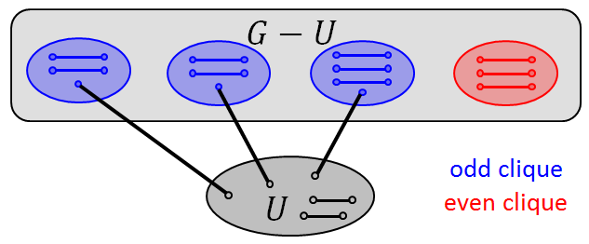
$U$ clique ⇒ all $U$’s rest vertices (even) can be matched ⇒ $G$has perfect matching.
So assume that $G−U$ is not all cliques.
There are non-adjacent vertices $x,z∈G−U$ sharing a common vertex $y∉U$ (otherwise $x,z$ are in clique).

Slide 57
Since $y∉U$ ($d\left(v\right)=\left|V\right|−1$ $∀v ∈U$), there is $w∈G−U$ not adjacent to $y$.
$G$ maximal not having perfect matching ⇒
$∃$ $M_{1}$ perfect matchings in $G+xz$ , $xz∈M_{1}$, and
$∃$ $M_{2}$ perfect matchings in $G+yw$, $yw∈M_{2}$.

Slide 58
Showing $M_{1}∪M_{2}$ yields matching excluding $\left\{xz,yw\right\}$, contradicts $G$maximal with no perfect matching.
Let $F=M_{1}∆M_{2}$. $xz∈M_{1}$ and $yw∈M_{2}$⇒ $xz,yw∈F$.
$d\left(v\right)=1$ $∀v∈\left\{M_{1},M_{2}\right\}$ (perfect matchings) ⇒
$F$ has only isolated vertices and disjoint even cycles (open path ⇒ no perfect matching in either $M_{1}$or $M_{2}$).

Slide 59
W.l.o.g let $C$ be cycle in $F$ s.t. $xz∈C$, but $yw∉C$.
$$x$$
$$z$$
Then $M=\left(M_{2}∩C\right)∪\left(M_{1}\backslash C\right)$ is perfect matching in $G$, but $xz,yw∉M$, contradiction to $G$.

Slide 60
If $xz,yw∈C$, following cycle occurs.
$$y$$
$$w$$
$$x$$
$$z$$
Here is $V\left(C\right)$ matching avoiding $xz$ and $yw$. Outside $C$ use either $M_{1}$or $M_{2}$ edges, ⇒ perfect matching in $G$. $∎$
$$y$$
$$w$$
$$x$$
$$z$$

Slide 61
Application: Clock Gating Optimization
Clock (CLK) of flip-flops (FFs) disabled if data unchanged.
k
O
X
D1
FF
CL
D2
Q1
FF
clk_g
Q2
clk_g
D3
Latch
Q3
A
clk
To minimize gating overhead, group FFs in $k$-size sets for joint clock gating.

Slide 62
$k$: FF group size (optimize), $q$: FF’s probability for $D=Q$.
Savings (dynamic capacitance) at single FF (gain, loss):
$C_{\text{save}}≥q^{k}\left(C_{\text{FF}}+C_{\text{wire}}\right)−$
$\left[\frac{C_{\text{latch}}}{k}+\left(1−q\right)\left(C_{\text{wire}}+c_{\text{OR}}\right)\right]$
Derivate by $k$:
$q^{k}\text{ln}q\left(C_{\text{FF}}+C_{\text{wire}}\right)+\frac{C_{\text{latch}}}{k^{2}}=0$

Slide 63
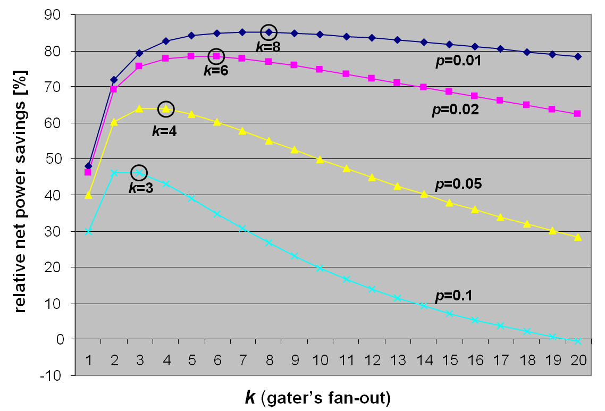

Slide 64
Optimal $k$-size Flip-flop Grouping
Given $n$ FFs toggled along $m+1$ cycles let $\text{a}=\left(a_{1},⋯,a_{m}\right)$ be $0/1$ FF’s toggling vector, where $a_{i}=\left(Q\left(i+1\right)≠Q\left(i\right)\right)$, $1≤i≤m$
Let ${\text{a}}_{i}$ and ${\text{a}}_{j}$be vectors of ${\text{FF}}_{i}$and ${\text{FF}}_{j}$, $1≤i,j≤n$.
Number of redundant clock pulses occurred by clocking jointly ${\text{FF}}_{i}$and ${\text{FF}}_{j}$ is $\left\|{\text{a}}_{i}⊕{\text{a}}_{j}\right\|$.
If $k=2$, minimizing the redundant clock pulses turns to finding min cost matching in weighted $K_{n}$.

Slide 65
$${\text{FF}}_{j}$$
$$\left\|{\text{a}}_{i}⊕{\text{a}}_{j}\right\|$$
$${\text{FF}}_{i}$$
Optimal FF pairing ($k=2$) is solved in polynomial time by minimal cost perfect matching.

Slide 66
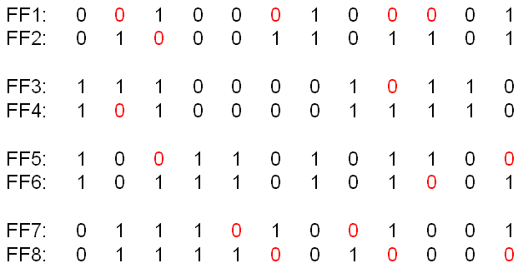
Example: 8 FFs, 13 cycles min cost matching. Redundant CLK occurs at 0.

Slide 67
What happens for $k>2$?
Is repetitive min cost matching optimal for $k=4,8,⋯,2^{p}$ ?
$${\text{a}}_{k}|{\text{a}}_{l}$$
$${\text{a}}_{i}|{\text{a}}_{j}$$
$${\text{FF}}_{i}$$
$${\text{FF}}_{k}$$
$${\text{FF}}_{j}$$
$${\text{FF}}_{l}$$

Slide 68
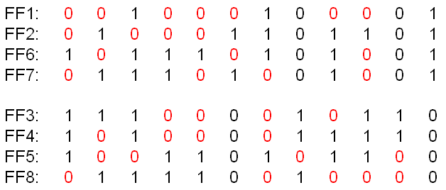
No! Here is the optimal 4-size grouping
Optimal $k$-grouping is NP-hard

Slide 69
Problem. Let $G\left(V,E\right)$ be a simple graph (no parallel edges and loops) of $2n$ vertices. Let the degree $d\left(v\right)≥n$, $∀v∈V$. Show that $G$ has a perfect matching.
Solution. If $G$ has no perfect matching, let $F$ be a maximum matching.
Let $xy∈F$. Since $F$ is not perfect and $\left|V\right|=2n$, there are at least two unmatched vertices $\left\{u,v\right\}$ s.t. $uv∉E$.
Consider how $\left\{x,y\right\}$ and $\left\{u,v\right\}$ can be connected. Assume $ux∈E$ and $vy∈E$ .

Slide 70
$$u$$
$$v$$
$$u$$
$$v$$
$$x$$
$$y$$
$$x$$
$$y$$
Then $xy$ can be removed and both $ux$ and $vy$ added, contradicting that $F$ is a maximum matching.
Consequently, $\left\{u,v\right\}$ cannot be both connected to any of the vertices involved in $F$, which number is at most $2n−2$. Consequently, $d\left(u\right)+d\left(v\right)≤2n−2$.
But $d\left(u\right)+d\left(v\right)≥2n$, hence a contradiction. $∎$

Slide 71
Problem Let $α$ be the size of the largest independent set of $G\left(V,E\right)$. Show that the vertices of $G$ can be covered by no more than $α$ vertex-disjoint paths.

Slide 72
Proof: Let $V_{1}$ be a maximum independent set of $G$, and let $V_{i+1}$ be the maximum independent set of $G−V_{1}−V_{2}−⋯−V_{i}$.
There is $\left|V_{i+1}\right|≤\left|V_{i}\right|$ by construction.
Since $V_{i}$ and $V_{i+1}$ are independent sets, for any $xy∈G\left[V_{i}∪V_{i+1}\right]$ there is $x∈V_{i}$ and $y∈V_{i+1}$. Hence $G\left[V_{i}∪V_{i+1}\right]$ is bipartite $G\left[V_{i},V_{i+1}\right]$.
$$V_{i}$$
$$V_{i+1}$$

Slide 73
We show that the minimum vertex cover satisfies $β\left(G\left[V_{i},V_{i+1}\right]\right)=\left|V_{i+1}\right|$.
Since $G\left[V_{i},V_{i+1}\right]$ is bipartite the minimum vertex cover may consist of $V_{i+1}$ vertices alone.
It must also include all the vertices of $V_{i+1}$, as otherwise $V_{i}$ could be enlarged, hence not maximal by its choice.
Consequently $β\left(G\left[V_{i},V_{i+1}\right]\right)=\left|V_{i+1}\right|$.

Slide 74
By König’s theorem there is$β\left(G\left[V_{i}∪V_{i+1}\right]\right)=$ $α^{′}\left(G\left[V_{i}∪V_{i+1}\right]\right)$. ⇒ $∃$ matching $F_{i+1}$of $V_{i+1}$ into $V_{i}$.
$$V_{i}$$
$$V_{i+1}$$
$F_{2}∪F_{3}∪⋯$consists of $\left|V_{2}\right|$ vertex-disjoint paths covering $V\left(G\right)$, except $\left|V_{1}\right|−\left|V_{2}\right|$ vertices of $V_{1}$.
Taking $V_{1}−V_{2}$as one-point paths, we obtain $\left|V_{1}\right|=α\left(G\right)$ vertex-disjoint paths covering $V\left(G\right).$ $∎$

