Slide 1
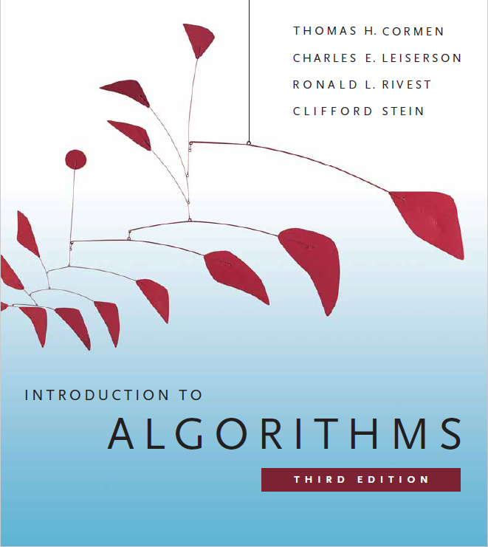
Order Statistics
Prepared by Shmuel Wimer
Courtesy of Prof. Dror Rawitz

Slide 2
Order Statistics and Selection Problem
The $i\text{th}$ order statistics of $n$ elements is the $i\text{th}$ smallest element.
Given a set $A$ of $n$ distinct elements, the $i\text{th}$ order statistics selection problem is to find $x∈A$ s.t. $x$ is larger than exactly $i−1$ elements.
Sorting $A$ in $O\left(n\log{n}\right)$ time enables to solve in $O\left(n\right)$ time, but faster solution in $O\left(n\right)$ time (no sorting) is possible.
Minimum $i=1$ and maximum $i=n$ problems complexity is $Θ\left(n\right)$.
$Θ\left(n\right)$ is possible for any $i\text{th}$ order statistics.

Slide 3
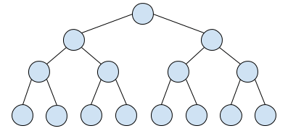
Finding the 2nd Smallest
Can be found by knockout tournament with $n+\left\lceil \log{n}\right\rceil −2$
comparisons.
2
6
2
7
6
2
3
10
7
6
9
8
2
12
3

Slide 4
Divide input into $k=\left\lceil n/2\right\rceil$ element pairs.
Get the set of $k$ smaller of every pair.
If $k==1$ stop, smallest found. Else set $n=k$ and go back to 1.
Knockout tournament has $n−1$ comparisons.
Smallest wins after $\left\lceil \log{n}\right\rceil$ comparisons, implying binary tree.
At some comparison the smallest must beat the 2nd smallest.
Traversal of the $\left\lceil \log{n}\right\rceil −1$ beats of smallest discover the 2nd.

Slide 5
Selection of $k$th Order Statistics in Expected $Θ\left(n\right)$
A divide-and-conquer algorithm similar to Quicksort, except that it proceeds with only one of the partitions rather than both.
$\text{RANDOMIZED}\text{−}\text{SELECT}$ seeks the $i\text{th}$ order statistics of $A$.
It partitions the array recursively.
It chooses a pivot randomly with $\text{RANDOMIZED}\text{−}\text{PARTITION}$but proceed with only one side of the partition where $i$ is surely located.

Slide 6
$\text{RANDOMIZED}\text{−}\text{SELECT}\left(A,p,r,i\right)$ // $i\text{th}$order statistics
$\text{if} p==r \text{return} A\left[p\right]$ // $A\left[p\right]$ $i\text{th}$smallest element
// partition $A\left[p..r\right]$ into $A\left[p..q−1\right]$ and $A\left[q+1..r\right]$
// around pivot $A\left[q\right]$
$q=\text{RANDOMIZED}\text{−}\text{PARTITION}\left(A,p,r\right)$
$k=q−p+1$ // number of elements in $A\left[p..q\right]$
$\text{if} i==k \text{return} A\left[q\right]$ // $A\left[q\right]$ is $i\text{th}$smallest element
$\text{else} \text{if} i<k$ // $i\text{th}$is in the lower part
$\text{return}$ $\text{RANDOMIZED}\text{−}\text{SELECT}\left(A,p,q−1,i\right)$
$\text{else}$ // $i\text{th}$is in the higher part
$\text{return}$ $\text{RANDOMIZED}\text{−}\text{SELECT}\left(A,q+1,r,i−k\right)$

Slide 7
Run time analysis
Worst-case run time is $Θ\left(n^{2}\right)$. When it happens? (HW)
Run time $T\left(n\right)$ on $A\left[p..r\right]$ of $n$ elements is random variable.
$\text{RANDOMIZED}\text{−}\text{PARTITION}\left(A,p,r\right)$ likely returns any element as pivot $A\left[q\right]$. ⇒ $Pr\left[\left|\left[p..q\right]\right|=k\right]=1/n$, $1≤k≤n$.
Define random variable $X_{k}=\left\{\begin{matrix}1 & \left|\left[p..q\right]\right|=k \\ 0 & \text{otherwise}\end{matrix}\right.$ ⇒ $\text{E}\left[X_{k}\right]=\frac{1}{n}$.
It is unknown a priori whether selection proceeds with $A\left[p..q−1\right]$, $A\left[q\right]$ or $A\left[q+1..r\right]$, so larger interval is safely assumed.

Slide 8
When $X_{k}=1$, the implied subarrays have size $k−1$ and $n−k$. ⇒ $T\left(n\right)≤\sum_{k=1}^{n}{X_{k}∙\left(T\left(\text{max}\left(k−1,n−k\right)\right)+O\left(n\right)\right)}$.
Taking expectation and applying its linearity, there is
$\text{E}\left[T\left(n\right)\right]≤\sum_{k=1}^{n}{\text{E}\left[X_{k}∙T\left(\text{max}\left(k−1,n−k\right)\right)\right]+O\left(n\right)}$
Independence: $\text{Pr}\left[X_{k}=0 \text{/} 1|\text{max}\left(k−1,n−k\right)\right]=\text{Pr}\left[X_{k}=0 \text{/} 1\right]$
$=\sum_{k=1}^{n}{\text{E}\left[X_{k}\right]∙\text{E}\left[T\left(\text{max}\left(k−1,n−k\right)\right)\right]+O\left(n\right)}$
$=$ $\frac{1}{n}\sum_{k=1}^{n}{\text{E}\left[T\left(\text{max}\left(k−1,n−k\right)\right)\right]+O\left(n\right)}$.

Slide 9
There is $\text{max}\left(k−1,n−k\right)=\left\{\begin{matrix}k−1 & \text{if} k>\left\lceil n/2\right\rceil \\ n−k & \text{if} k≤\left\lceil n/2\right\rceil \end{matrix}\right.$.
In $\sum_{k=1}^{n}{\text{E}\left[∙\right]}$, for even $n$ each term from $T\left(\left\lceil n/2\right\rceil \right)$ to $T\left(n−1\right)$ appears twice. Same for odd $n$ plus $T\left(\left\lfloor n/2\right\rfloor \right)$ which appears once. ⇒
$\text{E}\left[T\left(n\right)\right]≤$ $\frac{2}{n}\sum_{k=\left\lfloor n/2\right\rfloor }^{n−1}{\text{E}\left[T\left(k\right)\right]+O\left(n\right)}$.
Above recursion is solved by substitution, yielding $\text{E}\left[T\left(n\right)\right]=O\left(n\right)$. (HW, see $\text{CLRS} \text{9.2}$).

Slide 10
Selection of $k$th Order Statistics in $O\left(n\right)$ Worst Case
$\text{SELECT}\left(A,k\right)$
Divide input into $\left\lceil \frac{n}{5}\right\rceil$ groups of 5 elements, one possibly smaller.
Find the median of each group. Let $B$ be the set of all medians.
Let $x=\text{SELECT}\left(B,\left\lfloor \frac{\left|B\right|}{2}\right\rfloor \right)$ be $B$’s median.
Divide $A$ around $x$ : $L=\left\{a∈A | a<x\right\}$ , $R=\left\{a∈A | a>x\right\}$.
If $k=\left|L\right|+1$ return $x$.
If $k≤\left|L\right|$ then $\text{SELECT}\left(L,k\right)$ else $\text{SELECT}\left(R,k−\left(\left|L\right|+1\right)\right)$.
$$k>\left|L\right|+1$$

Slide 11
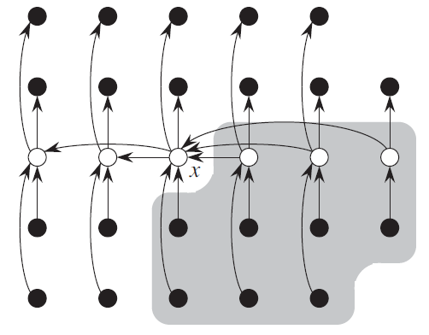
●$→$●
greater to smaller
$$A$$
Surely smaller
$$x:\left\lfloor {\left|B\right|}/2\right\rfloor$$
$$B$$
$$x$$
$\left|L\right|≥\frac{n}{4}$ and $\left|R\right|≥\frac{n}{4}$ guaranteed.
Surely greater

Slide 12
Correctness proof:
Consider $\text{SELECT}\left(A_{i},k_{i}\right)$ call at line 6, where $A_{0}=A$ and $k_{0}=k$. Assume by induction that $k_{i}=k$ and consider $\left(A_{i+1},k_{i+1}\right)$. Then
$$k_{i}=k$$
If $k_{i}≤\left|L_{i}\right|$
then $k_{i+1}=k_{i}=k$
$$A_{i+1}=L_{i}$$
$${x }_{i}$$
$$R_{i}$$
$$k_{i+1}$$
$$k_{i}=k$$
else $k_{i+1}=k_{i}−\left(\left|L_{i}\right|+1\right)$
$$L_{i}$$
$${x }_{i}$$
$$A_{i+1}=R_{i}$$
$$k_{i+1}=k_{i}−\left|L_{i}\right|$$

Slide 13
Run time analysis: Assume w.l.o.g that all the elements are distinct.
Then at least half of the medians in step 2 are not smaller than $x$.
⇒ At least half of the $\left\lceil \frac{n}{5}\right\rceil$ groups contribute 3 elements >$x$, maybe except one smaller group and the group containing $x$.
⇒ $\left|R\right|≥3\left(\frac{1}{2}\left\lceil \frac{n}{5}\right\rceil −2\right)≥\frac{3n}{10}−6$. Similarly, $\left|L\right|≥\frac{3n}{10}−6$.
Consequently, $\frac{3n}{10}−6≤\left|L\right|,\left|R\right|≤\frac{7n}{10}+6$.

Slide 14
Let $T\left(n\right)$ be the worst-case run time. Steps 1, 2 and 4 take $O\left(n\right)$ time.
Steps 3 takes $T\left(\left\lceil n/5\right\rceil \right)$ time.
Step 6 takes at most $T\left({7n}/{10}+6\right)$ time.
The following recurrence is in order
$T\left(n\right)=T\left(\left\lceil n/5\right\rceil \right)+T\left({7n}/{10}+6\right)+O\left(n\right)$.
We show that $T\left(n\right)=O\left(n\right)$.
Assume $T\left(n\right)≤cn$ for sufficiently large $n$ and a constant $c$. Then

Slide 15
$T\left(n\right)≤c\left(\left\lceil n/5\right\rceil \right)+c\left({7n}/{10}+6\right)+an$
$≤c\left(n/5+1\right)+c\left({7n}/{10}+6\right)+an$
$={9cn}/{10}+7c+an$
$=cn+\left({−cn}/{10}+7c+an\right)≤cn$
$$O\left(n\right)=an$$
by assumption
⇒ ${−cn}/{10}+7c+an≤0$
⇒ $c≥10a\left(n/{\left(n−70\right)}\right)→10a$ as $n→∞$.
Choosing $c≥20a$ will satisfy (1). ∎

Slide 16
What happens if 5 is replaced by 3? 7? (HW).
SELECT is a deterministic algorithm. We can use probabilistic pivot choice in line 3 (as in Quicksort) and then proceed in one side of the partitions.
Show that its expected run time is linear (HW).
Quicksort can use SELECT for balanced partition, yielding worst-case $O\left(n\log{n}\right)$ time deterministic Quicksort.
Impractical because of the large constants in SELECT.

