Slide 1
Fibonacci Heaps
Prepared by Shmuel Wimer
Courtesy of Prof. Dror Rawitz

Slide 2
Priority Queue
$$\text{INSERT}$$
in
out
$$4$$
$$5$$
$$3$$
$$5$$
$$4$$
$$3$$
$$7$$
$$7$$
$$\text{EXTRACT}\text{-}\text{MIN}$$
in
out
$$7$$
$$5$$
$$4$$
$$3$$
$$\text{DECREASE}\text{-}\text{KEY}$$
in
out
$$5$$
$$4$$
$$3$$
$$5$$
$$4$$
$$3$$
$$1$$
$$7$$

Slide 3
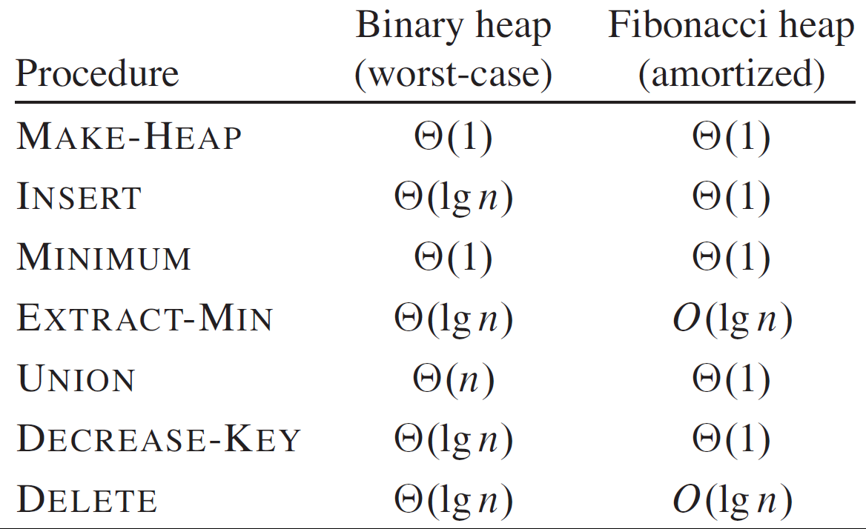

Slide 4
Fibonacci heap is a collection of rooted trees that are min-heaps.
$$H.\text{min}$$

Slide 5
Each node $x$ has a pointer to parent and to all its children, which are doubly linked in circularly. Siblings may appear in any order.
A node can be inserted and deleted in $O\left(1\right)$, and same for concatenating linked lists into one.
$$H.\text{min}$$
root list
$$\text{m}\text{arked} \text{node}$$

Slide 6
Potential Function
$x.\text{deg}$stores the number of $x$’s children.
$x.\text{mark}$ (Boolean) indicates whether node $x$ has lost a child since last time $x$ was made child of another node. New $x$ is unmarked.
$x$becomes unmarked whenever it is made child of another node.
Given a Fibonacci heap $H$, $t\left(H\right)$ is the number of trees in the root list, and $m\left(H\right)$ is $H$’s number of marked nodes. The potential of $H$ is
$Φ\left(H\right)=t\left(H\right)+2m\left(H\right)$.

Slide 7
By definition $Φ\left(H\right)≥0$, and initially $H=∅$, hence $Φ\left(H\right)=0$.
For the heap example there is $Φ\left(H\right)=t\left(H\right)+2m\left(H\right)=5+2∙3=11$.
The potential of set of heaps is the sum of the individual heaps.
We assume that a unit of potential can pay for any $O\left(1\right)$ work that we might encounter.
Let $\left|H\right|=n$. We assume that the bound $\max_{x∈H}{x.\text{deg}}≤D\left(n\right)$ is known a priori.

Slide 8
Mergeable-Heap Operations
Operations delay work as long as possible.
For example, $\text{INSERT}$ first adds to the root list, which takes $O\left(1\right)$. Starting empty, and then follow by $k$ $\text{INSERT}$, the heap becomes just root list of $k$ nodes.
If an $\text{EXTRACT}\text{−}\text{MIN}$ follows, after removing $H.\text{min}$ the new $\text{min}$ is searched through the other $k−1$ nodes.
This traversal also consolidate nodes into min-heap-ordered trees, thus reducing the size of the root list.

Slide 9
Insertion, Finding Minimum and Union
$\text{FIB}\text{−}\text{HEAP}\text{−}\text{INSERT}\left(H,x\right)$
// initialize degree, parent, child and mark of node $x$
$x.\text{deg}=0$ ; $x.\text{p}=∅$ ; $x.\text{child}=∅$ ; $x.\text{mark}=\text{FASLSE}$ ;
$\text{if} H.min⁡==∅$
$\text{create} \text{a} \text{root} \text{list} \text{for} \text{H} \text{containing} \text{just} x$
$H.min⁡=x$
$\text{else}$ $\text{insert} x \text{into} H’\text{s} \text{root} \text{list}$
$\text{if} \left(x.key<H.min.key\right)$
$H.min⁡=x$ // new node’s key is smallest
$++H.\text{m}\text{un}$ // increase heap size

Slide 10
$$H.\text{min}$$
$$H:$$
$\text{FIB}\text{−}\text{HEAP}\text{−}\text{INSERT}\left(H,x\right)$, $x.key=21$
$$H.\text{min}$$
$$H^{′}:$$

Slide 11
$∆Φ=Φ\left(H^{′}\right)−Φ\left(H\right)$
$=\left(\left(t\left(H\right)+1\right)+2m\left(H\right)\right)−\left(t\left(H\right)+2m\left(H\right)\right)=1$
The actual cost of $\text{FIB}\text{−}\text{HEAP}\text{−}\text{INSERT}$ is $O\left(1\right)$ and amortized cost is $O\left(1\right)+1=O\left(1\right)$.
The amortized cost of finding minimum is $O\left(1\right)$ and $∆Φ=0$, so the amortized cost is also $O\left(1\right)$.
Union of $H_{1}$ and $H_{2}$ concatenates their root lists and then determines the new minimum node. $H_{1}$ and $H_{2}$ are destroyed.

Slide 12
$\text{FIB}\text{−}\text{HEAP}\text{−}\text{UNION}\left(H_{1}\text{,} H_{2}\right)$
$H=\text{MAKE}\text{−}\text{FIB}\text{−}\text{HEAP}()$ // create empty heap
$H.min=H_{1}.min$ // make $H$ be $H_{1}$ set heap minimum
concatenate root list of $H_{2}$ with root list of $H$
$\text{if} \left(H_{1}.min⁡==∅ \right)||$ // set heap minimum
$\left(\left(H_{2}.min⁡≠∅ \right)\&\&\left(H_{2}.min.key<H_{1}.min.key\right)\right)$
$H.min=H_{2}.min$
$H.\text{mun}=H_{1}.\text{mun}\text{+}H_{2}.\text{mun}$ // determine heap size
$\text{return} H$

Slide 13
The change in potential is
$$∆Φ=Φ\left(H\right)−\left(Φ\left(H_{1}\right)+Φ\left(H_{2}\right)\right)=\left(t\left(H\right)+2m\left(H\right)\right)−\left(\left(t\left(H_{1}\right)+2m\left(H_{1}\right)\right)+\left(t\left(H_{2}\right)+2m\left(H_{2}\right)\right)\right)=0$$
The amortized cost of $\text{FIB}\text{−}\text{HEAP}\text{−}\text{UNION}$ is therefore equal to its $O\left(1\right)$ actual cost.

Slide 14
Min Node Extraction
The most complicated of the operations.
It is where the delayed work of consolidating trees in the root list finally occurs.

Slide 15
$\text{FIB}\text{−}\text{HEAP}\text{−}\text{EXTRACT}\text{−}\text{MIN} \left(H\right)$
$z=H.min$
$\text{if} z≠∅$ // verify non empty heap
$∀x \text{s}\text{.}\text{t}\text{. }x.p==z$ // add all min node children to root list
$\text{add} x \text{to} H^{′}\text{s} \text{root} \text{list}$ ; $x.p=∅$ ;
$\text{remove} z \text{from} H^{′}\text{s} \text{root} \text{list}$
$\text{if} z==z.\text{right}$ $H.min=∅$ // check for empty new heap
$\text{else} H.min=z.\text{right}$ // new min is the node right to old
$\text{CONSOLIDATE}\left(H\right)$
$H.\text{mun}=H.\text{mun}−\text{1}$ // decrease heap size
$\text{return} z$

Slide 16
$$H.\text{min}$$
Upon removal of the min node $3$, its children are added to the root list
The note $17$ next to the extracted min $3$becomes the new min.
It is not the min ($7$ is), and consolidation will fix it.
$$H.\text{min}$$

Slide 17
Consolidation of the root list consists of repeatedly execution of two steps until every root in the list has a distinct degree value:
Find two roots $x$ and $y$ in the root list with the same degree. W.l.o.g let $x.\text{key}≤y.\text{key}$.
Link $y$ to $x$: remove $y$ from the root list, making $y$ a child of $x$, incrementing $x.\text{deg}$and resetting $y.\text{mark}=\text{FALSE}$.
Consolidation uses an auxiliary array $A\left[0..D\left(H.\text{num}\right)\right]$ to track roots’ degrees. If $A\left[i\right]=y$ then $y.\text{deg}=i$.

Slide 18
$$0$$
$$1$$
$$2$$
$$3$$
$$A$$
$$A$$
$$A$$
$$A$$
/
/
/
/
Consolidation processes the root list by starting at the node pointed to by $H.\text{min}$ and following right pointers node after node.
$A\left[∗\right]$ is filled in turn according to node’s degree.

Slide 19
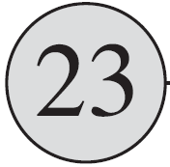
$$0$$
$$1$$
$$2$$
$$3$$
$$A$$
$$/$$
$$/$$
$$/$$
We want at most one root per degree. Hence if $A\left[x.\text{deg}\right]=y$, $x$and $y$are linked s.t. whichever has the smaller key becomes the parent.
Parent’s degree is increased by 1.

Slide 20
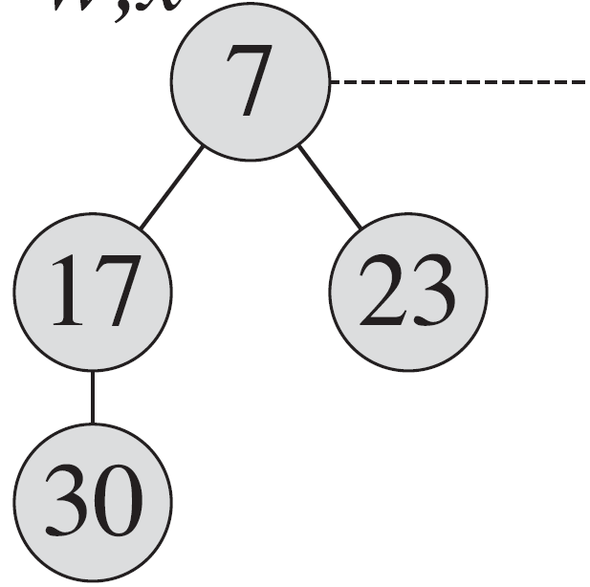
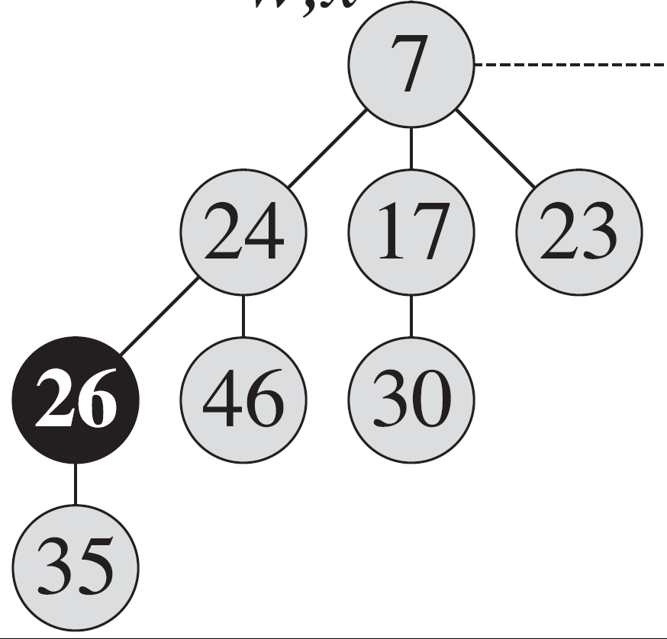
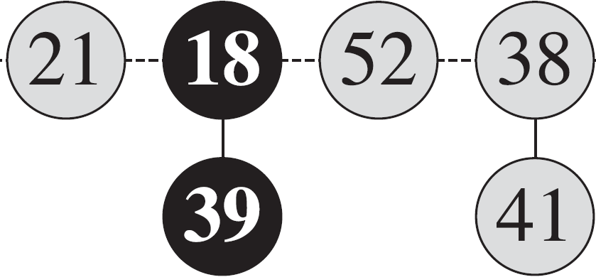
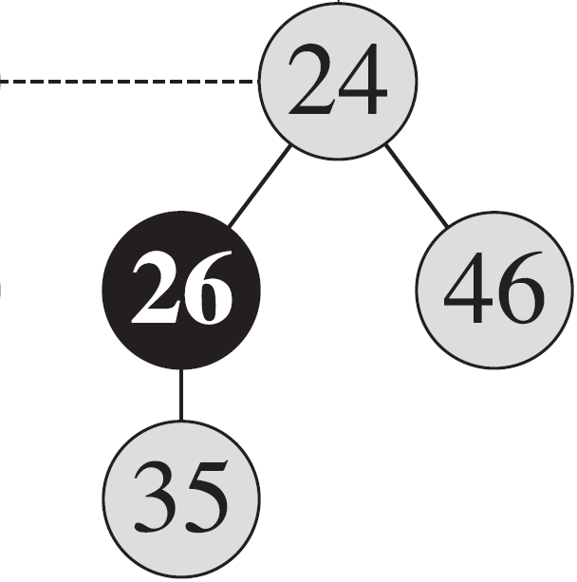
$$0$$
$$1$$
$$2$$
$$3$$
$$A$$
$$/$$
$$/$$
$$/$$
$$/$$
This continues until $A\left[x.\text{deg}\right]=∅$, ensuring unique node per degree. We then set $A\left[x.\text{deg}\right]=x$.

Slide 21
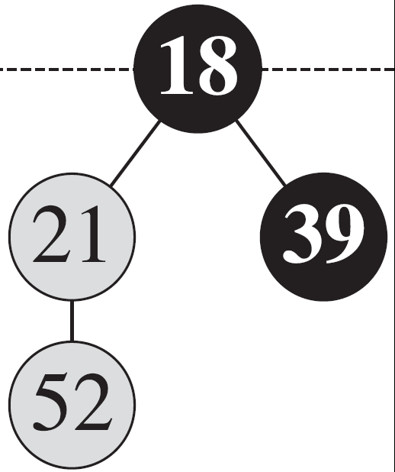
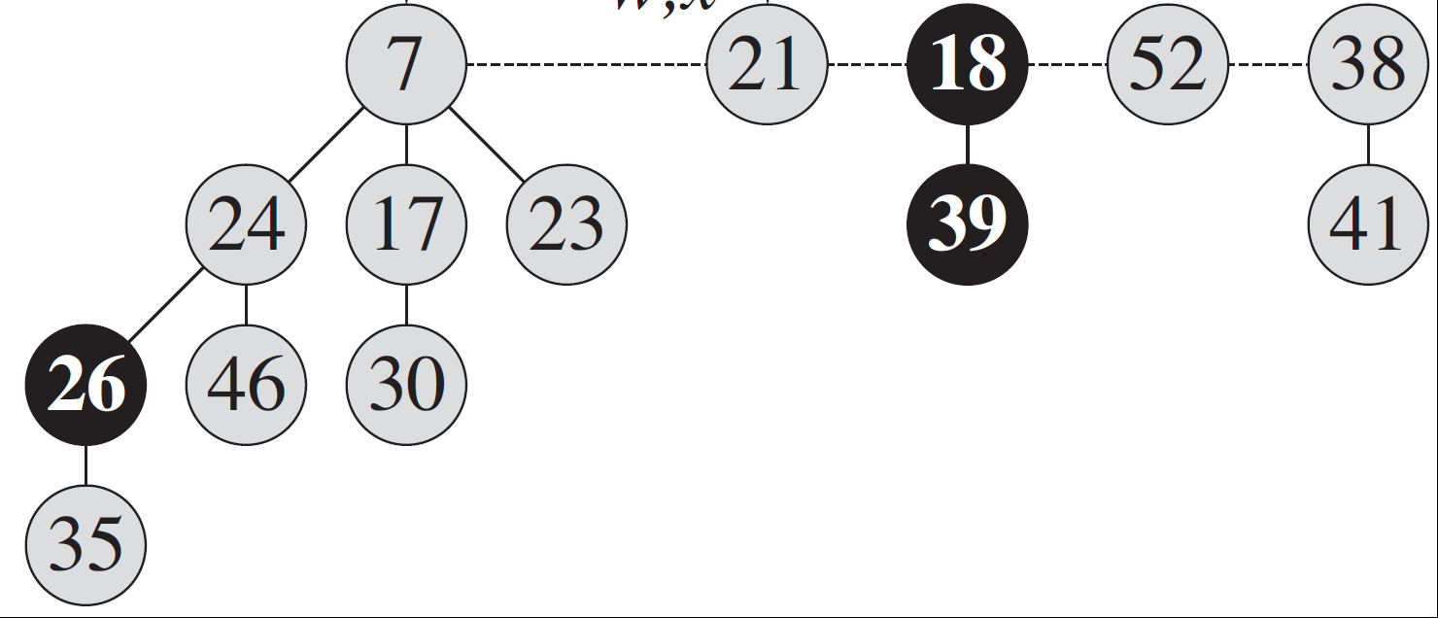
$$0$$
$$1$$
$$2$$
$$3$$
$$A$$
$$/$$
$$/$$
$$/$$
Iterations over root list terminate once nodes’ degrees are distinct.

Slide 22
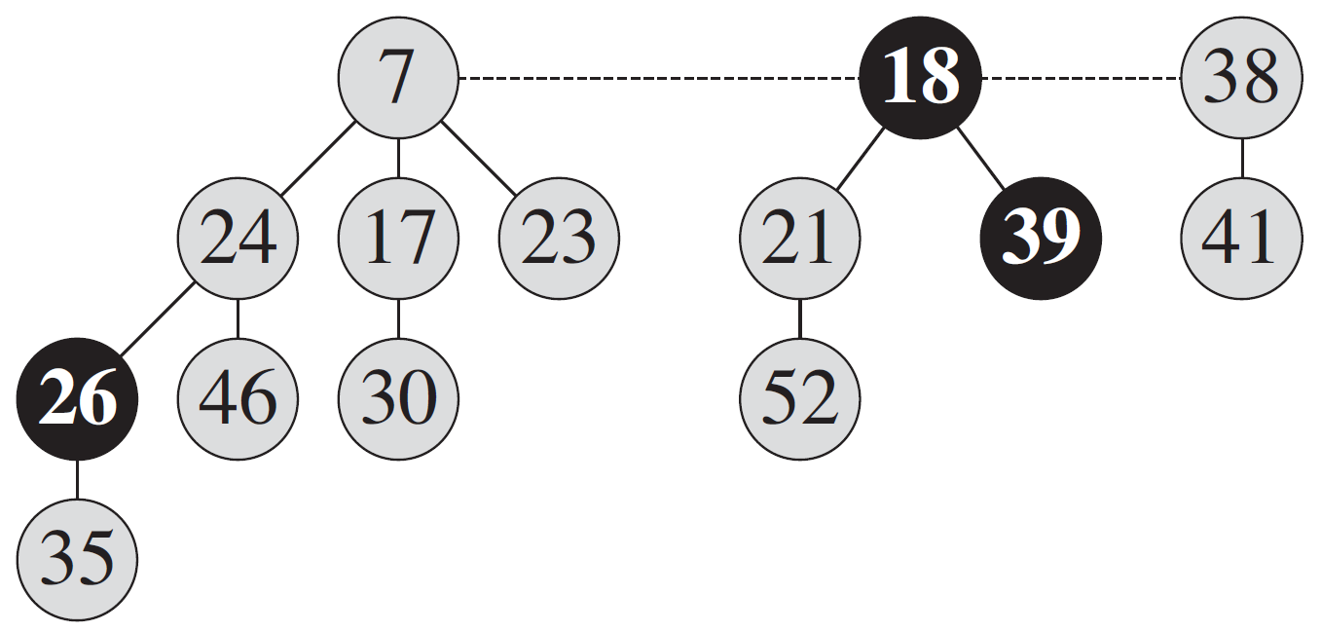
$$H.\text{min}$$
Root list is reconstructed by traversing the array $A$.

Slide 23
The amortized cost of extracting the minimum node is $O\left(D\left(n\right)\right)$.
The extraction of the minimum node per se contributes $O\left(D\left(n\right)\right)$ since all its children join the root list.
Also, the construction of the new root list by traversal over $A\left[0..D\left(n\right)\right]$ yields $O\left(D\left(n\right)\right)$ cost.
For the consolidation iteration we use aggregate analysis.
Since before iterations $H.\text{min}$ is deleted and its children join the root list, its size is bounded by $D\left(n\right)+t\left(H\right)−1$.

Slide 24
Each iteration processes a node of the new root list, where every time an action takes one of the roots is linked to another.
⇒ Total number of actions over all root list nodes is $O\left(D\left(n\right)+t\left(H\right)\right)$.
The potential before extracting the minimum node is $t\left(H\right)+2m\left(H\right)$, and is $\left(D\left(n\right)+1\right)+2m\left(H\right)$ afterward. ⇒ Amortized cost is at most
$O\left(D\left(n\right)+t\left(H\right)\right)+\left(\left(D\left(n\right)+1\right)+2m\left(H\right)\right)−\left(t\left(H\right)+2m\left(H\right)\right)=O\left(D\left(n\right)\right)+O\left(t\left(H\right)\right)−t\left(H\right)=O\left(D\left(n\right)\right)$.
consolidation work
$Φ\left(H\right)$ before
$Φ\left(H\right)$ after
scale up hidden constant

Slide 25
Decreasing a Key
$\text{FIB}\text{−}\text{HEAP}\text{−}\text{DECREASE}−KEY\left(H,x,k\right)$
$if k>x.key$
$error "new key greater than old“$
$x.key=k$; $y=x.p$ // modify node’s key and get its parent
$\text{if} y≠∅ \&\& x.key<y.key$ // promote node to root list
$CUT\left(H,x,k\right)$ // remove $x$ from $y$’s child list
$CASCADING−CUT\left(H,x,k\right)$
$\text{if} x.key<H.min.key$ // update min mode
$H.min=x$

Slide 26
If $x$ is a root or if $x$’s key is not smaller than its parent’s key, no structural changes occur, since min-heap is preserved.
If min-heap order has been violated, many changes may occur.
Firstly, $CUT$breaks the link between $x$ and its parent, and makes $x$ a root.
The mark attributes record the history of each node. It is made false, $x.mark=FALSE$.
Suppose that node $x$gone through the following events :

Slide 27
1. at some time, $x$ was a root,
2. then $x$ was linked to (made the child of) another node,
3. then two children of $x$ were removed by $CUT$s.
As soon as the second child has been lost, we cut $x$ from its parent, making it a new root.
If steps 1 and 2 have occurred and one child of $x$ has been cut. The

Slide 28
Bounding the Maximum Degree
The analysis so far relied on $D\left(n\right)=O\left(\log{n}\right)$, proved subsequently.
In particular $D\left(n\right)≤\left\lfloor \log_{φ}{n}\right\rfloor$, where $φ={\left(1+\sqrt{5}\right)}/2=1.618…$ is the golden ration, the positive root of $x^{2}=x+1$.
Let $\text{size}\left(x\right)$ be the number of nodes, including $x$ itself, in the subtree rooted at $x$.
It is shown that $\text{size}\left(x\right)$is exponential in $x.\text{deg}$, which will imply the bound.

Slide 29
Lemma 1: Let $x.\text{deg}=k$ and $y_{i} , 1≤i≤k$ be $x$’s children indexed in the order they have been linked to $x$. Then
$y_{1}.\text{deg}≥0$ and $y_{i}.\text{deg}≥i−2$ , $2≤i≤k$ .
Proof: Obviously, $y_{1}.\text{deg}≥0$. Let $i≥2$. $y_{i}$ is linked to $x$by consolidation, a link conditioned by $y_{i}.\text{deg}=x.\text{deg}$.
Since $y_{1}…y_{i−1}$ are already linked, there is $y_{i}.\text{deg}=x.\text{deg}≥i−1$.
Since then, if $y_{i}$ had lost two children, $\text{CASCADING}\text{−}\text{CUT}$ would have been cut $y_{i}$ from $x$, ⇒ $y_{i}.\text{deg}≥\left(i−1\right)−1=i−2$. $∎$

Slide 30
Reminder of Fibonacci number definition
$$F_{k}=\left\{\begin{matrix}0 & \text{if} k=0 , \\ 1 & \text{if} k=1 , \\ F_{k−1}+F_{k−2} & \text{if} k≥1 .\end{matrix}\right.$$
Lemma 2: $∀k≥0$ $F_{k+1}=1+\sum_{i=0}^{k−1}{F_{i}}$.
Lemma 3: $∀k≥0$ $F_{k+2}≥φ^{k}$.
Proof: By induction on $k$.
For $k=0$ there is $F_{2}=1=φ^{0}$ , and for $k=1$ there is $F_{3}=2>φ^{1}$.

Slide 31
Assume by induction that $∀ i<k$ $F_{i+2}≥φ^{i}$.
There is $F_{k+2}=F_{k+1}+F_{k}≥φ^{k−1}+φ^{k−2}$
$=φ^{k−2}\left(φ+1\right)=φ^{k−2}φ^{2}=φ^{k}$. $∎$
Lemma 4: Let $x$ be a node of a Fibonacci heap, and let $k=x.\text{deg}$. Then $\text{size}\left(x\right)≥F_{k+2}≥φ^{k}$.
Proof: Let $H$ be any Fibonacci heap and $s_{k}$ be the minimum size of any node $x∈H$ s.t. $x.deg=k$. Trivially, $s_{0}=1$ and $s_{1}=2$.
Also, $s_{k+1}>s_{k}$ since the addition of a child increases node’s size.

Slide 32
Let $z∈H$ s.t. $\text{size}\left(z\right)=s_{k}$ and $z.\text{deg}=k$ and $y_{i} , 1≤i≤k$ be $z$’s children indexed in the order they have been linked to $z$.
Since $\text{size}\left(z\right)$ counts $1$ for $z$ and $\text{size}\left(y_{i}\right)≥1$, there is
(1) $s_{k}≥2+\sum_{i=2}^{k}{s_{y_{i}.\text{deg}}}≥2+\sum_{i=2}^{k}{s_{i−2}}$ .
Let us show that $∀k≥0$, $s_{k}≥F_{k+2}$.
For the bases $s_{0}=1=F_{2}$ and $s_{1}=2=F_{3}$.
Assume by induction that $∀i<k$ , $s_{i}≥F_{i+2}$. By the above
by lemma 1 $y_{i}.\text{deg}≥i−2$

Slide 33
By (1)
by induction
By lemma 2
$s_{k}≥2+\sum_{i=2}^{k}{s_{i−2}}≥2+\sum_{i=2}^{k}{F_{i}}=1+\sum_{i=0}^{k}{F_{i}}=F_{k+2}≥φ^{k}$. $∎$
$F_{0}=0$, $F_{1}=1$
By lemma 3
Corollary 5: $D\left(n\right)=O\left(\log{n}\right)$.
Proof: Let $x∈H$ be any node and let $x.deg=k$.
By lemma 4 there is ${n≥s}_{k}≥φ^{k}$. ⇒ $\log_{φ}{n}≥k$.
Since $k$ is an integer there is $k≤\left\lfloor \log_{φ}{n}\right\rfloor$. Hence, the maximum degree satisfied $D\left(n\right)=O\left(\log{n}\right)$. $∎$

