Slide 1


Weighted Graphs
Prepared by Shmuel Wimer
Instructed by Hillel Kugler and Shmuel Wimer

Slide 2
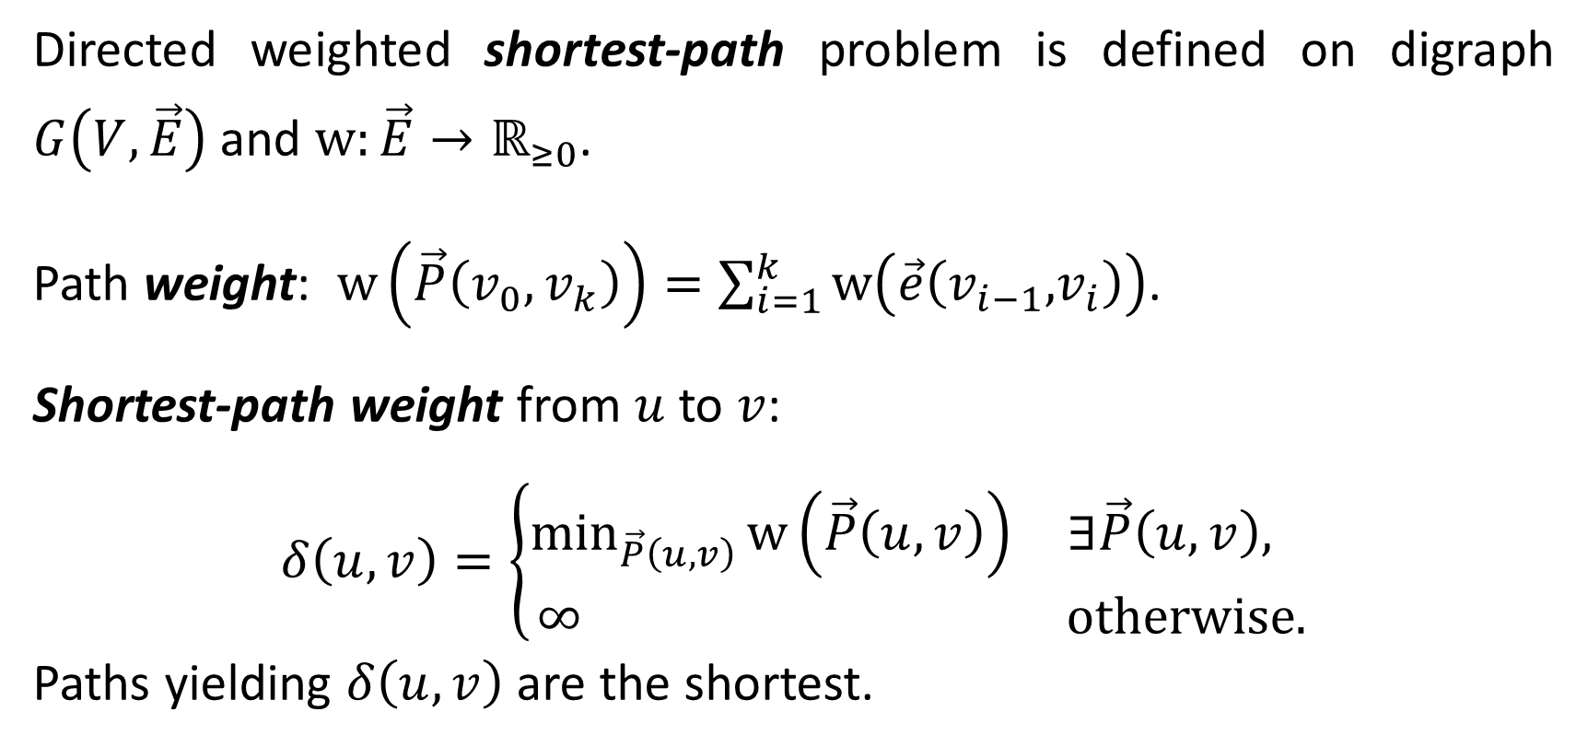
Single Source Shortest Paths
Directed weighted shortest-path problem is defined on digraph $G\left(V,\vec{E}\right)$ and $\text{w}:\vec{E}→ℝ_{≥0}$.
Path weight: $\text{w}\left(\vec{P}\left(v_{0},v_{k}\right)\right)=\sum_{i=1}^{k}{\text{w}\left(\vec{e}\left(v_{i−1}\text{,}v_{i}\right)\right)}$.
Shortest-path weight from $u$ to $v$:
$$δ\left(u,v\right)=\left\{\begin{matrix}\min_{\vec{P}\left(u,v\right)}{\text{w}\left(\vec{P}\left(u,v\right)\right)} & ∃\vec{P}\left(u,v\right), \\ ∞ & \text{otherwise}\text{.}\end{matrix}\right.$$
Paths yielding $δ\left(u,v\right)$ are the shortest.

Slide 3
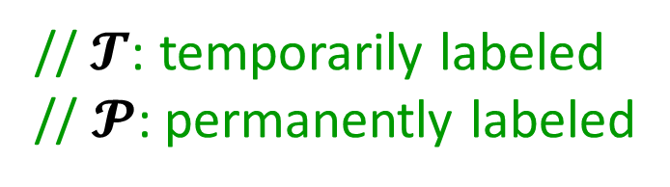

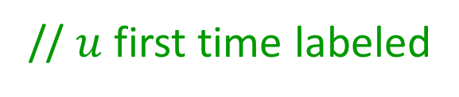
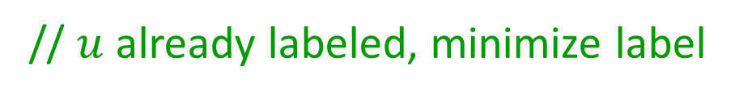
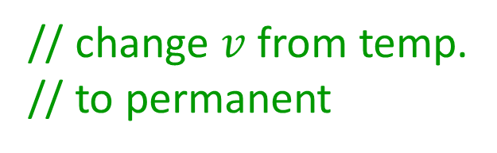
DIJKSTRA Algorithm (1959)
$\text{Procedure} \text{DIJKSTRA}\left(G\left(V,\vec{E}\right), s,\text{w}\text{:}\vec{E}\text{→}ℝ_{≥0};λ\right)$
$∀v∈V λ\left(v\right)=∞; λ\left(s\right)=0$
$𝓣=\left\{s\right\} ; 𝓟=∅$
$\text{while} 𝓣≠∅$
get $v∈𝓣$ s.t. $λ\left(v\right)$ is minimum
$𝓣=𝓣 \backslash \left\{v\right\} ; 𝓟=𝓟∪\left\{v\right\}$
$∀\vec{e}\left(v\text{,}u\right)$ $\text{do}$
$\text{if} u∈𝓣$
$λ\left(u\right)=\min\left(λ\left(u\right),λ\left(v\right)+\text{w}\left(\vec{e}\right)\right)$
$\text{else} \text{if} u∉𝓟$
$λ\left(u\right)=λ\left(v\right)+\text{w}\left(\vec{e}\right)$ ; $𝓣=𝓣∪\left\{u\right\}$
//$𝓣$: temporarily labeled
// $𝓟$: permanently labeled
// change $v$ from temp.
// to permanent
// $u$ already labeled, minimize label
// $u$ first time labeled

Slide 4



























































































$$∞$$
$$a$$
$$2$$
$$a$$
$$2$$
$$a$$
$$2$$
$$1$$
$$10$$
$$2$$
$$1$$
$$10$$
$$2$$
$$1$$
$$10$$
$$0$$
$$∞$$
$$0$$
$$4$$
$$∞$$
$$0$$
$$3$$
$$12$$
$$∞$$
$$s$$
$$4$$
$$b$$
$$8$$
$$d$$
$$s$$
$$4$$
$$b$$
$$8$$
$$d$$
$$s$$
$$4$$
$$b$$
$$8$$
$$d$$
$$7$$
$$5$$
$$3$$
$$7$$
$$5$$
$$3$$
$$7$$
$$5$$
$$3$$
$$∞$$
$$c$$
$$7$$
$$c$$
$$7$$
$$c$$
$$2$$
$$a$$
$$2$$
$$a$$
$$2$$
$$1$$
$$10$$
$$2$$
$$1$$
$$10$$
$$11$$
$$10$$
$$0$$
$$3$$
$$0$$
$$10$$
$$3$$
$$s$$
$$4$$
$$b$$
$$8$$
$$d$$
$$s$$
$$4$$
$$b$$
$$8$$
$$d$$
$$7$$
$$5$$
$$3$$
$$7$$
$$5$$
$$3$$
$$7$$
$$c$$
$$7$$
$$c$$

Slide 5
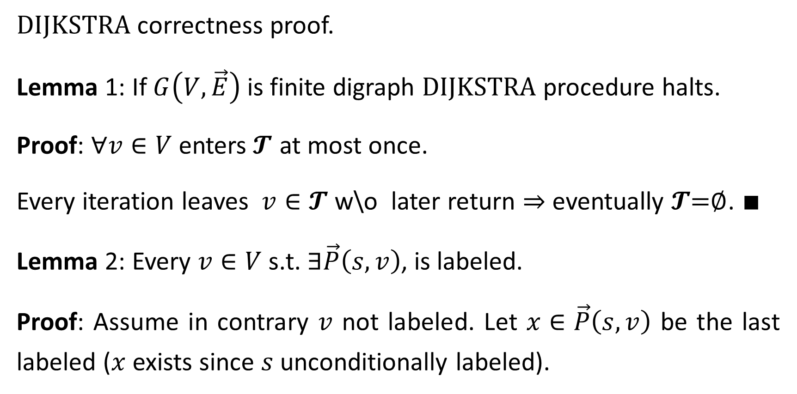
$\text{DIJKSTRA}$ correctness proof.
Lemma 1: If $G\left(V,\vec{E}\right)$ is finite digraph $\text{DIJKSTRA}$ procedure halts.
Proof: $∀v∈V$ enters$𝓣$ at most once.
Every iteration leaves $v∈𝓣$ w\o later return ⇒ eventually $𝓣\text{=}∅$. $∎$
Lemma 2: Every $v∈V$s.t. $∃\vec{P}\left(s,v\right)$, is labeled.
Proof: Assume in contrary $v$ not labeled. Let $x∈\vec{P}\left(s,v\right)$ be the last labeled ($x$exists since $s$ unconditionally labeled).

Slide 6
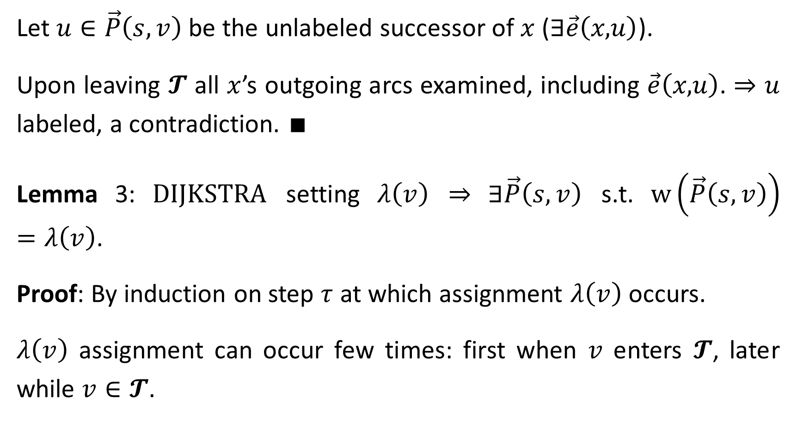
Let $u∈\vec{P}\left(s,v\right)$ be the unlabeled successor of $x$ ($∃\vec{e}\left(x\text{,}u\right)$).
Upon leaving $𝓣$ all $x$’s outgoing arcs examined, including $\vec{e}\left(x\text{,}u\right)$. ⇒ $u$ labeled, a contradiction. $∎$
Lemma 3: $\text{DIJKSTRA}$ setting $λ\left(v\right)$ ⇒ $∃\vec{P}\left(s,v\right)$ s.t. $\text{w}\left(\vec{P}\left(s,v\right)\right)=λ\left(v\right)$.
Proof: By induction on step $τ$ at which assignment $λ\left(v\right)$ occurs.
$λ\left(v\right)$ assignment can occur few times: first when $v$ enters $𝓣$, later while $v∈𝓣$.

Slide 7
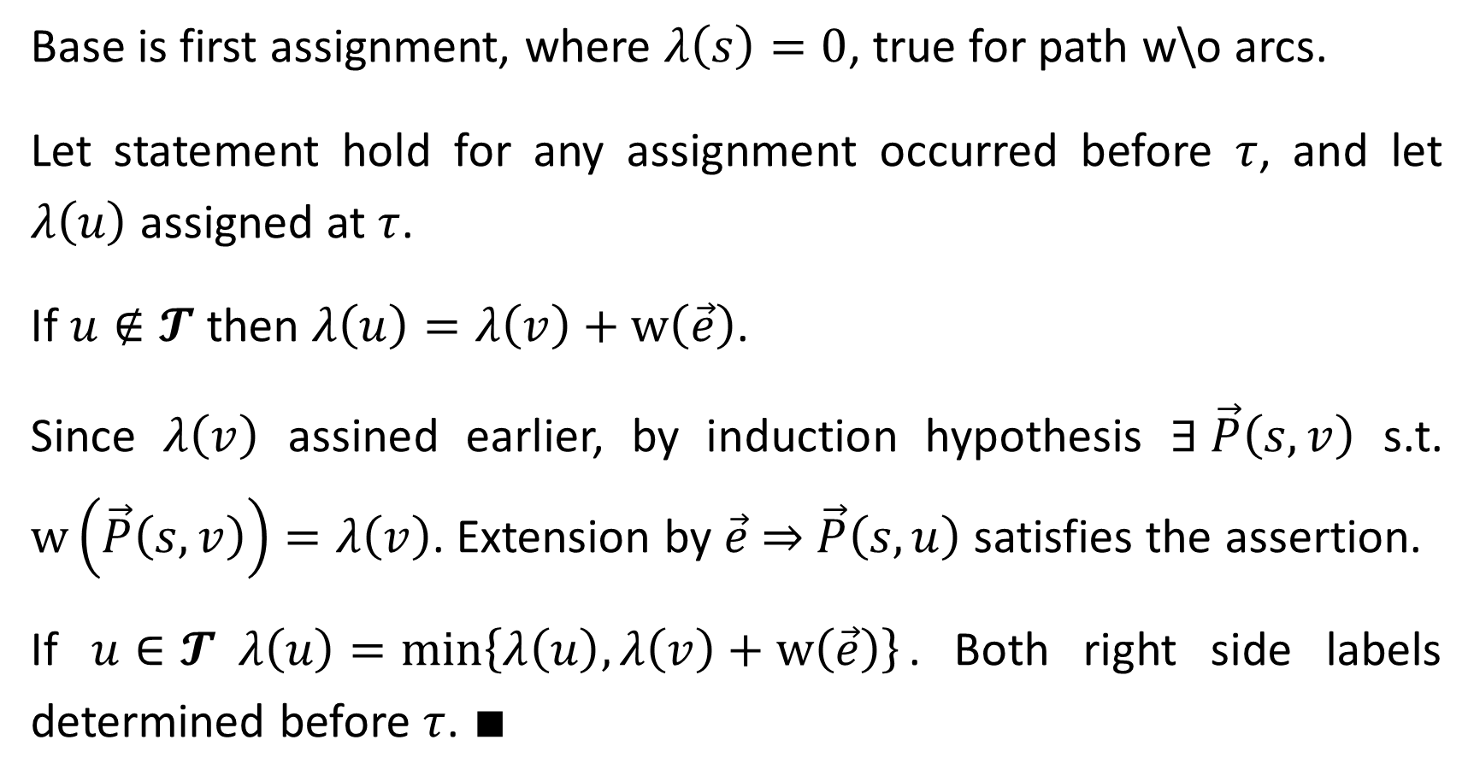
Base is first assignment, where $λ\left(s\right)=0$, true for path w\o arcs.
Let statement hold for any assignment occurred before $τ$, and let $λ\left(u\right)$ assigned at $τ$.
If $u∉𝓣$ then $λ\left(u\right)=λ\left(v\right)+\text{w}\left(\vec{e}\right)$.
Since $λ\left(v\right)$ assined earlier, by induction hypothesis $∃ \vec{P}\left(s,v\right)$ s.t. $\text{w}\left(\vec{P}\left(s,v\right)\right)=λ\left(v\right)$. Extension by $\vec{e}$ ⇒ $\vec{P}\left(s,u\right)$ satisfies the assertion.
If $u∈𝓣 λ\left(u\right)=\min\left\{λ\left(u\right),λ\left(v\right)+\text{w}\left(\vec{e}\right)\right\}$. Both right side labels determined before $τ$. $∎$

Slide 8
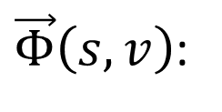
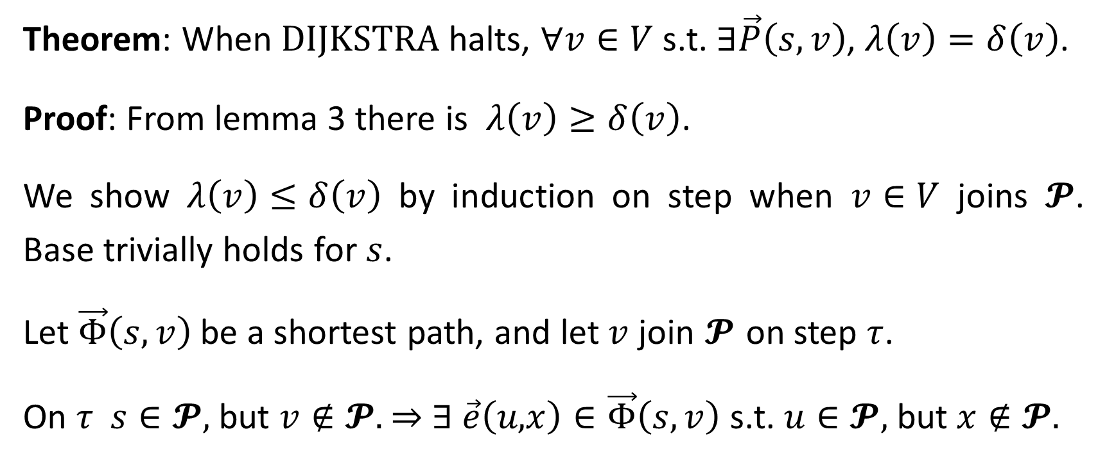





Theorem: When $\text{DIJKSTRA}$ halts, $∀v∈V$ s.t. $∃\vec{P}\left(s,v\right)$, $λ\left(v\right)=δ\left(v\right)$.
Proof: From lemma 3 there is $λ\left(v\right)≥δ\left(v\right)$.
We show $λ\left(v\right)≤δ\left(v\right)$ by induction on step when $v∈V$ joins $𝓟$. Base trivially holds for $s$.
Let $\vec{Φ}\left(s,v\right)$ be a shortest path, and let $v$ join $𝓟$ on step $τ$.
On $τ$ $s∈𝓟$, but $v∉𝓟$. ⇒ $∃$ $\vec{e}\left(u\text{,}x\right)∈\vec{Φ}\left(s,v\right)$ s.t. $u∈𝓟$, but $x∉𝓟$.
$\vec{Φ}\left(s,v\right)$:
$$s$$
$$\vec{e}$$
$$u$$
$$x$$
$$v$$

Slide 9
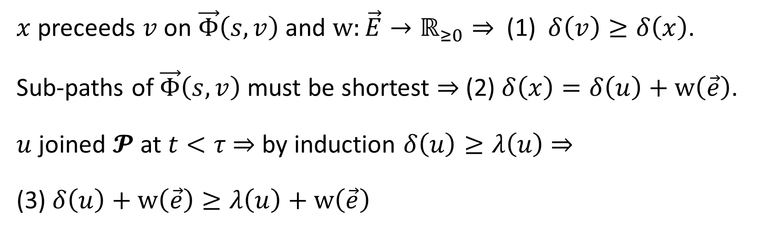
$x$preceeds $v$ on $\vec{Φ}\left(s,v\right)$ and $\text{w}:\vec{E}→ℝ_{≥0}$ ⇒ (1) $δ\left(v\right)≥δ\left(x\right)$.
Sub-paths of $\vec{Φ}\left(s,v\right)$ must be shortest ⇒ (2) $δ\left(x\right)=δ\left(u\right)+w\left(\vec{e}\right)$.
$u$joined $𝓟$ at $t<τ$⇒ by induction $δ\left(u\right)≥λ\left(u\right)$ ⇒
(3) $δ\left(u\right)+w\left(\vec{e}\right)≥λ\left(u\right)+w\left(\vec{e}\right)$
$\vec{Φ}\left(s,v\right)$:
$$s$$
$$\vec{e}$$
$$u$$
$$x$$
$$v$$

Slide 10
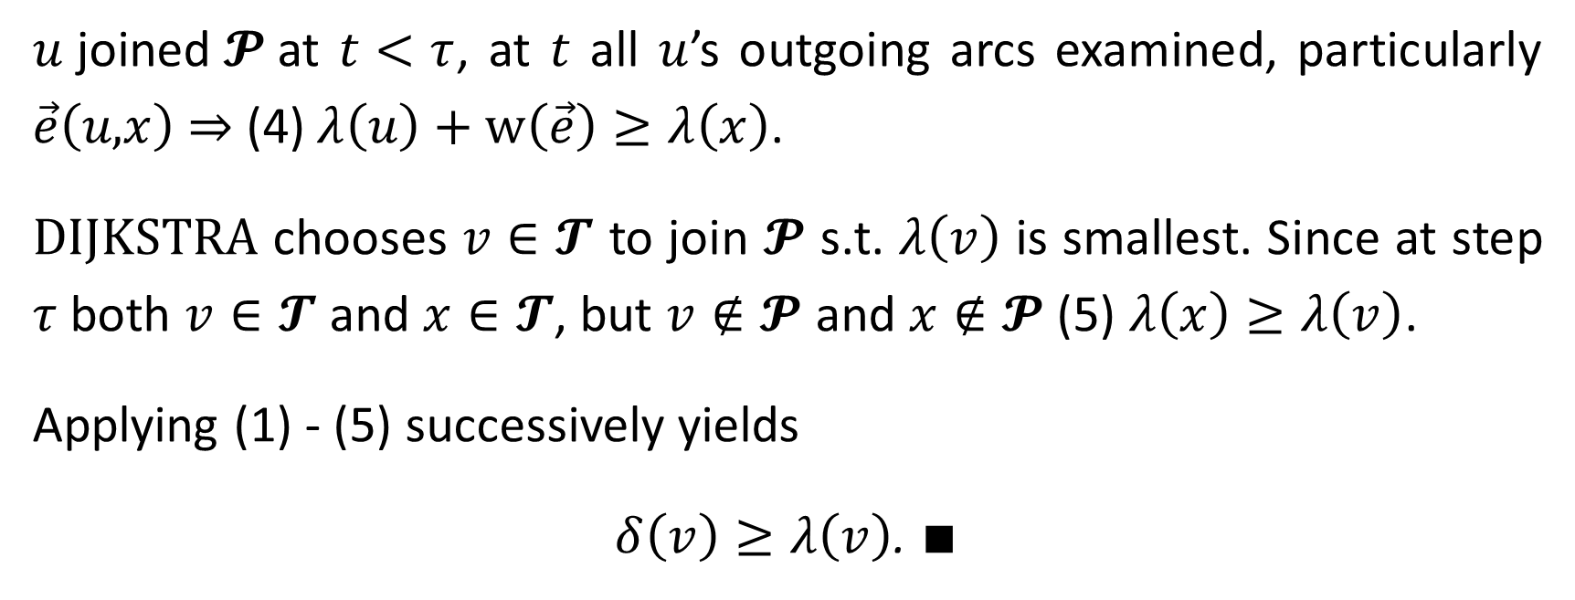
$u$joined$𝓟$at $t<τ$, at $t$ all $u$’s outgoing arcs examined, particularly $\vec{e}\left(u\text{,}x\right)$ ⇒ $\text{(}\text{4}\text{)}$ $λ\left(u\right)+w\left(\vec{e}\right)≥λ\left(x\right)\text{. }$
$\text{DIJKSTRA}$ chooses $v∈𝓣$ to join $𝓟$ s.t. $λ\left(v\right)$ is smallest. Since at step $τ$ both $v∈𝓣$ and $x∈𝓣$, but $v∉𝓟$ and $x∉𝓟$ (5) $λ\left(x\right)≥λ\left(v\right)$.
Applying (1) - (5) successively yields
$δ\left(v\right)≥λ\left(v\right)$. $∎$
$\vec{Φ}\left(s,v\right)$:
$$s$$
$$\vec{e}$$
$$u$$
$$x$$
$$v$$

Slide 11
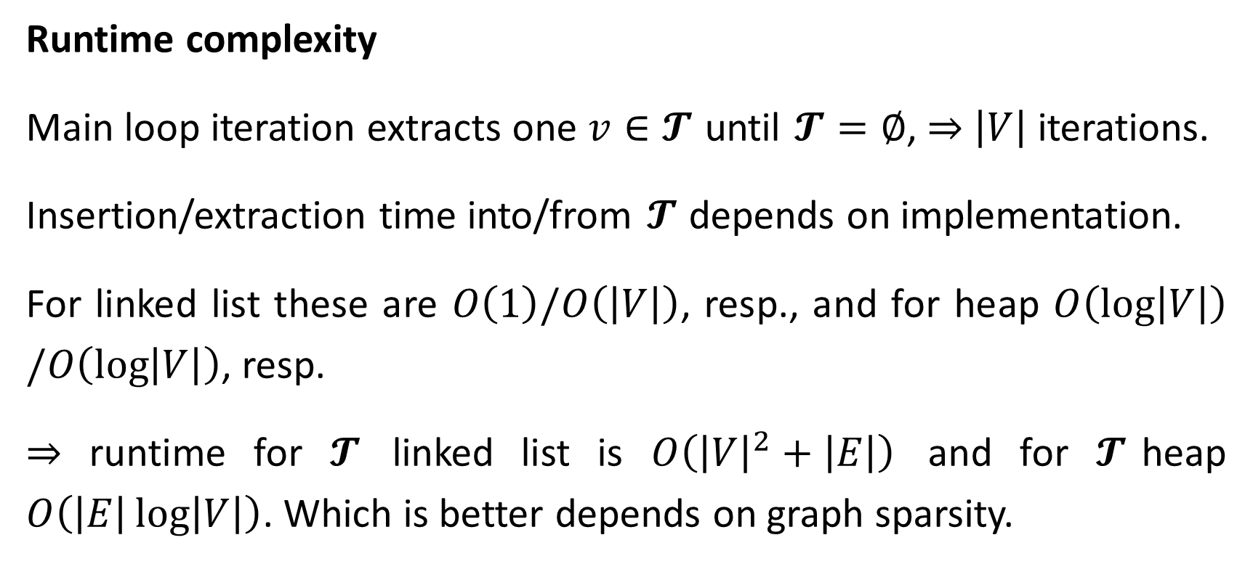
Runtime complexity
Main loop iteration extracts one $v∈𝓣$ until $𝓣=∅$, ⇒ $\left|V\right|$ iterations.
Insertion/extraction time into/from $𝓣$ depends on implementation.
For linked list these are $O\left(1\right)/O\left(\left|V\right|\right)$, resp., and for heap $O\left(\log\left|V\right|\right)/O\left(\log\left|V\right|\right)$, resp.
⇒ runtime for $𝓣$ linked list is $O\left({\left|V\right|}^{2}+\left|E\right|\right)$ and for $𝓣$heap $O\left(\left|E\right|\log\left|V\right|\right)$. Which is better depends on graph sparsity.

Slide 12
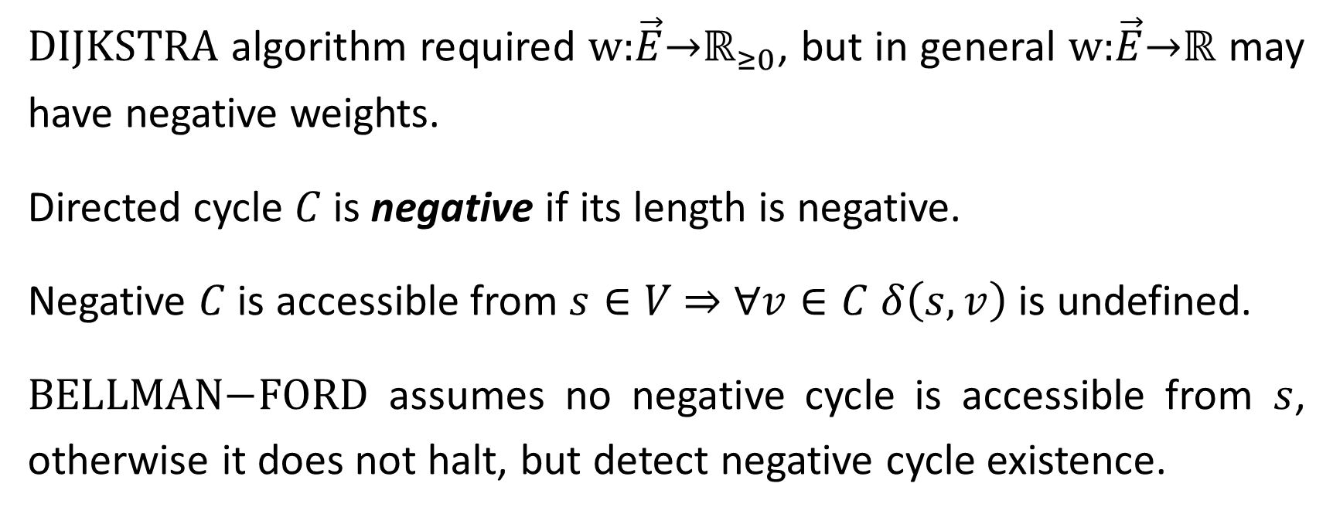
Bellman-Ford Algorithm (1958, 1962)
$\text{DIJKSTRA}$ algorithm required $\text{w}\text{:}\vec{E}\text{→}ℝ_{≥0}$, but in general $\text{w}\text{:}\vec{E}\text{→}ℝ$ may have negative weights.
Directed cycle $C$ is negative if its length is negative.
Negative $C$ is accessible from $s∈V$ $⇒$ $∀v∈C$ $δ\left(s,v\right)$ is undefined.
$\text{BELLMAN}\text{−}\text{FORD}$ assumes no negative cycle is accessible from $s$, otherwise it does not halt, but detect negative cycle existence.

Slide 13



$\text{Procedure} \text{BELLMAN}\text{−}\text{FORD}\left(G\left(V,\vec{E}\right), s,\text{w}\text{:}\vec{E}\text{→}ℝ;λ\right)$
$∀v∈V λ\left(v\right)=∞; λ\left(s\right)=0;$
$\text{r}\text{epeat}$
$\text{F}\text{lag}\text{=}\text{FALSE}$;
$∀\vec{e}\left(u\text{,}v\right)∈\vec{E}$
$\text{if} \left(λ\left(u\right)<∞\right) \&\& (λ\left(v\right)>λ\left(u\right)+\text{w}\left(\vec{e}\right))$
$λ\left(v\right)=λ\left(u\right)+\text{w}\left(\vec{e}\right)$;
$\text{Flag}\text{=}\text{TRUE}$;
$\text{until} \text{Flag}\text{=}\text{FALSE}$
// initialization
// examine arcs in deterministic order
// new and shorter
// path to $v$ discovered
// all paths from $s$ are shortest

Slide 14
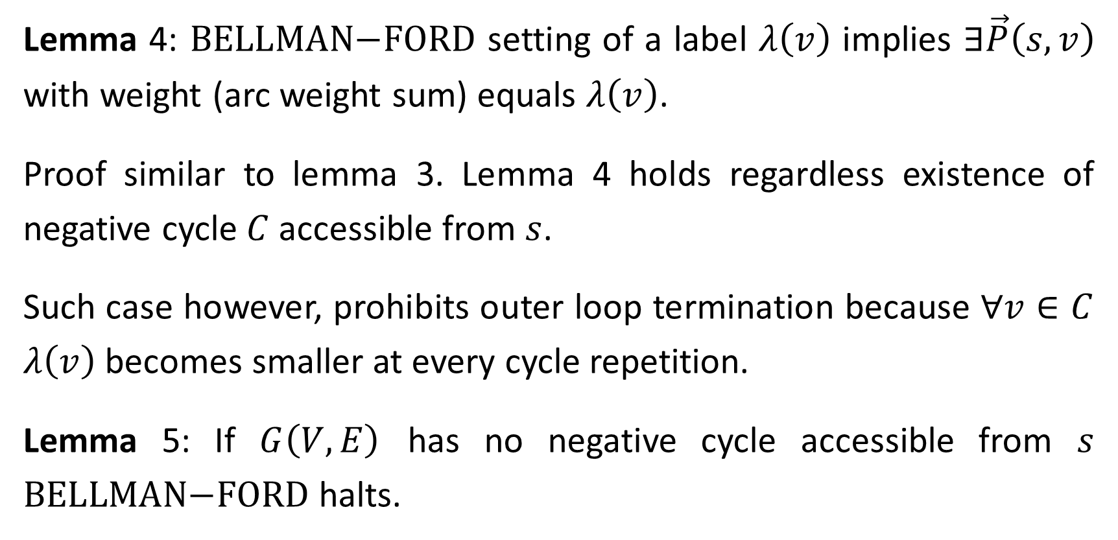
Lemma 4: $\text{BELLMAN}\text{−}\text{FORD}$ setting of a label $λ\left(v\right)$ implies $∃\vec{P}\left(s,v\right)$ with weight (arc weight sum) equals $λ\left(v\right)$.
Proof similar to lemma 3. Lemma 4 holds regardless existence of negative cycle $C$accessible from $s$.
Such case however, prohibits outer loop termination because $∀v∈C$ $λ\left(v\right)$ becomes smaller at every cycle repetition.
Lemma 5: If $G\left(V,E\right)$ has no negative cycle accessible from $s$ $\text{BELLMAN}\text{−}\text{FORD}$ halts.

Slide 15
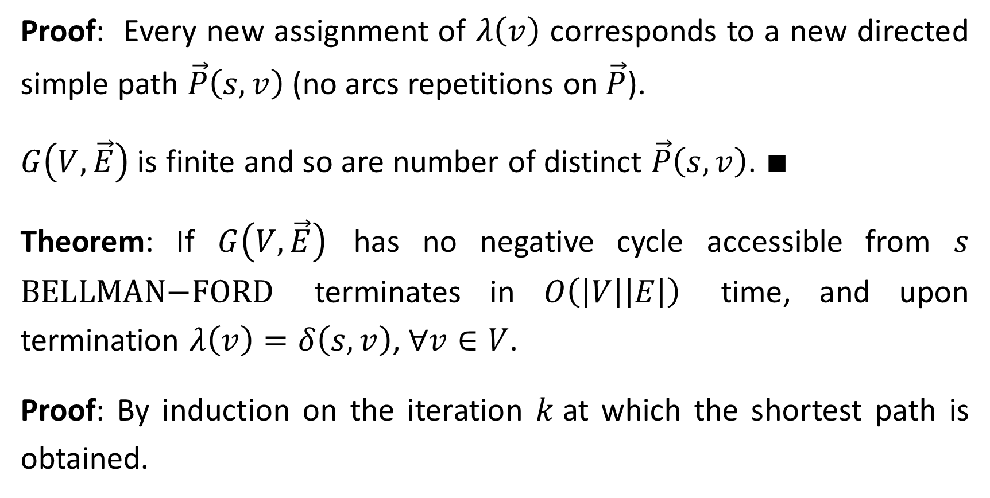
Proof: Every new assignment of $λ\left(v\right)$ corresponds to a new directed simple path $\vec{P}\left(s,v\right)$ (no arcs repetitions on $\vec{P}$).
$G\left(V,\vec{E}\right)$ is finite and so are number of distinct $\vec{P}\left(s,v\right)$. $∎$
Theorem: If $G\left(V,\vec{E}\right)$ has no negative cycle accessible from $s$ $\text{BELLMAN}\text{−}\text{FORD}$ terminates in $O\left(\left|V\right|\left|E\right|\right)$ time, and upon termination $λ\left(v\right)=δ\left(s,v\right)$, $∀v∈V$.
Proof: By induction on the iteration $k$at which the shortest path is obtained.

Slide 16
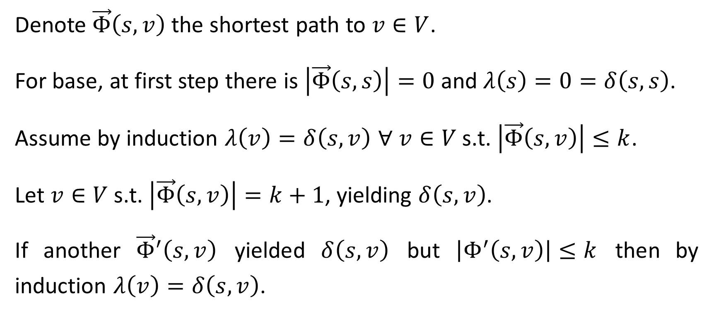
Denote $\vec{Φ}\left(s,v\right)$ the shortest path to $v∈V$.
For base, at first step there is $\left|\vec{Φ}\left(s,s\right)\right|=0$ and $λ\left(s\right)=0=δ\left(s,s\right)$.
Assume by induction $λ\left(v\right)=δ\left(s,v\right)$ ∀ $v∈V$s.t. $\left|\vec{Φ}\left(s,v\right)\right|≤k$.
Let $v∈V$s.t. $\left|\vec{Φ}\left(s,v\right)\right|=k+1$, yielding $δ\left(s,v\right)$.
If another ${\vec{Φ}}^{′}\left(s,v\right)$ yielded $δ\left(s,v\right)$ but $\left|Φ^{′}\left(s,v\right)\right|≤k$ then by induction $λ\left(v\right)=δ\left(s,v\right)$.

Slide 17
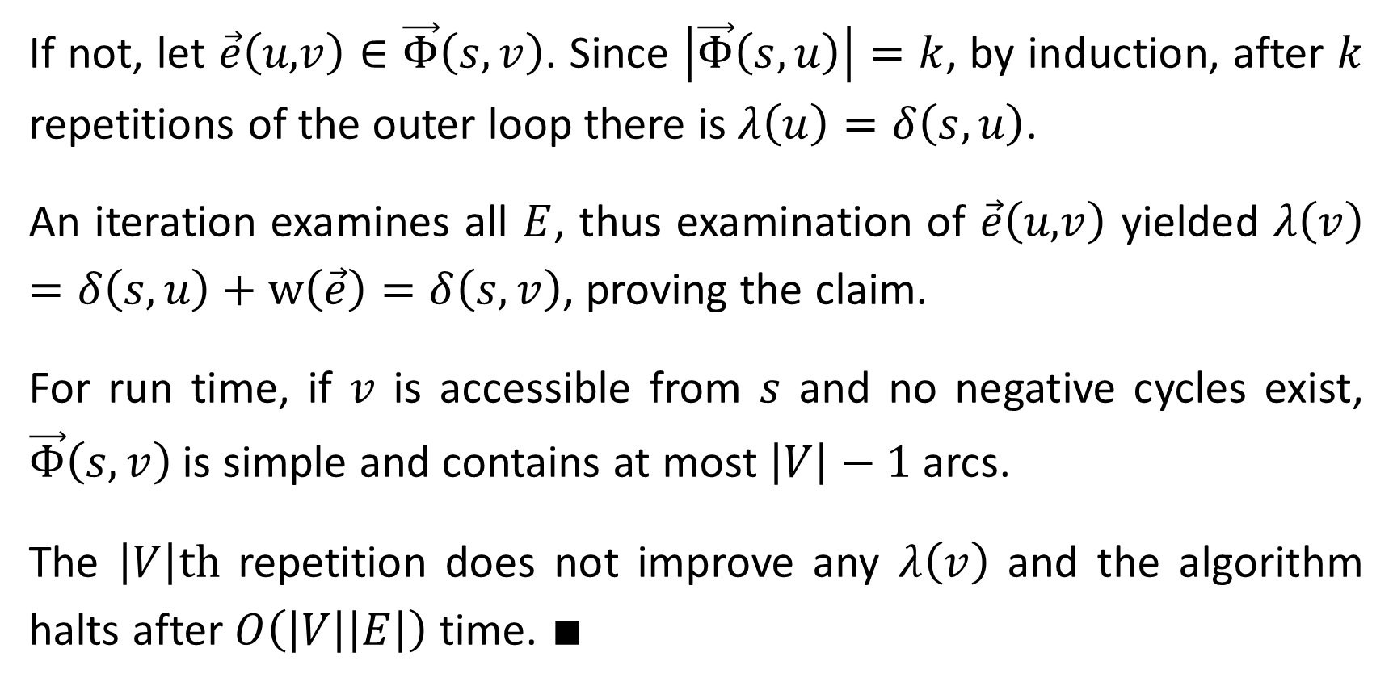
If not, let $\vec{e}\left(u\text{,}v\right)∈\vec{Φ}\left(s,v\right)$. Since $\left|\vec{Φ}\left(s,u\right)\right|=k$, by induction, after $k$ repetitions of the outer loop there is $λ\left(u\right)=δ\left(s,u\right)$.
An iteration examines all $E$, thus examination of $\vec{e}\left(u\text{,}v\right)$ yielded $λ\left(v\right)=δ\left(s,u\right)+\text{w}\left(\vec{e}\right)=δ\left(s,v\right)$, proving the claim.
For run time, if $v$ is accessible from $s$ and no negative cycles exist, $\vec{Φ}\left(s,v\right)$ is simple and contains at most $\left|V\right|−1$ arcs.
The $\left|V\right|\text{th}$ repetition does not improve any $λ\left(v\right)$ and the algorithm halts after $O\left(\left|V\right|\left|E\right|\right)$ time. $∎$

Slide 18
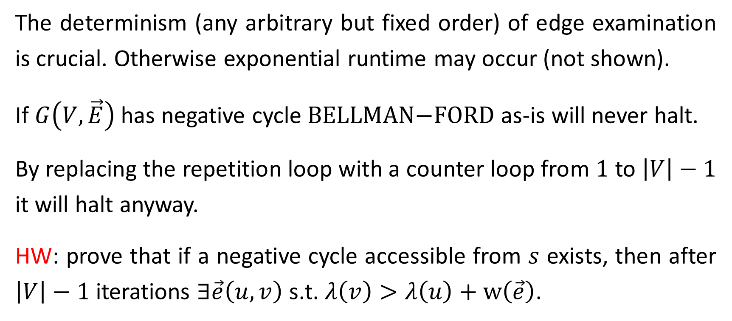
The determinism (any arbitrary but fixed order) of edge examination is crucial. Otherwise exponential runtime may occur (not shown).
If $G\left(V,\vec{E}\right)$ has negative cycle $\text{BELLMAN}\text{−}\text{FORD}$ as-is will never halt.
By replacing the repetition loop with a counter loop from $1$ to $\left|V\right|−1$ it will halt anyway.
HW: prove that if a negative cycle accessible from $s$ exists, then after $\left|V\right|−1$ iterations $∃\vec{e}\left(u,v\right)$ s.t. $λ\left(v\right)>λ\left(u\right)+\text{w}\left(\vec{e}\right)$.

Slide 19
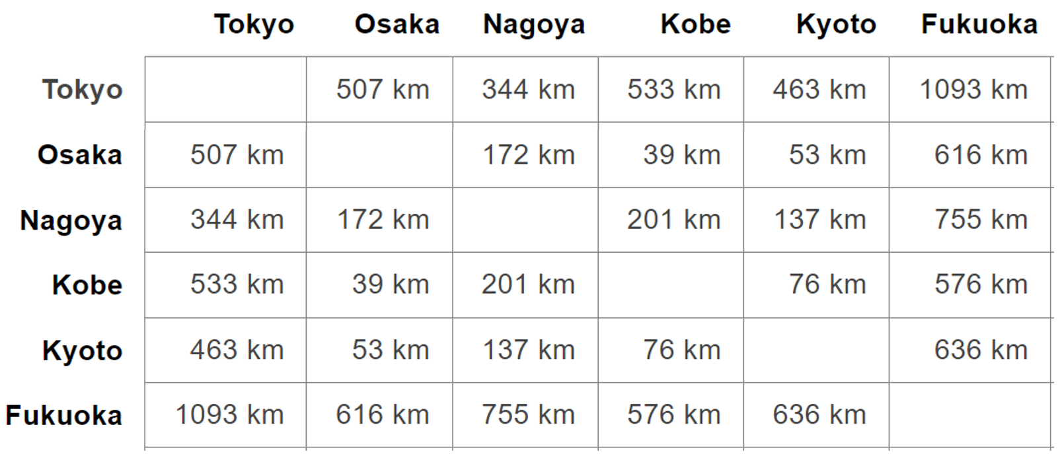
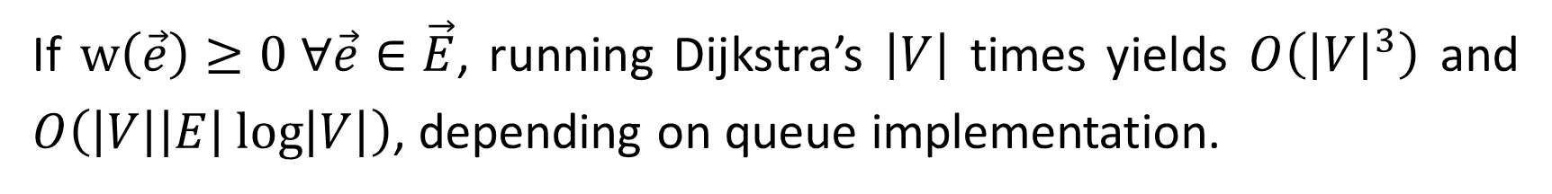
All-Pairs Shortest Paths
Example: making table of all distances between all pairs of cities.
If $\text{w}\left(\vec{e}\right)≥0 ∀\vec{e}∈\vec{E}$, running Dijkstra’s $\left|V\right|$ times yields $O\left({\left|V\right|}^{3}\right)$ and $O\left(\left|V\right|\left|E\right|\log\left|V\right|\right)$, depending on queue implementation.

Slide 20
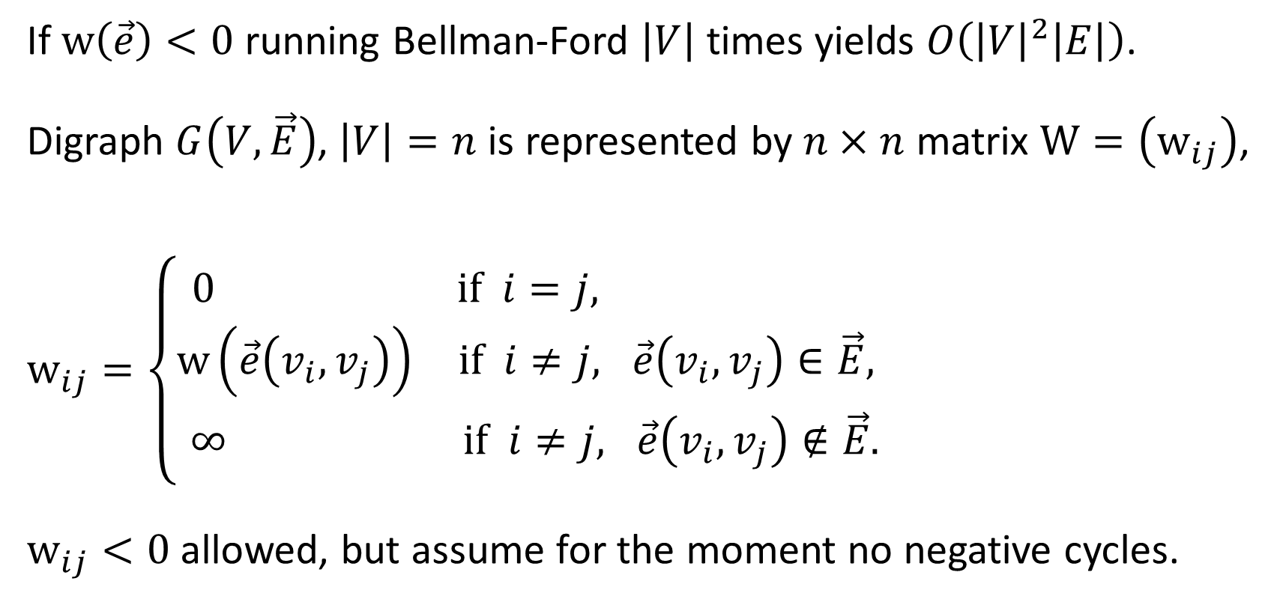
If $\text{w}\left(\vec{e}\right)<0$ running Bellman-Ford $\left|V\right|$ times yields $O\left({\left|V\right|}^{2}\left|E\right|\right)$.
Digraph $G\left(V,\vec{E}\right)$, $\left|V\right|=n$ is represented by $n×n$ matrix $\text{W}=\left({\text{w}}_{ij}\right)$,
${\text{w}}_{ij}=\left\{\begin{matrix}0 & \text{if} i=j, \\ \text{w}\left(\vec{e}\left(v_{i},v_{j}\right)\right) & \text{if} i≠j, \vec{e}\left(v_{i},v_{j}\right)∈\vec{E}, \\ ∞ & \text{if} i≠j, \vec{e}\left(v_{i},v_{j}\right)∉\vec{E}.\end{matrix}\right.$
${\text{w}}_{ij}<0$ allowed, but assume for the moment no negative cycles.

Slide 21
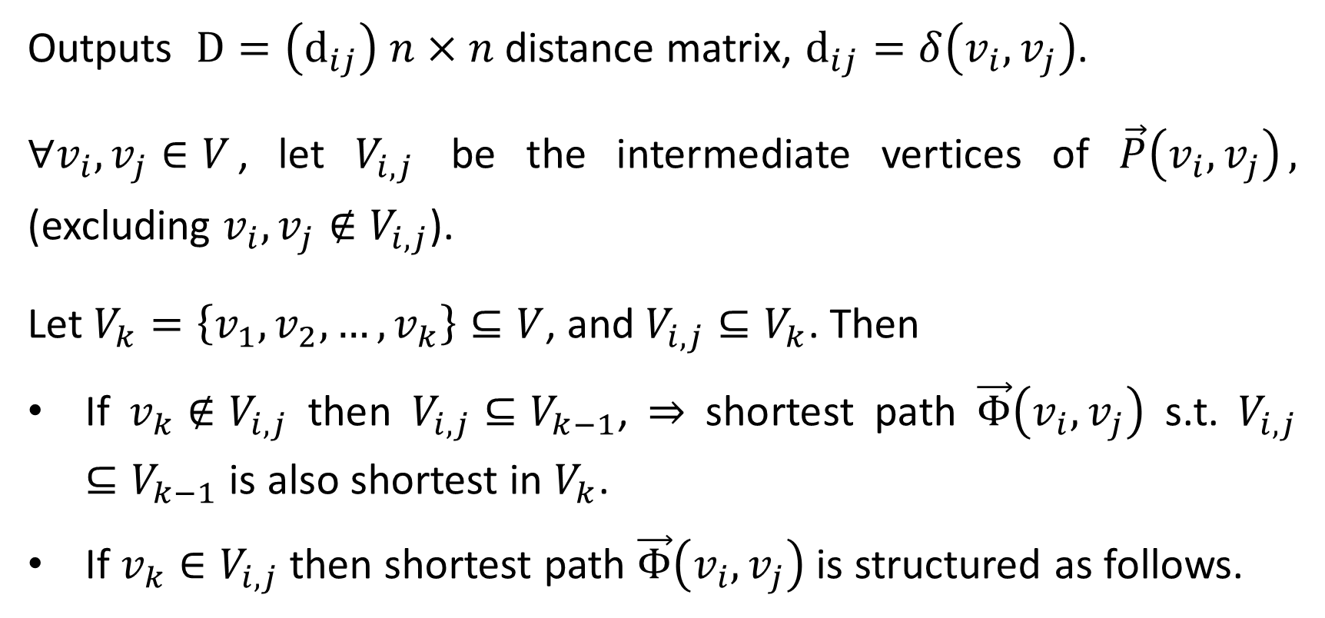
Floyd-Warshall Algorithm (1962)
Outputs $\text{D}=\left({\text{d}}_{ij}\right)$ $n×n$ distance matrix, ${\text{d}}_{ij}=δ\left(v_{i},v_{j}\right)$.
$∀v_{i},v_{j}∈V$, let $V_{i,j}$ be the intermediate vertices of $\vec{P}\left(v_{i},v_{j}\right)$, (excluding $v_{i},v_{j}∉V_{i,j}$).
Let $V_{k}=\left\{v_{1},v_{2},…,v_{k}\right\}⊆V$, and $V_{i,j}⊆V_{k}$. Then
If $v_{k}∉V_{i,j}$ then $V_{i,j}⊆V_{k−1}$, ⇒ shortest path $\vec{Φ}\left(v_{i},v_{j}\right)$ s.t. $V_{i,j}⊆V_{k−1}$ is also shortest in $V_{k}$.
If $v_{k}∈V_{i,j}$ then shortest path $\vec{Φ}\left(v_{i},v_{j}\right)$ is structured as follows.

Slide 22




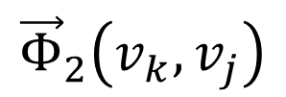


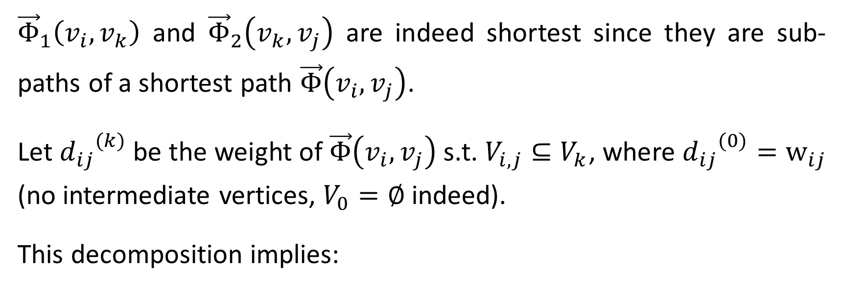
$${\vec{Φ}}_{1}\left(v_{i},v_{k}\right)$$
$${\vec{Φ}}_{2}\left(v_{k},v_{j}\right)$$
$$v_{k}$$
$$v_{i}$$
$$v_{j}$$
$$V_{i,k}⊆V_{k−1}$$
$$V_{k,j}⊆V_{k−1}$$
${\vec{Φ}}_{1}\left(v_{i},v_{k}\right)$ and ${\vec{Φ}}_{2}\left(v_{k},v_{j}\right)$ are indeed shortest since they are sub-paths of a shortest path $\vec{Φ}\left(v_{i},v_{j}\right)$.
Let ${d_{ij}}^{(k)}$ be the weight of $\vec{Φ}\left(v_{i},v_{j}\right)$ s.t. $V_{i,j}⊆V_{k}$, where ${d_{ij}}^{(0)}={\text{w}}_{ij}$ (no intermediate vertices, $V_{0}=∅$ indeed).
This decomposition implies:

Slide 23
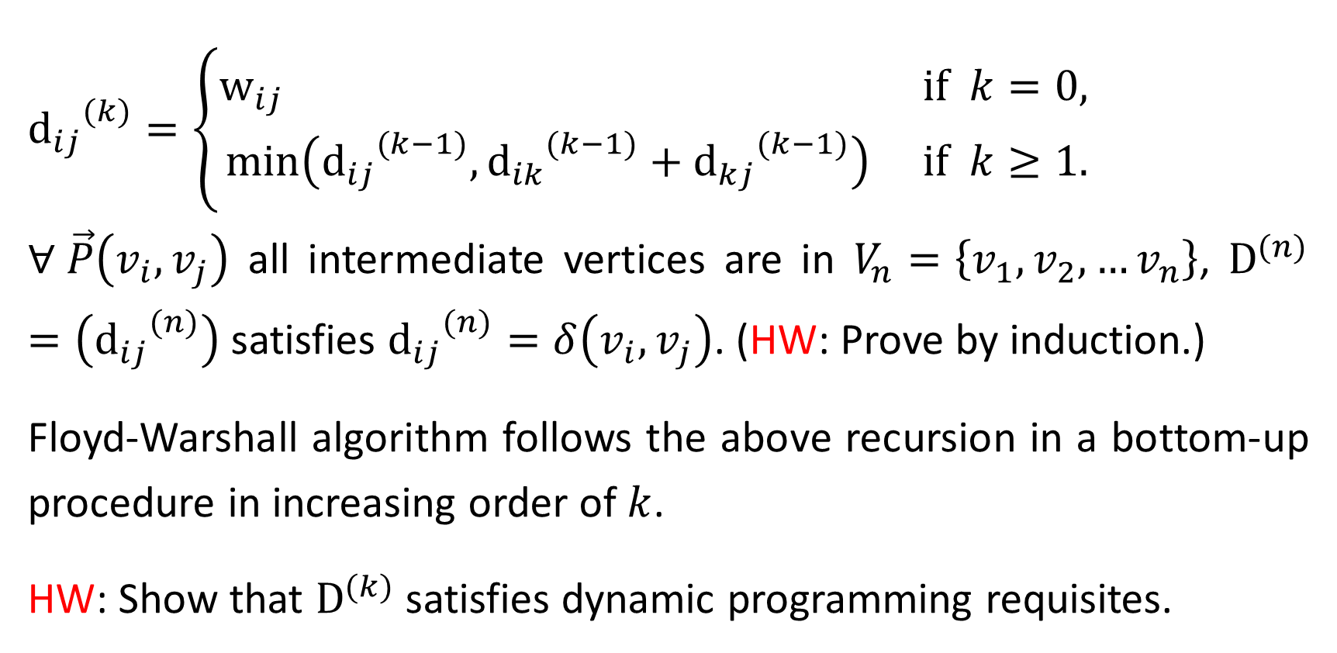
${{\text{d}}_{ij}}^{(k)}=\left\{\begin{matrix}{\text{w}}_{ij} & \text{if} k=0, \\ \min\left({{\text{d}}_{ij}}^{(k−1)},{{\text{d}}_{ik}}^{(k−1)}+{{\text{d}}_{kj}}^{(k−1)}\right) & \text{if} k≥1.\end{matrix}\right.$
$∀ \vec{P}\left(v_{i},v_{j}\right)$ all intermediate vertices are in $V_{n}=\left\{v_{1},v_{2},…v_{n}\right\}$, ${\text{D}}^{(n)}=\left({{\text{d}}_{ij}}^{(n)}\right)$ satisfies ${{\text{d}}_{ij}}^{(n)}=δ\left(v_{i},v_{j}\right)$. (HW: Prove by induction.)
Floyd-Warshall algorithm follows the above recursion in a bottom-up procedure in increasing order of $k$.
HW: Show that ${\text{D}}^{(k)}$ satisfies dynamic programming requisites.

Slide 24

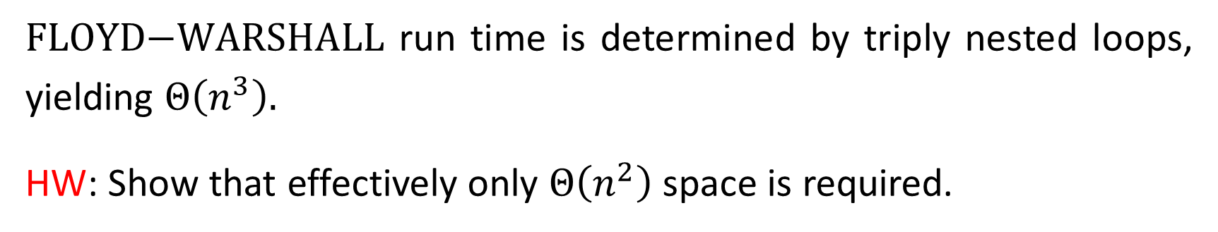
$\text{FLOYD}\text{−}\text{WARSHALL}(\text{W}, n;\text{D})$
${\text{D}}^{(0)}=\text{W}$
$\text{for} k=1 \text{to} n$
${\text{D}}^{(k)}=\left({{\text{d}}_{ij}}^{(k)}\right)$ $n×n$ matrix
$\text{for} i=1 \text{to} n$
$\text{for} j=1 \text{to} n$
${{\text{d}}_{ij}}^{(k)}=\min\left({{\text{d}}_{ij}}^{(k−1)},{{\text{d}}_{ik}}^{(k−1)}+{{\text{d}}_{kj}}^{(k−1)}\right)$
// Initial distance is arc length
// get new intermediate vertex
// get new matrix
// enhance all present shortest paths
$\text{FLOYD}\text{−}\text{WARSHALL}$ run time is determined by triply nested loops, yielding $Θ\left(n^{3}\right).$
HW: Show that effectively only $Θ\left(n^{2}\right)$ space is required.

Slide 25
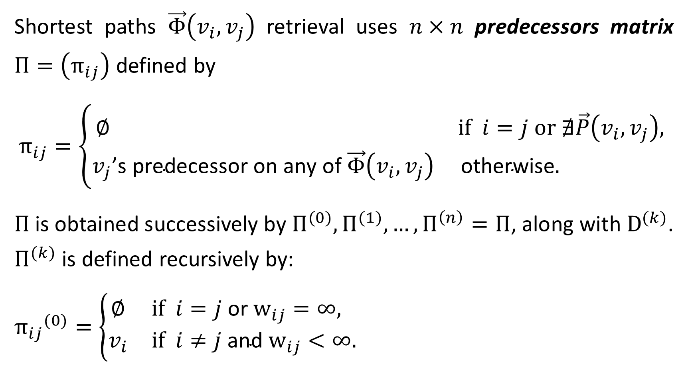
Shortest paths $\vec{Φ}\left(v_{i},v_{j}\right)$ retrieval uses $n×n$ predecessors matrix $Π=\left(π_{ij}\right)$ defined by
$$π_{ij}=\left\{\begin{matrix}∅ & \text{if} i=j \text{or} ∄\vec{P}\left(v_{i},v_{j}\right)\text{,} \\ v_{j}\text{’}\text{s} \text{predecessor} \text{on} \text{any} \text{of} \vec{Φ}\left(v_{i},v_{j}\right) & \text{otherwise}\text{. } \end{matrix}\right.$$
$Π$ is obtained successively by $Π^{(0)},Π^{(1)},…,Π^{\left(n\right)}=Π$, along with ${\text{D}}^{(k)}$. $Π^{(k)}$ is defined recursively by:
${π_{ij}}^{(0)}=\left\{\begin{matrix}∅ & \text{if} i=j \text{or}{ \text{w}}_{ij}=∞, \\ v_{i} & \text{if} i≠j \text{and}{ \text{w}}_{ij}<∞.\end{matrix}\right.$

Slide 26
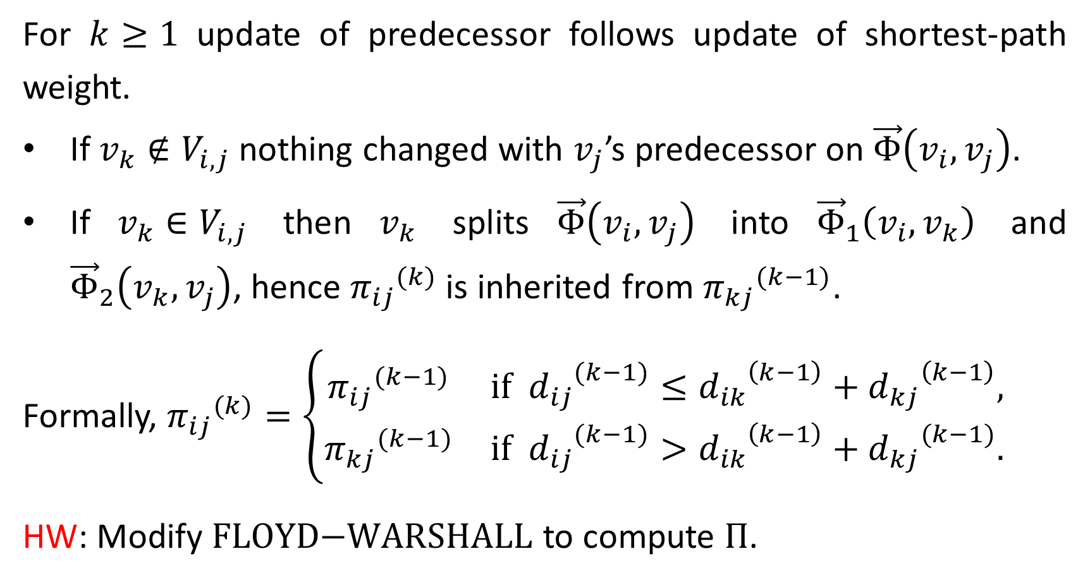
For $k≥1$ update of predecessor follows update of shortest-path weight.
If $v_{k}∉V_{i,j}$ nothing changed with $v_{j}$’s predecessor on $\vec{Φ}\left(v_{i},v_{j}\right)$.
If $v_{k}∈V_{i,j}$ then $v_{k}$ splits $\vec{Φ}\left(v_{i},v_{j}\right)$ into ${\vec{Φ}}_{1}\left(v_{i},v_{k}\right)$ and ${\vec{Φ}}_{2}\left(v_{k},v_{j}\right)$, hence ${π_{ij}}^{(k)}$ is inherited from ${π_{kj}}^{(k−1)}$.
Formally, ${π_{ij}}^{(k)}=\left\{\begin{matrix}{π_{ij}}^{(k−1)} & \text{if} {d_{ij}}^{(k−1)}≤{d_{ik}}^{\left(k−1\right)}+{d_{kj}}^{\left(k−1\right)}, \\ {π_{kj}}^{(k−1)} & \text{if} {d_{ij}}^{(k−1)}>{d_{ik}}^{\left(k−1\right)}+{d_{kj}}^{(k−1)}.\end{matrix}\right.$
HW: Modify $\text{FLOYD}\text{−}\text{WARSHALL}$ to compute $Π$.

Slide 27
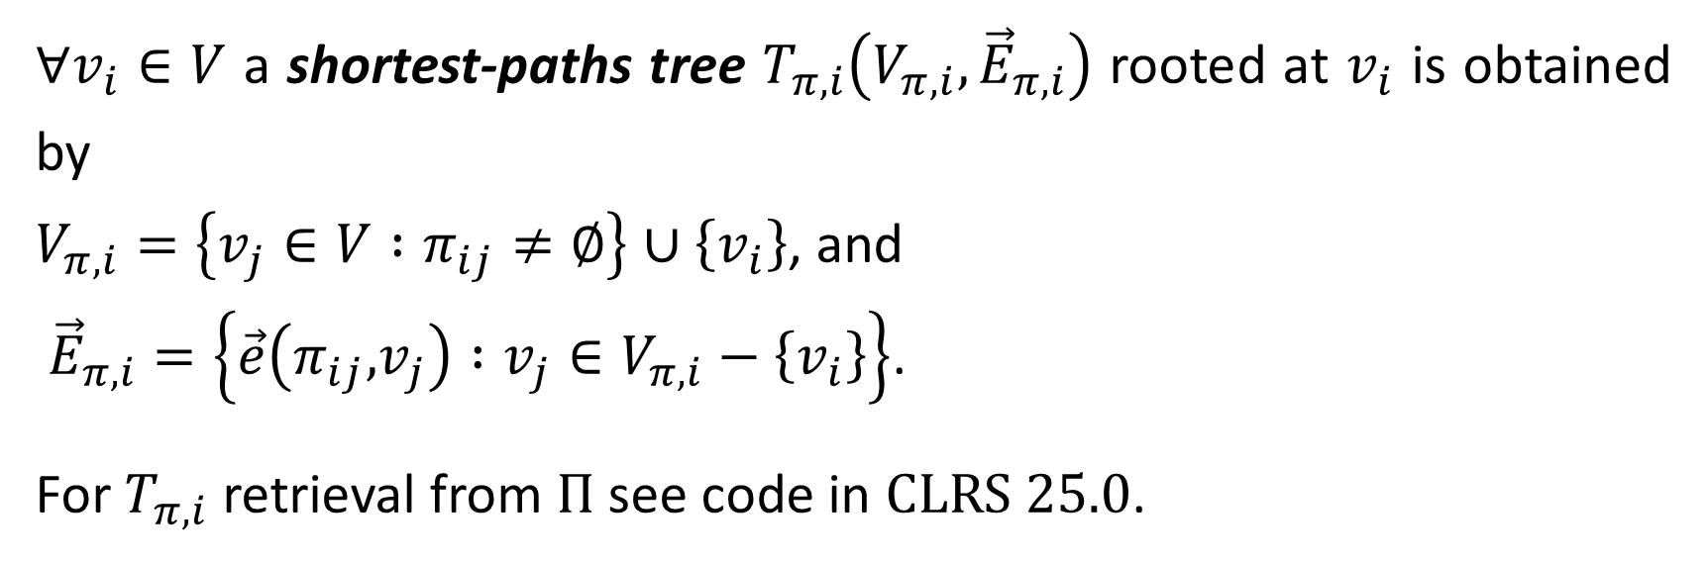
$∀v_{i}∈V$ a shortest-paths tree $T_{π,i}\left(V_{π,i},{\vec{E}}_{π,i}\right)$ rooted at $v_{i}$ is obtained by
$V_{π,i}=\left\{v_{j}∈V :π_{ij}≠∅\right\}∪\left\{v_{i}\right\}$, and
${\vec{E}}_{π,i}=\left\{\vec{e}\left(π_{ij}\text{,}v_{j}\right) :v_{j}∈V_{π,i}−\left\{v_{i}\right\}\right\}$.
For $T_{π,i}$ retrieval from $Π$ see code in CLRS 25.0.

