Slide 1
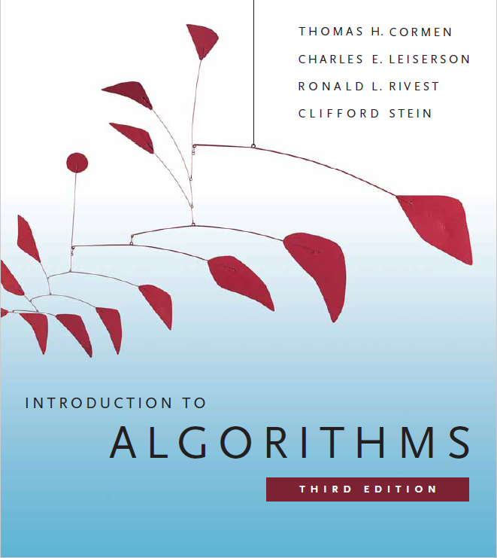
Search Trees
Prepared by Shmuel Wimer
Instructed by Hillel Kugler and Shmuel Wimer

Slide 2
Binary Search Tree
BST Supports dynamic-set operations: $\text{SEARCH}$, $\text{MINIMUM}$, $\text{MAXIMUM}$, $\text{PREDECESSOR}$, $\text{SUCCESSOR}$, $\text{INSERT}$, and $\text{DELETE}$.
Useful for dictionaries.
$O\left(\log{n}\right)$ worst-case time for complete BST,
$O\left(n\right)$ worst-case time if the tree is a chain of $n$ nodes.
Expected height of a randomly built BST is $O\left(\log{n}\right)$, special BSTs maintain $O\left(\log{n}\right)$ height.

Slide 3
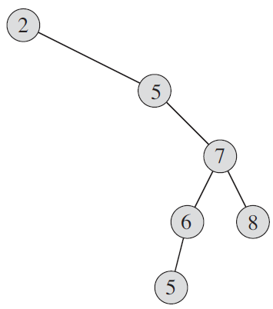
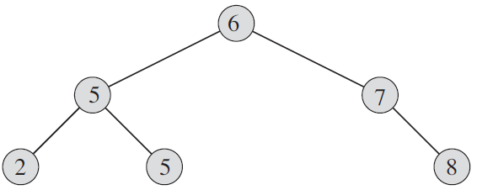
BST property
$$x$$
$$∀y∈\text{right} \text{subtree}$$
$$y.key≥x.key$$
$$∀y∈\text{left} \text{subtree}$$
$$y.key≤x.key$$
$$y$$
$$y$$

Slide 4
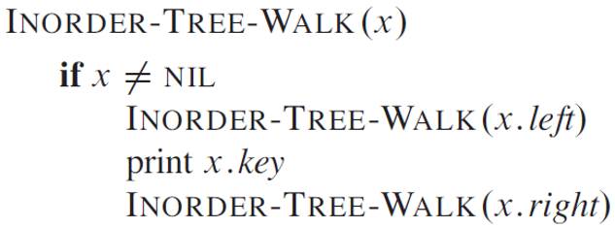
Nodes’ keys can be efficiently reported by an inorder traversal.
Node’s key (root) reported after all left subtree’s nodes and before right subtree’s nodes.
Postorder traversal reports root’s key after left and right subtrees.
Preorder traversal reports root’s key before left and right subtrees.

Slide 5
Theorem. For $n$-node BST $\text{INORDER}\text{−}\text{TREE}\text{−}\text{WALK}$, $T\left(n\right)=Θ\left(n\right)$.
Proof. $\text{INORDER}\text{−}\text{TREE}\text{−}\text{WALK}$ visits all nodes ⇒ $T\left(n\right)=Ω\left(n\right)$. We show $T\left(n\right)=O\left(n\right)$.
Empty subtree ($x=∅$) yields
(1) $T\left(0\right)=c$, for some constant $c>0$.
Let $x$ be root of $n$-node tree, $k$ in left and $n−k−1$ in right subtrees.
Excluding time spent on $\text{INORDER}\text{−}\text{TREE}\text{−}\text{WALK}$ calls, body spends time bounded by some $d>0$, hence

Slide 6
(2) $T\left(n\right)≤T\left(k\right)+T\left(n−k−1\right)+d$.
Let’s substitute the guess $T\left(n\right)≤\left(c+d\right)n+c$.
For induction base there is $T\left(0\right)≤\left(c+d\right)0+c=c$, true by (1).
Assume by induction $T\left(m\right)≤\left(c+d\right)m+c ∀ m<n$. Then from (2),
$T\left(n\right)≤T\left(k\right)+T\left(n−k−1\right)+d≤$
$\left(\left(c+d\right)k+c\right)+\left(\left(c+d\right)\left(n−k−1\right)+c\right)+d$ $=\left(c+d\right)n+c=O\left(n\right)$. $∎$
by induction
by induction

Slide 7
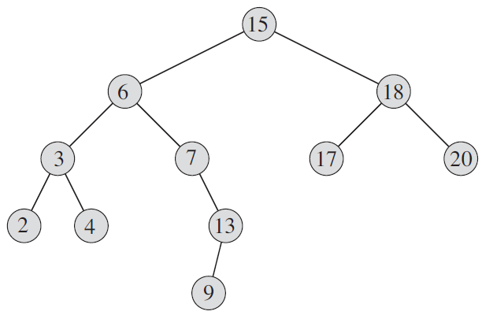
Querying
$\text{SEARCH}$, $\text{MINIMUM}$, $\text{MAXIMUM}$, $\text{PREDECESSOR}$, $\text{SUCCESSOR}$, all take $O\left(h\right)$ time, $h$is tree height (depth).
$13$ $< ?$
$13$ $< ?$
searching 13
$13$ $< ?$
$13$ $== ?$

Slide 8
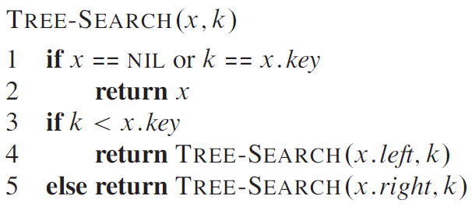
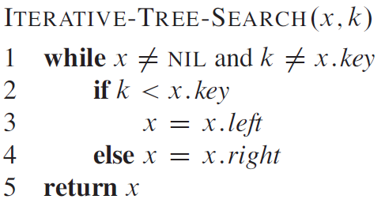
Recursive (left) and iterative (right) codes take $O\left(h\right)$ time.
Iterative code is much more efficient in most processors.
// found or not exists
// found or not exists

Slide 9
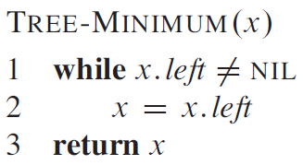
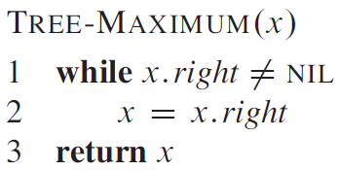
Minimum and maximum codes take $O\left(h\right)$ time.

Slide 10
If a successor of $x$ exists it is found by either two cases.
$$x$$
$$y$$
$$x$$
$$y$$
If $x$ has right subtree the successor is minimum $y$ (leftmost) of that right subtree.
If $x$ has no right subtree the successor is its lowest ancestor to which left subtree $x$ belongs.
Finding predecessor is symmetric. Both take $O\left(h\right)$ time. (see $\text{CLRS}$12.2 for code)

Slide 11
Insertion and Deletion
$$13$$
$$12$$
$$13$$
$$5$$
$$18$$
$$13$$
$$2$$
$$9$$
$$15$$
$$19$$
$$13$$
$$17$$

Slide 12
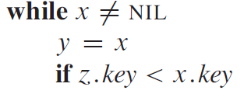
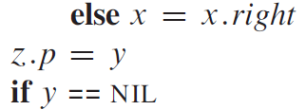
New value $v$ is inserted into $T$ at a new leaf in $O\left(h\right)$ time, preserving node’s property of left subtree smaller and right subtree larger keys.
// traverse to leaf
// add new leaf
// $T$ empty
Initialize node $z.key=v,$ $z.left=∅,$ $z.right=∅.$

Slide 13
Deletion of $z$ also takes $O\left(h\right)$ time but is more delicate and has few different cases. (See code in $\text{CLRS} \text{12.3}$)
$z$ is a leaf
$z$ has no left subtree
$z$ has no right subtree
$$q$$
$$q$$
$$q$$
$$q$$
$$q$$
$$q$$
$$z$$
$$z$$
$$r$$
$$z$$
$$l$$
$$r$$
$$l$$

Slide 14
$z$ has both left and right subtrees.
First need to find $z$’s successor $y$. $y$cannot have left subtree. (why?)
If it is $z$’s right child, then replace $z$ by $y$.
$$q$$
$$q$$
$$z$$
$$y$$
$$l$$
$$y$$
$$l$$
$$x$$
$$x$$

Slide 15
Otherwise, $y$is the leftmost in $z$’s right subtree.
All subtree nodes rooted at $r$ (included) are larger than $y$. Hence $y$ can replace $r$, with $r$becoming $y$’s right child.
$$q$$
$$q$$
$$q$$
$$z$$
$$z$$
$$y$$
$$y$$
$$l$$
$$r$$
$$l$$
$$r$$
$$l$$
$$r$$
$$y$$
$$x$$
$$x$$
$$x$$

Slide 16
Random BSTs
All operations are $O\left(h\right)$, so what is $O\left(h\right)$? ($\text{CLRS}\text{ 12.4}$)
$h$ depends on the order and the values of inserted and deleted keys.
Study only random insertions and assume w.l.o.g keys are $\left\{1,2,…,n\right\}$.
Let the root’s key $R_{n}$ chosen randomly uniformly from $\left\{1,2,…,n\right\}$ so $\text{Pr}\left(R_{n}=i\right)=1/n$.
$R_{n}=i$ ⇒ $\left\{1,2,…,i−1\right\}$ and $\left\{i+1,2,…,n\right\}$ reside in randomly built left and right subtrees, independent of each other.

Slide 17
$X_{n}$ random variable: height of randomly built BST of $\left\{1,2,…,n\right\}$.
If $R_{n}=i$ (chosen randomly) then
$$X_{n}=1+\max\left(X_{i−1},X_{n−i}\right).$$
$$i$$
$$X_{n}$$
$$X_{i−1}$$
$$X_{n−i}$$
$$\left\{1,…,i−1\right\}$$
$$\left\{i+1,…,n\right\}$$

Slide 18
Define random variable $Y_{n}=2^{X_{n}}$, then
(1) $Y_{n}=2^{1+\max\left(X_{i−1},X_{n−i}\right)}=2\max\left(Y_{i−1},Y_{n−i}\right).$
Define random variables $Z_{n,i}$ , $1≤i≤n$: $Z_{n,i}=\left\{\begin{matrix}1 & \text{if}{ R}_{n}=i \\ 0 & \text{if}{ R}_{n}≠i\end{matrix}\right.$, ⇒
(2) $E\left[Z_{n,i}\right]=1∙\text{Pr}\left(R_{n}=i\right)+0∙\text{Pr}\left(R_{n}≠i\right)=1/n$.
mean, average
Choosing $R_{n}=i$, subtrees randomly built on $i−1$ and $n−i$ keys.
Other than number of keys, subtrees’ structure not affected by the choice $R_{n}=i$.

Slide 19
$Z_{n,i}$, $Y_{i−1}$ and $Y_{n−i}$ are all independent of each other, hence (1) ⇒
$E$linearity
(2)
Independence: $\text{E}\left[XY\right]=\text{E}\left[X\right]\text{E}\left[Y\right]$
$$E\left[Y_{n}\right]=E\left[\sum_{i=1}^{n}{Z_{n,i}\left(2∙max\left(Y_{i−1},Y_{n−i}\right)\right)}\right]=$$
$\frac{2}{n}\sum_{i=1}^{n}{E\left[\max\left(Y_{i−1},Y_{n−i}\right)\right]}≤$
$\frac{2}{n}\sum_{i=1}^{n}{\left(E\left[Y_{i−1}\right]+E\left[Y_{n−i}\right]\right)}=\frac{4}{n}\sum_{i=0}^{n−1}{E\left[Y_{i}\right]}$.
⇒ $E\left[Y_{n}\right]$ is recursive.
summands appear twice
(HW: Show $E\left[Y_{n}\right]≤\frac{1}{4}\left(\begin{matrix}n+3 \\ 3\end{matrix}\right)$ by substitution, $\text{CLRS} \text{12.4}$).

Slide 20
Definition: $g\left(x\right)$ is convex if
$μg\left(x_{1}\right)+\left(1−μ\right)g\left(x_{2}\right)≥g\left(μx_{1}+\left(1−μ\right)x_{2}\right), 0≤μ≤1$.
$$g\left(x\right)$$
$$x$$
$$x_{1}$$
$$x_{2}$$

Slide 21
For convex function $g$of a random variable $X$ there is
$\text{E}\left[g\left(X\right)\right]≥g\left(\text{E}\left[X\right]\right)$, provided that $\text{E}$ exists and finite. (HW)
$f\left(x\right)=2^{x}$ is convex ($f^{′′}>0$) ⇒
$$2^{\text{E}\left[X_{n}\right]}≤\text{E}\left[2^{X_{n}}\right]=\text{E}\left[Y_{n}\right]≤\frac{1}{4}\left(\begin{matrix}n+3 \\ 3\end{matrix}\right)=O\left(n^{3}\right)$$
Log of both sides ⇒ $\text{E}\left[X_{n}\right]=O\left(\log{n}\right)$. $∎$
$$g\left(\text{E}\left[X\right]\right)≤\text{E}\left[g\left(X\right)\right]$$

Slide 22
Sorting with BST
BST can be used for sorting $n$elements by keys. (HW: write code)
$\text{TREE}\text{−}\text{INSERT}$ for every key ($n$ repetitions) creates $n$-node BST.
$\text{INORDER}\text{−}\text{WALK}$ will report the $n$ sorted keys.
What is the worst-case input, what runtime it yields? (HW)
Assuming random input, what is the average runtime? (HW)
What is the best-case input, what runtime it yields? (HW)

Slide 23
AVL Trees
BST can terribly perform $O\left(n\right)$ per insertion and search (HW: how?).
AVL trees (G.M. Adelson-Velskii, E.M. Landis, 1962) maintain $O\left(\log{n}\right)$ height by Dynamic rebalancing.
$$0$$
$$8$$
$$1$$
$$5$$
$$11$$
$$2$$
$$3$$
$$7$$
$$12$$
$$10$$
$$3$$
$$2$$
$$4$$
$$6$$
$$9$$
$$4$$
$$1$$
Balance invariance: left and right subtrees depth differ at most by 1.

Slide 24
Worst (imbalanced) AVL: 1 height diff occurs at all nodes. Otherwise leaves could be dropped without harming the invariance.
Let $N\left(h\right)$ be min number of nodes in $h$-height AVL tree.
W.l.o.g let $N\left(h−1\right)$ min nodes in left subtree, and $N\left(h−2\right)$ min in right subtree. Then
$$N\left(h\right)=N\left(h−1\right)+N\left(h−2\right)+1$$
$$N\left(h−2\right)$$
$$N\left(h−1\right)$$

Slide 25
$N\left(h\right)=1+N\left(h−1\right)+N\left(h−2\right)>2N\left(h−2\right)$.
Recursion solved by substituting $N\left(h\right)=λ^{h}$. Then,
$λ^{h}>2λ^{h−2}$ ⇒ $λ^{2}>2$ ⇒ $λ>2^{1/2}$ ⇒ $N>2^{h/2}$. Taking log,
$h<2\log{N}$.
The above is the worst situation, bounding any tree satisfying AVL balance invariance.
(Actually $h<1.44\log{N}$, but proof is more complex).

Slide 26
Insertion in AVL Tree
$ν∈T$, $\text{LSON}\left[ν\right]$ and $\text{R}\text{SON}\left[ν\right]$ left and right sons, $h\left(ν\right)$ its high.
To track AVL $\left|h\left(\text{LSON}\left[ν\right]\right)−h\left(\text{R}\text{SON}\left[ν\right]\right)\right|≤1$ balance invariance, $ν∈T$ maintains $h\left(ν\right)$.
After insertion to leaf (as in ordinary BST), leaf-to-root traversal updates the height of all affected nodes.
Balance violation at $ν$ is fixed by rotation at $ν$, while preserving key ordering invariance.

Slide 27
Re - balance takes place depending where leaf $μ$inserted.
By single rotation if inserted in $\text{LSON}\left[\text{LSON}\left[ν\right]\right]$ or $\text{R}\text{SON}\left[\text{RSON}\left[ν\right]\right]$.
Balance violation
$$ν$$
right rotation
$$ω$$
$$ν$$
$$ω$$
$$Z$$
$$X$$
$$Y$$
$$Z$$
$$Y$$
$$h$$
$$h+1$$
$$X$$
$$h$$
$$h$$
$$h$$
$$μ$$
$$h+1$$
$$μ$$

Slide 28
By double rotation if inserted in $\text{LSON}\left[\text{RSON}\left[ν\right]\right]$ or $\text{RSON}\left[\text{LSON}\left[ν\right]\right]$.
Balance violation
$$ν$$
2nd
$$ν$$
$$ω$$
$$ω$$
1st
$$Z$$
$$Z$$
$$X$$
$$h$$
$$X$$
$$h$$
$$Y$$
$$γ$$
$$h$$
$$h$$
$$h+1$$
$$μ$$
$$V$$
$$W$$
$$h$$
$$μ$$
$$h$$
$$μ$$
Right rotation alone does not solve the imbalance.
$Y$ subtree splits into $V$ and $W$. Either $μ∈V$ or $μ∈W$.

Slide 29
Balance restored by two rotations: 1st left, 2nd right.
$$ν$$
after left rotation
$X$, $V$, $W$, $Z$ key ordering preserved.
$$γ$$
$$Z$$
$$W$$
$$h$$
$$ω$$
$$h$$
after right rotation
$$X$$
$$V$$
$$γ$$
$$h$$
$$h$$
$$ω$$
$$ν$$
$$X$$
$$V$$
$$W$$
$$Z$$
$$h$$
$$h$$
$$h$$
$$h$$

