Slide 1
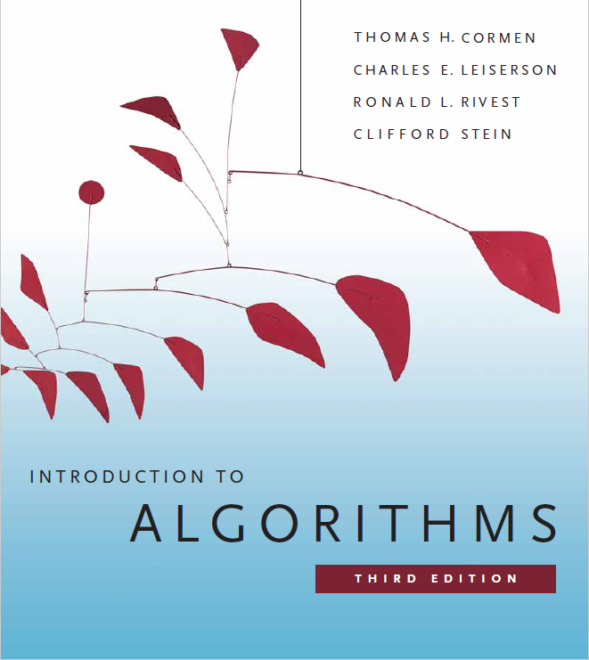
Number Theory Algorithms
Prepared by Shmuel Wimer
Instructed by Hillel Kugler and Shmuel Wimer

Slide 2
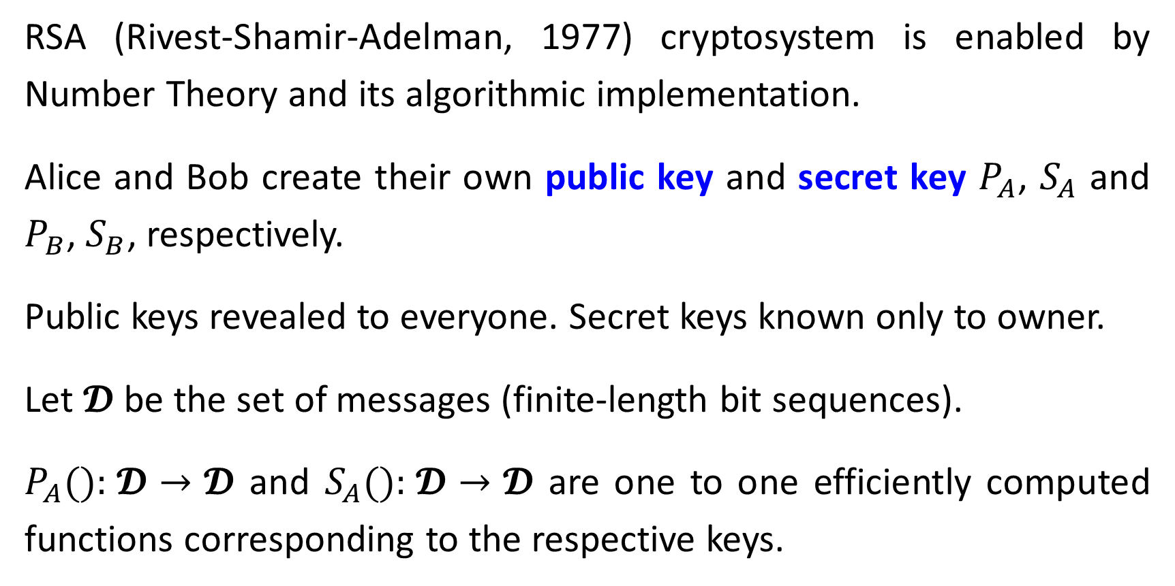
The RSA Public-Key Cryptosystem
RSA (Rivest-Shamir-Adelman, 1977) cryptosystem is enabled by Number Theory and its algorithmic implementation.
Alice and Bob create their own public key and secret key $P_{A}$, $S_{A}$ and $P_{B}$, $S_{B}$, respectively.
Public keys revealed to everyone. Secret keys known only to owner.
Let 𝓓 be the set of messages (finite-length bit sequences).
$P_{A}()\text{: }\text{𝓓}→\text{𝓓}$ and $S_{A}()\text{: }\text{𝓓}→\text{𝓓}$ are one to one efficiently computed functions corresponding to the respective keys.

Slide 3
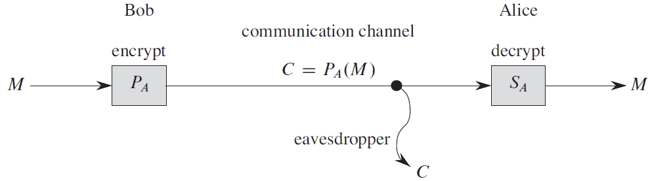
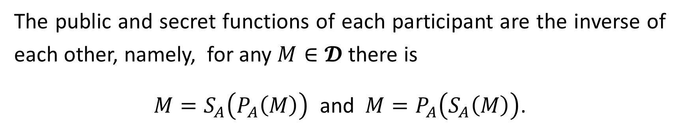
The public and secret functions of each participant are the inverse of each other, namely, for any $M∈\text{𝓓}$ there is
$M=S_{A}\left(P_{A}\left(M\right)\right)$ and $M=P_{A}\left(S_{A}\left(M\right)\right)$.

Slide 4
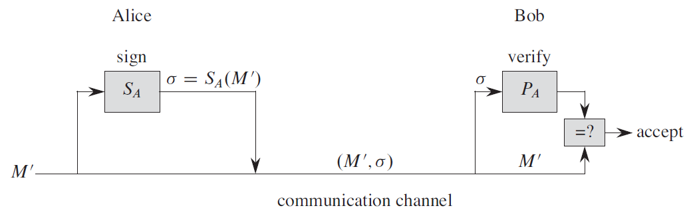
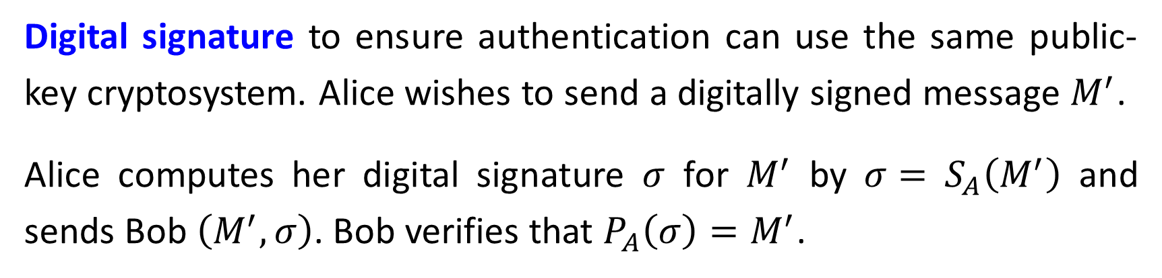
Digital signature to ensure authentication can use the same public-key cryptosystem. Alice wishes to send a digitally signed message $M^{′}$.
Alice computes her digital signature $σ$ for $M^{′}$ by $σ=$ $S_{A}\left(M^{′}\right)$ and sends Bob $\left(M^{′},σ\right)$. Bob verifies that $P_{A}\left(σ\right)=M^{′}$.

Slide 5
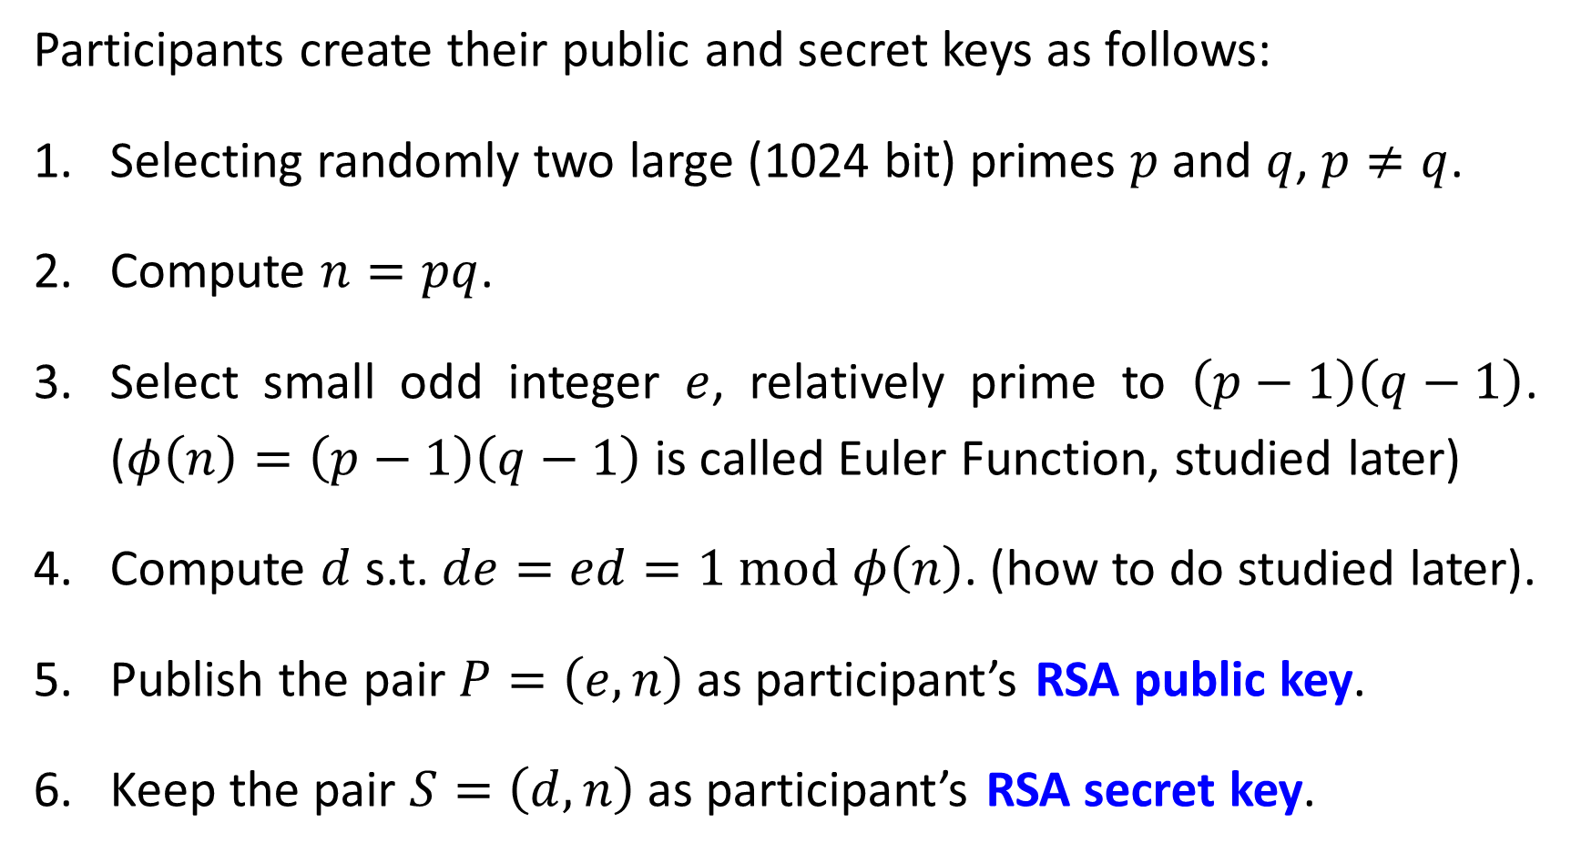
Participants create their public and secret keys as follows:
Selecting randomly two large (1024 bit) primes $p$ and $q$, $p≠q$.
Compute $n=pq$.
Select small odd integer $e$, relatively prime to $\left(p−1\right)\left(q−1\right)$. ($φ\left(n\right)=\left(p−1\right)\left(q−1\right)$ is called Euler Function, studied later)
Compute $d$ s.t. $de=ed=1 \text{mod} φ\left(n\right)$. (how to do studied later).
Publish the pair $P=\left(e,n\right)$ as participant’s RSA public key.
Keep the pair $S=\left(d,n\right)$ as participant’s RSA secret key.

Slide 6
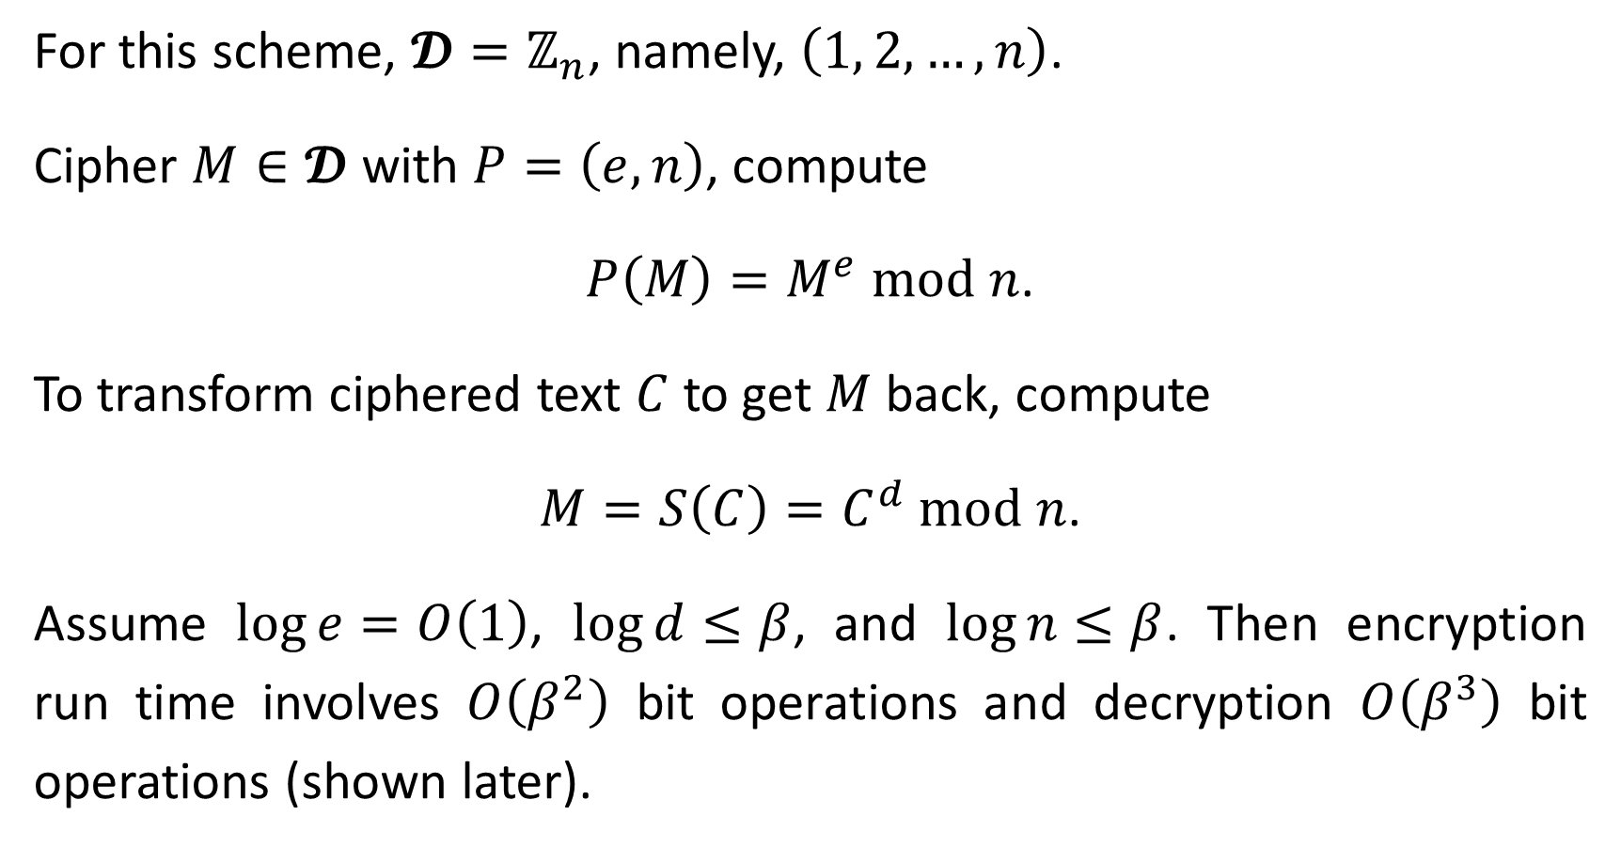
For this scheme, $\text{𝓓}=ℤ_{n}$, namely, $\left(1, 2, …, n\right)$.
Cipher $M∈\text{𝓓}$ with $P=\left(e,n\right)$, compute
$P\left(M\right)=M^{e} \text{mod} n$.
To transform ciphered text $C$ to get $M$ back, compute
$M=S\left(C\right)=C^{d} \text{mod} n$.
Assume $\log{e}=O\left(1\right)$, $\log{d}≤β$, and $\log{n}≤β$. Then encryption run time involves $O\left(β^{2}\right)$ bit operations and decryption $O\left(β^{3}\right)$ bit operations (shown later).

Slide 7
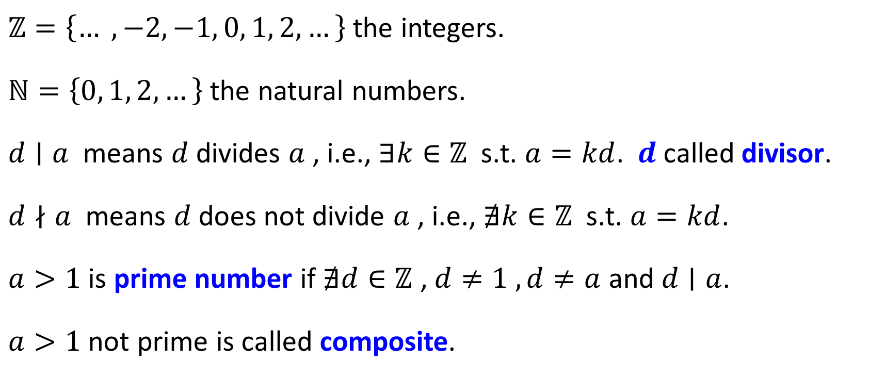
Notations
$ℤ=\left\{… ,−2, −1, 0, 1, 2, …\right\}$ the integers.
$ℕ=\left\{0, 1, 2, …\right\}$ the natural numbers.
$d∣a$ means $d$divides $a$ , i.e., $∃k∈ℤ$ s.t. $a=kd$. $d$called divisor.
$d∤a$ means $d$does not divide $a$ , i.e., $∄k∈ℤ$ s.t. $a=kd$.
$a>1$ is prime number if $∄d∈ℤ$ , $d≠1 , d≠a$ and $d∣a$.
$a>1$ not prime is called composite.

Slide 8
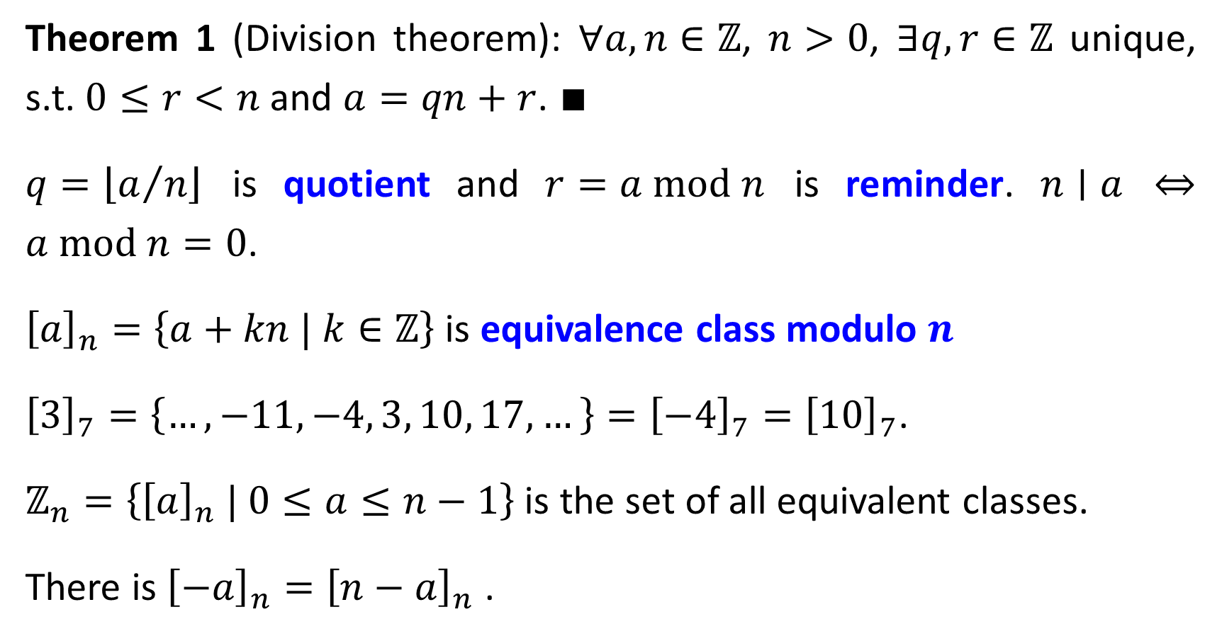
Theorem 1 (Division theorem): $∀a, n∈ℤ$, $n>0$, $∃q,r∈ℤ$ unique, s.t. $0≤r<n$ and $a=qn+r$. $∎$
$q=\left\lfloor a/n\right\rfloor$ is quotient and $r=a \text{mod} n$ is reminder. $n∣a$ ⇔ $a \text{mod} n=0$.
${\left[a\right]}_{n}=\left\{a+kn | k∈ℤ\right\}$ is equivalence class modulo $n$
${\left[3\right]}_{7}=\left\{…, −11,−4, 3, 10, 17, …\right\}={\left[−4\right]}_{7}={\left[10\right]}_{7}$.
$ℤ_{n}=\left\{{\left[a\right]}_{n} | 0≤a≤n−1\right\}$ is the set of all equivalent classes.
There is ${\left[−a\right]}_{n}={\left[n−a\right]}_{n}$ .

Slide 9
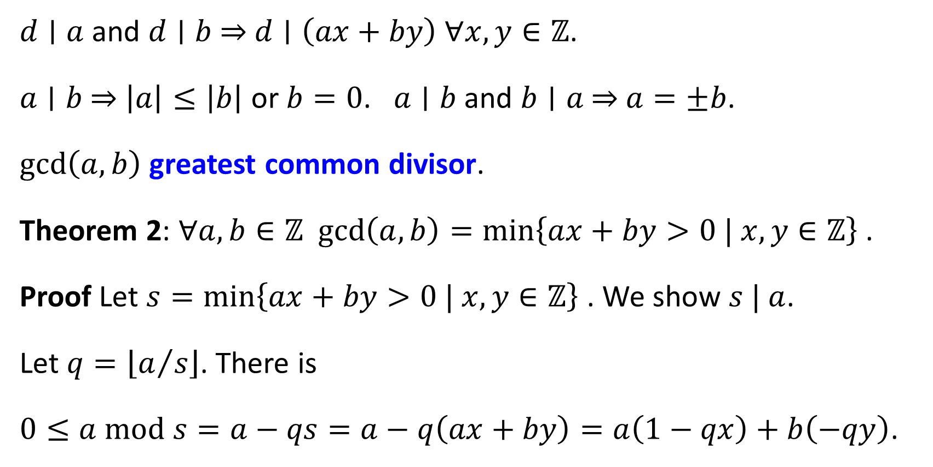
Common Divisors
$d∣a$ and $d∣b$⇒ $d∣\left(ax+by\right)$ $∀x,y∈ℤ$.
$a∣b$ ⇒ $\left|a\right|≤\left|b\right|$ or $b=0$. $a∣b$ and $b∣a$ ⇒ $a=±b$.
$\text{gcd}\left(a,b\right)$ greatest common divisor.
Theorem 2: $∀a,b∈ℤ$ $\text{gcd}\left(a,b\right)=\min\left\{ax+by>0 | x,y∈ℤ\right\}$ .
Proof Let $s=\min\left\{ax+by>0 | x,y∈ℤ\right\}$ . We show $s | a$.
Let $q=\left\lfloor a/s\right\rfloor$. There is
$0≤a \text{mod} s=a−qs=a−q\left(ax+by\right)=a\left(1−qx\right)+b\left(−qy\right)$.

Slide 10
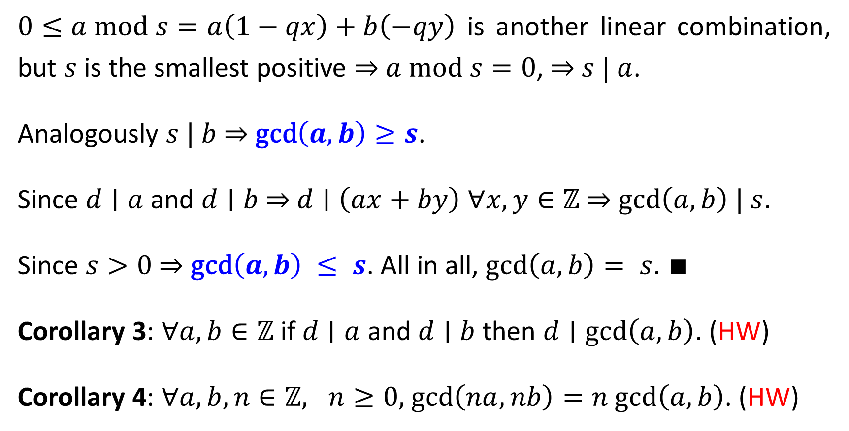
$0≤a \text{mod} s=a\left(1−qx\right)+b\left(−qy\right)$ is another linear combination, but $s$is the smallest positive ⇒ $a \text{mod} s=0$, ⇒ $s | a$.
Analogously $s | b$ ⇒ $\text{gcd}\left(a,b\right)≥s$.
Since $d∣a$ and $d∣b$⇒ $d∣\left(ax+by\right)$ $∀x,y∈ℤ$ ⇒ $\text{gcd}\left(a,b\right) | s$.
Since $s>0$ ⇒ $\text{gcd}\left(a,b\right) ≤ s$. All in all, $\text{gcd}\left(a,b\right)= s$. $∎$
Corollary 3: $∀a,b∈ℤ$ if $d∣a$ and $d∣b$then $d∣\text{gcd}\left(a,b\right)$. (HW)
Corollary 4: $∀a,b,n∈ℤ, n≥0,$ $\text{gcd}\left(na,nb\right)=n \text{gcd}\left(a,b\right)$. (HW)

Slide 11
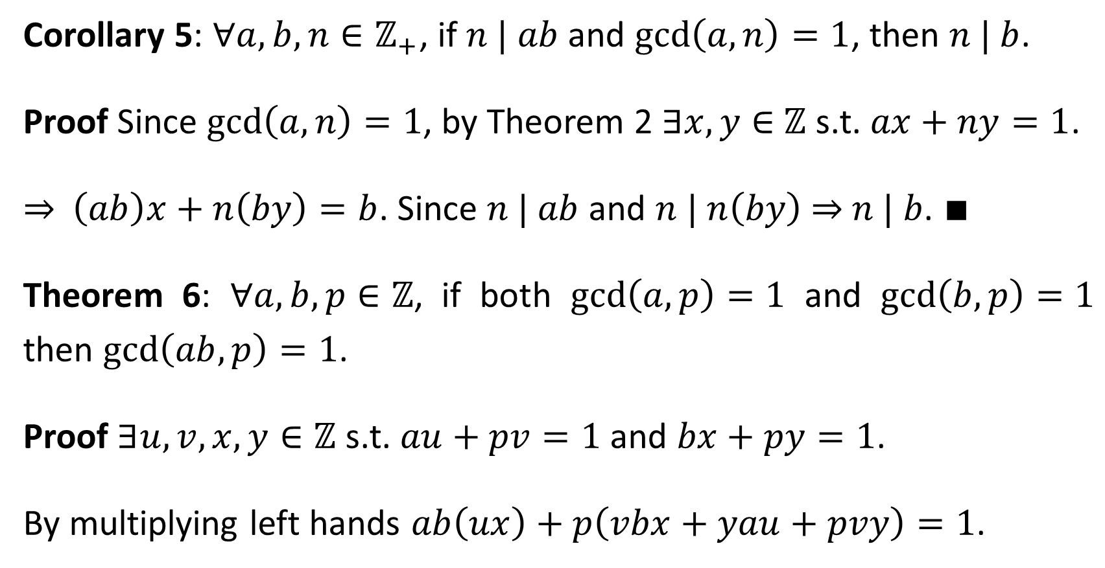
Corollary 5: $∀a,b,n∈ℤ_{+}$, if $n | ab$ and $\text{gcd}\left(a,n\right)=1$, then $n | b$.
Proof Since $\text{gcd}\left(a,n\right)=1$, by Theorem 2 $∃x,y∈$ $ℤ$ s.t. $ax+ny=1$.
⇒ $\left(ab\right)x+n\left(by\right)=b$. Since $n | ab$ and $n | n\left(by\right)$ ⇒ $n | b$. $∎$
Theorem 6: $∀a,b,p∈ℤ$, if both $\text{gcd}\left(a,p\right)=1$ and $\text{gcd}\left(b,p\right)=1$ then $\text{gcd}\left(ab,p\right)=1$.
Proof $∃u,v,x,y∈ℤ$ s.t. $au+pv=1$ and $bx+py=1$.
By multiplying left hands $ab\left(ux\right)+p\left(vbx+yau+pvy\right)=1$.

Slide 12
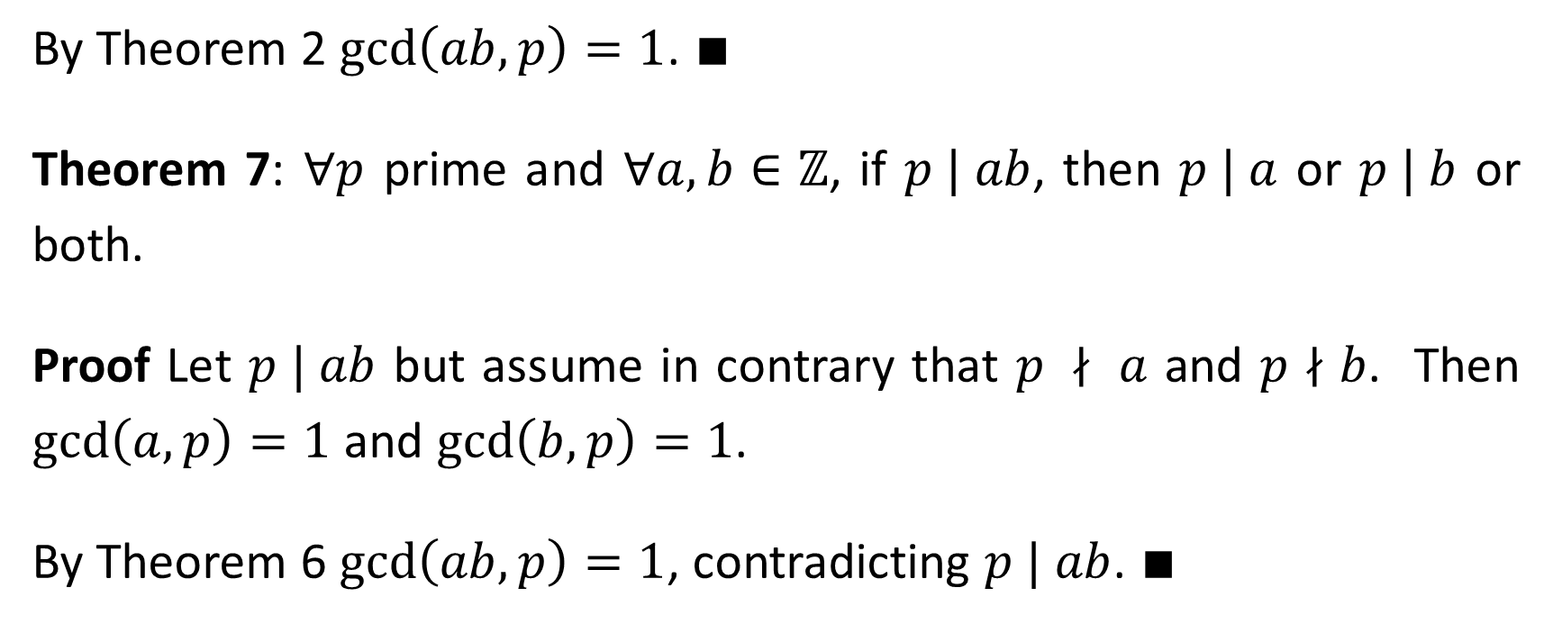
By Theorem 2 $\text{gcd}\left(ab,p\right)=1$. $∎$
Theorem 7: $∀p$ prime and $∀a,b∈ℤ$, if $p | ab$, then $p | a$ or $p | b$ or both.
Proof Let $p | ab$ but assume in contrary that $p ∤ a$ and $p∤b$. Then $\text{gcd}\left(a,p\right)=1$ and $\text{gcd}\left(b,p\right)=1$.
By Theorem 6 $\text{gcd}\left(ab,p\right)=1$, contradicting $p | ab$. $∎$

Slide 13
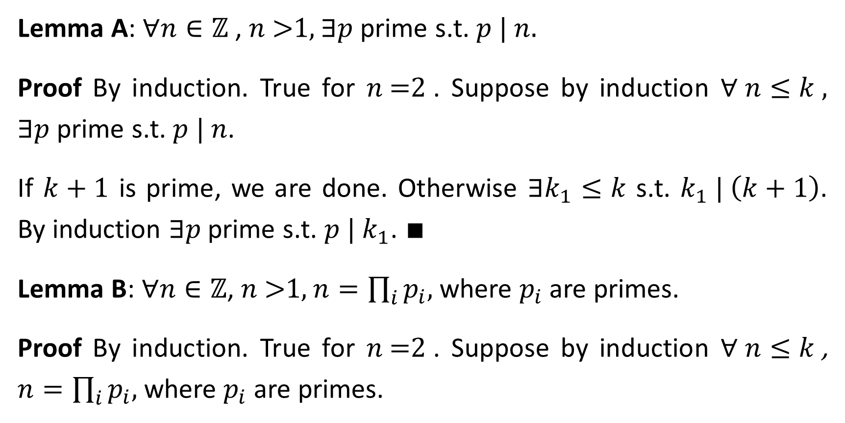
Unique Factorization
Lemma A: $∀n∈ℤ$ , $n \text{>}\text{1}$, $∃p$ prime s.t. $p | n$.
Proof By induction. True for $n \text{=}\text{2}$. Suppose by induction $∀ n≤k$, $∃p$ prime s.t. $p | n$.
If $k+1$ is prime, we are done. Otherwise $∃k_{1}≤k$ s.t. $k_{1} | \left(k+1\right)$. By induction $∃p$ prime s.t. $p |{ k}_{1}$. $∎$
Lemma B: $∀n∈ℤ$, $n \text{>}\text{1}$, $n=\prod_{i}{p_{i}}$, where $p_{i}$ are primes.
Proof By induction. True for $n \text{=}\text{2}$. Suppose by induction $∀ n≤k$, $n=\prod_{i}{p_{i}}$, where $p_{i}$ are primes.

Slide 14
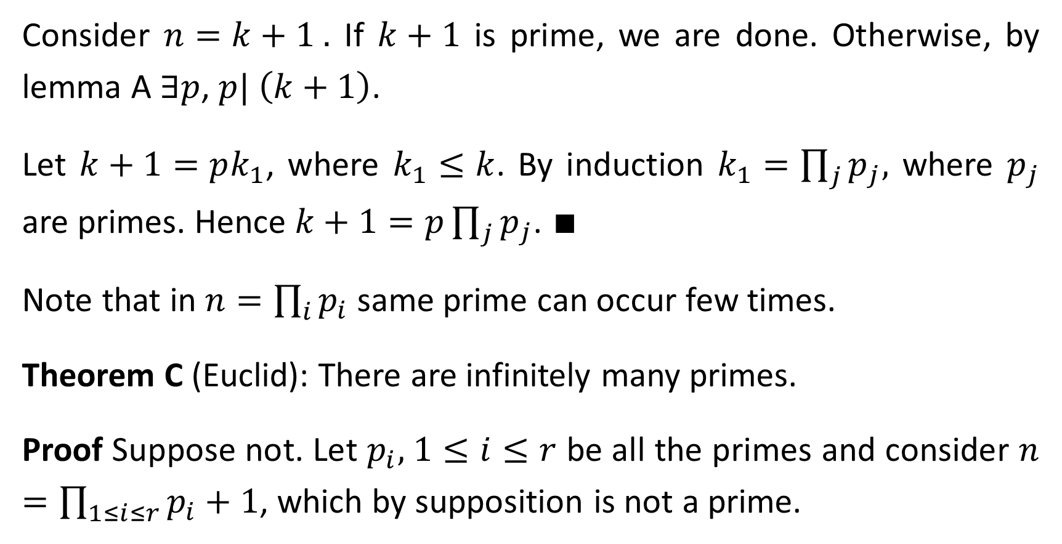
Consider $n=k+1$. If $k+1$ is prime, we are done. Otherwise, by lemma A $∃p$, $p| \left(k+1\right)$.
Let $k+1=pk_{1}$, where $k_{1}≤k$. By induction $k_{1}=\prod_{j}{p_{j}}$, where $p_{j}$ are primes. Hence $k+1=p\prod_{j}{p_{j}}$. $∎$
Note that in $n=\prod_{i}{p_{i}}$ same prime can occur few times.
Theorem C (Euclid): There are infinitely many primes.
Proof Suppose not. Let $p_{i},$ $1≤i≤r$ be all the primes and consider $n=\prod_{1≤i≤r}{p_{i}}+1$, which by supposition is not a prime.

Slide 15
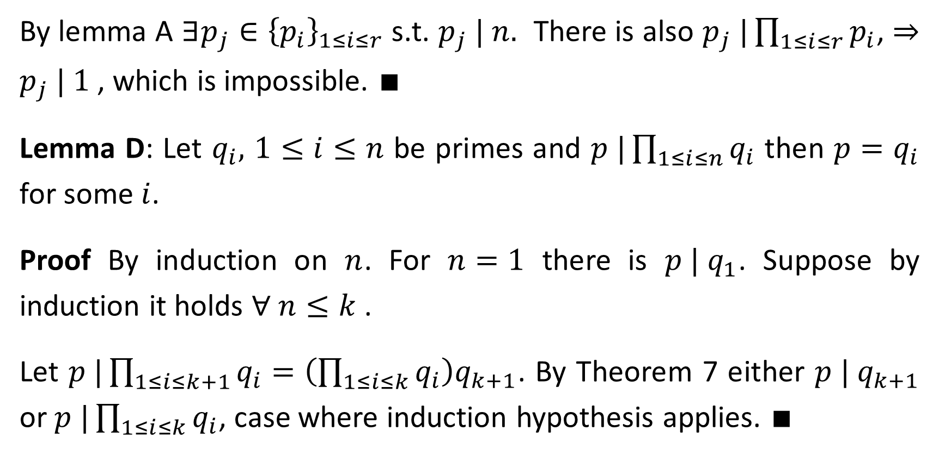
By lemma A $∃p_{j}∈{\left\{p_{i}\right\}}_{1≤i≤r}$ s.t. $p_{j} | n$. There is also $p_{j} |\prod_{1≤i≤r}{p_{i}}$, ⇒ $p_{j} | 1$ , which is impossible. $∎$
Lemma D: Let $q_{i},$ $1≤i≤n$ be primes and $p |\prod_{1≤i≤n}{q_{i}}$ then $p=q_{i}$ for some $i$.
Proof By induction on $n$. For $n=1$ there is $p | q_{1}$. Suppose by induction it holds $∀ n≤k$.
Let $p |\prod_{1≤i≤k+1}{q_{i}}=\left(\prod_{1≤i≤k}{q_{i}}\right)q_{k+1}$. By Theorem 7 either $p | q_{k+1}$ or $p |\prod_{1≤i≤k}{q_{i}}$, case where induction hypothesis applies. $∎$

Slide 16
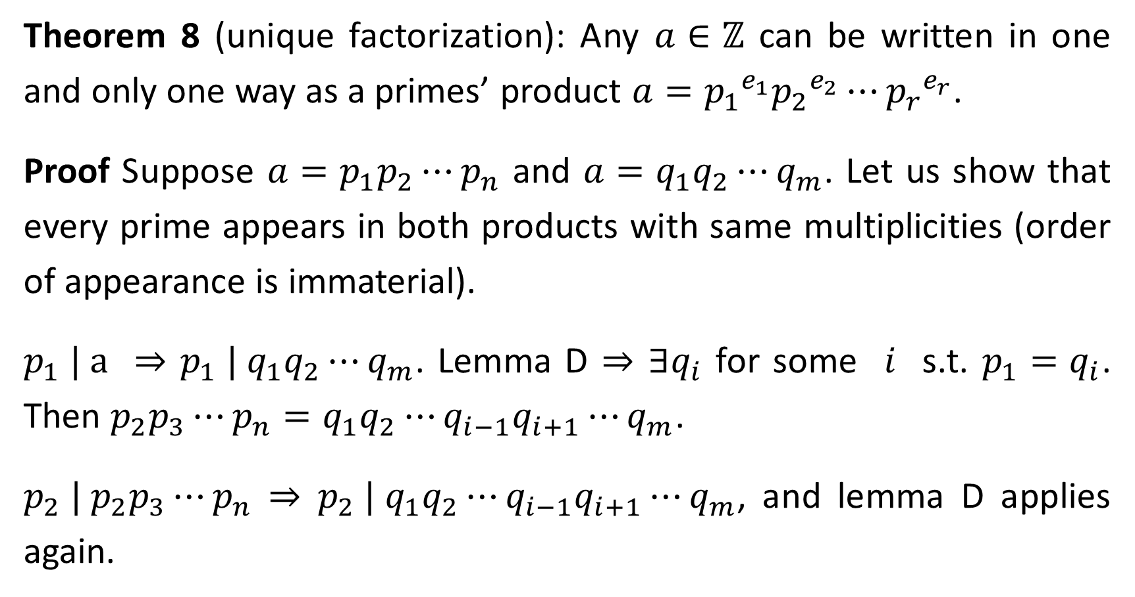
Theorem 8 (unique factorization): Any $a∈ℤ$ can be written in one and only one way as a primes’ product $a={p_{1}}^{e_{1}}{p_{2}}^{e_{2}}⋯{p_{r}}^{e_{r}}$.
Proof Suppose $a=p_{1}p_{2}⋯p_{n}$ and $a=q_{1}q_{2}⋯q_{m}$. Let us show that every prime appears in both products with same multiplicities (order of appearance is immaterial).
$p_{1} | a$ ⇒ $p_{1} | q_{1}q_{2}⋯q_{m}$. Lemma D ⇒ $∃q_{i}$ for some $i$ s.t. $p_{1}=q_{i}$. Then $p_{2}p_{3}⋯p_{n}=q_{1}q_{2}⋯{q_{i−1}q_{i+1}⋯q}_{m}$.
$p_{2} |{ p}_{2}p_{3}⋯p_{n}$ ⇒ $p_{2} |{ q}_{1}q_{2}⋯{q_{i−1}q_{i+1}⋯q}_{m}$, and lemma D applies again.

Slide 17
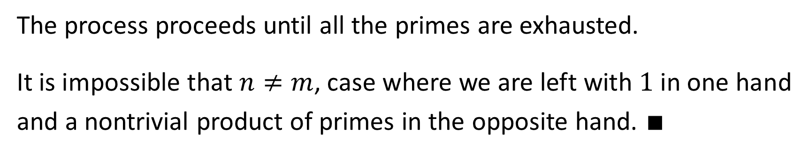
The process proceeds until all the primes are exhausted.
It is impossible that $n≠m$, case where we are left with $1$ in one hand and a nontrivial product of primes in the opposite hand. $∎$

Slide 18
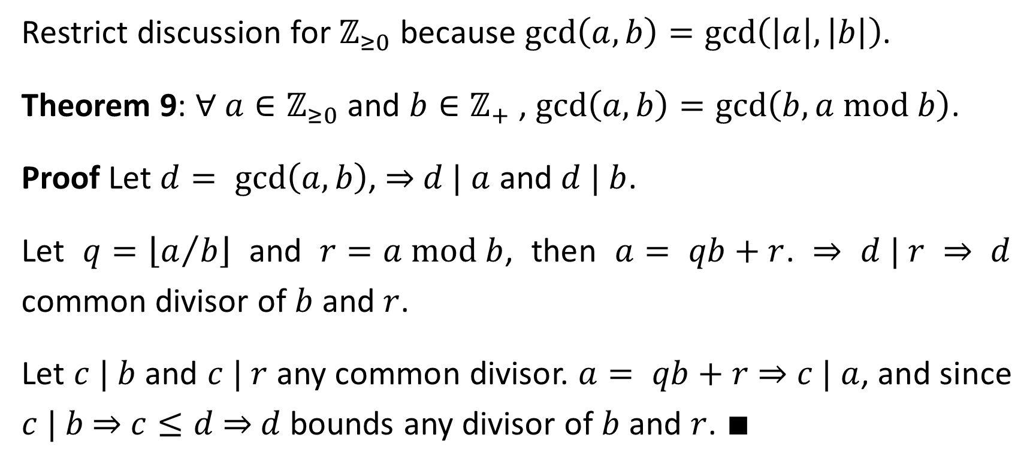
Greatest Common Divisor and Euclid Algorithm
Restrict discussion for $ℤ_{≥0}$ because $\text{gcd}\left(a,b\right)=\text{gcd}\left(\left|a\right|,\left|b\right|\right)$.
Theorem 9: $∀ a∈ℤ_{≥0}$ and $b∈ℤ_{+}$ , $\text{gcd}\left(a,b\right)=\text{gcd}\left(b,a \text{mod} b\right)$.
Proof Let $d= \text{gcd}\left(a, b\right)$, ⇒ $d | a$ and $d | b$.
Let $q=\left\lfloor a/b\right\rfloor$ and $r=a \text{mod} b$, then $a= qb+r$. ⇒ $d | r$ ⇒ $d$ common divisor of $b$ and $r$.
Let $c | b$ and $c | r$ any common divisor. $a= qb+r$ ⇒ $c | a$, and since $c | b$ ⇒ $c≤d$ ⇒ $d$ bounds any divisor of $b$ and $r$. $∎$

Slide 19
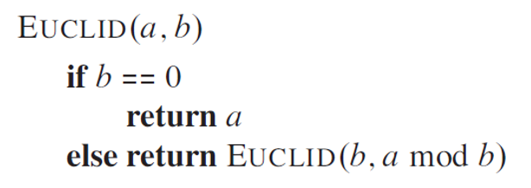
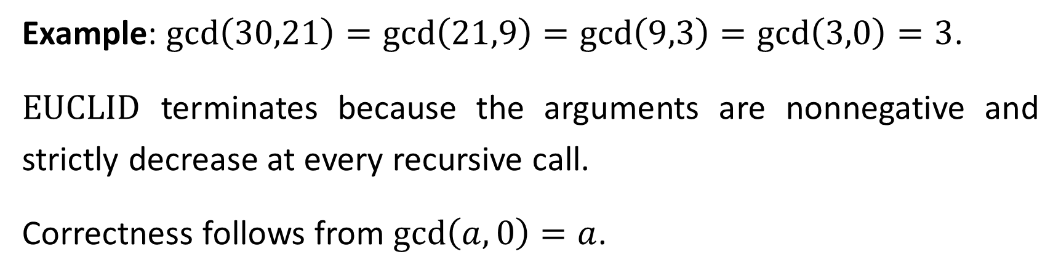
Example: $\text{gcd}\left(30,21\right)=\text{gcd}\left(21,9\right)=\text{gcd}\left(9,3\right)=\text{gcd}\left(3,0\right)=3$.
$\text{EUCLID}$ terminates because the arguments are nonnegative and strictly decrease at every recursive call.
Correctness follows from $\text{gcd}\left(a,0\right)=a$.

Slide 20
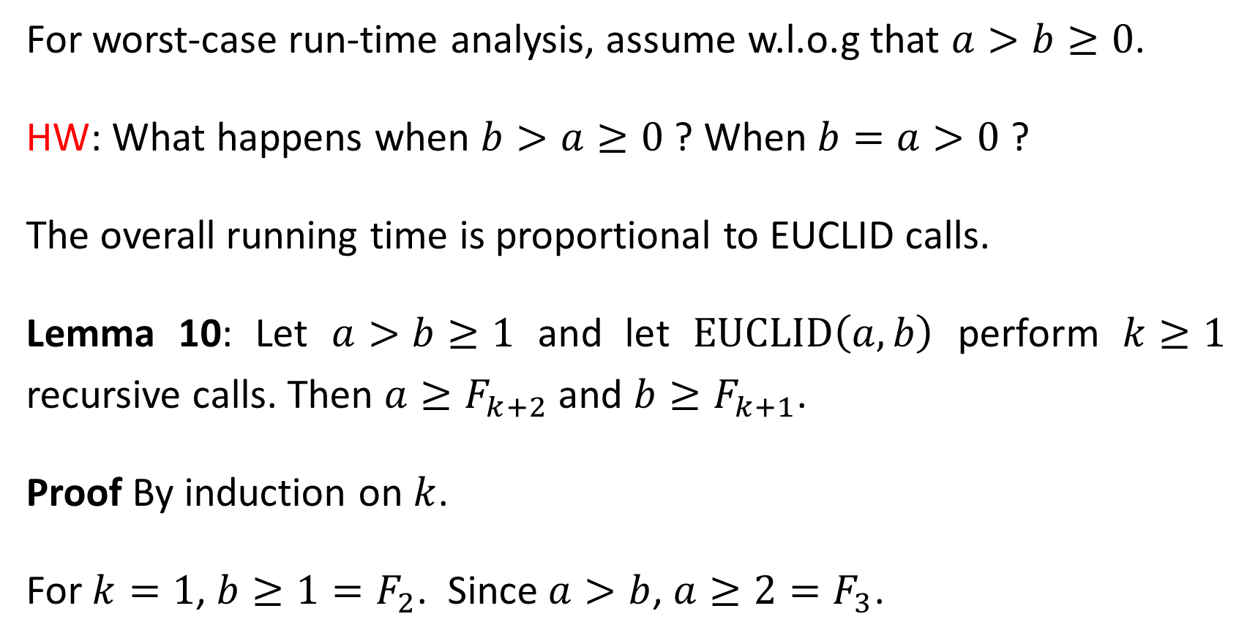
For worst-case run-time analysis, assume w.l.o.g that $a>b≥0$.
HW: What happens when $b>a≥0$ ? When $b=a>0$ ?
The overall running time is proportional to EUCLID calls.
Lemma 10: Let $a>b≥1$ and let $\text{EUCLID}\left(a,b\right)$ perform $k≥1$ recursive calls. Then $a≥F_{k+2}$ and $b≥F_{k+1}$.
Proof By induction on $k$.
For $k=1$, $b≥1=F_{2}$. Since $a>b$, $a≥2=F_{3}$.

Slide 21
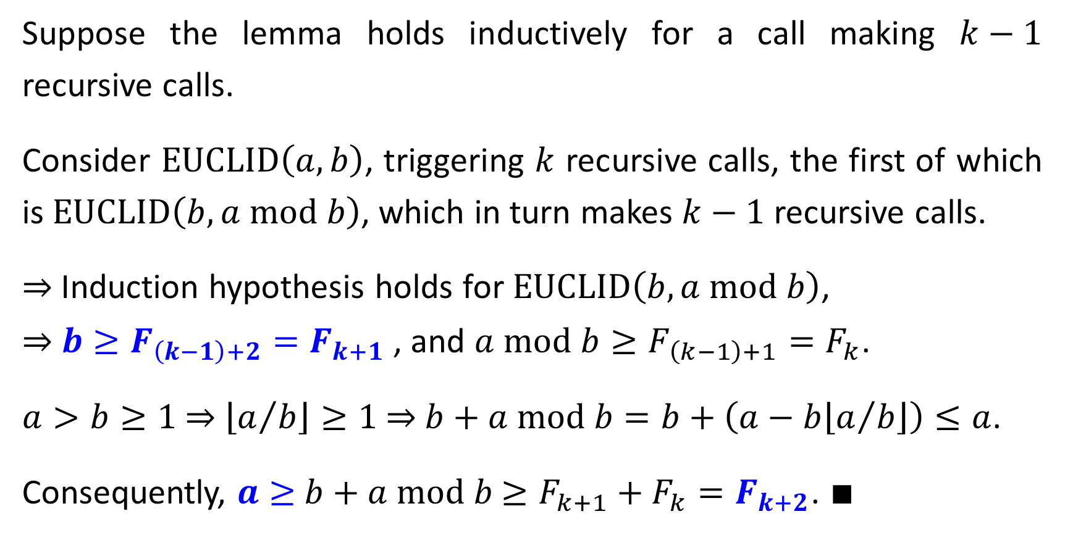
Suppose the lemma holds inductively for a call making $k−1$ recursive calls.
Consider $\text{EUCLID}\left(a,b\right)$, triggering $k$ recursive calls, the first of which is $\text{EUCLID}\left(b,a \text{mod} b\right)$, which in turn makes $k−1$ recursive calls.
⇒ Induction hypothesis holds for $\text{EUCLID}\left(b,a \text{mod} b\right)$,
⇒ $b≥F_{\left(k−1\right)+2}=F_{k+1}$ , and $a \text{mod} b≥F_{\left(k−1\right)+1}=F_{k}$.
$a>b≥1$ ⇒ $\left\lfloor a/b\right\rfloor ≥1$ ⇒ $b+a \text{mod} b=b+\left(a−b\left\lfloor a/b\right\rfloor \right)≤a$.
Consequently, $a≥$ $b+a \text{mod} b$ $≥F_{k+1}+F_{k}=F_{k+2}$. $∎$

Slide 22
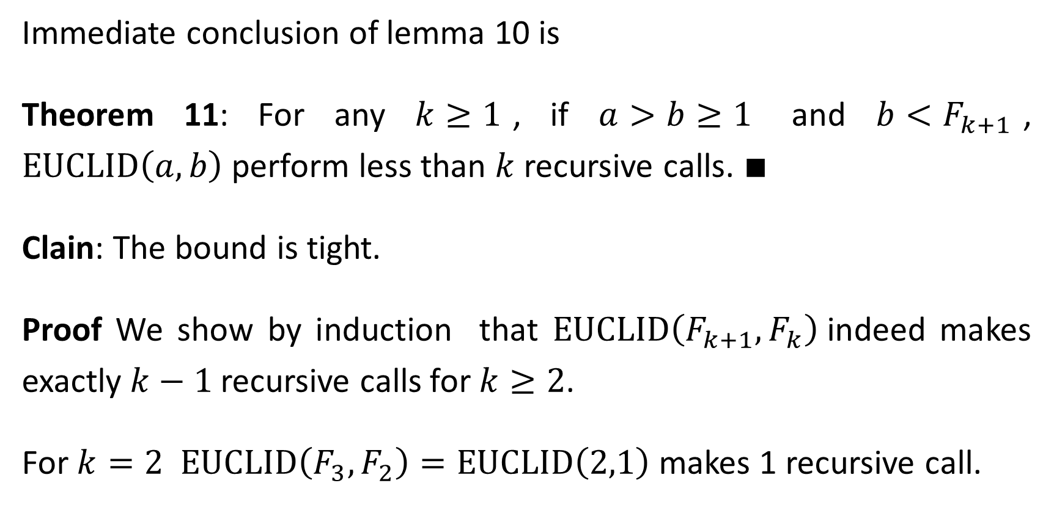
Immediate conclusion of lemma 10 is
Theorem 11: For any $k≥1$, if $a>b≥1$ and $b<F_{k+1}$, $\text{EUCLID}\left(a,b\right)$ perform less than $k$ recursive calls. $∎$
Clain: The bound is tight.
Proof We show by induction that $\text{EUCLID}\left(F_{k+1},F_{k}\right)$indeed makes exactly $k−1$recursive calls for $k≥2$.
For $k=2$ $\text{EUCLID}\left(F_{3},F_{2}\right)=\text{EUCLID}\left(2,1\right)$ makes 1 recursive call.

Slide 23
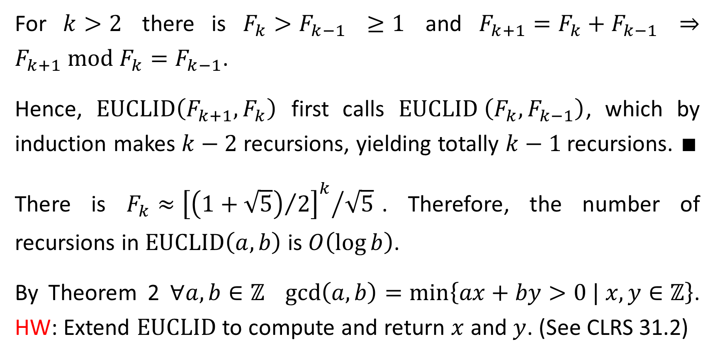
For $k>2$ there is $F_{k}>F_{k−1}$ $≥1$ and $F_{k+1}=F_{k}+F_{k−1}$ ⇒ $F_{k+1} \text{mod}{ F}_{k}=F_{k−1}$.
Hence, $\text{EUCLID}\left(F_{k+1},F_{k}\right)$ first calls $\text{EUCLID} \left(F_{k},F_{k−1}\right)$, which by induction makes $k−2$ recursions, yielding totally $k−1$recursions. $∎$
There is $F_{k}≈{{\left[{\left(1+\sqrt{5}\right)}/2\right]}^{k}}/{\sqrt{5}}$. Therefore, the number of recursions in $\text{EUCLID}\left(a,b\right)$ is $O\left(\log{b}\right)$.
By Theorem 2 $∀a,b∈ℤ$ $\text{gcd}\left(a,b\right)=\min\left\{ax+by>0 | x,y∈ℤ\right\}$. HW: Extend $\text{EUCLID}$ to compute and return $x$ and $y$. (See CLRS 31.2)

Slide 24
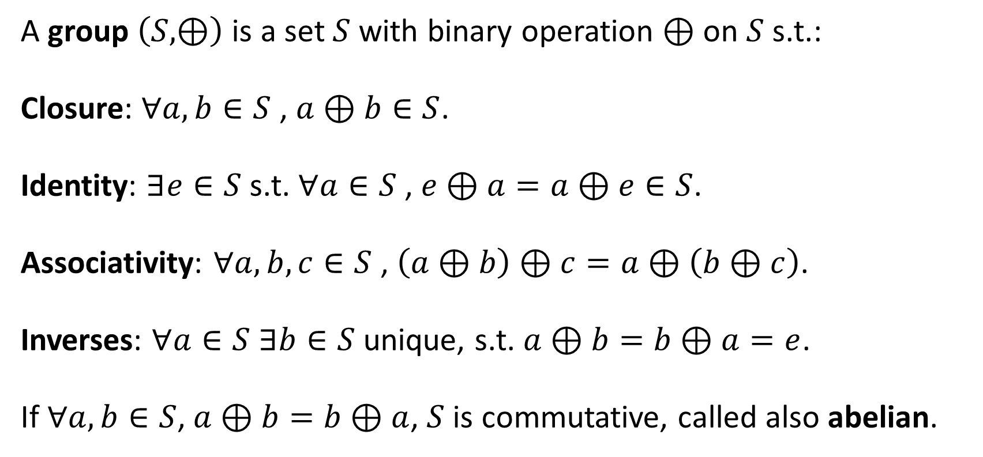
Modular Arithmetic
A group $\left(S,⊕\right)$ is a set $S$ with binary operation $⊕$ on $S$ s.t.:
Closure: $∀a,b∈S$ , $a⊕b∈S$.
Identity: $∃e∈S$ s.t. $∀a∈S$ , $e⊕a=a⊕e∈S$.
Associativity: $∀a,b,c∈S$ , $\left(a⊕b\right)⊕c=a⊕\left(b⊕c\right)$.
Inverses: $∀a∈S$ $∃b∈S$ unique, s.t. $a⊕b=b⊕a=e$.
If $∀a,b∈S$, $a⊕b=b⊕a$, $S$is commutative, called also abelian.

Slide 25
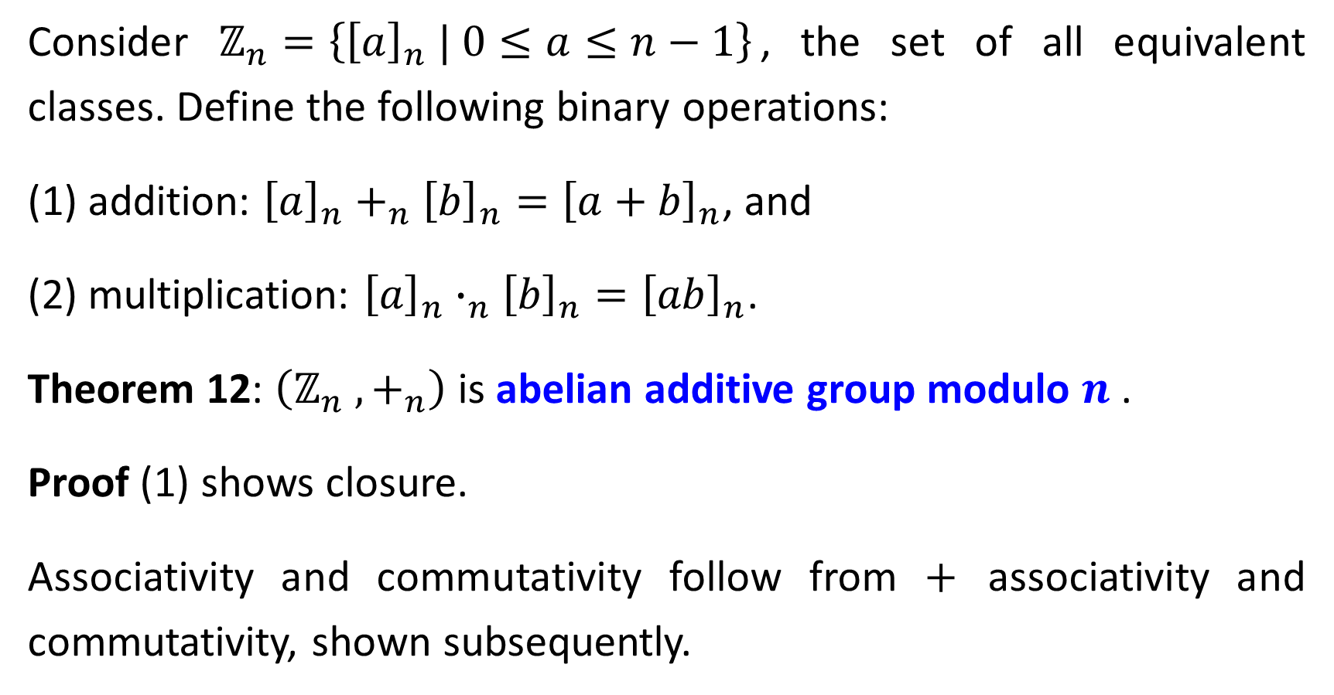
Consider $ℤ_{n}=\left\{{\left[a\right]}_{n} | 0≤a≤n−1\right\}$, the set of all equivalent classes. Define the following binary operations:
(1) addition: ${\left[a\right]}_{n}+_{n}{\left[b\right]}_{n}={\left[a+b\right]}_{n}$, and
(2) multiplication: ${\left[a\right]}_{n}∙_{n}{\left[b\right]}_{n}={\left[ab\right]}_{n}$.
Theorem 12: $\left(ℤ_{n} ,+_{n}\right)$ is abelian additive group modulo $n$ .
Proof (1) shows closure.
Associativity and commutativity follow from $+$ associativity and commutativity, shown subsequently.

Slide 26
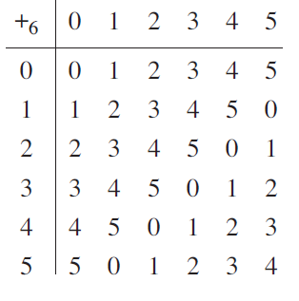
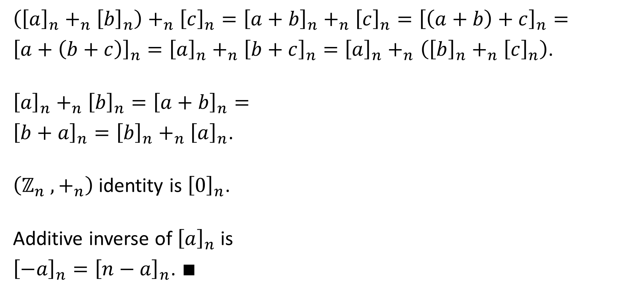
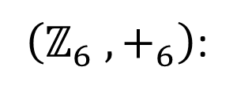
$\left({\left[a\right]}_{n}+_{n}{\left[b\right]}_{n}\right)+_{n}{\left[c\right]}_{n}={\left[a+b\right]}_{n}+_{n}{\left[c\right]}_{n}={\left[\left(a+b\right)+c\right]}_{n}=$
${\left[a+\left(b+c\right)\right]}_{n}=$ ${\left[a\right]}_{n}+_{n}{\left[b+c\right]}_{n}={\left[a\right]}_{n}+_{n}$ $\left({\left[b\right]}_{n}+_{n}{\left[c\right]}_{n}\right)$.
${\left[a\right]}_{n}+_{n}{\left[b\right]}_{n}={\left[a+b\right]}_{n}=$
${\left[b+a\right]}_{n}={\left[b\right]}_{n}+_{n}{\left[a\right]}_{n}$.
$\left(ℤ_{n} ,+_{n}\right)$ identity is ${\left[0\right]}_{n}$.
Additive inverse of ${\left[a\right]}_{n}$ is
${\left[−a\right]}_{n}={\left[n−a\right]}_{n}$. $∎$
$\left(ℤ_{6} ,+_{6}\right)$:

Slide 27
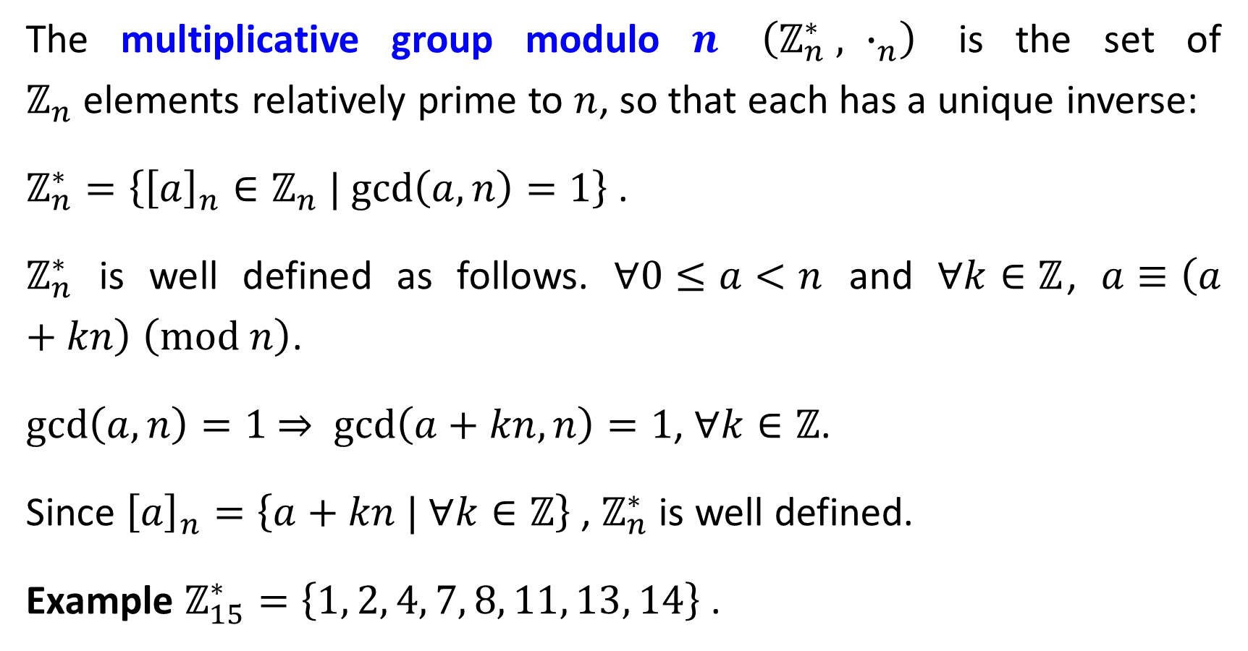
The multiplicative group modulo $n$ $\left(ℤ_{n}^{∗} , ∙_{n}\right)$ is the set of $ℤ_{n}$elements relatively prime to $n$, so that each has a unique inverse:
$ℤ_{n}^{∗}=\left\{{\left[a\right]}_{n}∈ℤ_{n} | \text{gcd}\left(a,n\right)=1\right\}$ .
$ℤ_{n}^{∗}$ is well defined as follows. $∀0≤a<n$ and $∀k∈ℤ$, $a≡\left(a+kn\right) \left(\text{mod} n\right)$.
$\text{gcd}\left(a,n\right)=1$ $⇒$ $\text{gcd}\left(a+kn,n\right)=1$, $∀k∈ℤ$.
Since ${\left[a\right]}_{n}=\left\{a+kn | ∀k∈ℤ\right\}$ , $ℤ_{n}^{∗}$ is well defined.
Example $ℤ_{15}^{∗}=\left\{1, 2, 4, 7, 8, 11, 13, 14\right\}$ .

Slide 28
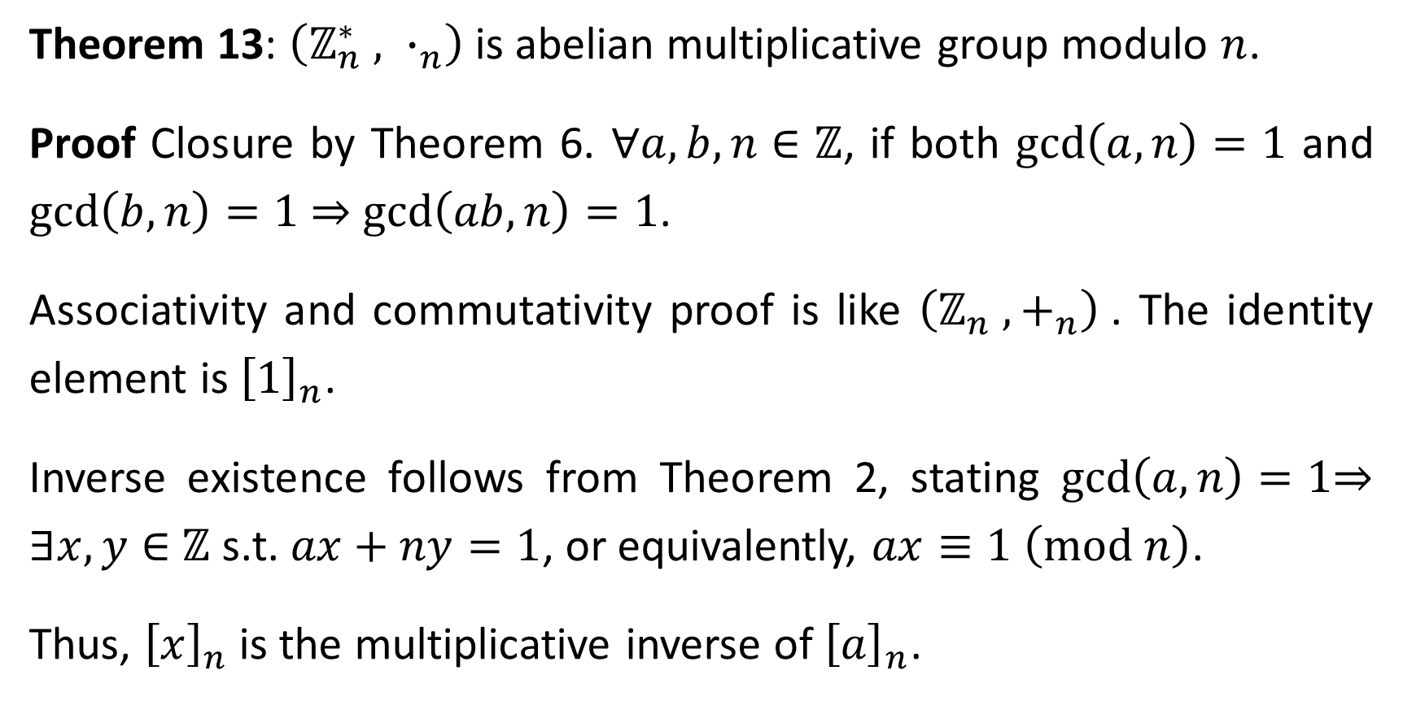
Theorem 13: $\left(ℤ_{n}^{∗} , ∙_{n}\right)$ is abelian multiplicative group modulo $n$.
Proof Closure by Theorem 6. $∀a,b,n∈ℤ$, if both $\text{gcd}\left(a,n\right)=1$ and $\text{gcd}\left(b,n\right)=1$ ⇒ $\text{gcd}\left(ab,n\right)=1$.
Associativity and commutativity proof is like $\left(ℤ_{n} ,+_{n}\right)$. The identity element is ${\left[1\right]}_{n}$.
Inverse existence follows from Theorem 2, stating $\text{gcd}\left(a,n\right)=1$⇒ $∃x,y∈$ $ℤ$ s.t. $ax+ny=1$, or equivalently, $ax≡1 \left(\text{mod} n\right)$.
Thus, ${\left[x\right]}_{n}$ is the multiplicative inverse of ${\left[a\right]}_{n}$.

Slide 29
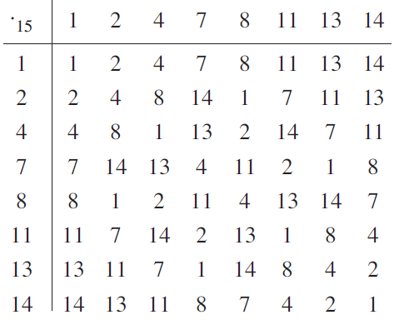
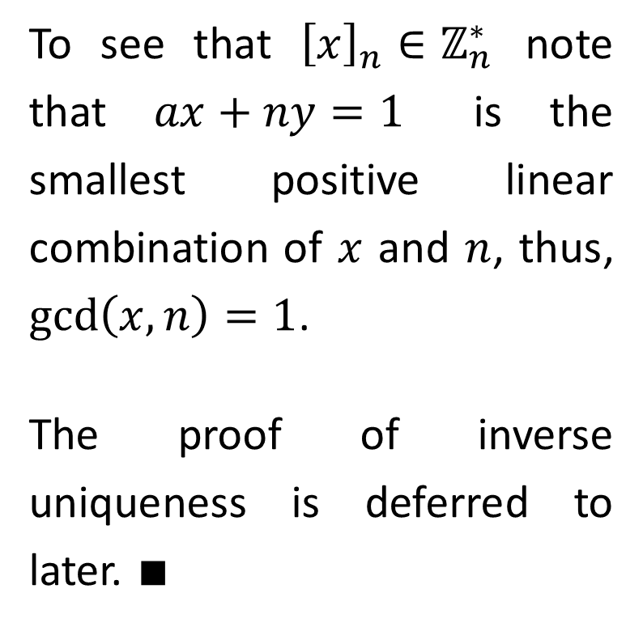
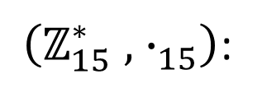
$\left(ℤ_{15}^{∗} ,{ ∙}_{15}\right)$:
To see that ${\left[x\right]}_{n}∈ℤ_{n}^{∗}$ note that $ax+ny=1$ is the smallest positive linear combination of $x$ and $n$, thus, $\text{gcd}\left(x,n\right)=1$.
The proof of inverse uniqueness is deferred to later. $∎$

Slide 30
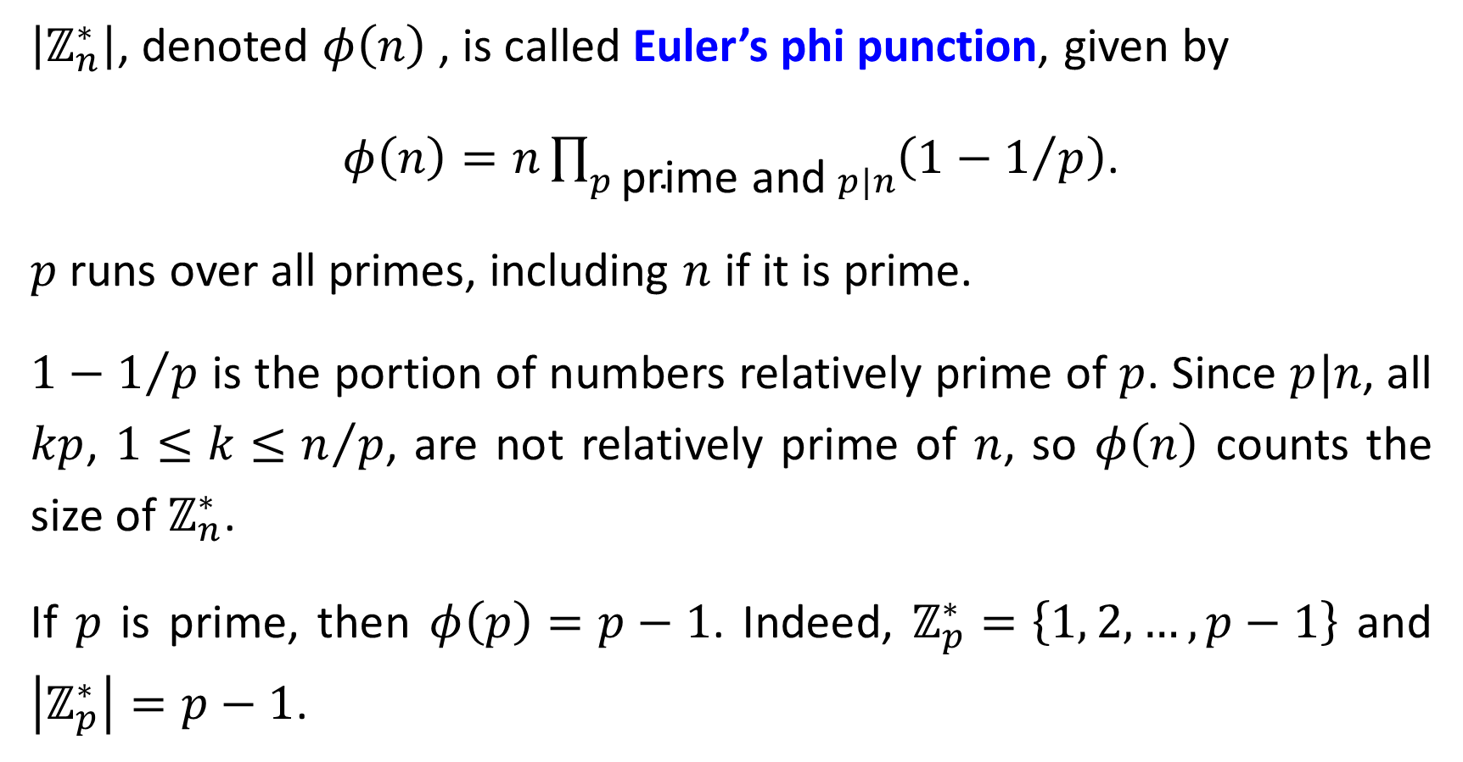
$\left|ℤ_{n}^{∗}\right|$, denoted $φ\left(n\right)$, is called Euler’s phi punction, given by
$φ\left(n\right)=n\prod_{p \text{p}\text{rime} \text{and} p|n}{\left(1−1/p\right)}$.
$p$ runs over all primes, including $n$ if it is prime.
$1−1/p$ is the portion of numbers relatively prime of $p$. Since $p|n$, all $kp$, $1≤k≤n/p$, are not relatively prime of $n$, so $φ\left(n\right)$ counts the size of $ℤ_{n}^{∗}$.
If $p$ is prime, then $φ\left(p\right)=p−1$. Indeed, $ℤ_{p}^{∗}=\left\{1, 2, …, p−1\right\}$ and $\left|ℤ_{p}^{∗}\right|=p−1$.

Slide 31
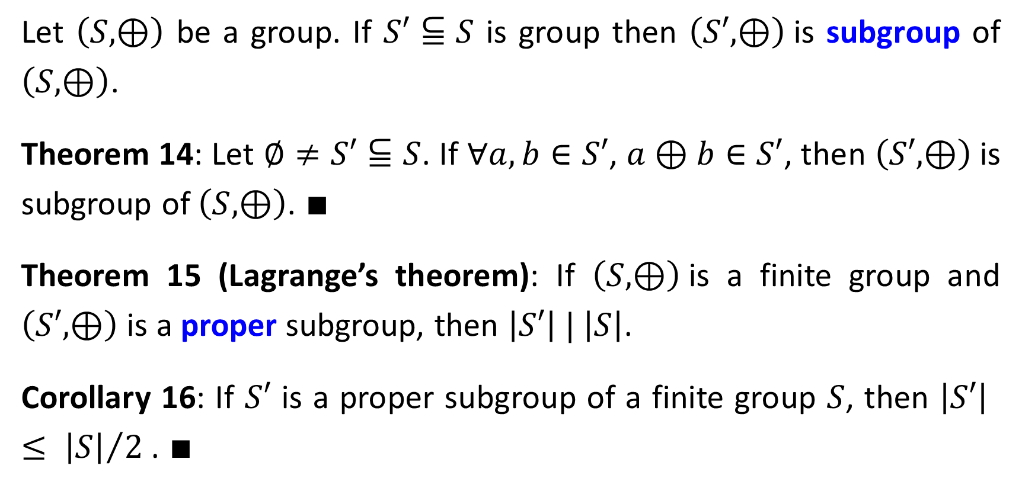
Subgroups
Let $\left(S,⊕\right)$ be a group. If $S′⫅S$ is group then $\left(S′,⊕\right)$is subgroup of $\left(S,⊕\right)$.
Theorem 14: Let $∅≠S′⫅S$. If $∀a,b∈S′$, $a⊕b∈S′$, then $\left(S′,⊕\right)$is subgroup of $\left(S,⊕\right)$. $∎$
Theorem 15 (Lagrange’s theorem): If $\left(S,⊕\right)$is a finite group and $\left(S′,⊕\right)$ is a proper subgroup, then $\left|S′\right| | \left|S\right|$.
Corollary 16: If $S′$ is a proper subgroup of a finite group $S$, then $\left|S′\right| ≤ {\left|S\right|}/2$ . $∎$

Slide 32
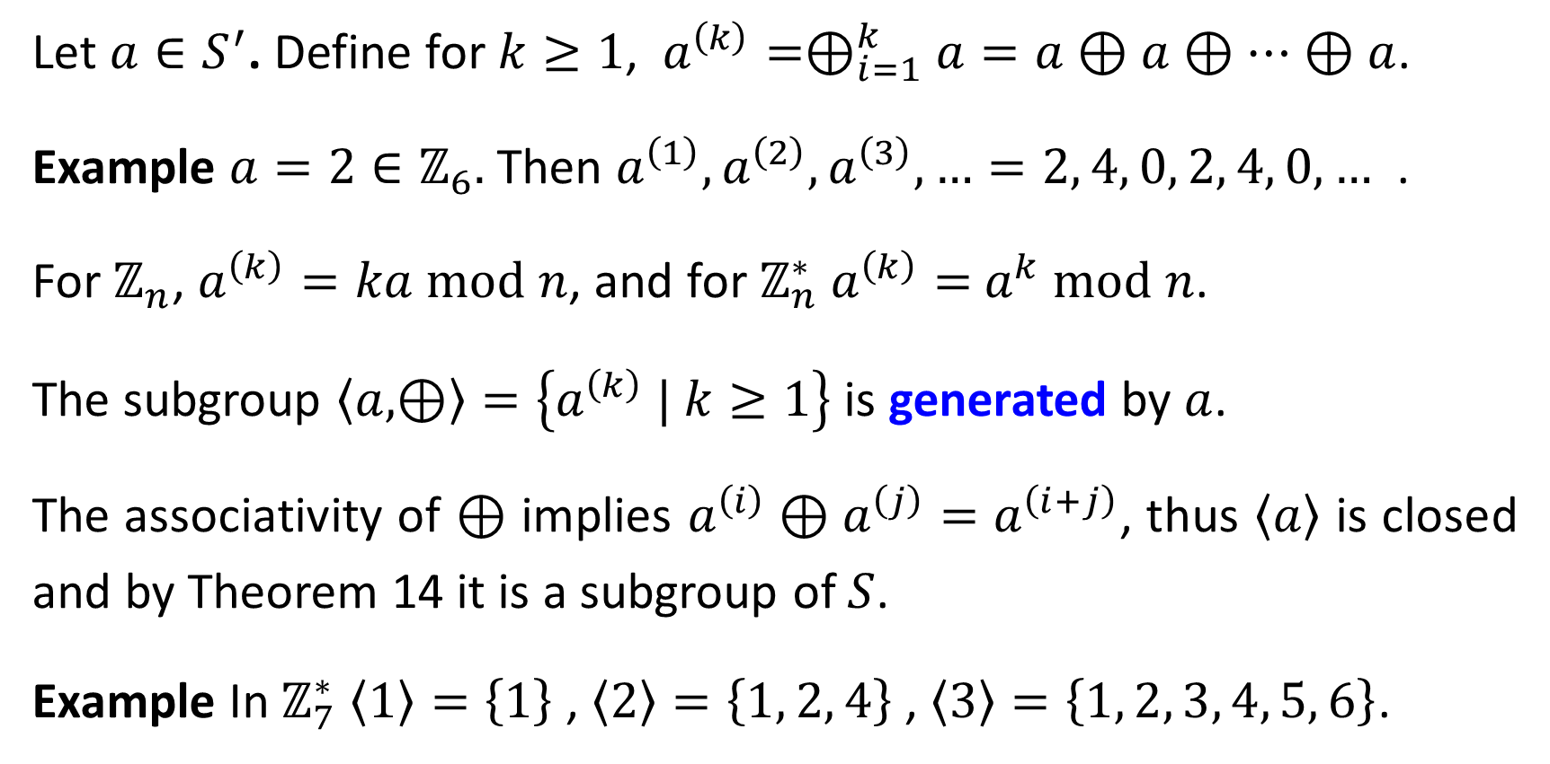
Let ${a∈S}^{′}$. Define for $k≥1$, $a^{\left(k\right)}=⊕_{i=1}^{k}a=a⊕a⊕⋯$ $⊕a$.
Example $a=2∈ℤ_{6}.$ Then $a^{\left(1\right)}, a^{\left(2\right)}, a^{\left(3\right)},…=2, 4, 0, 2, 4, 0, …$ .
For $ℤ_{n}$, $a^{\left(k\right)}=ka$ $\text{mod} n$, and for $ℤ_{n}^{∗}$ $a^{\left(k\right)}=$ $a^{k} \text{mod} n$.
The subgroup $\left\langle a,⊕\right\rangle =\left\{a^{\left(k\right)} | k≥1\right\}$ is generated by $a$.
The associativity of $⊕$ implies $a^{\left(i\right)}⊕a^{\left(j\right)}=$ $a^{\left(i+j\right)}$, thus $\left\langle a\right\rangle$ is closed and by Theorem 14 it is a subgroup of $S$.
Example In $ℤ_{7}^{∗}$ $\left\langle 1\right\rangle =\left\{1\right\}$ , $\left\langle 2\right\rangle =\left\{1, 2, 4\right\}$ , $\left\langle 3\right\rangle =\left\{1, 2, 3, 4, 5, 6\right\}$.

Slide 33
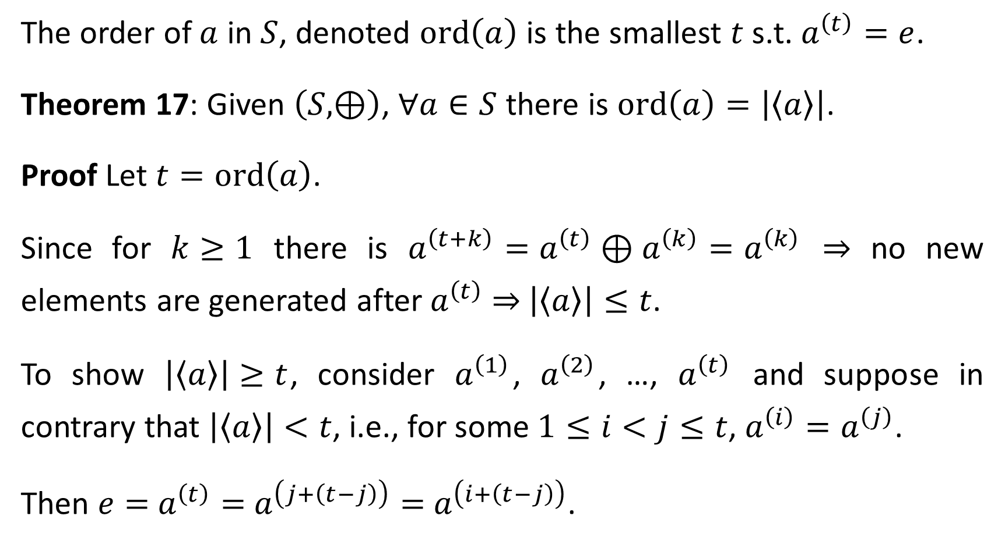
The order of $a$ in $S$, denoted $\text{ord}\left(a\right)$ is the smallest $t$ s.t. $a^{\left(t\right)}=e$.
Theorem 17: Given $\left(S,⊕\right)$, $∀a∈S$ there is $\text{ord}\left(a\right)=\left|\left\langle a\right\rangle \right|$.
Proof Let $t=\text{ord}\left(a\right)$.
Since for $k≥1$ there is $a^{\left(t+k\right)}=a^{\left(t\right)}⊕a^{\left(k\right)}=a^{\left(k\right)}$ ⇒ no new elements are generated after $a^{\left(t\right)}$ ⇒ $\left|\left\langle a\right\rangle \right|≤t$.
To show $\left|\left\langle a\right\rangle \right|≥t$, consider $a^{\left(1\right)}$, $a^{\left(2\right)}$, …, $a^{\left(t\right)}$ and suppose in contrary that $\left|\left\langle a\right\rangle \right|<t$, i.e., for some $1≤i<j≤t$, $a^{\left(i\right)}=a^{\left(j\right)}$.
Then $e=$ $a^{\left(t\right)}=$ $a^{\left(j+\left(t−j\right)\right)}=$ $a^{\left(i+\left(t−j\right)\right)}$.

Slide 34
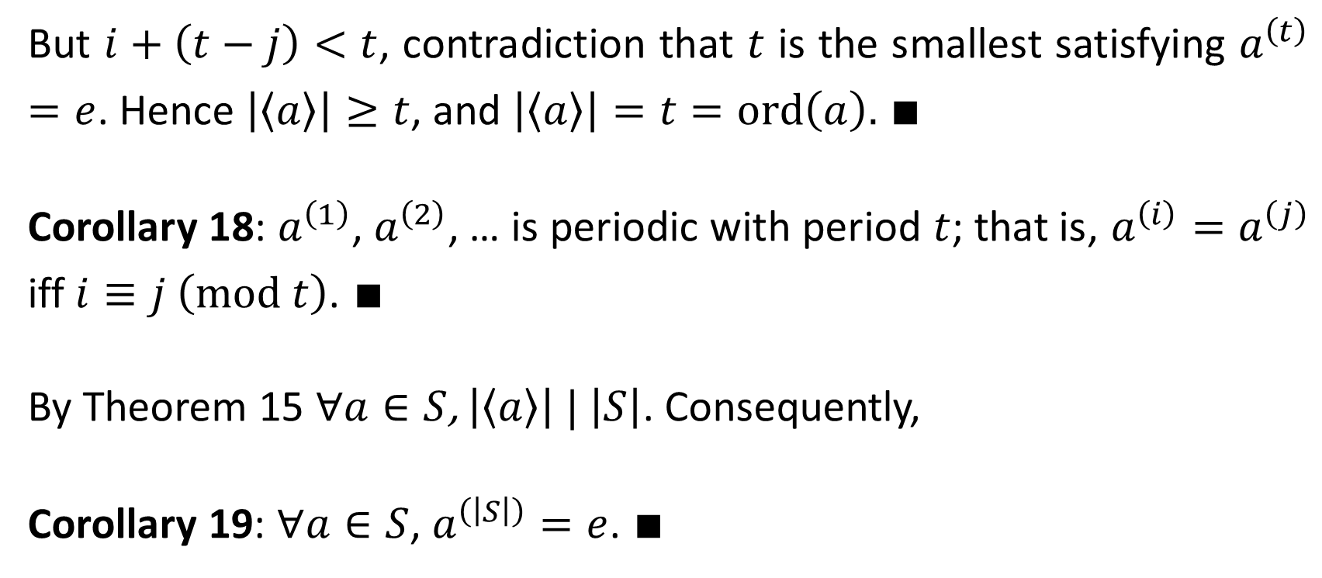
But $i+\left(t−j\right)<t$, contradiction that $t$ is the smallest satisfying $a^{\left(t\right)}=e$. Hence $\left|\left\langle a\right\rangle \right|≥t$, and $\left|\left\langle a\right\rangle \right|=t=ord\left(a\right).$ $∎$
Corollary 18: $a^{\left(1\right)}$, $a^{\left(2\right)}$, … is periodic with period $t$; that is, $a^{\left(i\right)}=a^{\left(j\right)}$ iff $i≡j \left(\text{mod} t\right)$. $∎$
By Theorem 15 $∀a∈S$, $\left|\left\langle a\right\rangle \right| | \left|S\right|$. Consequently,
Corollary 19: $∀a∈S$, $a^{\left(\left|S\right|\right)}=e$. $∎$

Slide 35
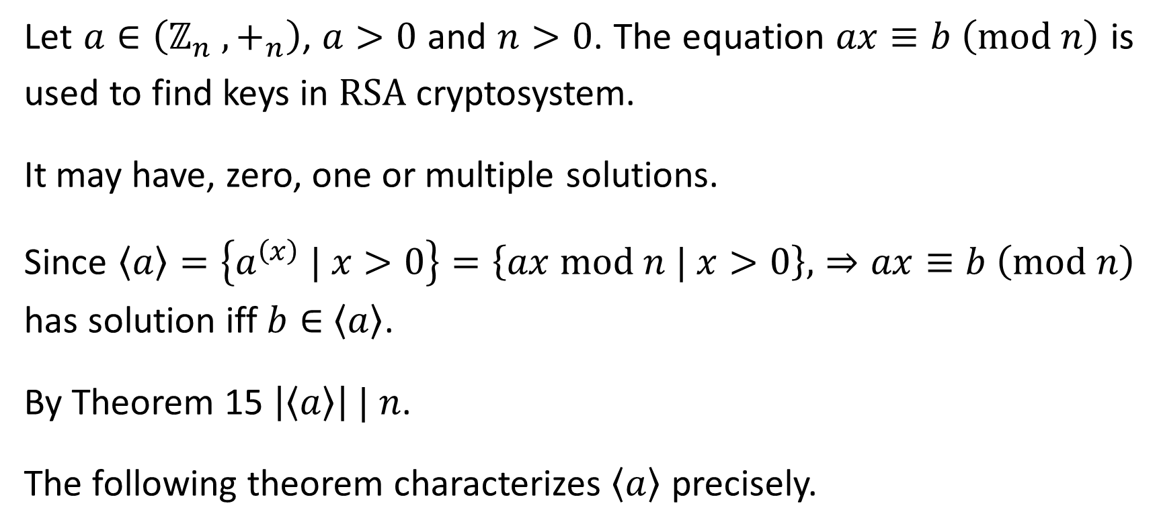
Modular Linear Equations
Let $a∈\left(ℤ_{n} ,+_{n}\right)$, $a>0$ and $n>0$. The equation $ax≡b \left(\text{mod} n\right)$ is used to find keys in $\text{RSA}$ cryptosystem.
It may have, zero, one or multiple solutions.
Since $\left\langle a\right\rangle =\left\{a^{\left(x\right)} | x>0\right\}=\left\{ax \text{mod} n | x>0\right\}$, ⇒ $ax≡b \left(\text{mod} n\right)$ has solution iff $b∈$ $\left\langle a\right\rangle$.
By Theorem 15 $\left|\left\langle a\right\rangle \right| | n$.
The following theorem characterizes $\left\langle a\right\rangle$ precisely.

Slide 36
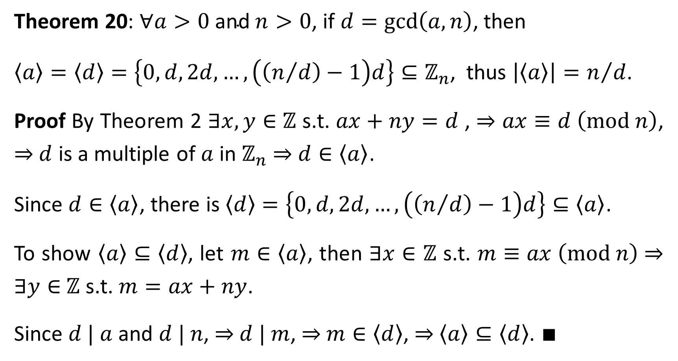
Theorem 20: $∀a>0 \text{and} n>0$, if $d=\text{gcd}\left(a,n\right)$, then
$\left\langle a\right\rangle =\left\langle d\right\rangle =\left\{0, d, 2d, …, \left(\left(n/d\right)−1\right)d\right\}⊆ℤ_{n}$, thus $\left|\left\langle a\right\rangle \right|=n/d$.
Proof By Theorem 2 $∃x,y∈$ $ℤ$ s.t. $ax+ny=d$ , ⇒ $ax≡d \left(\text{mod} n\right)$, ⇒ $d$ is a multiple of $a$ in $ℤ_{n}$ ⇒ $d∈\left\langle a\right\rangle$.
Since $d∈\left\langle a\right\rangle$, there is $\left\langle d\right\rangle =\left\{0, d, 2d, …, \left(\left(n/d\right)−1\right)d\right\}⊆\left\langle a\right\rangle$.
To show $\left\langle a\right\rangle ⊆\left\langle d\right\rangle$, let $m∈\left\langle a\right\rangle$, then $∃x∈$ $ℤ$ s.t. $m≡ax \left(\text{mod} n\right)$⇒ $∃y∈$ $ℤ$ s.t. $m=ax+ny$.
Since $d | a$ and $d | n$, ⇒ $d | m$, ⇒ $m∈\left\langle d\right\rangle$, ⇒ $\left\langle a\right\rangle ⊆\left\langle d\right\rangle$. $∎$

Slide 37
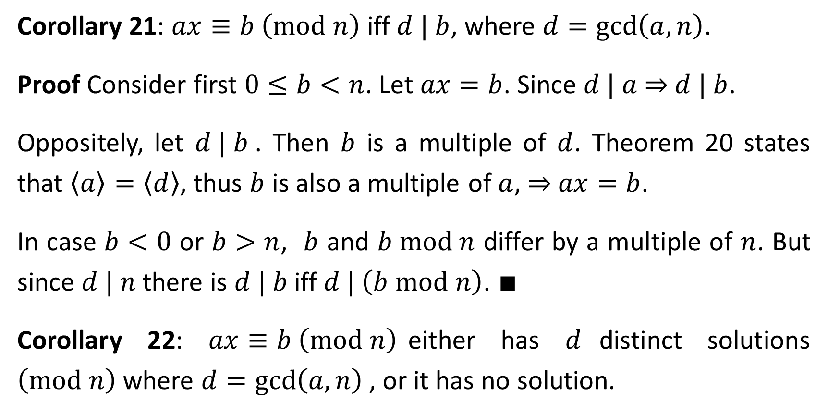
Corollary 21: $ax≡b \left(\text{mod} n\right)$ iff $d | b$, where $d=\text{gcd}\left(a,n\right)$.
Proof Consider first $0≤b<n$. Let $ax=b$. Since $d | a$ ⇒ $d | b$.
Oppositely, let $d | b$. Then $b$ is a multiple of $d$. Theorem 20 states that $\left\langle a\right\rangle =\left\langle d\right\rangle$, thus $b$ is also a multiple of $a$, ⇒ $ax=b$.
In case $b<0$ or $b>n$, $b$ and $b \text{mod} n$ differ by a multiple of $n$. But since $d | n$ there is $d | b$iff $d | \left(b \text{mod} n\right)$. $∎$
Corollary 22: $ax≡b \left(\text{mod} n\right)$either has $d$distinct solutions $\left(\text{mod} n\right)$where $d=\text{gcd}\left(a,n\right)$, or it has no solution.

Slide 38
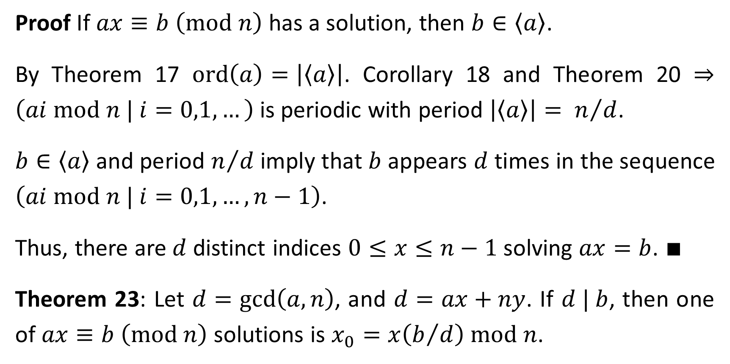
Proof If $ax≡b$ $\left(\text{mod} n\right)$ has a solution, then $b∈\left\langle a\right\rangle$.
By Theorem 17 $\text{ord}\left(a\right)=\left|\left\langle a\right\rangle \right|$. Corollary 18 and Theorem 20 ⇒ $\left(ai \text{mod} n | i=0,1,…\right)$is periodic with period $\left|\left\langle a\right\rangle \right|= n/d$.
$b∈\left\langle a\right\rangle$ and period $n/d$ imply that $b$ appears $d$ times in the sequence $\left(ai \text{mod} n | i=0,1,…,n−1\right)$.
Thus, there are $d$ distinct indices $0≤x≤n−1$ solving $ax=b$. $∎$
Theorem 23: Let $d=\text{gcd}\left(a,n\right)$, and $d=ax+ny$. If $d | b$, then one of $ax≡b \left(\text{mod} n\right)$ solutions is $x_{0}=x\left(b/d\right) \text{mod} n$.

Slide 39
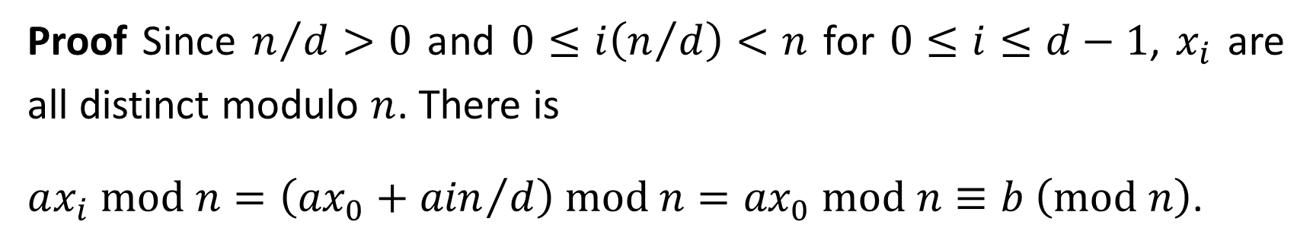

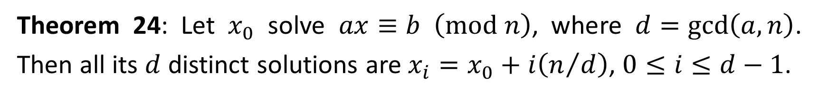
Proof $ax_{0}≡ax\left(b/d\right) \left(\text{mod} n\right)≡d\left(b/d\right) \left(\text{mod} n\right)≡b \left(\text{mod} n\right)$. $∎$
$$d=ax+ny ⇒ax≡d \left(\text{mod} n\right)$$
Theorem 24: Let $x_{0}$ solve $ax≡b$ $\left(\text{mod} n\right)$, where $d=\text{gcd}\left(a,n\right)$. Then all its $d$ distinct solutions are $x_{i}=x_{0}+i\left(n/d\right)$, $0≤i≤d−1$.
Proof Since $n/d>0$ and $0≤i\left(n/d\right)<n$ for $0≤i≤d−1$, $x_{i}$ are all distinct modulo $n$. There is
$ax_{i} \text{mod} n=\left({ax}_{0}+{ain}/d\right) \text{mod} n={ax}_{0} \text{mod} n≡b \left(\text{mod} n\right)$.
$$d | a ⇒{ain}/d\left(\text{mod} n\right)=0$$
By Theorem 22 there are exactly $d$ solutions, hence these are $x_{i}$. $∎$

Slide 40
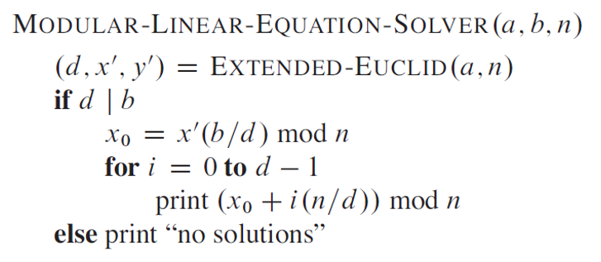
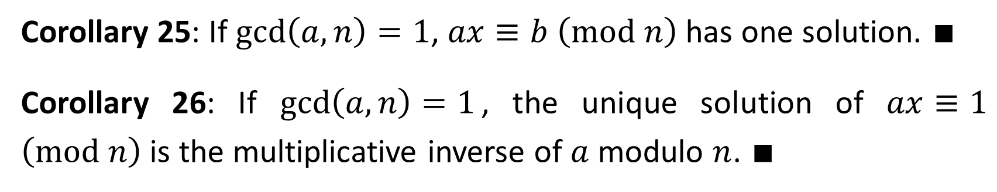
// HW, CLRS 31.2
// Theorem 23
// Theorem 24
Corollary 25: If $\text{gcd}\left(a,n\right)=1$, $ax≡b$ $\left(\text{mod} n\right)$ has one solution. $∎$
Corollary 26: If $\text{gcd}\left(a,n\right)=1$, the unique solution of $ax≡1$ $\left(\text{mod} n\right)$ is the multiplicative inverse of $a$ modulo $n$. $∎$

Slide 41
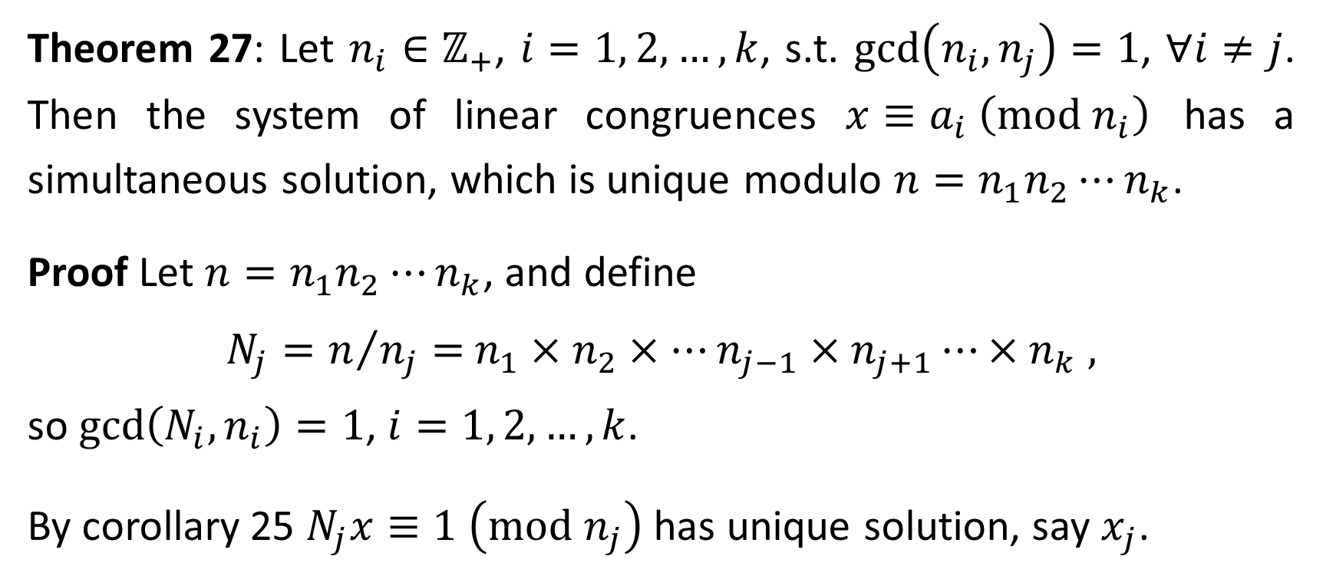
The Chinese Reminder Theorem
Theorem 27: Let $n_{i}∈ℤ_{+}$, $i=1, 2, …, k$, s.t. $\text{gcd}\left(n_{i},n_{j}\right)=1$, $∀i≠j$. Then the system of linear congruences $x≡a_{i} \left(\text{mod} n_{i}\right)$ has a simultaneous solution, which is unique modulo $n=n_{1}n_{2}{⋯n}_{k}$.
Proof Let $n=n_{1}n_{2}⋯n_{k}$, and define
$N_{j}=n/{n_{j}}=$ $n_{1}×n_{2}×⋯n_{j−1}×n_{j+1}⋯×n_{k}$ ,
so $\text{gcd}\left(N_{i},n_{i}\right)=1$, $i=1, 2, …, k$.
By corollary 25 $N_{j}x≡1 \left(\text{mod} n_{j}\right)$ has unique solution, say $x_{j}$.

Slide 42

We show that the integer
$$\overline{x}=a_{1}N_{1}x_{1}+a_{2}N_{2}x_{2}+⋯+a_{k}N_{k}x_{k}$$
is a simultaneous solution of the system.
First, there is $N_{i}≡0 \left(\text{mod} n_{j}\right)$, since $n_{j}|N_{i}$, $∀j≠i$. Hence
$\overline{x}=a_{1}N_{1}x_{1}+a_{2}N_{2}x_{2}+⋯+a_{k}N_{k}x_{k}≡a_{j}N_{j}x_{j} \left(\text{mod} n_{j}\right)$.
But $x_{j}$satisfies $N_{j}x≡1 \left(\text{mod} n_{j}\right)$, yielding
$\overline{x}≡a_{j}∙1≡a_{j} \left(\text{mod} n_{j}\right)$,
Showing that solution of the system exists.

Slide 43

To show uniqueness suppose that
$\overline{x}≡a_{j}≡x^{′} \left(\text{mod} n_{j}\right)$,
so $n_{j}$|$\overline{x}−x^{′}$, $j=1, 2, …, k$.
Since $\text{gcd}\left(n_{i},n_{j}\right)=1$, $∀i≠j$, ⇒ $n_{1}n_{2}{⋯n}_{k}| \overline{x}−x^{′}$. (HW: prove)
Hence $\overline{x}≡x^{′} \left(\text{mod} n\right)$ and uniqueness follows. $∎$
Example: $x≡2 \left(\text{mod} 3\right)$, $x≡3 \left(\text{mod} 5\right)$, $x≡2 \left(\text{mod} 7\right)$.
$n=n_{1}n_{2}n_{3}=3∙5∙7=105$.
$N_{1}={105}/3=35$, $N_{2}={105}/5=21$, $N_{3}={105}/7=15$.

Slide 44

Three congruences follow
$35x≡1 \left(\text{mod} 3\right)$, $21x≡1 \left(\text{mod} 5\right)$ and $15x≡1 \left(\text{mod} 7\right)$, solved to $x_{1}=2$, $x_{2}=1$, $x_{3}=1$.
The simultaneous solution is therefore
$x=2∙35∙2+3∙21∙1+2∙15∙1=233$,
yielding the unique solution $x=233≡23 \left(\text{mod} 105\right)$. $∎$

Slide 45

Powers of an Element
Let $a∈ℤ_{n}^{∗}$, and consider the sequence $a^{0},a^{1},a^{2},a^{3},…$ modulo $n$.
Corollary 19 stated that given $\left(S,⊕\right)$, $∀a∈S$ there is $a^{\left(\left|S\right|\right)}=e$.
Recall Euler $φ\left(n\right)=\left|ℤ_{n}^{∗}\right|$, namely, the number of integers relatively prime to $n$.
With the above notation, there is
Theorem 30 (Euler’s theorem): $∀n∈ℤ , n>1,$
$a^{φ\left(n\right)}≡1 \left(\text{mod} n\right) ∀a∈ℤ_{n}^{∗}$. $∎$

Slide 46

Theorem 31 (Fermat’s theorem): If $p$ is prime then
$a^{p−1}≡1 \left(\text{mod} p\right), ∀a∈ℤ_{n}^{∗}$.
Proof Since for prime $p$ there is $φ\left(p\right)=p−1$, then the theorem follows by substitution in Theorem 30.
Modular exponentiation is the raising of one integer to a power modulo another integer. Repeated squaring solves it efficiently.
Let $\left\langle b_{k},b_{k−1},…,b_{1},b_{0}\right\rangle$ be the binary representation of $b$, $b_{k}$ is MSB and $b_{0}$ is LSB. The following procedure computes ${d≡a}^{b} \left(\text{mod} n\right)$.

Slide 47

$\text{MODULAR}\text{−}\text{EXPONENTIAION}\left(a, b=\left\langle b_{k},b_{k−1},…,b_{1},b_{0}\right\rangle , n\right)$
$c=0 ;$ $d=1;$ // exponent $c$and result $d$initialization
// Prior to each iteration $c=\left\langle b_{k},b_{k−1},…,b_{i+1}\right\rangle$ and $d=a^{c}$
$\text{for} i=k \text{downto} 0$ // iterate from MSB to LSB
$c=2c ;$ // 0 at current bit doubles exponent
$d=\left(d∙d\right) \text{mod} n;$ // 0 at current bit square result
$\text{if} b_{i}==1$ // 1 at current bit increases exponent by 1
$c=c+1;$ // and result by one more a multiplication
$d=\left(d∙a\right) \text{mod} n;$
$\text{return} d;$

Slide 48

The RSA Public-Key Cryptosystem
Recall the RSA introduction of this lecture, motivated introduction of number theory and some related algorithms.
We prove below RSA correctness.
Theorem 36 (Correctness of RSA): The RSA equations
(1) $P\left(M\right)=M^{e} \left(\text{mod} n\right)$ and (2) $M=S\left(C\right)=C^{d} \left(\text{mod} n\right)$,
satisfy (3) $M=S\left(P\left(M\right)\right)$ and (4) $M=P\left(S\left(M\right)\right)$.
Proof Substitution of (3) and (4) into (1)and (2) yield

Slide 49



$P\left(S\left(M\right)\right)=S\left(P\left(M\right)\right)=M^{ed}$ $\left(\text{mod} n\right)$.
$e$ and $d$ are multiplicative inverse modulo $φ\left(n\right)=\left(p−1\right)\left(q−1\right)$ ⇒
$∃k∈ℤ$ s.t. $ed=1+k\left(p−1\right)\left(q−1\right)$.
Then, for $M≢0 \left(\text{mod} p\right)$ there is
$M^{ed}≡{M\left(M^{p−1}\right)}^{k\left(q−1\right)} \left(\text{mod} p\right)≡{M\left(M^{p−1}\text{mod} p\right)}^{k\left(q−1\right)} \left(\text{mod} p\right)$
${≡M\left(1\right)}^{k\left(q−1\right)}≡M \left(\text{mod} p\right)$.
$1$by Theorem 31 (Fermat’s)
If $M≡0 \left(\text{mod} p\right)$then $M^{ed}≡M \left(\text{mod} p\right)$.

Slide 50

Similarly, $M^{ed}≡M \left(\text{mod} q\right)$.
By Theorem 37 (Chinese Reminder) we conclude that
$M^{ed}≡M \left(\text{mod} n\right)$ for all $M$. $∎$
RSA security cryptosystem rest on the difficulty of factoring large integers.
Although $n$ is publically known, finding $p$ and $q$, that are known only to the key creator is very difficult.

Slide 51
Supplementary

Slide 52

Proof of Theorem 1 Let $S=\left\{a−tn | t=0, ±1, ±2, … \right\}$ and let $0≤r∈S$ be the smallest, obtained for some $t=q$. Then $a−qn=r≥0$.
Assume in contrary that $r≥n$. Then $r=n+r_{1}$ with $r_{1}≥0$.
Then $r_{1}=r−n=a−qn−n=a−\left(q+1\right)n$, $⇒$ $r_{1}$ $∈S$ , but $r_{1}<r$ contradicting that $0≤r∈S$ is the smallest.
To show that $q,r∈ℤ$ are unique, suppose $a=qn+r=q_{1}n+r_{1}$.
Then $n\left(q−q_{1}\right)=r_{1}−r$, ⇒ $n∣\left(r_{1}−r\right)$.

Slide 53

But both $0≤r<n$ and ${0≤r}_{1}<n$ ⇒ $−n<r_{1}−r<n$.
The only multiple of $n$ between $−n$ and $n$ is $0$.
⇒ $r_{1}−r=0$ ⇒ $q−q_{1}=0$ ⇒ uniqueness. $∎$

Slide 54

Proof of Theorem 15 Let $x∈$ $S$\$S′$, then $x^{−1}∉S′$.
Let $S^{′′}=\left\{x⊕y | y∈S′\right\}$ and suppose $∃z=x⊕y∈S^{′}∩S^{′′}$.
Since $S^{′}$ subgroup, $∃z^{−1}∈S^{′}$ s.t. $e=z⊕z^{−1}=x⊕\left(y ⊕z^{−1}\right)$ ⇒ $y ⊕z^{−1}=$ $x^{−1}$.
$y,z^{−1}∈S′$, so closure implies $x^{−1}$ $∈S′$, contradicting $x^{−1}∉S′$.
⇒ The supposition $z∈S^{′}∩S^{′′}$ is false, ⇒ $S$ is partitioned into finite disjoint subgroups all of size $\left|S′\right|$, ⇒ $\left|S′\right| | \left|S\right|$. $∎$

