Slide 1
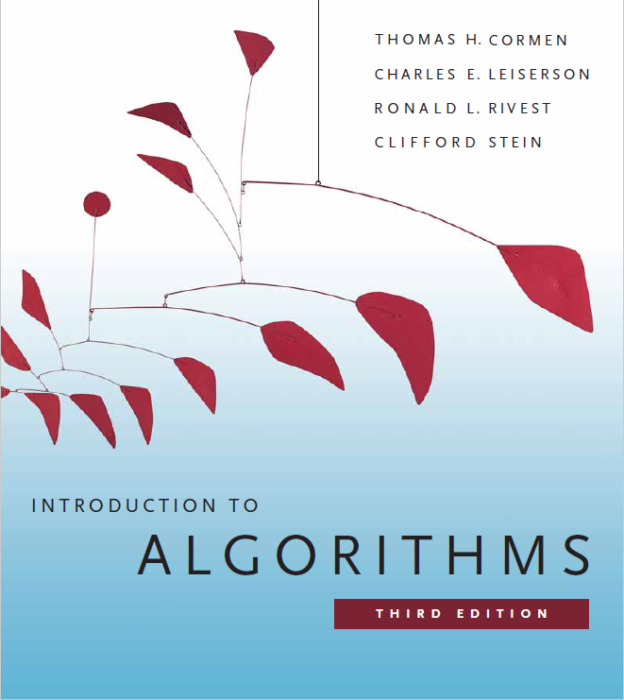
Hashing
Prepared by Shmuel Wimer
Instructed by Hillel Kugler and Shmuel Wimer

Slide 2
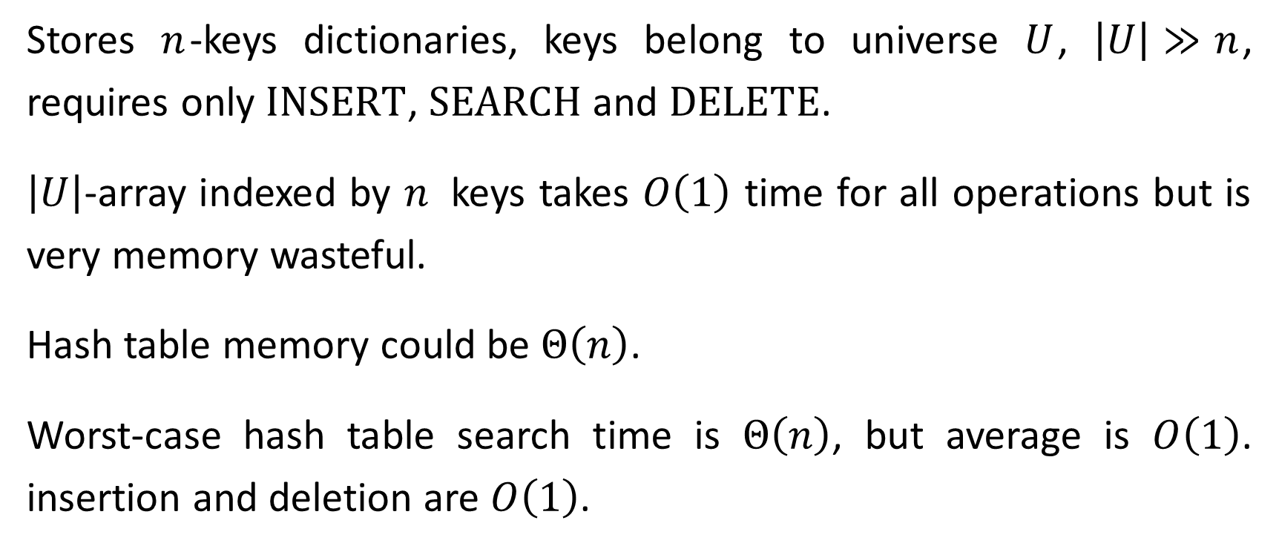
Hash Tables
Stores $n$-keys dictionaries, keys belong to universe $U$, $\left|U\right|≫n$, requires only $\text{INSERT}$, $\text{SEARCH}$ and $\text{DELETE}$.
$\left|U\right|$-array indexed by $n$ keys takes $O\left(1\right)$ time for all operations but is very memory wasteful.
Hash table memory could be $Θ\left(n\right)$.
Worst-case hash table search time is $Θ\left(n\right)$, but average is $O\left(1\right)$. insertion and deletion are $O\left(1\right)$.

Slide 3
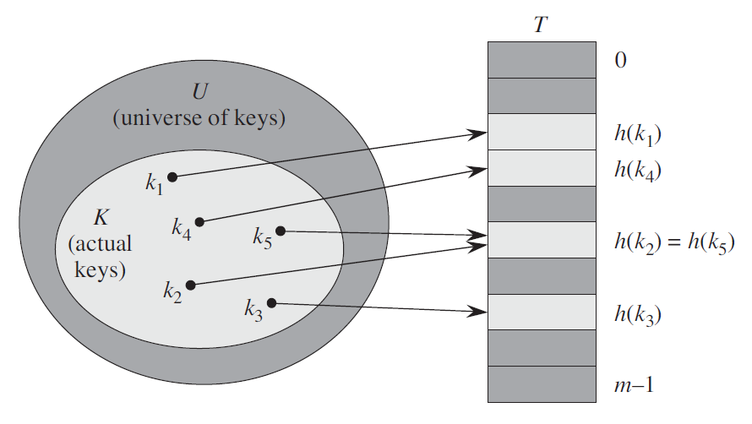
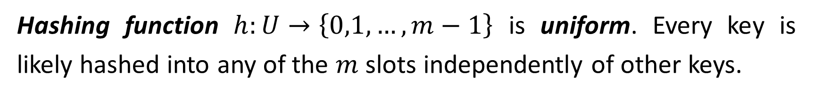


$$\left|U\right|≫m$$
$$\text{c}\text{ollision}$$
Hashing function $h:U→\left\{0,1,…,m−1\right\}$ is uniform. Every key is likely hashed into any of the $m$ slots independently of other keys.

Slide 4
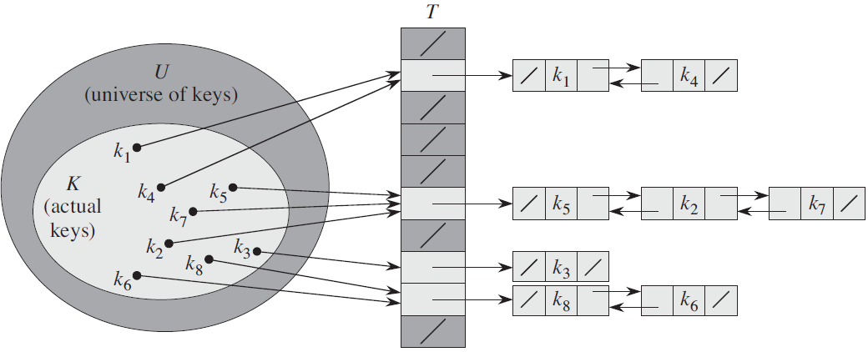


Collision resolution by chaining
$$\left|U\right|≫m$$
$$h:U→\left\{0,1,…,m−1\right\}$$

Slide 5
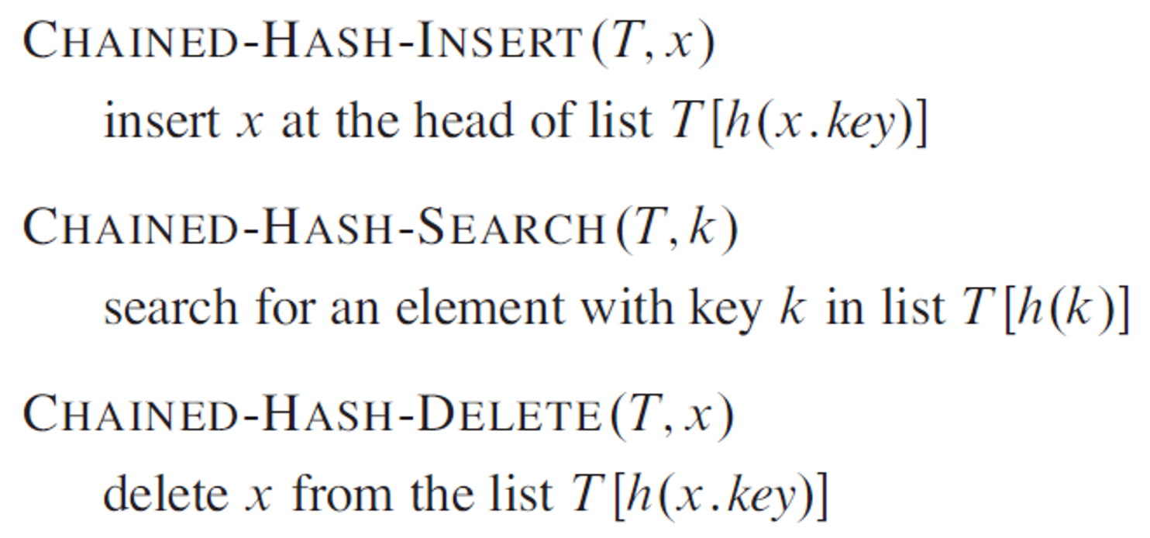
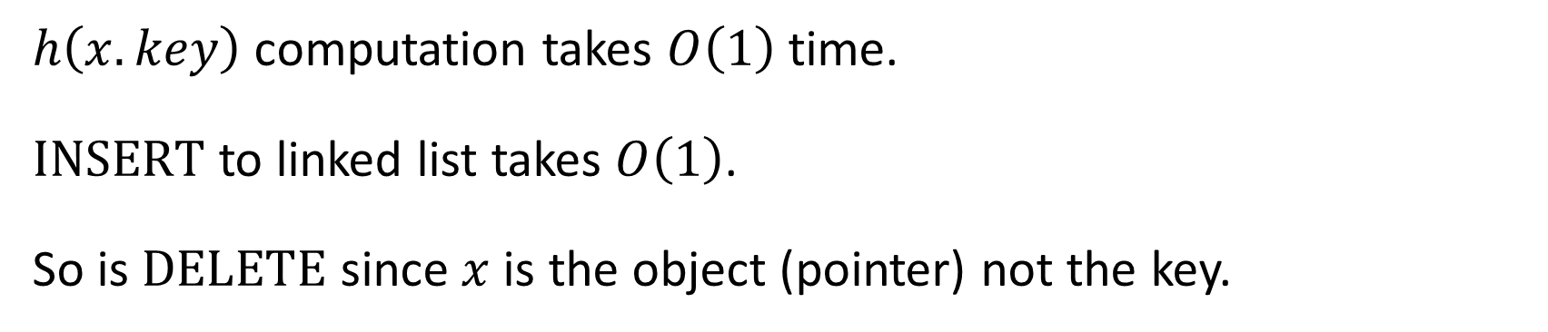
$h\left(x.key\right)$ computation takes $O\left(1\right)$ time.
$\text{INSERT}$ to linked list takes $O\left(1\right)$.
So is $\text{DELETE}$ since $x$is the object (pointer) not the key.

Slide 6
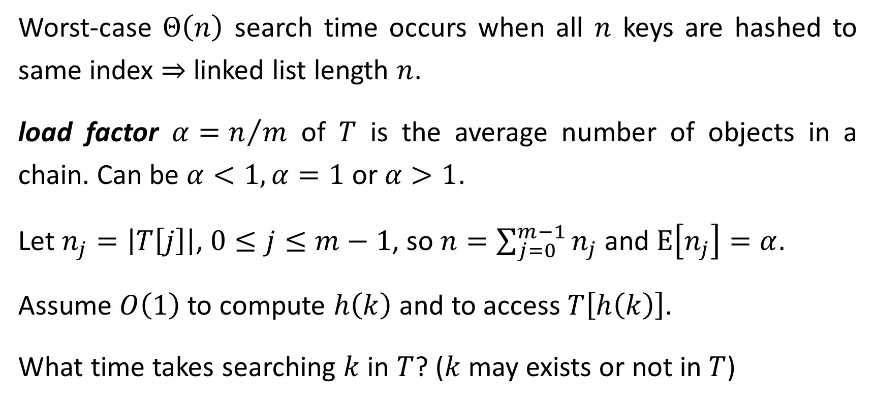
Worst-case $Θ\left(n\right)$ search time occurs when all $n$ keys are hashed to same index $⇒$ linked list length $n$.
load factor $α=n/m$ of $T$ is the average number of objects in a chain. Can be $α<1,α=1$ or $α>1$.
Let $n_{j}=\left|T\left[j\right]\right|$, $0≤j≤m−1$, so $n=\sum_{j=0}^{m−1}{n_{j}}$ and $\text{E}\left[n_{j}\right]=α$.
Assume $O\left(1\right)$ to compute $h\left(k\right)$ and to access $T\left[h\left(k\right)\right]$.
What time takes searching $k$ in $T$? ($k$may exists or not in $T$)

Slide 7
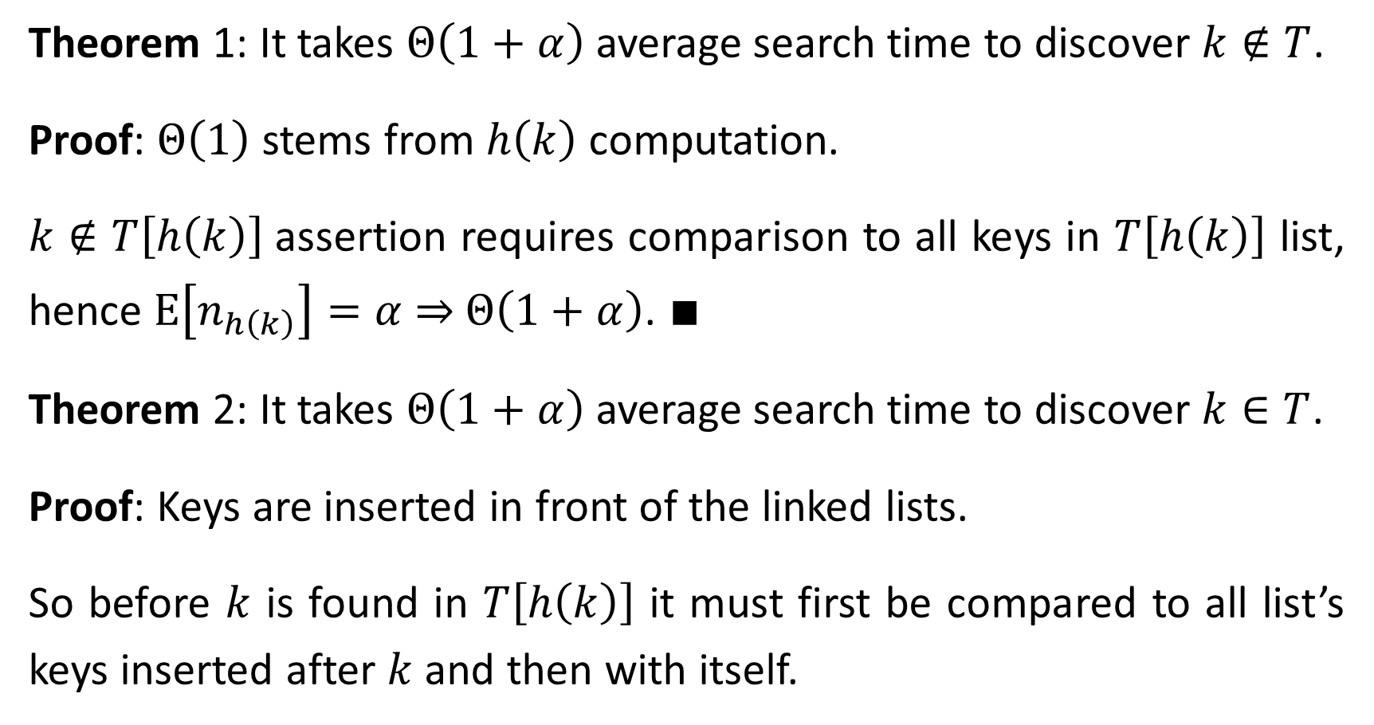
Theorem 1: It takes $Θ\left(1+α\right)$ average search time to discover $k∉T$.
Proof: $Θ\left(1\right)$ stems from $h\left(k\right)$ computation.
$k∉T\left[h\left(k\right)\right]$assertion requires comparison to all keys in $T\left[h\left(k\right)\right]$ list, hence $\text{E}\left[n_{h\left(k\right)}\right]=α$ ⇒ $Θ\left(1+α\right)$. $∎$
Theorem 2: It takes $Θ\left(1+α\right)$ average search time to discover $k∈T$.
Proof: Keys are inserted in front of the linked lists.
So before $k$ is found in $T\left[h\left(k\right)\right]$ it must first be compared to all list’s keys inserted after $k$ and then with itself.

Slide 8
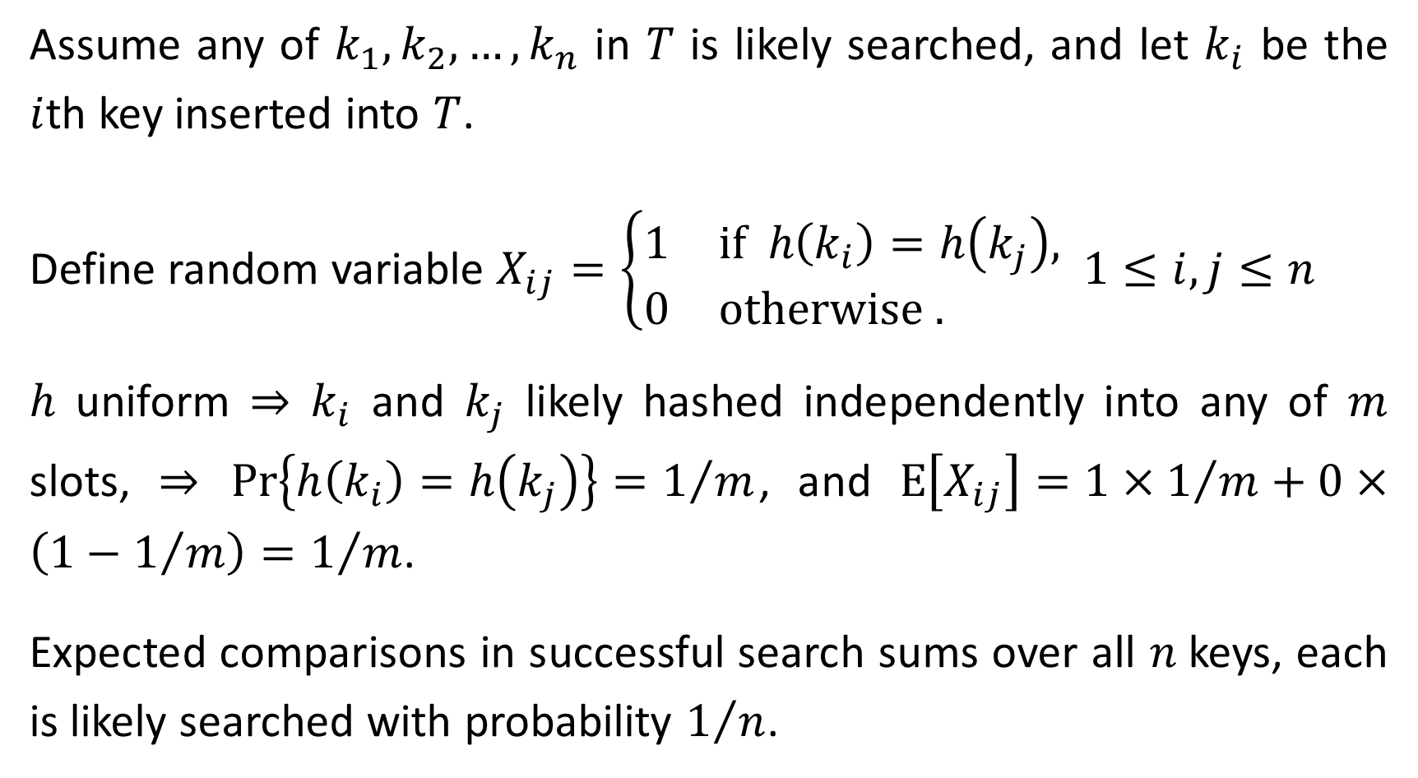
Assume any of $k_{1}, k_{2},…,k_{n}$ in $T$ is likely searched, and let $k_{i}$ be the $i$th key inserted into $T$.
Define random variable $X_{ij}=\left\{\begin{matrix}1 & \text{if} h\left(k_{i}\right)=h\left(k_{j}\right), \\ 0 & \text{otherwise}\text{ . }\end{matrix}\right.$ $1≤i,j≤n$
$h$ uniform ⇒ $k_{i}$ and $k_{j}$ likely hashed independently into any of $m$ slots, $⇒$ $\text{Pr}\left\{h\left(k_{i}\right)=h\left(k_{j}\right)\right\}=1/m$, and $E\left[X_{ij}\right]=1×1/m+0×\left(1−1/m\right)=1/m$.
Expected comparisons in successful search sums over all $n$keys, each is likely searched with probability $1/n$.

Slide 9
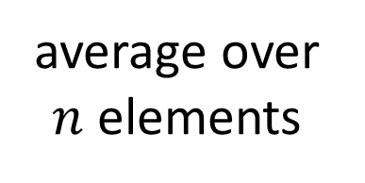
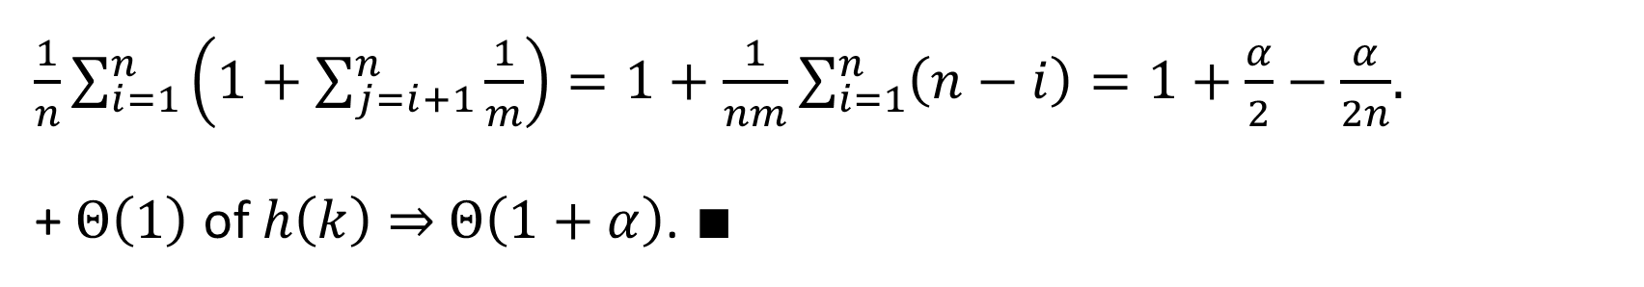

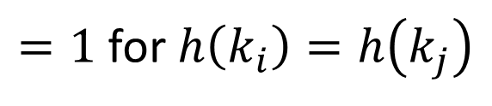
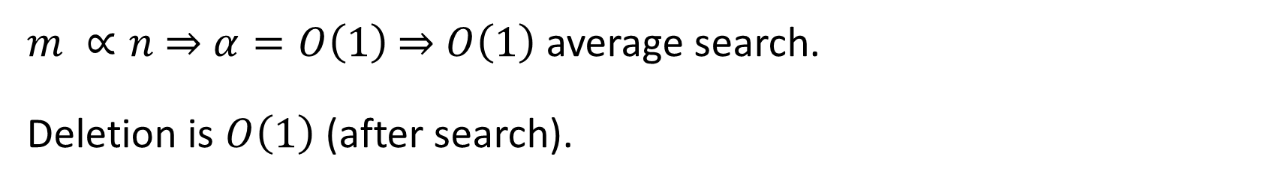
key found
$=1$ for $h\left(k_{i}\right)=h\left(k_{j}\right)$
$\text{E}\left[\sum_{i=1}^{n}{\frac{1}{n}\left(1+\sum_{j=i+1}^{n}{X_{ij}}\right)}\right]=\frac{1}{n}\sum_{i=1}^{n}{\left(1+\sum_{j=i+1}^{n}{\text{E}\left[X_{ij}\right]}\right)}=$
average over $n$ elements
search only over elements inserted after $i$
expectation linearity
$\frac{1}{n}\sum_{i=1}^{n}{\left(1+\sum_{j=i+1}^{n}{\frac{1}{m}}\right)}=1+\frac{1}{nm}\sum_{i=1}^{n}{\left(n−i\right)}=1+\frac{α}{2}−\frac{α}{2n}$.
+ $Θ\left(1\right)$ of $h\left(k\right)$ ⇒ $Θ\left(1+α\right)$. $∎$
$m ∝n$ ⇒ $α=O\left(1\right)$ ⇒ $O\left(1\right)$ average search.
Deletion is $O\left(1\right)$ (after search).

Slide 10
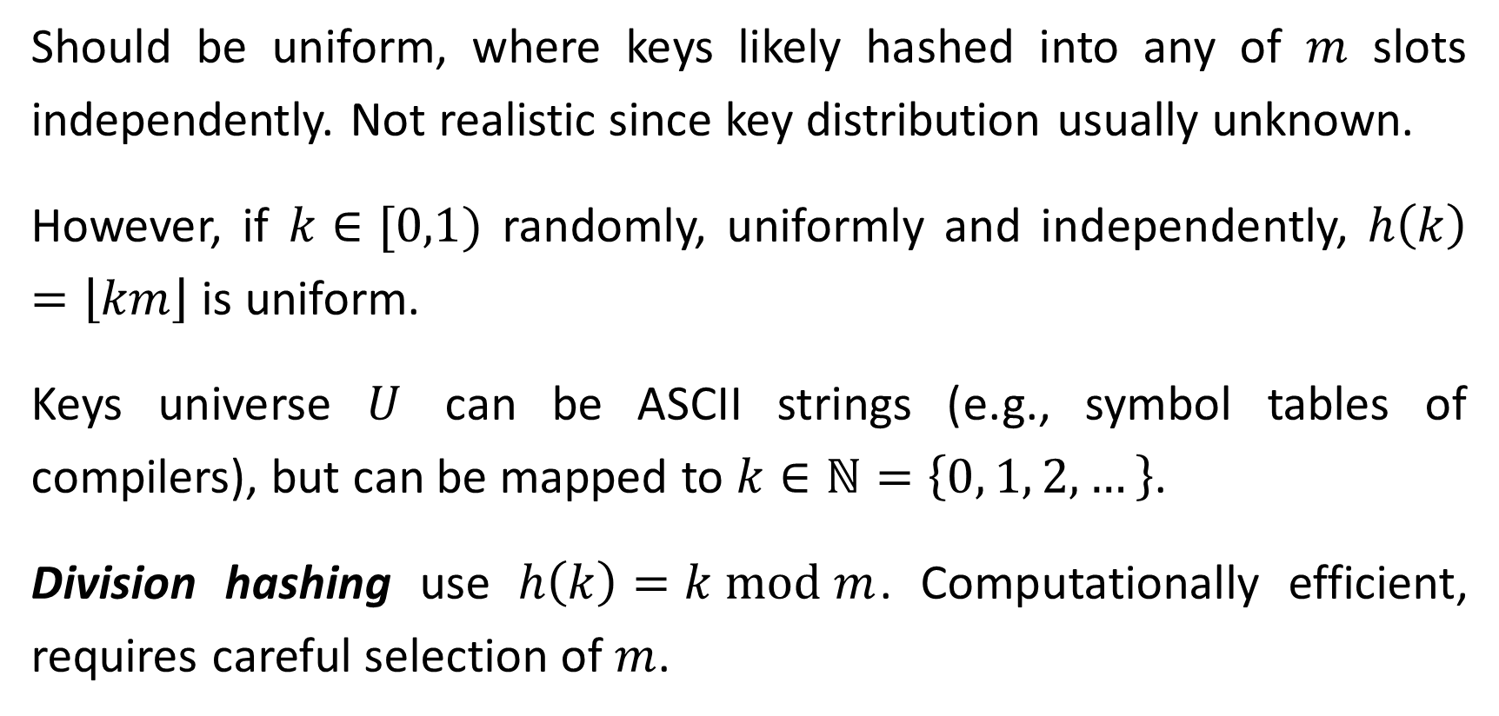
Hash Functions
Should be uniform, where keys likely hashed into any of $m$ slots independently. Not realistic since key distribution usually unknown.
However, if $k∈[0,1)$ randomly, uniformly and independently, $h\left(k\right)=\left\lfloor km\right\rfloor$ is uniform.
Keys universe $U$ can be ASCII strings (e.g., symbol tables of compilers), but can be mapped to $k∈ℕ=\left\{0, 1, 2,…\right\}$.
Division hashing use $h\left(k\right)=k \text{mod} m$. Computationally efficient, requires careful selection of $m$.

Slide 11
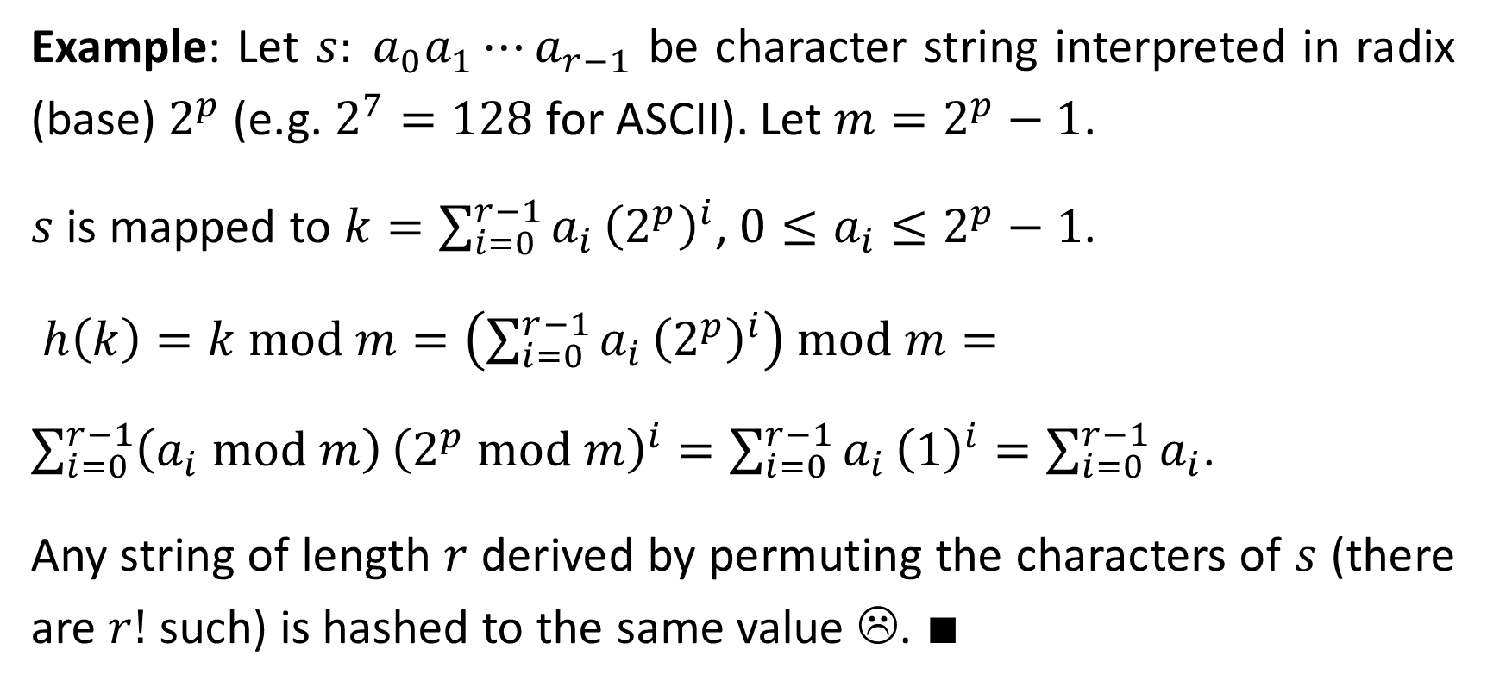
Example: Let $s: a_{0}a_{1}⋯a_{r−1}$ be character string interpreted in radix (base) $2^{p}$ (e.g. $2^{7}=128$ for ASCII). Let $m=2^{p}−1$.
$s$ is mapped to $k=\sum_{i=0}^{r−1}{a_{i}}{\left(2^{p}\right)}^{i}$, $0≤a_{i}≤2^{p}−1$.
$h\left(k\right)=k \text{mod} m=\left(\sum_{i=0}^{r−1}{a_{i}}{\left(2^{p}\right)}^{i}\right) \text{mod} m=$
$\sum_{i=0}^{r−1}{\left(a_{i} \text{mod} m\right)}{\left(2^{p} \text{mod} m\right)}^{i}=\sum_{i=0}^{r−1}{a_{i}}{\left(1\right)}^{i}=\sum_{i=0}^{r−1}{a_{i}}$.
Any string of length $r$ derived by permuting the characters of $s$ (there are $r!$such) is hashed to the same value ☹. $∎$

Slide 12
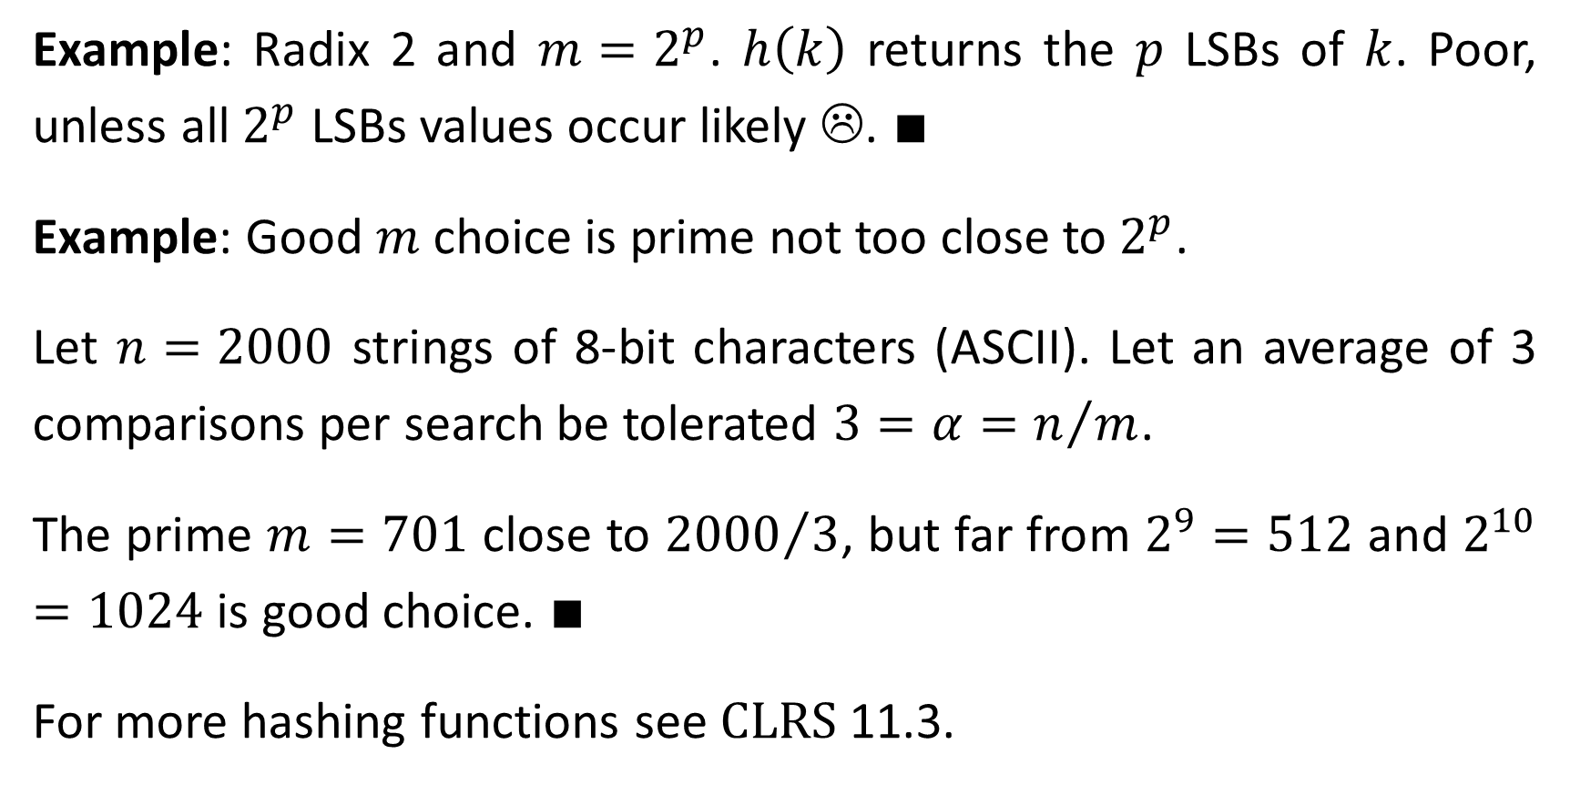
Example: Radix 2 and $m=2^{p}$. $h\left(k\right)$ returns the $p$ LSBs of $k$. Poor, unless all $2^{p}$ LSBs values occur likely ☹. $∎$
Example: Good $m$choice is prime not too close to $2^{p}$.
Let $n=2000$ strings of 8-bit characters (ASCII). Let an average of 3 comparisons per search be tolerated $3=α=n/m$.
The prime $m=701$ close to ${2000}/3$, but far from $2^{9}=512$ and $2^{10}=1024$ is good choice. $∎$
For more hashing functions see $\text{CLRS}$ 11.3.

Slide 13
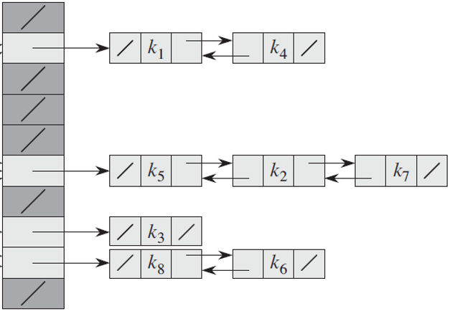


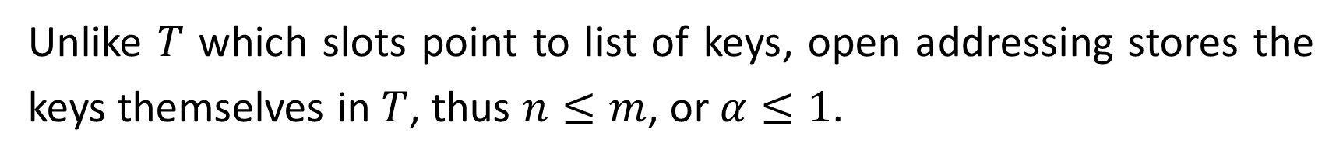






Open Addressing Hash
Unlike $T$ which slots point to list of keys, open addressing stores the keys themselves in $T$, thus $n≤m$, or $α≤1$.
$$/$$
$$k_{1}$$
$$k_{6}$$
$$k_{4}$$
$$k_{5}$$
$$k_{3}$$
$$/$$
$$k_{2}$$

Slide 14
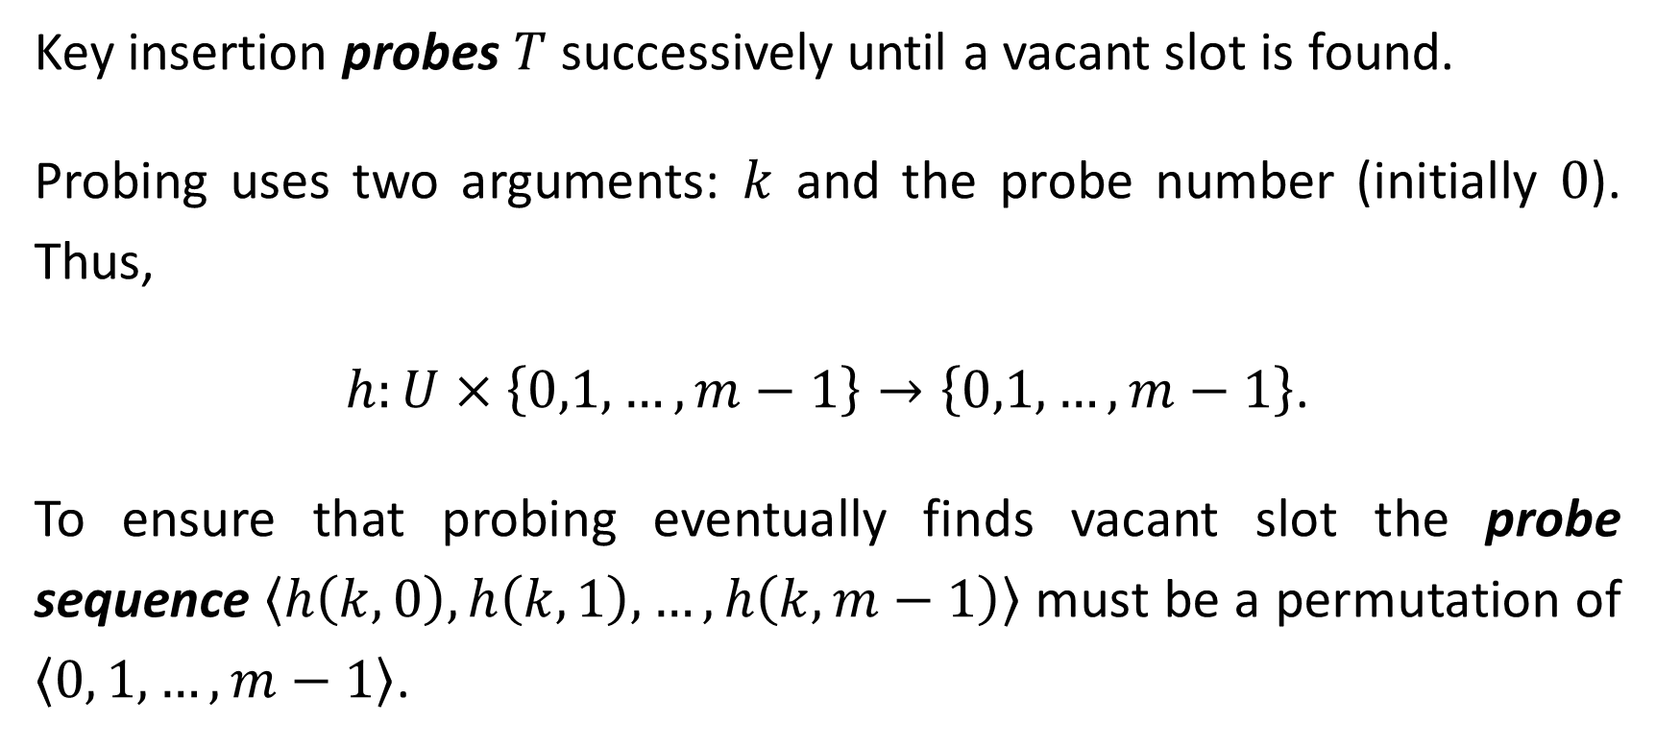
Key insertion probes $T$ successively until a vacant slot is found.
Probing uses two arguments: $k$ and the probe number (initially $0$). Thus,
$h:U×\left\{0,1,…,m−1\right\}→\left\{0,1,…,m−1\right\}$.
To ensure that probing eventually finds vacant slot the probe sequence $\left\langle h\left(k,0\right),h\left(k,1\right),…,h\left(k,m−1\right)\right\rangle$ must be a permutation of $\left\langle 0, 1,…,m−1\right\rangle$.

Slide 15
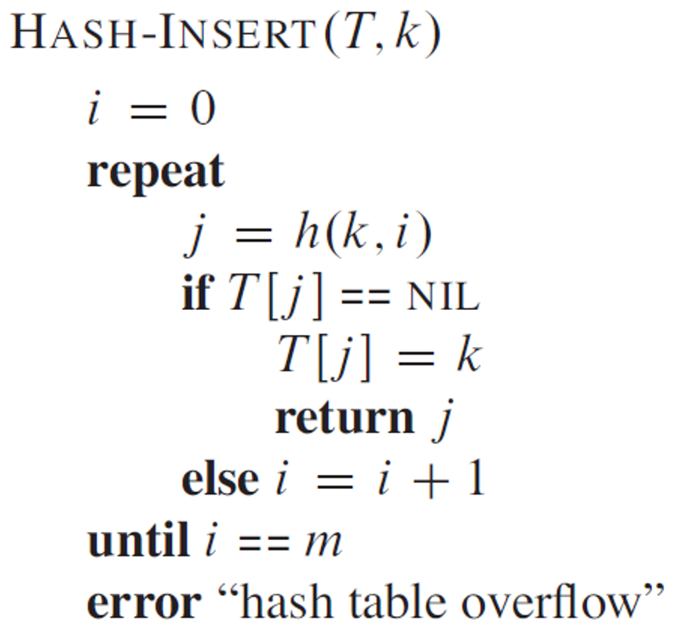
// next probe
// vacant slot found
// slot occupied

Slide 16
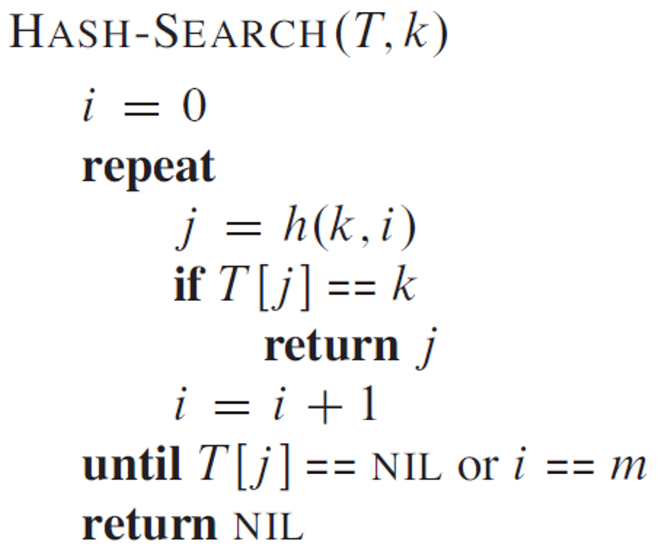

// next probe
// key found
// probe continues
// key not in table
To find $k$, if inserted, $\text{HASH}\text{−}\text{SEARCH}$ must probe same sequence as $\text{HASH}\text{−}\text{INSERT}$ did (assuming keys are not deleted from $T$).

Slide 17
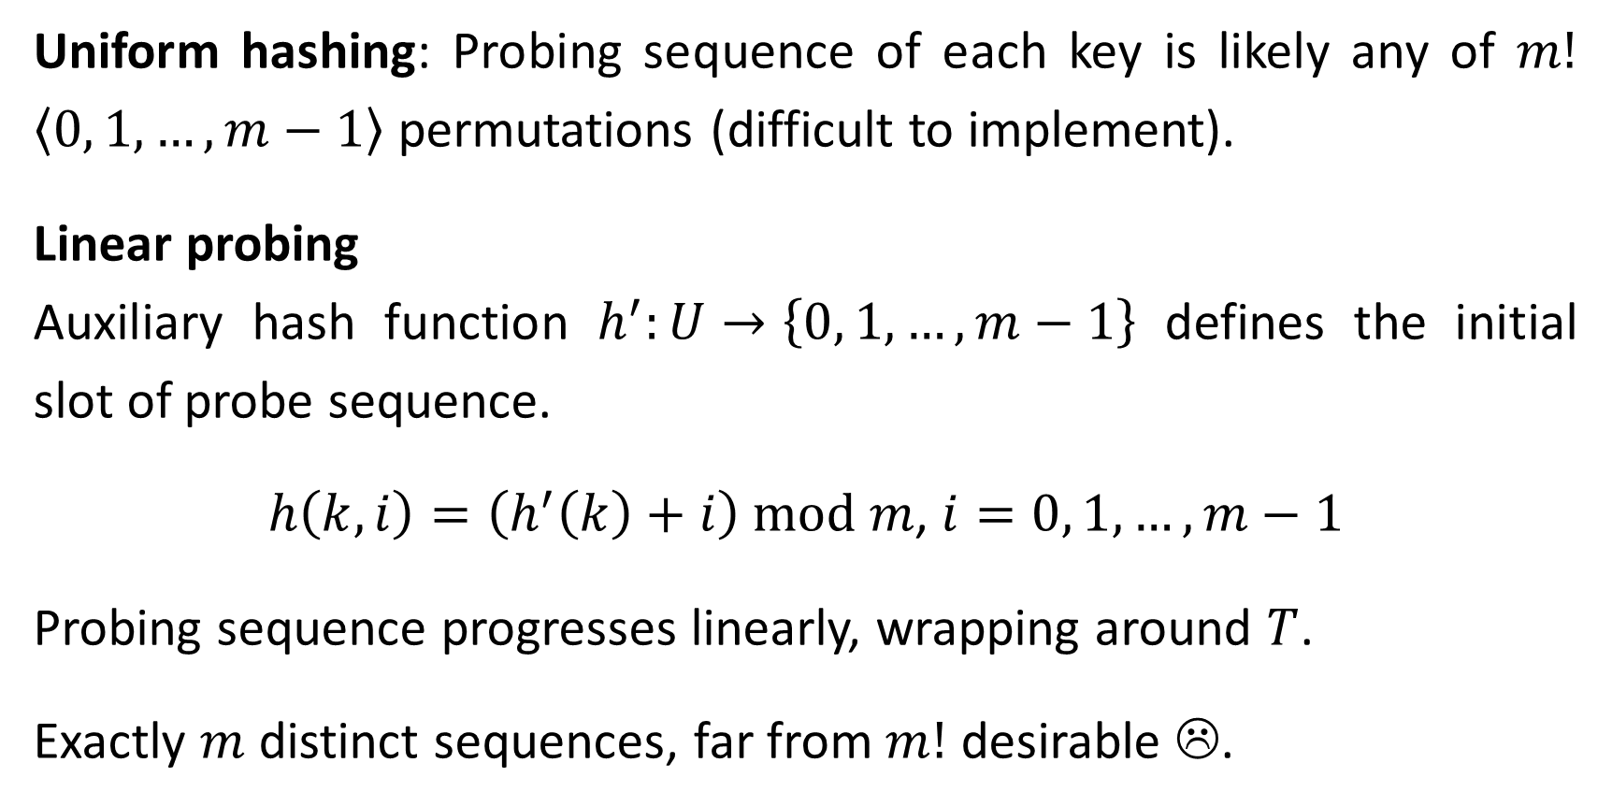
Uniform hashing: Probing sequence of each key is likely any of $m!$ $\left\langle 0, 1,…, m−1\right\rangle$ permutations (difficult to implement).
Linear probing
Auxiliary hash function $h^{′}:U→\left\{0, 1, …,m−1\right\}$ defines the initial slot of probe sequence.
$h\left(k,i\right)=\left(h^{′}\left(k\right)+i\right) \text{mod} m$, $i=0, 1, …, m−1$
Probing sequence progresses linearly, wrapping around $T$.
Exactly $m$ distinct sequences, far from $m!$ desirable ☹.

Slide 18
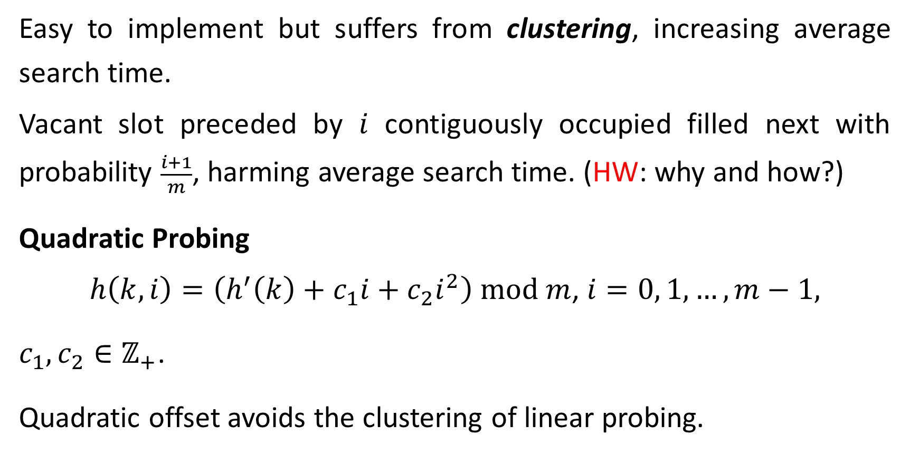
Easy to implement but suffers from clustering, increasing average search time.
Vacant slot preceded by $i$ contiguously occupied filled next with probability $\frac{i+1}{m}$, harming average search time. (HW: why and how?)
Quadratic Probing
$h\left(k,i\right)=\left(h^{′}\left(k\right)+c_{1}i+c_{2}i^{2}\right) \text{mod} m$, $i=0, 1, …, m−1,$
$c_{1},c_{2}∈ℤ_{+}$.
Quadratic offset avoids the clustering of linear probing.

Slide 19
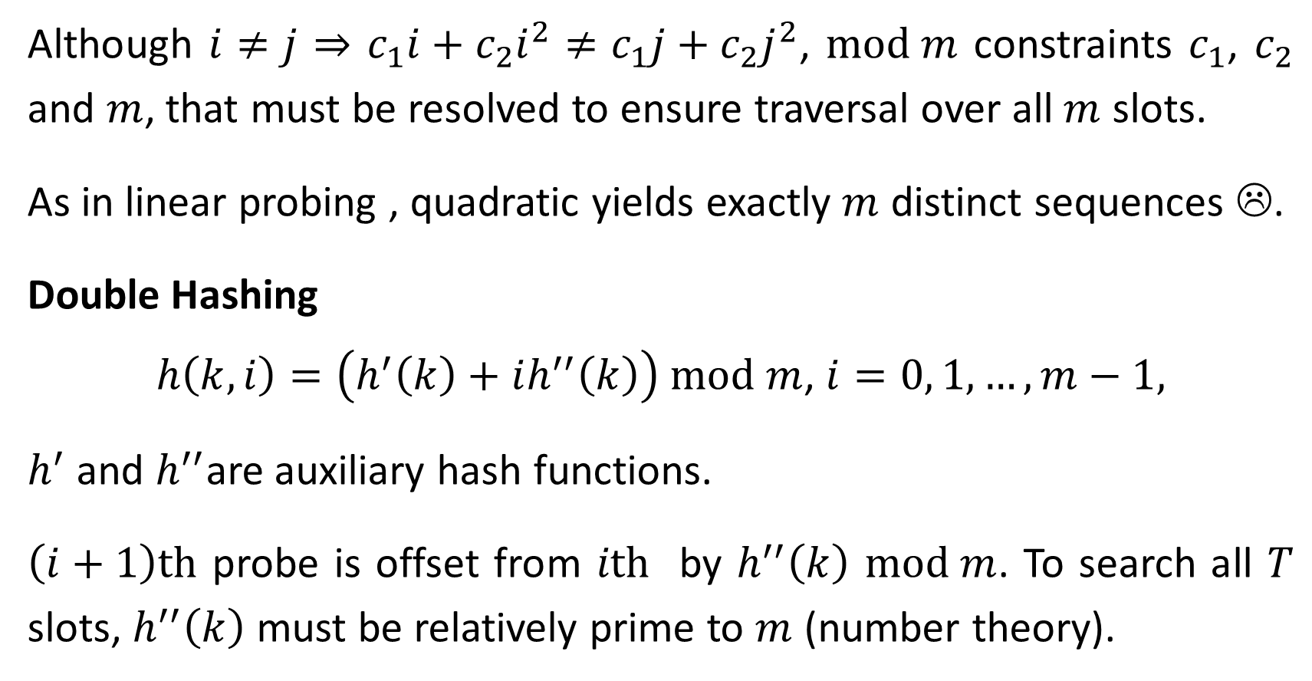
Although $i≠j$ ⇒ $c_{1}i+c_{2}i^{2}≠c_{1}j+c_{2}j^{2}$, $\text{mod} m$ constraints $c_{1}$, $c_{2}$ and $m$, that must be resolved to ensure traversal over all $m$ slots.
As in linear probing , quadratic yields exactly $m$ distinct sequences ☹.
Double Hashing
$h\left(k,i\right)=\left(h^{′}\left(k\right)+ih^{′′}\left(k\right)\right) \text{mod} m$, $i=0, 1, …, m−1,$
$h^{′}$ and $h^{′′}$are auxiliary hash functions.
$\left(i+1\right)\text{th}$ probe is offset from $i\text{th}$ by $h^{′′}\left(k\right)$ $\text{mod} m$. To search all $T$ slots, $h^{′′}\left(k\right)$ must be relatively prime to $m$ (number theory).

Slide 20



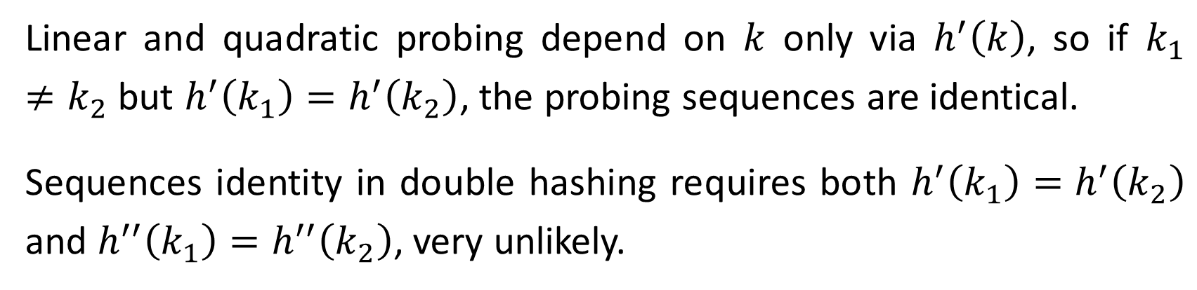



Linear and quadratic probing depend on $k$ only via $h^{′}\left(k\right)$, so if $k_{1}≠k_{2}$ but $h^{′}\left(k_{1}\right)=h^{′}\left(k_{2}\right)$, the probing sequences are identical.
Sequences identity in double hashing requires both $h^{′}\left(k_{1}\right)=h^{′}\left(k_{2}\right)$ and $h^{′′}\left(k_{1}\right)=h^{′′}\left(k_{2}\right)$, very unlikely.
Insertion example: $h^{′}\left(k\right)=k \text{mod} 13$, $h^{′′}\left(k\right)=1+\left(k \text{mod} 11\right)$
$$h\left(14,0\right)=1$$
$$h\left(14,1\right)=5$$
$$h\left(14,2\right)=9$$
$$1≤h′′\left(k\right)≤11$$
0 | 1 | 2 | 3 | 4 | 5 | 6 | 7 | 8 | 9 | 10 | 11 | 12
 | 79 |  |  | 69 | 98 |  | 72 |  |  |  | 50
$$m=13$$
$$14$$

Slide 21
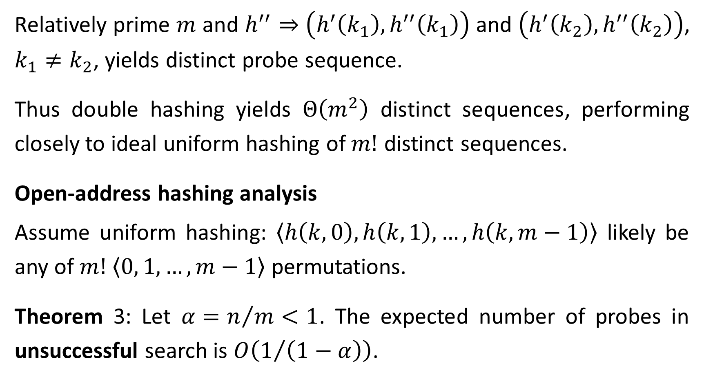
Relatively prime $m$ and $h^{′′}$ ⇒ $\left(h^{′}\left(k_{1}\right),h^{′′}\left(k_{1}\right)\right)$ and $\left(h^{′}\left(k_{2}\right),h^{′′}\left(k_{2}\right)\right)$, $k_{1}≠k_{2}$, yields distinct probe sequence.
Thus double hashing yields $Θ\left(m^{2}\right)$ distinct sequences, performing closely to ideal uniform hashing of $m!$ distinct sequences.
Open-address hashing analysis
Assume uniform hashing: $\left\langle h\left(k,0\right),h\left(k,1\right),…,h\left(k,m−1\right)\right\rangle$ likely be any of $m!$ $\left\langle 0, 1,…, m−1\right\rangle$ permutations.
Theorem 3: Let $α=n/m<1$. The expected number of probes in unsuccessful search is $O\left(1/{\left(1−α\right)}\right)$.

Slide 22
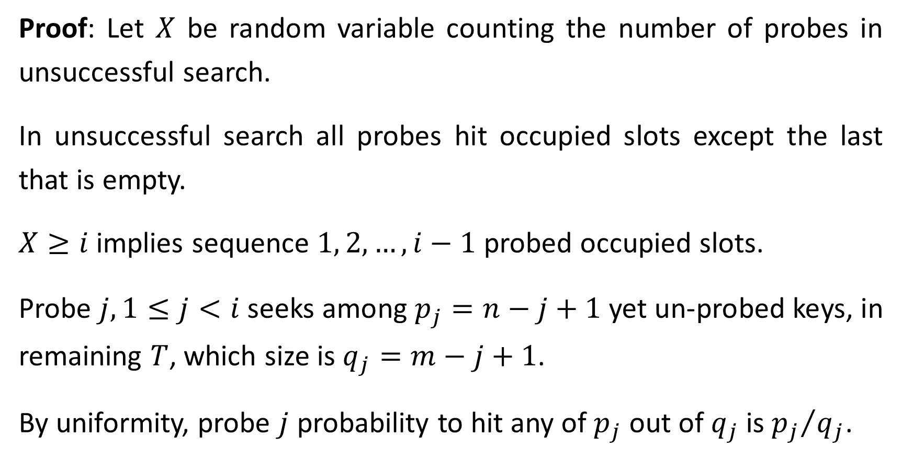
Proof: Let $X$ be random variable counting the number of probes in unsuccessful search.
In unsuccessful search all probes hit occupied slots except the last that is empty.
$X≥i$ implies sequence $1, 2, …, i−1$ probed occupied slots.
Probe $j, 1≤j<i$ seeks among $p_{j}=n−j+1$ yet un-probed keys, in remaining $T$, which size is $q_{j}=m−j+1$.
By uniformity, probe $j$ probability to hit any of $p_{j}$ out of $q_{j}$ is ${p_{j}}/{q_{j}}$.

Slide 23
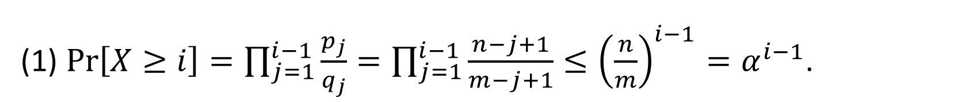
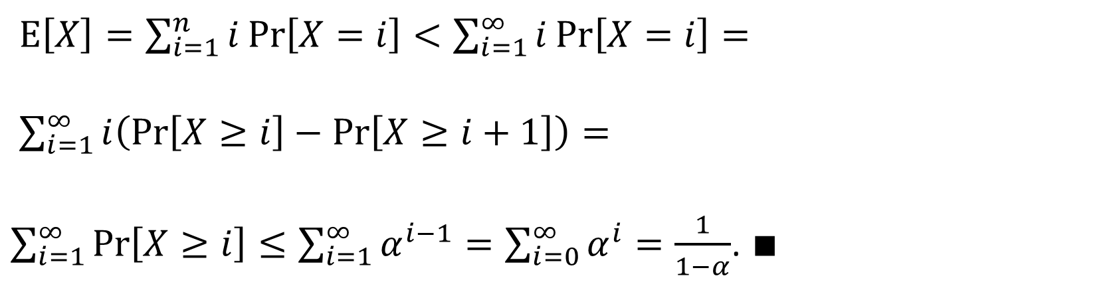
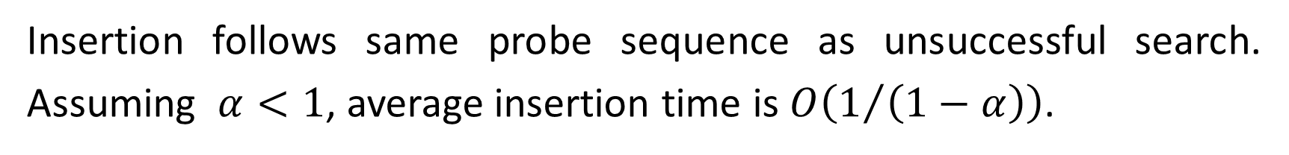
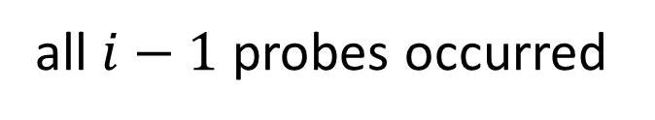
all $i−1$ probes occurred
(1) $\text{Pr}\left[X≥i\right]=\prod_{j=1}^{i−1}{\frac{p_{j}}{q_{j}}}=\prod_{j=1}^{i−1}{\frac{n−j+1}{m−j+1}}≤{\left(\frac{n}{m}\right)}^{i−1}=α^{i−1}$.
$\text{E}\left[X\right]=\sum_{i=1}^{n}{i \text{Pr}\left[X=i\right]}<\sum_{i=1}^{∞}{i \text{Pr}\left[X=i\right]}=$
$\sum_{i=1}^{∞}{i\left(\text{Pr}\left[X≥i\right]−\text{Pr}\left[X≥i+1\right]\right)=}$
$\sum_{i=1}^{∞}{\text{Pr}\left[X≥i\right]}≤\sum_{i=1}^{∞}{α^{i−1}}=\sum_{i=0}^{∞}{α^{i}}=\frac{1}{1−α}$. $∎$
(1)
telescopic sum
Insertion follows same probe sequence as unsuccessful search. Assuming $α<1$, average insertion time is $O\left(1/{\left(1−α\right)}\right)$.

Slide 24
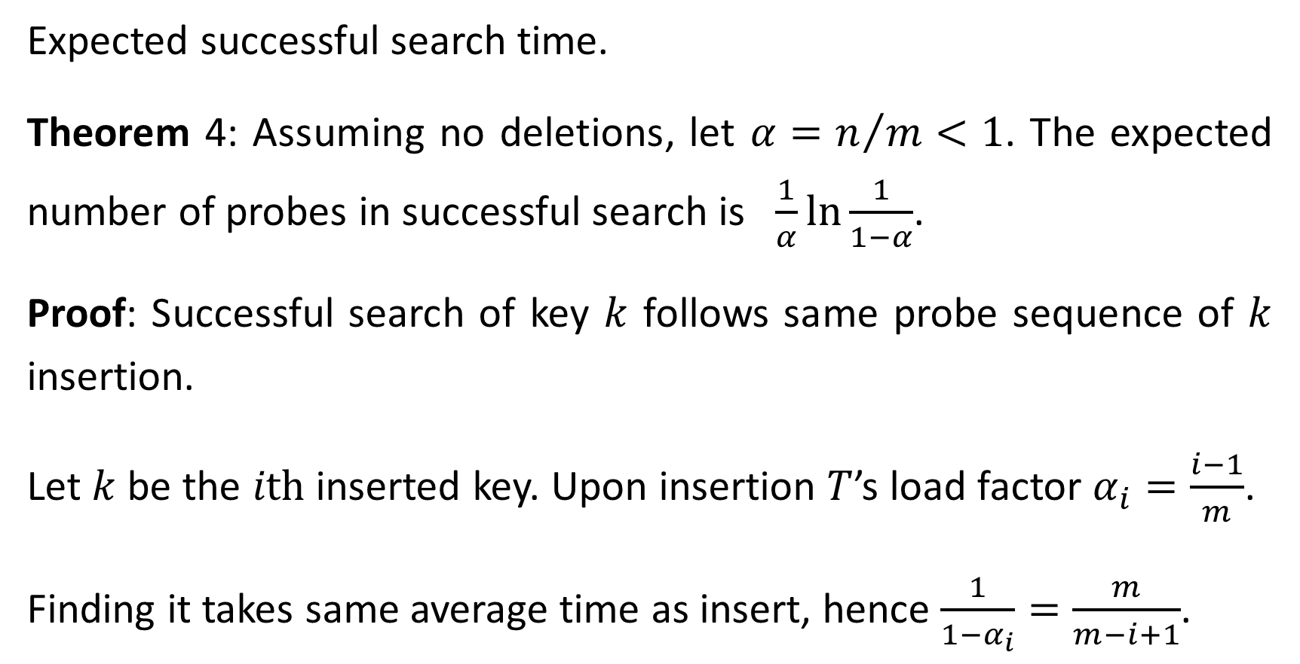
Expected successful search time.
Theorem 4: Assuming no deletions, let $α=n/m<1$. The expected number of probes in successful search is $\frac{1}{α}\ln{\frac{1}{1−α}}$.
Proof: Successful search of key $k$ follows same probe sequence of $k$ insertion.
Let $k$ be the $i\text{th}$ inserted key. Upon insertion $T$’s load factor $α_{i}=\frac{i−1}{m}$.
Finding it takes same average time as insert, hence $\frac{1}{1−α_{i}}=\frac{m}{m−i+1}$.

Slide 25
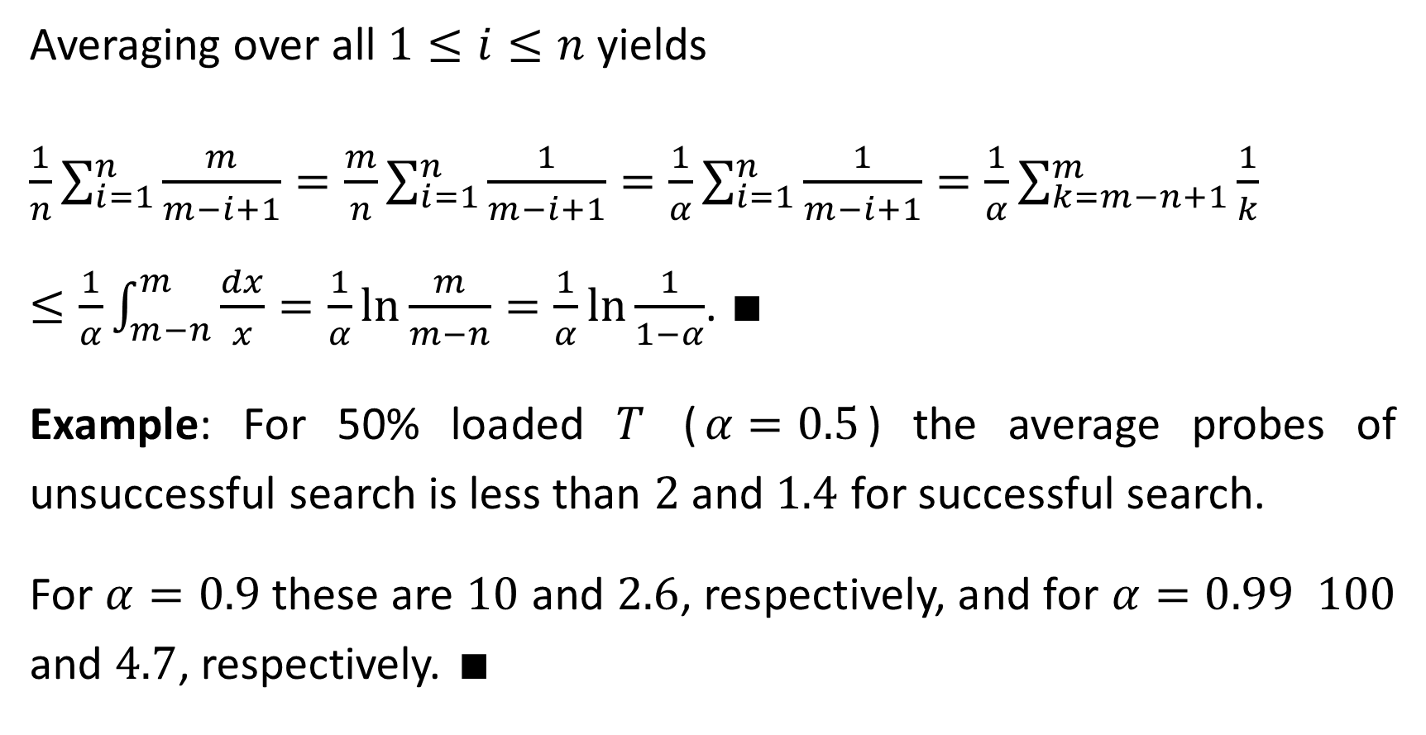
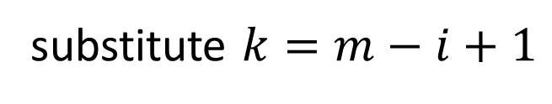
Averaging over all $1≤i≤n$ yields
$\frac{1}{n}\sum_{i=1}^{n}{\frac{m}{m−i+1}}=\frac{m}{n}\sum_{i=1}^{n}{\frac{1}{m−i+1}}=\frac{1}{α}\sum_{i=1}^{n}{\frac{1}{m−i+1}}=\frac{1}{α}\sum_{k=m−n+1}^{m}{\frac{1}{k}}≤\frac{1}{α}\int_{m−n}^{m}{\frac{dx}{x}}=\frac{1}{α}\ln{\frac{m}{m−n}}=\frac{1}{α}\ln{\frac{1}{1−α}}$. $∎$
Example: For 50% loaded $T$ ($α=0.5$) the average probes of unsuccessful search is less than $2$ and $1.4$ for successful search.
For $α=0.9$these are $10$ and $2.6$, respectively, and for $α=0.99$ $100$ and $4.7$, respectively. $∎$
substitute $k=m−i+1$
harmonic sum

