Slide 1


Pipeline Extensions
prepared and instructed by
Shmuel Wimer
Eng. Faculty, Bar-Ilan University

Slide 2
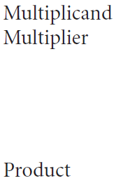
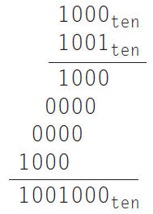
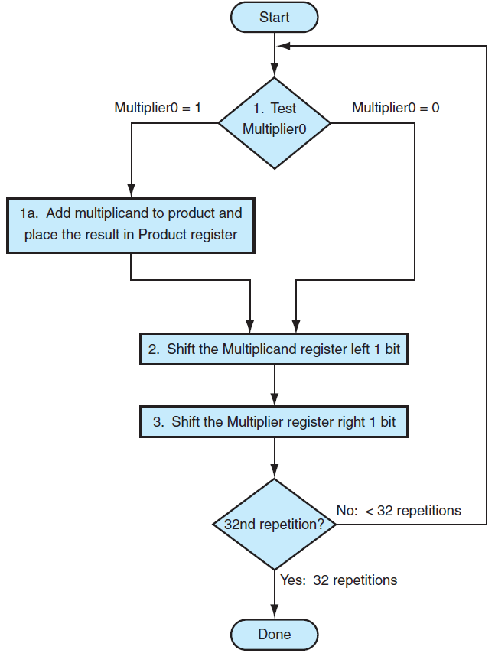
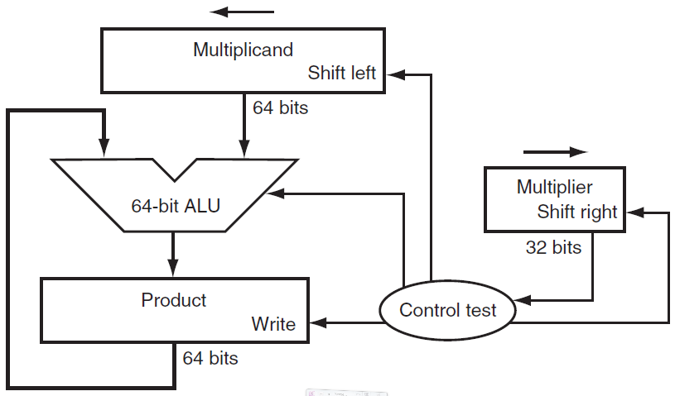

Multiplication
$$×$$
one clock cycle

Slide 3
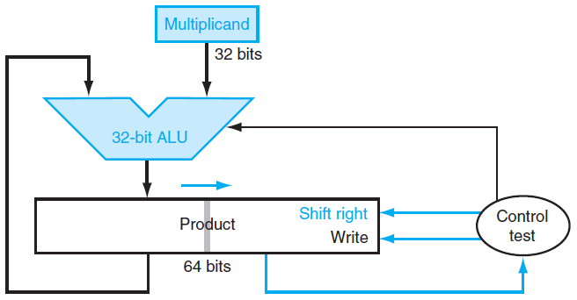
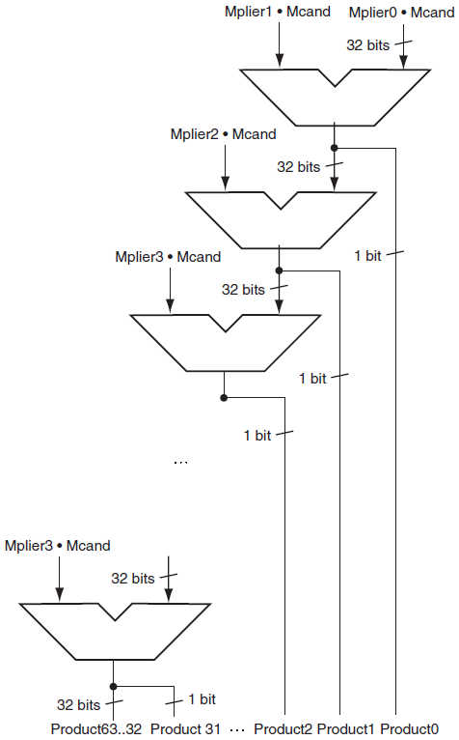
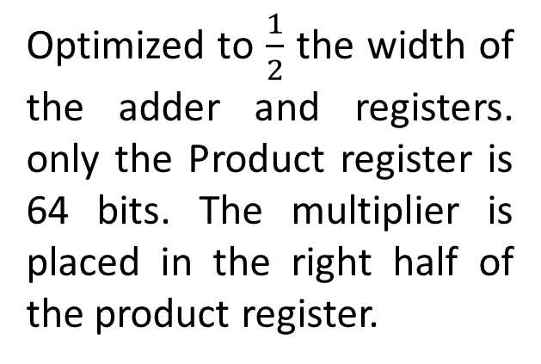
Fast multiplication
hardware (concept)
Optimized to $\frac{1}{2}$ the width of the adder and registers. only the Product register is 64 bits. The multiplier is placed in the right half of the product register.

Slide 4
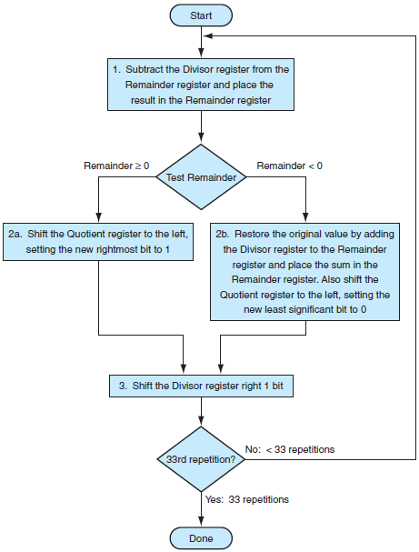
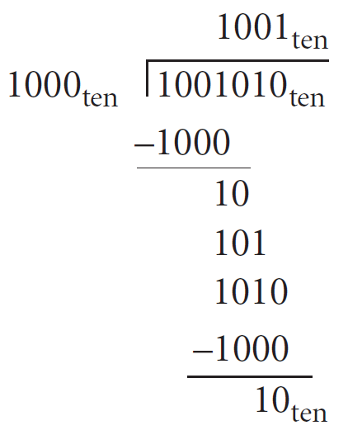
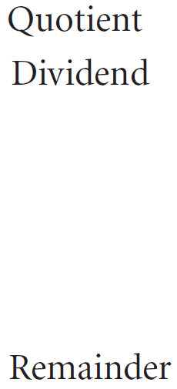

Division

Slide 5
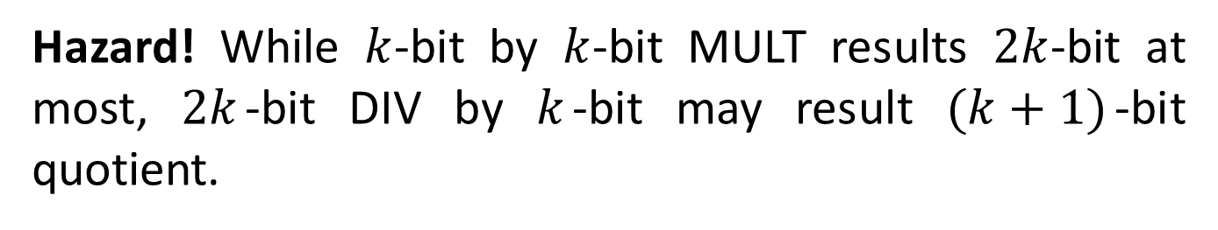
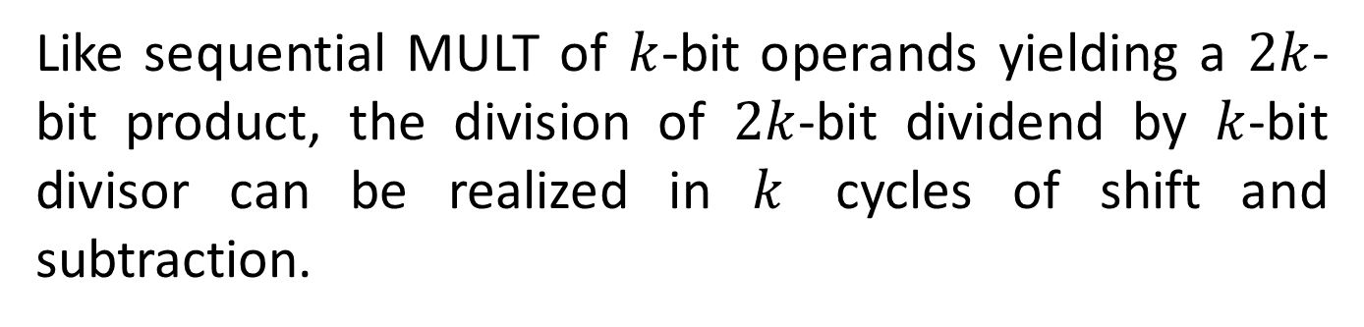
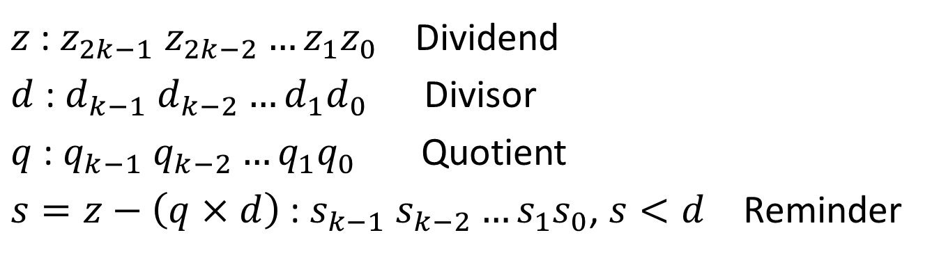
Unsigned Division
$z$: $z_{2k−1}$ $z_{2k−2}…z_{1}z_{0}$ Dividend
$d$ : $d_{k−1}$ $d_{k−2}…d_{1}d_{0}$ Divisor
$q$ : $q_{k−1}$ $q_{k−2}…q_{1}q_{0}$ Quotient
$s=z−\left(q×d\right)$ : $s_{k−1} s_{k−2}…s_{1}s_{0}$, $s<d$ Reminder
Like sequential MULT of $k$-bit operands yielding a $2k$-bit product, the division of $2k$-bit dividend by $k$-bit divisor can be realized in $k$ cycles of shift and subtraction.
Hazard! While $k$-bit by $k$-bit MULT results $2k$-bit at most, $2k$-bit DIV by $k$-bit may result $(k+1)$-bit quotient.

Slide 6
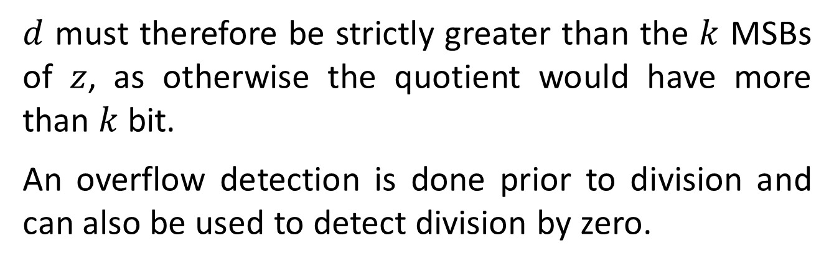
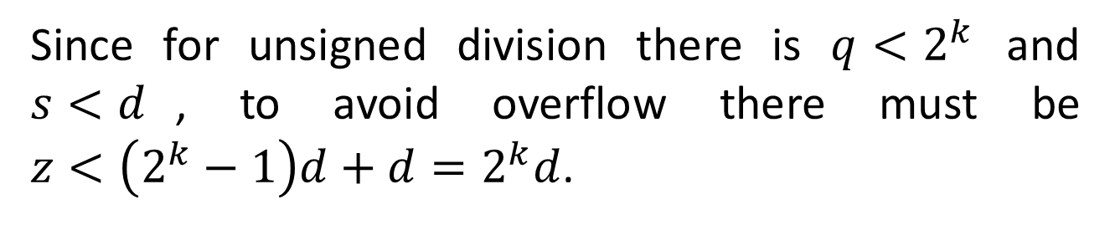
Since for unsigned division there is $q<2^{k}$ and $s<d$, to avoid overflow there must be $z<\left(2^{k}−1\right)d+d=2^{k}d$.
$d$ must therefore be strictly greater than the $k$ MSBs of $z$, as otherwise the quotient would have more than $k$ bit.
An overflow detection is done prior to division and can also be used to detect division by zero.

Slide 7
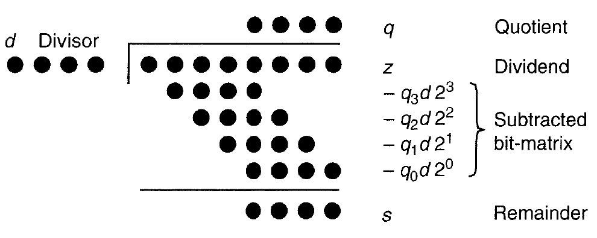
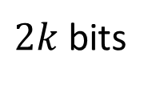
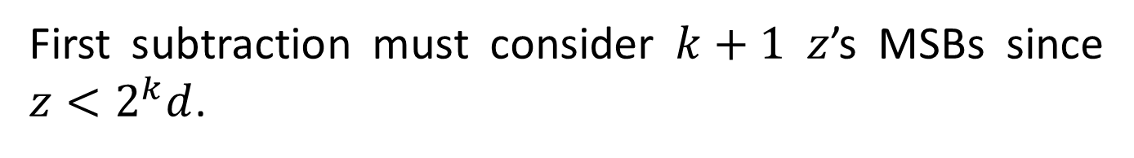
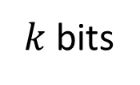
$k$ bits
$2k$ bits
First subtraction must consider $k+1$ $z$’s MSBs since $z<2^{k}d$.

Slide 8
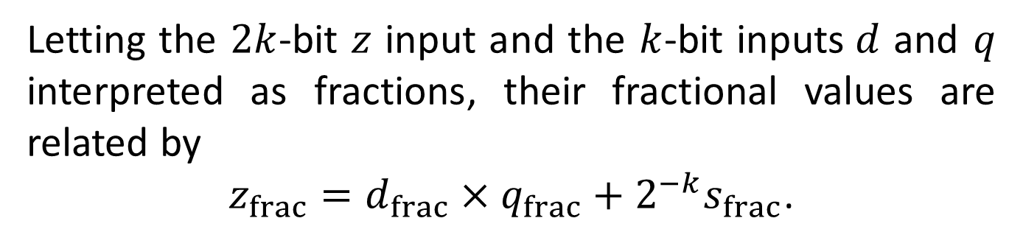
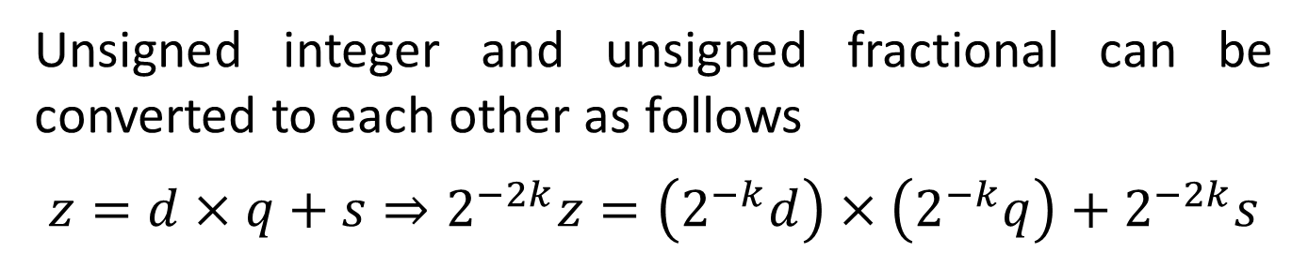

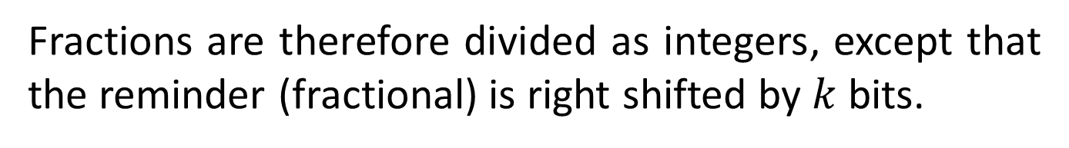
Fractional Division
Unsigned integer and unsigned fractional can be converted to each other as follows
$$z=d×q+s⇒2^{−2k}z=\left(2^{−k}d\right)×\left(2^{−k}q\right)+2^{−2k}s$$
Letting the $2k$-bit $z$ input and the $k$-bit inputs$d$ and $q$ interpreted as fractions, their fractional values are related by
$z_{frac}=$ $d_{frac}×q_{frac}+2^{−k}s_{frac}$.
Fractions are therefore divided as integers, except that the reminder (fractional) is right shifted by $k$ bits.
Overflow detects that $z_{frac}<$ $d_{frac}$. Otherwise the quotient would be not smaller than 1.

Slide 9
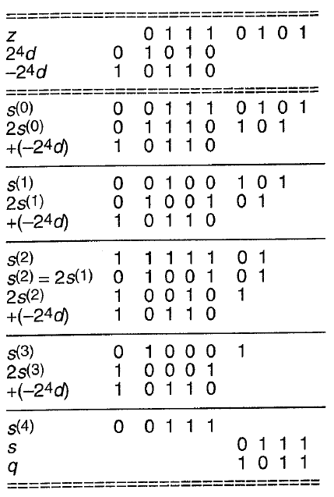
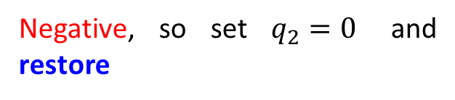



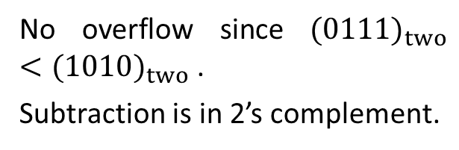

Restoring Unsigned Division
$$01110101 ÷1010$$
No overflow since ${(0111)}_{two}<{(1010)}_{two}$.
Subtraction is in 2’s complement.
Positive, so set $q_{3}=1$
Negative, so set $q_{2}=0$ and restore
Positive, so set $q_{1}=1$
Positive, so set $q_{0}=1$

Slide 10
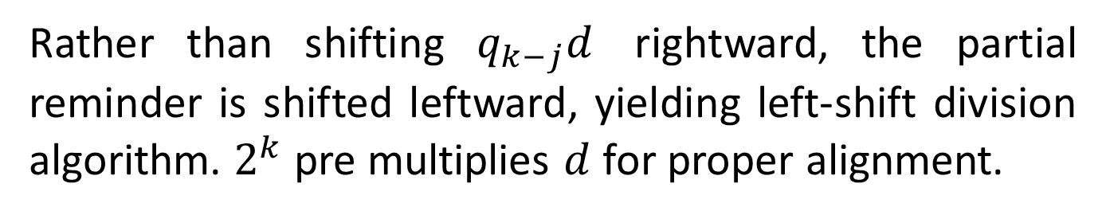
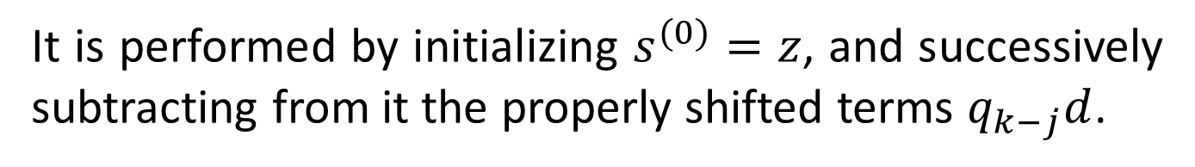
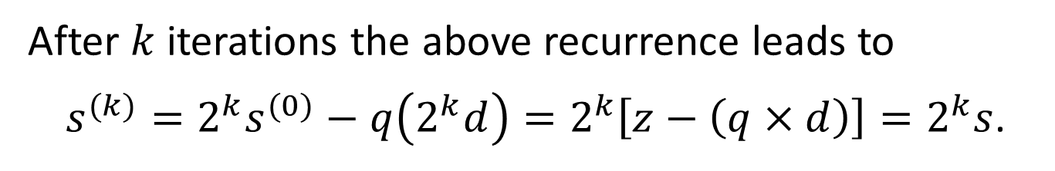
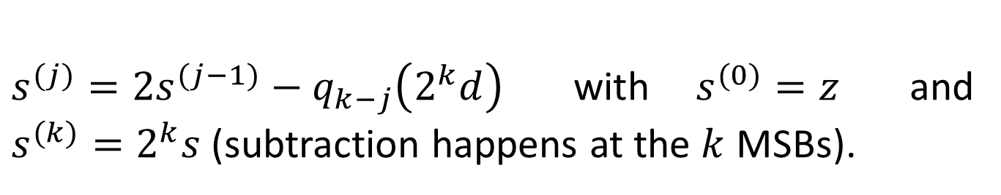
Sequential Bit-at-a-time Division
It is performed by initializing $s^{(0)}=z$, and successively subtracting from it the properly shifted terms $q_{k−j}d$.
Rather than shifting $q_{k−j}d$ rightward, the partial reminder is shifted leftward, yielding left-shift division algorithm. $2^{k}$ pre multiplies $d$ for proper alignment.
shift left
subtract
$s^{(j)}=2s^{(j−1)}−q_{k−j}\left(2^{k}d\right)$ with $s^{(0)}=z$ and $s^{(k)}=2^{k}s$ (subtraction happens at the $k$ MSBs).
After $k$ iterations the above recurrence leads to
$s^{(k)}=2^{k}s^{(0)}−q\left(2^{k}d\right)=2^{k}\left[z−\left(q×d\right)\right]=2^{k}s$.

Slide 11
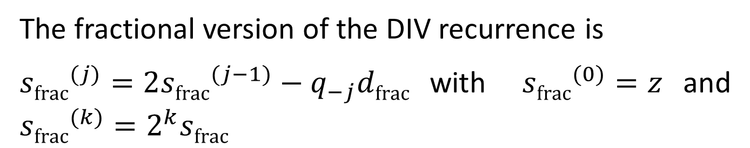
The fractional version of the DIV recurrence is
${sfrac}^{(j)}=2{sfrac}^{(j−1)}−q_{−j}dfrac$with ${sfrac}^{(0)}=z$and ${sfrac}^{(k)}=2^{k}sfrac$
Subtractions can be performed by 2’s complements.
Unlike MULT that can be performed by right and left shifts, DIV can be done only by left shift.
That follows from the bit of the quotient that are discovered progressively, starting from MSB. In MULT the multiplier’s bits are known in the outset.

Slide 12
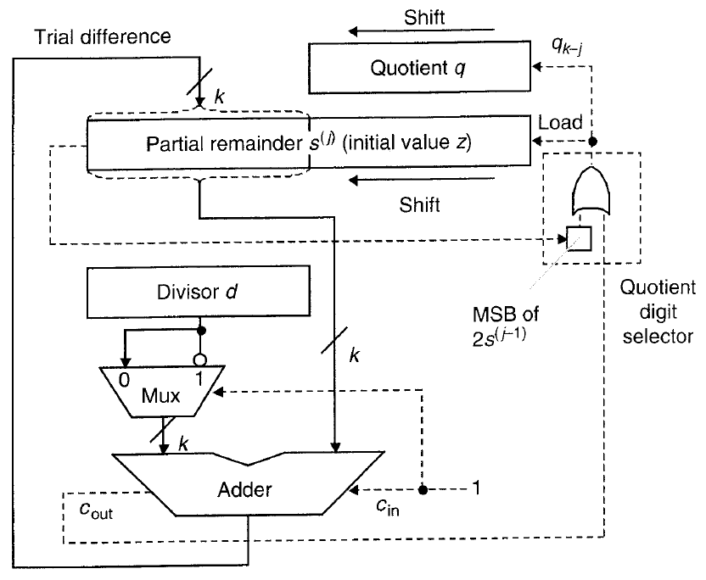
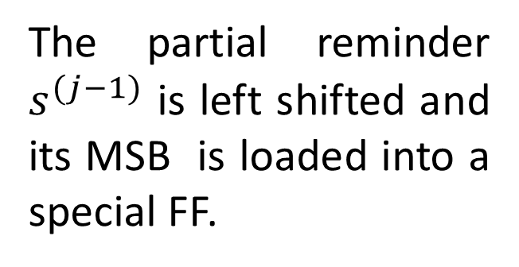
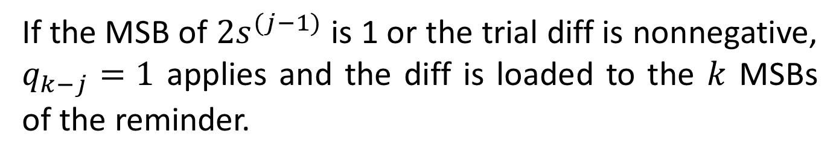
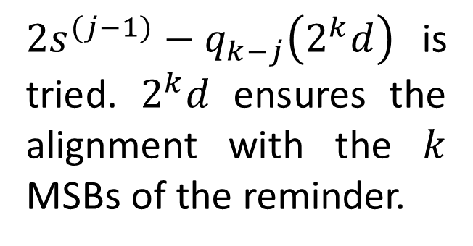
Restoring Sequential Unsigned Divider
The partial reminder $s^{(j−1)}$ is left shifted and its MSB is loaded into a special FF.
$2s^{(j−1)}−q_{k−j}\left(2^{k}d\right)$ is tried. $2^{k}d$ ensures the alignment with the $k$ MSBs of the reminder.
If the MSB of $2s^{(j−1)}$is 1 or the trial diff is nonnegative, $q_{k−j}=1$ applies and the diff is loaded to the $k$ MSBs of the reminder.

Slide 13
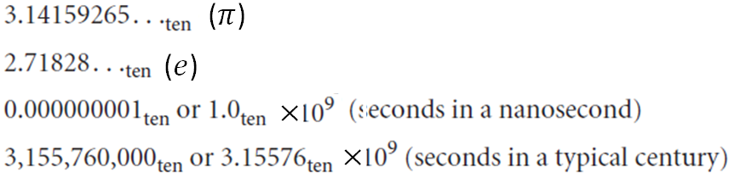
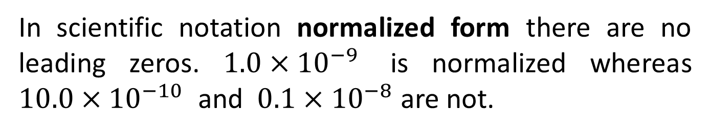
Floating Point
In scientific notation there is a single digit to the left of the decimal point.
In scientific notation normalized form there are no leading zeros. $1.0×{10}^{−9}$ is normalized whereas $10.0×{10}^{−10}$ and $0.1×{10}^{−8}$ are not.

Slide 14
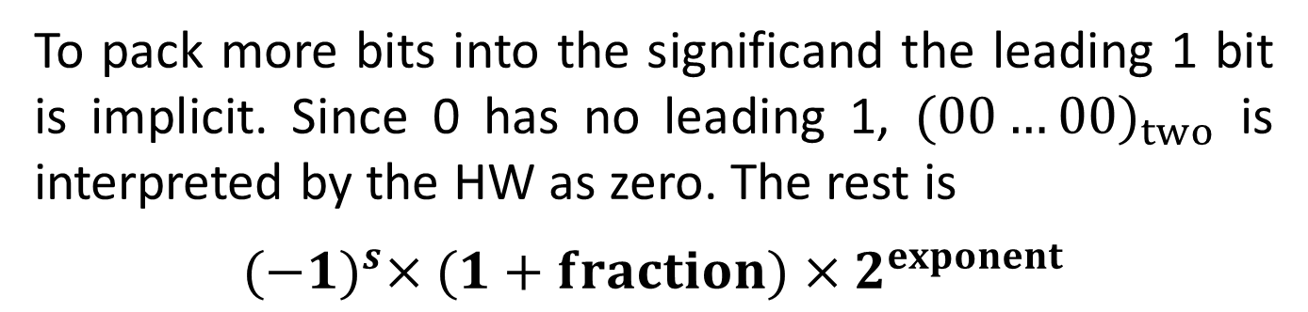
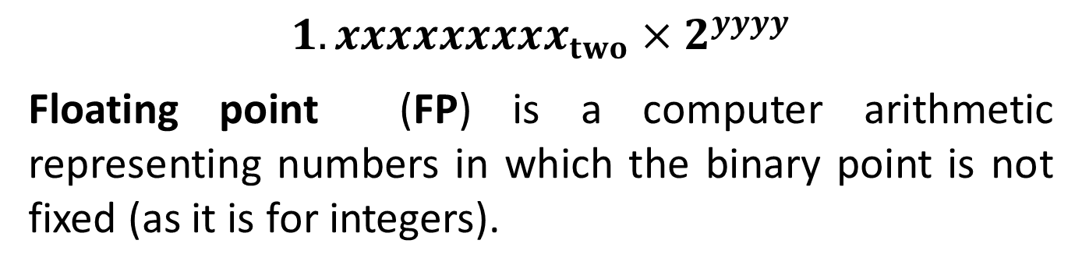
$${1.xxxxxxxxx}_{two}×2^{yyyy}$$
Floating point (FP) is a computer arithmetic representing numbers in which the binary point is not fixed (as it is for integers).
significand
exponent
IEEE754 is a FP representation standard supported by all computers. 32-bit FP is called single precision.
To pack more bits into the significand the leading 1 bit is implicit. Since 0 has no leading 1, ${(00…00)}_{two}$ is interpreted by the HW as zero. The rest is
${(−1)}^{s}×(1+fraction)×2^{exponent}$

Slide 15
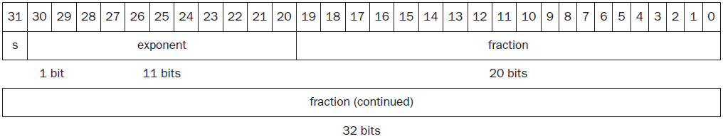
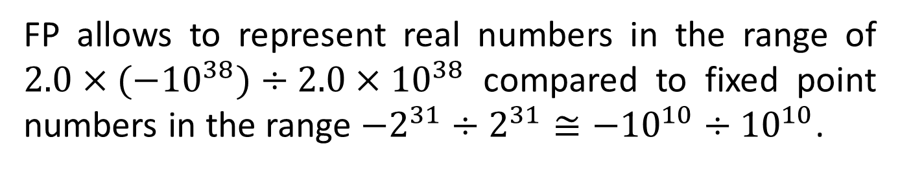
FP allows to represent real numbers in the range of ${2.0×(−10}^{38})÷{2.0×10}^{38}$ compared to fixed point numbers in the range ${−2}^{31}÷2^{31}≅{−10}^{10}÷{10}^{10}$.
Unlike fixed point, the FP numbers are non uniformly distributed.
Overflow – the exponent is too large (positive or negative) to be represented. Underflow – the fraction is too small to be represented.
Double precision

Slide 16
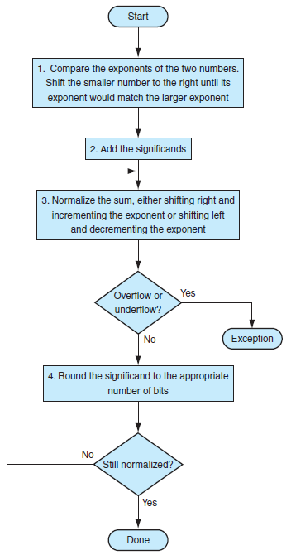
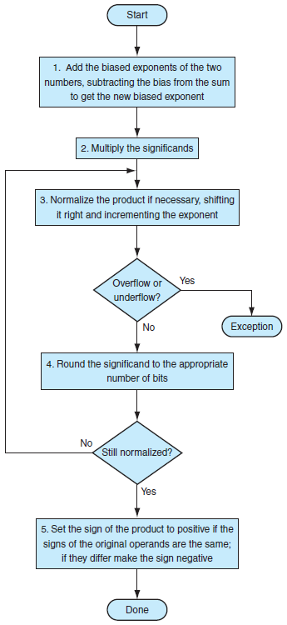
FP ADD
FP MULT

Slide 17
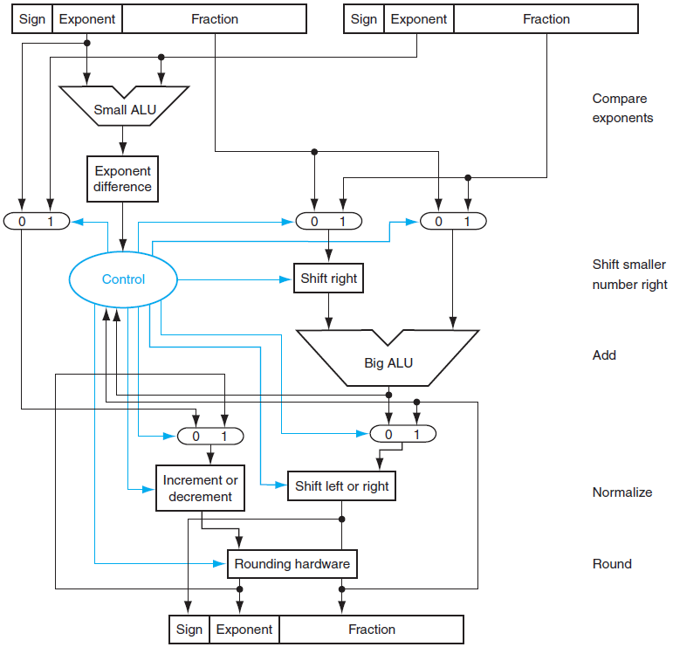
FP ADD hardware

Slide 18
Pipeline Extension – Multicycle Operations
MIPS Pipeline should support floating point (FP) operations which may take few clock cycles (rounding mantissa may change exponent, DIV, etc.).
Dictating single cycle for FP operation would mean slow clock or enormous hardware, both undesired.
We rather allow the EX cycle repeat many time as needed. Number of repetitions may vary for different operations.
There may be multiple FP functional units (FPUs) working simultaneously.

Slide 19
A stall will occur if the issued instruction cause either a structural hazard or a data hazard.
Assume four separate functional units that can be operated in parallel.
The main integer unit, handling ordinary integer ALU, loads stores, and branches.
FP and integer multiplier.
FP adder handling FP add, subtract and conversion.
FP and integer divider.

Slide 20
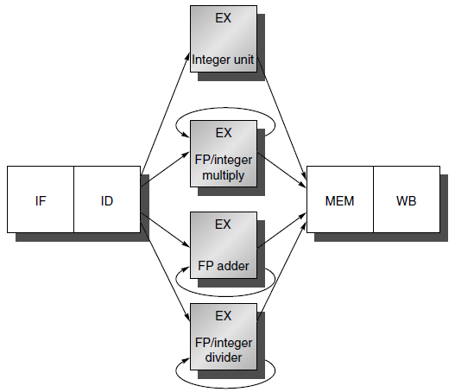
The instructions executed in the functional units are not pipelined, so no two instructions can reside in a functional unit.
If an instruction cannot proceed to EX, the entire pipeline behind is stalled.

Slide 21
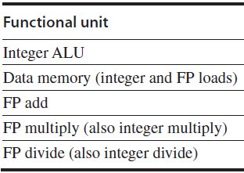

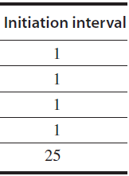
We can generalize the structure of the FP pipeline to allow pipelining of some stages and multiple ongoing operations.
Latency : the number of intervening cycles between an instruction that produces a result and an instruction that uses it.
Initiation: the number of cycles that must elapse between issuing two operations of a given type.

Slide 22
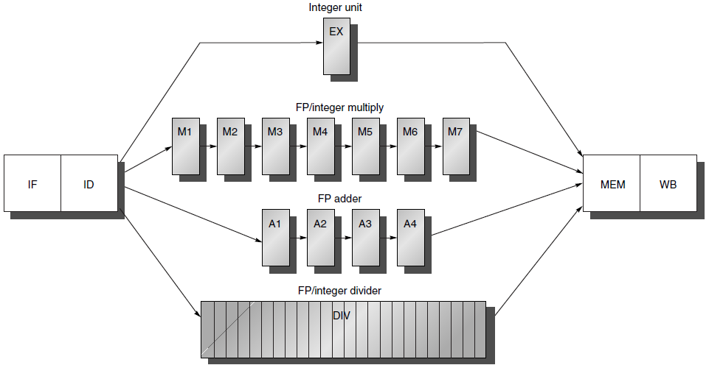
Integer ALU has a latency of 0, since the results can be used on the next clock cycle.
Loads have a latency of 1, since their results can be used after one intervening cycle.
Up to 7 FP/int outstanding multiplications
Up to 4 FP/int outstanding additions
DIV not pipelined

Slide 23
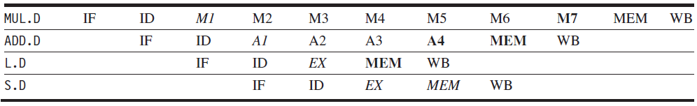
New pipeline registers (A1/A2,…, A3/A4), (M1/M2,…, M6/M7)
The ID/EX register is replaced by ID/EX, ID/DIV, ID/M1, and ID/A1.
The “.D” extension on the instruction mnemonic indicates double-precision (64-bit) floating-point operations
data needed
result available

Slide 24
Data Hazards
A hazard is created whenever a dependence between instructions is close enough.
Program order must be preserved.
The goal of both SW and HW techniques is to exploit parallelism by preserving program order only where it affects the outcome of the program.
Detecting and avoiding hazards ensures that necessary program order is preserved.
Data hazards are classified depending on the order of read and write accesses in the instructions. Consider two instructions $i$ and $j$, with $i$ preceding $j$

Slide 25
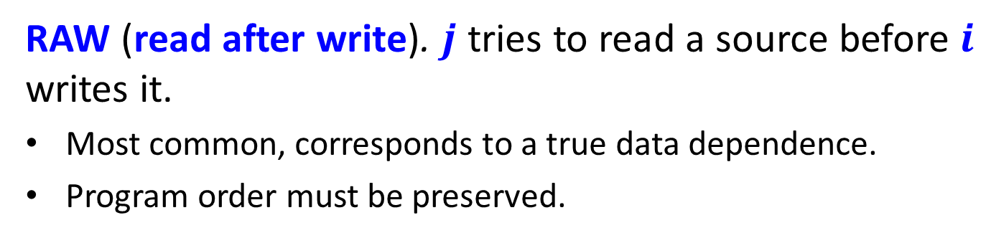
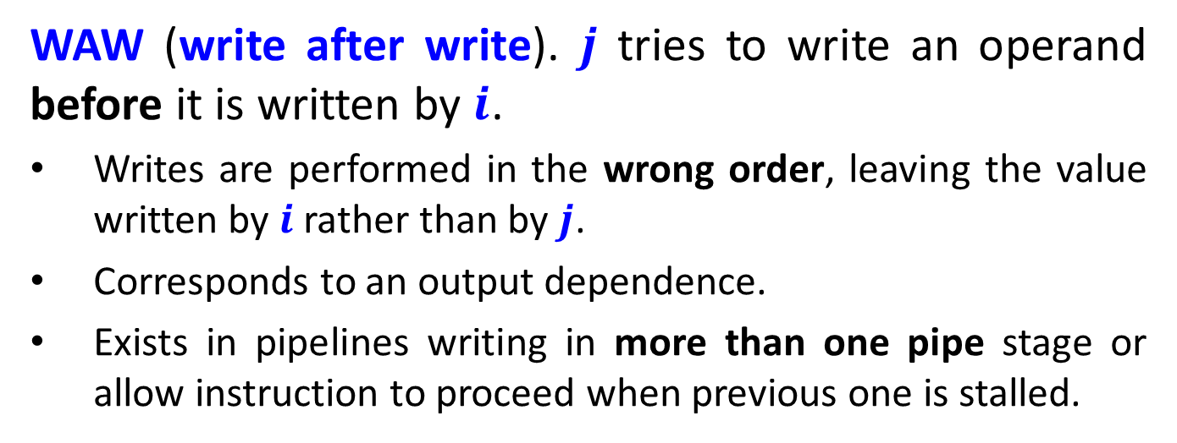
The possible data hazards are:
RAW (read after write). $j$ tries to read a source before $i$ writes it.
Most common, corresponds to a true data dependence.
Program order must be preserved.
WAW (write after write). $j$ tries to write an operand before it is written by $i$.
Writes are performed in the wrong order, leaving the value written by $i$ rather than by $j$.
Corresponds to an output dependence.
Exists in pipelines writing in more than one pipe stage or allow instruction to proceed when previous one is stalled.

Slide 26

WAR (write after read). $j$ tries to write a destination before it is read by $i$, so $i$ incorrectly gets the new value.
Arises from anti dependence.
Cannot occur in most static issue pipelines because all reads are early (in ID) and all writes are late (in WB).
Occurs when there are some instructions that write results early in the pipeline and other instructions that read a source late in the pipeline.
Occurs also when instructions are reordered.

Slide 27
Hazards and Forwarding
Because the divide unit is not pipelined, structural hazards can occur. Must be detected and instructions issue be stalled.
The varying running times of instruction may result in a few register writes in a cycle.
WAW hazards are possible, since instructions no longer reach WB in order. WAR hazards are not possible, since the register reads always occur in ID.
Instructions can complete in a different order than they were issued, causing problems with exceptions.

Slide 28

Because of longer latency of operations, stalls for RAW hazards will be more frequent.
Each instruction below depends on the previous and proceeds as soon as data are available, assuming that the pipeline has full bypassing and forwarding.
The S.D is stalled an extra cycle so that its MEM does not conflict with the MEM of ADD.D. Extra hardware could easily handle this case.

Slide 29

Three instructions in MEM. Is it a structural hazard?
No. The first two MEM do not write to MEM.
Instructions are in WB, resulting in a structural hazard. The processor must serialize the WB. Write ports could be increased, but it may not pay (only rarely used 2nd).

Slide 30




single port RF
ID: MULT$→$R2
shift
1
EXE+MEM+WB
ID: MULT$→$R6
shift
1
1
Stall
required
$$⋮$$
ID: ADD $→$R8
shift
1
1
EXE+MEM+WB

Slide 31

dual port RF
ID: MULT$→$R2
shift
R2
EXE+MEM+WB
ID: MULT$→$R6
shift
R2
R6
Stall
required
$$⋮$$
ID: ADD $→$R6
shift
R2
R6
EXE+MEM+WB

Slide 32
A solution to the WB interlock is to track the use of the write port in the ID with a shift register indicating when already-issued instructions will use the RF.
If the instruction in ID needs to use the RF at the same time as an instruction already issued, the instruction in ID is stalled for a cycle.
On each clock the WB reservation register shifts 1 bit. Advantage is that all interlock detection and stalls occur in ID (centralized).
The cost is the addition of the shift register and write conflict logic.

Slide 33
An alternative solution is to detect conflicts at MEM or WB stage, a case where either instruction can be stalled.
A simple heuristic is to give priority to the unit with the longest latency, since that is the one most likely to cause other stalls due to RAW hazards.
The advantage is the simple implementation.
The disadvantage is that it complicates pipeline control, as stalls can now arise from two places.
We subsequently assume that WB interlock are resolved in ID.

Slide 34

The above code has a WAW hazard. It occurs only when the code overwrites the result of ADD.D without any instruction ever using it! ADD.D is useless. (Why?)
If F2 is used between the ADD.D and the L.D, the pipeline is stalled for a RAW hazard, and the L.D would not be issued until the ADD.D is completed.

