Slide 1

Paging Algorithms
prepared and instructed by
Shmuel Wimer
Eng. Faculty, Bar-Ilan University

Slide 2
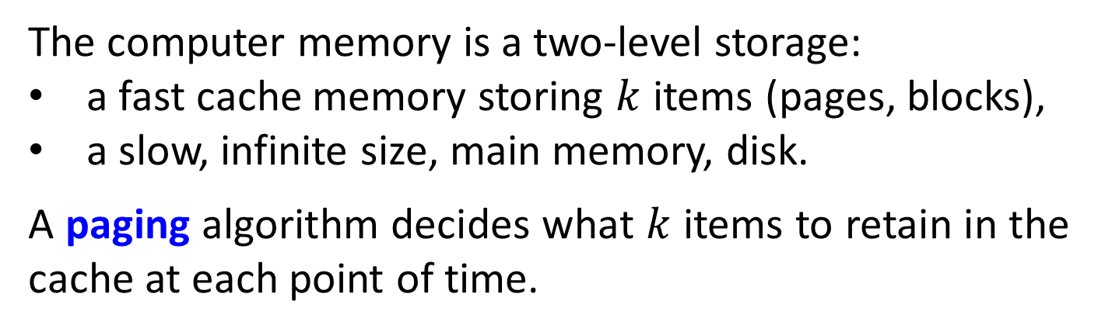
The Online Paging Problem
The computer memory is a two-level storage:
a fast cache memory storing $k$ items (pages, blocks),
a slow, infinite size, main memory, disk.
A paging algorithm decides what $k$ items to retain in the cache at each point of time.
There is a sequence of requests (a program), each specifies a memory item.
a hit occurs if it is found in the cache, and
a miss occurs if it is not, where the item must be fetched from the memory in a unit cost.

Slide 3
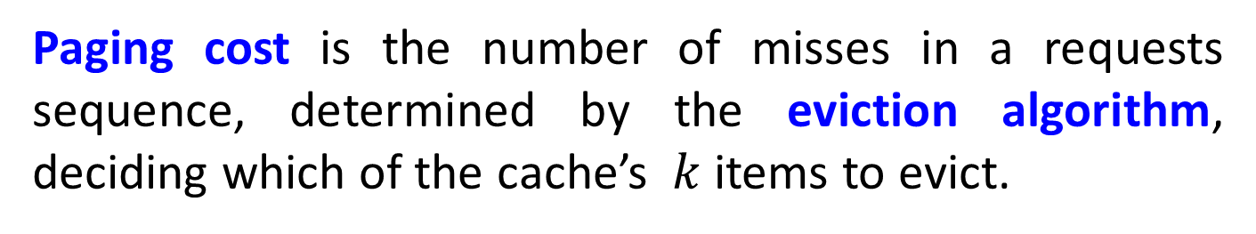
Paging cost is the number of misses in a requests sequence, determined by the eviction algorithm, deciding which of the cache’s $k$ items to evict.
An online eviction algorithm is blind of the future references.
An offline algorithm has full knowledge of the future.
Some typical deterministic online paging algorithms.
Least Recently Used (LRU): evict the item whose most recent request is the furthest in the past.

Slide 4
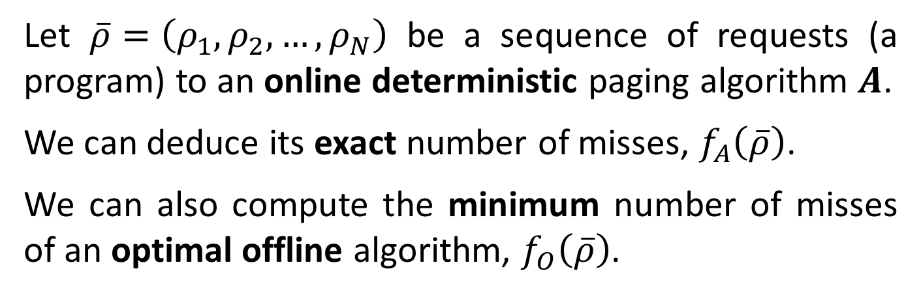
First-in, First-out (FIFO): evict the item that is in the cache the longest period.
Least Frequently Used (LFU): evict the item that has been requested least often.
It is complicated to maintain some online algorithms. LRU may require handling priority queue.
Let $\overline{ρ}=\left(ρ_{1},ρ_{2},…,ρ_{N}\right)$ be a sequence of requests (a program) to an online deterministic paging algorithm $A$.
We can deduce its exact number of misses, $f_{A}\left(\overline{ρ}\right)$.
We can also compute the minimum number of misses of an optimal offline algorithm, $f_{O}\left(\overline{ρ}\right)$.

Slide 5
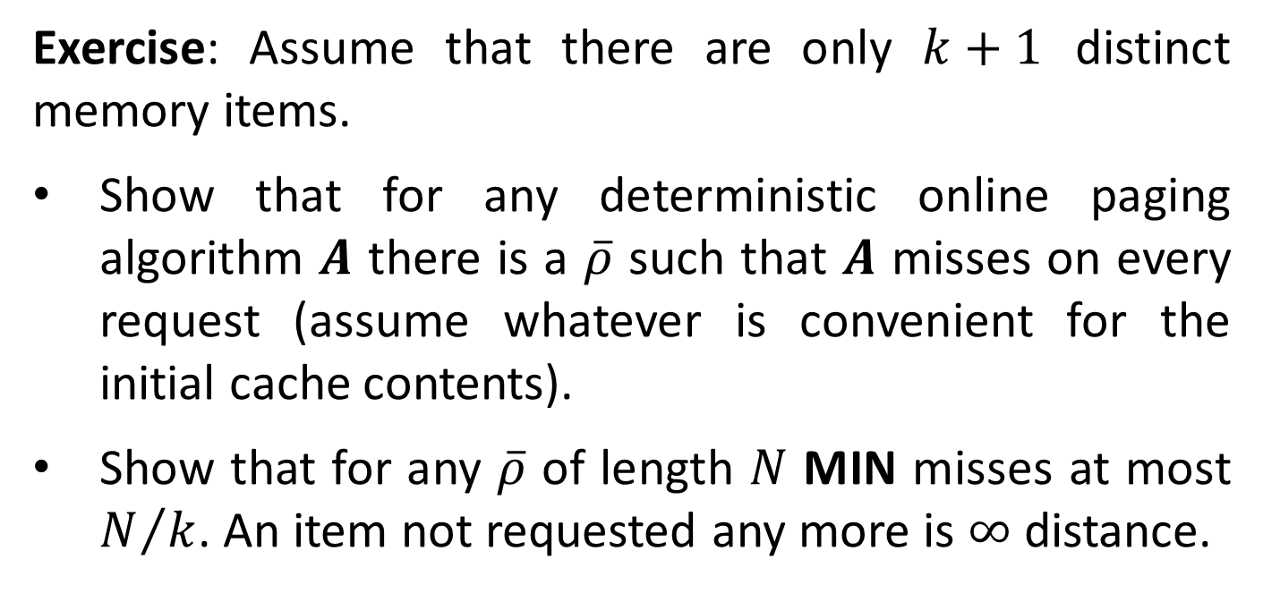
The optimal offline eviction algorithm is called MIN, evicting the item whose next request occurs furthest in the future (non-trivial optimality proof).
Exercise: Assume that there are only $k+1$ distinct memory items.
Show that for any deterministic online paging algorithm $A$ there is a $\overline{ρ}$ such that $A$ misses on every request (assume whatever is convenient for the initial cache contents).
Show that for any $\overline{ρ}$ of length $N$ MIN misses at most $N/k$. An item not requested any more is $∞$ distance.

Slide 6
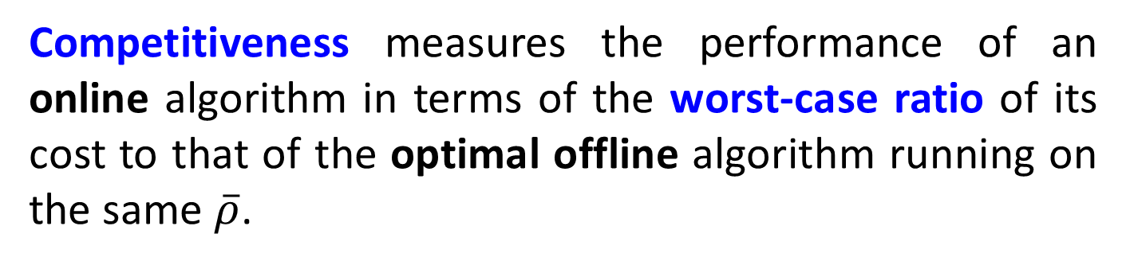
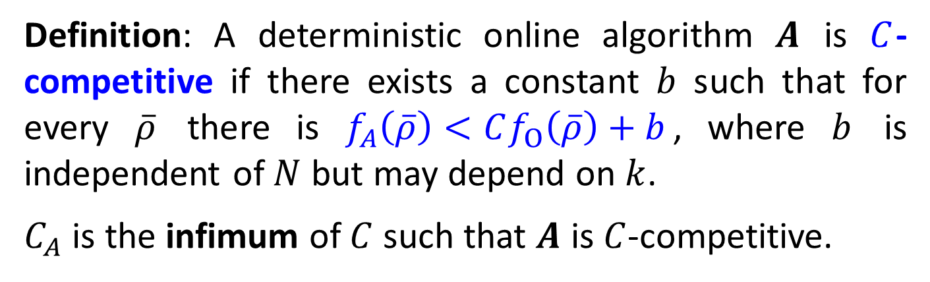
Competitiveness
Competitiveness measures the performance of an online algorithm in terms of the worst-case ratio of its cost to that of the optimal offline algorithm running on the same $\overline{ρ}$.
Definition: A deterministic online algorithm $A$ is $C$-competitive if there exists a constant $b$ such that for every $\overline{ρ}$ there is $f_{A}\left(\overline{ρ}\right)<Cf_{O}\left(\overline{ρ}\right)+b$, where $b$ is independent of $N$ but may depend on $k$.
$C_{A}$ is the infimum of $C$ such that $A$ is $C$-competitive.
Exercise: Show that both $C_{LRU}≥k$ and $C_{FIFO}≥k$ .

Slide 7
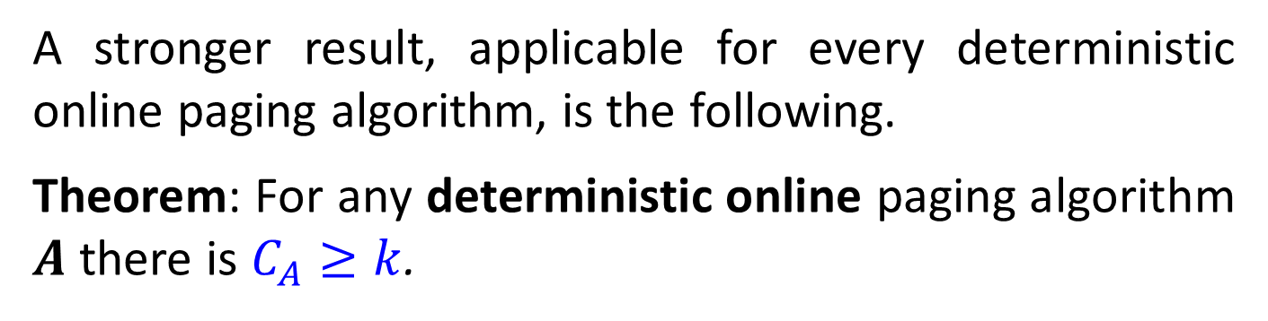
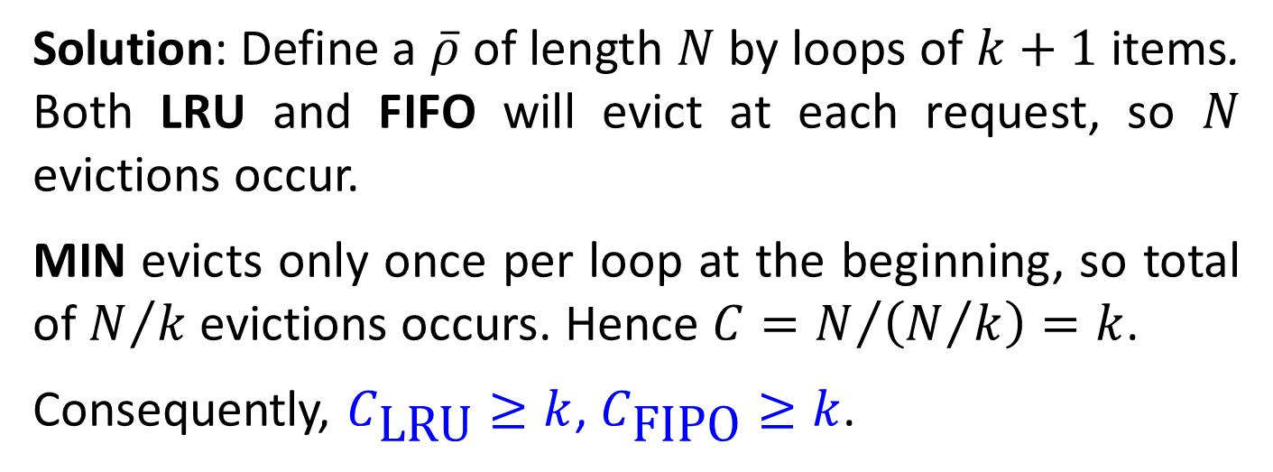
Solution: Define a $\overline{ρ}$ of length $N$ by loops of $k+1$ items. Both LRU and FIFO will evict at each request, so $N$ evictions occur.
MIN evicts only once per loop at the beginning, so total of $N/k$ evictions occurs. Hence $C=N/{\left(N/k\right)}=k$.
Consequently, $C_{\text{LRU}}≥k$, $C_{\text{FIPO}}≥k$.
A stronger result, applicable for every deterministic online paging algorithm, is the following.
Theorem: For any deterministic online paging algorithm $A$ there is $C_{A}≥k$.

Slide 8
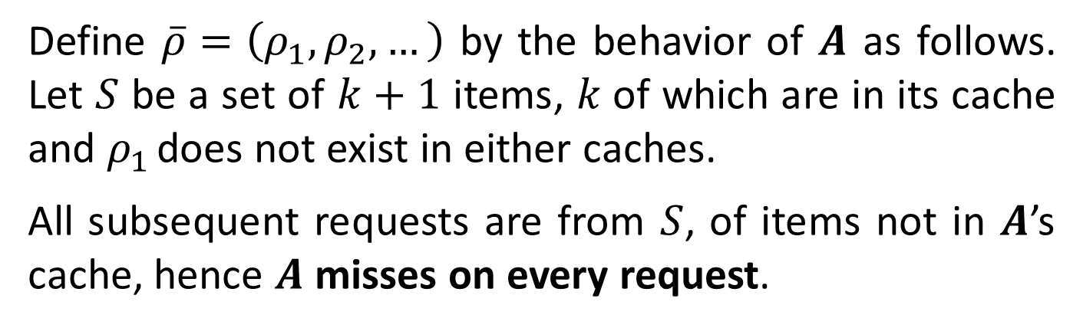
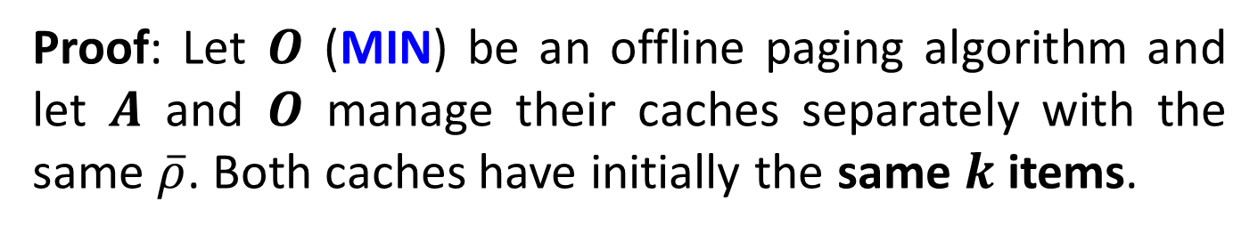
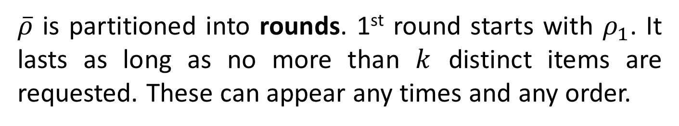
Proof: Let $O$ (MIN) be an offline paging algorithm and let $A$ and $O$ manage their caches separately with the same $\overline{ρ}$. Both caches have initially the same $k$ items.
Define $\overline{ρ}=\left(ρ_{1},ρ_{2},…\right)$ by the behavior of $A$ as follows. Let $S$ be a set of $k+1$ items, $k$of which are in its cache and $ρ_{1}$ does not exist in either caches.
All subsequent requests are from $S$, of items not in $A$’s cache, hence $A$ misses on every request.
$\overline{ρ}$ is partitioned into rounds. 1st round starts with $ρ_{1}$. It lasts as long as no more than $k$ distinct items are requested. These can appear any times and any order.

Slide 9
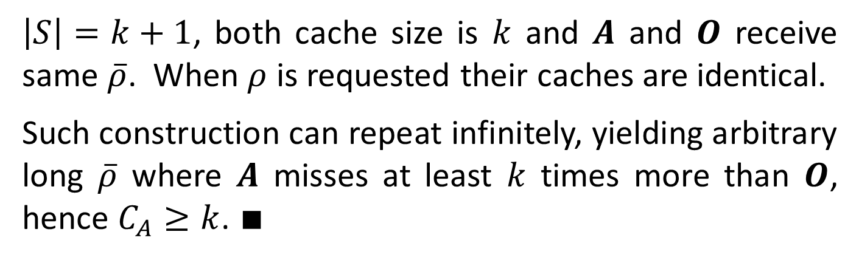
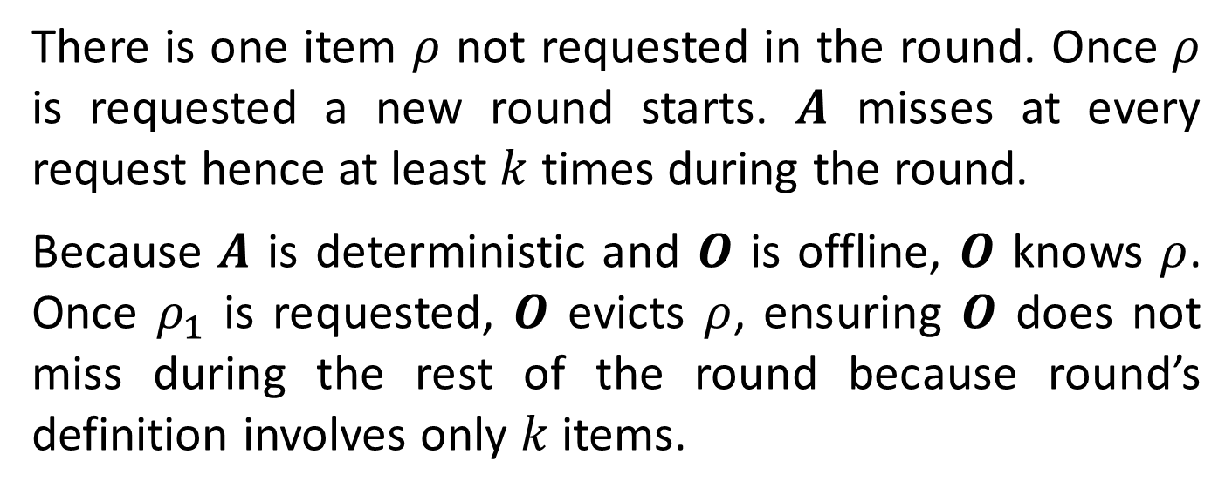
There is one item $ρ$ not requested in the round. Once $ρ$ is requested a new round starts. $A$ misses at every request hence at least $k$ times during the round.
Because $A$ is deterministic and $O$ is offline, $O$ knows $ρ$. Once $ρ_{1}$ is requested, $O$ evicts $ρ$, ensuring $O$ does not miss during the rest of the round because round’s definition involves only $k$ items.
$\left|S\right|=k+1$, both cache size is $k$ and $A$ and $O$ receive same $\overline{ρ}$. When $ρ$ is requested their caches are identical.
Such construction can repeat infinitely, yielding arbitrary long $\overline{ρ}$ where $A$ misses at least $k$ times more than $O$, hence $C_{A}≥k$. $∎$

Slide 10
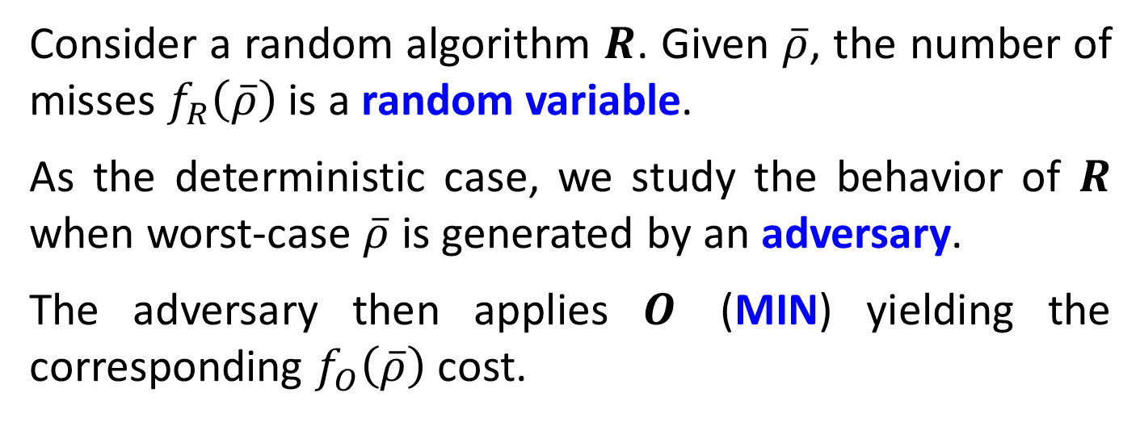
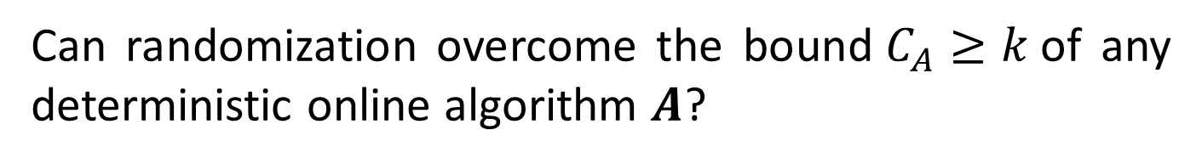
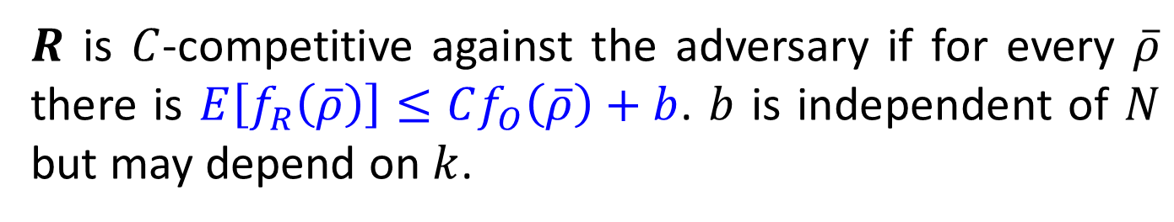
Random Eviction
Can randomization overcome the bound$C_{A}≥k$of any deterministic online algorithm $A$?
Consider a random algorithm $R$. Given $\overline{ρ}$, the number of misses $f_{R}\left(\overline{ρ}\right)$ is a random variable.
As the deterministic case, we study the behavior of $R$ when worst-case $\overline{ρ}$ is generated by an adversary.
The adversary then applies $O$ (MIN) yielding the corresponding $f_{O}\left(\overline{ρ}\right)$ cost.
$R$ is $C$-competitive against the adversary if for every $\overline{ρ}$ there is $E\left[f_{R}\left(\overline{ρ}\right)\right]≤Cf_{O}\left(\overline{ρ}\right)+b$. $b$ is independent of $N$ but may depend on $k$.

Slide 11
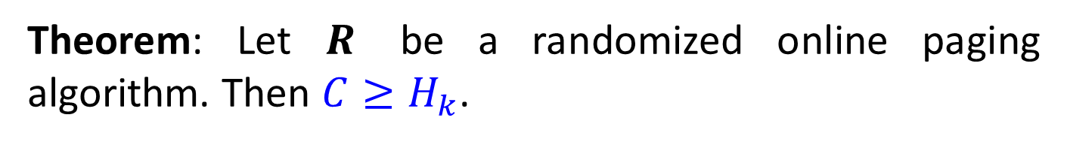
$\sum_{j=1}^{k}{\left(\frac{1}{j}\right)}≜H_{k}$ is called the Harmonic Number $H_{k}$.
Here is a negative result for any randomized online alg.
Theorem: Let $R$ be a randomized online paging algorithm. Then $C≥H_{k}$.
The good news are that there is a randomized online paging alg. called Marker achieving the lower bound.
Marker emulates the best aspects of deterministic LRU, but uses randomization to avoid worst-case situations.
The Marker proceeds in a series of rounds.

Slide 12
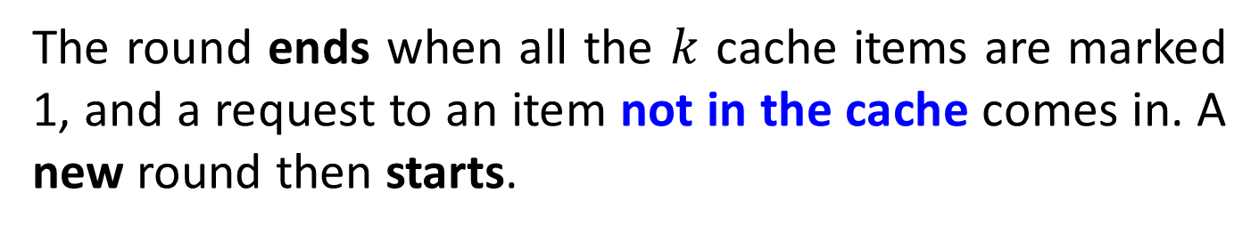
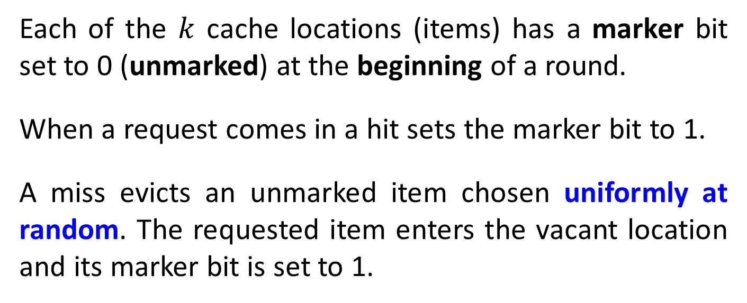
Each of the $k$ cache locations (items) has a marker bit set to 0 (unmarked) at the beginning of a round.
When a request comes in a hit sets the marker bit to 1.
A miss evicts an unmarked item chosen uniformly at random. The requested item enters the vacant location and its marker bit is set to 1.
The round ends when all the $k$ cache items are marked 1, and a request to an item not in the cache comes in. A new round then starts.

Slide 13
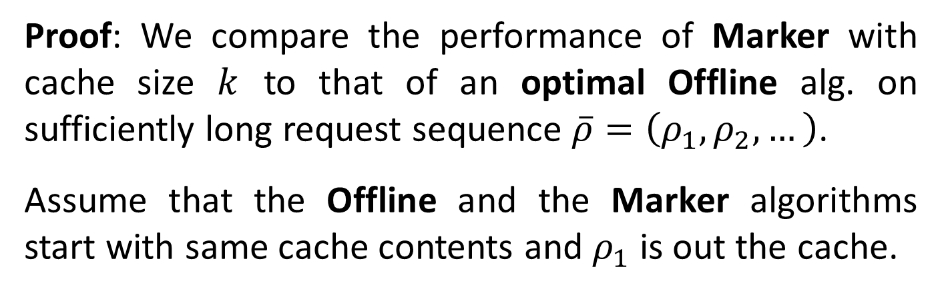
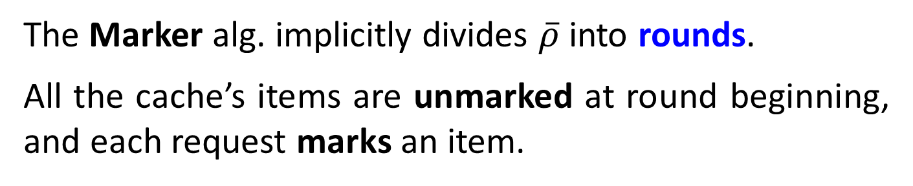
Theorem: The Marker algorithm is $\left(2H_{k}\right)$-competitive.
Proof: We compare the performance of Marker with cache size $k$ to that of an optimal Offline alg. on sufficiently long request sequence $\overline{ρ}=\left(ρ_{1},ρ_{2},…\right)$.
Assume that the Offline and the Marker algorithms start with same cache contents and $ρ_{1}$ is out the cache.
The Marker alg. implicitly divides $\overline{ρ}$ into rounds.
All the cache’s items are unmarked at round beginning, and each request marks an item.

Slide 14
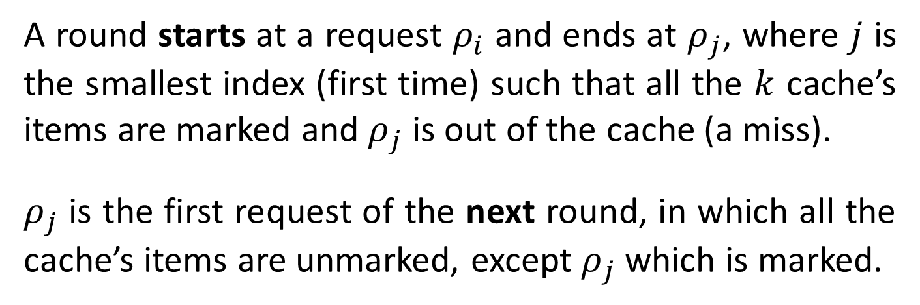
A round starts at a request $ρ_{i}$ and ends at $ρ_{j}$, where $j$ is the smallest index (first time) such that all the $k$ cache’s items are marked and $ρ_{j}$ is out of the cache (a miss).
$ρ_{j}$ is the first request of the next round, in which all the cache’s items are unmarked, except $ρ_{j}$ which is marked.
Consider the requests of any round.
An item in the Marker’s cache is called stale if it is unmarked but was marked in the previous round (hence in the cache at the beginning of the present round).

Slide 15
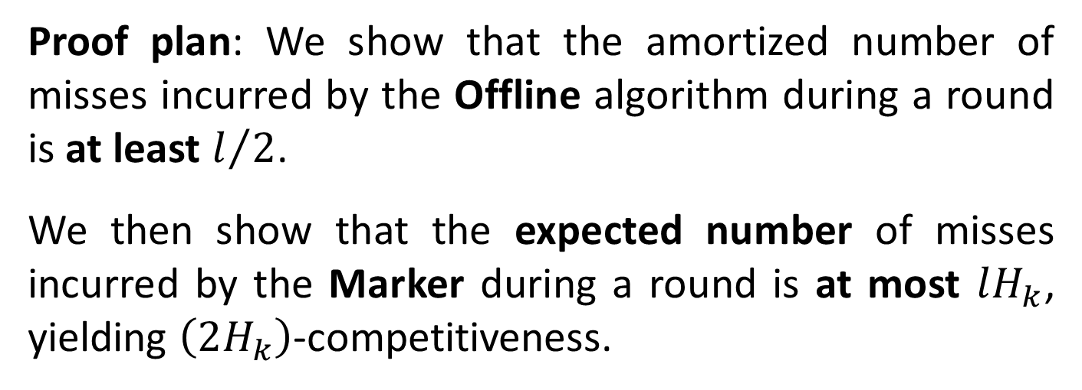

An item is called clean if it is neither stale nor marked (reside outside the cache at round’s beginning).
Let $l$ be the number of clean item requests in a round. They were by definition missed by Marker.
Proof plan: We show that the amortized number of misses incurred by the Offline algorithm during a round is at least $l/2$.
We then show that the expected number of misses incurred by the Marker during a round is at most $lH_{k}$, yielding $\left(2H_{k}\right)$-competitiveness.

Slide 16
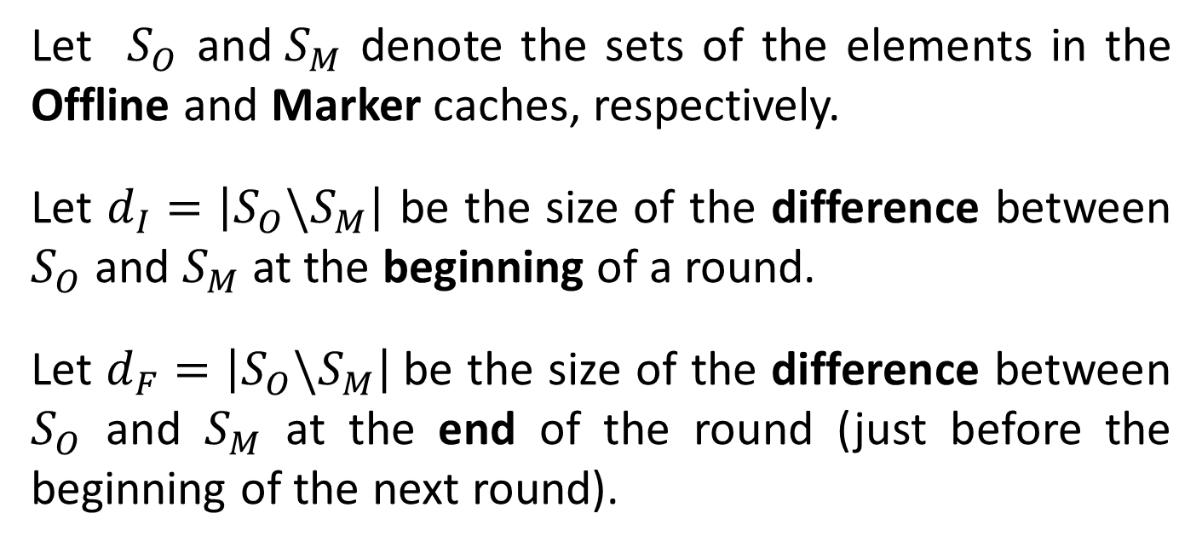
How many misses ${ M}_{O}$the Offline has during a round?
Let $S_{O}$ and${ S}_{M}$ denote the sets of the elements in the Offline and Marker caches, respectively.
Let $d_{I}=\left|S_{O}\backslash S_{M}\right|$ be the size of the difference between $S_{O}$ and $S_{M}$ at the beginning of a round.
Let $d_{F}=\left|S_{O}\backslash S_{M}\right|$be the size of the difference between $S_{O}$ and $S_{M}$ at the end of the round (just before the beginning of the next round).

Slide 17
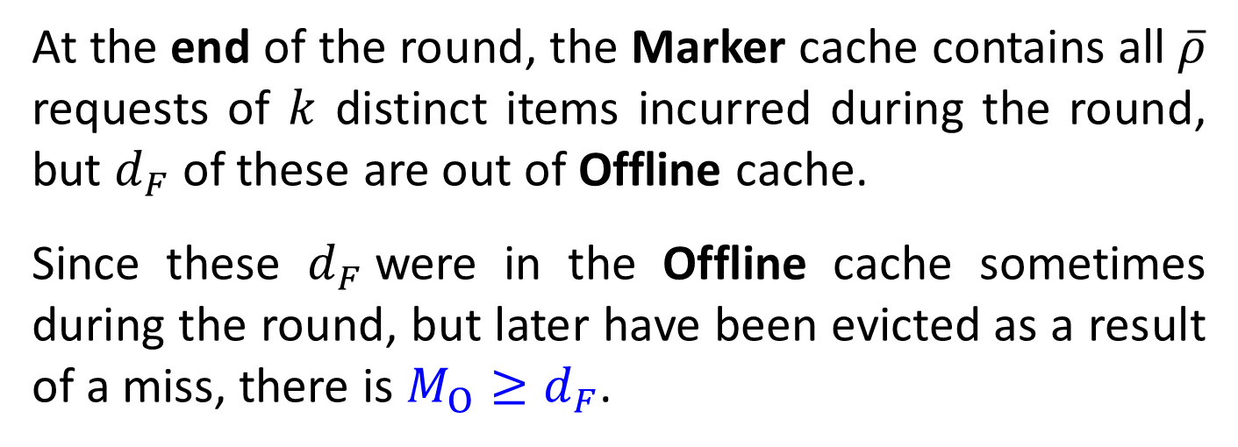
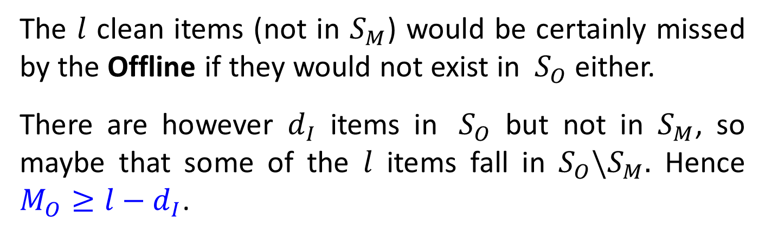
The $l$ clean items (not in $S_{M}$) would be certainly missed by the Offline if they would not exist in ${ S}_{O}$ either.
There are however $d_{I}$ items in ${ S}_{O}$ but not in $S_{M}$, so maybe that some of the $l$ items fall in $S_{O}\backslash S_{M}.$ Hence $M_{O}≥l−d_{I}$.
At the end of the round, the Marker cache contains all $\overline{ρ}$ requests of $k$ distinct items incurred during the round, but $d_{F}$ of these are out of Offline cache.
Since these $d_{F}$were in the Offline cache sometimes during the round, but later have been evicted as a result of a miss, there is $M_{O}≥d_{F}$.

Slide 18
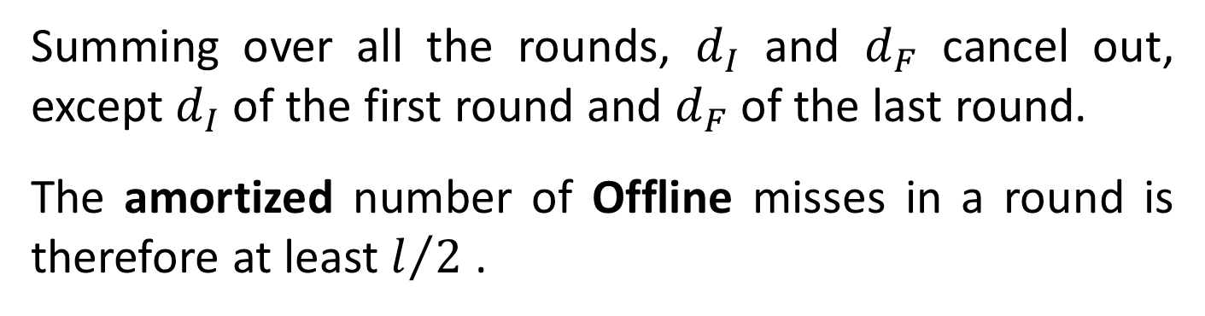
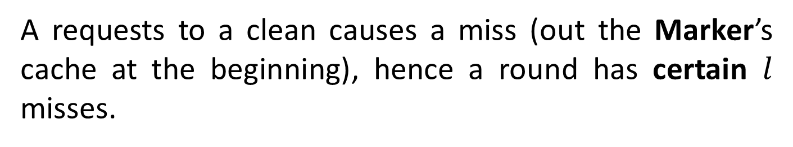
Hence $M_{O}≥max\left\{l−d_{I},d_{F}\right\}≥{\left(l−d_{I}+d_{F}\right)}/2$.
Summing over all the rounds, $d_{I}$ and $d_{F}$ cancel out, except $d_{I}$ of the first round and $d_{F}$ of the last round.
The amortized number of Offline misses in a round is therefore at least $l/2$ .
What is the expected number of Marker alg. misses during a round? We shall derive an upper bound.
A requests to a clean causes a miss (out the Marker’s cache at the beginning), hence a round has certain $l$ misses.

Slide 19
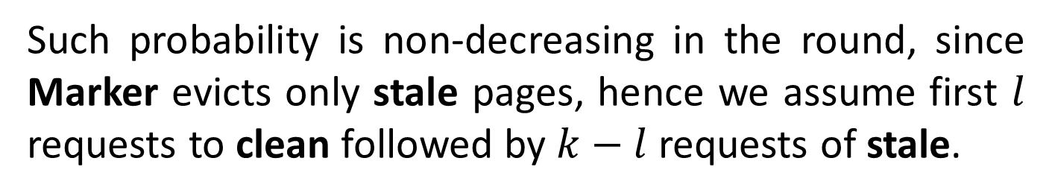
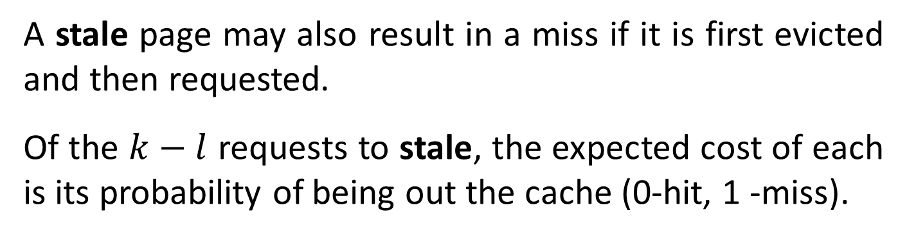
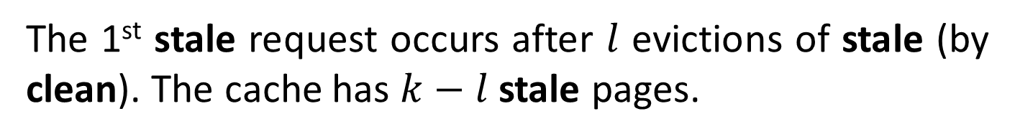
A stale page may also result in a miss if it is first evicted and then requested.
Of the $k−l$ requests to stale, the expected cost of each is its probability of being out the cache (0-hit, 1 -miss).
Such probability is non-decreasing in the round, since Marker evicts only stale pages, hence we assume first $l$ requests to clean followed by $k−l$ requests of stale.
The 1st stale request occurs after $l$ evictions of stale (by clean). The cache has $k−l$ stale pages.

Slide 20
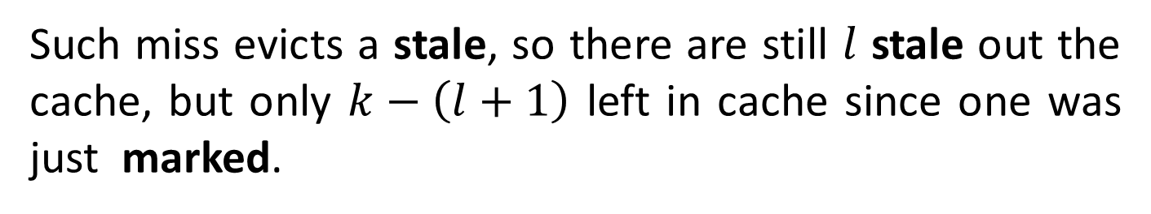
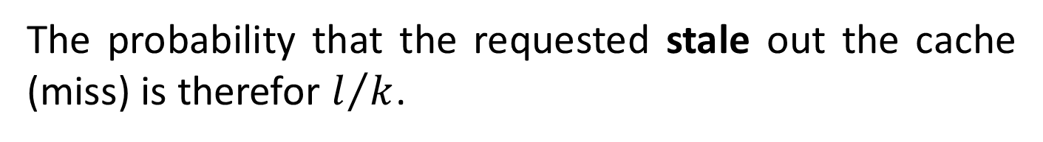
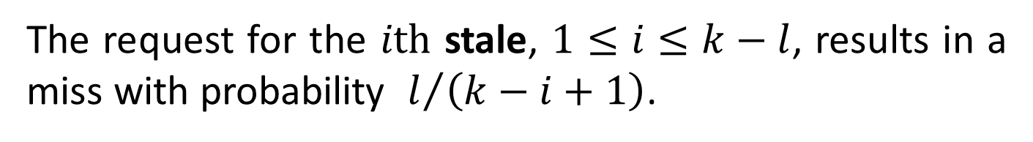
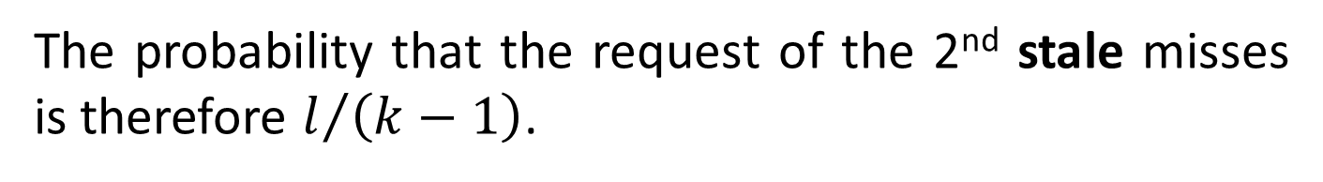
The probability that the requested stale out the cache (miss) is therefor $l/k$.
Such miss evicts a stale, so there are still $l$ stale out the cache, but only $k−\left(l+1\right)$ left in cache since one was just marked.
The probability that the request of the 2nd stale misses is therefore $l/{\left(k−1\right)}$.
The request for the $ith$ stale, $1≤i≤k−l$, results in a miss with probability $l/{\left(k−i+1\right)}$.

Slide 21
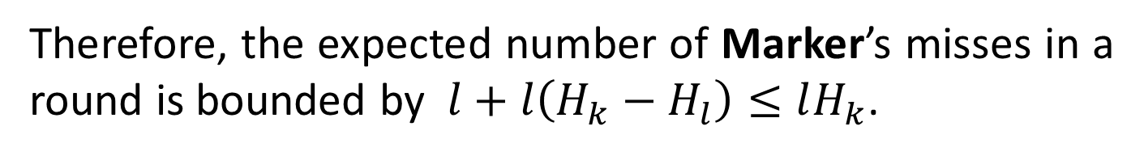
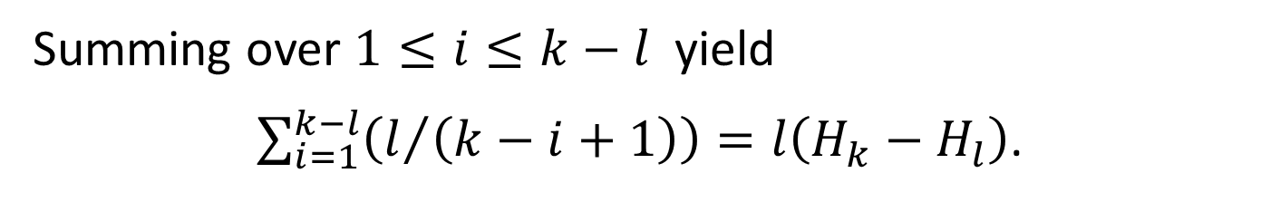
Summing over $1≤i≤k−l$ yield
$\sum_{i=1}^{k−l}{\left(l/{\left(k−i+1\right)}\right)=l\left(H_{k}−H_{l}\right)}$.
Therefore, the expected number of Marker’s misses in a round is bounded by $l+l\left(H_{k}−H_{l}\right)≤lH_{k}$.
Hence $\frac{Marker cost upper bound }{Offline cost lower bound}≤\frac{lH_{k}}{l/2}=2H_{k}$. $∎$

