Slide 1

Multi Processing
prepared and instructed by
Shmuel Wimer
Eng. Faculty, Bar-Ilan University

Slide 2
Introduction
Since mid 2000s uniprocessor performance increase slows down:
  diminishing returns in exploiting ILP
  growing concern over power
  diminishing performance improvement of transistors
Since 1990s designers sought a way to build servers and supercomputers achieving higher performance than a single microprocessor.
A new era in computer architecture, where multiprocessors play a major role.

Slide 3
Taxonomy
Flynn [1966] proposed four categories:
1. Single Instruction stream, Single Data stream (SISD)—Ordinary uniprocessor.
2. Single Instruction stream, Multiple Data streams (SIMD)—Same instruction executed by multiple processors using different data streams.
Each processor has its own data memory, but there is a single instruction memory and control processor, which fetches and dispatches instructions.
Popular in multimedia, graphics, vector operations.

Slide 4
3. Multiple Instruction streams, Single Data stream (MISD)—Not practical, no commercial.
4. Multiple Instruction streams, Multiple Data streams (MIMD)—Each processor fetches its own instructions and operates on its own data.
Exploits thread-level parallelism , since multiple threads operate in parallel.
Thread-level parallelism is more flexible than data-level parallelism and thus more generally applicable.

Slide 5
MIMD is the most popular. The increasing silicon capacity enables placing multiple processors on a single die, called multicore.
Multicore share L2, L3 cache or memory and I/O buses.
2000’s processors, as IBM Power5, Sun T1, and Intel Pentium D and Xeon-MP, are multicore.
Multicore which relies on replication is advantageous over wide superscalar.
Each processor is executing its own instruction stream.

Slide 6
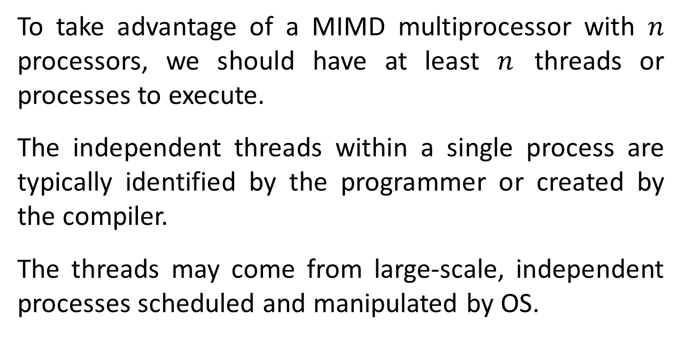
To take advantage of a MIMD multiprocessor with $n$ processors, we should have at least $n$ threads or processes to execute.
The independent threads within a single process are typically identified by the programmer or created by the compiler.
The threads may come from large-scale, independent processes scheduled and manipulated by OS.

Slide 7
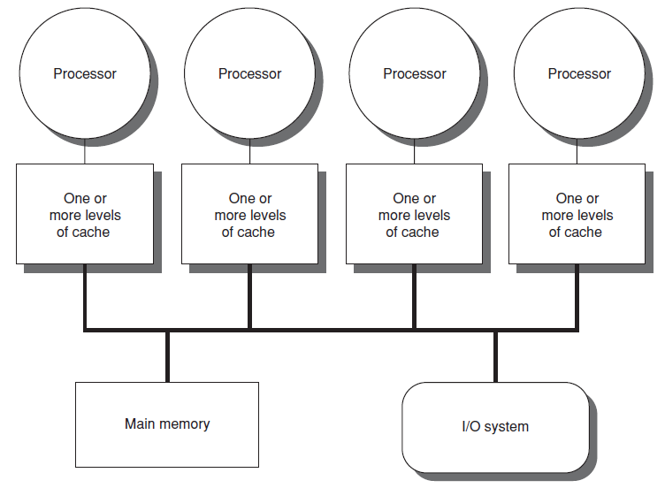
Centralized Shared-Memory

Slide 8
With large caches, a single memory can satisfy the memory demands of a small number of processors.
By using appropriate network it can be scaled to a few dozen processors.
Because the main memory is symmetric to all processors, these are called Symmetric (shared-memory) Multiprocessors (SMPs).
Due to the uniform access time from any processor, it is sometimes called Uniform Memory Access (UMA).
Another group consists of multiprocessors with physically distributed memory.

Slide 9
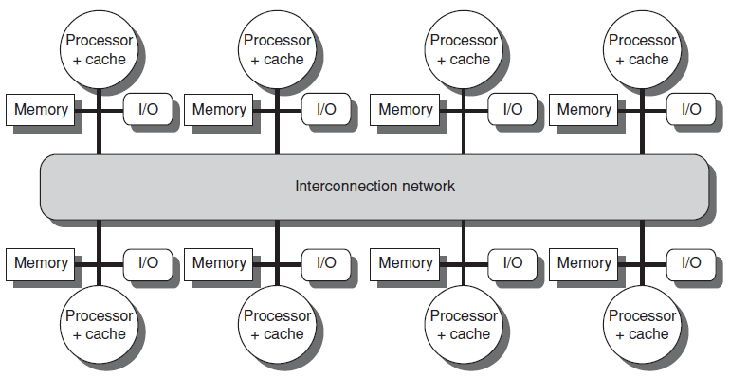
Distributed Memory
To support many processors, memory is distributed among the processors rather than centralized.

Slide 10
Otherwise the memory system would not be able to support the bandwidth demands without incurring excessively long access latency.
The larger number of processors also raises the need for a high-bandwidth interconnect.
Distributed memory is a cost-effective way to scale the memory bandwidth if most of the accesses are to the local memory in the node.
A disadvantage is that communicating data between processors becomes complex, requiring more effort in the SW.

Slide 11
Communication in Distributed Memory
In Distributed Shared-Memory (DSM) architectures, communication occurs through a shared address space, as in a symmetric shared-memory.
The physically separate memories are addressed as one logical address space, so memory reference can be made by any processor to any memory location.
Alternatively, the address space can consist of multiple, logically disjoint, private address spaces, which cannot be addressed by a remote processor.

Slide 12
The same physical address in different processors refers to different locations in different memories.
For a multiprocessor with a shared address space, the address space is used to communicate data implicitly via load and store operations.
Multiprocessor with multiple address spaces communicates data by explicitly passing messages among the processors, called message-passing multiprocessors.
Amdahl’s Law makes parallel processing challenging. A hurdle is the limited parallelism in programs.

Slide 13
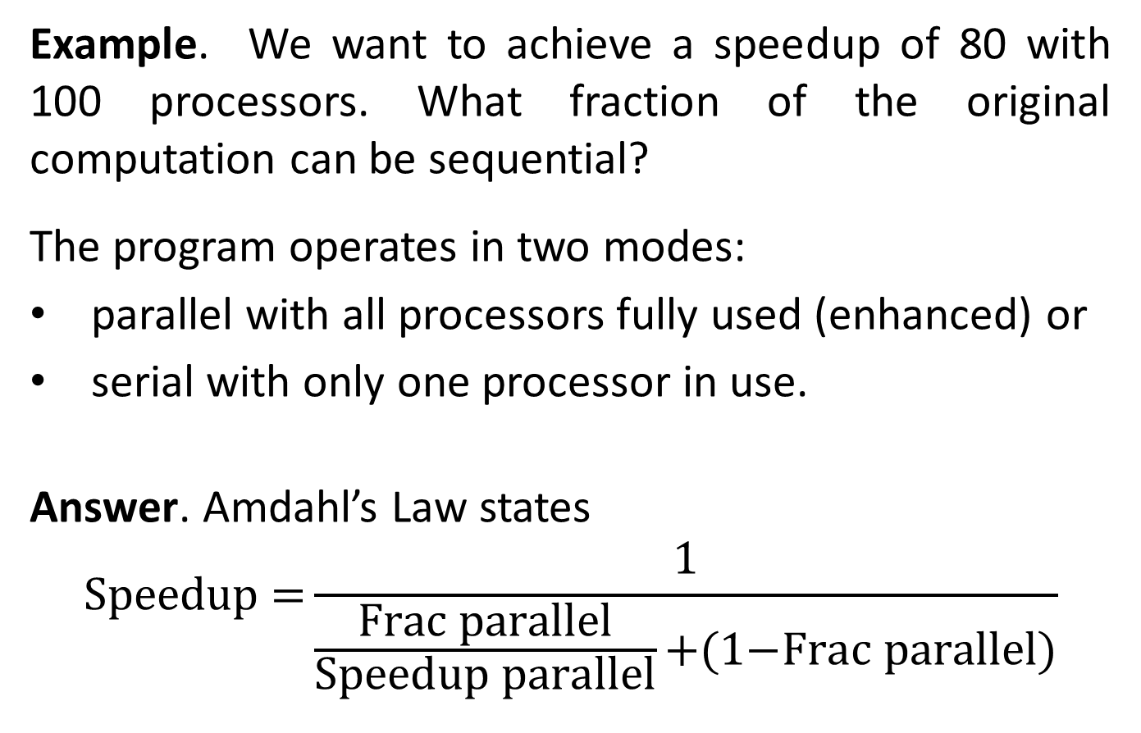
Example. We want to achieve a speedup of 80 with 100 processors. What fraction of the original computation can be sequential?
The program operates in two modes:
parallel with all processors fully used (enhanced) or
serial with only one processor in use.
Answer. Amdahl’s Law states
$$\text{Speedu}\text{p}\text{ =}\frac{\text{1}}{\frac{\text{Frac} \text{parallel}}{\text{Speedup} \text{parallel}}\text{+(}\text{1}\text{−}\text{Frac} \text{parallel}\text{)}}$$

Slide 14
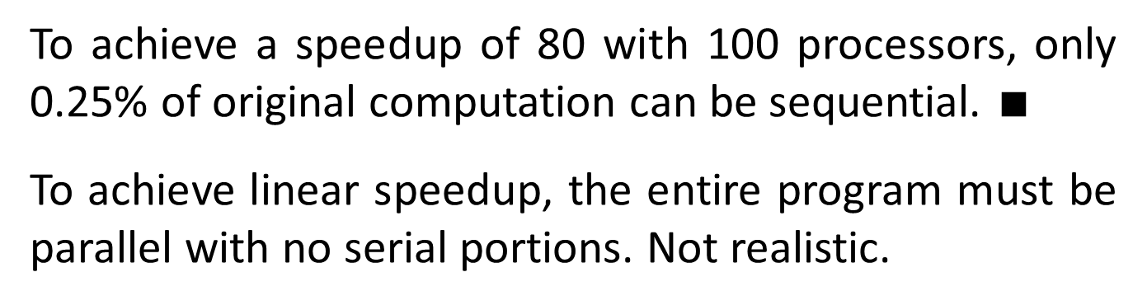
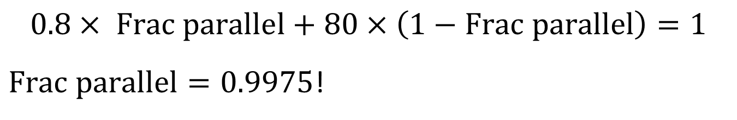
$$0.8× Frac parallel+80×\left(1−Frac parallel\right)=1$$
$Frac parallel=0.9975$!
To achieve a speedup of 80 with 100 processors, only 0.25% of original computation can be sequential. $∎$
To achieve linear speedup, the entire program must be parallel with no serial portions. Not realistic.

Slide 15
A second hurdle arises from the relatively high cost of communications, from 50 to over 1000 clock cycles.
It depends on the communication mechanism, the type of interconnection network, and the scale of the multiprocessor.
Symmetric shared-memory machines support the caching of both shared and private data.
Private data are used by a single processor.

Slide 16
shared data are used by multiple processors, providing communication among the processors through reads and writes of the shared data.
When a private item is cached, since no other processor uses the data, the program behavior is identical to uniprocessor.
When shared data are cached, the shared value may be replicated in multiple caches.

Slide 17
Advantages:
Reduction in access latency
Reduction in required memory bandwidth
Reduction in contention that exists for shared data items read by multiple processors simultaneously.
New problem: cache coherence.
The view of memory held by two different processors is through their individual caches, which could end up seeing two different values.

Slide 18
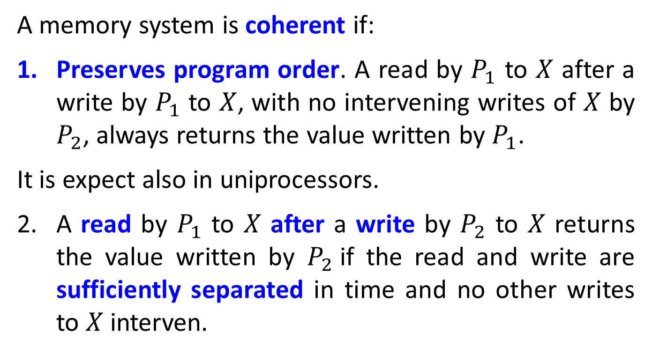
Cache Coherence
A memory system is coherent if:
Preserves program order. A read by $P_{1}$ to $X$ after a write by $P_{1}$ to $X$, with no intervening writes of $X$ by $P_{2}$, always returns the value written by $P_{1}$.
It is expect also in uniprocessors.
A read by $P_{1}$ to $X$ after a write by $P_{2}$ to $X$ returns the value written by $P_{2}$if the read and write are sufficiently separated in time and no other writes to $X$ interven.

Slide 19
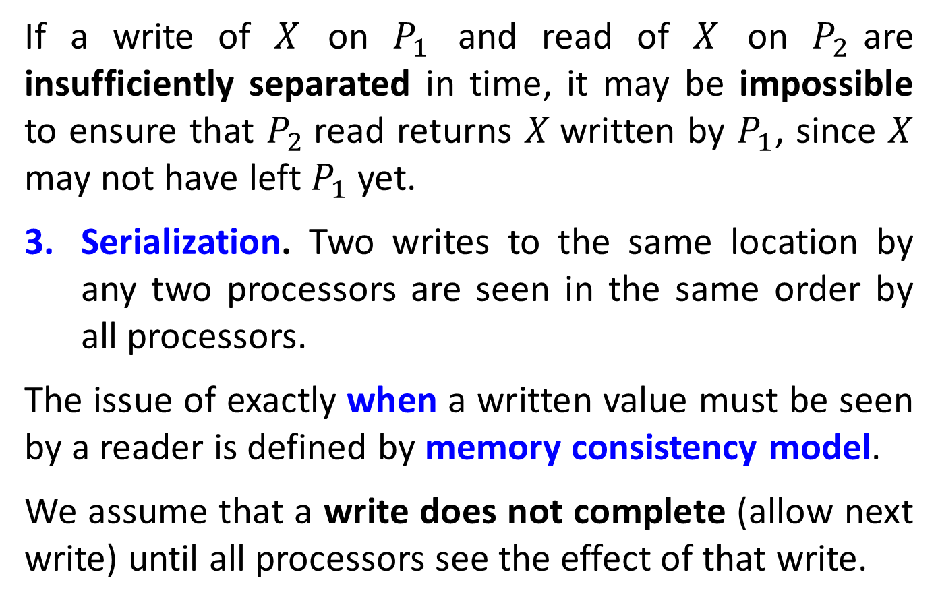
If a write of $X$ on $P_{1}$ and read of $X$ on $P_{2}$are insufficiently separated in time, it may be impossible to ensure that $P_{2}$read returns $X$written by $P_{1}$, since $X$ may not have left $P_{1}$yet.
Serialization. Two writes to the same location by any two processors are seen in the same order by all processors.
The issue of exactly when a written value must be seen by a reader is defined by memory consistency model.
We assume that a write does not complete (allow next write) until all processors see the effect of that write.

Slide 20
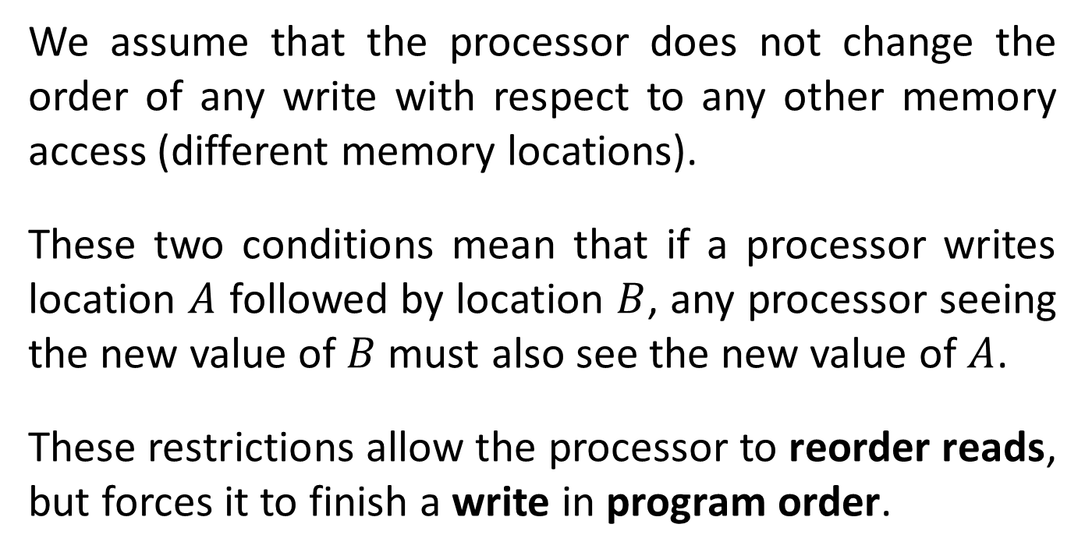
We assume that the processor does not change the order of any write with respect to any other memory access (different memory locations).
These two conditions mean that if a processor writes location $A$ followed by location $B$, any processor seeing the new value of $B$ must also see the new value of $A$.
These restrictions allow the processor to reorder reads, but forces it to finish a write in program order.

Slide 21
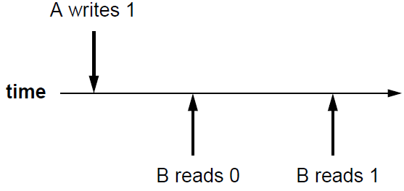

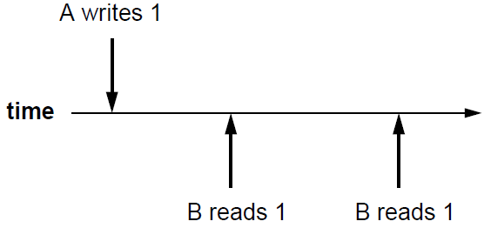
Memory Consistency
strict consistency x
sequential consistency v
strict consistency v
sequential consistency v

Slide 22
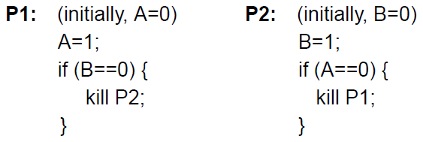
Consistency Implications
Sequential consistency allows 0 or 1 processes to be killed, but not both.
P1 will only try to kill P2 if P1’s read to B occurs before P2’s write to B.
The in-order execution of memory events implies that P1’s write to A must come before P2’s read of A.

Slide 23
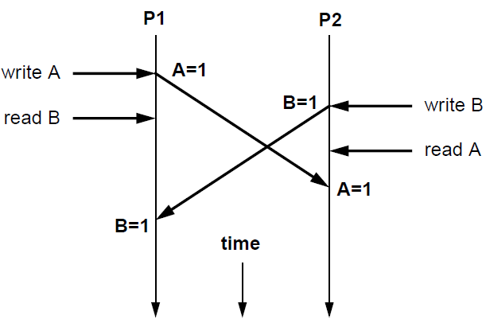


P1 and P2 try to kill each other, disallowed by sequential model.
$$∆t$$
$$∆t$$

Slide 24
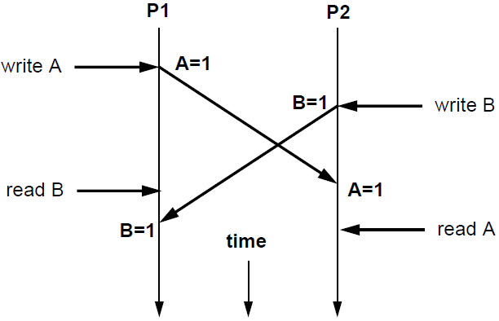


Sequential consistency must delay all memory operations following a write until the write is observed by all other clients.
$$∆t$$
$$∆t$$

Slide 25
Can also be solved by speculation.
Execute memory instructions subsequent to write, but hold commitment long enough after write to ensure that all processor cores observe the write.
If the write observed conflicts with an early read, that instruction’s commitment must be halted, its results must be discarded, and the instruction must be re executed in light of the new data.

Slide 26
Coherence Enforcement
A program running on multiple processors will normally have copies of the same data in several caches.
The protocols to maintain coherence for multiple processors are called cache coherence protocols.
Cache coherence protocol implementation must track the state of any sharing of a data block.
Two classes of protocols. A directory based keeps the sharing status of a block of physical memory in one location, called the directory (not discussed).

Slide 27
Snooping protocols have no centralized state.
Every cache having a copy of a block of physical memory has a copy of the block’s sharing status (status bits).
All caches are accessible via a bus or switch, and all cache controllers snoop (monitor) to determine whether or not they have a copy of a block that is requested for access.
Write invalidate protocol is a method ensuring that a processor has exclusive access to a data item before it writes that item, invalidating other copies on a write.

Slide 28
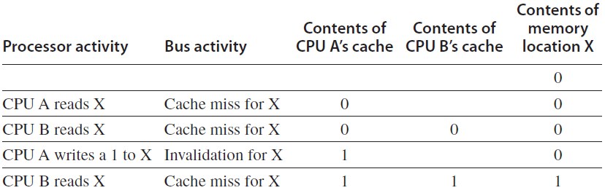
Exclusive access ensures that no other readable or writable copies of an item exist when the write occurs. All other cached copies of the item are invalidated.
Consider a write followed by a read by another processor.

Slide 29
If two processors do attempt to write the same data simultaneously, one of them wins the race, invalidating the other processor’s copy.
To complete its write the other processor must obtain a new copy of the data, now containing the new value. This protocol enforces write serialization.
The alternative to an invalidate protocol is to update all the cached copies of a data item when that item is written. This type of protocol is called a write update or write broadcast protocol.

Slide 30
Write Invalidate Implementation
For invalidation, the writing processor acquires bus access and broadcasts the address to be invalidated. All processors continuously snoop on the bus, watching the addresses.
The processors check whether the address on the bus is in their cache. If so, the corresponding data in the cache are invalidated.
If two processors attempt to write shared blocks at the same time, their attempts to broadcast invalidation are serialized when they arbitrate for the bus.

Slide 31
We also need to locate a data item when a cache miss occurs. In a write-through cache, it is easy to find the recent value in the memory.
The problem of finding the most recent data value in write-back cache is harder, since most recent data item is in a cache. Write-back caches use snooping both for cache misses and for writes.
Each processor snoops every address placed on the bus. If it finds to have a dirty copy of the requested block, it provides that block in response to the read request and aborts the memory access.

Slide 32
Snooping Protocol Example
A snooping coherence protocol is implemented by incorporating a finite state controller in each node.
The controller responds to requests from the processor and the bus, changing the state of the selected block and using the bus to access data or to invalidate it.
The protocol has three states: invalid, shared, and modified (MSI) .
The shared state indicates that the block is potentially shared. The modified state indicates that the block has been updated in the cache, implying that it is exclusive.

Slide 33
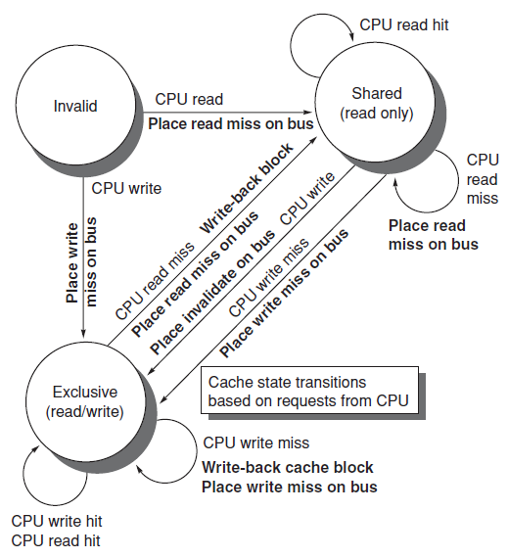
Cache block state transitions for CPU requests

Slide 34
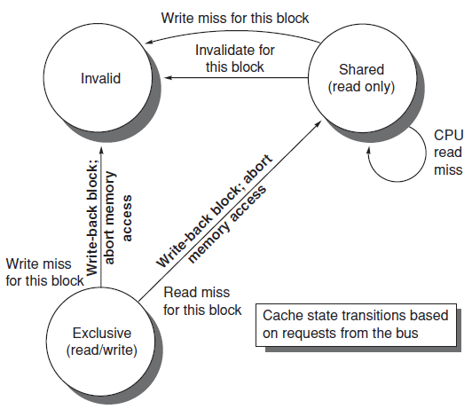
Cache block state transitions for bus requests

Slide 35
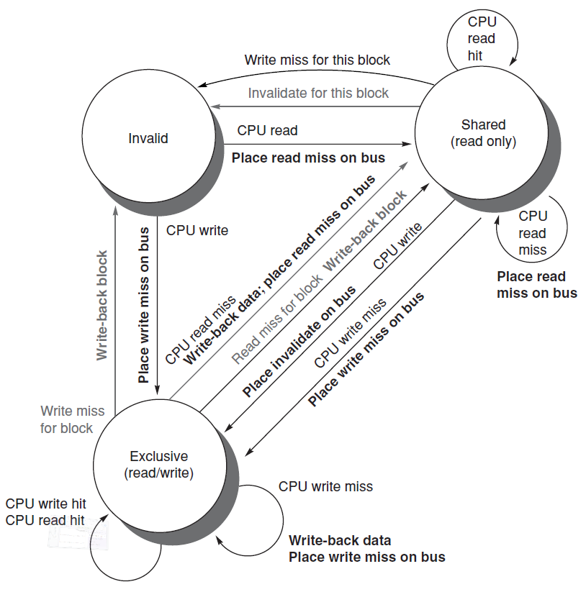
This protocol is for a write-back cache but is easily modified for a write through cache.

Slide 36
The normal cache tags can be used to implement the snooping and the valid bit to implement invalidation.
Read misses, whether generated by an invalidation or by some other event, are also straightforward since they simply rely on the snooping capability.
Writes like to know whether any other copies of the block are cached because otherwise the write need not be placed on the bus in a write-back cache.
Not sending the write on the bus reduces both the time taken by the write and the required bandwidth.

Slide 37
A bit indicating whether the block is shared enables to decide whether a write must generate an invalidate.
The cache generates an invalidation on the bus and marks the block as exclusive.
The processor with the sole copy of a cache block is normally called the owner of the cache block.
Since our snooping cache also sees any misses, it knows when the exclusive cache block has been requested by another processor and the state should be made shared.

Slide 38
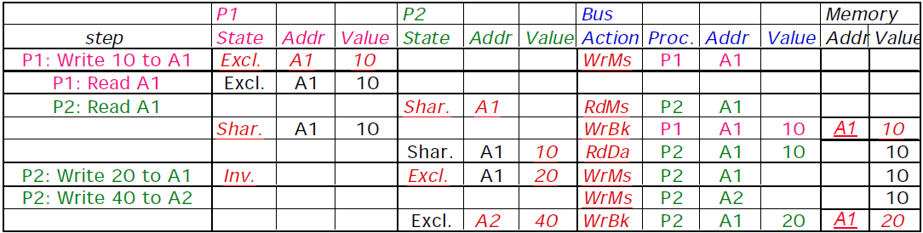
Shared Memory Example
Assumes A1 and A2 map to same cache block

Slide 39
Performance of SMP (Shared Memory)
Misses arising from inter-processor communication, called coherence misses, are broken into two sources.
The first is true sharing misses, arising from data communication through cache coherence mechanism.
In an invalidation-based protocol, the first write by a processor to a shared block causes an invalidation to establish ownership of that block.
Additionally, when another processor attempts to read a modified word in that cache block, a miss occurs and the resultant block is transferred.

Slide 40
The second is false sharing, occurs when a block is invalidated (subsequent reference causes a miss) because some word in the block, other than the read one, is written into (at another processor).
If written and read words are different and the invalidation does not cause a new value to be communicated, but only causes an extra cache miss, then it is a false sharing miss.
In a false sharing miss, the block is shared, but no word in the cache is actually shared. The miss is always true for single word block size.

Slide 41
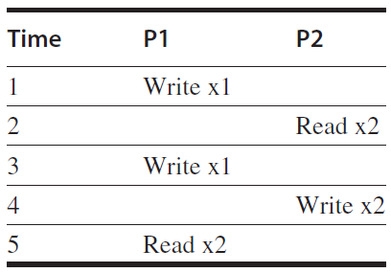
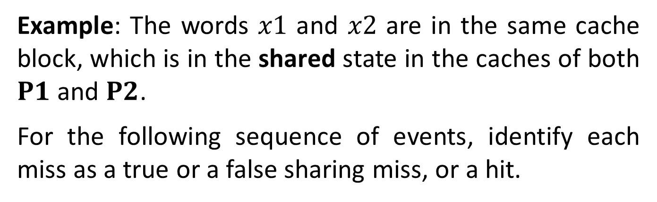
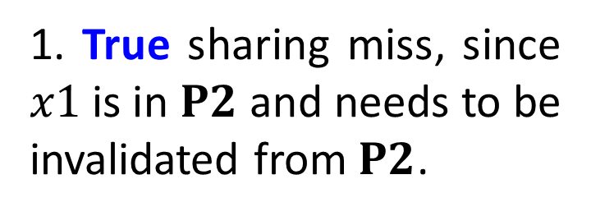
Example: The words $x1$ and $x2$ are in the same cache block, which is in the shared state in the caches of both $P1$ and $P2$.
For the following sequence of events, identify each miss as a true or a false sharing miss, or a hit.
1. True sharing miss, since $x1$ is in $P2$ and needs to be invalidated from $P2$.

Slide 42
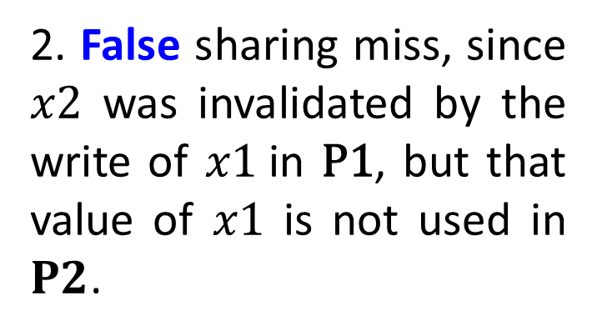
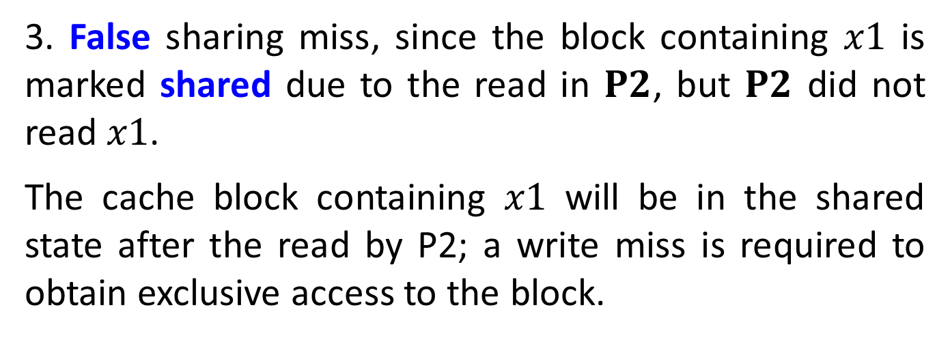
2. False sharing miss, since $x2$ was invalidated by the write of $x1$in $\text{P}\text{1}$, but that value of $x1$ is not used in $P2$.
3. False sharing miss, since the block containing $x1$ is marked shared due to the read in $P2$, but $P2$ did not read $x1$.
The cache block containing $x1$ will be in the shared state after the read by P2; a write miss is required to obtain exclusive access to the block.

Slide 43
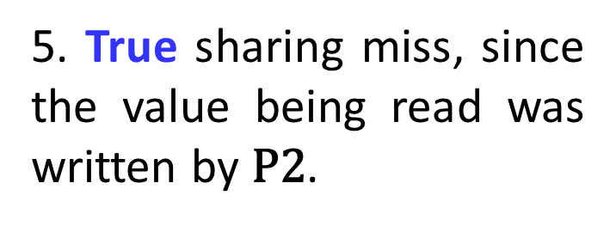
4. False sharing miss for the same reason as step 3.
5. True sharing miss, since the value being read was written by $\text{P}\text{2}$.
The role of coherence misses is more significant for tightly coupled applications that share significant amounts of user data.

Slide 44
The Problem with MSI
A block is in no cache to begin with
Problem: On a read, the block immediately goes to “Shared” state although it may be the only copy to be cached (i.e., no other processor will cache it)
Why is this a problem?
  Suppose the cache that read the block wants to write to it at some point
  It needs to broadcast “invalidate” even though it has the only cached copy!
  If the cache knew it had the only cached copy in the system, it could have written to the block without notifying any other cache → saves unnecessary broadcasts of invalidations

Slide 45
The Solution: MESI
Idea: Add another state indicating that this is the only cached copy and it is clean.
  Exclusive state
Block is placed into the exclusive state if, during BusRd, no other cache had it
  Wired-OR “shared” signal on bus can determine this: snooping caches assert the signal if they also have a copy
Silent transition Exclusive → Modified is possible on write

Slide 46

