Slide 1

Instruction-Level Parallelism dynamic scheduling
prepared and instructed by
Shmuel Wimer
Eng. Faculty, Bar-Ilan University

Slide 2
Dynamic Scheduling
Dynamic Scheduling rearranges instruction execution to reduce the stalls while maintaining data flow and exception behavior.
☺ Enables handling some cases when dependences are unknown at compile time (e.g. memory reference).
☺ Simplifies the compiler.
☺ Allows the processor to tolerate cache misses delays by executing other code while waiting for miss resolution.
☺ Allows code compiled for one pipeline to run efficiently on a different pipeline.
☹ Increases significantly the hardware complexity.

Slide 3
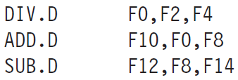
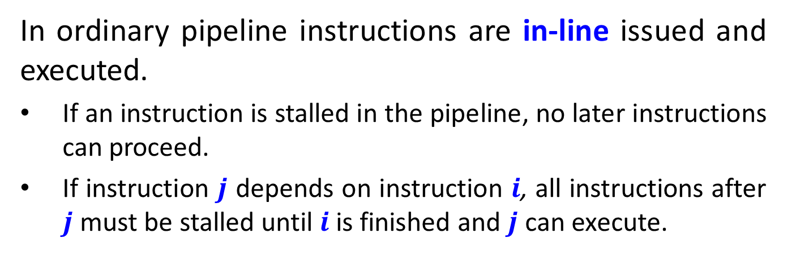
In ordinary pipeline instructions are in-line issued and executed.
If an instruction is stalled in the pipeline, no later instructions can proceed.
If instruction $j$ depends on instruction $i$, all instructions after $j$ must be stalled until $i$ is finished and $j$ can execute.
SUB.D cannot execute because ADD.D dependence on DIV.D causes stall, but is independent of the present pipeline.
To execute SUB.D we separate instruction issue (at ID) into two parts: checking for structural hazards and waiting for the absence of a data hazard.

Slide 4
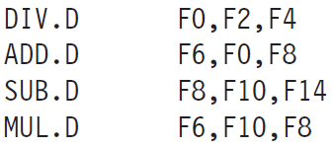
Out-Of-Order Execution
Instructions are still in-order issued, but start execution as soon as their data operands are available.
Such a pipeline does out-of-order (OOO) execution, implying out-of-order completion.
OOO introduces possibilities of WAR and WAW hazards, not existing in in-order pipeline.
ADD.D and SUB.D are anti dependent.
Executing SUB.D before ADD.D (waits for F0) violates the anti dependence, causing a WAR hazard.
???

Slide 5
Likewise, to avoid violating output dependences of F6 by MUL.D, WAW hazards must be handled.
register renaming avoids these hazards.
OOO completion must preserve exception behavior to happen exactly as by in-order.
No instruction generates an exception until the processor knows that the instruction raising the exception will be executed.
OOO splits the ID stage into two stages:
Issue—Decode instructions, check for structural hazards.
Read operands—Wait until no data hazards, then read operands.

Slide 6
An IF stage preceding issue stage fetches either into an instruction register or a pending instructions queue. Instructions are issued from these.
The EX stage follows the read operands stage and may take multiple cycles, depending on the operation.
The pipeline allows simultaneous execution of multiple instructions.
Without it a major advantage of OOO is lost.
Requires multiple functional units.
Instructions are issued in-order, but can enter execution out of order. There are two OOO techniques: scoreboarding and Tomasulo’s algorithm.

Slide 7
Tomasulo’s Dynamic Scheduling
Invented for IBM 360/91 FPU by Robert Tomasulo.
Minimizes RAW hazards by tracking when operands are available.
Minimizes WAR and WAW hazards by register renaming.
We assume the existence of FPU and load-store unit, and use MIPS ISA.
Register renaming eliminates WAR and WAW hazards.
Rename all destination registers, including those with pending read and write for earlier instructions.
OOO writes do not affect instructions depending on earlier value of an operand.

Slide 8
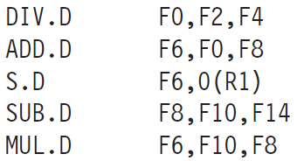
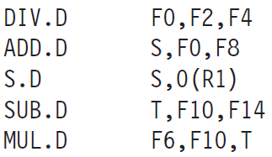
This code includes potential WAW and WAR hazards.
Anti dependence, WAR hazard, and WAW hazard if MUL.D finishes before ADD.D. It is called name dependence.
True data dependencies.
Name dependencies can be eliminated by register renaming. Any subsequent usage of F8 must be replaced by T. Very difficult for the compiler (branches may intervene).

Slide 9
Tomasulo’s algorithm can handle renaming across branches.
Register renaming is provided by Reservation Station (RS), buffering the operands of instructions waiting to issue.
RS fetches and buffers an operand as soon as it is available, eliminating the need to get it from the Register File (RF).
Pending instruction designate the RS that will provide their operands. At issue, pending operands are renamed from RF specifier to RS.
When successive writes to RF (WAW) overlap in execution, only the last one actually updates the RF.

Slide 10
Here can be more RSs than real registers, so it can eliminate hazards that compiler could not.
Unlike the ordinary pipelined processor, where the hazard detection and execution control was centralized, it is now distributed.
The information held at each RS of a functional unit determines when an instruction can start execution at that unit.
RS passes results directly to the functional units where the results are required through Common Data Bus (CDB) rather than going through RF.
Pipeline supporting multiple execution units and issuing multiple instructions per CLK cycle requires more than one CDB.

Slide 11
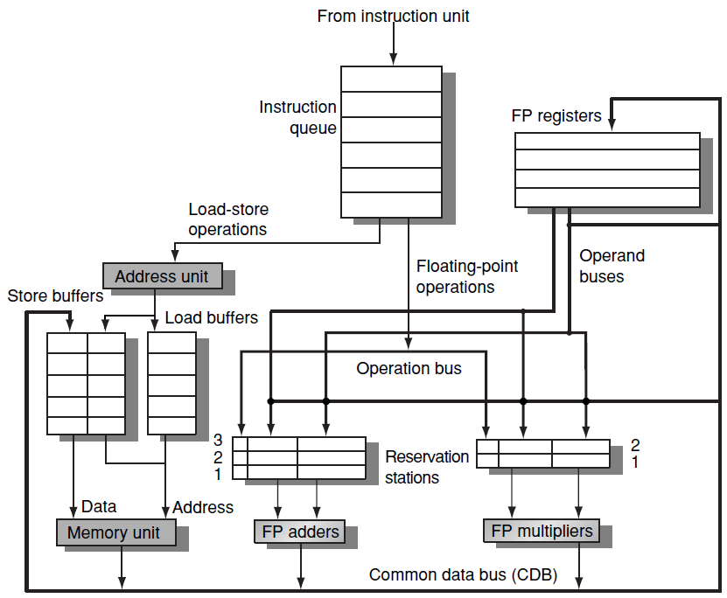
This serves as IF/ID register

Slide 12
Instructions are sent from the instruction unit into a queue from where they issue in FIFO order.
RSs include the operations and the actual operands, together with information for hazard detection and resolution.
Load buffers:
hold the components of the effective address until it is computed,
track outstanding loads waiting on memory, and
hold the results of completed loads, waiting for the CDB.

Slide 13
Store buffers:
hold the components of the effective address until it is computed,
hold the destination addresses of outstanding stores waiting for the data value to store, and
hold the address and data to store until the memory unit is available.
All results of the FPU and load unit are put on the CDB, which goes to the FP registers, to the RSs and to the store buffers.
The adder implements also subtraction and the multiplier implements also division.

Slide 14
The Steps of an Instruction
Issue
Get next instruction from the head of the queue. Instructions are maintained in FIFO and hence issued in-order.
If there is an empty matched RS, issue the instruction to that RS together with the operands if those are currently in RF.
If there is not an empty matched RS, there is a structural hazard. Instruction stalls until RS is freed.

Slide 15
If the operands are not in RF, keep track of the functional unit producing the operands. This steps renames registers, eliminating WAR and WAW hazards.
2. Execute
If an operand is not yet available, monitor CDB for its readiness.
When available, the operand is placed at any RS awaiting it. When all the operands are available the operation is executed.
By delaying operations until all their operands are available RAW hazards are avoided.

Slide 16
Several instructions could become ready on the same CLK cycle.
Independent units can start execution in the same cycle.
If few instructions are ready for the same FPU, choice can be arbitrary.
Load and stores require two-step execution process.
The 1st step computes the effective address when the register is available. The address is placed in the load or store buffer.
Load is executed as soon as the memory unit is available.

Slide 17
Stores wait for the value to be stored before being sent to the memory unit.
Load and stores are maintained in the program order to prevent hazards through memory.
To preserve exception behavior, no instruction is allowed to initiate execution until all branches preceding that instruction in program order have completed.
This guarantees that only instructions that would really be executed raise an exception. If BP is used, the processor must know that the BP is correct before allowing execution of instruction after BP (in program).

Slide 18
If the processor records the exception, it can allow the execution after BP, but raise it only if it enters to write results.
Speculation will provide more complete solution
3. Write Results
When the result is available, put it on the CDB and from there into the RF and any RSs waiting for the result.
Stores are buffered into the store buffer until both the value to be stored and the store address are available.
The result is then written as soon as the memory unit is free.

Slide 19
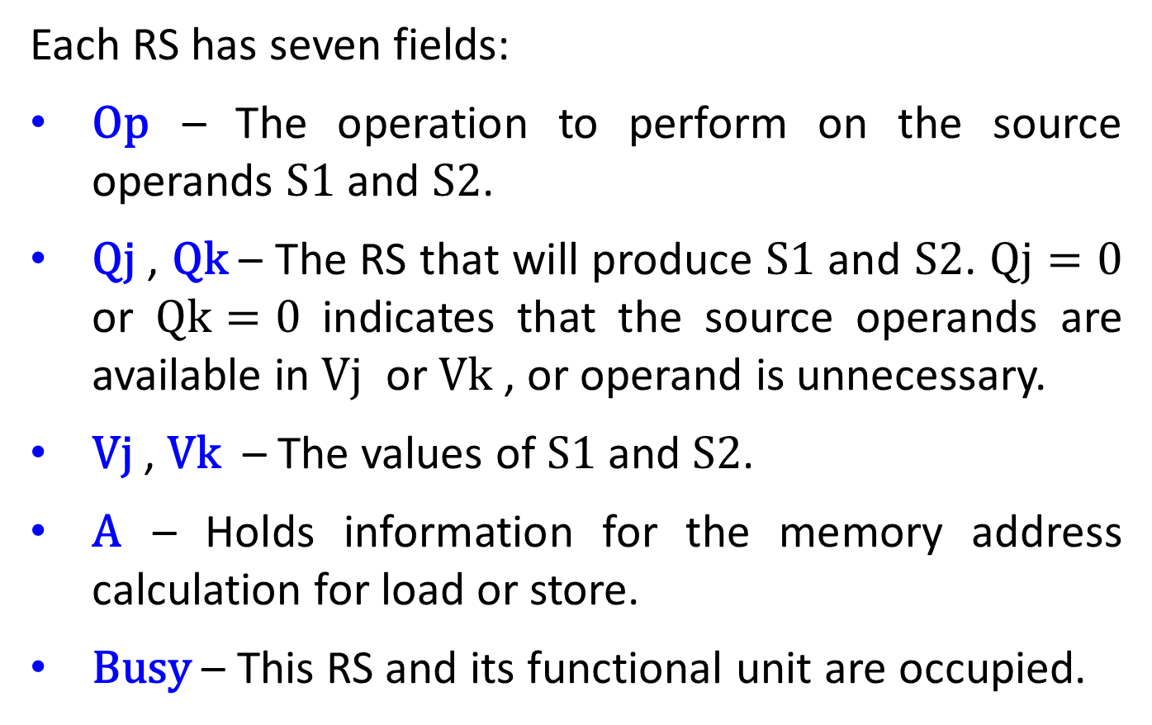
The Reservation Station Data Structure
Each RS has seven fields:
$\text{Op}$ – The operation to perform on the source operands $\text{S}\text{1}$ and $\text{S}\text{2}$.
$\text{Qj}$ , $\text{Qk}$ – The RS that will produce $\text{S}\text{1}$ and $\text{S}\text{2}$. $\text{Qj}=0$ or $\text{Q}\text{k}=0$ indicates that the source operands are available in $\text{V}\text{j}$ or $\text{V}\text{k}$ , or operand is unnecessary.
$\text{V}\text{j}$ , $\text{V}\text{k}$ – The values of $\text{S}\text{1}$ and $\text{S}\text{2}$.
$\text{A}$ – Holds information for the memory address calculation for load or store.
$\text{Busy}$ – This RS and its functional unit are occupied.

Slide 20
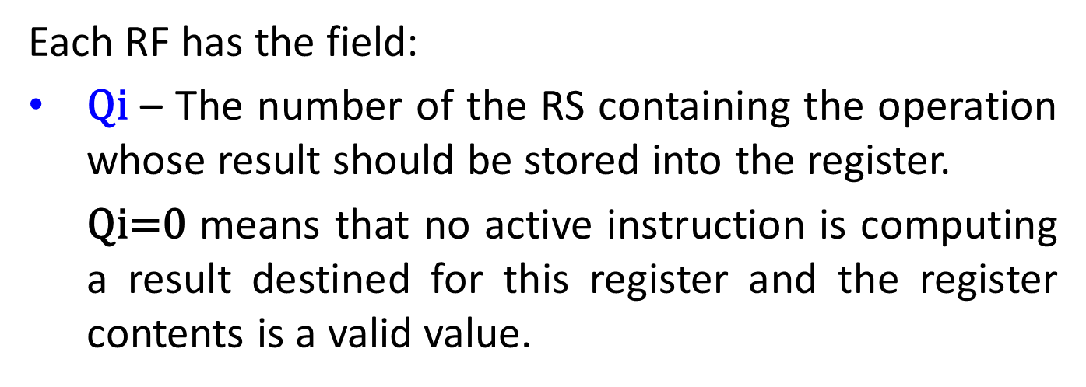
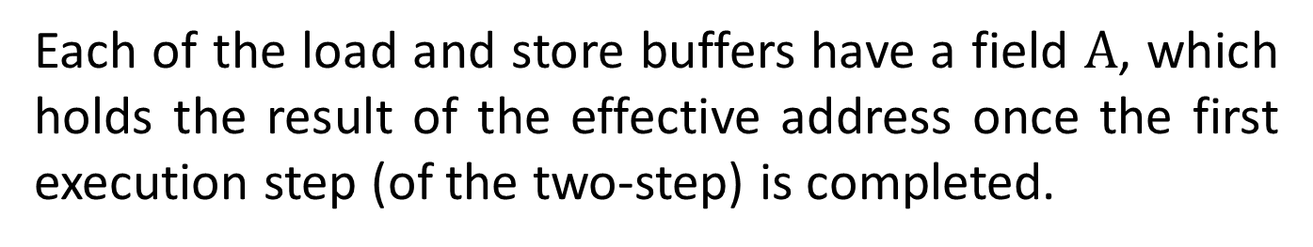
Each RF has the field:
$\text{Qi}$ – The number of the RS containing the operation whose result should be stored into the register.
  $\text{Qi}\text{=}\text{0}$ means that no active instruction is computing a result destined for this register and the register contents is a valid value.
Each of the load and store buffers have a field $\text{A}$, which holds the result of the effective address once the first execution step (of the two-step) is completed.
Tomasulo’s scheme has two major advantages:
the distribution of the hazard detection logic, and
the elimination of stalls for WAW and WAR hazards.

Slide 21
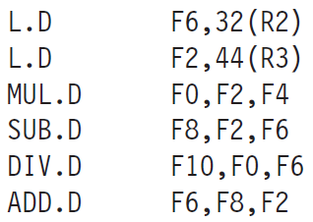
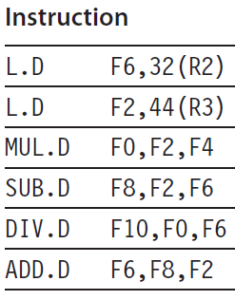

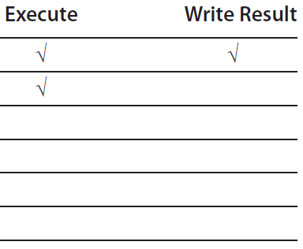
Example: What is the contents of Tomasulo’s data structure when the first load has completed and written its result?
Instruction status
Instruction status is not a part of the hardware

Slide 22
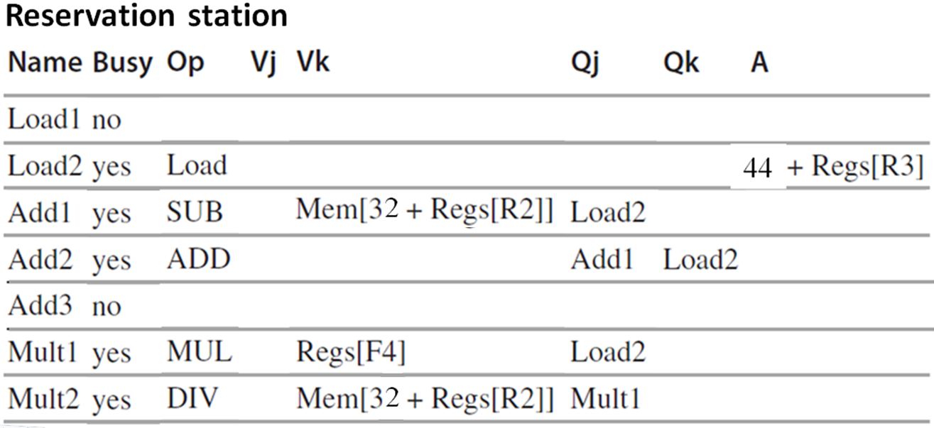
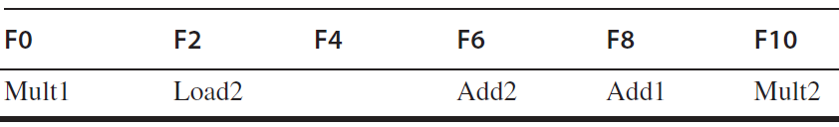
Register status

Slide 23
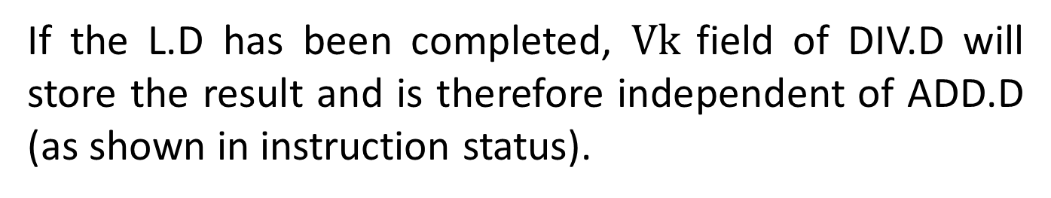
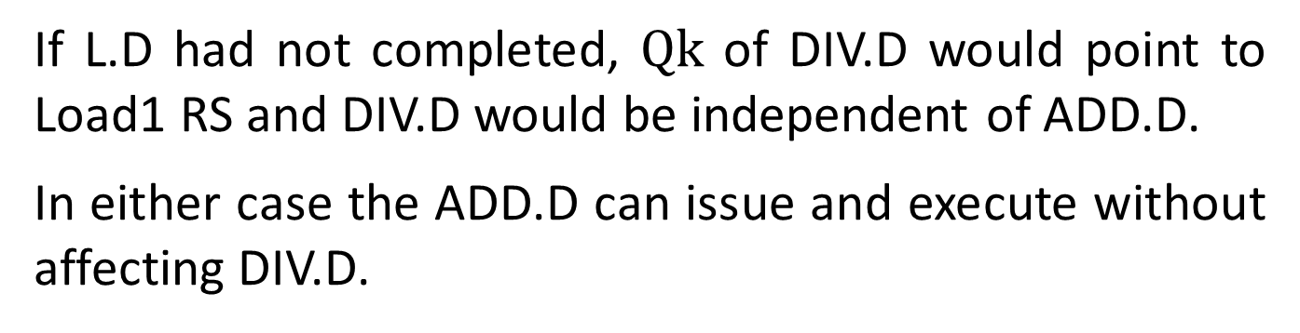
WAR hazard involving R6 is eliminated in one of two ways.
If the L.D has been completed, $\text{Vk}$ field of DIV.D will store the result and is therefore independent of ADD.D (as shown in instruction status).
If L.D had not completed, $\text{Q}\text{k}$ of DIV.D would point to Load1 RS and DIV.D would be independent of ADD.D.
In either case the ADD.D can issue and execute without affecting DIV.D.

Slide 24
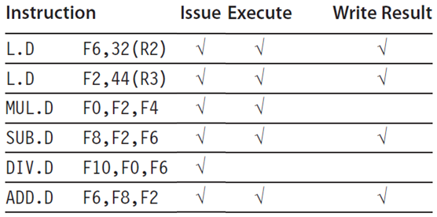
Example: Assume the following latencies: load 1 cycle, add 2 cycles, multiply 6 cycles and divide 12 cycles.
What the status tables look like when the MUL.D is ready to write result?
Instruction status
Latency
1
1
6
2
12
2

Slide 25
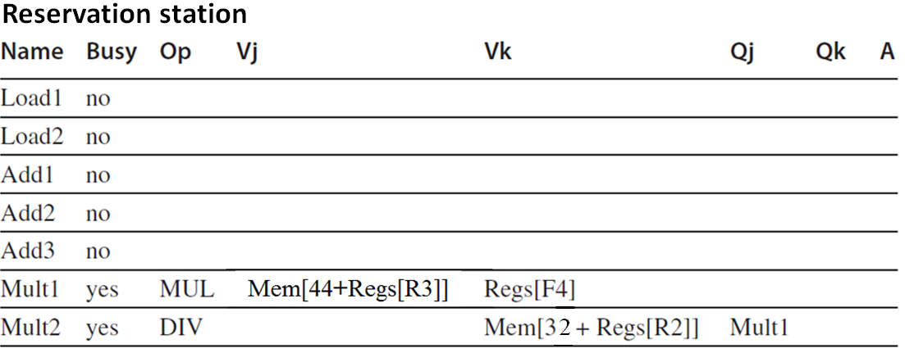
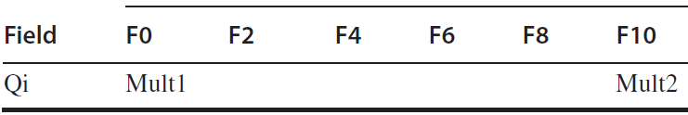
Load1
Load1
Register status
Add has been completed since the operands of DIV.D were copied, thereby avoiding the WAR hazard in F6.
Even if the load of F6 was delayed, the add into F6 could be executed without triggering a WAW hazard.

Slide 26
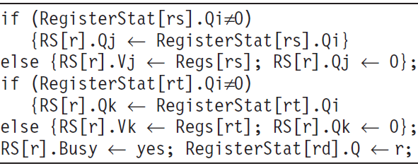
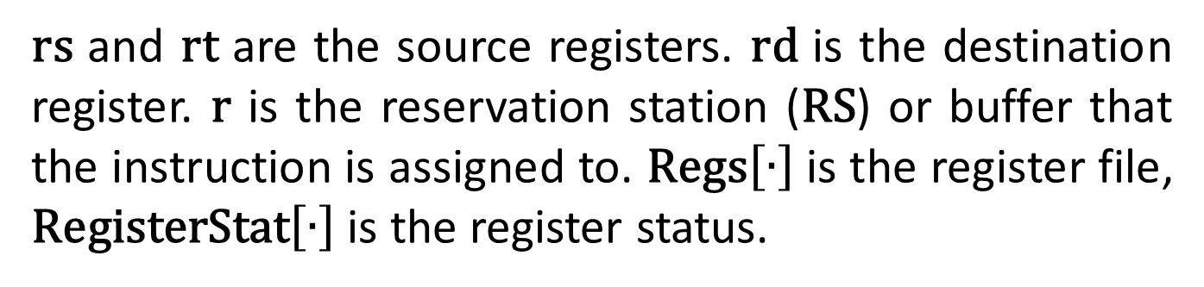
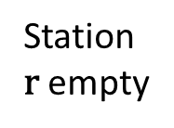
Tomasulo Algorithm Details
Instruction state
Wait until
Action or bookkeeping
Issue FP operation
Station
$\text{r}$ empty
i
$\text{rs}$ and $\text{r}\text{t}$ are the source registers. $\text{r}\text{d}$ is the destination register. $\text{r}$ is the reservation station ($\text{RS}$) or buffer that the instruction is assigned to. $\text{Regs}\left[∙\right]$is the register file, $\text{Reg}\text{isterStat}\left[∙\right]$ is the register status.

Slide 27
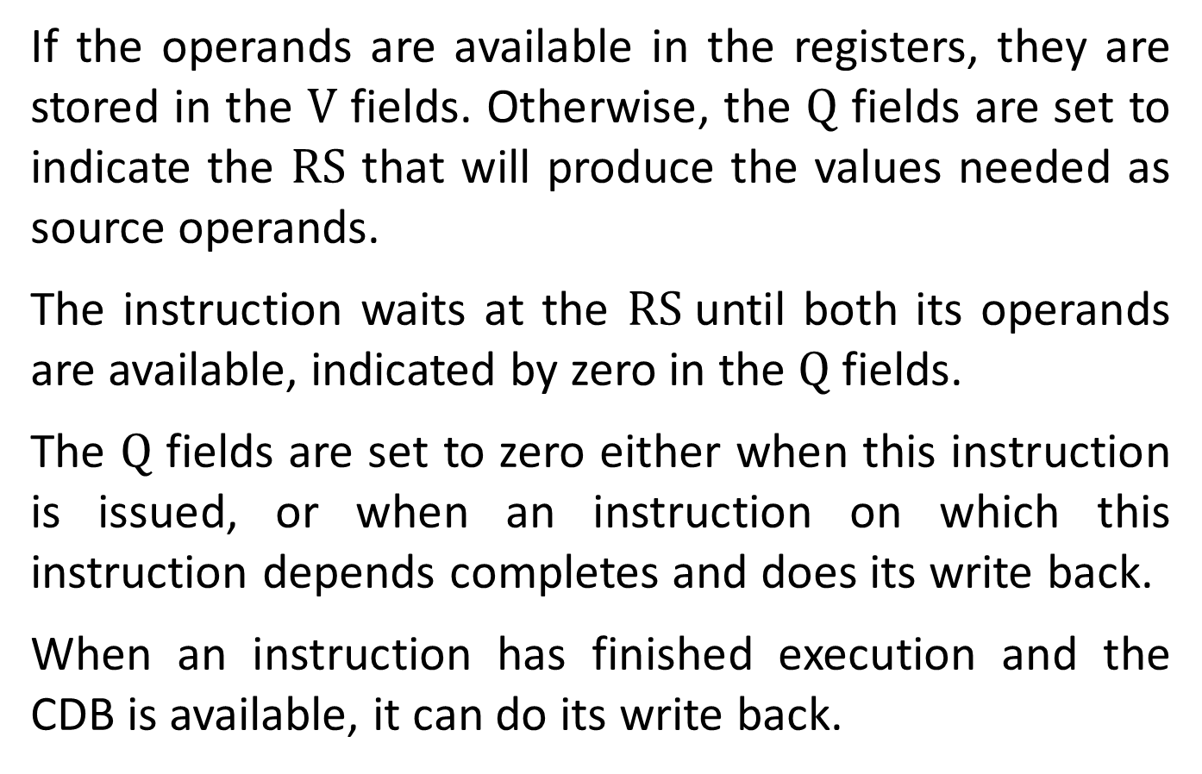
If the operands are available in the registers, they are stored in the $\text{V}$ fields. Otherwise, the $\text{Q}$ fields are set to indicate the $\text{RS}$ that will produce the values needed as source operands.
The instruction waits at the $\text{RS}$until both its operands are available, indicated by zero in the $\text{Q}$ fields.
The $\text{Q}$ fields are set to zero either when this instruction is issued, or when an instruction on which this instruction depends completes and does its write back.
When an instruction has finished execution and the CDB is available, it can do its write back.

Slide 28
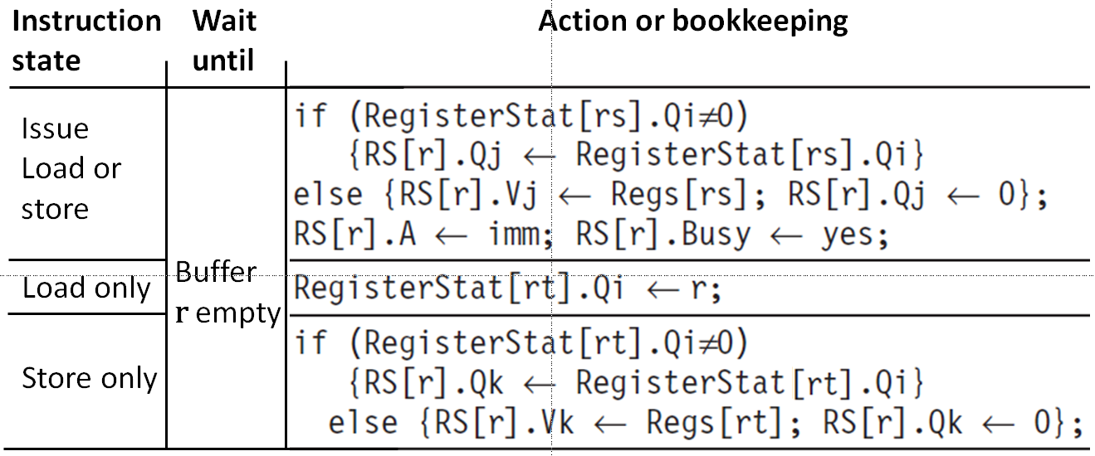
$\text{imm}$ is the sign-extended immediate field.

Slide 29
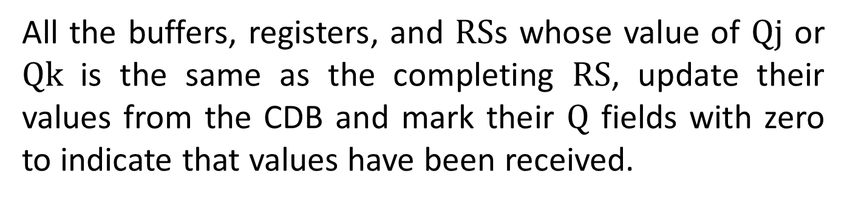
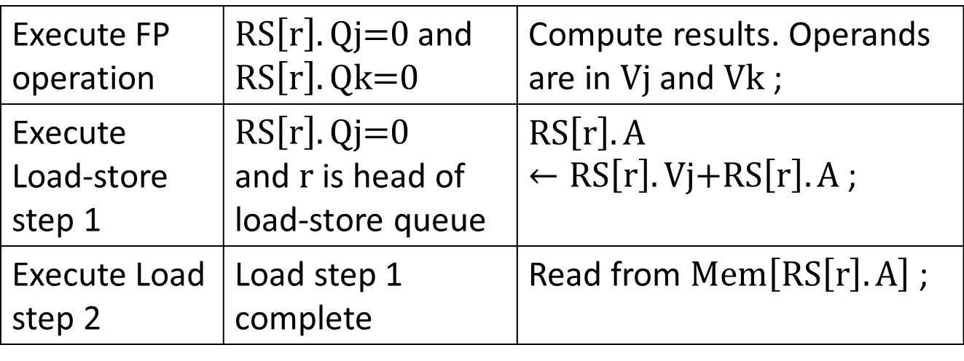
Instruction state
Wait until
Action or bookkeeping
Compute results. Operands are in $\text{Vj}$ and $\text{Vk}$ ; | $\text{RS}\left[\text{r}\right].\text{Qj}\text{=}\text{0}$ and $\text{RS}\left[\text{r}\right].\text{Qk}\text{=}\text{0}$ | Execute FP operation
$\text{RS}\left[\text{r}\right].\text{A}←\text{RS}\left[\text{r}\right].\text{Vj}\text{+}\text{RS}\left[\text{r}\right].\text{A}$ ; | $$\text{RS}\left[\text{r}\right].\text{Qj}\text{=}\text{0 }$$ and $\text{r}$ is head of load-store queue | Execute Load-store step 1
Read from $\text{Mem}\left[\text{RS}\left[\text{r}\right].\text{A}\right]$ ; | Load step 1 complete | Execute Load step 2
All the buffers, registers, and $\text{RS}$s whose value of $\text{Qj}$ or $\text{Qk}$ is the same as the completing $\text{RS}$, update their values from the CDB and mark their $\text{Q}$ fields with zero to indicate that values have been received.

Slide 30
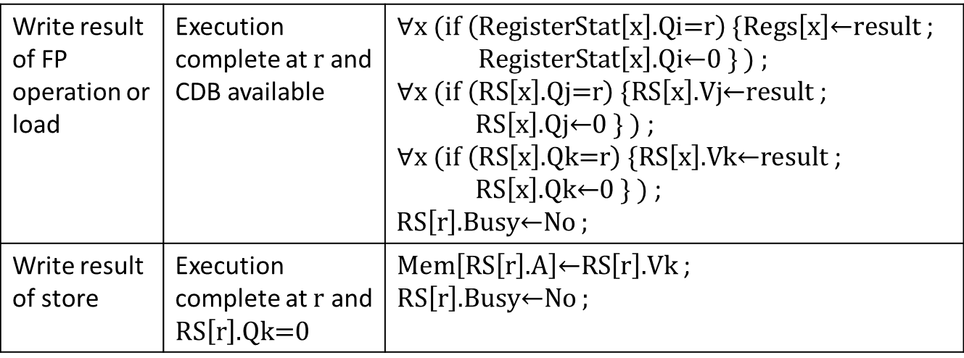
Instruction
state
Wait
until
Action or bookkeeping
$\text{∀}\text{x} (\text{if} \left(\text{RegisterStat}\left[\text{x}\right]\text{.}\text{Qi}\text{=}\text{r}\right) \{\text{Regs}\left[\text{x}\right]\text{←}\text{result}$ ; $\text{RegisterStat}\left[\text{x}\right]\text{.}\text{Qi}\text{←}\text{0 }\text{\} ) ;}$ $\text{∀}\text{x} (\text{if} \left(\text{RS}\left[\text{x}\right]\text{.}\text{Qj}\text{=}\text{r}\right) \{\text{RS}\left[\text{x}\right]\text{.}\text{Vj}\text{←}\text{result}$ ; $\text{RS}\left[\text{x}\right]\text{.}\text{Qj}\text{←}\text{0 }\text{\} )}$ ; $\text{∀}\text{x} (\text{if} \left(\text{RS}\left[\text{x}\right]\text{.}\text{Qk}\text{=}\text{r}\right) \{\text{RS}\left[\text{x}\right]\text{.}\text{Vk}\text{←}\text{result}$ ; $\text{RS}\left[\text{x}\right]\text{.}\text{Qk}\text{←}\text{0 }\text{\} )}$ ; $\text{RS}\left[\text{r}\right]\text{.}\text{Busy}\text{←}\text{No}$ ; | Execution complete at $\text{r}$and CDB available | Write result of FP operation or load
$\text{Mem}\left[\text{RS}\left[\text{r}\right]\text{.}\text{A}\right]\text{←}\text{RS}\left[\text{r}\right]\text{.}\text{Vk}$ ; $\text{RS}\left[\text{r}\right]\text{.}\text{Busy}\text{←}\text{No}$ ; | Execution complete at $\text{r}$ and $\text{RS}\left[\text{r}\right]\text{.}\text{Qk}\text{=}\text{0}$ | Write result of store
The CDB broadcasts its result to many destinations in a single clock cycle.
If the waiting instructions have their operands, they can all begin execution on the next clock cycle.

Slide 31
Loads go through two steps in Execute, and stores perform slightly differently during Write Result, where they may have to wait for the value to store.
To preserve exception behavior, instructions should not be allowed to execute if a branch that is earlier in program order has not yet completed.
Because program order is not maintained after the issue stage, this restriction is usually implemented by preventing any instruction from leaving the issue step, if there is a pending branch in the pipeline.
We will later remove this restriction.

Slide 32
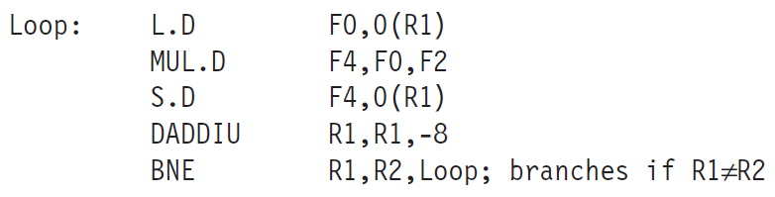
A Loop Example
The power of Tomasulo’s algorithm in handling WAR and WAW hazards is demonstrated in loops.
If branched are predicted taken, RS usage allows multiple executions of the loop to proceed at once.
The loop is unrolled dynamically by HW, using the RSs obtained by renaming to act as additional registers.
No need for compiler unrolling.

Slide 33
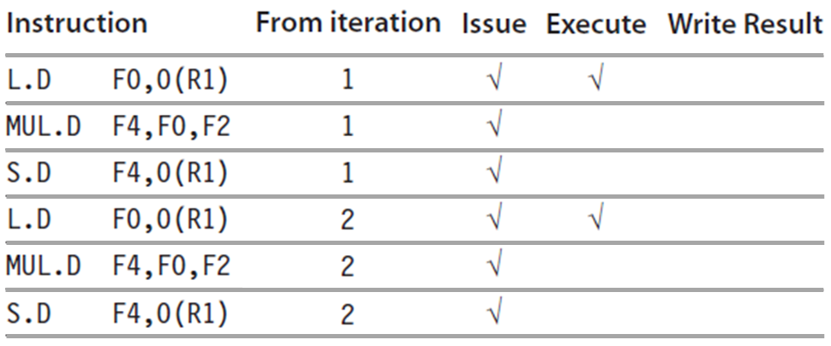
Let all the instructions in two successive iterations be issued, but assume that none of the operations within the loop has completed.
Instruction status
The integer ALU operation is ignored, and it is assumed the branch was predicted as taken.

Slide 34
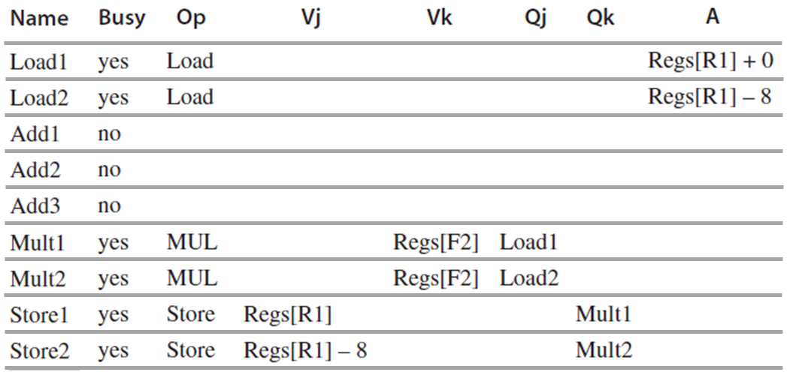
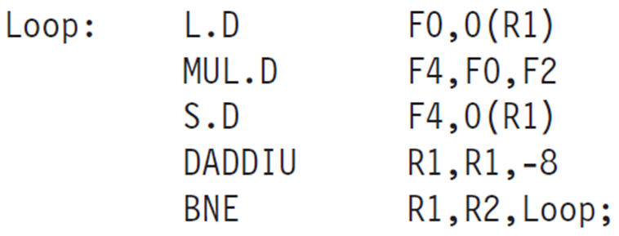
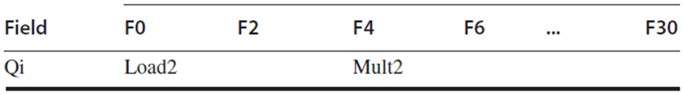
Reservation station
0
0
0
Register status

Slide 35
Two copies of the loop could be sustained with a CPI close to 1.0, provided MULT completes in 4 clock cycles.
For 6 cycles MULT, additional iteration is needed to be processed before the steady state can be reached, requiring more FP RSs.
Load and store can safely be done OOO if they access different addresses.
In case of same address, if load precedes store, order interchange results in a WAR hazard.
If store precedes load, interchanging order results in a RAW hazard.

Slide 36
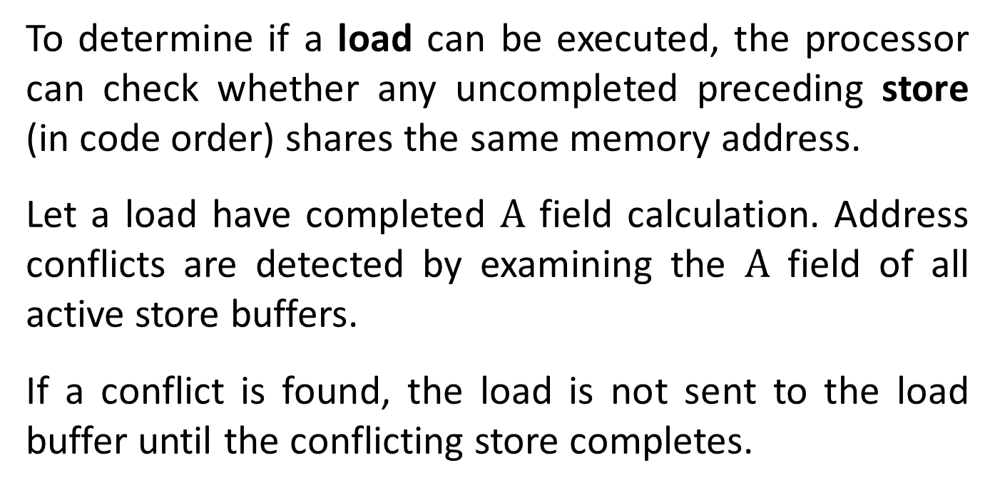
Similarly, interchanging two stores to the same address results in a WAW hazard.
To determine if a load can be executed, the processor can check whether any uncompleted preceding store (in code order) shares the same memory address.
Let a load have completed $A$ field calculation. Address conflicts are detected by examining the $A$ field of all active store buffers.
If a conflict is found, the load is not sent to the load buffer until the conflicting store completes.

Slide 37
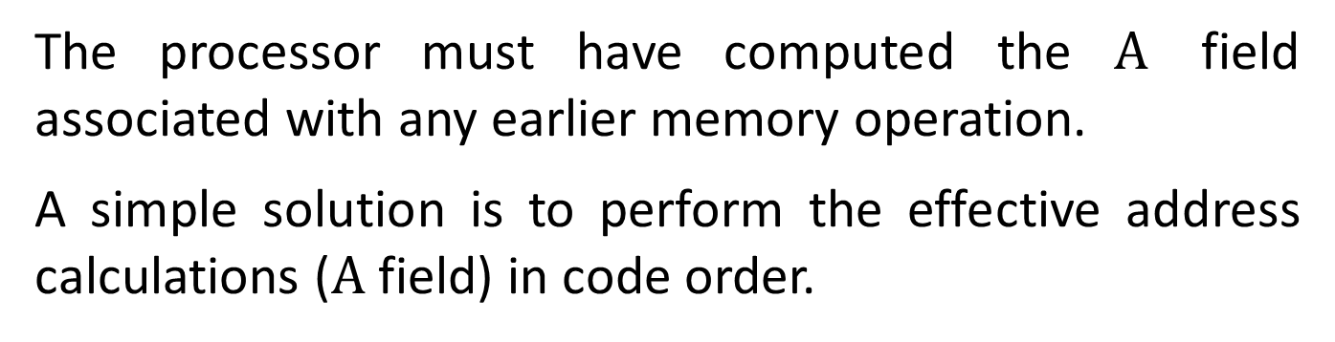
The processor must have computed the $A$ field associated with any earlier memory operation.
A simple solution is to perform the effective address calculations ($A$ field) in code order.
Stores operate similarly, except that the processor must check for conflicts in both load and store buffers.
A store must wait until there are no unexecuted loads or stores that are earlier in program order and share the same memory address.
Notice that loads can be reordered freely. (why?)

Slide 38
Dynamic scheduling yields very high performance, provided branches are predicted accurately. The major drawback is the HW complexity.
Each RS must contain a high speed associative buffer, and complex control logic.
Single CDB is a bottleneck. More CDBs can be added.
Since each CDB must interact with each RS, the associative tag-matching HW must be duplicated at each RS for each CDB.
Summary: Tomasulo’s alg. combines two techniques: renaming of the ISA registers to a larger set, and buffering of source operands from the RF.

Slide 39
Tomasulo’s scheme, invented for IBM 360/91, is widely adopted in multiple-issue processors since 1990s.
It can achieve high performance without requiring the compiler to target code to a specific pipeline structure.
Caches, with the inherently unpredictable delays, is one of the major motivations for dynamic scheduling.
OOO execution allows the processor to continue executing instructions while awaiting the completion of a cache miss, hiding some of the cache miss penalty.
Dynamic scheduling is a key component of speculation (discussed next).

Slide 40
Hardware-Based Speculation
Hardware speculation extends the ideas of dynamic scheduling.
Branch prediction (BP) reduces the direct stalls attributable to branches, but is insufficient to generate the desired amount of ILP.
Exploiting more parallelism requires to overcome the limitation of control dependence.
It is done by speculating on the outcome of branches and executing the program as if our guesses were correct.

Slide 41
Speculation combines three key ideas: dynamic BP, speculation and dynamic scheduling.
dynamic BP speculatively chooses which instructions to execute, allowing the execution of instructions before control dependences are resolved.
Speculation fetches, issues, and executes instructions, as if BP were always correct, unlike dynamic scheduling which only fetches and issues such instructions.
A mechanism to handle the situation where the speculation is incorrect is required (undo).

Slide 42
An undo capability is required to cancel the effects of an incorrectly speculated sequence.
Dynamic scheduling without speculation only partially overlaps basic blocks because it requires that a branch be resolved before actually executing any instructions in the successor basic code block.
Dynamic scheduling with speculation deals with the scheduling of different combinations of basic code blocks.
HW-based speculation is essentially a data-flow execution: Operations execute as soon as their operands are available.

Slide 43
An instruction is executed and bypassing its results to other instructions.
It however does not perform any updates that cannot be undone (writing to RF or MEM), until it is known to be no longer speculative.
This additional step in the execution sequence is called instruction commit.
instructions may finish execution considerably before they are ready to commit.
Speculation allows instructions to execute OOO but it forces them to commit in order.

Slide 44
The commit phase requires special set of buffers holding the results of instructions that have finished execution but have not committed yet.
This buffer is called the reorder buffer (ROB). It is also used to pass results among instructions that may be speculated.
The ROB holds the result of an instruction between completion and commitment.
The ROB is a source of operands for instructions in the interval between completion and commitment, just as the RSs provide operands in Tomasulo’s algorithm.

Slide 45
In Tomasulo’s algorithm, once an instruction writes its result, any subsequently issued instructions will find the result in the RF.
With speculation, the RF is not updated until the instruction commits.
The ROB is similar to the store buffer in Tomasulo’s algorithm. The function of the store buffer is integrated into the ROB for simplicity.
Each entry in the ROB contains four fields:
The instruction type field indicates whether the instruction is a branch, a store, or a register operation (ALU, load).

Slide 46
The destination field supplies the register number (for loads and ALU operations) or the memory address (for stores) where the instruction result should be written.
The value field holds the value of the instruction result until the instruction commits.
The ready field indicates that the instruction has completed execution, and the value is ready.

Slide 47
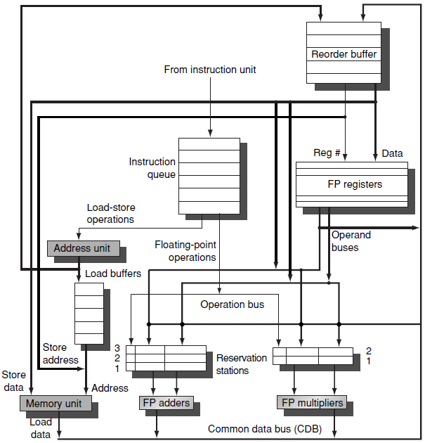
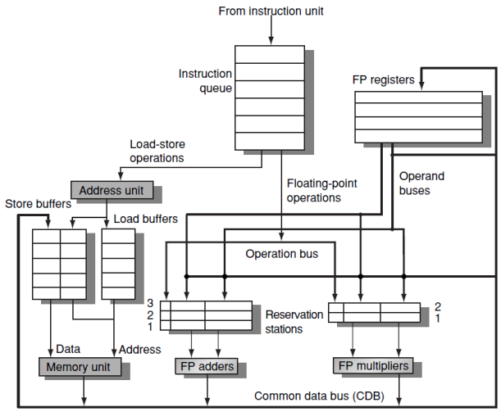
FP unit supporting speculation

Slide 48
The Four Steps of Instruction Execution
Issue. Get an instruction from the instruction queue. Issue it if there is an empty RS and an empty slot in the ROB, otherwise instruction issue is stalled.
Send the operands to the RS if they are available in either RF or the ROB. Update the control entries to indicate the buffers are in use.
The number of the ROB entry allocated for the result is also sent to the RS, so that it can be used to tag the result when it is placed on the CDB.
Notice that the ROB is a queue. Its update at Issue ensures in-order commitment.

Slide 49
Execute. If one or more of the operands is not yet available, monitor the CDB while waiting for the register to be computed. This step checks for RAW hazards.
When both operands are available at RS, execute the operation.
Instructions may take multiple clock cycles in this stage, and loads still require two steps in this stage.
Stores need only have the base register available at this step, since execution for a store at this point is only effective address calculation.

Slide 50
Write result. Write it on the CDB (with the ROB tag sent when the instruction issued) and from the CDB into the ROB and any RS waiting for this result.
Mark the RS as available.
Special actions are required for stores. If the value to be stored is available, it is written into the Value field of the ROB entry for the store.
If not available yet, the CDB is monitored until that value is broadcast, at which time the Value field of the ROB entry of the store is updated.

Slide 51
Commit. Commitment takes three different sequences.
A branch reached the head of the ROB. If prediction is correct the branch finishes. If incorrect (wrong speculation), the ROB is flushed and execution restarts at the correct successor of the branch.
Normal commit occurs when an instruction reaches the head of the ROB and its result is present in the buffer. The processor then updates the RF with the result and removes the instruction from the ROB.
Store is similar except that MEM is updated rather than RF.

Slide 52
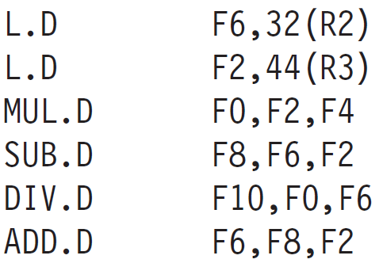
Instruction commitment reclaims its entry in the ROB and the RF or MEM destination is updated, eliminating the need for the ROB entry.
If the ROB fills, issuing instructions stops until an entry is made free, thus enforcing in-order commitment.
Example. How tables look when MUL.D is ready to commit? (same example discussed in Tomasulo)

Slide 53
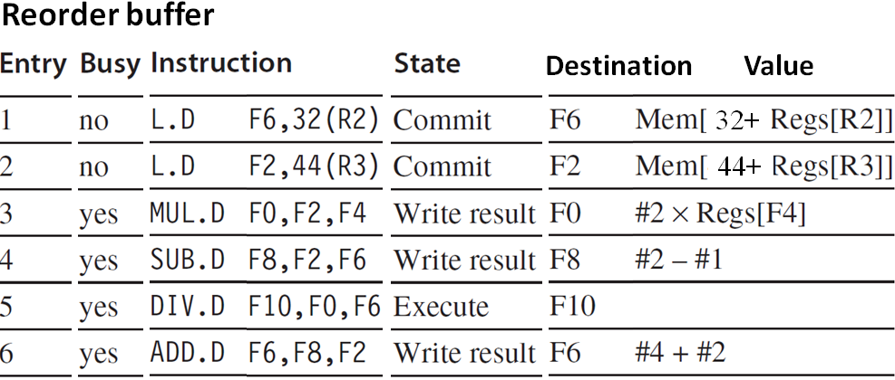
(status)
The ROB entries are dictated at the issue stage, hence the #1, #2, #4, etc.
Although the SUB.D (#4) has completed execution, it does not commit until the MUL.D (#3) commits.

Slide 54
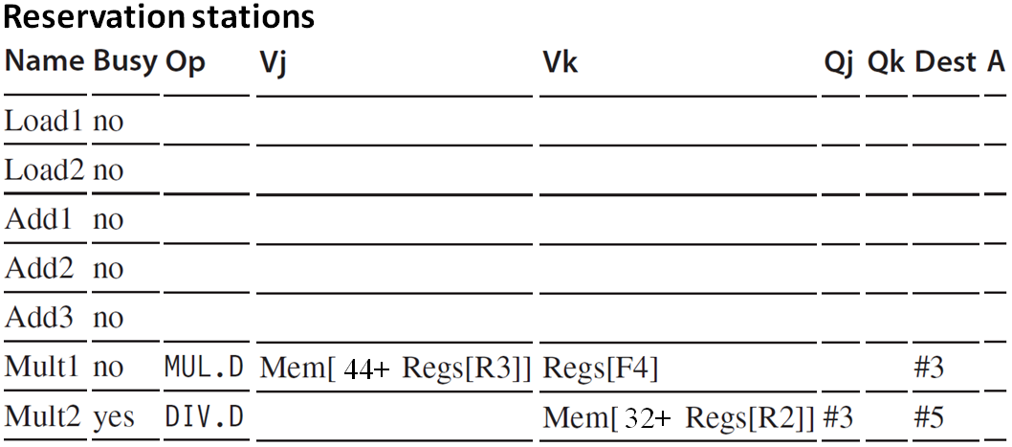
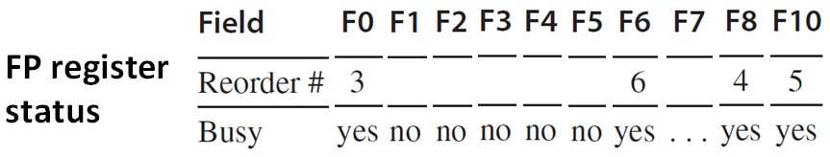

Slide 55
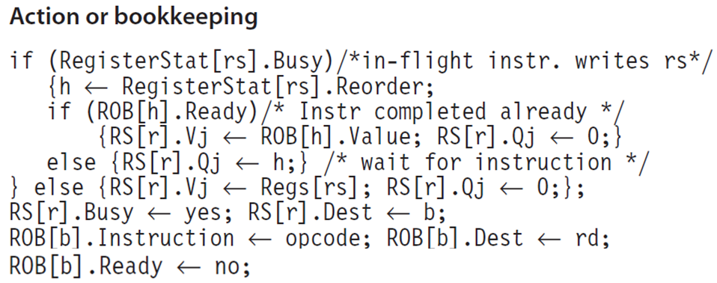
Issue all instructions
Waits until RS[r] and ROB[b] both available

Slide 56

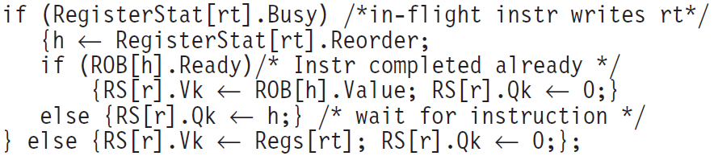
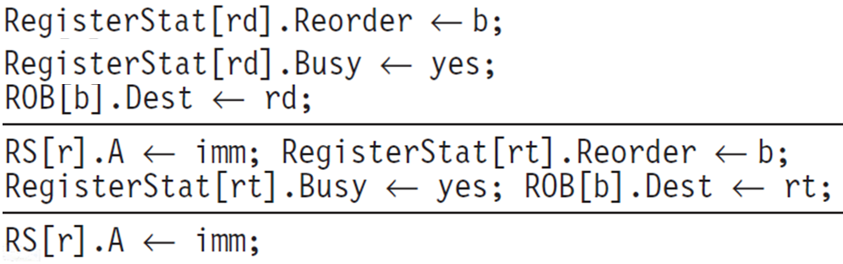
Waits until RS[r] and ROB[b] both available
FP operations and stores
FP
loads
stores

Slide 57
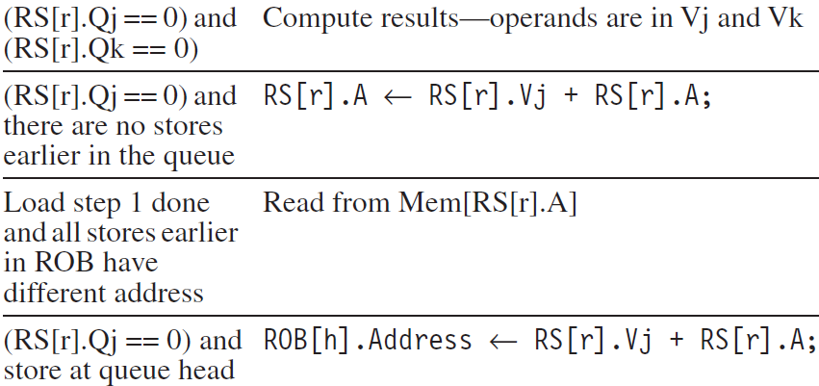
Instructions execution
Waits until
Action or bookkeeping
Execute FP op
Load step 1
Load step 2
Store

Slide 58
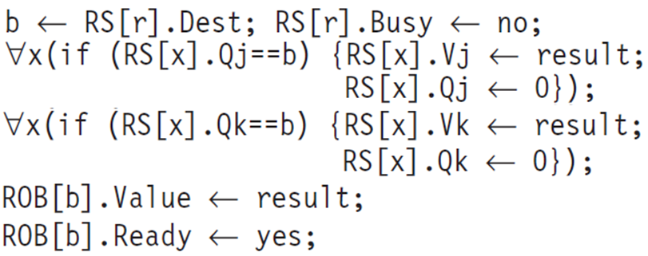
Write results all except store
Waits until execution done at RS [r] and CDB available
Write results store
Waits until execution done at RS[r] and RS[r].Qk == 0

Slide 59
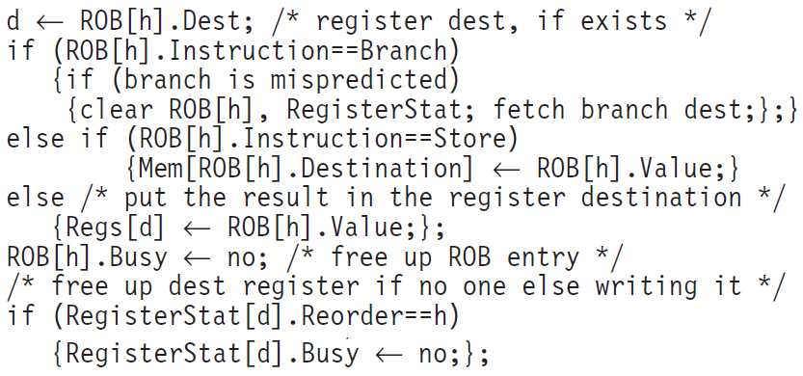
Commit
Waits until Instruction is at the head (h) of the ROB and ROB[h].ready == yes.
Action or bookkeeping

Slide 60
A Loop Example
Assume that all the instructions in the loop have been issued twice, and that the L.D and MUL.D from the first iteration have committed and all other instructions have completed execution.
Since only the FP pipeline is considered, assume the effective address (R1) for the store is computed by the time the instruction is issued.

Slide 61
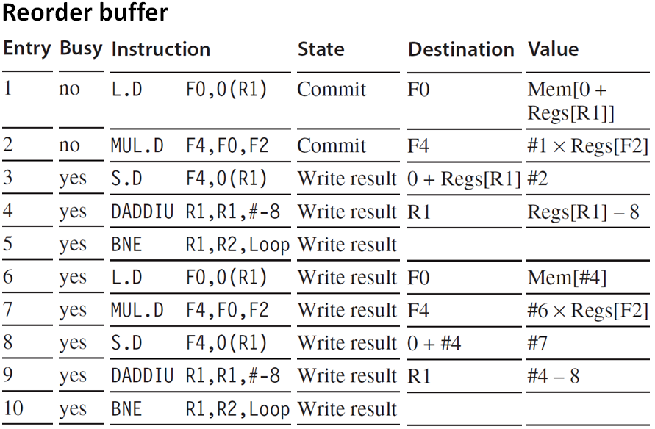
(status)

Slide 62
The register values and any memory values are not written until an instruction commits, enabling undoing speculative actions upon miss prediction.
Let the BNE be not taken the first time (the first loop is always performed). The instructions prior to the branch will commit when each reaches the head of the ROB.
When the branch reaches the ROB head, the ROB is cleared and the instructions fetch begins from the other path.
In practice, speculative processors try to recover as early as possible after a branch is miss predicted.

Slide 63
Recovery is done by clearing the ROB for all entries that appear after the miss predicted branch, allowing those that are in the ROB before the branch to continue.
Fetch restarts at the correct branch successor.
Exceptions are handled by not recognizing the exception until it is ready to commit.
If a speculated instruction raises an exception, the exception is recorded in the ROB, being flushed along with the instruction when the ROB is cleared.

Slide 64
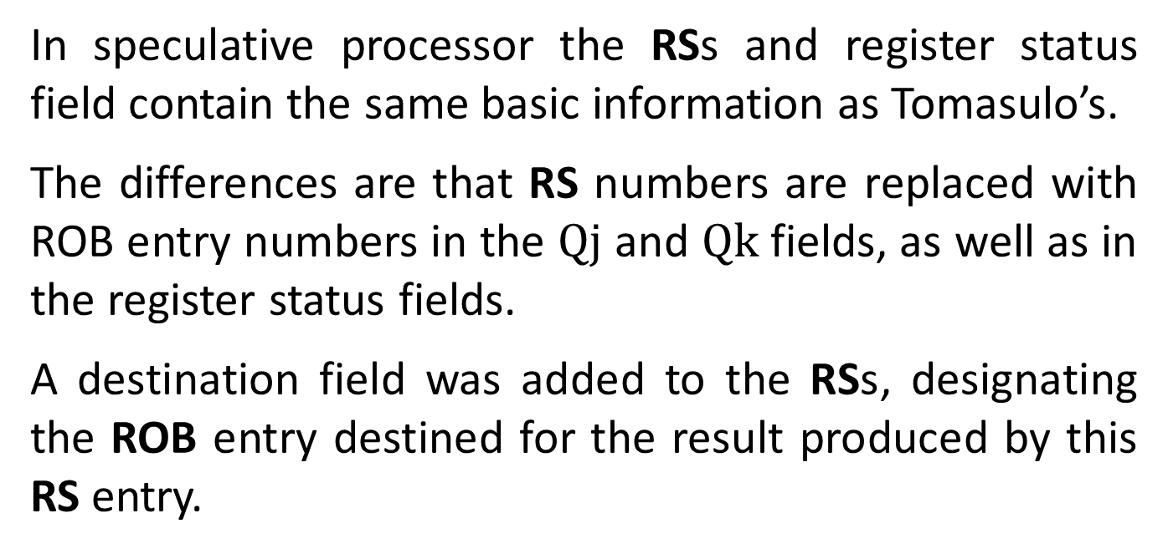
In speculative processor the RSs and register status field contain the same basic information as Tomasulo’s.
The differences are that RS numbers are replaced with ROB entry numbers in the $\text{Qj}$ and $\text{Q}\text{k}$ fields, as well as in the register status fields.
A destination field was added to the RSs, designating the ROB entry destined for the result produced by this RS entry.
The key difference from Tomasulo is that no instruction after the earliest uncommitted instruction is allowed to commit (complete).

Slide 65
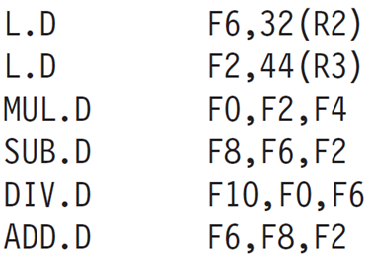
It implies that the processor with the ROB can dynamically execute code while maintaining a precise exception.
If MUL.D caused an exception, it waits until it reaches the ROB’s head and takes the exception, flushing all pending instructions from the ROB. Because commitment happens in order, this yields a precise exception.
Tomasulo’s algorithm in contrast completes the SUB.D and ADD.D, and F8 and F6 are overwritten before the MUL.D raised exception, yielding imprecise exception.

Slide 66
Multiple Issue
Dynamic scheduling and speculation can achieve an ideal CPI of one.
We would like to decrease the CPI to less than one. But cannot if only one instruction is issued per clock cycle.
A VLIW (very long instruction word) multiple-issue processor is issuing a fixed number of instructions formatted either as one large instruction or as a fixed instruction packet.
VLIW processors are inherently statically scheduled by the compiler.

Slide 67
VLIWs use multiple, independent functional units. It issues multiple operations by placing these in one instruction.
Intel Itanium I and II contain six operations per instruction packet.
We consider a VLIW processor with instructions that contain five operations: one integer operation (which could also be a branch), two FP operations, and two memory references.
The instruction have a 16–24 bit field for each unit, yielding an instruction length of 80 - 120 bits.

Slide 68
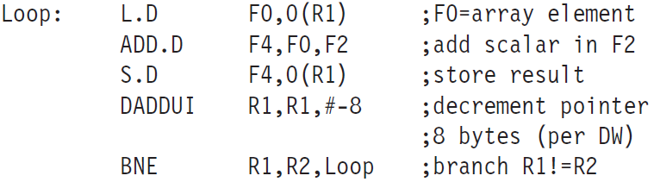

Example: Suppose we have a VLIW that could issue two memory references, two FP operations, and one integer operation or branch in every clock cycle.
Show an unrolled (compiler) version of the loop $x\left[i\right]=x\left[i\right]+s$ for such a processor. Unroll to minimize stalls. Ignore delayed branches.

Slide 69

Load hazard
Addition latency
VLIW instructions that occupy the inner loop replace the unrolled sequence (23 cycles).
The code takes 9 cycles assuming no branch delay. The issue rate is 2.5 operations per cycle.

Slide 70
The efficiency, the percentage of available slots that contained an operation, is about 60%.
To achieve this issue rate requires a larger number of registers than MIPS would normally use in this loop.
The VLIW code requires at least eight FP registers, while the same code for the base MIPS can use two FP registers or five when unrolled and scheduled.

Slide 71
+ Dynamic Scheduling + Speculation
Put multiple issue, dynamic scheduling and speculation together. Such microarchitecture is used in modern microprocessors.
Consider an issue rate of two instructions per clock, no different from modern processors that issue more instructions per clock.
Assume a separate integer and FPU, each can initiate an operation on every clock. The pipeline can issue any combination of two instructions in a clock.
Tomasulo’s scheme supports integer unit, FPU and speculative execution.

Slide 72

Combining speculative dynamic scheduling with multiple issue requires to be able to complete and commit multiple instructions per clock.
Example: Execute the following code on a two-issue processor, once without speculation and once with speculation.

Slide 73
There are separate integer units for address calculation, ALU operations, and branch condition evaluation.
Create a table for the first three iterations of this loop for both processors. Assume that up to two instructions of any type can commit per clock.

Slide 74

Loop iteration
Execute
Mem access
Write CDB
Instruction
Issue
Comment
Cannot start EXE until branch resolution
Cannot start EXE until branch resolution
No speculation

Slide 75

Loop iteration
Execute
Read access
Write CDB
Commit
Instruction
Issue
Comment
Start EXE upon R1’s value written to CDB
Start EXE upon R1’s value written to CDB
With speculation

Slide 76
Because the completion rate on the non speculative pipeline is falling behind the issue rate rapidly, the non speculative pipeline will stall when a few more iterations are issued.
The branch can be a critical performance limiter. Speculation helps significantly.
The third branch in the speculative processor executes in clock cycle 13, while it executes in clock cycle 19 on the non speculative pipeline.

Slide 77


