Slide 1

Instruction-Level Parallelism compiler techniques and branch prediction
prepared and instructed by
Shmuel Wimer
Eng. Faculty, Bar-Ilan University

Slide 2
Concepts and Challenges
The potential overlap among instructions is called instruction-level parallelism (ILP).
Two approaches exploiting ILP:
Hardware discovers and exploit the parallelism dynamically.
Software finds parallelism, statically at compile time.
CPI for a pipelined processor:
  Ideal pipeline CPI + Structural stalls + Data hazard stalls + Control stalls
Basic block: a straight-line code with no branches.
Typical size between three to six instructions.
Too small to exploit significant amount of parallelism.
We must exploit ILP across multiple basic blocks.

Slide 3

Loop-level parallelism exploits parallelism among iterations of a loop. A completely parallel loop adding two 1000-element arrays:
Within an iteration there is no opportunity for overlap, but every iteration can overlap with any other iteration.
The loop can be unrolled either statically by compiler or dynamically by hardware.
Vector processing is also possible. Supported in DSP, graphics, and multimedia applications.

Slide 4
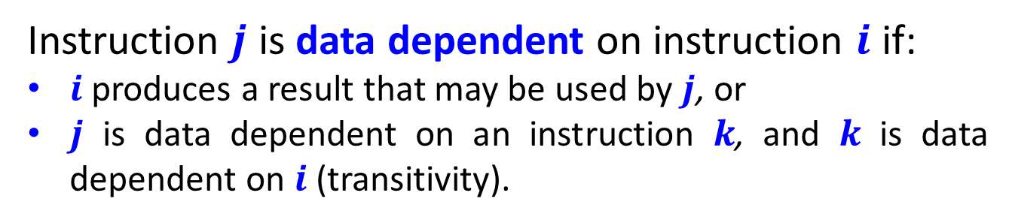
Data Dependences and Hazards
If two instructions are parallel, they can be executed simultaneously in a pipeline without causing any stalls, assuming the pipeline has sufficient resources.
Two dependent instructions must be executed in order, but can often be partially overlapped.
Three types of dependences: data dependences, name dependences, and control dependences.
Instruction $j$ is data dependent on instruction $i$ if:
$i$ produces a result that may be used by $j$, or
$j$ is data dependent on an instruction $k$, and $k$ is data dependent on $i$ (transitivity).

Slide 5
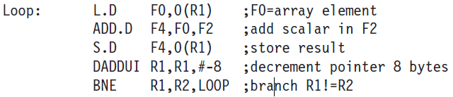
The following loop increments a vector of values in memory by a scalar in register F2, starting at 0(R1), with the last element at 8(R2)).
The data dependences in this code sequence involve both floating-point and integer data.
Since between two data dependent instructions there is a chain of one or more data hazards, they cannot be executed simultaneously or completely overlap.

Slide 6
Data dependence conveys:
the possibility of a hazard,
the order in which results must be calculated, and
an upper bound on how much parallelism can be exploited.
Detecting dependence of registers is straightforward.
Register names are fixed in the instructions.
Dependences that flow through memory locations are more difficult to detect.
Two addresses may refer to the same location but look different: For example, 100(R4) and 20(R6).
The effective address of a load or store may change from one execution of the instruction to another (so that 100(R4) and 20(R6) may be different).

Slide 7

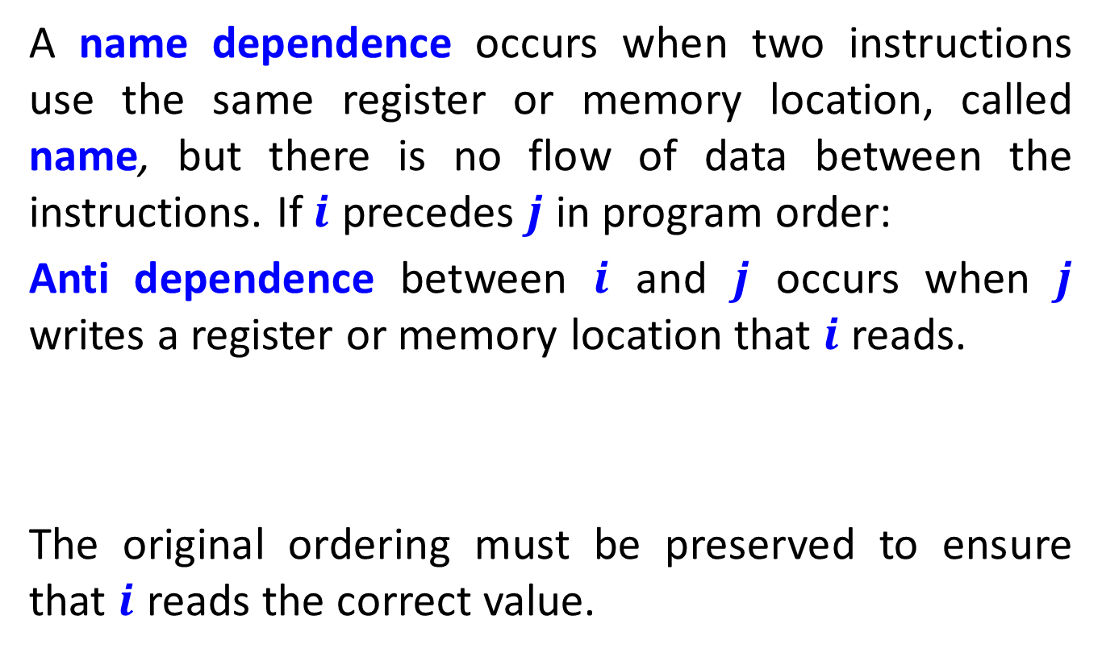
Name Dependences
A name dependence occurs when two instructions use the same register or memory location, called name, but there is no flow of data between the instructions. If $i$ precedes $j$ in program order:
Anti dependence between $i$ and $j$ occurs when $j$ writes a register or memory location that $i$ reads.
The original ordering must be preserved to ensure that $i$ reads the correct value.

Slide 8
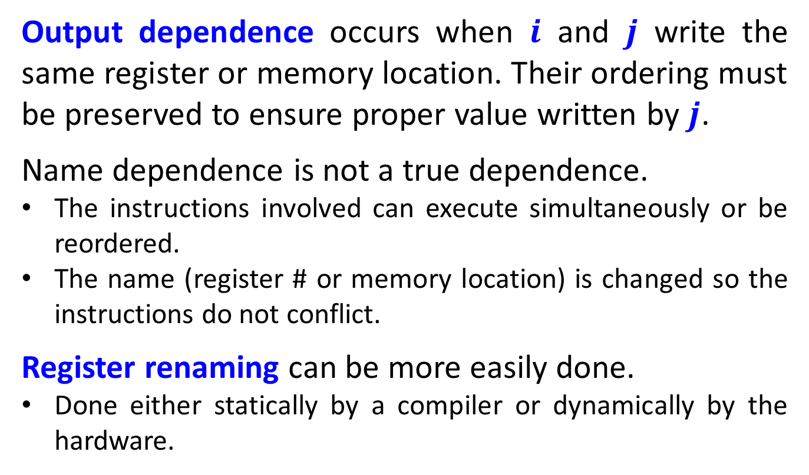
Output dependence occurs when $i$ and $j$ write the same register or memory location. Their ordering must be preserved to ensure proper value written by $j$.
Name dependence is not a true dependence.
The instructions involved can execute simultaneously or be reordered.
The name (register # or memory location) is changed so the instructions do not conflict.
Register renaming can be more easily done.
Done either statically by a compiler or dynamically by the hardware.

Slide 9
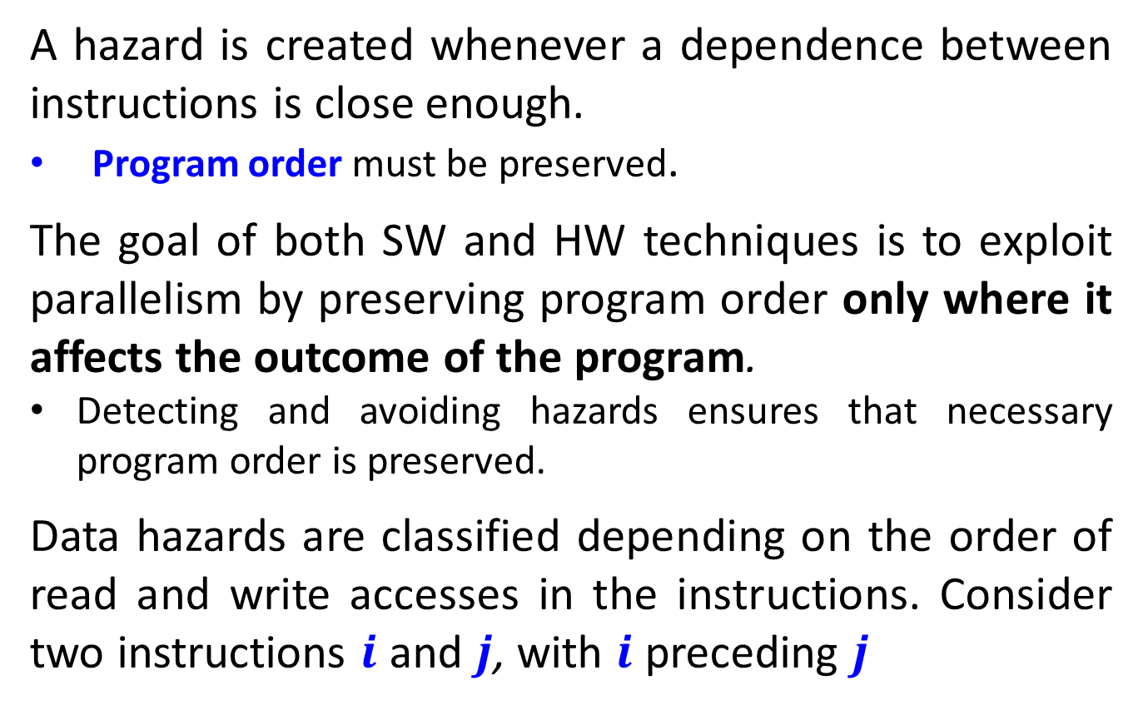
Data Hazards
A hazard is created whenever a dependence between instructions is close enough.
Program order must be preserved.
The goal of both SW and HW techniques is to exploit parallelism by preserving program order only where it affects the outcome of the program.
Detecting and avoiding hazards ensures that necessary program order is preserved.
Data hazards are classified depending on the order of read and write accesses in the instructions. Consider two instructions $i$ and $j$, with $i$ preceding $j$

Slide 10
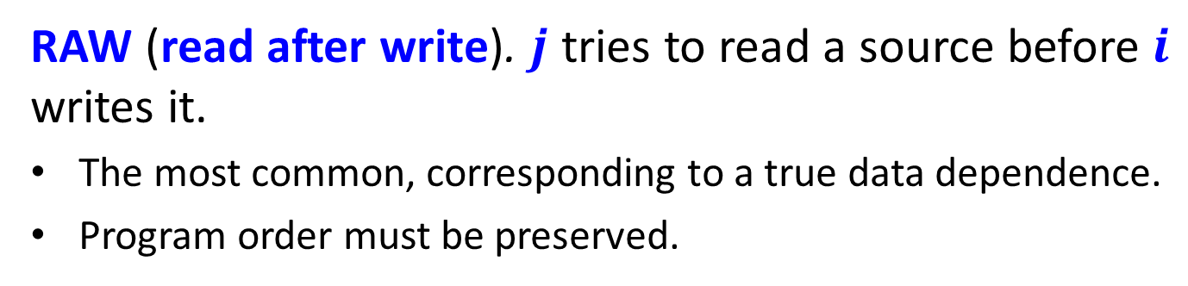
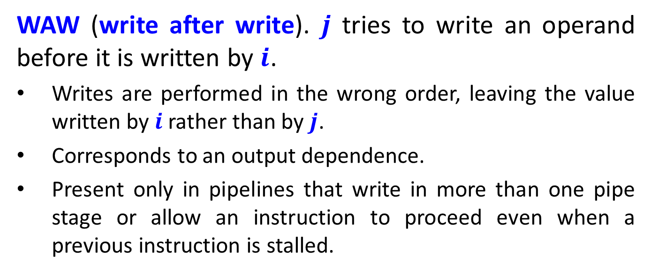
The possible data hazards are:
RAW (read after write). $j$ tries to read a source before $i$ writes it.
The most common, corresponding to a true data dependence.
Program order must be preserved.
WAW (write after write). $j$ tries to write an operand before it is written by $i$.
Writes are performed in the wrong order, leaving the value written by $i$ rather than by $j$.
Corresponds to an output dependence.
Present only in pipelines that write in more than one pipe stage or allow an instruction to proceed even when a previous instruction is stalled.

Slide 11
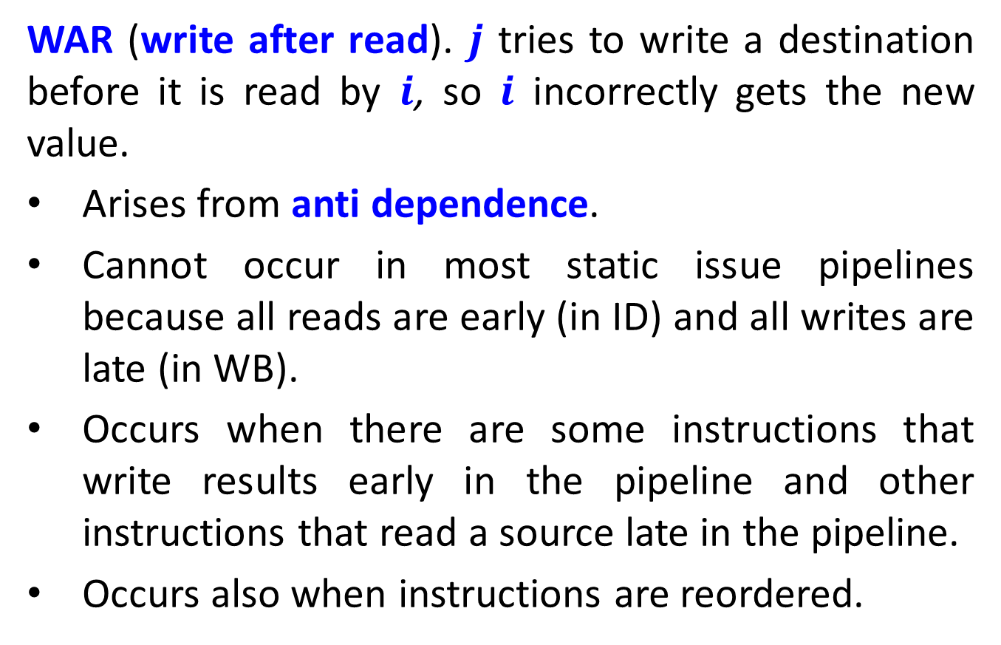
WAR (write after read). $j$ tries to write a destination before it is read by $i$, so $i$ incorrectly gets the new value.
Arises from anti dependence.
Cannot occur in most static issue pipelines because all reads are early (in ID) and all writes are late (in WB).
Occurs when there are some instructions that write results early in the pipeline and other instructions that read a source late in the pipeline.
Occurs also when instructions are reordered.

Slide 12
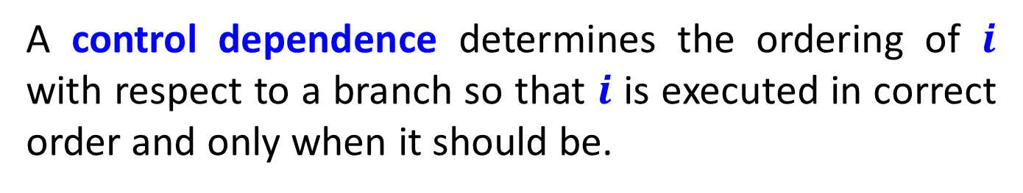
Control Dependences
A control dependence determines the ordering of $i$ with respect to a branch so that $i$ is executed in correct order and only when it should be.
There are two constraints imposed by control dependences:
An instruction that is control dependent on a branch cannot be moved before the branch so that its execution is no longer controlled by the branch.
An instruction that is not control dependent on a branch cannot be moved after the branch so that its execution is controlled by the branch.

Slide 13
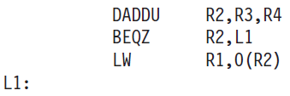
Consider this code:
If we do not maintain the data dependence involving R2, the result of the program can be changed.
If we ignore the control dependence and move the load before the branch, the load may cause a memory protection exception. (why?)
It is not data dependence preventing interchanging the BEQZ and the LW; it is only the control dependence.

Slide 14
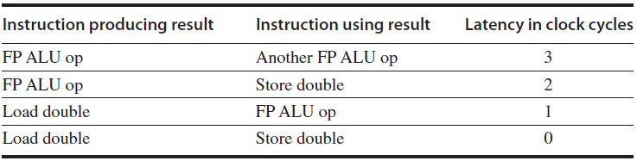
Compiler Techniques for Exposing ILP
Pipeline is kept full by finding sequences of unrelated instructions that can be overlapped in the pipeline.
To avoid stall, a dependent instruction must be separated from the source by a distance in clock cycles equal to the pipeline latency of that source.
Example: Latencies of FP operations

Slide 15

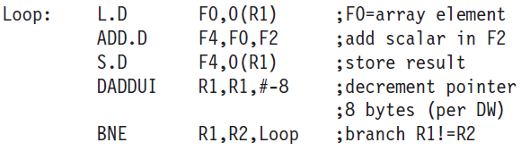
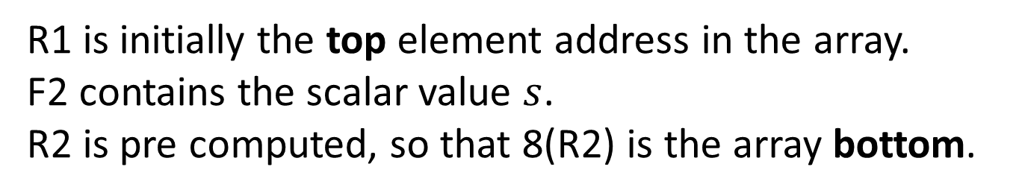
Code adding
scalar to vector:
Straightforward MIPS assembly code:
R1 is initially the top element address in the array.
F2 contains the scalar value $s$.
R2 is pre computed, so that 8(R2) is the array bottom.

Slide 16
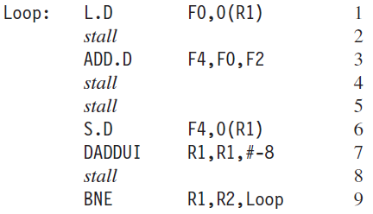
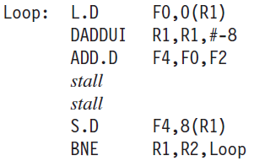
Without any scheduling the loop takes 9 cycles:
Scheduling the loop obtains only two stalls, taking 7 cycles:

Slide 17
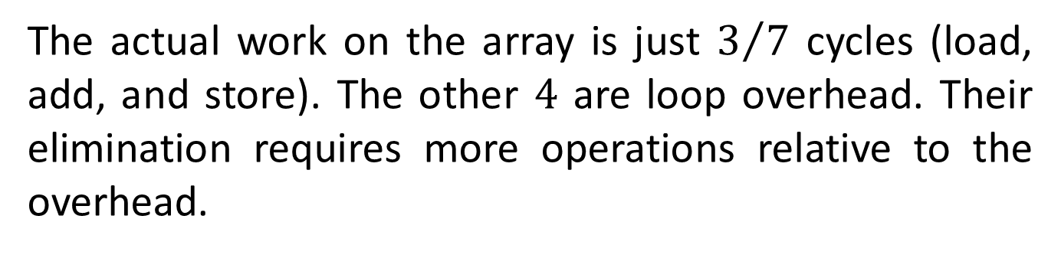
The actual work on the array is just $3/7$ cycles (load, add, and store). The other $4$ are loop overhead. Their elimination requires more operations relative to the overhead.
Loop unrolling replicating the loop body multiple times.
Adjustment of the loop termination code is required.
Used also to improve scheduling.
Instruction replication is insufficient. Different registers for each replication are required.
Required number of registers increases.

Slide 18
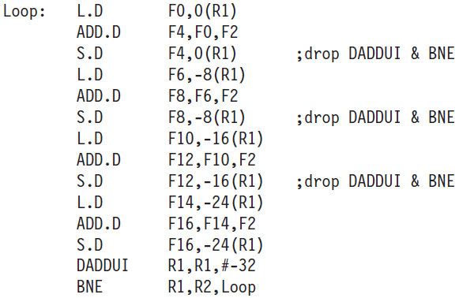
Unrolled code (not rescheduled)
1 stall
2 stalls
1 stall
2 stalls
1 stall
2 stalls
1 stall
2 stalls
1 stall
Stalls are still there.
Run in 27 clock cycles, 6.75 per block.

Slide 19
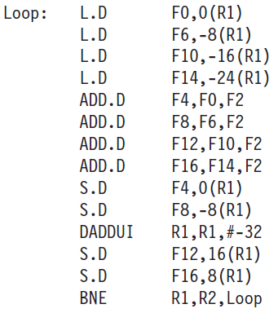
Unrolled and rescheduled code
No stalls are required!
Execution dropped to 14 clock cycles, 3.5 per block.
Compared with 9 per block before unrolling or scheduling and 7 when scheduled but not unrolled.
Is it a hazard?

Slide 20
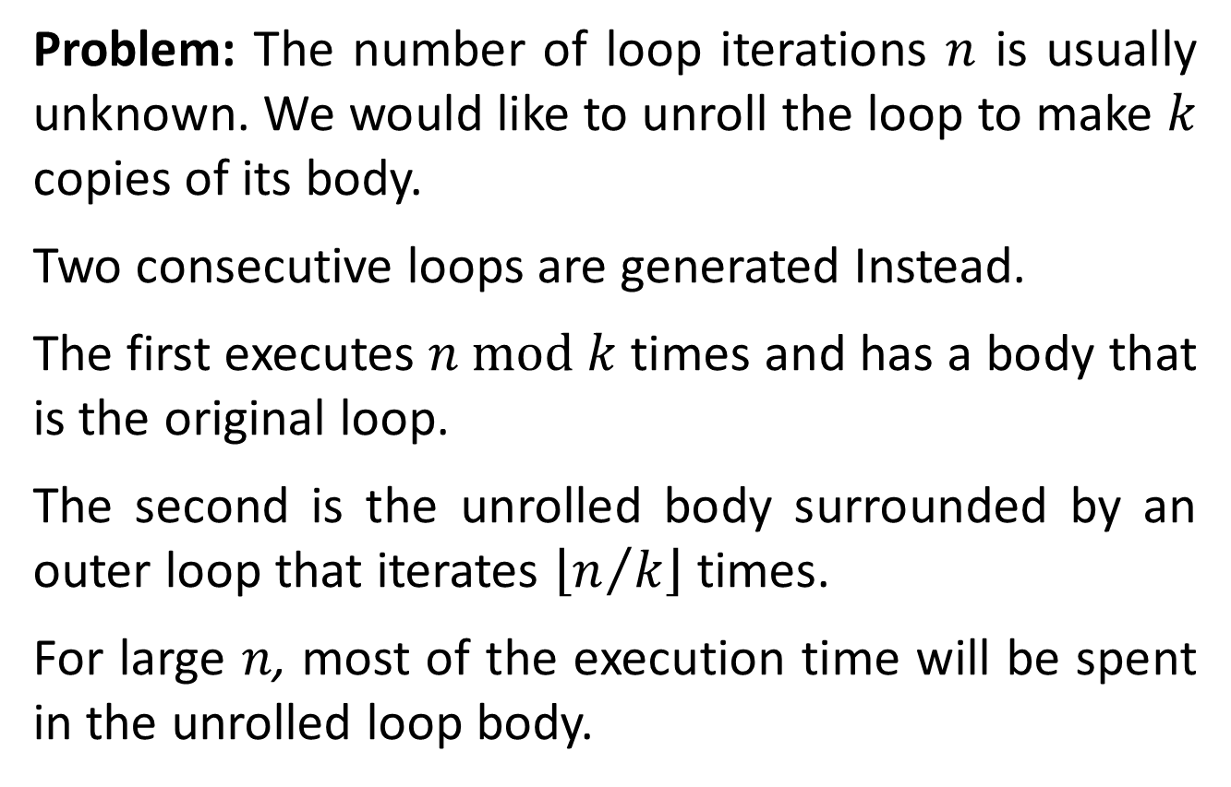
Problem: The number of loop iterations $n$ is usually unknown. We would like to unroll the loop to make $k$ copies of its body.
Two consecutive loops are generated Instead.
The first executes $n \text{mod} k$times and has a body that is the original loop.
The second is the unrolled body surrounded by an outer loop that iterates $\left\lfloor n/k\right\rfloor$ times.
For large $n$, most of the execution time will be spent in the unrolled loop body.

Slide 21
Branch Prediction
performance losses can be reduced by predicting how branches will behave.
Branch prediction (BP) can be done statically at compilation (SW) and dynamically at execution time (HW).
The simplest static scheme is to predict a branch as taken. Misprediction equal to the untaken frequency (34% for the SPEC benchmark).
BP based on profiling is more accurate.

Slide 22
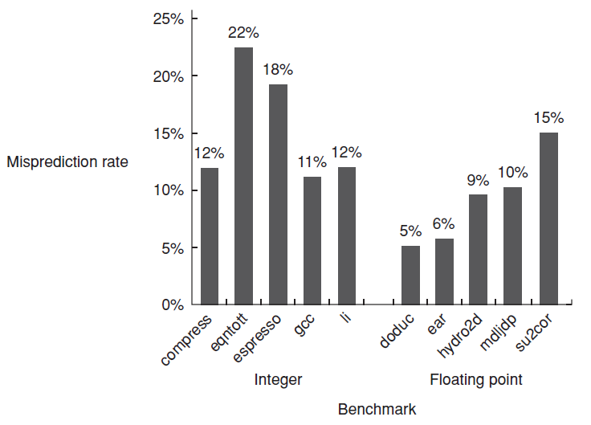
Misprediction on SPEC92 for a profile-based predictor

Slide 23
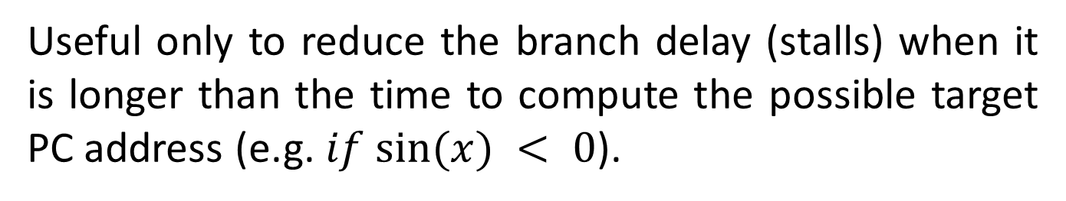
Dynamic Branch Prediction
The simplest is a BP buffer, a small 1-bit memory indexed by the LSBs of the address of the branch instruction (no tags).
BP may have been put there by another branch that has the same LSBs address bits!
Useful only to reduce the branch delay (stalls) when it is longer than the time to compute the possible target PC address (e.g. $if sin⁡(x) < 0$).
Fetching begins in the predicted direction. If it was wrong, the BP bit is inverted and stored back.

Slide 24
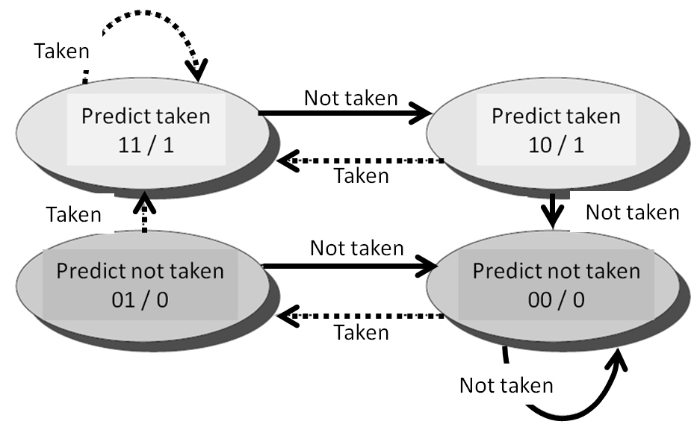
Problem: Even if almost always taken, we will likely predict incorrectly twice. (why?)
Example: Consider a certain loop. Upon exiting the loop a miss prediction occurs. Re-entry of that loop will cause another miss prediction.
Solution:
saturation counter.

Slide 25
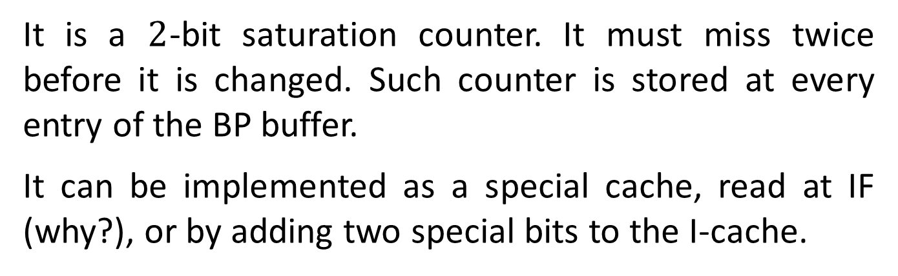
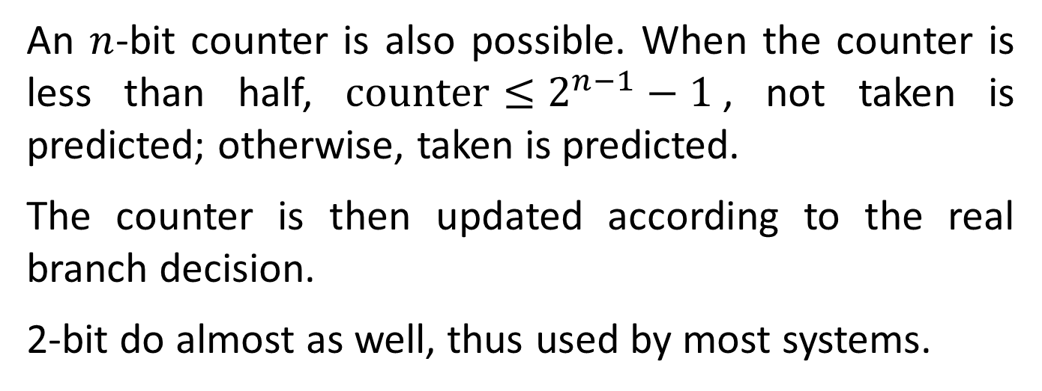
It is a $2$-bit saturation counter. It must miss twice before it is changed. Such counter is stored at every entry of the BP buffer.
It can be implemented as a special cache, read at IF (why?), or by adding two special bits to the I-cache.
An $n$-bit counter is also possible. When the counter is less than half, $\text{counter}≤2^{n−1}−1$, not taken is predicted; otherwise, taken is predicted.
The counter is then updated according to the real branch decision.
2-bit do almost as well, thus used by most systems.

Slide 26
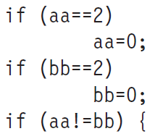
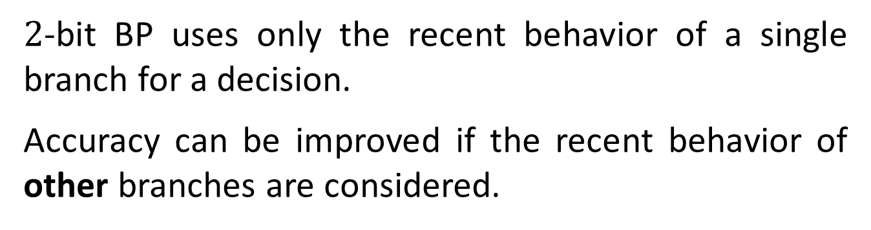
Correlating Branch Predictors
$2$-bit BP uses only the recent behavior of a single branch for a decision.
Accuracy can be improved if the recent behavior of other branches are considered.
Consider the code:
Let aa and bb be assigned to registers R1 and R2, and label the three branches b1, b2, and b3. The compiler generates the typical MIPS code:

Slide 27
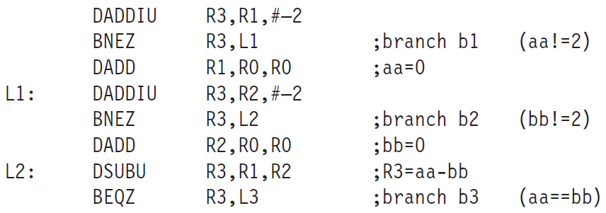
The behavior of b3 is correlated with that of b1 and b2.
A predictor using only the behavior of a single branch to predict its outcome is blind of this behavior.
Correlating or two-level predictors add information about the most recent branches to decide on a branch.

Slide 28
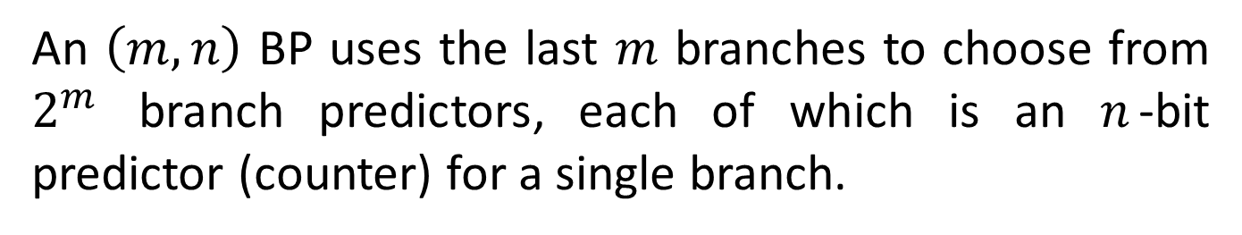
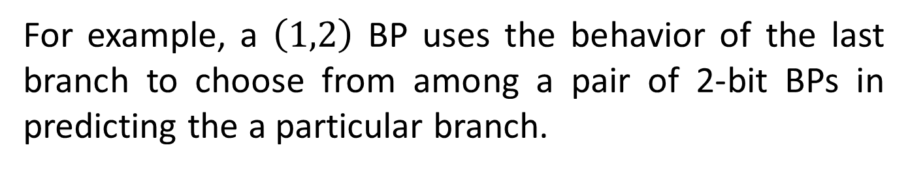
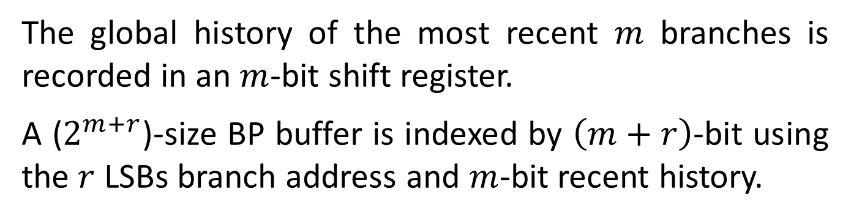
For example, a $\left(1,2\right)$ BP uses the behavior of the last branch to choose from among a pair of 2-bit BPs in predicting the a particular branch.
An $\left(m,n\right)$ BP uses the last $m$ branches to choose from $2^{m}$ branch predictors, each of which is an $n$-bit predictor (counter) for a single branch.
More accurate than $2$-bit and requires simple HW.
The global history of the most recent $m$ branches is recorded in an $m$-bit shift register.
A ($2^{m+r}$)-size BP buffer is indexed by $\left(m+r\right)$-bit using the $r$ LSBs branch address and $m$-bit recent history.

Slide 29
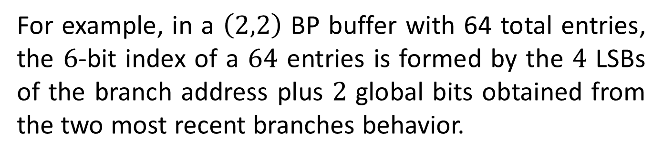
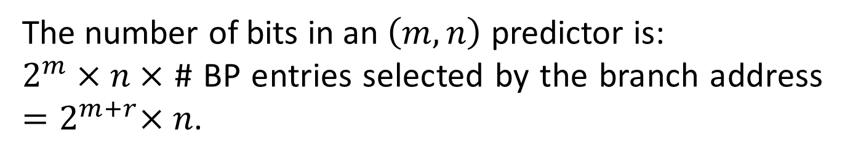
For example, in a $\left(2,2\right)$ BP buffer with 64 total entries, the $6$-bit index of a $64$ entries is formed by the $4$ LSBs of the branch address plus $2$ global bits obtained from the two most recent branches behavior.
For a fair comparison of the performance of BPs, the same number of state bits are used.
The number of bits in an $\left(m,n\right)$ predictor is:
$2^{m}×n×$ # BP entries selected by the branch address ${=2}^{m+r}×n$.
A $2$-bit predictor w/o global history is a $\left(0,2\right)$ predictor.

Slide 30
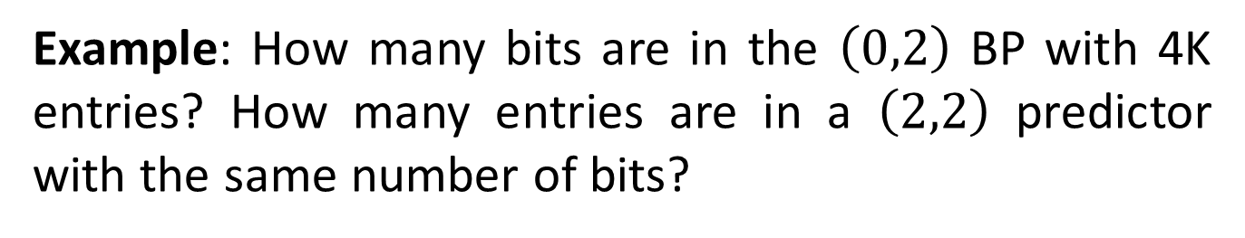
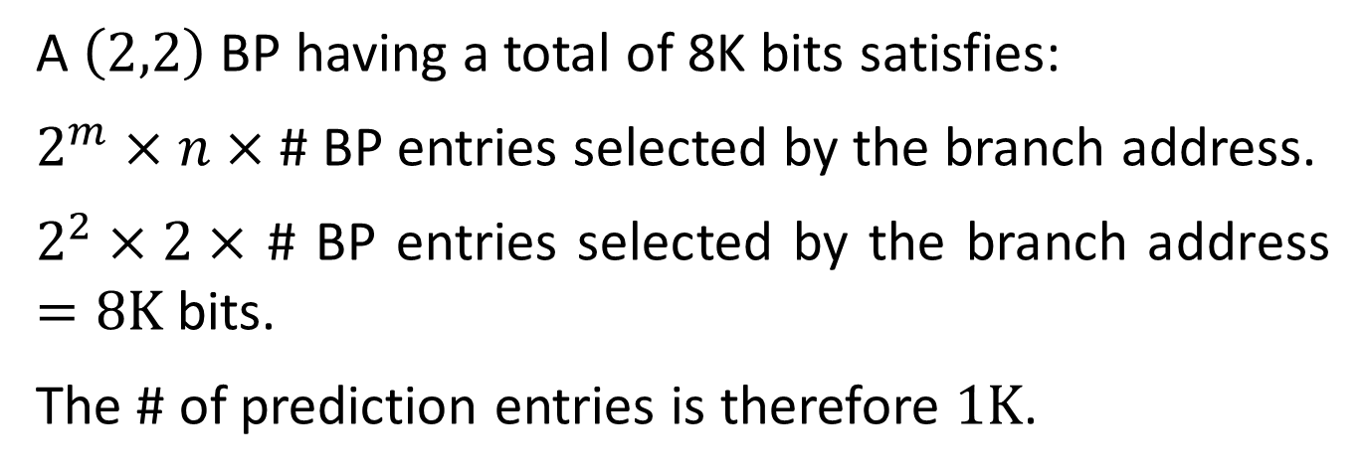
Example: How many bits are in the $\left(0,2\right)$ BP with 4K entries? How many entries are in a $\left(2,2\right)$ predictor with the same number of bits?
A $4K$-entries $\left(0,2\right)$BP has $2^{0}×2×4\text{K}\text{=}\text{8}\text{K}$ bits.
A $\left(2,2\right)$ BP having a total of 8K bits satisfies:
$2^{m}×n×$ # BP entries selected by the branch address.
$2^{2}×2×$ # BP entries selected by the branch address $=8\text{K}$ bits.
The # of prediction entries is therefore $\text{1}\text{K}$.

Slide 31
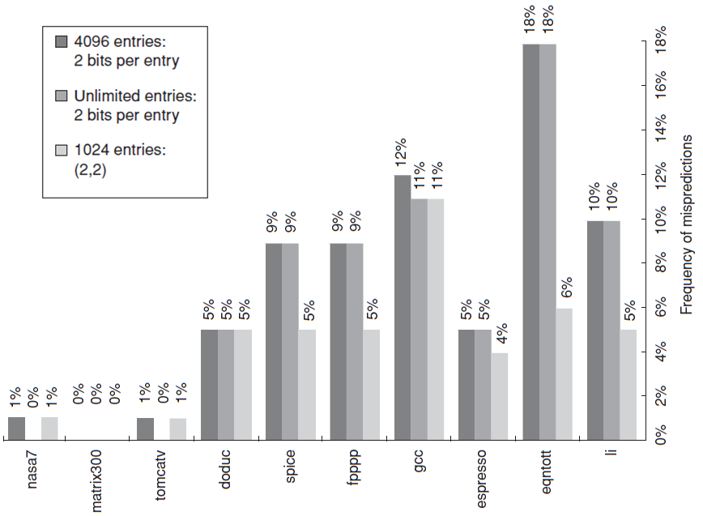
not much improvement
significant improvement

Slide 32
Tournament Predictors
Tournament predictors combine predictors based on global and local information.
They achieve better accuracy and effectively use very large numbers of prediction bits.
Tournament BPs use a 2-bit saturating counter per branch to select between two different BP (local, global), based on which was most effective in recent predictions.
As in a simple 2-bit predictor, the saturating counter requires two mispredictions before changing the identity of the preferred BP.

Slide 33
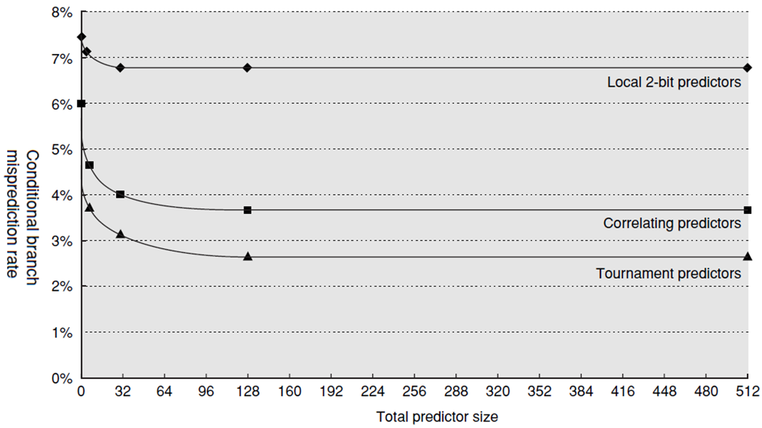

Slide 34





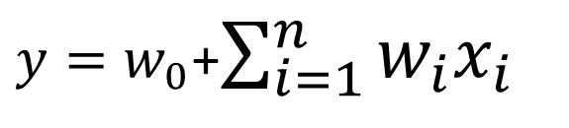




Perceptron-Based Branch Predictor
$$1$$
$$x_{1}$$
$$x_{i}$$
$$x_{n}$$
$$w_{0}$$
$$w_{1}$$
$$w_{i}$$
$$w_{n}$$
$y=w_{0}$+$\sum_{i=1}^{n}{w_{i}x_{i}}$
$$y$$
$x_{i}$ are $±1$ bits of global recent $n$-bit branch history.
$t=±1$ is the real branch outcome (taken, not taken).

Slide 35
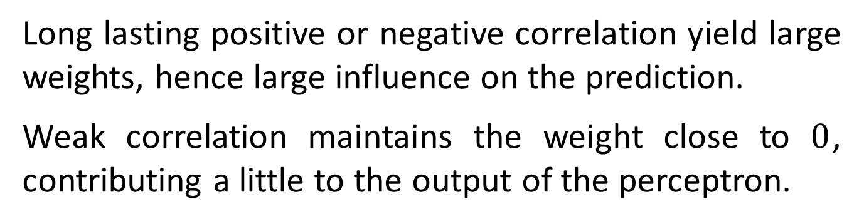
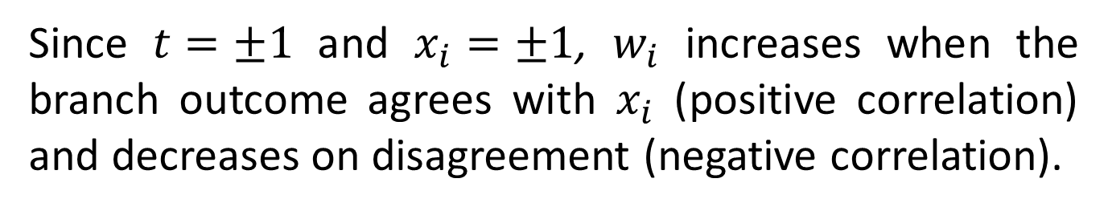
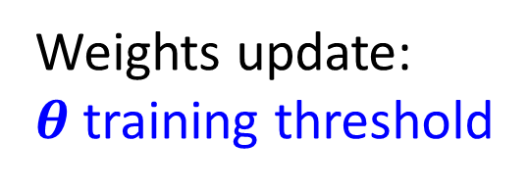
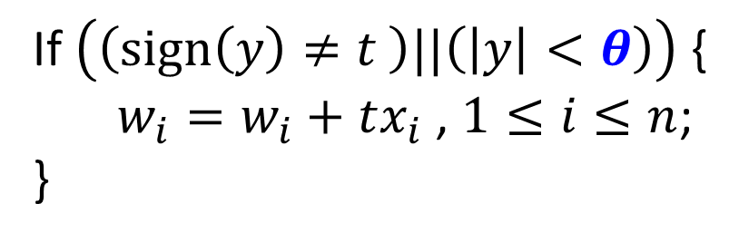
If $\left(\left(\text{sign}\left(y\right)≠t \right)||\left(\left|y\right|<θ\right)\right)$ {
$w_{i}=w_{i}+tx_{i}$ , $1≤i≤n$;
}
Weights update: $θ$training threshold
Since $t=±1$ and $x_{i}=±1$, $w_{i}$ increases when the branch outcome agrees with $x_{i}$ (positive correlation) and decreases on disagreement (negative correlation).
Long lasting positive or negative correlation yield large weights, hence large influence on the prediction.
Weak correlation maintains the weight close to $0$, contributing a little to the output of the perceptron.

Slide 36
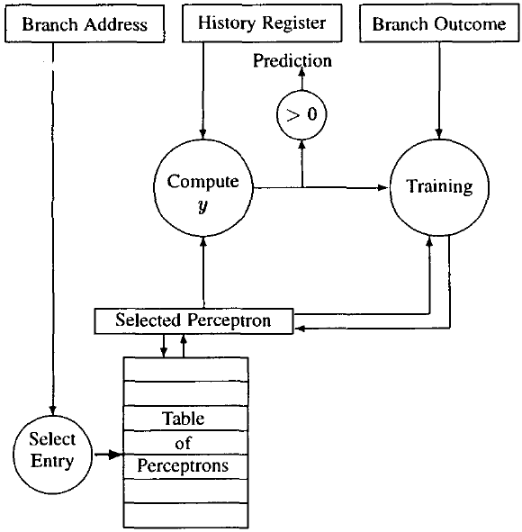

Slide 37
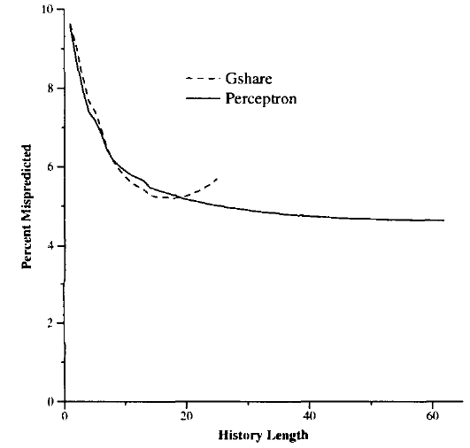


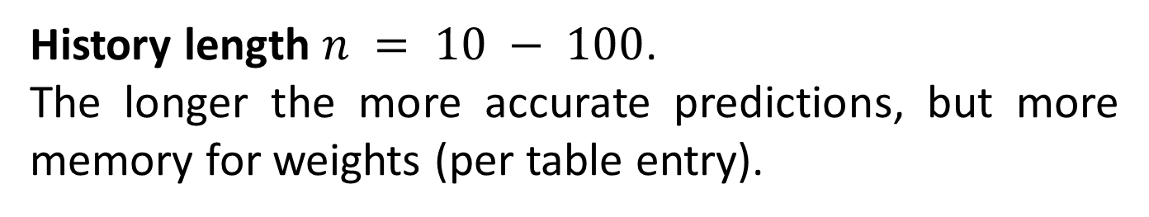



History length $n = 10 − 100$.
The longer the more accurate predictions, but more memory for weights (per table entry).
$$10\%$$
misprediction
$$5\%$$
$$10$$
$$60$$
history length $n$

