Slide 1
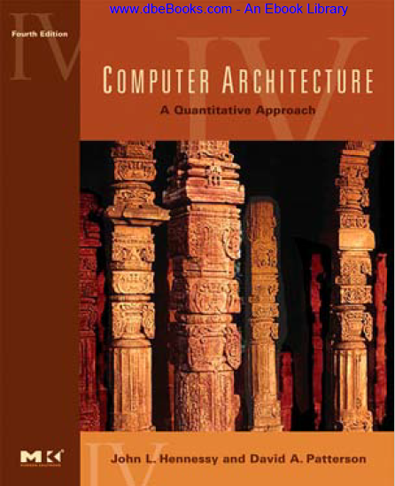
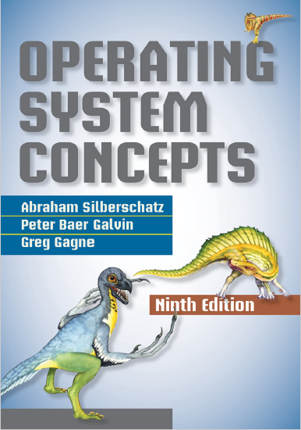
I/O and Storage
prepared and instructed by
Shmuel Wimer
Eng. Faculty, Bar-Ilan University

Slide 2
Overview
Two main jobs of a computer: I/O and processing.
Controlling devices is major OS design concern, since I/O vary in function and speed (e.g. mouse, hard disk).
I/O HW elements, such as ports, buses, and device controllers, accommodate a wide variety of I/O devices.
To encapsulate the details and oddities of different devices, OS kernel uses device-driver modules.
Device drivers allow uniform access I/O interface. System calls provide standard interface between the application and OS.

Slide 3
I/O Hardware
The device communicates with the machine via port.
Devices are connected by bus with well defined protocol specifying the messages that can be sent.
Buses vary in their signaling methods, speed, throughput, and connection methods.
PC bus called PCI bus connects the processor–memory subsystem to fast devices.
Expansion bus connects slow devices (keyboard, serial and USB ports).

Slide 4
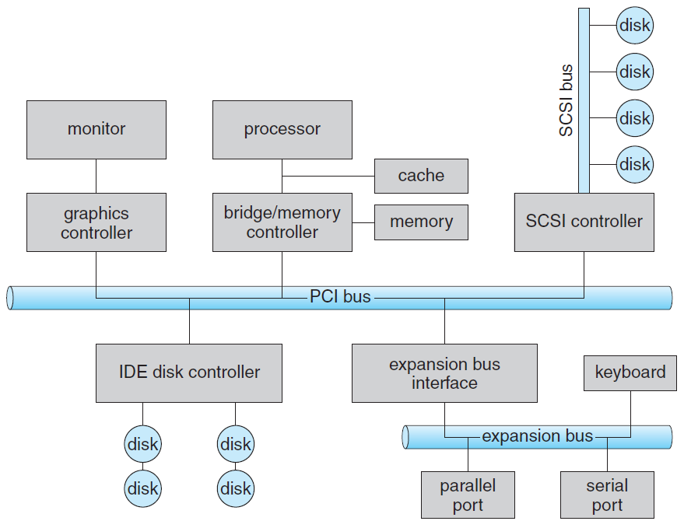
PC bus structure.

Slide 5
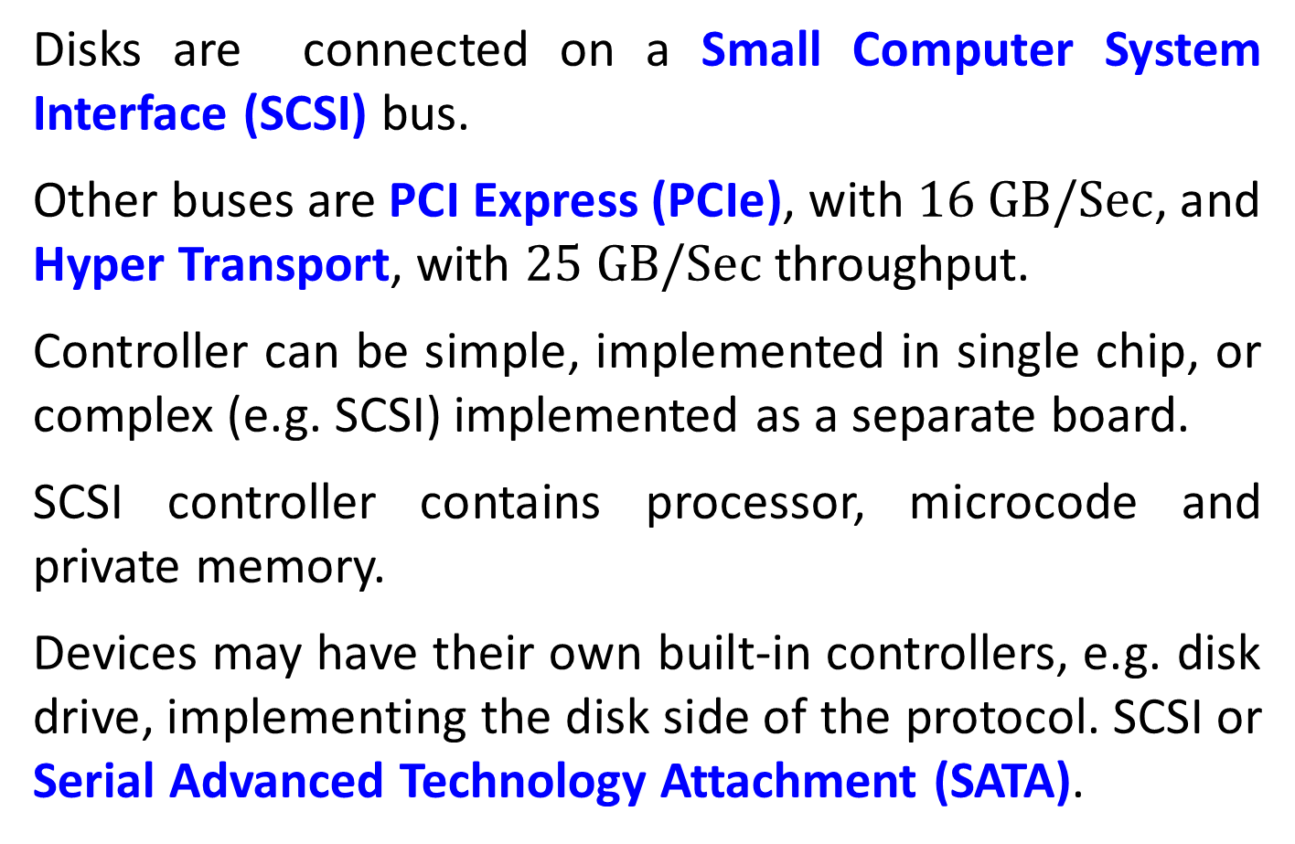
Disks are connected on a Small Computer System Interface (SCSI) bus.
Other buses are PCI Express (PCIe), with $\text{16 }\text{GB}\text{/}\text{Sec}$, and Hyper Transport, with $\text{25 }\text{GB}\text{/}\text{Sec}$throughput.
Controller can be simple, implemented in single chip, or complex (e.g. SCSI) implemented as a separate board.
SCSI controller contains processor, microcode and private memory.
Devices may have their own built-in controllers, e.g. disk drive, implementing the disk side of the protocol. SCSI or Serial Advanced Technology Attachment (SATA).

Slide 6
It has microcode and processor doing many tasks, as bad-sector mapping, prefetching, buffering, and caching.
The controller has registers for data and control, used by the processor to communicate with the controller.
Special I/O instructions specify the transfer of a byte or word to an I/O port address.
The I/O instruction triggers bus lines to select the proper device and to move bits into or out of a device register.
Alternatively, the device controller can support memory-mapped I/O.

Slide 7
Device-control registers are mapped into the address space of the processor.
CPU executes I/O requests by ordinary R/W instructions to mapped locations in physical memory.
Graphics controller for instance has I/O ports for basic control operations, but has large memory mapped region for screen contents.
The controller generates the screen image based on the contents of this memory.
Writing millions bytes to the graphics memory is faster than issuing millions of I/O instructions.

Slide 8
I/O port has four registers:
Data-in, read by the host to get input.
Data-out, written by the host to send output.
Status read by the host, indicating command completion, byte availability to be read from the data-in, device error occurrence.
Control written by the host to start command, change device mode (e.g. full-duplex or half-duplex, enable parity check, select speed of serial port).
Controller may have FIFO to expand data register capacity, to hold device or host data burst until receive is possible.

Slide 9
Polling
2 bits coordinate the producer–consumer relationship between the controller and the host.
Busy bit in status register indicates controller state, set when busy, clear when ready to accept next command.
Command-ready bit in the command register signals host wishes, sets when a command is available for the controller to execute.
The host writes output through a port, coordinating with the controller by handshaking as follows.
1. Host repeatedly reads busy bit until becomes clear.

Slide 10
2. Host sets write bit in the command register and writes a byte into the data-out register.
3. Host sets command-ready bit.
4. Once controller notices that command-ready bit is set, it sets busy bit.
5. Controller reads the command register and sees the write command. It reads the data-out register to get the byte and does I/O to device.
6. Controller clears command-ready bit, clears error bit in the status register to indicate device I/O succeeded, and clears busy bit to indicate it is finished.

Slide 11
Polling loop is reasonable if controller device are fast, but if the wait is long, the host switches to another task.
How, then, does it know when the controller has become idle?
Polling is inefficient when attempted repeatedly yet rarely finds a device ready for service, while other useful CPU processing remains undone.
It is more efficient that hardware controller notifies the CPU when device becomes ready for service.
The HW enabling device notify the CPU is called interrupt.

Slide 12
Interrupts
The CPU has a wire called the interrupt-request line sensed after executing every instruction.
When detecting that controller has asserted a signal on the line, CPU state is saved.
CPU jumps to the interrupt-handler routine at fixed address in memory.
Interrupt handler determines cause of interrupt and performs necessary processing, and returns CPU state prior to the interrupt.

Slide 13
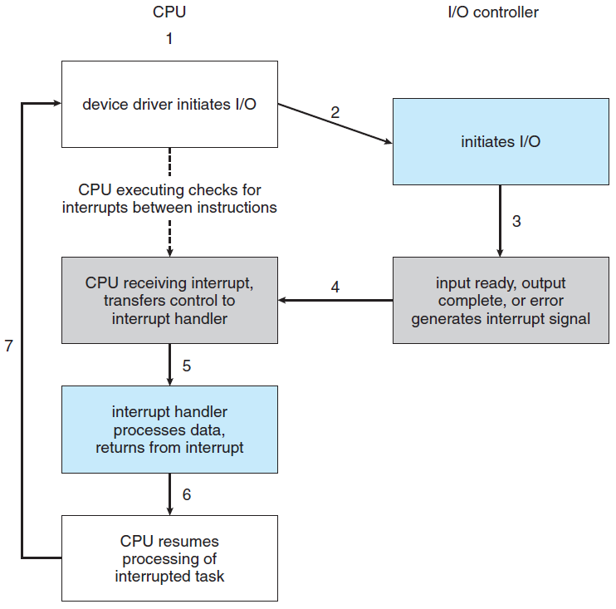
Interrupt-driven I/O cycle.

Slide 14
Modern OS, use more sophisticated interrupt-handling features.
1. Defer interrupt handling during critical processing.
2. Dispatch to proper interrupt handler without polling all devices to see which one raised the interrupt.
3. Support multilevel interrupts, allowing OS responding by interrupts priority.
Above are provided by the CPU and by the interrupt controller hardware.
CPUs have two interrupt request lines.

Slide 15
One is nonmaskable interrupt, reserved for events such as unrecoverable memory errors.
Second is maskable, used by device controllers to request service, is turned off by CPU before executing critical instruction that must not be interrupted.
Interrupt accepts an address (offset in interrupt vector) to selects interrupt-handling routine.
Interrupts have priority levels, enabling CPU to defer low-priority interrupts without masking all, making high priority interrupt to preempt.

Slide 16
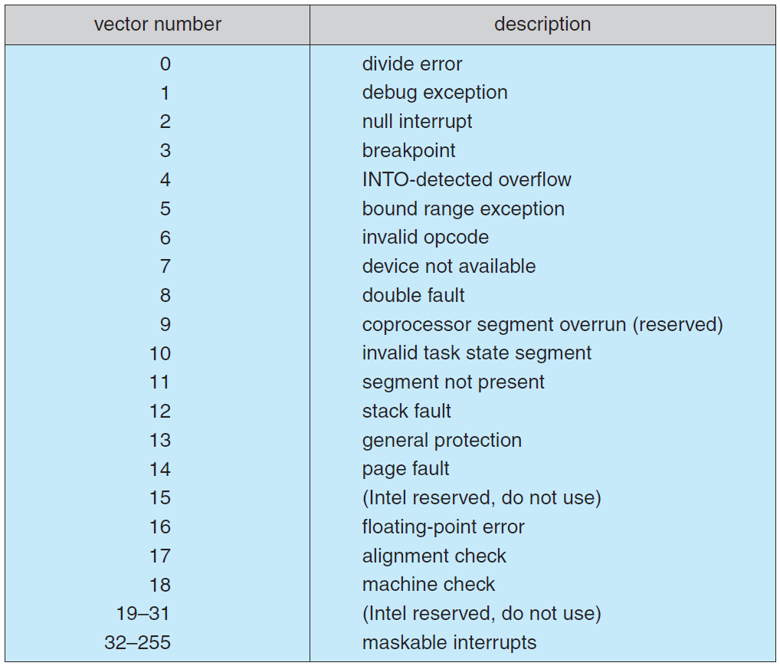
Intel Pentium processor event-vector.

Slide 17
Interrupts are used to handle exceptions (e.g. dividing by 0, access protected memory address, attempt execute non user mode instruction).
Interrupts are also used for trap, used to issue system calls, calling the kernel.
Trap has low priority compared to device. System call on behalf of application is less urgent than servicing device controller, before FIFO queue overflows and loses data.
Threaded kernel is well suited to implement multiple interrupt priorities and enforce precedence.

Slide 18
Direct Memory Access
Interrupts or polling are wasteful for transferring big amount of data between the disk and memory.
Rather, special-purpose processor called direct-memory-access (DMA) is used.
The CPU writes a DMA command block into memory, containing a pointer to transfer source, a pointer to transfer destination, and number of transferred bytes.
The CPU writes the address of this command block to the DMA controller, then goes on with other work.

Slide 19
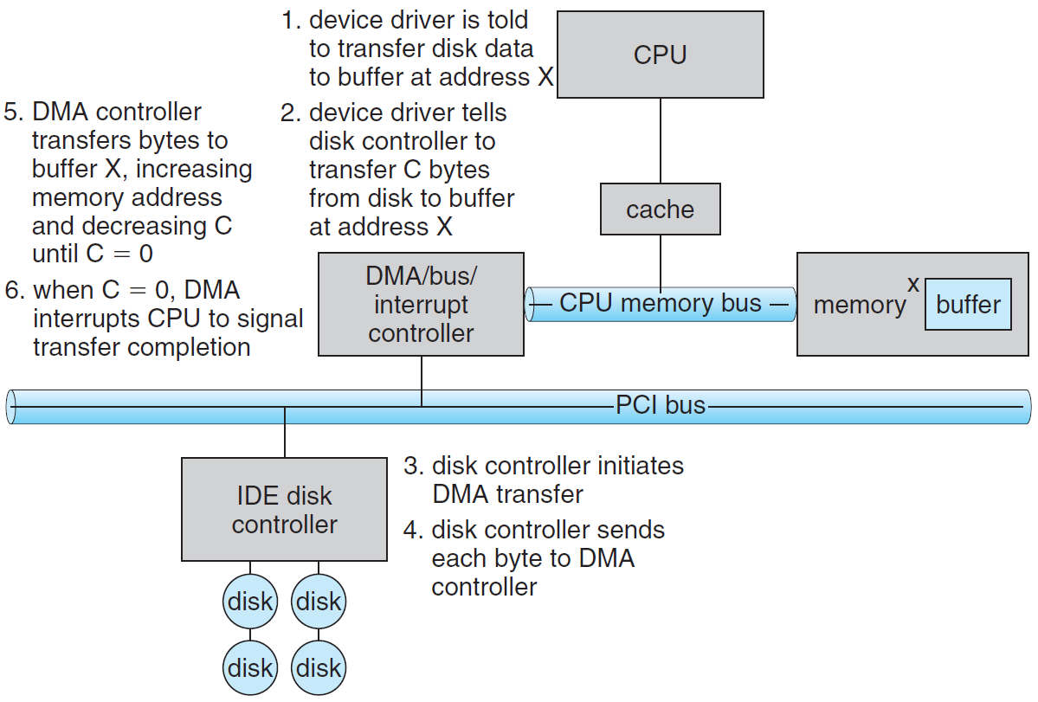
DMA transfer

Slide 20
The DMA places addresses on the bus to perform transfers without CPU intervention.
DMA-disk handshaking is performed via a pair of DMA-request and DMA-acknowledge wires.
Disk controller sets DMA-request when data is available for transfer.
DMA controller seizes memory bus, placing address on memory-address wires, and setting DMA-acknowledge.
Device controller receives DMA-acknowledge, transfers word of data to memory and clears the DMA-request.

Slide 21
When the entire transfer is finished, the DMA controller interrupts the CPU.
DMA controller seize of memory bus prevents CPU momentary access to main memory (but not to cache), called cycle stealing.
Although cycle stealing can slow down the CPU, offloading data-transfer work to a DMA improves the total system performance.

Slide 22
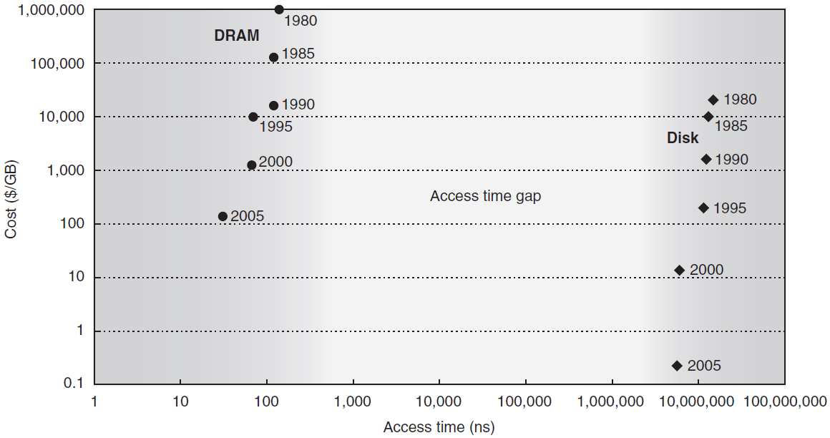
Disk Storage
5 orders of magnitude
2.5 orders of magnitude
Density and access time improvement over 25 years

Slide 23
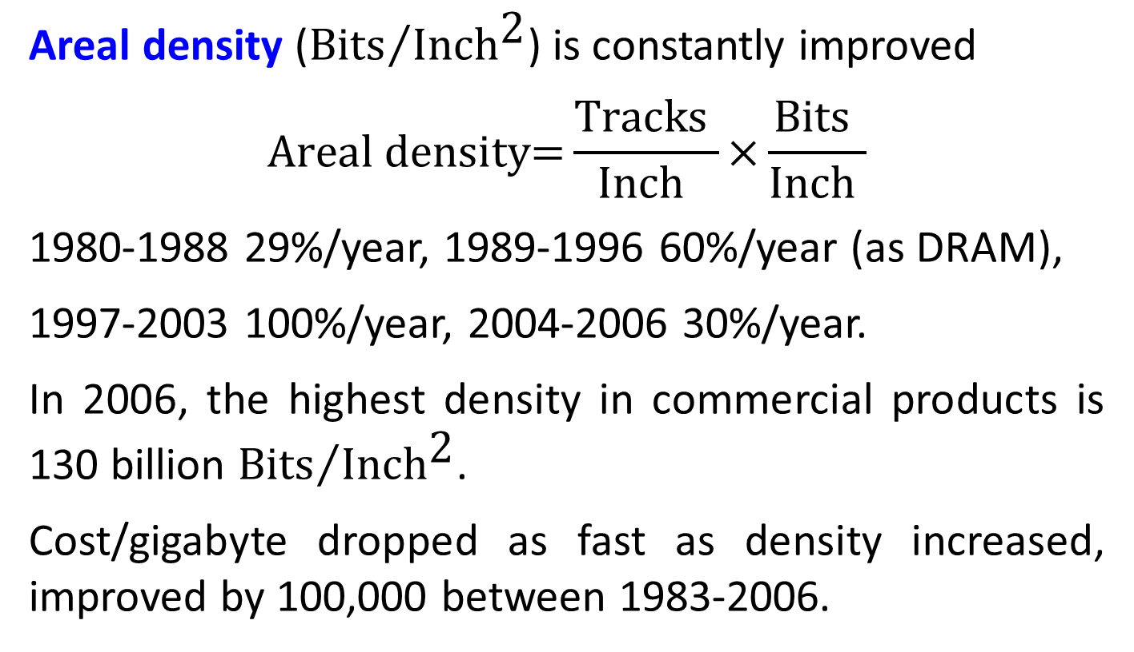
Areal density (${\text{Bits}}/{{\text{Inch}}^{\text{2}}}$) is constantly improved
$$\text{Areal} \text{density}\text{=}\frac{\text{Tracks} }{\text{Inch} }\text{×}\frac{\text{Bits} }{\text{Inch} }$$
1980-1988 29%/year, 1989-1996 60%/year (as DRAM),
1997-2003 100%/year, 2004-2006 30%/year.
In 2006, the highest density in commercial products is 130 billion ${\text{Bits}}/{{\text{Inch}}^{\text{2}}}$.
Cost/gigabyte dropped as fast as density increased, improved by 100,000 between 1983-2006.

Slide 24
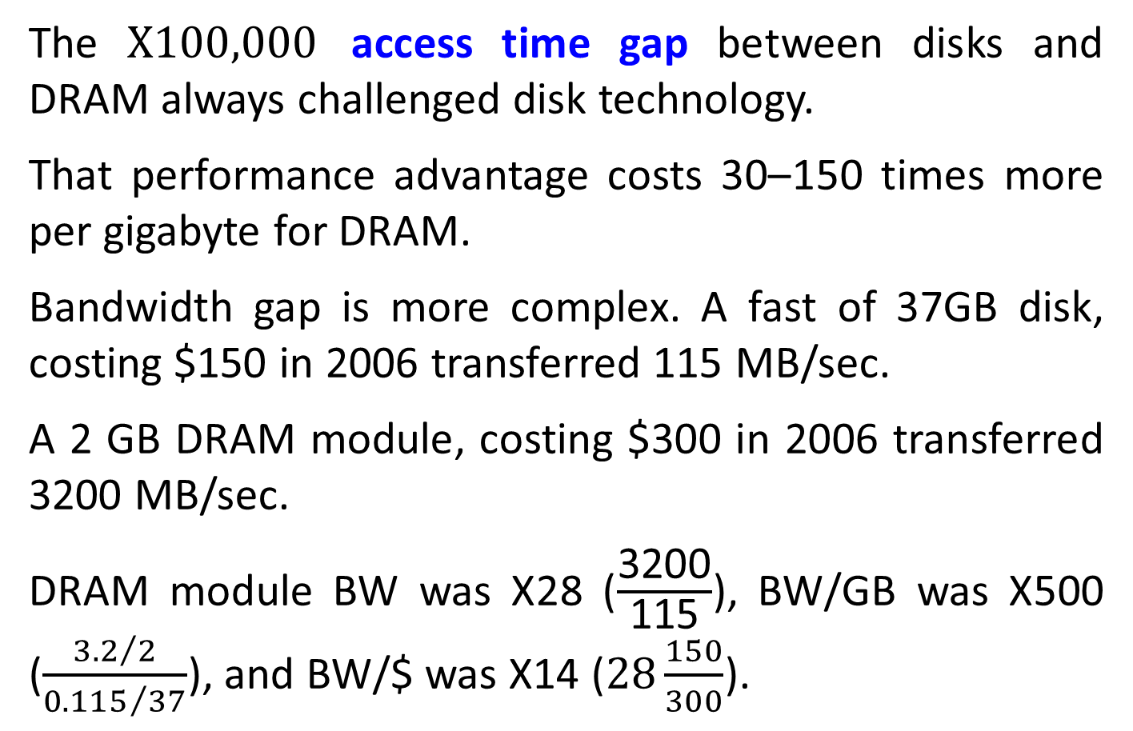
The $\text{X}\text{100}\text{,}\text{000}$ access time gap between disks and DRAM always challenged disk technology.
That performance advantage costs 30–150 times more per gigabyte for DRAM.
Bandwidth gap is more complex. A fast of 37GB disk, costing $150 in 2006 transferred 115 MB/sec.
A 2 GB DRAM module, costing $300 in 2006 transferred 3200 MB/sec.
DRAM module BW was X28 ($\frac{\text{3200}}{\text{115}}$), BW/GB was X500 ($\frac{{3.2}/2}{{0.115}/{37}}$), and BW/$ was X14 ($28\frac{150}{300}$).

Slide 25
Flash memory (SSD) may be an alternative. Nonvolatile with same BW as disks, but latency is 100–1000 faster and much smaller power.
$/GB of flash is about the same as DRAM (X50 than disks), and endurance is a problem.
Disks will remain viable for the foreseeable future, replacing the sector-track-cylinder model by serpentine model across a single surface.
With microprocessor inside, disks offer higher-level intelligent interfaces, like ATA and SCSI.

Slide 26
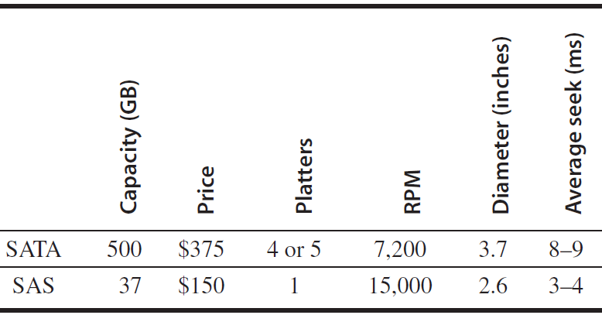
Disk Power ≈ Diameter^{4.6} × RPM^{2.8} × Number of platters

Slide 27

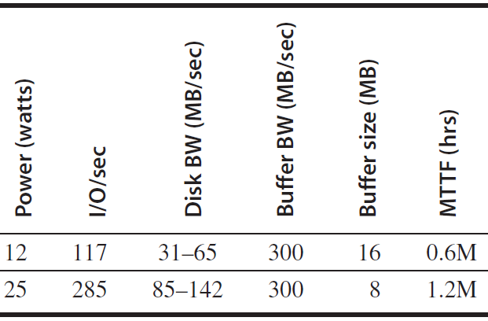

Slide 28
Disks include buffers to hold the data until the computer is ready to accept it.
Caches are also included to avoid read accesses.
Disks have a command queue allowing to decide the access order to maximize performance while maintaining correct behavior.
Depth of 50 can double the number of I/Os per second of random I/Os due to better scheduling of accesses.
Number of platters shrank from 12 to 4 or even 1.

Slide 29
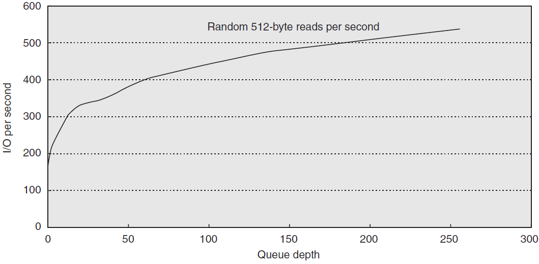

Slide 30
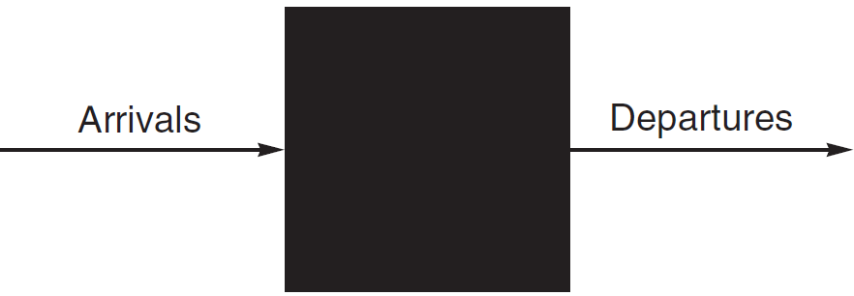
I/O and Queuing Theory
Probabilistic nature of I/O suggests queuing theory to calculate response time and throughput of I/O system.
Processor makes I/O requests arriving the I/O device. The requests “depart” when the I/O device fulfills them. We focus on the long term, or steady state.

Slide 31
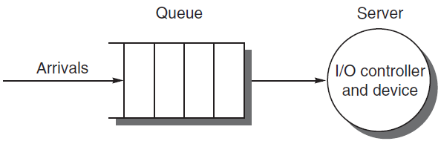
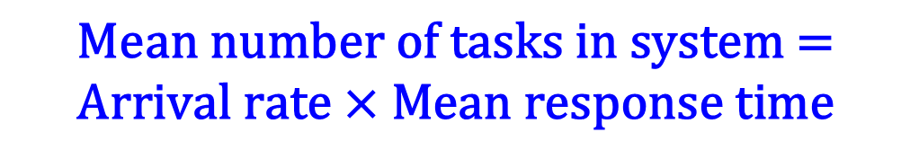
Simplifying assumptions:
Multiple independent I/O request in equilibrium: input rate = output rate.
Steady supply of tasks independent for how long they wait for service.
$$\text{Mean} \text{number} \text{of} \text{tasks} \text{in} \text{system}\text{ =}$$
$$\text{Arrival} \text{rate}\text{ × }\text{Mean} \text{response} \text{time}$$
Can be >1 since tasks services may overlap (few servers).
I/O request “departs” by server completion.

Slide 32
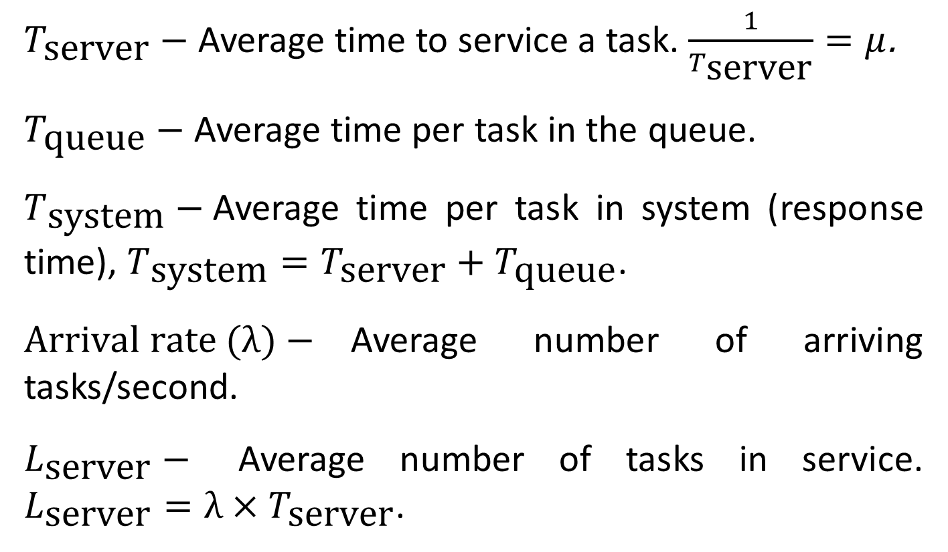
$T_{\text{server}}−$ Average time to service a task. $\frac{1}{T_{\text{server}}}=μ$.
$T_{\text{queue}}−$ Average time per task in the queue.
$T_{\text{system}}−$Average time per task in system (response time), $T_{\text{system}}=T_{\text{server}}+T_{\text{queue}}$.
$\text{Arrival} \text{rate}\text{ (}λ)−$Average number of arriving tasks/second.
$L_{\text{server}}−$ Average number of tasks in service. $L_{\text{server}}=λ×T_{\text{server}}$.

Slide 33
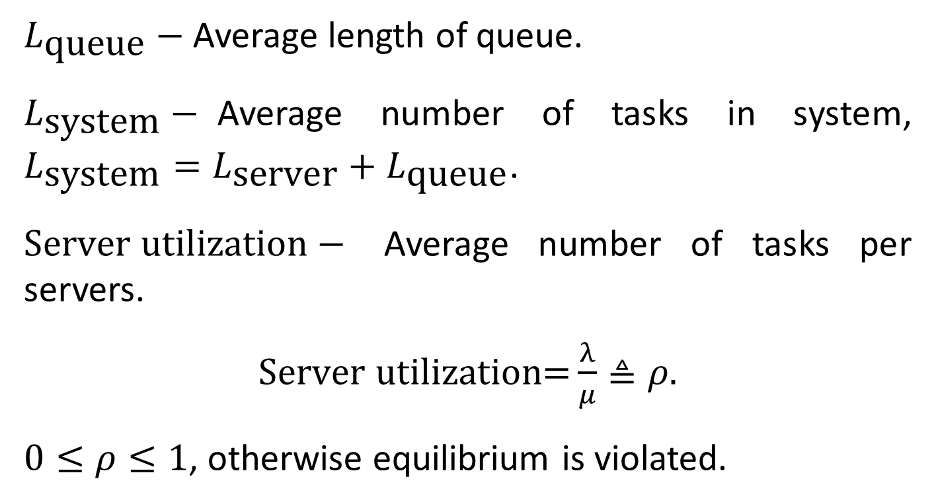
$L_{\text{queue}}−$ Average length of queue.
$L_{\text{system}}−$Average number of tasks in system, $L_{\text{system}}=L_{\text{server}}+L_{\text{queue}}$.
$\text{Server} \text{utilization}−$ Average number of tasks per servers.
$\text{Server} \text{utilization}\text{=}\frac{λ}{μ}≜ρ$.
$0≤ρ≤1$, otherwise equilibrium is violated.

Slide 34
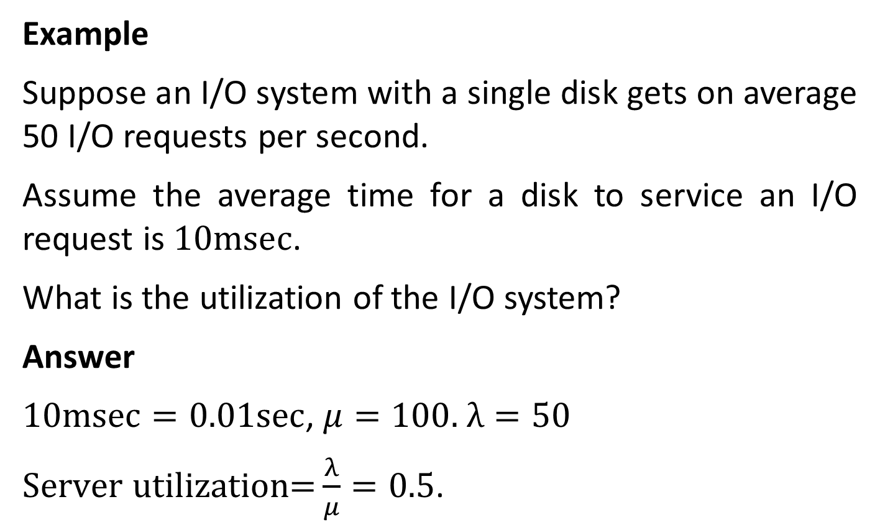
Example
Suppose an I/O system with a single disk gets on average 50 I/O requests per second.
Assume the average time for a disk to service an I/O request is $10\text{msec}$.
What is the utilization of the I/O system?
Answer
$10\text{msec}=0.01\text{sec}$, $μ=100.$ $λ=50$
$\text{Server} \text{utilization}\text{=}\frac{λ}{μ}=0.5$.

Slide 35
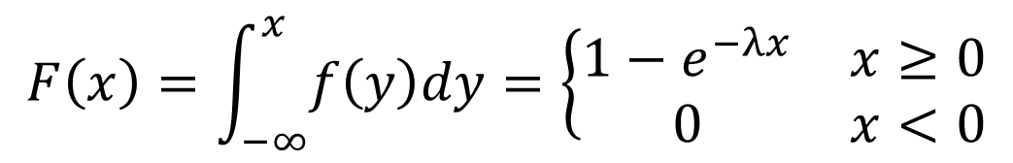
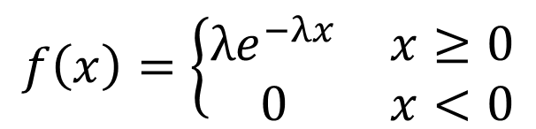
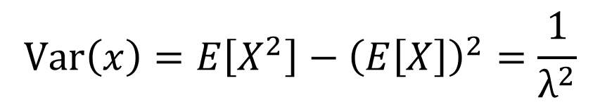
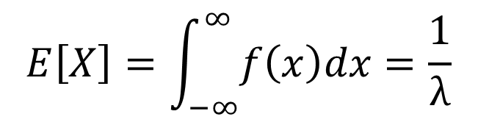
The Exponential Distribution
$X$ exponentially distributed with parameter $λ>0$
$$f\left(x\right)=\left\{\begin{matrix}{λe}^{−λx} & x≥0 \\ 0 & x<0\end{matrix}\right.$$
pdf:
$$F\left(x\right)=\int_{−∞}^{x}{f\left(y\right)dy}=\left\{\begin{matrix}{1−e}^{−λx} & x≥0 \\ 0 & x<0\end{matrix}\right.$$
cdf:
$$E\left[X\right]=\int_{−∞}^{∞}{f\left(x\right)dx}=\frac{1}{λ}$$
mean:
$$Var\left(x\right)=E\left[X^{2}\right]−{\left(E\left[X\right]\right)}^{2}=\frac{1}{λ^{2}}$$
variance:

Slide 36
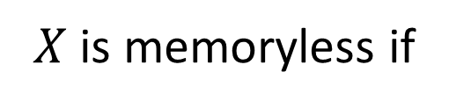
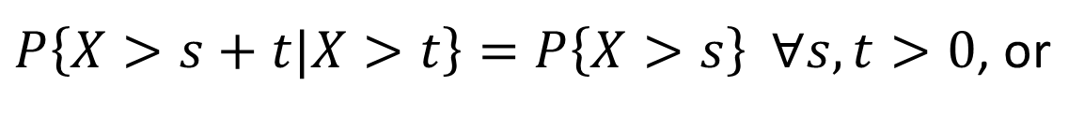

$X$ is memoryless if
$P\left\{X>s+t|X>t\right\}=P\left\{X>s\right\} ∀s,t>0$, or
$$P\left\{X>s+t\right\}=P\left\{X>s\right\}P\left\{X>t\right\}$$
Exponential distribution is memoryless since
$$e^{−λ\left(s+t\right)}=e^{−λs}e^{−λt}$$

