Slide 1


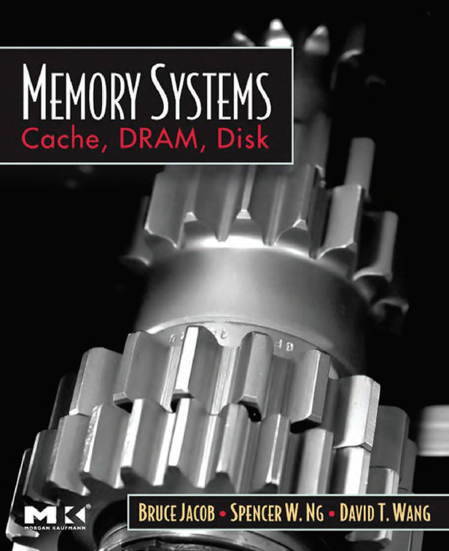
Caches
prepared and Instructed by
Shmuel Wimer
Eng. Faculty, Bar-Ilan University

Slide 2
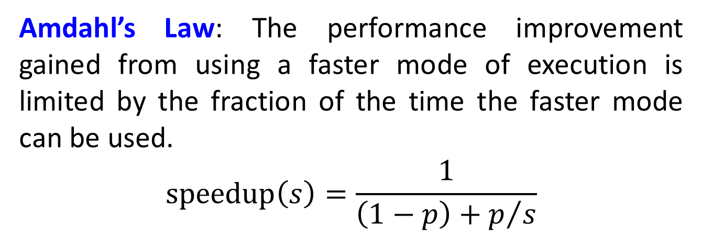
Amdahl’s Law
Speedup: How much faster a task will run on the computer with an enhancement, compared to the original computer.
Amdahl’s Law: The performance improvement gained from using a faster mode of execution is limited by the fraction of the time the faster mode can be used.
$$\text{speedup}\left(s\right)=\frac{1}{\left(1−p\right)+p/s}$$

Slide 3
Principle of Locality
Temporal locality (locality in time): If an item is referenced, it will tend to be referenced again soon.
Spatial locality (locality in space): If an item is referenced, items whose addresses are close will tend to be referenced soon.
locality in programs
loops - temporal
instructions are usually accessed sequentially - spatial
Data access of array - spatial

Slide 4
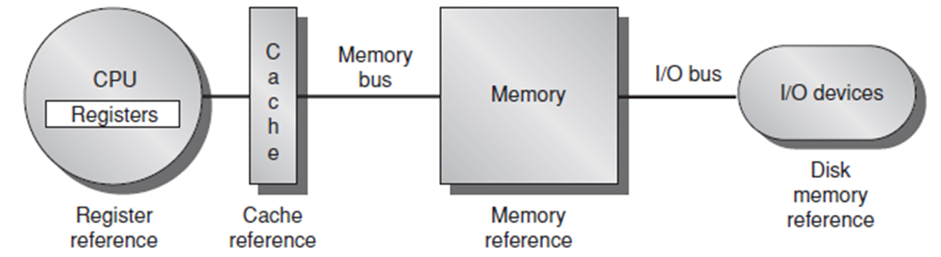
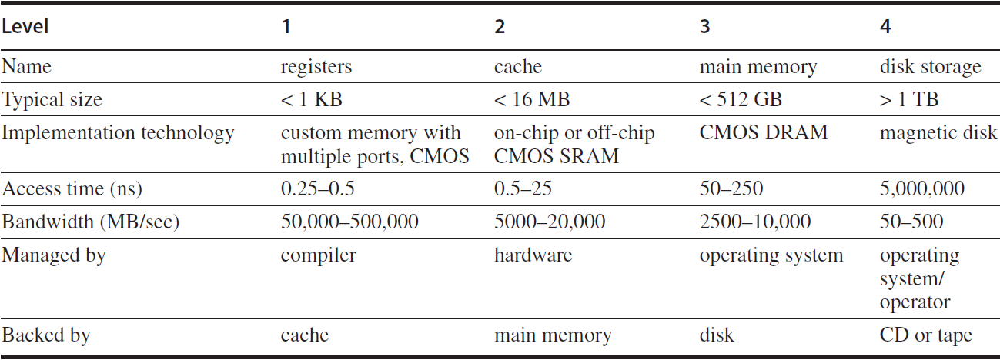
Memory Hierarchy

Slide 5
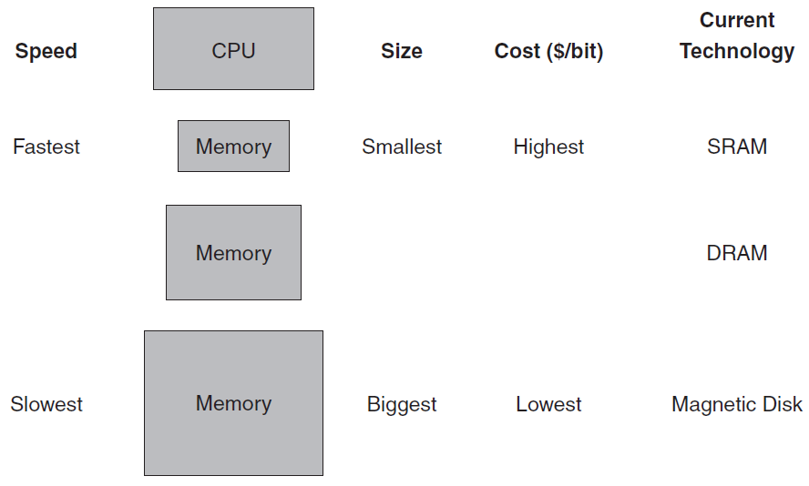
Memory Hierarchy
The memory system is organized as a hierarchy
A level closer to the processor is a subset of any level further away.
All the data is stored at the lowest level.
Hierarchical implementation makes the illusion of a memory size as the largest, but can be accessed as the fastest.

Slide 6
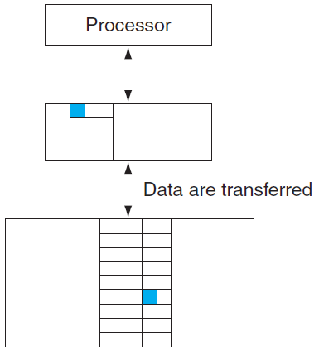
Hit and Miss
In a pair of levels one is upper and one is lower.
The unit within each level is called a block.
We transfer an entire block when we copy something between levels.
Hit rate, or hit ratio, is the fraction of memory accesses found in the upper level. Miss rate = 1 – hit rate.

Slide 7
Hit time: the time required to access a level of the memory hierarchy.
Includes the time needed to determine whether hit or miss.
Miss penalty: the time required to fetch a block into the memory hierarchy from the lower level.
Includes the time to access the block, transmit it from the lower level, and insert it in the upper level.
The memory system affects many other aspects of a computer:
How the operating system manages memory and I/O
How compilers generate code
How applications use the computer

Slide 8
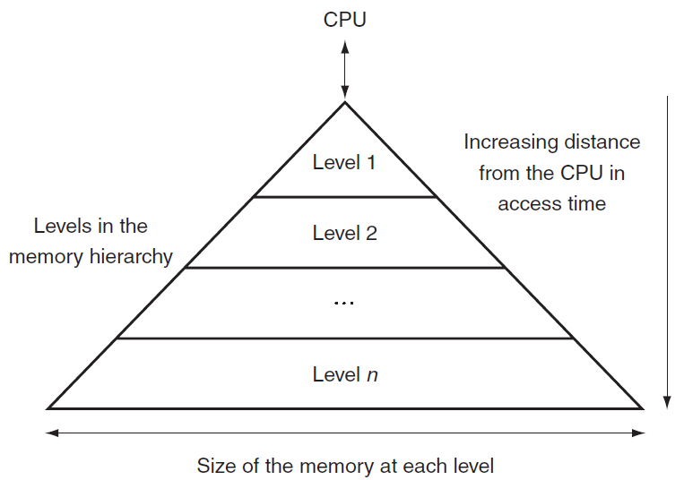
This structure allows the processor to have an access time that is determined primarily by level 1 of the hierarchy and yet have a memory as large as level n.

Slide 9
General Memory architecture
Bit-line Conditioning
Word-lines
Bit-lines
8 bits
Array of 2^{n}x2^{m} cells, organized in 2^{n-k} rows by 2^{m+k} columns
Row Decoder
2
n-k
k
1
Column Circuitry
n
3
Column Decoder
2^{m} bits
m=2
4-word by 8-bit folded memory

Slide 10
6-Transistor SRAM Cell

Slide 11
Dynamic RAM
bit0
bit1
bit511
word0
word1
word255

Slide 12
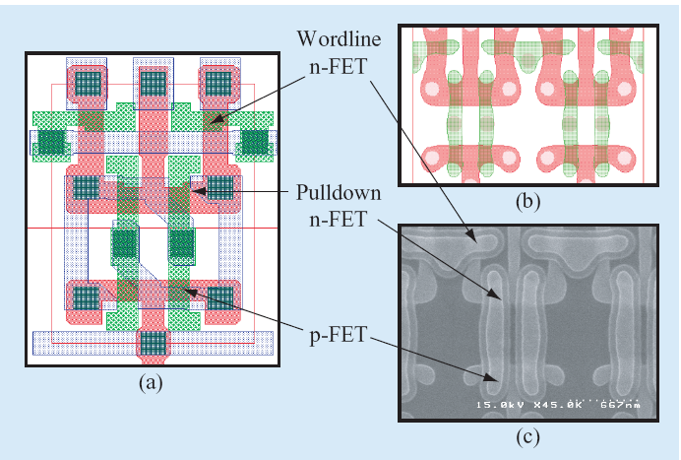
Lithography simulation
Layout design
Silicon

Slide 13
Polysilicon Word-Line
Sense Amp
Metal Bit-Line
n+ Diffusion
Word-Line Decoder
Bit-Line Contact
Capacitor
Word-Line Decoder
Word-Line Decoder
Word-Line Decoder
Sense Amp

Slide 14
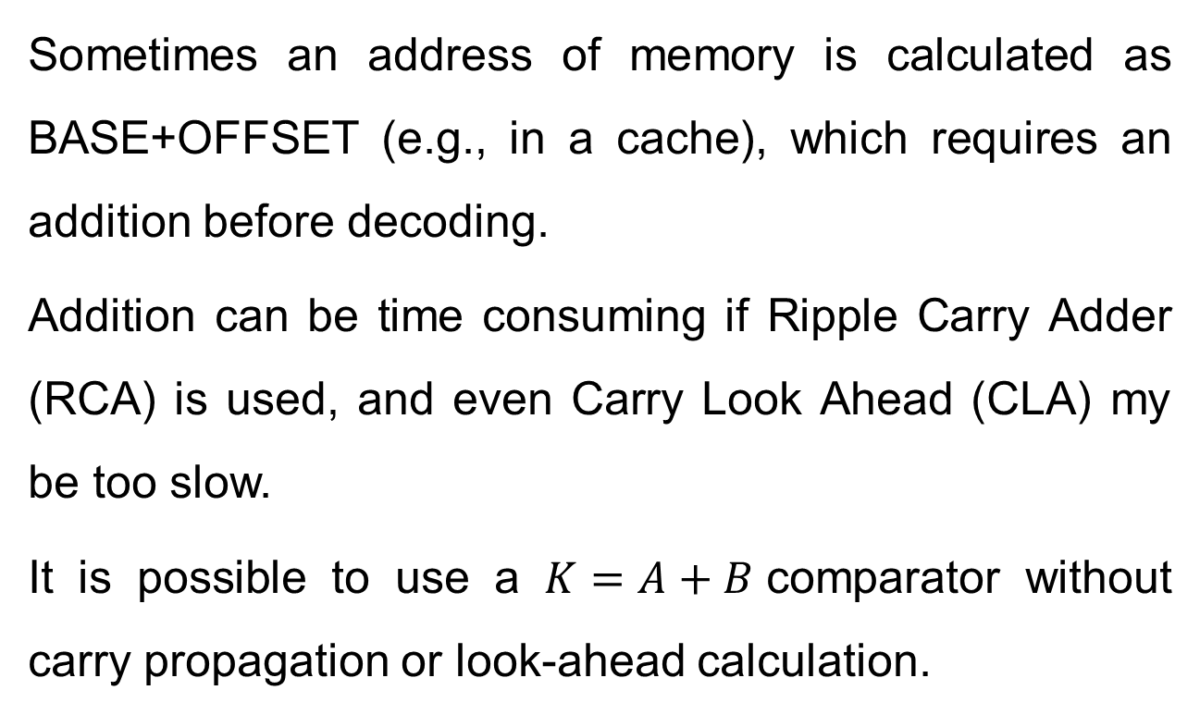
Sum-addressed Decoders
Sometimes an address of memory is calculated as BASE+OFFSET (e.g., in a cache), which requires an addition before decoding.
Addition can be time consuming if Ripple Carry Adder (RCA) is used, and even Carry Look Ahead (CLA) my be too slow.
It is possible to use a $K=A+B$comparator without carry propagation or look-ahead calculation.

Slide 15
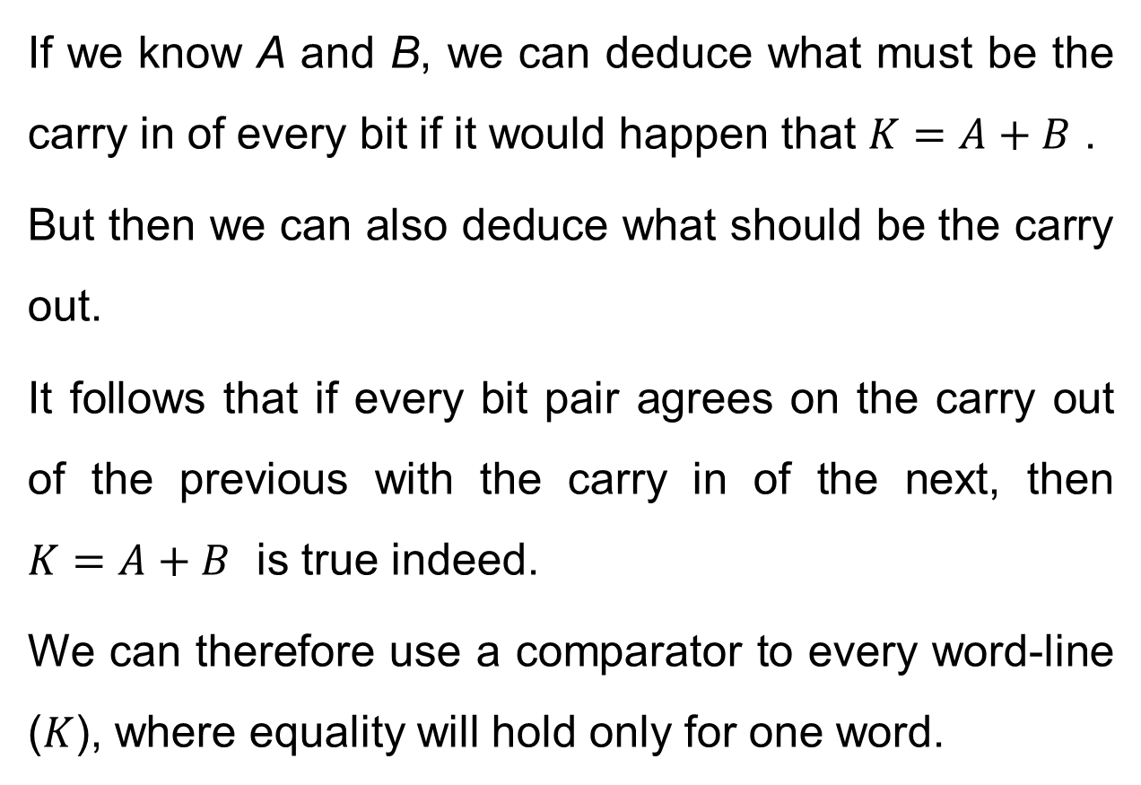
If we know A and B, we can deduce what must be the carry in of every bit if it would happen that $K=A+B$ .
But then we can also deduce what should be the carry out.
It follows that if every bit pair agrees on the carry out of the previous with the carry in of the next, then $K=A+B$ is true indeed.
We can therefore use a comparator to every word-line ($K$), where equality will hold only for one word.

Slide 16
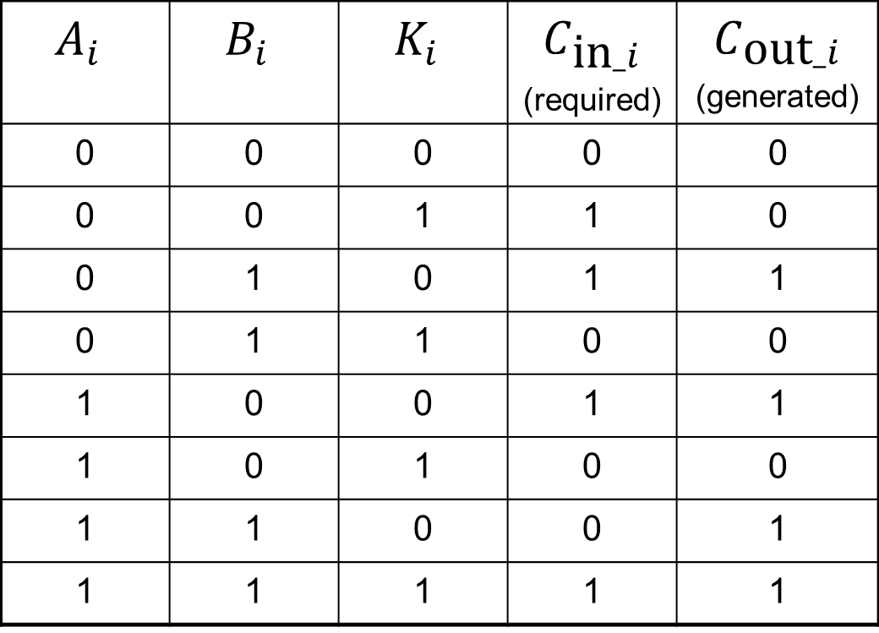
We can derive the equations of the carries from the required and generated carries below.
$$A_{i}$$ | $$B_{i}$$ | $$K_{i}$$ | $$C_{\text{in}_i}$$ (required) | $$C_{\text{out}_i}$$ (generated)
0 | 0 | 0 | 0 | 0
0 | 0 | 1 | 1 | 0
0 | 1 | 0 | 1 | 1
0 | 1 | 1 | 0 | 0
1 | 0 | 0 | 1 | 1
1 | 0 | 1 | 0 | 0
1 | 1 | 0 | 0 | 1
1 | 1 | 1 | 1 | 1

Slide 17
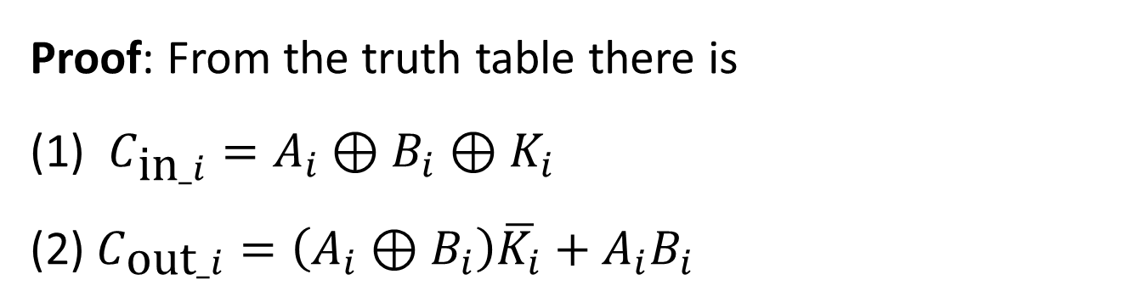
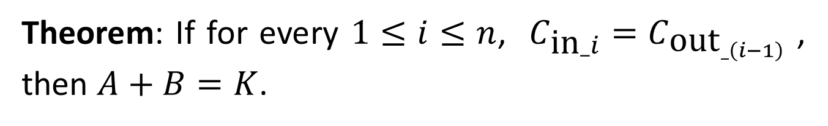
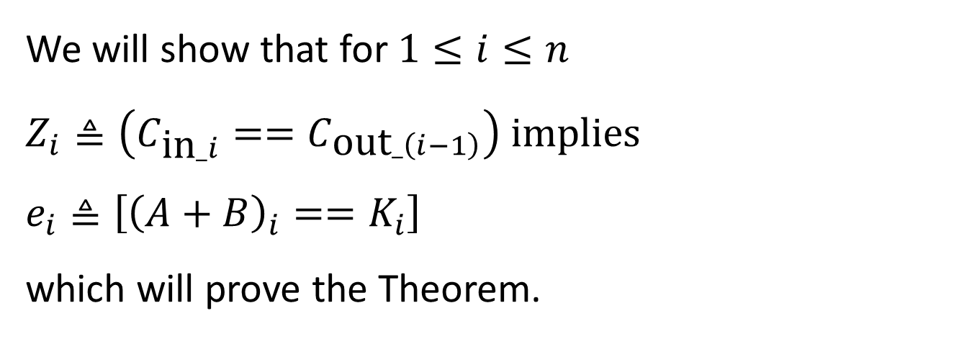
Theorem: If for every $1≤i≤n$, $C_{\text{in}_i}=C_{{\text{out}}_{_\left(i−1\right)}}$ , then $A+B=K$.
Proof: From the truth table there is
(1) $C_{\text{in}_i}=A_{i}⊕B_{i}⊕K_{i}$
(2) $C_{\text{out}_i}=\left(A_{i}⊕B_{i}\right)\overline{K_{i}}+A_{i}B_{i}$
We will show that for $1≤i≤n$
$Z_{i}≜\left(C_{\text{in}_i}==C_{\text{out}_\left(i−1\right)}\right)$ implies $e_{i}≜\left[{\left(A+B\right)}_{i}==K_{i}\right]$
which will prove the Theorem.

Slide 18
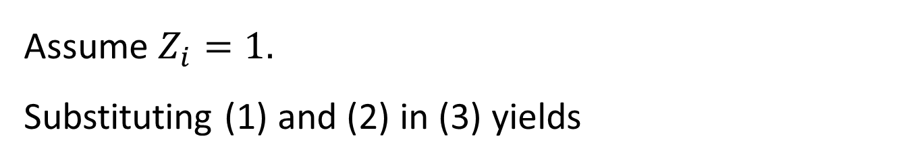
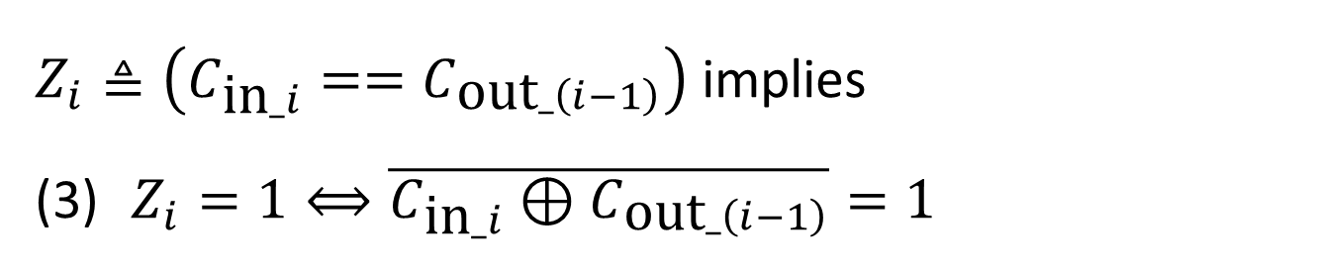
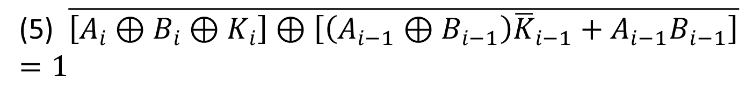
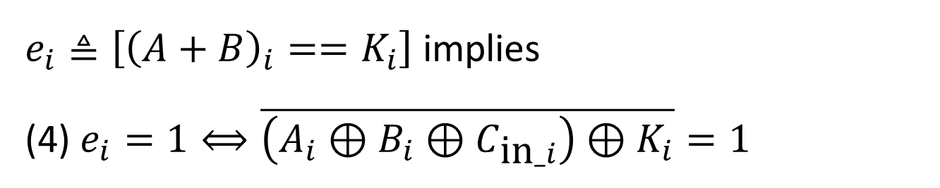
$Z_{i}≜\left(C_{\text{in}_i}==C_{\text{out}_\left(i−1\right)}\right)$ implies
$Z_{i}=1⟺\overline{C_{\text{in}_i}⊕C_{\text{out}_\left(i−1\right)}}=1$
$e_{i}≜\left[{\left(A+B\right)}_{i}==K_{i}\right]$ implies
(4) $e_{i}=1⟺\overline{\left(A_{i}⊕B_{i}⊕C_{\text{in}_i}\right)⊕K_{i}}=1$
Assume $Z_{i}=1$.
Substituting (1) and (2) in (3) yields
(5) $\overline{\left[A_{i}⊕B_{i}⊕K_{i}\right]⊕\left[\left(A_{i−1}⊕B_{i−1}\right){\overline{K}}_{i−1}+A_{i−1}B_{i−1}\right]}=1$

Slide 19
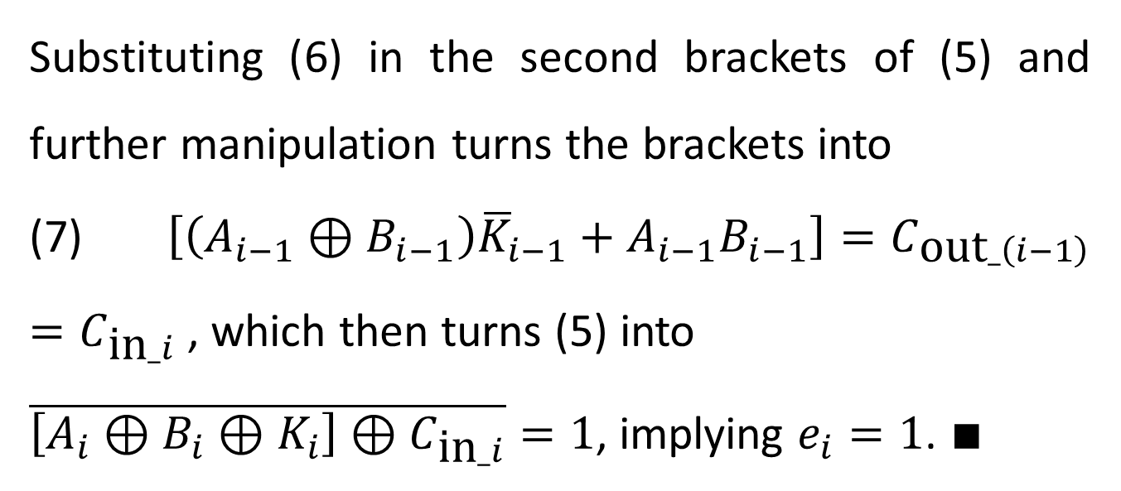
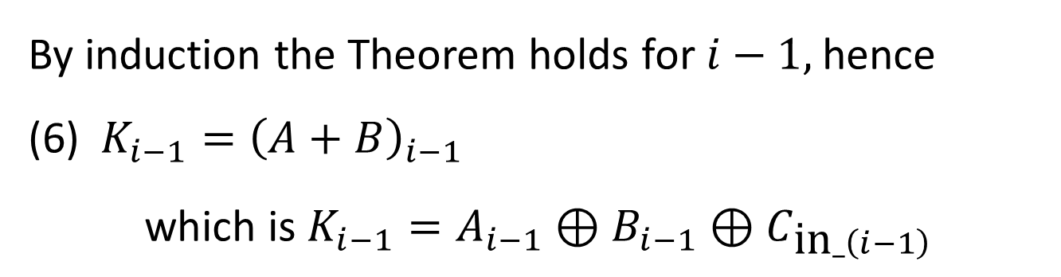
By induction the Theorem holds for $i−1$, hence
(6) $K_{i−1}={\left(A+B\right)}_{i−1}$
$$\text{w}\text{hich} \text{is} K_{i−1}=A_{i−1}⊕B_{i−1}⊕C_{\text{in}_\left(i−1\right)}$$
Substituting (6) in the second brackets of (5) and further manipulation turns the brackets into
(7) $\left[\left(A_{i−1}⊕B_{i−1}\right){\overline{K}}_{i−1}+A_{i−1}B_{i−1}\right]=C_{\text{out}_\left(i−1\right)}=C_{\text{in}_i}$ , which then turns (5) into
$\overline{\left[A_{i}⊕B_{i}⊕K_{i}\right]⊕C_{\text{in}_i}}=1$, implying $e_{i}=1$. $∎$

Slide 20







$$C_{\text{out}_i}$$
$$Equal$$
$$A_{i}$$
$$C_{\text{in}_i}$$
$$B_{i}$$
$$K_{i}$$
$$C_{\text{out}_\left(i−1\right)}$$

Slide 21
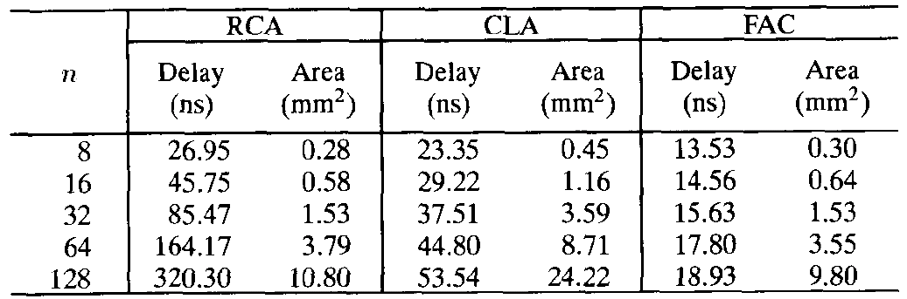
Below is a comparison of sum-addressed decoder with ordinary decoder combined with a ripple carry adder (RCA) and carry look ahead adder (CLA). A significant delay and area improvement is achieved.

Slide 22
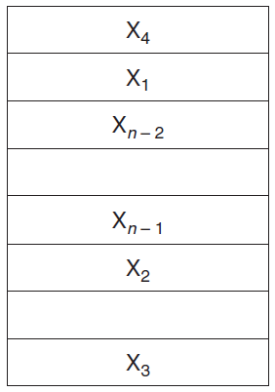
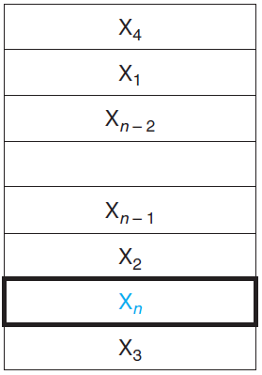
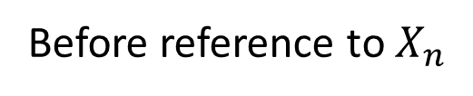
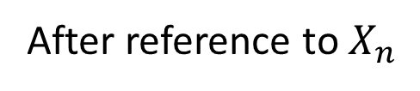
Requesting data from the cache
The processor requests a word $X_{n}$ that is not in the cache
Before reference to $X_{n}$
After reference to $X_{n}$
Two questions :
How do we know if a data item is in the cache?
If it is, how do we find it?

Slide 23
Direct-Mapped Cache
Each memory location is mapped to one cache location
Mapping between addresses and cache locations:
(Block address in Mem) % (# of blocks in cache)
Modulo is computed by using log₂(cache size in blocks) LSBs of the address.
The cache is accessed directly with the LSBs of the requested memory address.
Problem: this is a many-to-one mapping.
A tag field in a table containing the MSBs to identify whether the block in the hierarchy corresponds to a requested word.

Slide 24
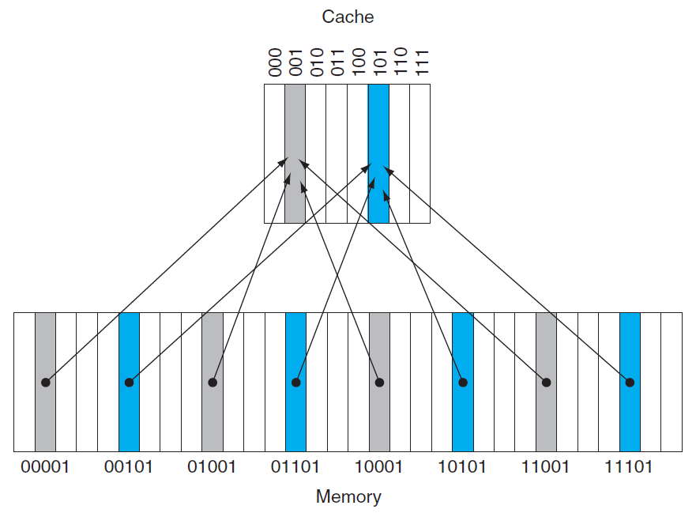
Mem address mod 8 = 101
Mem address mod 8 = 001
tag

Slide 25
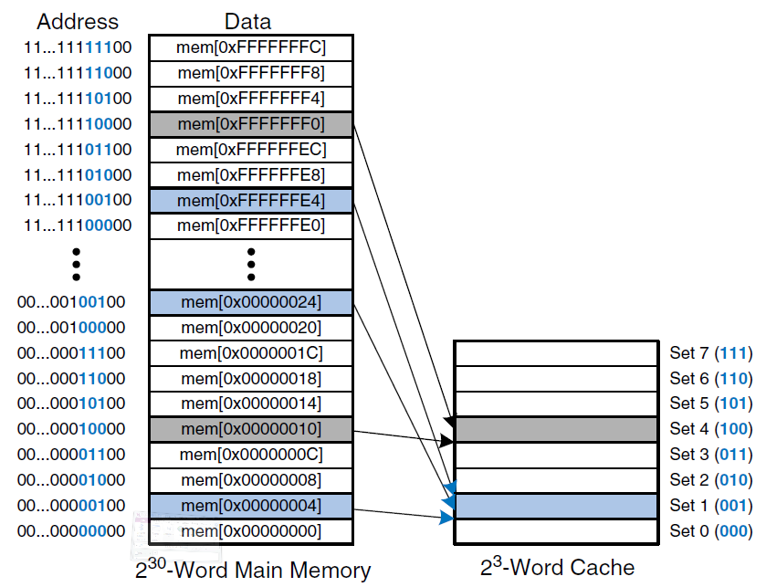
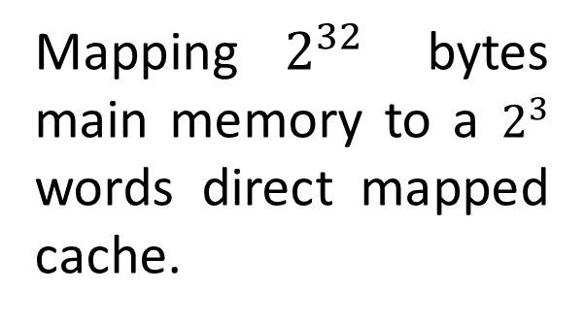
Mapping $2^{32}$ bytes main memory to a $2^{3}$ words direct mapped cache.

Slide 26
Some of the cache entries may still be empty.
We need to know that the tag should be ignored for such entries.
We add a valid bit to indicate whether an entry contains a valid address.

Slide 27
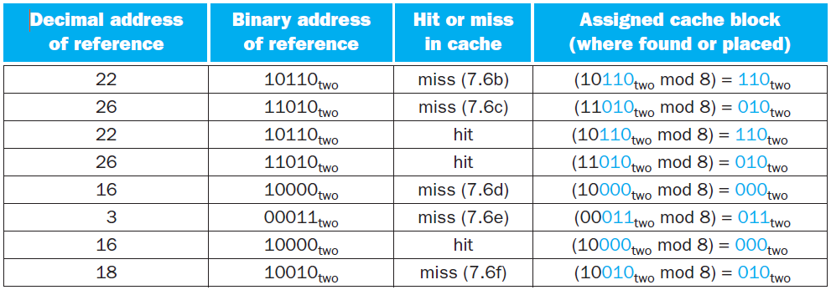
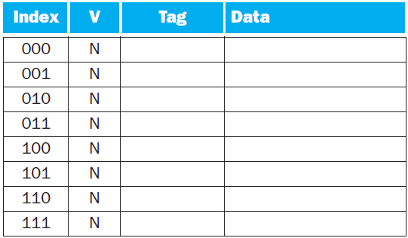
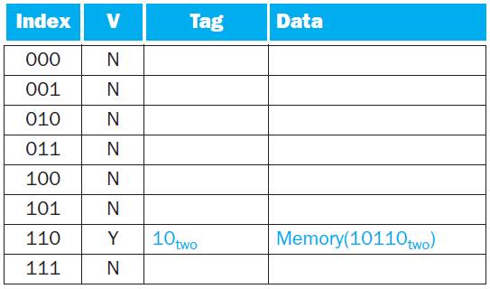
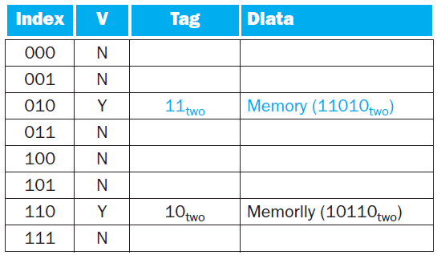
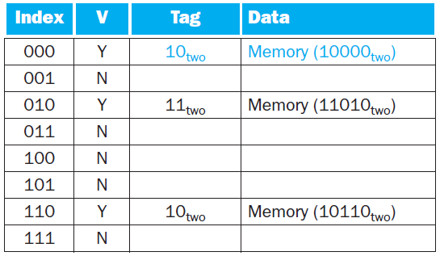
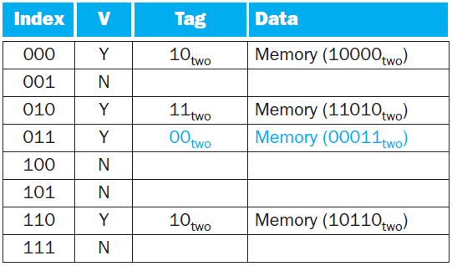
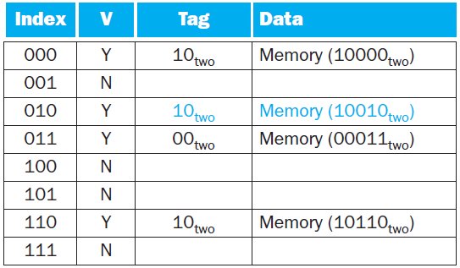
Cache Access Sequence

Slide 28
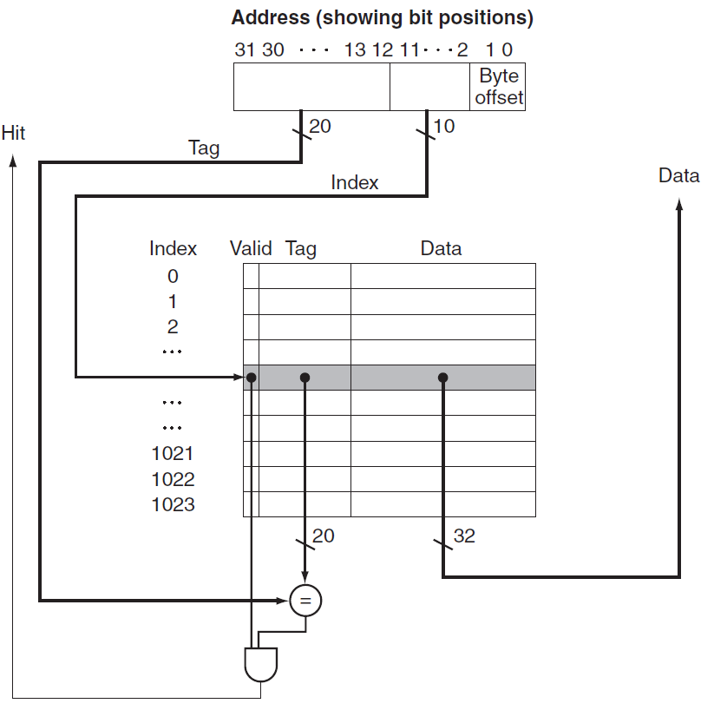
Referenced address is divided into
a cache index, used to select the block
a tag field, compared with the value of the tag field of the cache

Slide 29
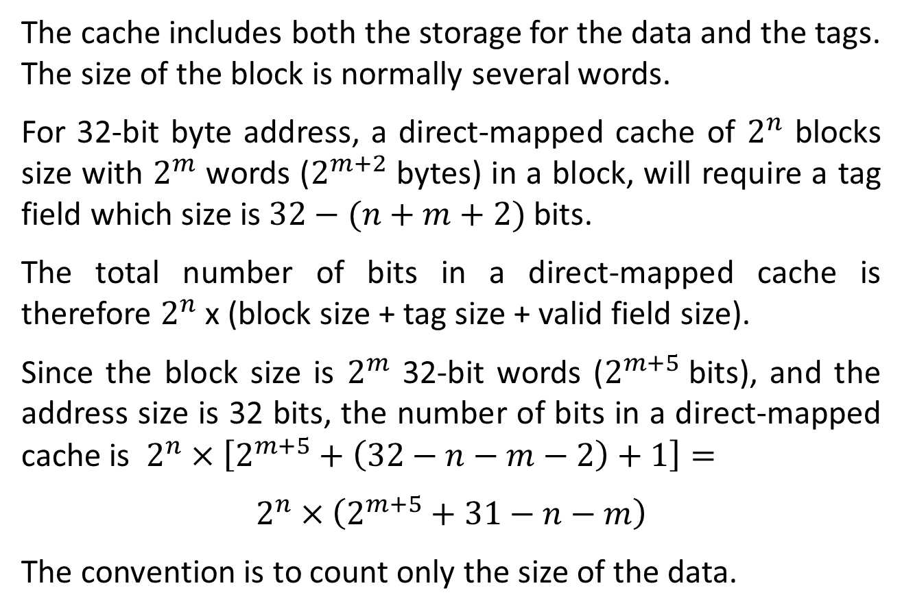
Cache Size
The cache includes both the storage for the data and the tags.
The size of the block is normally several words.
For 32-bit byte address, a direct-mapped cache of $2^{n}$ blocks size with $2^{m}$ words ($2^{m+2}$ bytes) in a block, will require a tag field which size is $32−(n+m+2)$ bits.
The total number of bits in a direct-mapped cache is therefore $2^{n}$ x (block size + tag size + valid field size).
Since the block size is $2^{m}$ 32-bit words ($2^{m+5}$bits), and the address size is 32 bits, the number of bits in a direct-mapped cache is $2^{n}×\left[2^{m+5}+\left(32−n−m−2\right)+1\right]=$
$$2^{n}×\left(2^{m+5}+31−n−m\right)$$
The convention is to count only the size of the data.

Slide 30
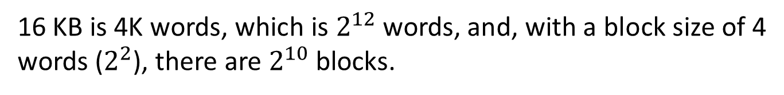
Example: How many total bits are required for a direct-mapped cache with 16 KB of data and 4-word blocks, assuming a 32-bit address?
16 KB is 4K words, which is $2^{12}$ words, and, with a block size of 4 words ($2^{2}$), there are $2^{10}$ blocks.
Each block has 4 x 32 = 128 bits of data, plus a tag of 32 - 10 - 2 - 2 bits, plus a valid bit. The total cache size is therefore
$2^{10}$ x (128 + (32 - 10 - 2 - 2) + 1 ) = 147 Kbits = 18.4 KB
For a 16 KB cache it is about 1.15 times as many as needed just for data storage.

Slide 31
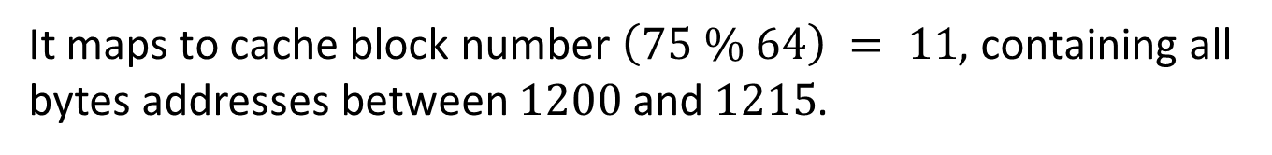
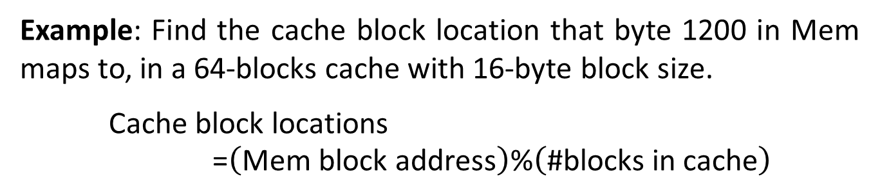
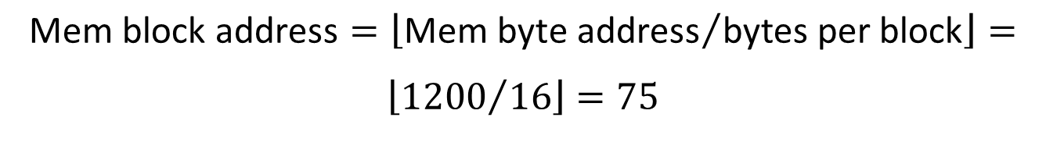
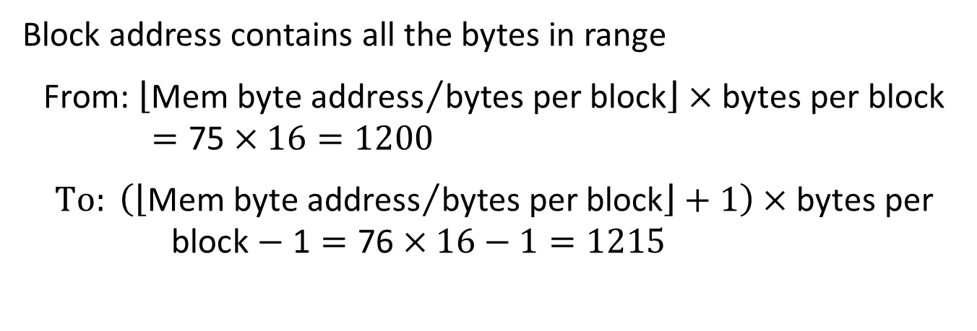
Example: Find the cache block location that byte 1200 in Mem maps to, in a 64-blocks cache with 16-byte block size.
$$\text{Cache} \text{block} \text{locations}\text{ =}\left(\text{Mem} \text{block} \text{address}\right)\text{\%}\left(\text{\#}\text{blocks} \text{in} \text{cache}\right)$$
$$\text{Mem} \text{block} \text{address}=\left\lfloor {\text{Mem} \text{byte} \text{address}}/{\text{bytes} \text{per} \text{block}}\right\rfloor =$$
$$\left\lfloor {1200}/{16}\right\rfloor =75$$
Block address contains all the bytes in range
$$\text{F}\text{rom}\text{: }\left\lfloor {\text{Mem} \text{byte} \text{address}}/{\text{bytes} \text{per} \text{block}}\right\rfloor ×\text{bytes} \text{per} \text{block}=\text{75}×16=1200$$
$$To: \left(\left\lfloor {\text{Mem} \text{byte} \text{address}}/{\text{bytes} \text{per} \text{block}}\right\rfloor +1\right)×\text{bytes} \text{per} \text{block}−\text{1}=\text{7}\text{6}×16−1=1215$$
It maps to cache block number $\left(75 \% 64\right) = 11$, containing all bytes addresses between $1200$ and $1215$.

Slide 32
Block Size Implications
Larger blocks exploit spatial locality to lower miss rates.
Block increase will eventually increase miss rate
Spatial locality among the words in a block decreases with a very large block.
The number of blocks held in the cache will become small.
There will be a big competition for these blocks.
A block will be thrown out of the cache before most of its words are accessed.

Slide 33
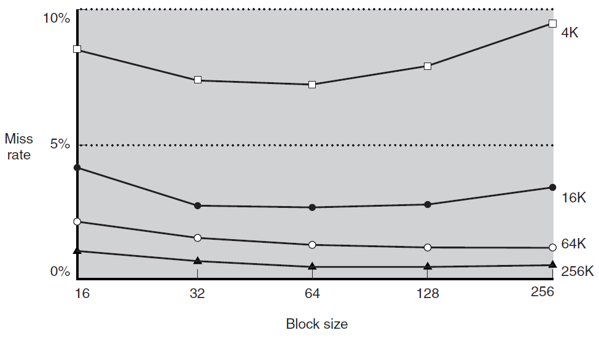
Miss rate versus block size

Slide 34
A more serious issue in block size increase is the increase of miss cost.
Determined by the time required to fetch the block and load it into the cache.
Fetch time has two parts:
the latency to the first word, and
the transfer time for the rest of the block.
Transfer time (miss penalty) increases as the block size grows.
The increase in the miss penalty overwhelms the decrease in the miss rate for large blocks, thus decreasing cache performance.

Slide 35
Shortening transfer time is possible by early restart, resuming execution once the word is returned.
Useful for instruction, that are largely sequential.
Requires that the memory delivers a word per cycle.
Less effective for data caches. High probability that a word from different block will be requested soon.
If the processor cannot access the data cache because a transfer is ongoing, it must stall.
Requested word first
starting with the address of the requested word and wrapping around.
Slightly faster than early restart.

Slide 36
Handling Cache Misses
Modifying the control of a processor to handle a hit is simple.
Misses require extra work done with the processor’s control unit and a separate controller.
Cache miss creates a stall by freezing the contents of the pipeline and programmer-visible registers, while waiting for memory.

Slide 37
Steps taken on an instruction cache miss:
Send to the memory the original PC value.
Instruct main memory to perform a read and wait for the memory to complete its access.
Write the cache entry: memory’s data in the entry’s data portion, upper bits of the address into the tag field, turn the valid bit on.
Restart the instruction execution at the first step, which will re-fetch the instruction, this time finding it in the cache.
The control of the data cache is similar: miss stalls the processor until the memory responds with the data.

Slide 38
Handling Writes
After a hit writes into the cache, memory has a different value than the cache. Memory is inconsistent.
We can always write the data into both the memory and the cache, a scheme called write-through.
Write miss first fetches block from memory. After it is placed into cache, we overwrite the word that caused the miss into the cache block and also write it to the main memory.
Write-through is simple but has bad performance. Write is done both to cache and memory, taking many clock cycles (e.g. 100).
If 10% of the instructions are stores and the CPI without misses was 1.0, new CPI is 1.0 + 100 x 10% = 11, a 10x slowdown!

Slide 39
Speeding Up
A write buffer is a queue holding data waiting to be written to memory, so the processor can continue working. When a write to memory completes, the entry in the queue is freed.
If the queue is full when the processor reaches a write, it must stall until there is an empty position in the queue.
An alternative to write-through is write-back. At write, the new value is written only to the cache. The modified block is written to the main memory when it is replaced.
Write-back improves performance when processor generates writes faster than the writes can be handled by main memory. Implementation is more complex than write-through.

Slide 40
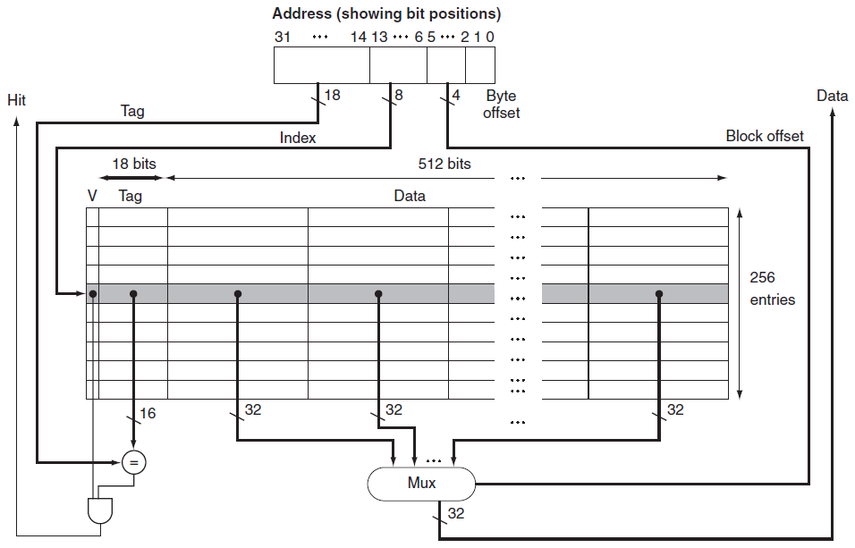
Cache Example (Data and Instruction)
Miss sends the address to memory. Returned data is written into the cache and is then read to fulfill request.
instruction cache: from PC data cache: from ALU
18
Hit selects by offset the word from the block

Slide 41
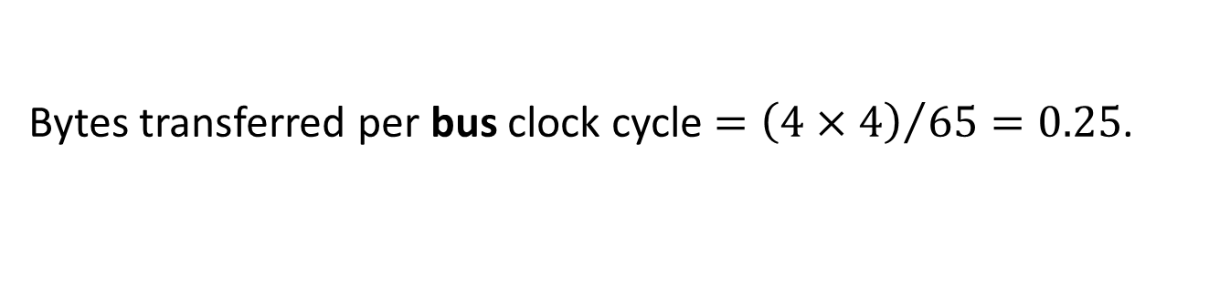
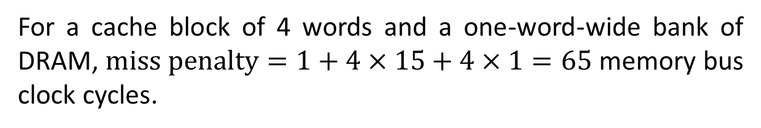
Main Memory Design Considerations
Cache misses are satisfied from DRAM main memory, designed for density rather than access time.
Miss penalty can be reduced by increasing bandwidth from the memory to the cache.
Bus clock rate is 10x slower than processor, affecting the miss penalty. Assume
1 memory bus clock cycle to send the address
15 memory bus clock cycles for each DRAM access initiated
1 memory bus clock cycle to send a word of data
For a cache block of 4 words and a one-word-wide bank of DRAM, $\text{miss} \text{penalty}=1+4×15+4×1=65$ memory bus clock cycles.
Bytes transferred per bus clock cycle $={\left(4×4\right)}/{65=0.25}$.

Slide 42
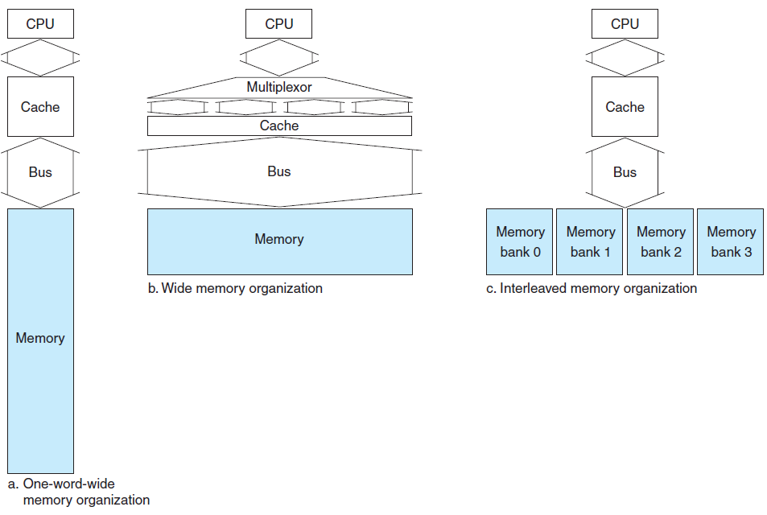
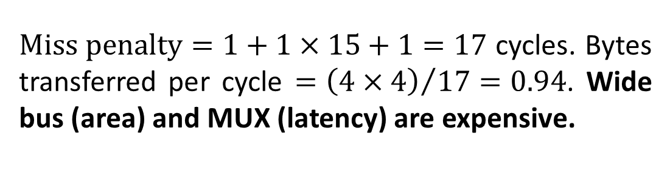
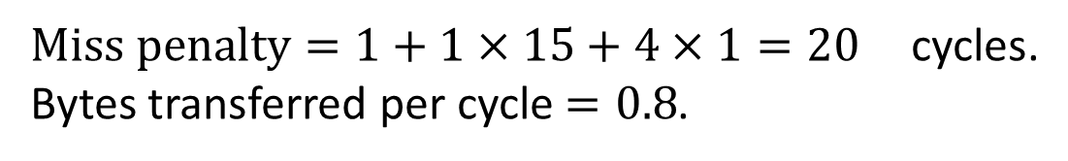
$\text{M}\text{iss} \text{penalty}=1+1×15+1=17$ cycles. Bytes transferred per cycle $={\left(4×4\right)}/{17=0.94}$. Wide bus (area) and MUX (latency) are expensive.
$\text{Miss} \text{penalty}=1+1×15+4×1=20$ cycles. Bytes transferred per cycle $=0.8$.

Slide 43
Cache Performance
Two techniques to reduce miss rate:
Reducing the probability that two different memory blocks will contend for the same cache location by associativity.
Adding a level to the hierarchy, called multilevel caching.

Slide 44
CPU Time
CPU time = (CPU execution clock cycles + Memory-stall clock cycles) x Clock cycle time
Memory-stall clock cycles = Read-stall cycles + Write-stall cycles
Read-stall cycles = Reads/Program x Read miss rate x Read miss penalty
Write-stall cycles = Writes/Program x Write miss rate x Write miss penalty + Write buffer stall cycles (write-through)
Write buffer term is complex. It can be ignored for buffer depth > 4 words, and a memory capable of accepting writes at > 2x rate than the average write frequency.

Slide 45
Write-back also has additional stalls arising from the need to write a cache block back to memory when it is replaced.
Write-through has about the same read and write miss penalties (fetch time of block from memory). Ignoring the write buffer stalls, the miss penalty is:
Memory-stall clock cycles (simplified) =
Memory accesses/Program x Miss rate x Miss penalty =
Instructions/Program x Misses/Instruction x Miss penalty

Slide 46
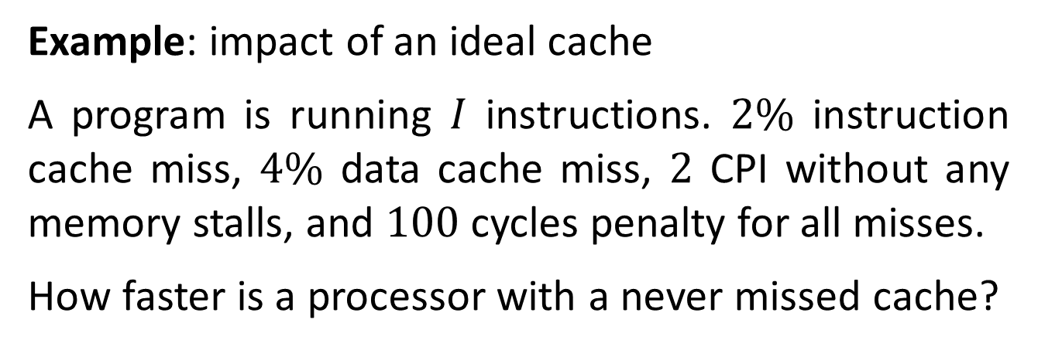

Example: impact of an ideal cache
A program is running $I$ instructions. $2\%$ instruction cache miss, $4\%$ data cache miss, $2$ CPI without any memory stalls, and $100$ cycles penalty for all misses.
How faster is a processor with a never missed cache?
Instruction miss cycles = $I×2\%×100=2.0×I$
With 36% loads and stores,
Data miss cycles = $I×36\%×4\%×100=1.44×I$
CPI with memory stalls = $2+2+1.44=5.44$
$$\text{Speedup}\text{=}{{\text{CPI}}_{\text{stall}}}/{{\text{CPI}}_{\text{perfect}}=}{5.44}/2=2.77$$

Slide 47




Example: Accelerating processor but not memory. Memory stalls time fraction is increased.
CPI reduced from $2$ to $1$, system with cache misses have $\text{CPI}=1+3.44=4.44$. System with perfect cache is ${4.44}/1=4.44$ faster.
The execution time spent on memory stalls increases from ${3.44}/{5.44}=63\%$ to ${3.44}/{4.44}=77\%$. ☹
Processor’s clock cycle reduced by 2x, but memory bus not, ${\text{CPI}}_{\text{stall}}=2+2\%×200+36\%×4\%×200=8.88$
${{\text{Perf}}_{\text{slow}}}/{{\text{Perf}}_{\text{fast}}}={5.44}/{\left(8.88×1/2\right)}=1.22$, rather than 2x. ☹

Slide 48
Relative cache penalties increase as a processor becomes faster.
If a processor improves both CPI and clock rate
The smaller the CPI, the more impact of stall cycles is.
If the main memories of two processors have the same absolute access times, higher processor’s clock rate leads to larger miss penalty.
The importance of cache performance for processors with small CPI and faster clock is greater.

Slide 49

Reducing Cache Misses
Direct map scheme places a block in a unique location.
Fully associative scheme places a block in any location.
All cache’s entries must be searched.
Expensive: done in parallel with a comparator for each entry.
Practical only for caches with a small number of blocks.
A middle solution is called $n$-way set-associative map.
Fixed number $(n)$ of locations where a block can be placed.
A number of sets, each of which consists of $n$ blocks.
A memory block maps to a unique set in the cache given by the index field. A block is placed in any element of that set.

Slide 50


Slide 51

Cache size (blocks) = number of sets x associativity.
For fixed cache size, increasing the associativity decreases the number of sets.

Slide 52


Example: Misses and associativity in caches.
Three caches of 4 1-word blocks, fully associative, two-way set associative, and direct mapped.
For the sequence of block addresses: 0, 8, 0, 6, 8, what is the number of misses for each cache?
direct mapped
5 misses

Slide 53



two-way set associative
4 misses
fully associative
3 misses

Slide 54

Size and associativity are dependent in determining cache performance.
For 8 blocks in the cache, there are no replacements in the two-way set-associative cache. (why?)
There are same number of misses as the fully associative cache.
For 16 blocks, all three caches would have the same number of misses.
Benchmarks of a 64 KB data cache with a 16-word block

Slide 55

Four-way set-associative cache
1-word block
4-block set
set
parallel
MUX with a decoded select signal

Slide 56
Locating a Block in the Cache
Set is found by the index. Tag of a block within the appropriate set is checked for matching. Block offset is the address of the word within the block.
For speed all the tags in a set are searched in parallel.
In a fully associative cache, we search the entire cache without any indexing. Huge HW overhead.
The choice among direct-mapped, set-associative, or fully associative depends on the miss (performance) cost versus HW cost (power, area).

Slide 57
Example: Size of tags versus set associativity
Given cache of 4K=2¹² blocks, a 4-word block size, and a 32-bit address. What is the total number of tag bits?
There are 16=2⁴ bytes / block. 32-bit address yields 32-4 =28 bits for index and tag.
Direct-mapped cache has 12=log₂(4K) bits of index. Tag is 28-12=16 bits, yielding a total of 16 x 4K = 64 Kbits of tags.

Slide 58
For a 2-way set-associative cache, there are
2K = 2¹¹ sets, and the total number of tag bits is
(28 - 11) x 2 x 2K =34 x 2K = 68 Kbits.
For a 4-way set-associative cache, there are
1K = 2¹⁰ sets, and the total number of tag bits is
(28 - 10) x 4 x 1K = 72 x 1K = 72 Kbits.
Fully associative cache has one set with 4K blocks, and the total number of tag bits is
28 x 4K x 1 = 112K bits.

Slide 59
Which Block to Replace?
In a direct-mapped cache the requested block can go in exactly one position.
In a set-associative cache, we must choose among the blocks in the selected set.
The most commonly used scheme is least recently used (LRU), where the block replaced is the one that has been unused for the longest time.
For a two-way set-associative cache, tracking when the two elements were used can be implemented by keeping a single bit in each set.

Slide 60
As associativity increases, implementing LRU gets harder.
Random
Spreads allocation uniformly.
Blocks are randomly selected.
System generates pseudorandom block numbers to get reproducible behavior (useful for HW debug).
First in, first out (FIFO) Because LRU can be complicated to calculate, this approximates LRU by determining the oldest block rather than the LRU.

Slide 61
Multilevel Caches
Used to reduce miss penalty.
Many processors support an on-die 2nd-level (L2) cache.
L2 is accessed whenever a miss occurs in L1.
If L2 contains the desired data, the miss penalty for L1 is the access time of L2, much less than the access time of main memory.
If neither L1 nor L2 contains the data, main memory access is required, and higher miss penalty incurs.

Slide 62
Example: performance of multilevel caches
Given a 5 GHz processor with a base CPI of 1.0 if all references hit in the L1.
Main memory access time is 100 ns, including all the miss handling.
L1 miss rate per instruction is 2%.
How faster the processor is if we add a L2 that has a 5 ns access time for either a hit or a miss, reducing the miss rate to main memory to 0.5% ?

Slide 63
Miss penalty to main memory (memory-stall):
5GHz x 100 ns = 500 cycles.
The effective CPI with L1:
Base CPI + Memory-stall cycles per instruction =
1 + 500 x 2% = 11
The effective CPI with L2:
1 + 25 x (2% - 0.5%) + (500 + 25) x 0.5% = 4
The processor with L2 is faster by:
11 / 4 = 2.8

Slide 64
דוגמא: נתונה מערכת זיכרון במעבד הפועל בתדר 500 MHz בעלת שתי רמות של זיכרון מטמון.
L1-data cache הינו direct-mapped, write-through, בגודל כולל של 8KByte וגודל בלוק של 8Byte.
מניחים שחוצץ הכתיבה שלו מושלם ואין אף פעם stalls. miss-rate הינו 15%.
L1-instruction cache הינו direct-mapped, בגודל כולל של 4KByte וגודל בלוק של 8Byte. נתון שה miss-rate הינו 2%.
L2 הינו יחיד ומשותף, 2-way set associative, write-back, בגודל כולל של 2MByte וגודל בלוק של 32 Byte. miss-rate הינו 10%.
בממוצע %50 מהבלוקים ב L2 הינם "מלוכלכים", כלומר רשום בהם מידע שאיננו כרגע בזיכרון הראשי.

Slide 65
כמה סיביות בכל אחד מזיכרונות המטמון משמשות לאינדקס?
L1 Data: 8Kbyte/8Byte = 1024 blocks => 10 bits
L1 Instruction: 4Kbyte/8Byte = 512 blocks => 9 bits
L2: 2MByte/32Bytes = 64K blocks = 32K sets => 15 bits
איזה אחוז מתוך גישות הנתונים לזיכרון מגיע לזיכרון הראשי?
(L1 miss rate) x (L2 miss rate) = 0.15 X 0.1 = 1.5%
40% מהפקודות הינן פקודות גישה לזיכרון, 60% מהן קריאה(LOAD) ו 40% מהן כתיבה(STORE) . L1 hits אינם גורמים ל stalls.
זמן גישה ל L2 הינו 20 ננו שניות.
זמן גישה לזיכרון הראשי הינו 0.2 מיקרו שניה, ומרגע זה מספר מילים כרוחב ה memory bus נשלחות כל מחזור שעון. רוחב ה bus המחבר בין L2 לזיכרון הראשי הינו 128 סיביות.

Slide 66
מה מספר מחזורי השעון המרבי שעשוי להידרש בעת גישה לזיכרון הראשי? מהו רצף האירועים המתרחש במצב קיצוני כזה?
Maximum clock cycles occur when L1 missed first, then L2 missed, then write-back takes place.
L2 access cycles: (20 nSec) / (2 nSec) = 10 cycles
Main memory access cycles: (0.2 µSec) / (2 nSec) = 100 cycles
Block is 32 Bytes and memory bus is 128 bits (16 Bytes), two bus transactions of 16 Bytes each are required. The first 16 bytes take 100 cycles, the next 16 bytes takes one cycle.
Getting a new block from the memory may evict a block from L2, which is a write-back. In that case the evicted block must be written into the memory, requiring a total of L2-memory write-back 2 x (100 + 1) = 202 cycles.

Slide 67
Summing all
L1 miss + L2 miss + write-back = 1 + 10 + 202 = 213 cycles
מהו מספר מחזורי השעון הממוצע בגישה לזיכרון (AMAT) כולל פקודות ונתונים ?
The weight of instruction accesses to memory is 1/(1 + 0.4), while the weight of data accesses is 0.4/(1 + 0.4). Therefore
AMAT_{total} = 1/1.4 AMAT_{inst} + 0.4/1.4 AMAT_{data}
For any 2-level cache system there is
AMAT = (L1 hit time) + (L1 miss rate) x (L2 hit time) + (L1 miss rate) x (L2 miss rate) x (main memory transfer time).
AMAT must account for the average percentage of L2 dirty blocks, which for the given L2 means that 50% of the blocks must be updated in main memory upon L2 miss, yielding a factor of 1.5 multiplying (100 +1).

Slide 68
AMAT_{inst} = 1 + 0.02 x 10 + 0.02 x 0.1 x 1.5 x (100 + 1) = 1.503
AMAT_{data} = 1 + 0.15 x 10 + 0.15 x 0.1 x 1.5 x (100 + 1) = 4.7725
AMAT_{total} = 1/1.4 x 1.503 + 0.4/1.4 x 4.7725 = 2.44

Slide 69
Victim Cache
Memory hierarchy so far was inclusive. Exclusive organization of caches may help to overcome the associativity vs. block-size tradeoff.
A direct-mapped/limited-associativity cache + small fully associative victim cache can perform as a multi-way set associative.
A block is found either in the main cache or in the victim cache but not in both.
Proposed in 1990’s for L1. Used today at higher levels L3/L4 by Intel and IBM (PowerPC).

Slide 70
Victim cache captures temporal locality: blocks accessed frequently, even if replaced from the main cache, remain within the larger cache organization.
It addresses the limitation of main cache by giving blocks a second chance if they exhibit conflict with other blocks competing for the same set.
The victim cache contains the data items that have been thrown out of the main cache.
Cache probe looks in both caches. If the requested block is found in the victim, that block is swapped with the block it replaces in main cache.

Slide 71


Slide 72
FIFO replacement policy of victim cache effectively achieves true-LRU behavior (why?).
A reference to the victim cache pulls the referenced block out of it. Thus, its LRU block is by definition the oldest one there.
Let b1 be thrown by FIFO (victim oldest ) and b2 reside in the victim but used last time before b1 did (LRU).
At its usage time b1 was pulled into L1, so its re-entrance into the victim occurred when b2 was already there, hence b1 cannot be older than b2.

Slide 73
Assist Cache
Was motivated by the processor’s stride-based prefetch. If too aggressive it would prefetch data that would victimize soon-to-be-used cache entries.
The incoming prefetch block is loaded into the associative, promoted into the main only if it exhibits temporal locality by being referenced again soon.
Blocks exhibiting only spatial locality are not moved to the main cache and are replaced to main memory in FIFO.
Used by HP in 1990’s in HP-7200 microprocessor.

Slide 74


Slide 75
An incoming block is moved into the assist cache; the replaced block is thrown out.
If a reference misses the main and hits the assist, the assist’s block is swapped into the main. The corresponding main’s block is inserted into the assist.
Only blocks exhibiting temporal locality get promoted to the main cache, hence separating blocks exhibiting spatial locality from those exhibiting temporal locality.
Using FIFO, the scheme may discard blocks exhibiting streaming behavior once used, without moving them into the main cache.

Slide 76
Dynamic L1 Exclusion
Consider direct-mapped L1 and a loop-based code, where instructions conflict with each other (e.g. by instructions external of the loop).
We like to stick the loop instruction to L1 and avoid its evection, as it will probably be required again soon.
To address conflicts without disturbing ordinary L1 behavior, a sticky bit at each entry indicates that its current block is valuable and should not be replaced.
A hit-last bit at each cache block indicates that it was used (again) the last time it was already in the cache.

Slide 77


Slide 78

A, B: cached blocks (same index) a, b: requested blocks
h_{a’} h_{b} : hit-last bit of the incoming block
action
condition

Slide 79



Homework: Let L1 block be 1-word and instructions a and b mapped to same index. Assume initial state A,s and h_{a} = h_{b} = 0 in L2. Find the miss rate in ordinary and a dynamic exclusion L1 in the following codes.

Slide 80
The scheme extends to data caches as well.
Any block in the backing store is potentially cacheable or non-cacheable. The partition changes dynamically with application behavior.

Slide 81
Summary – Four Questions
Q1: Where can a block be placed in the upper level? (block placement)
Q2: How is a block found if it is in the upper level? (block identification)
Q3: Which block should be replaced on a miss? (block replacement)
Q4: What happens on a write? (write strategy)

